Slide 1

Shelter Cluster meeting
28 July 2015
PWD Offices, Port-Vila

Slide 2
Agenda
1. Post PAM shelter & settlement recovery situation
2. Fully funded Shelter/housing contribution to national cyclone pam recovery,
3. The Housing Working Group
4. Partners update and issues
5. AOB

Slide 3
1. Post PAM shelter & settlement recovery situation
Post Disaster Needs Assessment
Shelter/housing & settlements throughout the cyclone PAM affected area have been seriously hit by the cyclone as indicated by the Post Disaster Needs Assessment (PDNA), which clearly shows that Housing has been the most affected sector, with a total needs of 12 256 Million VT, representing more than 35% of overall recovery needs.

Slide 4
1. Post PAM shelter & settlement recovery situation Shelter & Settlement Vulnerability Assessment
81% of households reported that their shelter had sustained some level of damage as a result of the cyclone
72% of households reported that they had completed substantial repairs or reconstruction work on their shelter at the time of the assessment, confirming anecdotal evidence as to the high capacity for self-recovery inherent to the ni-Vanuatu.
Just under half of TC Pam-affected households interviewed (45%) reported that they were able to recover and recycle materials that were suitable for use during repair and reconstruction.

Slide 5
1. Post PAM shelter & settlement recovery situation Shelter & Settlement Vulnerability Assessment
Medium to long term interventions that support shelter self-recovery should take into account beneficiaries’ reported priorities, and consider supporting the recovery of income-generating livelihoods as well as the direct provision of shelter support;
Recognising the time required to implement a comprehensive ‘build back safer’ strategy, the development of community shelters able to withstand sudden onset disasters should be explored;
A ‘build back safer’ approach should be integrated into recovery phase shelter programming as a result of the widespread use of pre-crisis shelter materials for repairs and reconstruction work.

Slide 6
1. Post PAM shelter & settlement recovery situation Shelter Cluster response (HAP)
As defined within the Tropical Cyclone PAM Humanitarian Action Plan (HAP), the shelter cluster has 3 objectives:
1. Provide emergency shelter and non-food items for people whose houses have been partially damaged or destroyed.
2. Assist affected people with repair and reconstruction of houses, water and sanitation facilities.
3. Investment in safer community buildings
Government reduce the HAP timeframe from 6 to 3 months and request to focus on first objective.

Slide 7
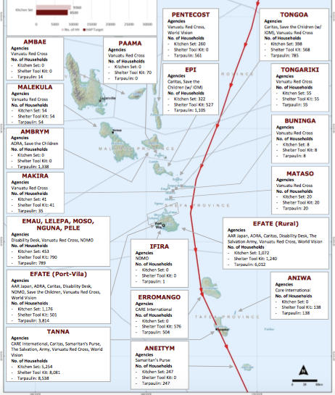
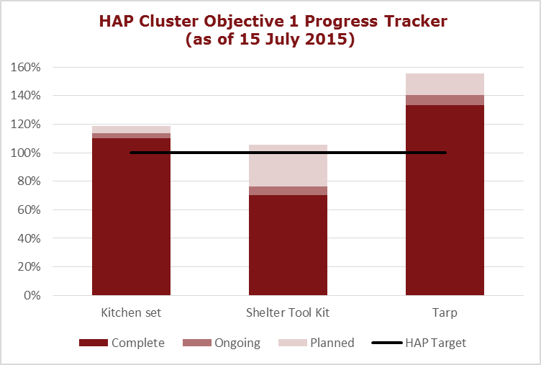
1. Post PAM shelter & settlement recovery situation Shelter Cluster response (HAP)
At the end of the humanitarian phase, on 31 July, shelter agencies will eventually reached and exceed the target of 18,000 households supported with tarpaulins and access to toolkit and 8,000 with kitchen sets.

Slide 8
2. Shelter/housing contribution to national cyclone pam recovery
On 16 June 2015, the Office of the Prime Minister released the National Recovery and Strengthening Program Plan entitled “Strengthening ni-Vanuatu Resilience”. In this document, three areas of critical recovery need have been identified:
Restore and develop essential social services
Repair and improve infrastructure
Promote and support ni-Vanuatu livelihoods and lifeways

Slide 9
2. Shelter/housing contribution to national cyclone pam recovery
Under the category Infrastructure
Under the strategy: Assist to rebuild/repair/upgrade private housing and infrastructure, especially on projects submitted to the priority action:
Priority action Strengthening housing & settlement community resilience activities initiated within the HAP and new planned projects aiming to

Slide 10
RECOVERY PLAN |  | STRENGTHING NI-VANUATU RESILIENCE
CATEGORY |  | Infrastructure
LEAD MINISTRY |  | Ministry of Infrastructure and Public Utilities - Public Work Department
GOVERNEMENTAL AGENCIES |  | PWD, DLA, NDMO
STRATEGIC PRIORITY |  | Assist to rebuild/repair/upgrade private housing and infrastructure
ACTION |  | Strengthening housing & settlement community resilience
KEY ACTIVITIES |  | (1) assisting in the repairing, retrofitting and reconstruction of damaged houses, (2) households and community safe shelter awareness, (3) building back safer training of skilled and unskilled workers, (4) assisting in the repairing, retrofitting and reconstruction of damaged community building, (5) local and traditional construction knowledge and capacity strengthening, (6) building back safer knowledge dissemination, mass and affected population communication, (7) Strengthening local and national capacity in post disaster shelter & housing

Slide 11
RECOVERY PLAN |  | STRENGTHING NI-VANUATU RESILIENCE
CATEGORY |  | Infrastructure
LEAD MINISTRY |  | Ministry of Infrastructure and Public Utilities - Public Work Department
GOVERNEMENTAL AGENCIES |  | PWD, DLA, NDMO
STRATEGIC PRIORITY |  | Assist to rebuild/repair/upgrade private housing and infrastructure
ACTION |  | Strengthening housing & settlement community resilience
KEY ACTIVITIES |  | (1) assisting in the repairing, retrofitting and reconstruction of damaged houses, (2) households and community safe shelter awareness, (3) building back safer training of skilled and unskilled workers, (4) assisting in the repairing, retrofitting and reconstruction of damaged community building, (5) local and traditional construction knowledge and capacity strengthening, (6) building back safer knowledge dissemination, mass and affected population communication, (7) Strengthening local and national capacity in post disaster shelter & housing
FUNDING |  | Fully funded. 6,508,000,000 VUV.
STATUS |  | 11 Projects already started and fully funded. 4 Projects will start after 31 July 2015 and are fully funded.
TIMEFRAME |  | From 1 August 2015 to 30 November 2018
TARGETED BENEFICIARIES |  | At least 12 240 Households (61 200 people)
IMPLEMENTING AGENCIES |  | ADRA Vanuatu, Caritas, Vanuatu Christian Council, Vanuatu TVET, Disability Desk, The Salvation Army, World Vision, Care International, Vanuatu Red Cross, VMGD, Save the Children, IOM, Latter-day Saint Charities
PARTNERS |  | Habitat NZ working through ADRA Vanuatu, Act for Peace Australia, Lume Rural Training Centre & Lorakau Rural Training Centre, Friends Vanuatu and LifeChanger Ministry, Erakor Bilingual School, Liberty for the Nations, FAO, Tafea, Shefa and Penama Provincial Government, ACTIV Association, Wan Smolbag, IFRC, Australian Red Cross, French Red Cross, and New Zealand Red Cross, Vanuatu Institute of Technology, Ministry of Education and Training, Tafea Provincial Disaster Committee, VMGD, MCCA, DARD, VARTC, DGMWR
DONORS |  | New Zealand Aid Programme, Caritas Australy and New Zealand, Act for Peace Australia, Australian Aid Program, Friends Vanuatu, The Salvation Army World Service Office, MFAT, DFID (Department for International Development - United Kingdom) DFAT (Department Foreign Affairs and Trade - Australia) MOFA (Ministry of Foreign Affairs - Netherlands) OFDA (Office of Disaster Assistance - USA), Danish Red Cross Norwegian Red Cross American Red Cross Hong Kong Red Cross Permanent Mission of the Republic of Korea to UN Australian Red Cross The Permanent Mission of Italy to UN Canadian Red Cross- DFATD EDAF British Red Cross DFID Netherlands Red Cross Monaco Red Cross Government of Malta USAID Belgian Red Cross The Permanent Mission of Italy to UN Japanese Red Cross Society Swiss Red Cross Tuvalu Red Cross New Zealand Red Cross, EU GCCA, EU GFDR, GEF, Hong Kong Governement, Ikea, South Korea Governement, European Commission & Private donors.

Slide 12
1 | ADRA Vanuatu |  | ADRA - Cyclone Pam Recovery Project - Shelter Construction SE Ambrym
2 | Caritas |  | Support to 10 vulnerable Households to repair and rebuild their damaged house by cyclone PAM in Port Vila and Tanna
3 | Vanuatu Christian Council |  | Small Grants Scheme for Repair of Church Buildings Used as Evacuation Centres
4 | Vanuatu TVET |  | Building Construction pilot program
5 | Disability Desk, |  | Shelters for People with Disabilities
6 | The Salvation Army |  | Erakor School Kindergarten
7 | The Salvation Army |  | Tanna shelter and water harvesting project
8 | World Vision |  | Cyclone Pam Response in Tafea, Vanuatu - MFAT
9 | World Vision |  | World Vision Vanuatu Cyclone Pam Response – DFAT
10 | CARE International |  | CARE International TC Pam response
11 | Vanuatu Red Cross / IFRC |  | Vanuatu Red Cross cyclone PAM response
12 | VMGD |  | IRCCNH Increasing Resilience to Climate Change and Natural Hazard
13 | Save the Children |  | Save the Children Shelter Distribution
14 | IOM |  | 1- VERITAS : Vanuatu Emergency Response For Internally Displaced Persons And Technical Assistance . 2- REBUILT: Resilient Environmentally-appropriate Building through Upgrading Indigenous and Local Techniques inVanuatu
15 | Latter-day Saint Charities |  | LDS Rebuilding Plan

Slide 13
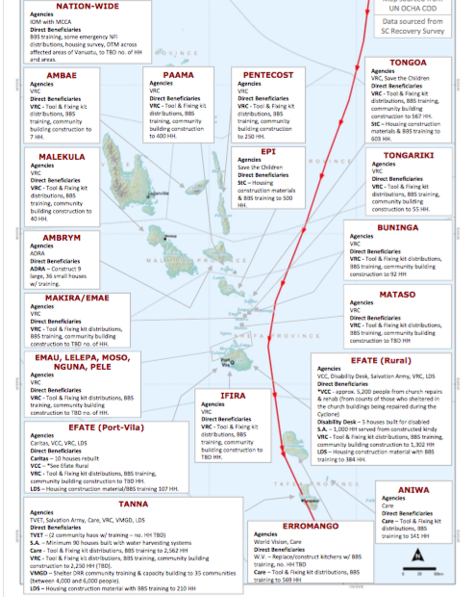

Slide 20
Projects timeframe
 |  | 2015 |  |  |  |  | 2016 |  |  |  |  |  |  |  |  |  |  |  | 2017 |  |  |  |  |  |  |  |  |  |  |  | 2018
 |  | 8 | 9 | 10 | 11 | 12 | 1 | 2 | 3 | 4 | 5 | 6 | 7 | 8 | 9 | 10 | 11 | 12 | 1 | 2 | 3 | 4 | 5 | 6 | 7 | 8 | 9 | 10 | 11 | 12 | 1 | 2 | 3 | 4 | 5 | 6 | 7 | 8 | 9 | 10 | 11 | 12
1 | ADRA Vanuatu
2 | Caritas
3 | Vanuatu Christian Council
4 | Vanuatu TVET
5 | Disability Desk,
6 | The Salvation Army
7 | The Salvation Army
8 | World Vision
9 | World Vision
10 | CARE International
11 | Vanuatu Red Cross /IFRC
12 | VMGD
13 | Save the Children
14 | IOM
15 | Latter-day Saint Charities

Slide 24
2. Shelter/housing contribution to national cyclone pam recovery
For these 15 fully funded projects (focal point Xavier):
Transfer to survey inputs in « GIP form » by SCT.
Package (Action summary table, 15 forms) brought to PWD tomorrow Wednesday 29/07 2PM for sign off and submission to the recovery committee.
For projects seeking recovery funding (focal point Dick):
All to be sent to PWD before tomorrow Wednesday 29/07 2PM
Recovery Committee to follow up on these submission
All these shelter/housing projects to be part of Housing Working Group scope

Slide 25
3. The Housing Working Group
Building on the shelter cluster’s coordination platform, which will end on 31 July 2105 and partners recovery capacity, Public Works Department (MIPU) will implement a Housing sector working group starting on 1st of August, with the support of DLA (MOIA) and NDMO (MCCA)
Aiming to coordinate some of the related priority actions under the strategy: Assist to rebuild/repair/upgrade private housing and infrastructure, especially on projects submitted to the priority action Strengthening housing & settlement community resilience

Slide 26
3. The Housing Working Group
Strengthening housing & settlement community resilience, which would encompass activities, initiated within the HAP and new planned projects aiming to:
(1) assist in the repairing, retrofitting and reconstruction of damaged houses,
(2) households and community safe shelter awareness,
(3) building back safer training of skilled and unskilled workers,
(4) assist in the repairing, retrofitting and reconstruction of damaged community building,
(5) local and traditional construction knowledge and capacity strengthening,
(6) building back safer knowledge dissemination, mass and affected population communication,
(7) Strengthening local and national capacity in post disaster shelter & housing

Slide 27
Incoming events
TWiG on REACH2 preparation next week
Shelter Cluster SAG, Tuesday 4/08 2PM @PWD
Housing Working Group meeting on Thursday 06/08 3PM @PWD
Shelter Cluster Social club, on Thursday 06/08 7PM@ Au Farée

Slide 28
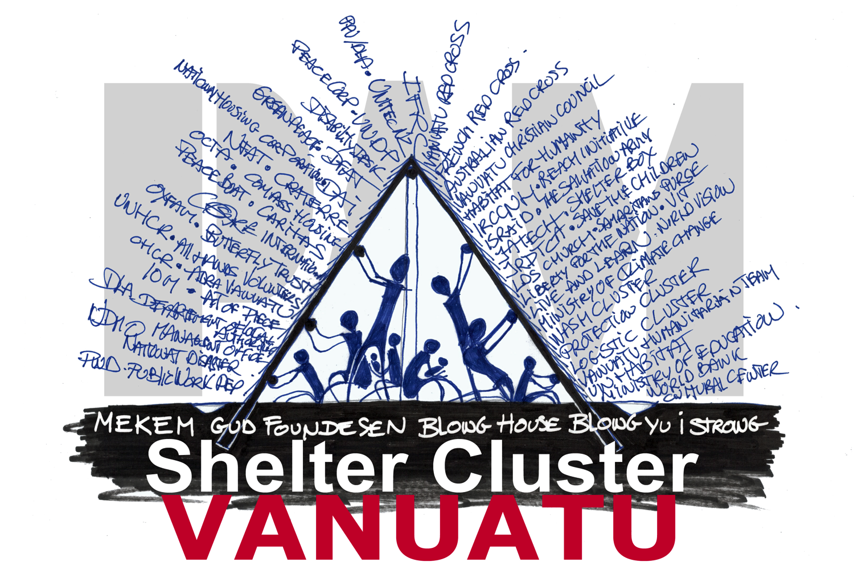

Slide 29
4. Partners update and issues

Slide 30
4. AOB

