Slide 1

2015 CHF First Round Standard Allocation
26 November 2014

Slide 2
Purpose
To share with partners the latest developments on the 2015 CHF First Standard Allocation process;
To present possible prioritization options for the Cluster envelope and come to a consensus on allocation priorities to guide the PRT;
To discuss possible Cluster envelopes and strategy for engagement with other clusters.

Slide 3
2015 CHF First Standard Allocation
ENVELOPE: $60 million USD
Parameters for prioritization:
Activities that best capitalize on the window of opportunity offered by the dry season;
Activities that directly address life-threatening needs, and in locations where such needs are greatest.
Further criteria to inform prioritization:
Proposals linked to high-immediate or high priority projects;
Proposals that undertake most time critical activities;
Proposals that demonstrate better value for money;
Proposals from national NGO partners, where other criteria are adequately met;
Proposals from partners that demonstrate better historical performance.

Slide 4
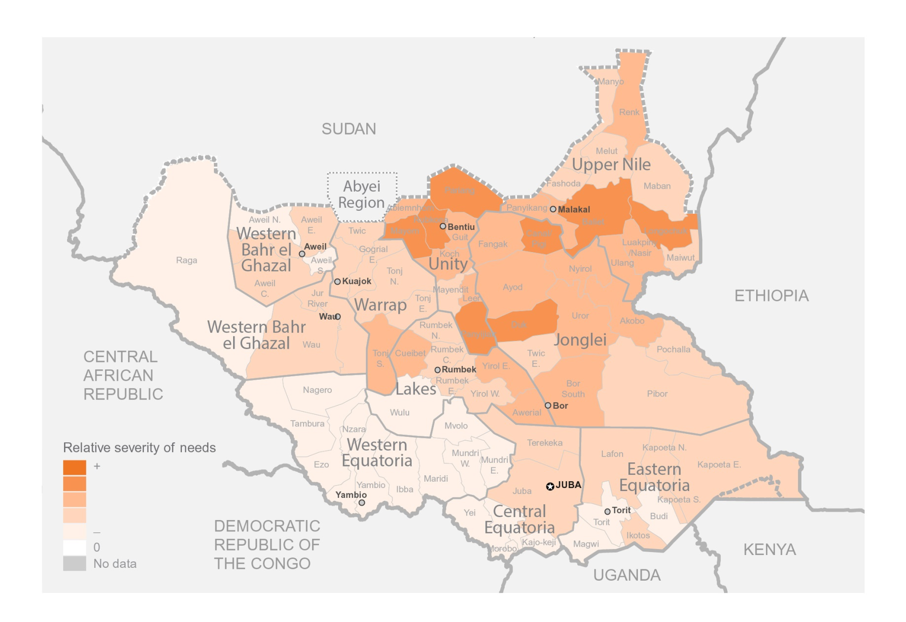
HNO Heat Map

Slide 5
Timeline
December 5: Project sheets DUE on GMS;
December 8: Peer Review Team (PRT) meeting;
December 9-11: Cluster portfolio assembled based on outcome of the PRT;
December 12-13: Cluster defense;
December 15-17: Implementation of Advisory Board recommendations (further PRT consultation)
December 20: All finalized project sheets submitted in GMS;
December 21: Final proposals approved in GMS; allocation documents compiled and submitted to CHF.

Slide 6
Current Situation: Pipeline

Slide 7
Current Situation: Frontline
Of the 14 SRP partners with frontline projects…
All partners received funding from the CHF in 2014 except for four;
Of these, three received funding through the CHF Reserve for mobile response and are seeking NCEs (through March/May 2015); one received funding through the first standard allocation and is seeking an NCE (through March 2015);
Six partners have CHF projects that have ended or will end by December 31 and no NCE has been sought;
Eight partners seek funding for coordination (national or state-level);
Five partners seek funding for shelter initiatives in the POCs;
Seven partners seek funding to maintain their mobile response teams.
** Seven frontline projects were ranked “high priority” in the SRP process while eight were ranked “medium.”

Slide 8
Cluster Portfolio
No | Organization | Priority | Funds requested in SRP | Frontline/pipeline | Activity Type
1 | Plan International | M | 580,000 | Frontline | NFI/Coordination
2 | UNHCR | M | 8,197,000 | Pipeline | Pipeline
3 | CRS | M | 1,089,000 | Frontline | Shelter (Mingkaman)/NFI
4 | Acted | L | 594,000 | Frontline | Shelter (POCs)/NFI
5 | DRC | M | 994,000 | Frontline | Shelter (POC)/NFI/Coordination
6 | Concern | H | 5,353,000 | Frontline | Shelter (POCs)/NFI/Coordination
7 | IOM - Cluster Coordination | H | 1,653,000 | Frontline | Coordination
8 | IOM | H | 41,648,000 | Pipeline/frontline | Pipeline/Shelter (POC)/NFI/Mobile response/Coordination
9 | World Vision | H | 1,166,000 | Frontline | Shelter/NFI/Mobile response/Coordination
10 | Intersos | M | 1,166,000 | Frontline | Shelter/NFI/Mobile response/Coordination
11 | LCED | H | 393,000 | Frontline | Shelter/NFI
12 | Save the Children | M | 531,000 | Frontline | NFI
13 | LWF | H | 517,000 | Frontline | Shelter/NFI/Mobile response
14 | Medair | H | 1,263,000 | Frontline | Coordination/NFI/Mobile response
15 | NRC | M | 4,063,000 | Frontline | Shelter (POC and Mingkaman)/NFI/Mobile response/Coordination
16 | PAH | M | 793,000 | Frontline | Shelter/NFI/Mobile response
 | TOTAL |  | 70,000,000 | (15 frontline, 2 pipeline)

Slide 9
Prioritization Options
Frontline v. pipeline
Full pipeline v. prioritized pipeline:
NFIs v. shelter
50% of shelter target v. prioritized POCs
25% NFI target v. less
Frontline partners:
CHF Reserve and NCEs
Current funding status
Priority ranking in SRP
Coordination v. mobile v. POC/ services

Slide 10
Overall Cluster Ask
Options | Approach | Breakdown | Amount
1 | Procurement and transport of key NFI and shelter for first quarter, with a focus on shelter in Bentiu and Malakal | 25% of target for NFIs; 20% of target for shelter (15,000 HHs) for Bentiu and Malakal | $6 million USD
2 | Procurement and transport of key NFI and shelter for the first quarter, with a focus on Bentiu and Malakal, plus frontline* | Same as above, plus frontline | $10million USD
3 | Procurement and transport of key NFI and shelter items for first quarter | 25% of target for NFIs; 50% of target for shelter | $11.3million USD
4 | Procurement and transport of key NFI and shelter items for first quarter, plus frontline* | Same as above, plus frontline | $20million USD
5 | Procurement and transport of key NFI and shelter items for first quarter, plus partial frontline | Same as above but with only partial frontline (e.g. high priority) | $15million USD
* - as calculated per kit

Slide 11
Discussion Points
How should the Cluster prioritize internally?
How should we allocate frontline v. pipeline?
What kind of prioritization, if any, should we have in the pipeline?
What kind of prioritization should we have in regards to frontline response?
What should be the Cluster’s overall strategy vis-à-vis other cluster asks?

