Slide 1
Sub-National Shelter & NFI Cluster Coordination meeting for KRI
Agenda
Review from previous meeting (2mn);
Information Management update (5mn);
Ongoing Emergency Response: (20mn);
Update on Mosul Operational Planning
Pre-positioning NFIs/liaison with Logistic Cluster
Access through Check-points (to avoid delays)
Winterization Preparedness (for current caseload and Mosul emergency) (5mn)
Technical Guidance: Settlement Typology, Cluster NFI kit and Emergency Shelter Kit Guidance (15mn);
Governorate and Agencies Updates KRI (10mn);
AOB (3mn);
Wednesday, 17th August 2016
http://sheltercluster.org/response/iraq

Slide 2
1. Review of action points from previous meeting minutes
Discussion Points
Communicate to OCHA on Final HNO indicators for the Heat Map for 2017 HRP. (Done, update will be provided in this meeting)
Update Partners on the upcoming combined WASH and Shelter and NFIs survey.
Request from OCHA standard reporting format on available stocks. (OCHA is working on it and will be soon available)
Follow up with Partners in KRI on available stocks (will do once the harmonized format is available)

Slide 3
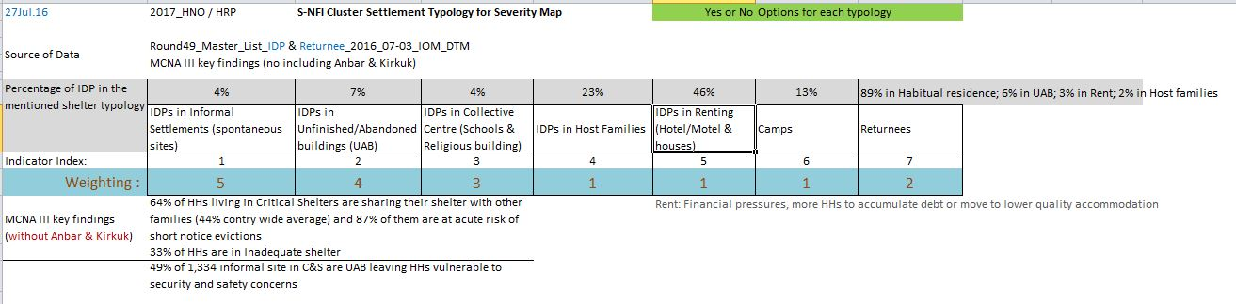
2. Information Management Update: 2017 HNO/HRP process: Heatmap
Vulnerability
+
-
2017_Shelter and NFI Severity Map

Slide 4
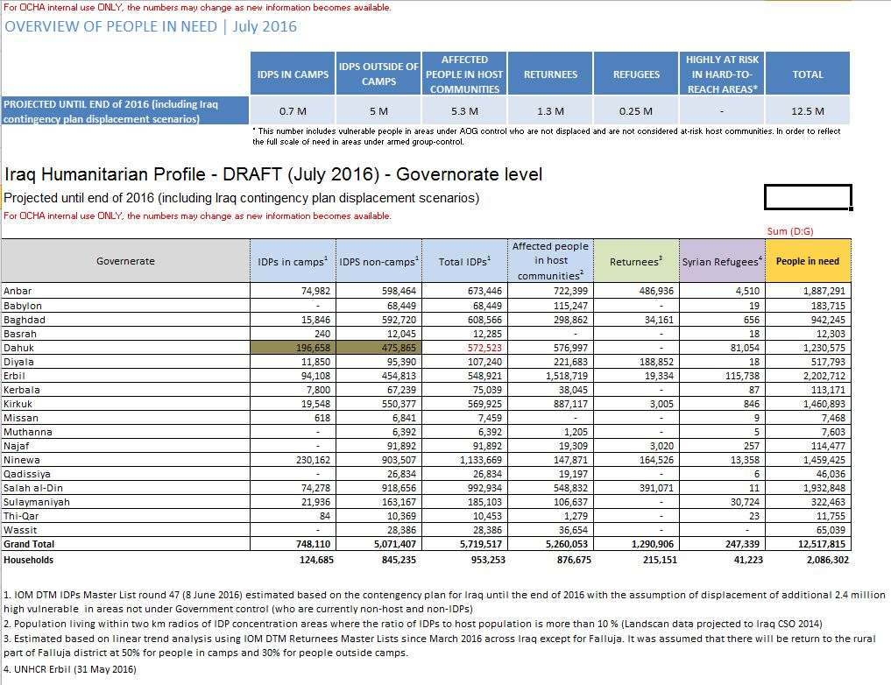
2. Information Management Update: 2017 HNO/HRP process: Projected until end of 2016

Slide 5
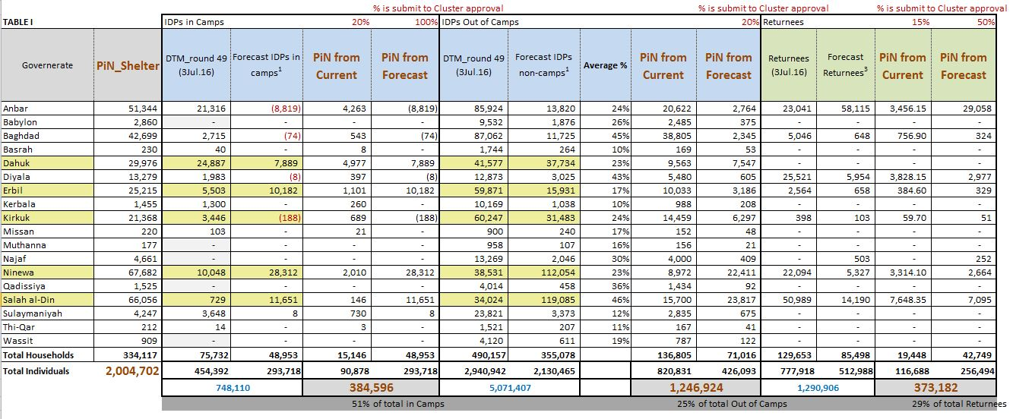
2. Information Management Update: 2017 HNO/HRP process: PiN_Shelter: 2 million
(1.6m in 2016 HNO)

Slide 6
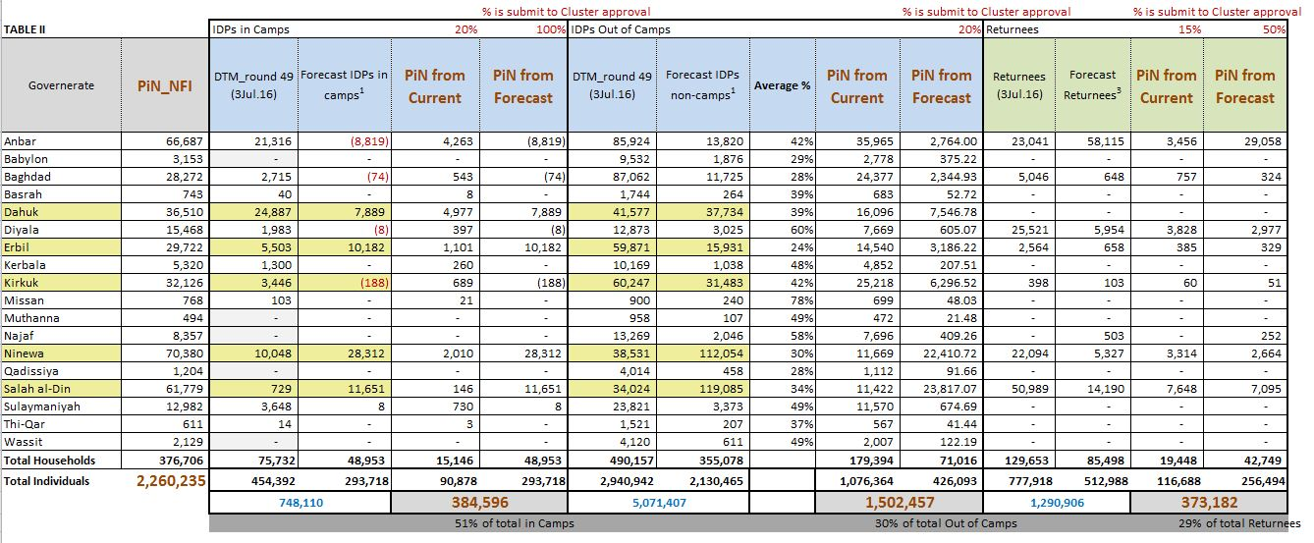
2. Information Management Update: 2017 HNO/HRP process: PiN_NFI: 2.3 million
(1.8m in 2016 HNO)

Slide 7
3. Ongoing Emergency Response – Mosul Operational Planning
Quadrants have provided inputs to Quadrant Coordinators many thanks to Partner input
Emergency Cell received presentations from Quadrant Coordinators on 9th August 2016
Quadrant Coordinator were given two days to review the Mosul Quadrant Operational Plans
Updated Quadrant Plans were presented to HCT in Erbil on 12th August 2016
The HC had a closed session with donors on possible funding for Mosul on 13th August 2016
The HC met with the GoI on 13th August 2016 to discuss ongoing Mosul preparedness and key messages to enable humanitarian actors to operate.
S-NFI current operational Partners & interested Partners to join Mosul response (next slide)

Slide 8
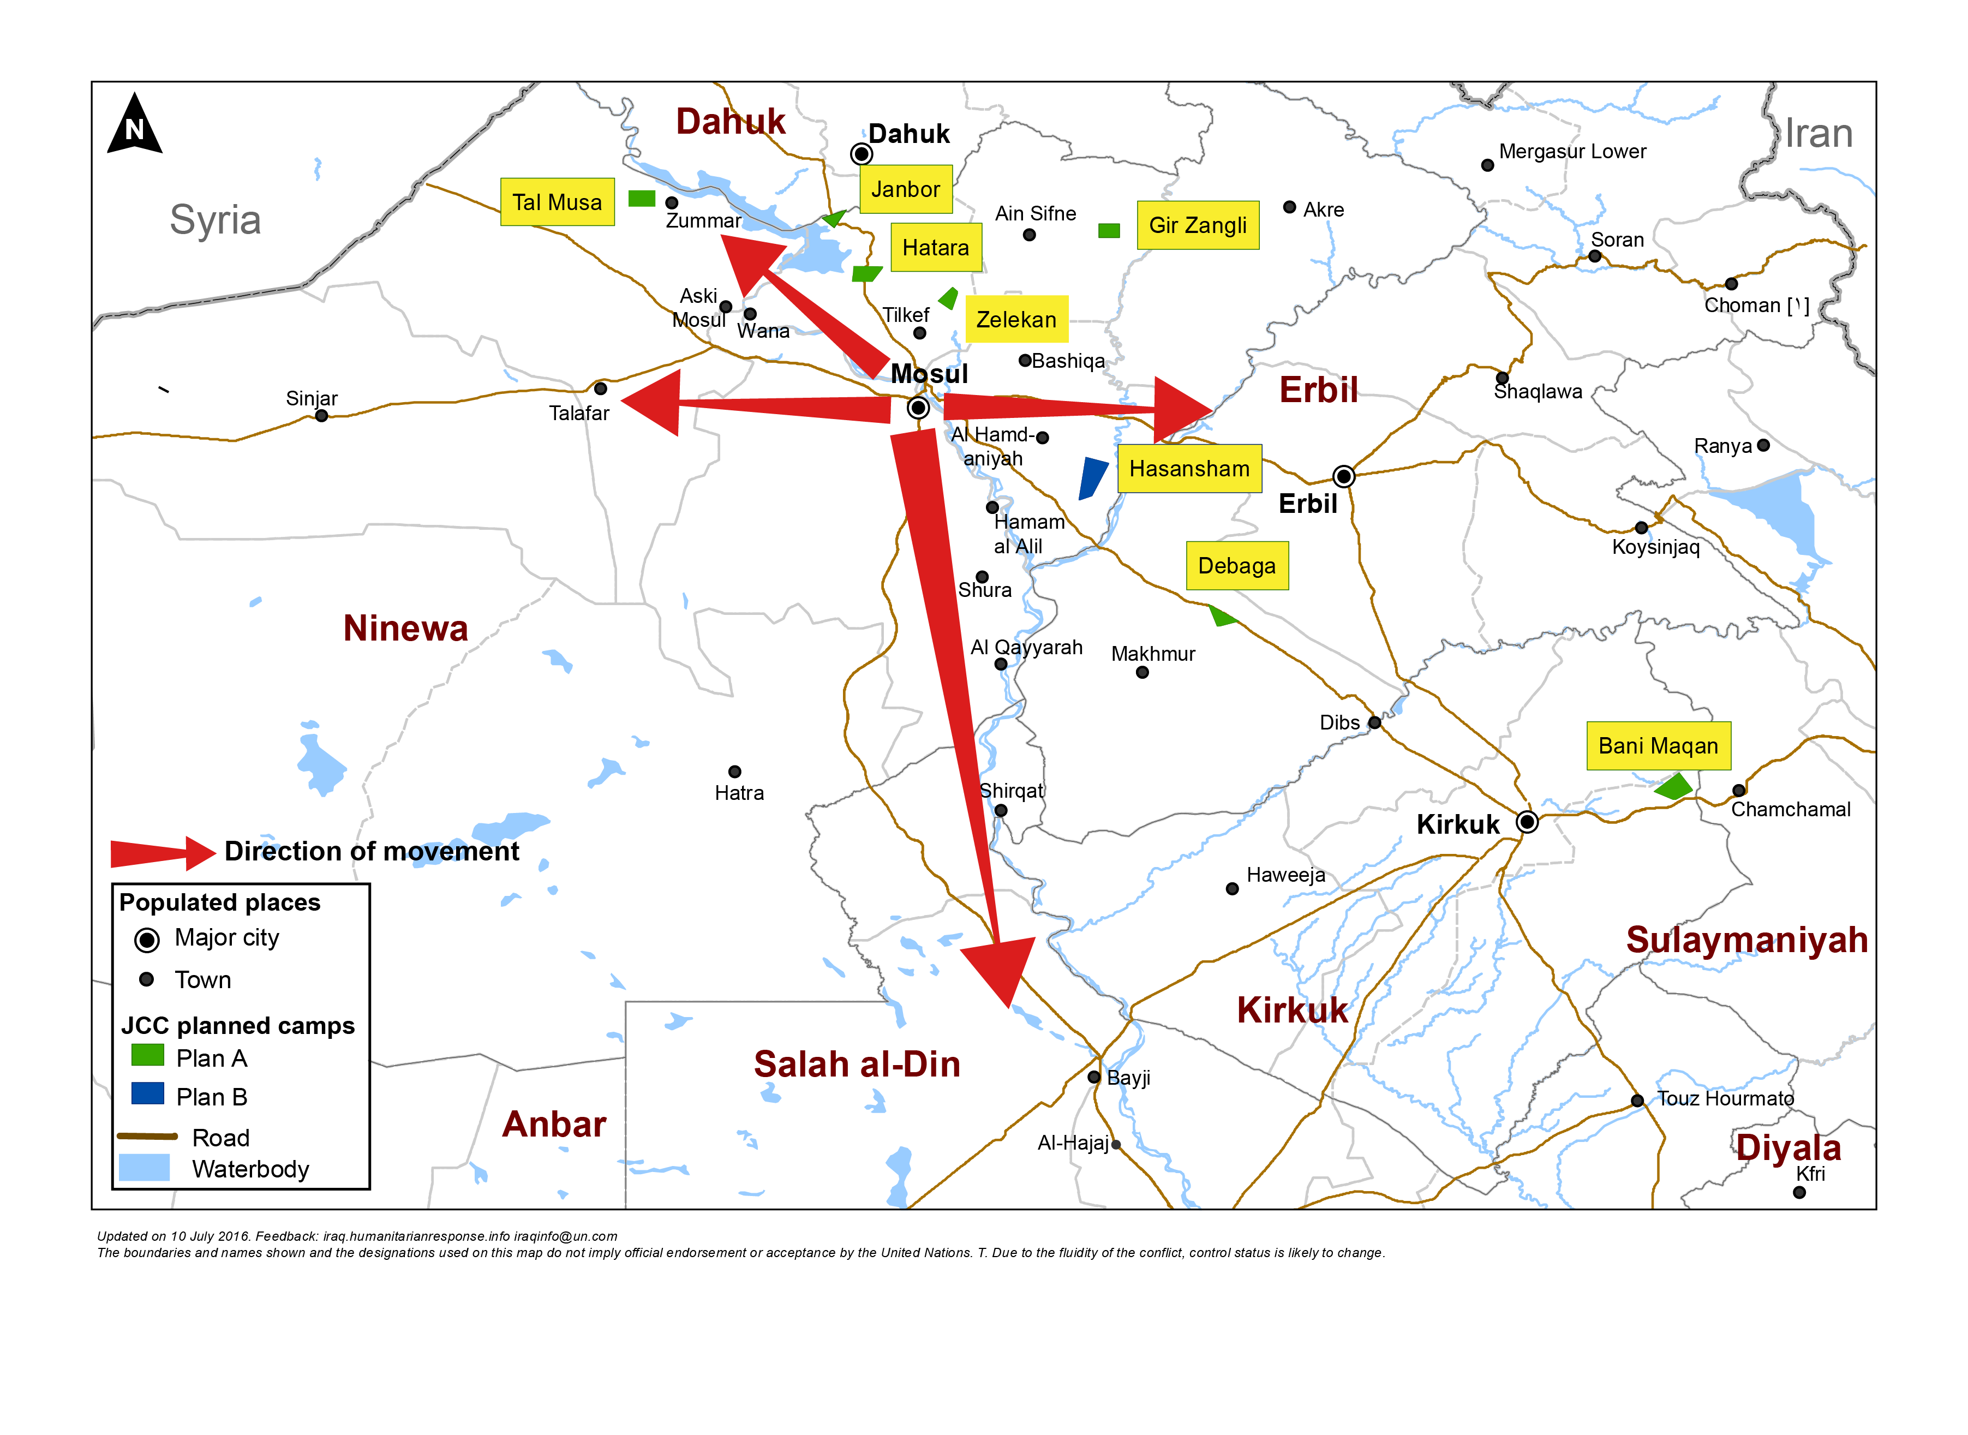
Mosul preparedness / NFI Partners / blue: current operational Partners & red: interested to join Mosul response
Quadrant II (25 Partners)
Dahuk : IOM, UNHCR, NRC, Qandil, BRHA, LWF, Save the Children, Samaritan Purse, CRS, Dorcas, Caritas, PWJ, JEN, GRC, CAPNI, CARE, IRCS, IBC, ACTED, WHH, Mission East, PIN, ZOA, French Red Cross & DRC
Quadrant III (11 Partners)
Quadrant I (17 Partners)
Ninewa : IOM, UNHCR, BCF, PWJ, Mission East, French Red Cross, Qandil, ACTED, PIN, Medair & DRC
Erbil : IOM, UNHCR, ACTED, NRC, BCF, ERC, IRW, PWJ, French Red Cross, Qandil, ZOA, Christian Aid, DRC, INTERSOS, Mercy Corps, CRS & Dorcas
Quadrant IV (15 Partners)
Salah al-Din : IOM, UNHCR, ISHO, RIRP, Muslim Aid, INTERSOS, Mercy Hands for Humanitarian Aid, Mercy Corps & Christian Aid
Kirkuk : IOM, UNHCR, DRC, Mission East, NRC, IRCS, Save the Children & Reach National
http://sheltercluster.org/response/iraq

Slide 9
Mosul preparedness / Shelter Partners / blue: current operational Partners & red: interested to join Mosul response
Quadrant II (15 Partners)
Dahuk : IOM, UNHCR, CRS, NRC, PWJ, KURDS, CARE, Qandil, WHH, UN-Habitat, ACTED, Dorcas, ZOA, PIN & DRC
Quadrant III (7 Partners)
Quadrant I (9 partners)
Ninewa : IOM, UNHCR, Qandil, ACTED, PIN, Medair & DRC
Erbil : IOM, UNHCR, ACTED, ZOA, Dorcas, NRC, INTERSOS, CRS & DRC
Quadrant IV (12 Partners)
Salah al-Din : IOM, UNHCR, ISHO, RIRP, INTERSOS & Muslim Aid
Kirkuk : IOM, UNHCR, NRC, CRS, Save the Children, IRD, Reach National & DRC
http://sheltercluster.org/response/iraq

Slide 10
3. Ongoing Emergency Response – Pre-positioning NFIs/liaison with Logistic Cluster
Common Storage:
The Logistics Cluster has storage capacity:
In Dahuk: 1,640 m²
In Erbil: 1,800 m²
In Baghdad: 2,000 m²
In Tikrit: 1,200 m²
Organisations requesting storage services must complete a Service Request Form (SRF) available on http://www.logcluster.org/document/service-request-form-6
And you submit it to Iraq.ClusterCargo@wfp.org

Slide 11
3. Ongoing Emergency Response – New Camps Constructions & Access through check points
Governorate | Quadrant |  | Current identified camps* | current planned capacity (HH) | expansion capacity (HH) |  | total with additonal (HH) | current planned capacity (ind) | expansion capacity (ind) | total with additional (ind) | Remarks
Ninewa | 1A |  | Zelekan | 1,070 | 430 |  | 1,500 | 6,420 | 2,580 | 9,000 | under construction
 | 1A |  | Gir Zangli | 1,200 | 800 |  | 2,000 | 7,200 | 4,800 | 12,000 | pending - very far from displacement sites
 | 1B |  | Wardak | 2,000 | 1,000 |  | 3,000 | 12,000 | 6,000 | 18,000 | no information available
 | 1B |  | Hasansham | 1,000 | 2,000 |  | 3,000 | 6,000 | 12,000 | 18,000 | currently inaccessible
Erbil | 1B |  | Debaga | - | - |  | - | - | - | - | no capacity for Mosul IDPs
 | 1B |  | Makhmur | - | - |  | - | - | - | - | no information available
 |  |  | Total: | 5,270 | 4,230 |  | 9,500 | 31,620 | 25,380 | 57,000
 | total individuals |  |  | 250,000 | total HH |  |  | 41,667
 | individuals in camps |  |  | 57,000 | HH in camps |  |  | 9,500
 | individuals out of camp |  |  | 193,000 | HH out of camp |  |  | 32,167
*Hatara and Janbour were removed from this list as they were deemed unsuitable for IDP camps
**neither Wardak nor Hasansham has been assessed yet, capacity figures based on preliminary estimates

Slide 12
4. Winterisation Preparedness – Current caseload and Mosul emergency

Slide 13
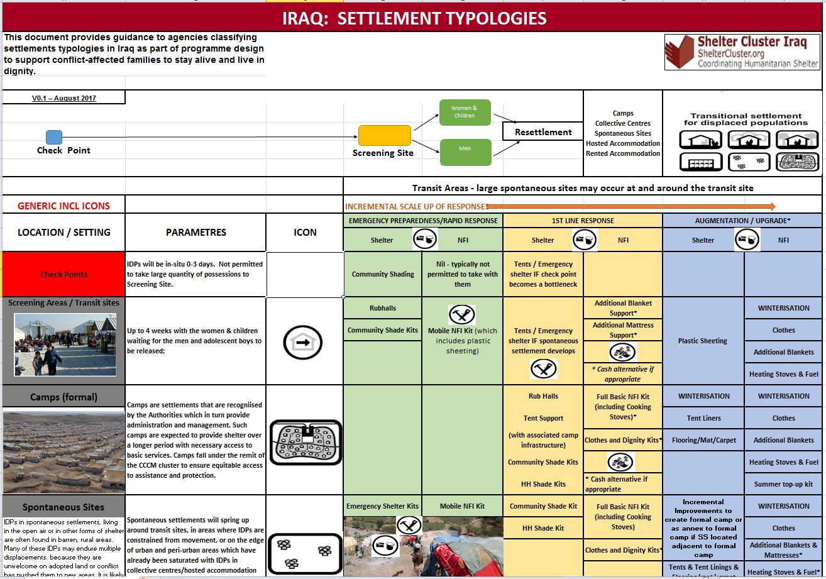

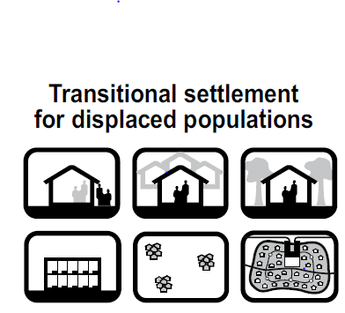



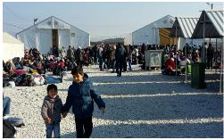


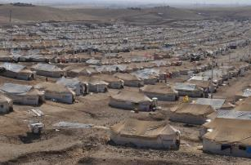

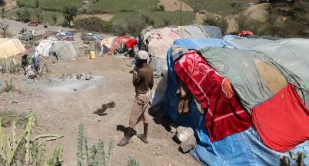

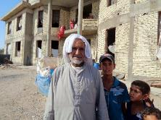

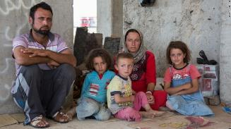
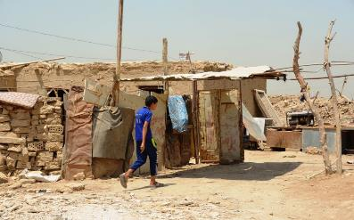


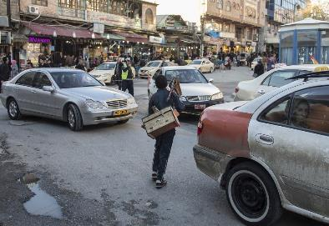

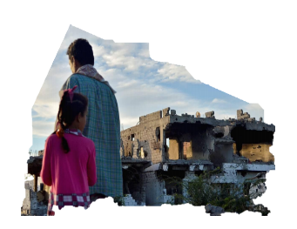


5. Technical Guidance: Settlement Typology, Cluster NFI kit and Emergency Shelter Kit Guidance
Women & Children
Men

Slide 14
5. Technical Guidance: Settlement Typology, Cluster NFI kit and Emergency Shelter Kit Guidance

Slide 15
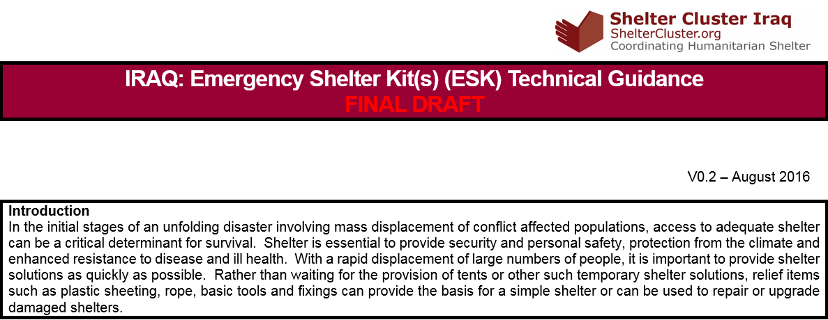
5. Technical Guidance: Settlement Typology, Cluster NFI kit and Emergency Shelter Kit Guidance

Slide 16
6. Governorate and Agencies Updates

Slide 17
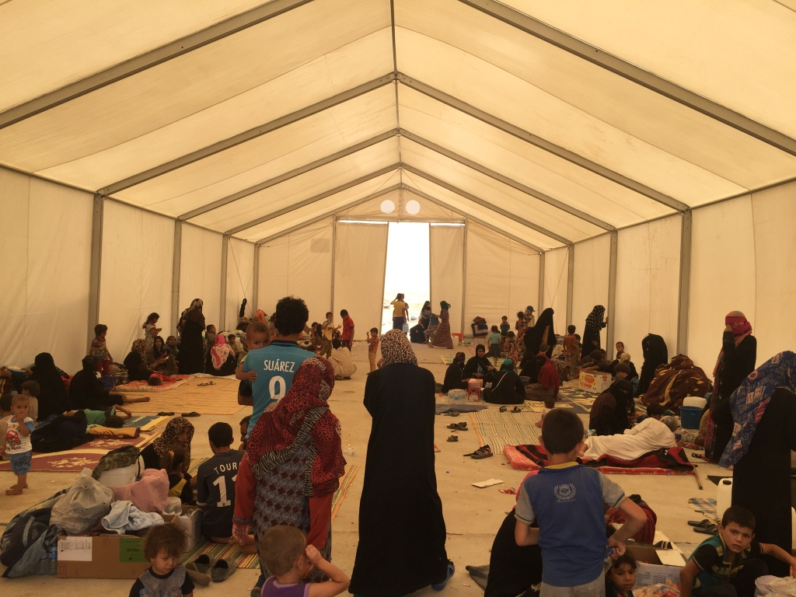
6. AOB
http://sheltercluster.org/response/iraq

