Slide 1
Sub-National Shelter & NFI Cluster Coordination meeting for Centre and South
Agenda
Review of action points from previous meeting minutes (5mn);
Information Management update (5mn);
Ongoing Emergency Response: (25mn);
  Qayyarah / Shirqat: cluster response update
  Fallujah: cluster response updates
  Mosul Operational Planning
  Kirkuk: update on current situation in Hawija and cluster response update
2016_IHPF: 2nd round allocation / Partners Capacity Assessment (5mn);
Governorate and Agencies Updates (10mn);
AOB (5mn);
Wednesday, 24th August 2016
http://sheltercluster.org/response/iraq

Slide 2
1. Review of action points from previous meeting minutes
Progress on Action Points
Include site names into the shelter and NFIs section of the google sheet for the Anbar Response. Michel to Update
Share the survey tools and methodology with the CCCM Mobile Teams Partners. Done
Share final agreed upon HNO information regarding population in need ; Heat Map for 2017. Michel to Update
Share consolidated documents on Mosul Operational Planning and Template for stocks. Ongoing to be shared by Woody in two weeks time

Slide 3
1. Review of action points from previous meeting minutes
Progress on Action Points
Share link for the Qayyarah / Shirqat response with Partners to Update. Done
Share settlement typologies document and consolidated technical guidance documents. Woody
Update response activities into Anbar google sheet, select site names. Ongoing
Share the Inter Cluster google sheet for capturing information on Mosul response. Ongoing

Slide 4
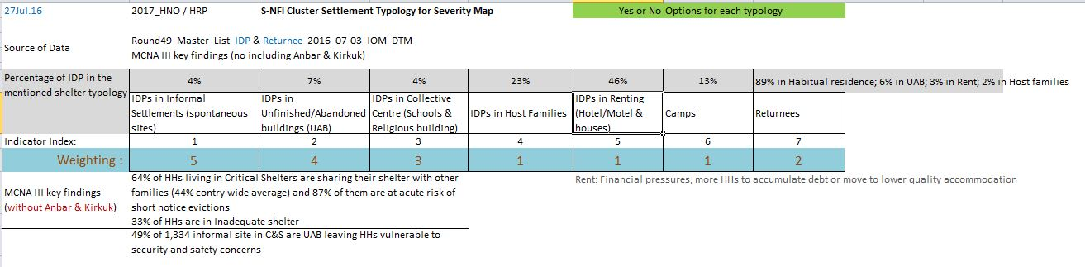
2. Information Management Update: 2017 HNO/HRP process: Heatmap
Vulnerability
+
-
2017_Shelter and NFI Severity Map

Slide 5
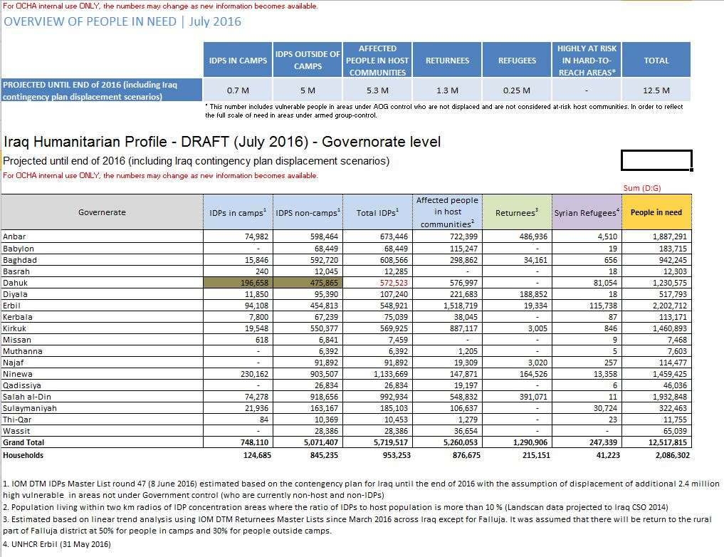
2. Information Management Update: 2017 HNO/HRP process: Projected until end of 2016

Slide 6
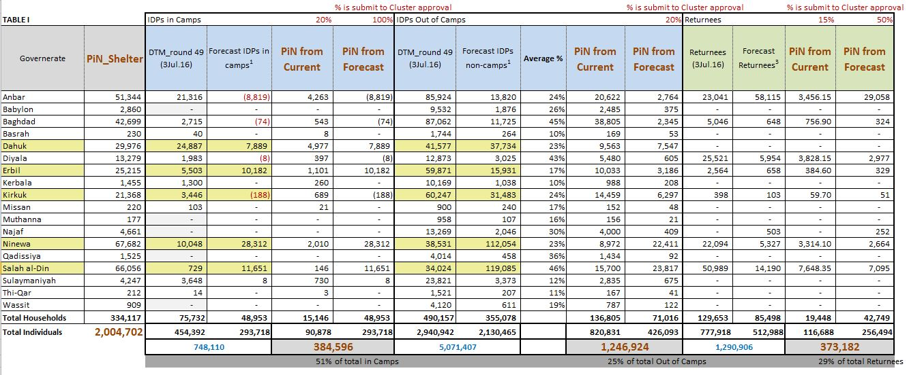
2. Information Management Update: 2017 HNO/HRP process: PiN_Shelter: 2 million
(1.6m in 2016 HNO)

Slide 7
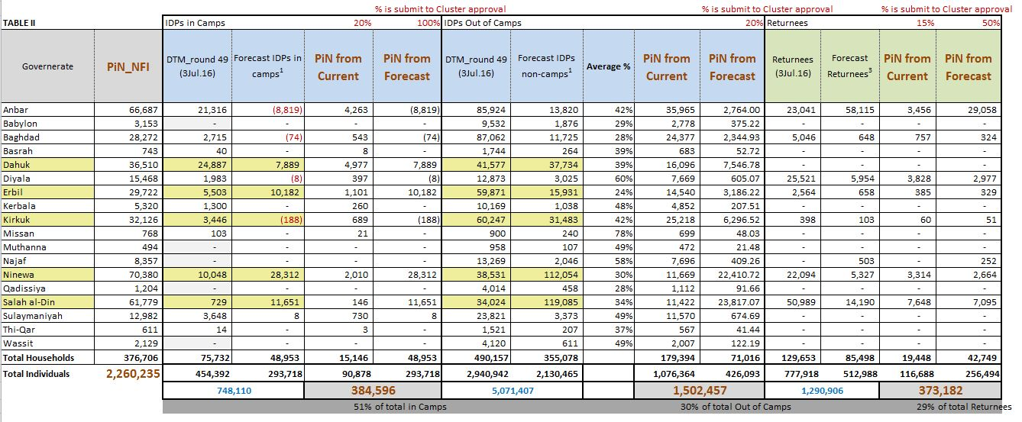
2. Information Management Update: 2017 HNO/HRP process: PiN_NFI: 2.3 million
(1.8m in 2016 HNO)

Slide 8
2. Information Management Update: Monthly report_End of July 2016
Dashboards been share on Aug. 21st 2016
National coverage :
  NFI Distributions: 59% coverage against target
  Shelter Interventions: 11% coverage against target
Only Centre and South
  NFI Distributions: 69% coverage against C&S target (149,816 HHs)
  Shelter Interventions: 12% coverage against C&S target (149,816 HHs)
Funding Status: 31% of USD 180 million
  25% from bilateral
  3% from IHPF
  3% from CERF

Slide 9
3. Ongoing Emergency Response – Qayyarah / Shirqat Crisis Response
IDP families Displaced In Salah a Din since June 2016.
Tikrit 9,954 Families
Baiji 696 Families
Balad 75 Families
Al Daur 182 Families
Total Salah Al-Din: 10,907 HHs as of 22nd August 2016
Response To date
Shelter Delivered: 4,000 tents – MODM ??
SOKs Delivered: 500 (IOM)
Shelter Prepositioned: 2,000 Tents (UNHCR)
Gap at Glance: 4,312 (No of IDPs with Host Families Unknown)
NFIs Delivered: 4,125 basic NFI kits
NFIs Planned: 4,500 basic NFI kits (Cluster partners)
Gap at glance: 2,272 NFI Kits (No of IDPs with Host Families Unknown)
Recommendation:
Partners are requested to Update Status in the google sheet
https://docs.google.com/spreadsheets/d/1bh74J55IzNiQ6UamyNbQcJi9ikv1hbpxLkj59Zb7G40/edit

Slide 10
3. Ongoing Emergency Response – Fallujah Response Updated
XX

Slide 11
3. Ongoing Emergency Response – Mosul Operational Planning
Quadrant 4 - Planning figure is 80,000 Individuals ( 13,333 HHs) for formal camps solutions , the figure may change. Shelter Cluster is advocating for combined mix shelter solutions i.e. formal Camps and out of Camp solutions( Collective centers, self reliant , and hosted families)
Camp solutions are very expensive for short term solutions.
Short term solution includes
  Collective centers
  Emergency Shelter kits that can be used in collective centers and independently
Need for Government to identify / map possible sites where people can be accommodated (such as AUBs, Public Buildings, ….. )
Partners are requested to look into prepositioning of emergency shelter kits

Slide 12
  3. Ongoing Emergency Response – Kirkuk: current situation in Hawija and cluster response
XX

Slide 13
  4. 2016_IHPF: Second round allocation: USD 45 million available to disburse.
OCHA’s Humanitarian Finance Unit (HFU) extended Partners capacity assessment application and document submission. Deadline was COB Monday 22 August (hope concerned partners succeeded to apply on time)
This allocation is open to NGOs (Nat’l & Int’l), Red Cross/Crescent Movement, UN and IOM.
Aug 22th 2016: the secretariat of IHPF opened the second standard allocation window in the Grant Management System (GMS) for partners planning to operate in the four quadrants of the Mosul Operational Plan to submit their project proposals.
The goal is to fund critical and life-saving projects, which cover first and second line responses in each cluster’s emergency package. Shelter and NFI Cluster among prioritised Clusters
The allocation window has been opened and will close on 29 August 2016 at 18:00 / then start the Strategic review, Technical & Budget review and Grant agreement process.
October 1st 2016 : Disbursements to partners

Slide 14
5. Governorate and Agencies Updates
Baghdad;
Basrah;
Kirkuk;

Slide 15
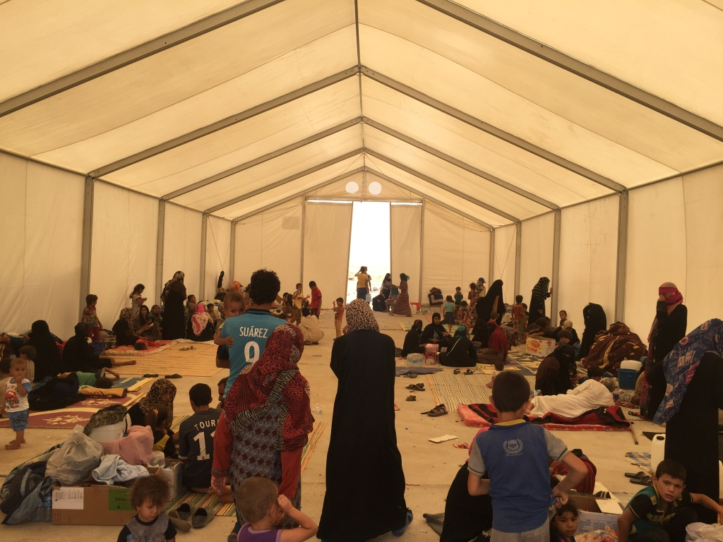
6. AOB
http://sheltercluster.org/response/iraq

