Slide 1
Sub-National Shelter & NFI Cluster Coordination meeting for KRI
Agenda
Review from previous meeting (2mn);
Information Management updates (5mn);
Ongoing Emergency Response (20mn);
Update on Mosul Operational Planning
Update on latest IHPF Process
Pre-positioning NFIs/liaison with Shelter Cluster
Winterization Preparedness (5mn)
Technical Guidance: Settlement Typology, Cluster NFI kit and Emergency Shelter Kit and Emergency Seal Off Kit Guidance (5mn)
Governorate and Agencies Updates KRI (5mn);
AOB (3mn)
Wednesday, 31st August 2016
http://sheltercluster.org/response/iraq

Slide 2
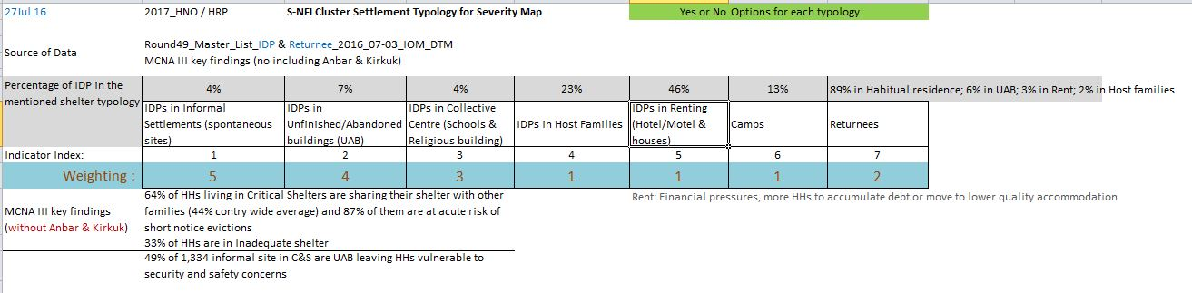
2. Information Management Update: 2017 HNO/HRP process: Heatmap
Vulnerability
+
-
2017_Shelter and NFI Severity Map

Slide 3
2. Information Management Update: improving reporting tools
NFI guidance to include reporting structure
Simplify indicators based on standard NFI kits
Account for replenishments (e.g. hygiene kits)
Include single items / non-standard kits
Update targets during emergencies
Differentiate between covered and reached
Include planned activities and cash/vouchers

Slide 4
3. Ongoing Emergency Response – Mosul Operational Planning
The HC recently met with MoMD and has announced some revised planning parameters for the quadrants.
There will be an OCHA-led inter-quadrant meeting tomorrow morning with the Shelter Cluster represented.
We are requesting that OCHA sends out a summary/overview/snapshot of the quadrant plans to assist cluster partners with proposals.
Partner Mapping – latest Shelter Cluster Maps are available on-line

Slide 5
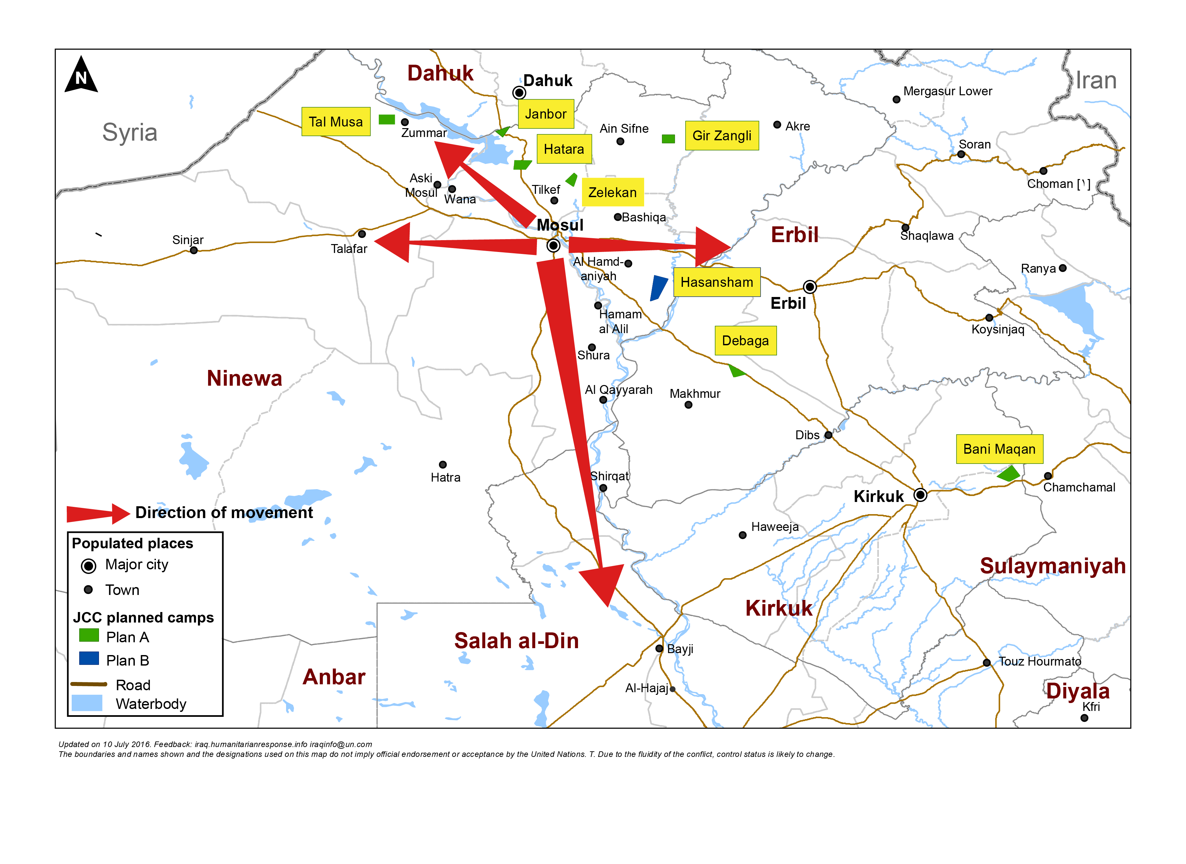
Mosul preparedness / NFI Partners / blue: current operational Partners & red: interested to join Mosul response
Quadrant II (25 Partners)
Dahuk : IOM, UNHCR, NRC, Qandil, BRHA, LWF, Save the Children, Samaritan Purse, CRS, Dorcas, Caritas, PWJ, JEN, GRC, CAPNI, CARE, IRCS, IBC, ACTED, WHH, Mission East, PIN, ZOA, French Red Cross & DRC
Quadrant III (11 Partners)
Quadrant I (17 Partners)
Ninewa : IOM, UNHCR, BCF, PWJ, Mission East, French Red Cross, Qandil, ACTED, PIN, Medair & DRC
Erbil : IOM, UNHCR, ACTED, NRC, BCF, ERC, IRW, PWJ, French Red Cross, Qandil, ZOA, Christian Aid, DRC, INTERSOS, Mercy Corps, CRS & Dorcas
Quadrant IV (15 Partners)
Salah al-Din : IOM, UNHCR, ISHO, RIRP, Muslim Aid, INTERSOS, Mercy Hands for Humanitarian Aid, Mercy Corps & Christian Aid
Kirkuk : IOM, UNHCR, DRC, Mission East, NRC, IRCS, Save the Children & Reach National
http://sheltercluster.org/response/iraq

Slide 6
Mosul preparedness / Shelter Partners / blue: current operational Partners & red: interested to join Mosul response
Quadrant II (15 Partners)
Dahuk : IOM, UNHCR, CRS, NRC, PWJ, KURDS, CARE, Qandil, WHH, UN-Habitat, ACTED, Dorcas, ZOA, PIN & DRC
Quadrant III (7 Partners)
Quadrant I (9 partners)
Ninewa : IOM, UNHCR, Qandil, ACTED, PIN, Medair & DRC
Erbil : IOM, UNHCR, ACTED, ZOA, Dorcas, NRC, INTERSOS, CRS & DRC
Quadrant IV (12 Partners)
Salah al-Din : IOM, UNHCR, ISHO, RIRP, INTERSOS & Muslim Aid
Kirkuk : IOM, UNHCR, NRC, CRS, Save the Children, IRD, Reach National & DRC
http://sheltercluster.org/response/iraq

Slide 7
3. Humanitarian Pooled Fund – Mosul Preparedness
Process “suspended” after concerns raised by Cluster Coordinators, NGOs and other key stakeholders.
Revised submission date is 10 September
Further guidance in form of addendum to Allocation Paper will be circulated.
Cluster Coordinators meeting with OCHA on Friday afternoon to develop information about priorities and guidance.
To date, more than 180 proposals submitted for $45m!!

Slide 8
3. Resource Mapping – Mosul Preparedness
Shelter Cluster is maintaining a matrix of Mosul preparedness (and response) activities by agency to get an overview of the resources available or in the pipeline.
We will share this with agencies and request updates.
CCCM and Shelter Clusters are collaborating to maintain a matrix and map ongoing camp construction for both the Mosul response and the Mosul Corridor. OCHA is producing a map based on this information.

Slide 9

3. Ongoing Emergency Response – Camp Planning Matrix

Slide 10
3. Ongoing Emergency Response – Pre-positioning NFIs/liaison with Logistic Cluster
Common Storage:
The Logistics Cluster has storage capacity:
In Dahuk: 1,640 m²
In Erbil: 1,800 m²
In Baghdad: 2,000 m²
In Tikrit: 1,200 m²
Organisations requesting storage services must complete a Service Request Form (SRF) available on http://www.logcluster.org/document/service-request-form-6
And you submit it to Iraq.ClusterCargo@wfp.org

Slide 11
4. Winterisation Preparedness – Current caseload and Mosul emergency
Current caseload
Mosul preparedness

Slide 12
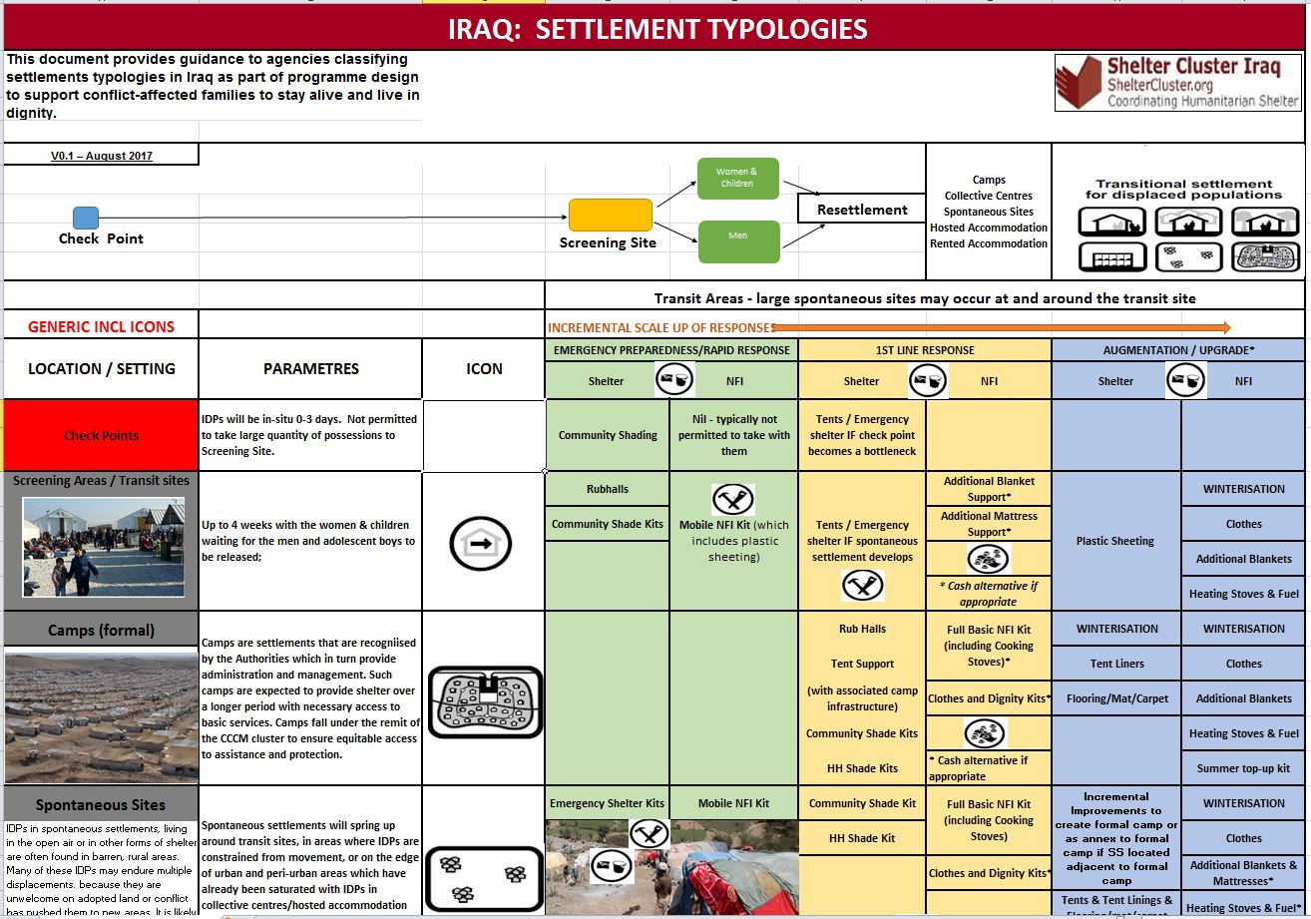

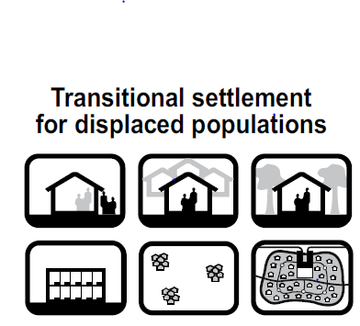



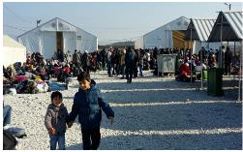


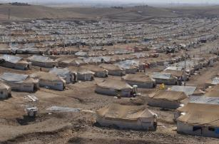

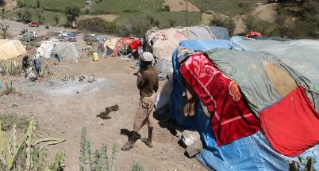

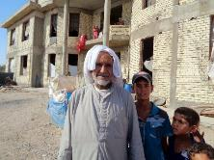

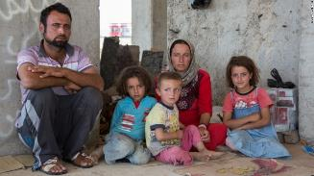
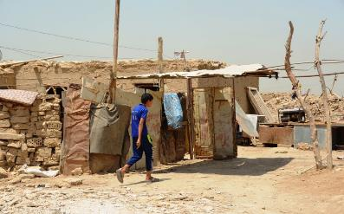


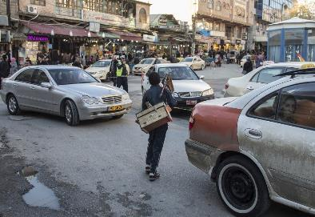




5. Technical Guidance: Settlement Typology, Cluster NFI kit and Emergency Shelter Kit Guidance
Women & Children
Men

Slide 13
5. Technical Guidance: Settlement Typology, Cluster NFI kit and Emergency Shelter Kit Guidance

Slide 14
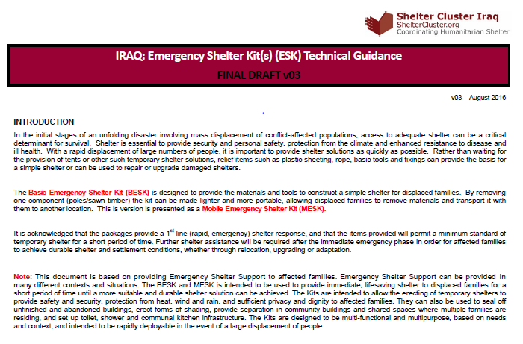
5. Technical Guidance: Settlement Typology, Cluster NFI kit and Emergency Shelter Kit Guidance

Slide 15
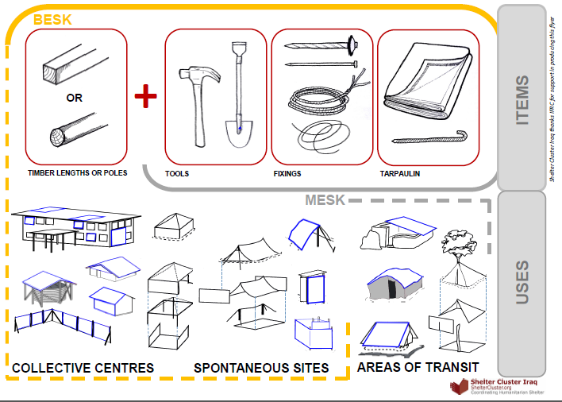
5. Technical Guidance: Settlement Typology, Cluster NFI kit and Emergency Shelter Kit Guidance

Slide 16
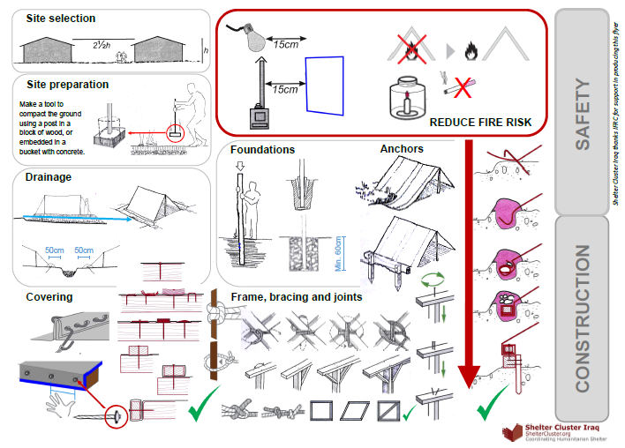
5. Technical Guidance: Settlement Typology, Cluster NFI kit and Emergency Shelter Kit Guidance

Slide 17
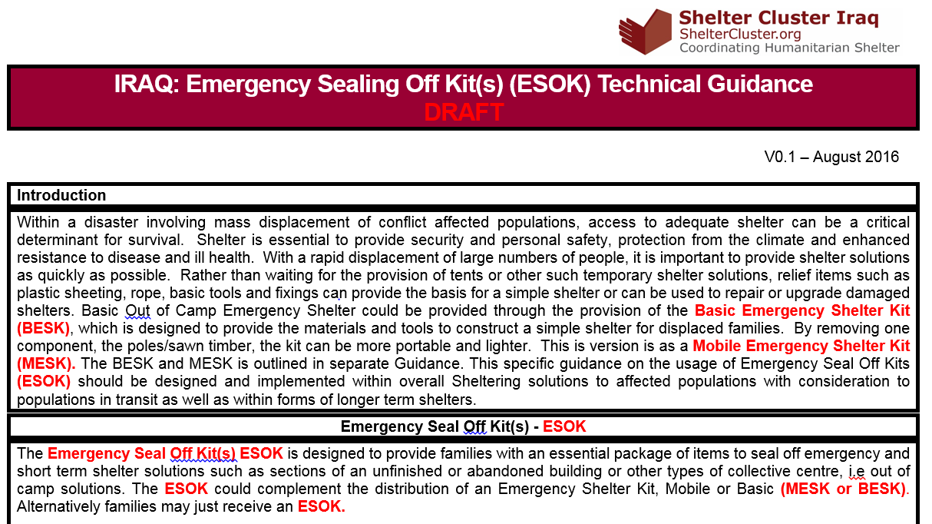
5. Technical Guidance: Settlement Typology, Cluster NFI kit and Emergency Shelter Kit Guidance

Slide 18
6. Governorate and Agencies Updates

Slide 19
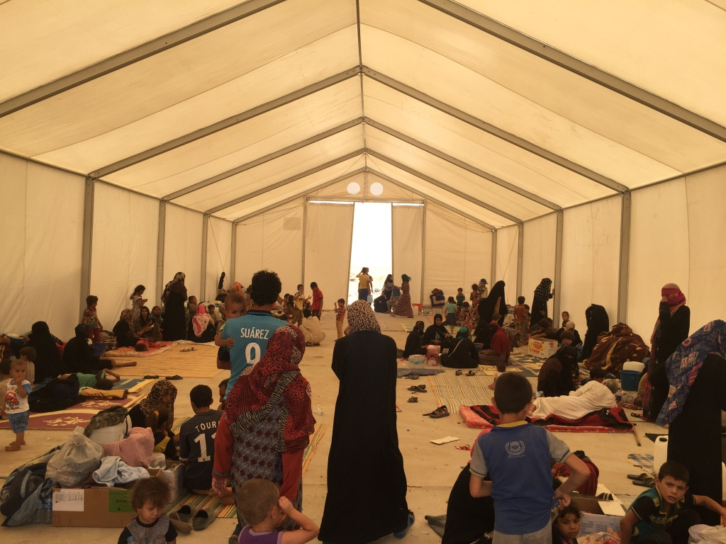
6. AOB
http://sheltercluster.org/response/iraq

