Slide 1
Sub-National Shelter & NFI Cluster Coordination meeting for Centre and South
Agenda
  Review of action points from previous meeting minutes (5mn);
  Information Management update (5mn);
  Ongoing Emergency Response: (15mn);
    Hawija
    Mosul Operational Planning
    2016_IHPF: 2nd round allocation;
  Governorate and Agencies Updates (15mn);
    Baghdad
    Kirkuk
    Basra
  AOB (5mn);
Wednesday, 7^{h} September 2016
http://sheltercluster.org/response/iraq

Slide 2
1. Review of action points from previous meeting minutes
Progress on Action Points
Share link for Ongoing Emergency Response of Qayyarah / Shirqat Crisis Google Sheet with partners
Share link for Ongoing Emergency Response of Fallujah Crisis Google Sheet with partners
Share the assessment of camps, sites and potential capacity by UNHCR and Government
Share the information with respect to the return of IDPs in Salah Al-Din with Protection Cluster for further action
Partners to share plans of intervention and stocks
Partners planning to operate in the four quadrants of the Mosul Operational Plan to submit their project proposals for IHPF
UNHCR to share info on the construction of a “Transit Center” located out-side Al-Hajaj Camp on Google Sheet

Slide 3
2. Information Management Update: improving reporting tools
NFI guidance to include reporting structure
Simplify indicators based on standard NFI kits
Account for replenishments (e.g. hygiene kits)
Include single items / non-standard kits
Update targets during emergencies
Differentiate between covered and reached
Include planned activities and cash/vouchers

Slide 4
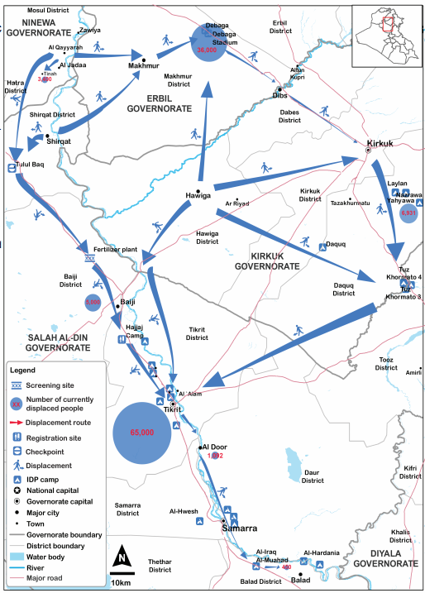
3. Ongoing Emergency Response – Hawija
Tikrit district: IDPs fom Hawiga go through Al Alam sub-district’s checkpoint, screening, and reception centre. MoDM and UNHCR are building a new camp in Tel Seebat to boost camp capacity
Kirkuk district: close to 7,000 IDPs were registered in August from the Hawiga district alone. IDPs arrive through Kirkuk checkpoints or are transferred from Debaga camps.
source: OCHA
Notes:
UNHCR has received reports of armed groups preventing IDPs from fleeing Hawiga in Kirkuk Governorate. Those that manage to flee are further at risk along the routes to safety. On 1 September, two children were killed by an explosive device while fleeing from Hawiga to Makhmur in Erbil Governorate. Meanwhile, nearly 400 IDPs from Hawiga arrived in Laylan camp in Kirkuk Governorate between 1 and 4 September.

Slide 5
3. Ongoing Emergency Response – Mosul Operational Planning
The HC recently met with MoMD and has announced some revised planning parameters for the quadrants.
We are requesting that OCHA sends out a summary/overview/snapshot of the quadrant plans to assist cluster partners with proposals.
Partner Mapping – latest Shelter Cluster Maps are available on-line

Slide 6
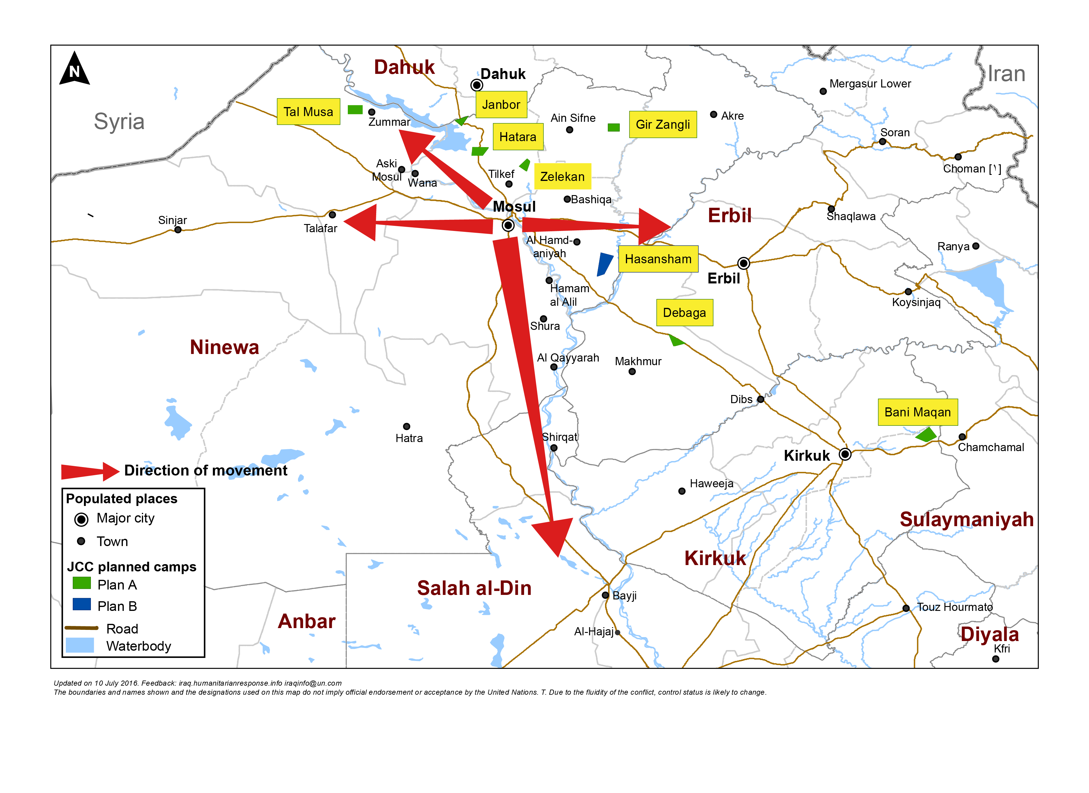
Mosul preparedness / NFI Partners / blue: current operational Partners & red: interested to join Mosul response
Quadrant II (25 Partners)
Dahuk : IOM, UNHCR, NRC, Qandil, BRHA, LWF, Save the Children, Samaritan Purse, CRS, Dorcas, Caritas, PWJ, JEN, GRC, CAPNI, CARE, IRCS, IBC, ACTED, WHH, Mission East, PIN, ZOA, French Red Cross & DRC
Quadrant III (11 Partners)
Quadrant I (18 Partners)
Ninewa : IOM, UNHCR, BCF, PWJ, Mission East, French Red Cross, Qandil, ACTED, PIN, Medair & DRC
Erbil : IOM, UNHCR, ACTED, NRC, BCF, ERC, IRW, PWJ, French Red Cross, Qandil, ZOA, Christian Aid, DRC, INTERSOS, Mercy Corps, CRS, CARE & Dorcas
Quadrant IV (16 Partners)
Salah al-Din : IOM, UNHCR, ISHO, RIRP, Muslim Aid, INTERSOS, Mercy Hands for Humanitarian Aid, Mercy Corps & Christian Aid
Kirkuk : IOM, UNHCR, DRC, Mission East, NRC, IRCS, Save the Children, Reach National, CRS
http://sheltercluster.org/response/iraq

Slide 7
Mosul preparedness / Shelter Partners / blue: current operational Partners & red: interested to join Mosul response
Quadrant II (15 Partners)
Dahuk : IOM, UNHCR, CRS, NRC, PWJ, KURDS, CARE, Qandil, WHH, UN-Habitat, ACTED, Dorcas, ZOA, PIN & DRC
Quadrant III (7 Partners)
Quadrant I (10 partners)
Ninewa : IOM, UNHCR, Qandil, ACTED, PIN, Medair & DRC
Erbil : IOM, UNHCR, ACTED, ZOA, Dorcas, NRC, INTERSOS, CRS, CARE & DRC
Quadrant IV (13 Partners)
Salah al-Din : IOM, UNHCR, ISHO, RIRP, INTERSOS & Muslim Aid
Kirkuk : IOM, UNHCR, NRC, CRS, Save the Children, IRD, Reach National & DRC
http://sheltercluster.org/response/iraq

Slide 8
3. Resource Mapping – Mosul Preparedness
Shelter Cluster is maintaining a matrix of Mosul preparedness (and response) activities by agency to get an overview of the resources available or in the pipeline.
We will share this with agencies and request updates.
CCCM and Shelter Clusters are collaborating to maintain a matrix and map ongoing camp construction for both the Mosul response and the Mosul Corridor. OCHA is producing a map based on this information.

Slide 9
3. Resource Mapping – Mosul Preparedness

Slide 10
3. Humanitarian Pooled Fund – Mosul Preparedness
Process “suspended” after concerns raised by Cluster Coordinators, NGOs and other key stakeholders.
Further guidance in form of addendum or revised Allocation Paper will be circulated at the end of the week. It is going before the HCT and Advisory Board on Wednesday.
Requested OCHA to provide further information about the planning process and parameters to accompany the allocation paper.
Agencies will be able to update and enhance their proposals and new proposals will be permitted.
To date, 118 proposals are sitting on GMS – total allocation is $45m!!

Slide 11
3. Ongoing Emergency Response – Pre-positioning NFIs/liaison with Logistic Cluster
Common Storage:
The Logistics Cluster has storage capacity:
In Dahuk: 1,640 m²
In Erbil: 1,800 m²
In Baghdad: 2,000 m²
In Tikrit: 1,200 m²
Organisations requesting storage services must complete a Service Request Form (SRF) available on http://www.logcluster.org/document/service-request-form-6
And you submit it to Iraq.ClusterCargo@wfp.org

Slide 12
5. Governorate and Agencies Updates
Baghdad;
Basrah;
Kirkuk;

Slide 13
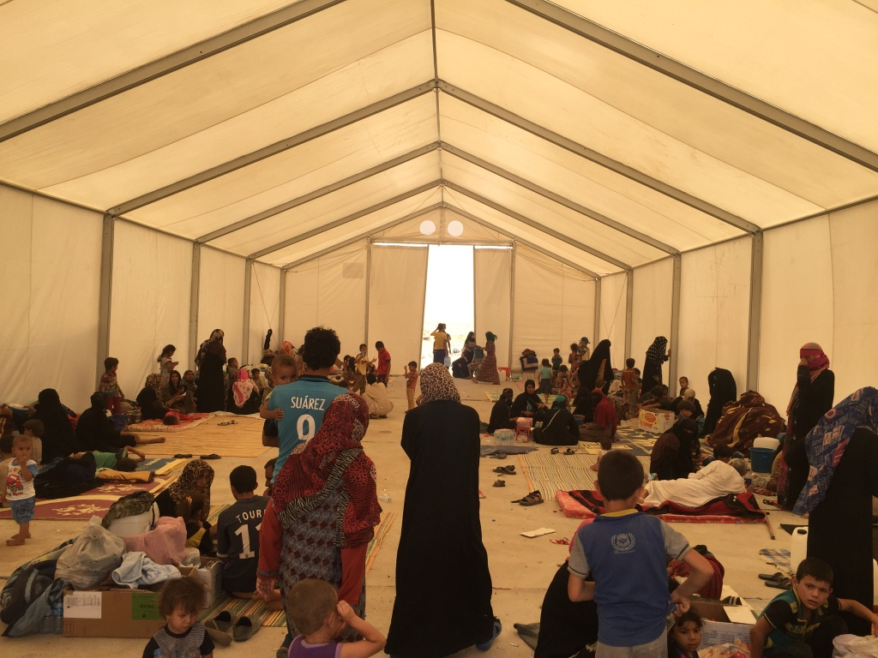
6. AOB
http://sheltercluster.org/response/iraq

