Slide 1
Sub-National Shelter & NFI Cluster Coordination meeting for KRI
Agenda
Review from previous meeting
Information Management updates
Ongoing Emergency Response
Update on Mosul Operational Planning
Update on latest IHPF Process
Technical Guidance: Cluster NFI kit and Emergency Shelter Kit and Emergency Seal Off Kit Guidance
Governorate and Agencies Updates KRI
AOB
Wednesday, 14th September 2016
http://sheltercluster.org/response/iraq

Slide 2
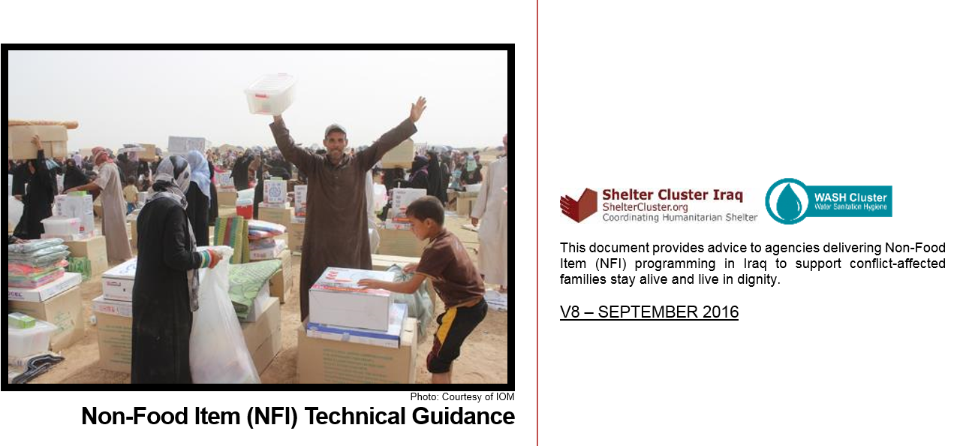
1. Technical Guidance: Information Management – Reporting on distributions

Slide 3
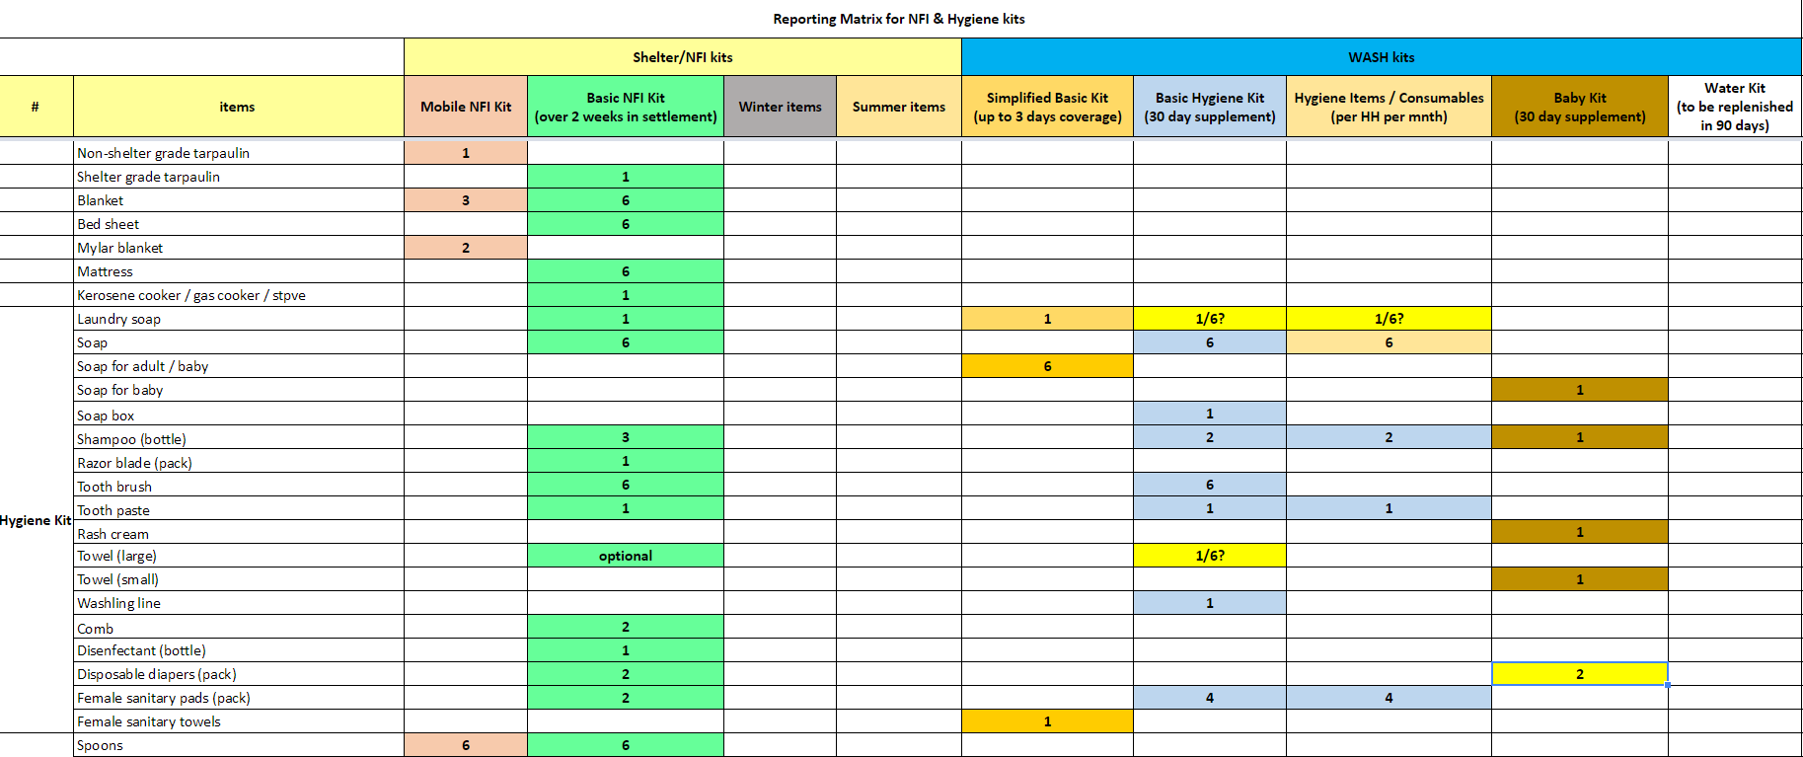
1. Technical Guidance: Information Management – Reporting on distributions
Notes:
Reporting guidance
The below sets out which kits should be reported to which clusters and what the thresholds are for reporting a kit.
For Shelter/NFI Cluster partners
Mobile NFI kit: at least 4 items (including at least 4 from kitchen set) are needed to report a kit
Basic NFI kit: at least 4 required items (including at least 4 from kitchen set and at least 7 from hygiene kit) are needed to report a kit
Winter Basic NFI kit: same as Basic NFI kit, but all 2 required seasonal items needed to report a winter appropriate NFI kit
Summer Basic NFI kit: same as Basic NFI kit, but all 2 required seasonal items needed to report a summer appropriate NFI kit
Winter top-up: all 2 required items needed to report a winter top-up
Summer top-up: all 2 required items needed to report a summer top-up
Clothing kits: all items required to report a kit
For WASH Cluster partners
Simplified Basic Kit: all 3 required items needed to report a kit
Basic Hygiene kit: at least 7 items needed to report a kit
Hygiene items / consumables: all 5 required items needed to report replenishment
Baby kit: at least 4 required items needed to report a kit
Water kit: at least 2 items needed to report a kit
Reporting needs to take into account type of distribution (to newly arrived or for replenishment) to avoid double counting where possible, hygiene kits distributed as part of Basic NFI kits reported to the Shelter Cluster will be reported to the WASH Cluster by the cluster IMO.

Slide 4
1. Information Management Update: 2017 HNO/HRP process: PIN calculation based on MCNA
Adequacy of shelter as indicator for need, this gives 27% of population (or 2.1 million people) in need of shelter support.
Summerisation kit as priority need as a proxy indicator for general NFI need, this gives 44% of the population (or 2.4 million people) in need of NFI support.
Notes:
For shelter: use only adequacy of shelter as indicator for need, this gives 27% of population (or 2.1 million people instead of 2) in need of shelter support.
Why: although other indicators such as eviction risk are also interesting, it is difficult to assign weightings to each and averaging out the scores suggest that all indicators are of equal importance, which is probably not the case.
For NFI: use summerisation kit as priority need as a proxy indicator for general NFI need, this gives 44% of the population (or 2.4 million people instead of 2.3) in need of NFI support.
Why: the problem with identifying need based on what people have received is that it does not say anything about their current need and also assumes that the total remainder of the population is in need.

Slide 5
1. Information Management Update: 2017 HNO/HRP process: PIN calculation
Notes:
Note: roughly 6,000 plots in camps are currently empty

Slide 6
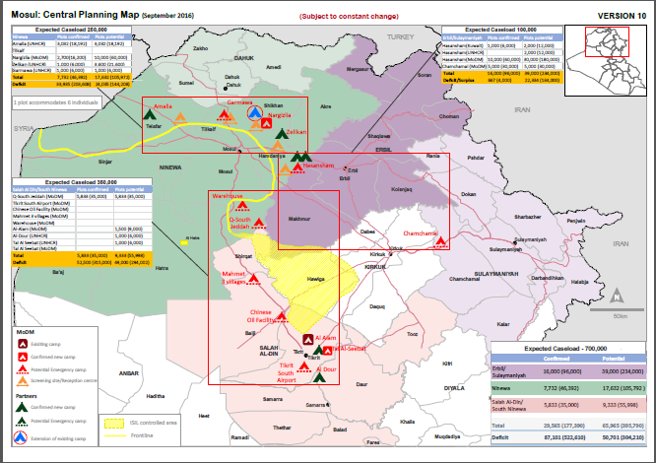
3. Ongoing Emergency Response – Mosul Operational Planning

Slide 7
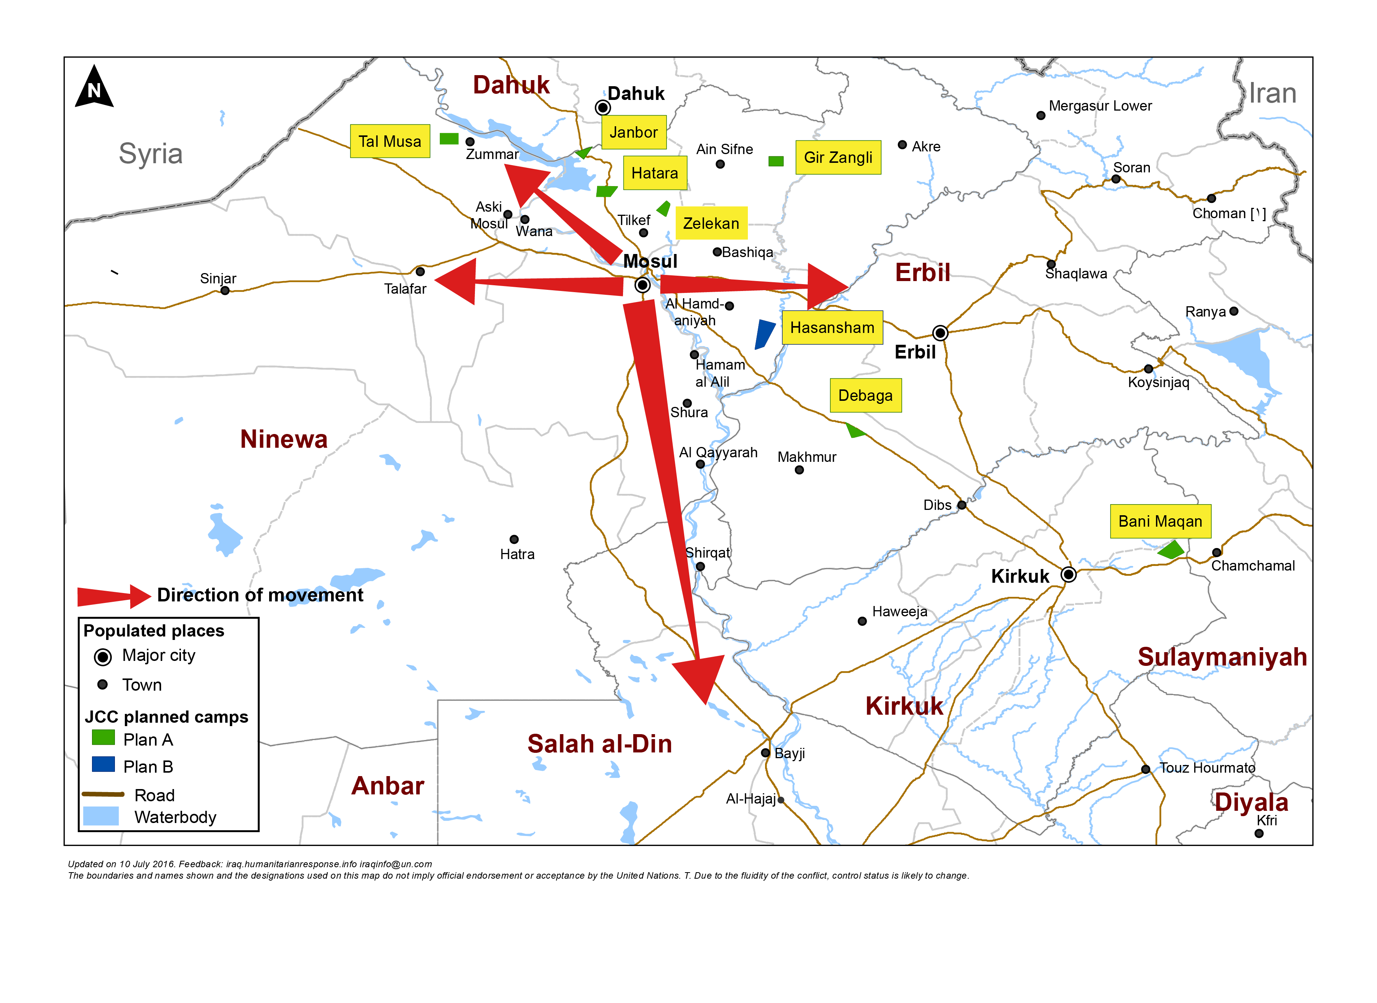
3. Mosul preparedness / NFI Partners / blue: current operational Partners & red: interested to join Mosul response
Quadrant II (25 Partners)
Dahuk : IOM, UNHCR, NRC, Qandil, BRHA, LWF, Save the Children, Samaritan Purse, CRS, Dorcas, Caritas, PWJ, JEN, GRC, CAPNI, CARE, IRCS, IBC, ACTED, WHH, Mission East, PIN, ZOA, French Red Cross & DRC
Quadrant III (11 Partners)
Quadrant I (18 Partners)
Ninewa : IOM, UNHCR, BCF, PWJ, Mission East, French Red Cross, Qandil, ACTED, PIN, Medair & DRC
Erbil : IOM, UNHCR, ACTED, NRC, BCF, ERC, IRW, PWJ, French Red Cross, Qandil, ZOA, Christian Aid, DRC, INTERSOS, Mercy Corps, CRS, CARE & Dorcas
Quadrant IV (16 Partners)
Salah al-Din : IOM, UNHCR, ISHO, RIRP, Muslim Aid, INTERSOS, Mercy Hands for Humanitarian Aid, Mercy Corps & Christian Aid
Kirkuk : IOM, UNHCR, DRC, Mission East, NRC, IRCS, Save the Children, Reach National, CRS
http://sheltercluster.org/response/iraq

Slide 8
3. Mosul preparedness / Shelter Partners / blue: current operational Partners & red: interested to join Mosul response
Quadrant II (15 Partners)
Dahuk : IOM, UNHCR, CRS, NRC, PWJ, KURDS, CARE, Qandil, WHH, UN-Habitat, ACTED, Dorcas, ZOA, PIN & DRC
Quadrant III (7 Partners)
Quadrant I (10 partners)
Ninewa : IOM, UNHCR, Qandil, ACTED, PIN, Medair & DRC
Erbil : IOM, UNHCR, ACTED, ZOA, Dorcas, NRC, INTERSOS, CRS, CARE & DRC
Quadrant IV (13 Partners)
Salah al-Din : IOM, UNHCR, ISHO, RIRP, INTERSOS & Muslim Aid
Kirkuk : IOM, UNHCR, NRC, CRS, Save the Children, IRD, Reach National & DRC
http://sheltercluster.org/response/iraq

Slide 9
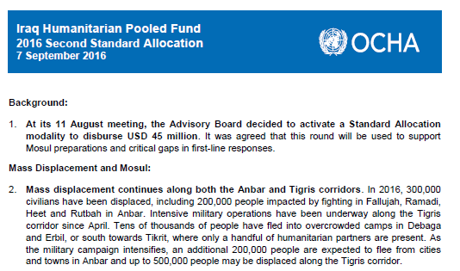
3. Humanitarian Pooled Fund – Mosul Preparedness

Slide 10
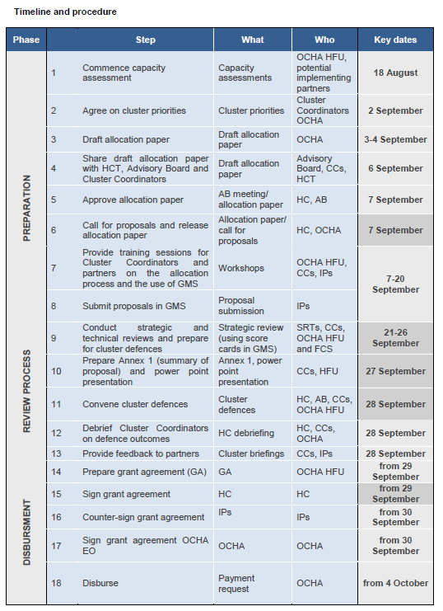
3. Humanitarian Pooled Fund – Mosul Preparedness

Slide 11
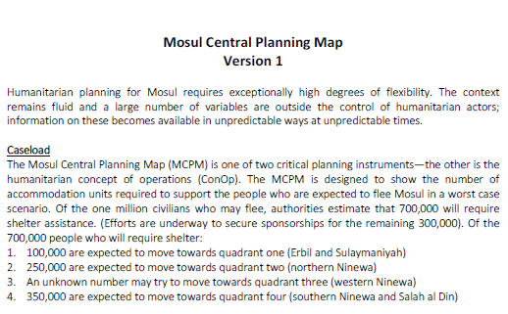
3. Humanitarian Pooled Fund – Mosul Preparedness

Slide 12
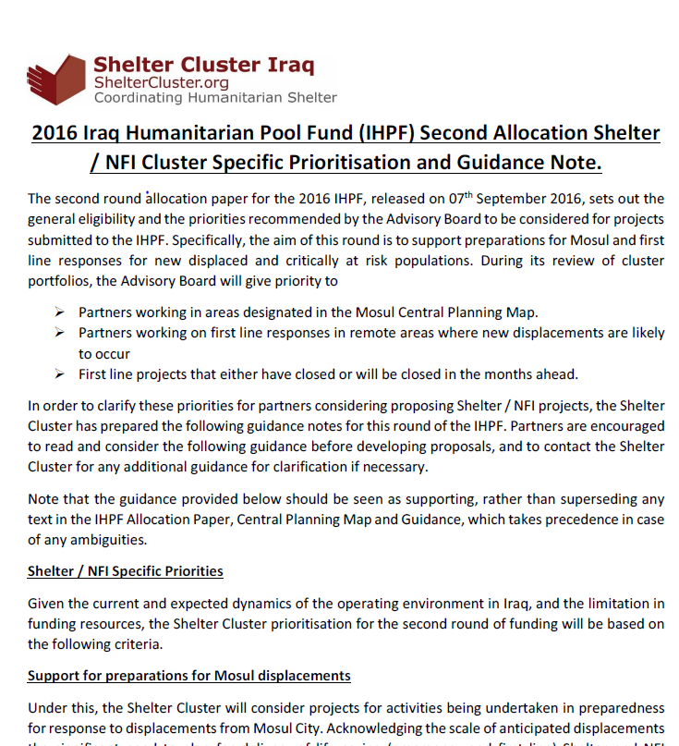
3. Humanitarian Pooled Fund – Mosul Preparedness

Slide 13
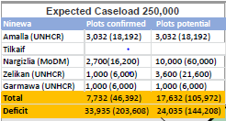
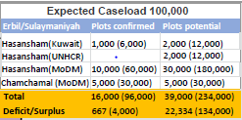
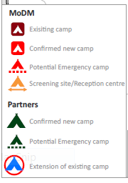
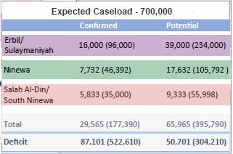
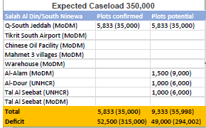
3. Humanitarian Pooled Fund – Mosul Preparedness

Slide 14
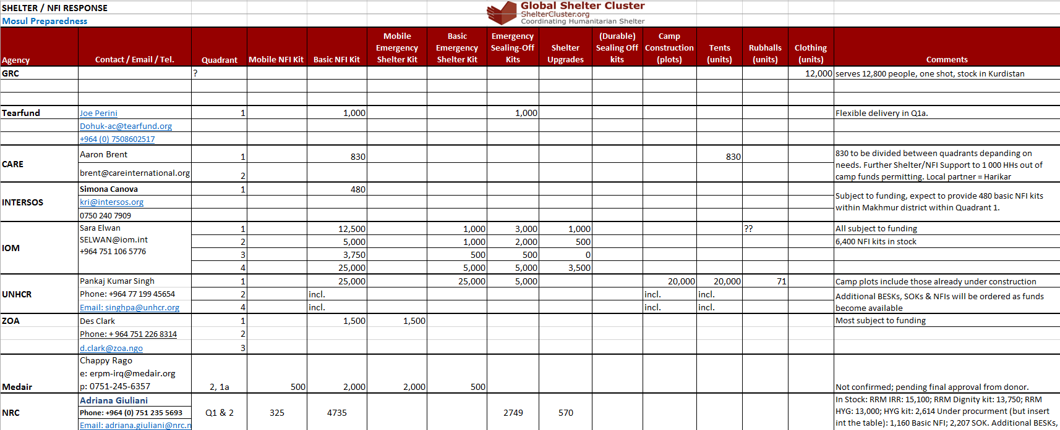
3. Resource Mapping – Mosul Preparedness
Shelter Cluster is maintaining a matrix of Mosul preparedness (and response) activities by agency to get an overview of the resources available or in the pipeline.

Slide 15
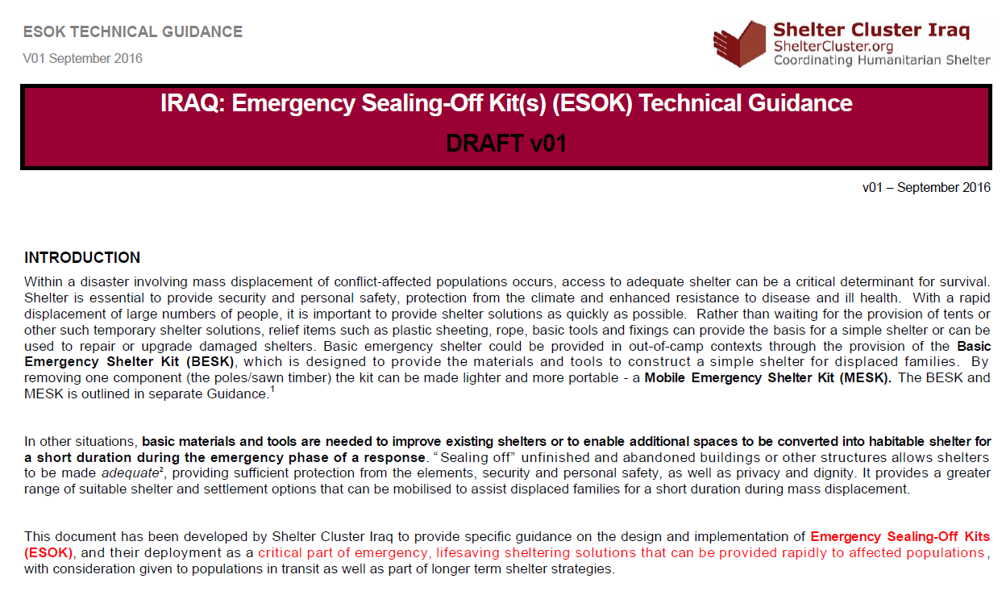
4. Technical Guidance: Settlement Typology, Cluster NFI kit and Emergency Shelter Kit Guidance

Slide 16
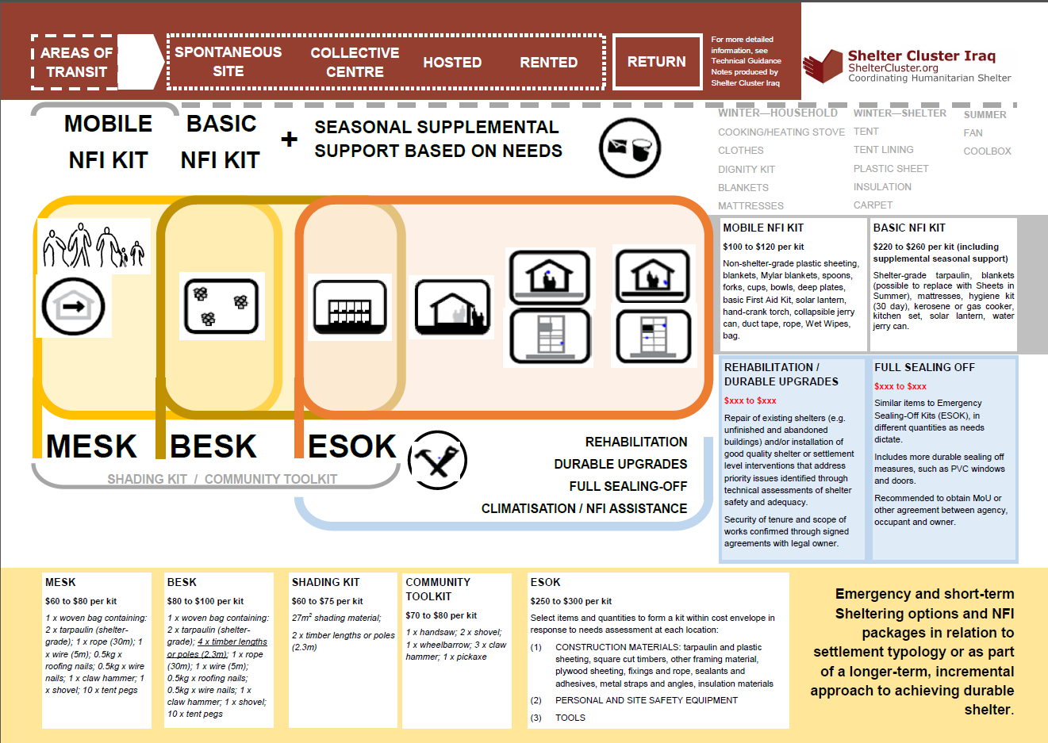
4. Technical Guidance: Settlement Typology, Cluster NFI kit and Emergency Shelter Kit Guidance

Slide 17
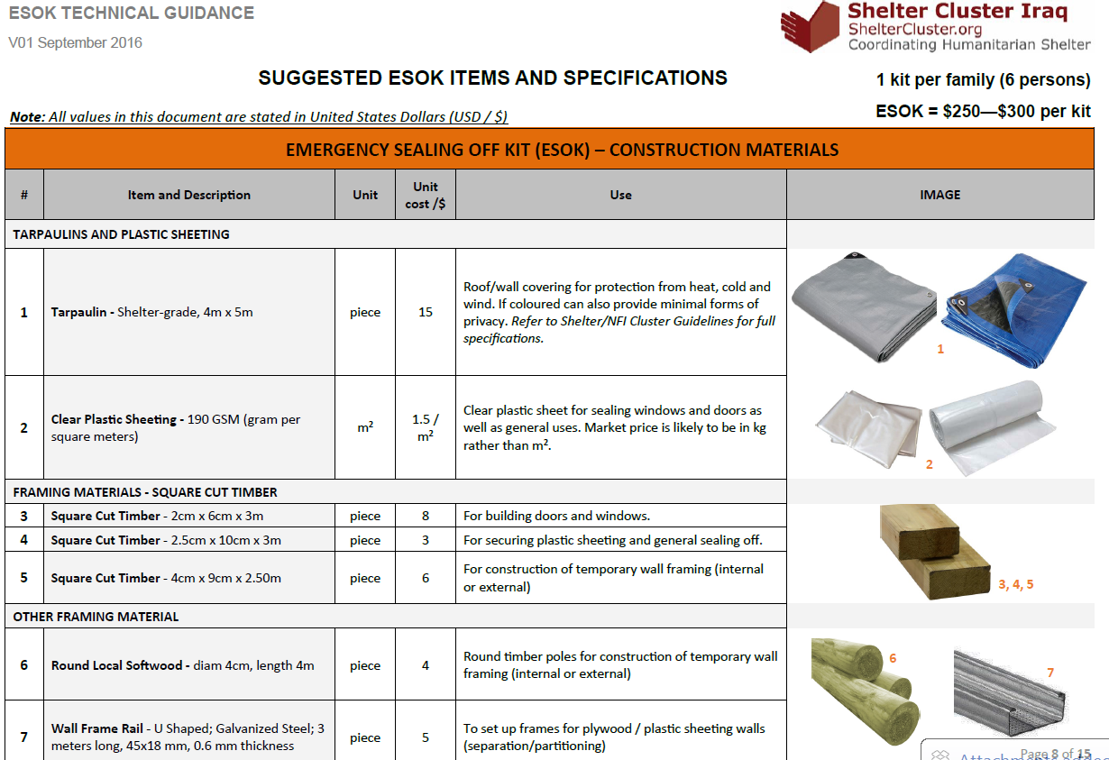
4. Technical Guidance: Settlement Typology, Cluster NFI kit and Emergency Shelter Kit Guidance

Slide 18
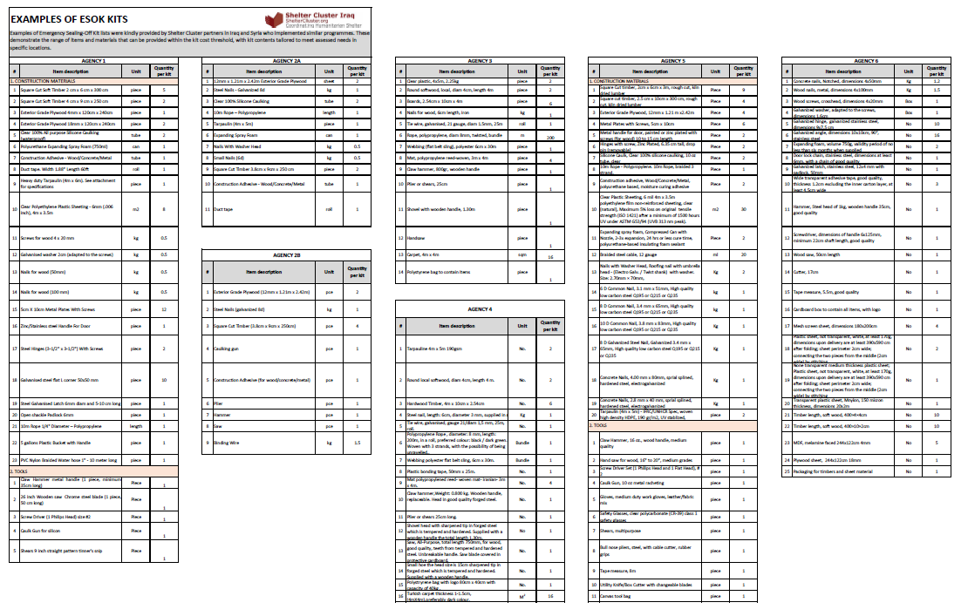
4. Technical Guidance: Settlement Typology, Cluster NFI kit and Emergency Shelter Kit Guidance

Slide 19
5. Governorate and Agencies Updates

Slide 20
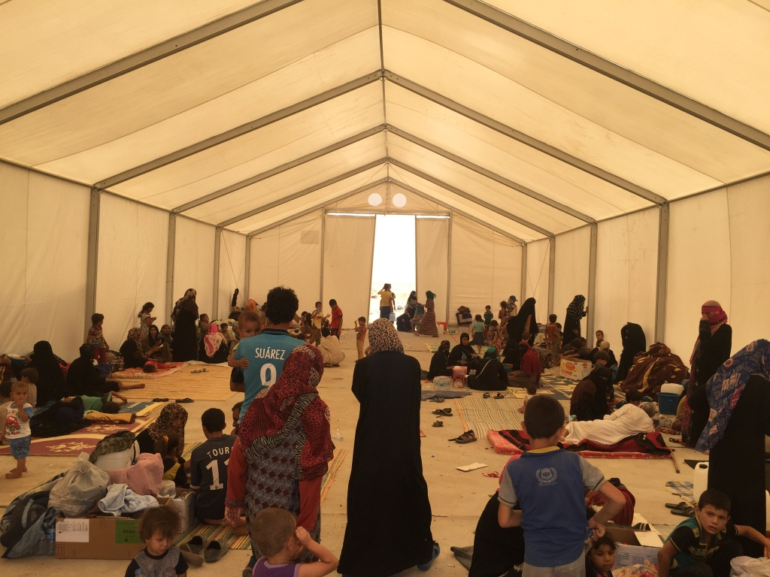
6. AOB
http://sheltercluster.org/response/iraq

