Slide 1
Sub-National Shelter & NFI Cluster Coordination meeting for KRI
Agenda
Review from previous meeting
Information Management updates (Full RASP/Rapid RASP – ODK and Reporting for Mosul response)
Technical Guidance updates
Ongoing Emergency Response
Governorate and Agencies Updates KRI
Update on Logistics (Warehousing & Distribution)
Update on IHPF Process
Update on Mosul Operational Planning including ConOps, Central Planning Map, Screening Centres,
AOB
Thursday, 6th October 2016
http://sheltercluster.org/response/iraq

Slide 2
Information Management – Full RASP/Rapid RASP – ODK
Inter sector Full RASP/Rapid RASP – ODK
http://sheltercluster.org/response/iraq

Slide 3
Information Management – Reporting for Mosul response
Partners will be requested to report distribution activities, capturing the following information:
Reporting Date | Quantity
Reporting Focal Point | Units
Contact Phone | Activity Start Date
Governorate | Activity End Date
District | Completed to date
QUADRANT | Status
Location | # of HH at site
Settlement Typology | # of individuals reached
Type of Relief | # of individuals reached
Activity | Place of Origin of Beneficiaries (District level)
http://sheltercluster.org/response/iraq

Slide 4
Information Management – Reporting for Mosul response
Lessons learned from Anbar highlight that a lack of clarity on site names, locations, displaced population figures etc. often caused:
duplication of assistance
issues in identifying and responding to critical gaps
For Mosul response, capturing GPS coordinates will enable reliable identification and verification of site names and locations. Will support:
Reliable and timely gaps analysis to determine requirements, gaps, partner capacity etc.

Slide 5
Information Management – Reporting for Mosul response
Creation of simple Kobo form, capturing key information + GPS points is most effective method. Allows for:
GPS location
Real-time reporting on activities (program staff complete form at distribution location, upload to server once in area with Wi-Fi)
Reporting requests completed in 5 minutes at distribution

Slide 6
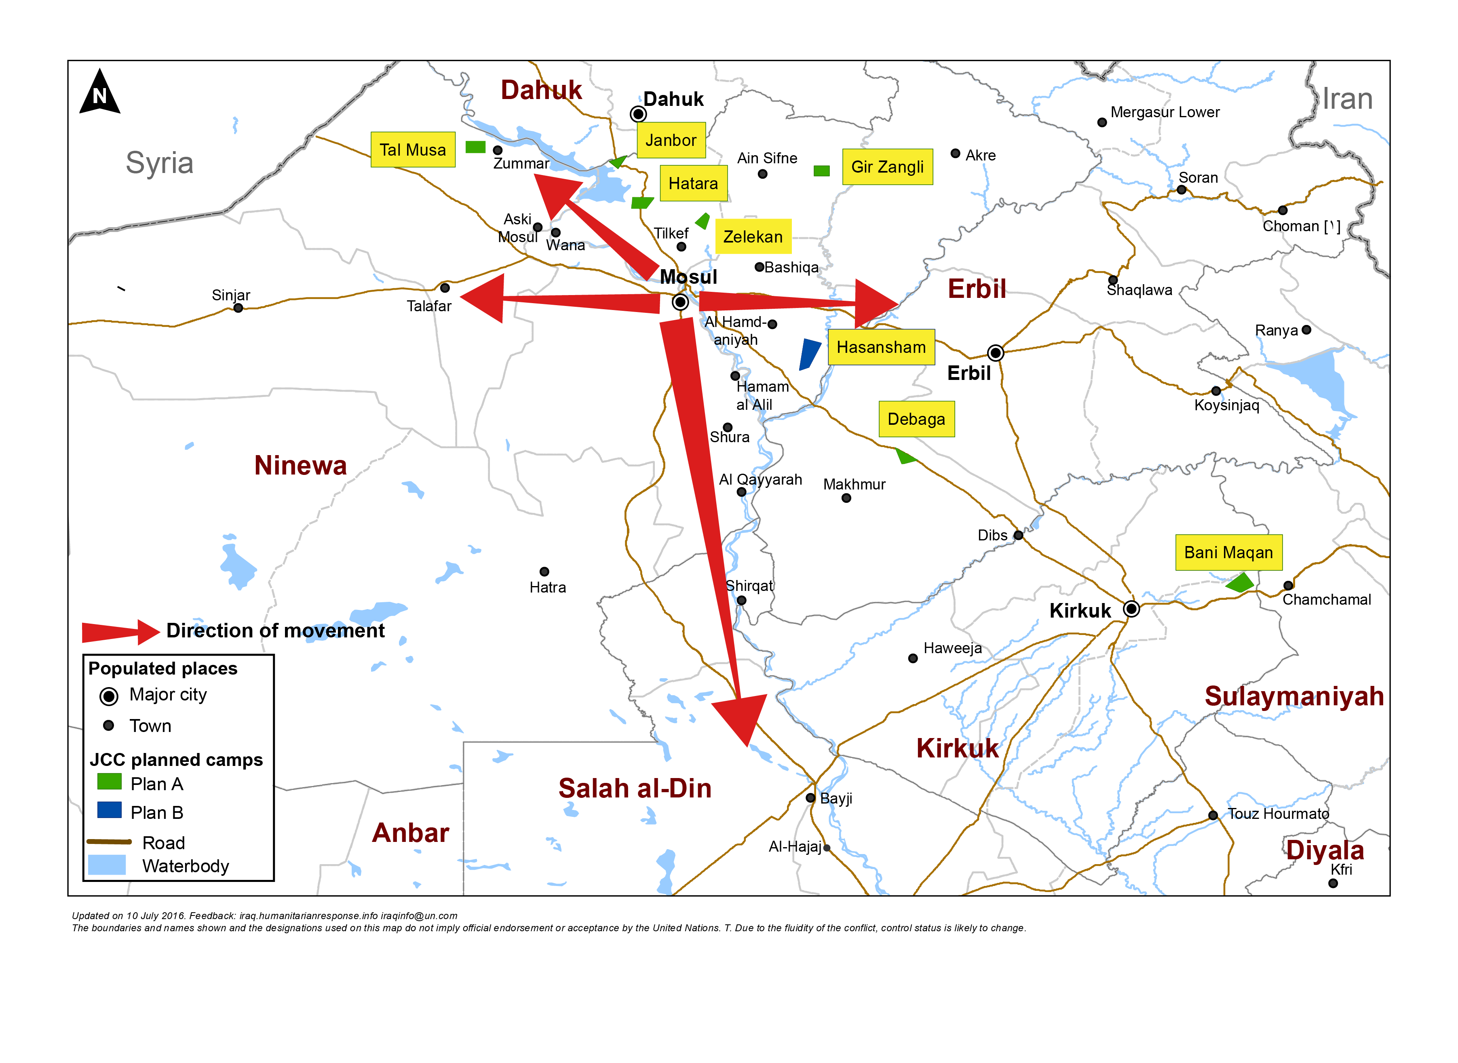
Information Management – Reporting for Mosul response
Quadrant II (25 Partners)
Dahuk : IOM, UNHCR, NRC, Qandil, BRHA, LWF, Save the Children, Samaritan Purse, CRS, Dorcas, Caritas, PWJ, JEN, GRC, CAPNI, CARE, IRCS, IBC, ACTED, WHH, Mission East, PIN, ZOA, French Red Cross & DRC
Quadrant III (11 Partners)
Quadrant I (18 Partners)
Ninewa : IOM, UNHCR, BCF, PWJ, Mission East, French Red Cross, Qandil, ACTED, PIN, Medair & DRC
Erbil : IOM, UNHCR, ACTED, NRC, BCF, ERC, IRW, PWJ, French Red Cross, Qandil, ZOA, Christian Aid, DRC, INTERSOS, Mercy Corps, CRS, CARE & Dorcas
Quadrant IV (16 Partners)
Salah al-Din : IOM, UNHCR, ISHO, RIRP, Muslim Aid, INTERSOS, Mercy Hands for Humanitarian Aid, Mercy Corps & Christian Aid
Kirkuk : IOM, UNHCR, DRC, Mission East, NRC, IRCS, Save the Children, Reach National, CRS
http://sheltercluster.org/response/iraq

Slide 7
Information Management – Reporting for Mosul response
Quadrant II (15 Partners)
Dahuk : IOM, UNHCR, CRS, NRC, PWJ, KURDS, CARE, Qandil, WHH, UN-Habitat, ACTED, Dorcas, ZOA, PIN & DRC
Quadrant III (7 Partners)
Quadrant I (10 partners)
Ninewa : IOM, UNHCR, Qandil, ACTED, PIN, Medair & DRC
Erbil : IOM, UNHCR, ACTED, ZOA, Dorcas, NRC, INTERSOS, CRS, CARE & DRC
Quadrant IV (13 Partners)
Salah al-Din : IOM, UNHCR, ISHO, RIRP, INTERSOS & Muslim Aid
Kirkuk : IOM, UNHCR, NRC, CRS, Save the Children, IRD, Reach National & DRC
http://sheltercluster.org/response/iraq

Slide 8
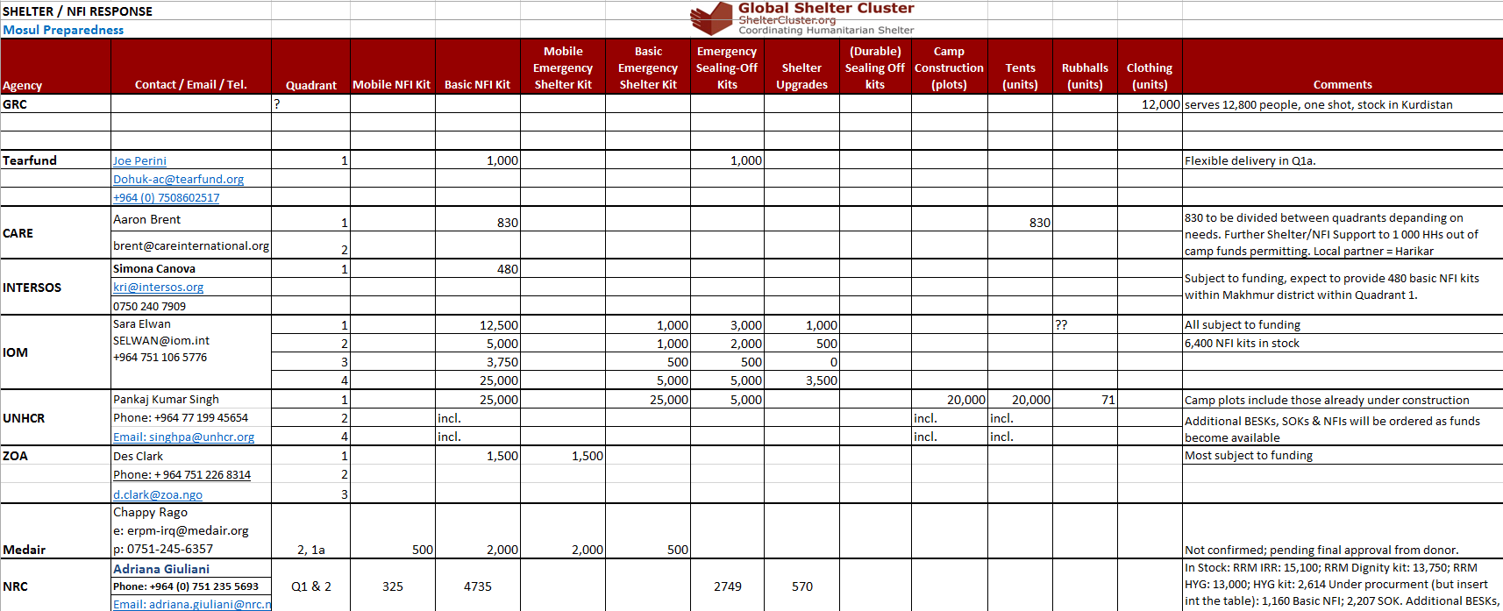
Information Management – Reporting for Mosul response
Shelter Cluster is maintaining a matrix of Mosul preparedness (and response) activities by agency to get an overview of the resources available or in the pipeline.

Slide 9
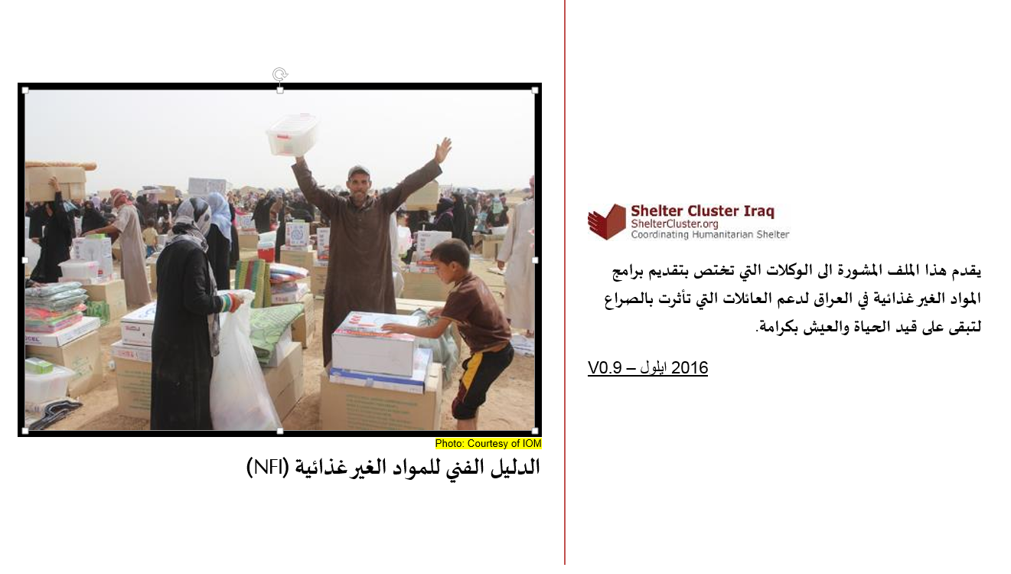
Technical Guidance Updates – Arabic Version of NFI Guidance

Slide 10
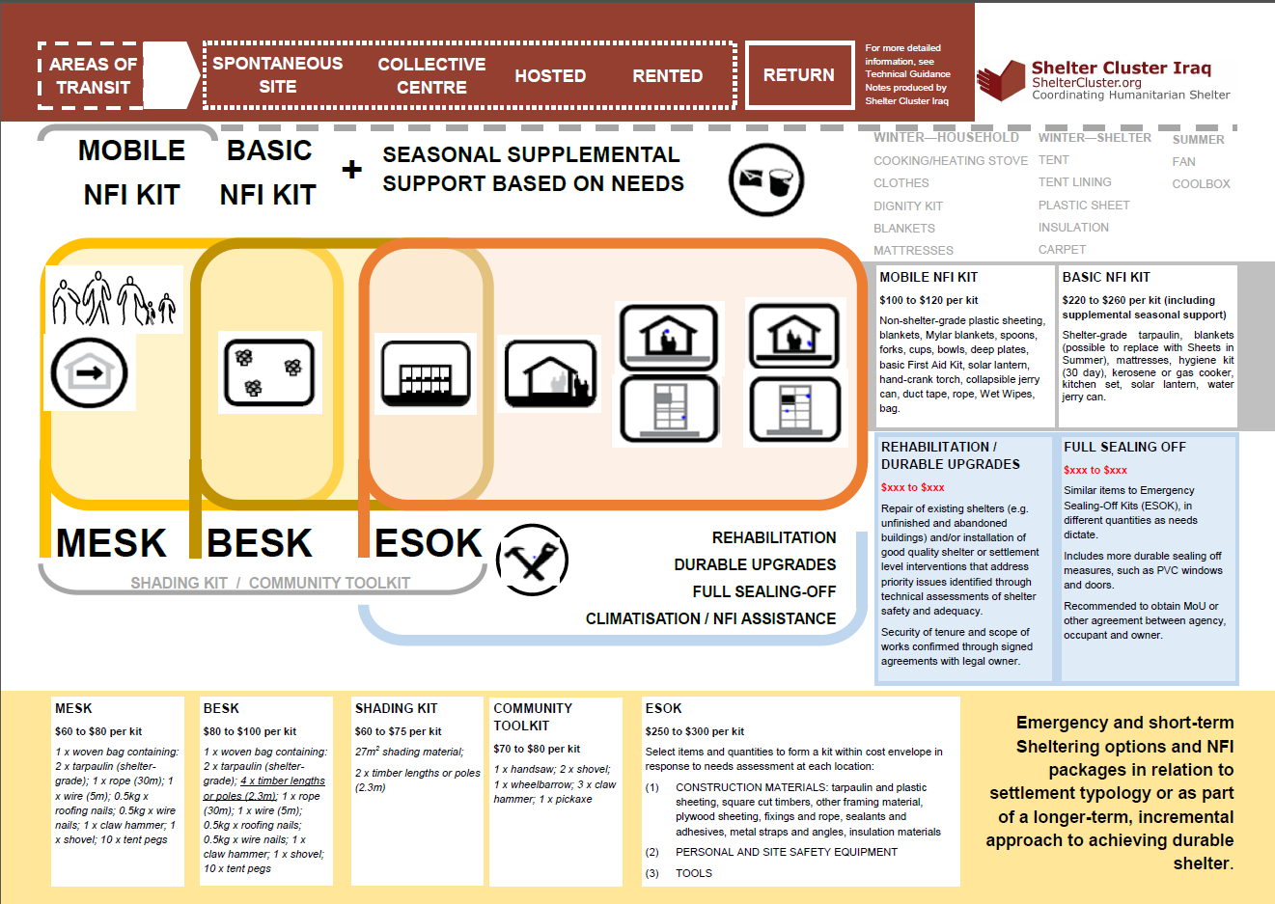
Technical Guidance Updates – Emergency Shelter Kit Training

Slide 11
Technical Guidance Updates – Emergency Shelter Kit Training
PPT Pictures from Emergency Shelter Kit Guidance – Workshop on ESK held on Oct. 5th in Dahuk

Slide 12
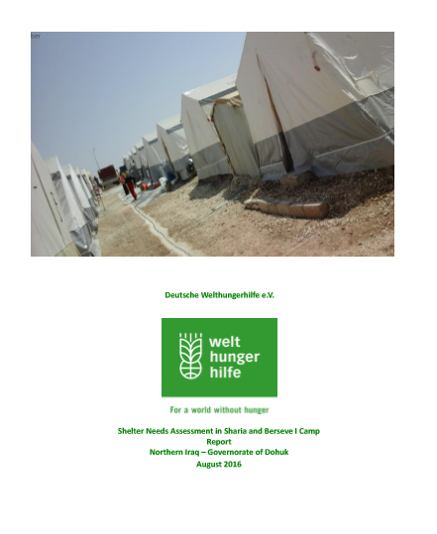
Ongoing Emergency Response
Camp Condition Report - WHH

Slide 13
Governorate and Agencies Updates KRI

Slide 14
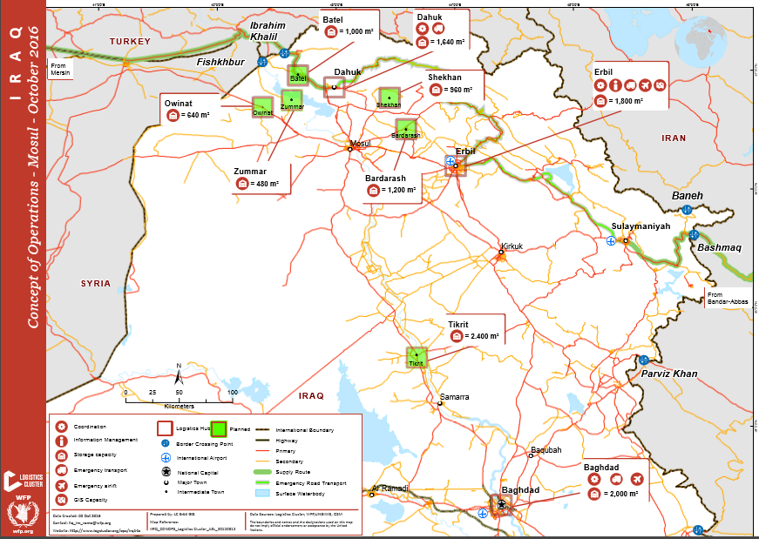
Update on Logistics (Warehousing & Distribution)

Slide 15
Updates on Humanitarian Pooled Fund Process – Mosul Preparedness
Total Shelter and NFI proposals: 25 (Incl. 11 multi-cluster)
Total budget: USD 24.5 million
After Cluster SAG review
Total approved proposals: 16 (5 multi-cluster) with initial budget: US $17.5 million
Revised budget: US $14.2 million
Last week the Advisory Board of the IHPF sanctioned a budget of US $13 million for the Shelter/NFI Cluster recommended proposals.
As such, we have secured funding for 16 Cluster partners of which 12 partners are specifically engaging in prepositioning shelter materials and NFIs.

Slide 16
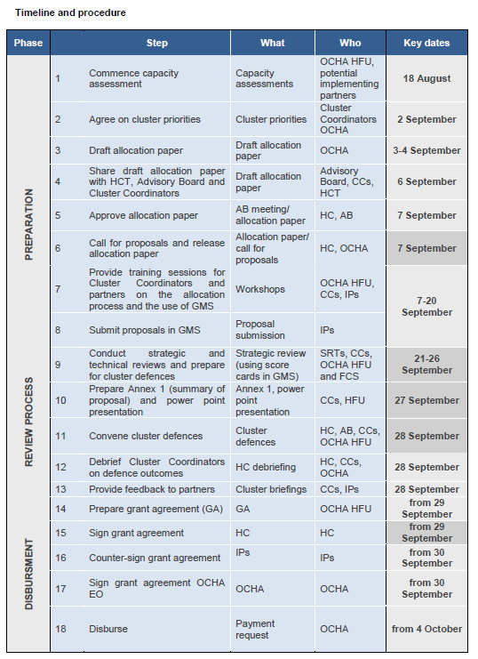
Humanitarian Pooled Fund – Mosul Preparedness

Slide 17
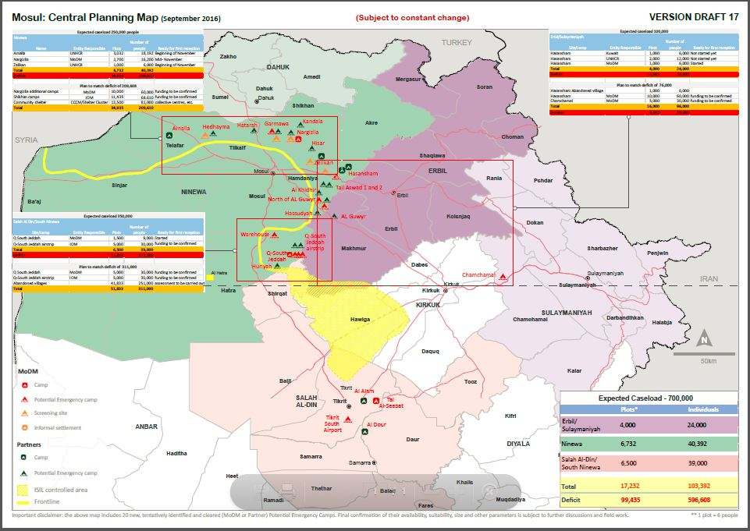
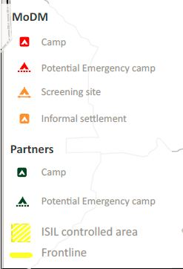
Update on Mosul Operational Planning including ConOps, Central Planning Map, Screening Centres

Slide 18
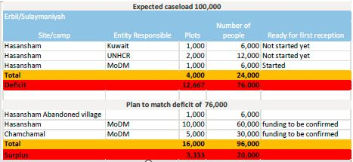
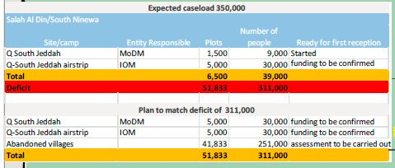
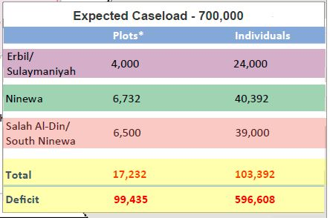
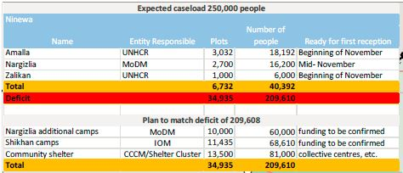
Update on Mosul Operational Planning including ConOps, Central Planning Map, Screening Centres

Slide 19
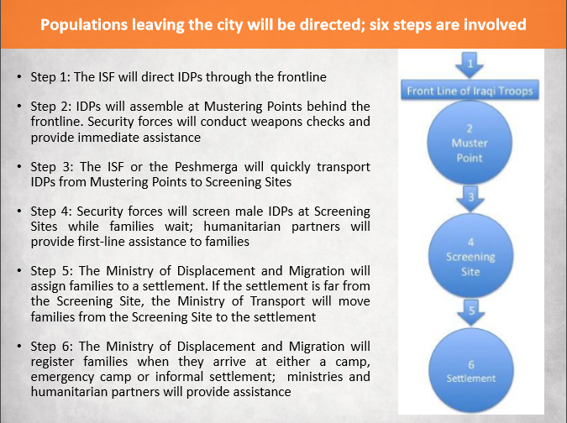
Update on Mosul Operational Planning including ConOps, Central Planning Map, Screening Centres

Slide 20
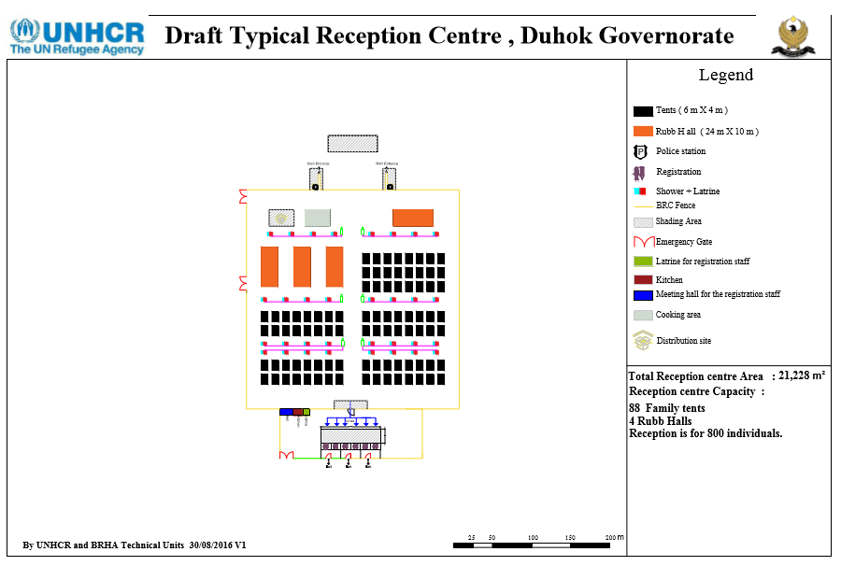
Update on Mosul Operational Planning including ConOps, Central Planning Map, Screening Centres
Madan: 800 people
Kaherta: 800 people
Kahreez: 400 people
Narghzlia: 800 people
Protection Issues

Slide 21
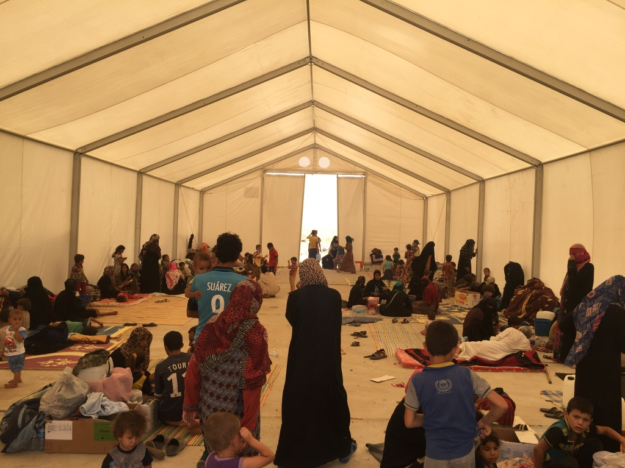
AOB
Iraq/Mosul Displacement/Shelter Environmental Screening
http://sheltercluster.org/response/iraq

