Slide 1
Sub-National Shelter & NFI Cluster Coordination meeting for Centre & South
Agenda
Review of action points from previous meeting
Information Management updates (Full RASP/Rapid RASP – ODK and Reporting for Mosul response)
Technical Guidance updates
Ongoing Emergency Response
Governorate and Agencies Updates C&S
Update on Logistics (Warehousing & Distribution)
Update on IHPF Process
Update on Mosul Operational Planning including ConOps, Central Planning Map, Screening Centres,
AOB
Monday, 10th October 2016
http://sheltercluster.org/response/iraq

Slide 2
Review of action points from previous meeting
Share link for Ongoing Emergency Response of Qayyarah / Shirqat Crisis Google Sheet with partners- Done
UNHCR to share info on the construction of a “Transit Center” located out-side Al-Hajaj Camp on Google Sheet -Done
Partners to share plans of intervention and stocks - Ongoing
Partners planning to operate in the four quadrants of the Mosul Operational Plan to submit their project proposals for IHPF - Done
OCHA sends out a summary/overview/snapshot of the quadrant plans to assist cluster partners with proposals.- Done
Share the assessment of camps, sites and potential capacity by UNHCR and Government – Ravi to Update
Share the information with respect to the return of IDPs in Salah Al-Din with Protection Cluster for further action-Ravi to Update
Share link for Ongoing Emergency Response of Fallujah Crisis Google Sheet with partners- Ravi to Update

Slide 3
Information Management – Full RASP/Rapid RASP – ODK
Inter sector Full RASP/Rapid RASP – ODK
http://sheltercluster.org/response/iraq

Slide 4
Information Management – Reporting for Mosul response
Partners will be requested to report distribution activities, capturing the following information:
Reporting Date | Quantity
Reporting Focal Point | Units
Contact Phone | Activity Start Date
Governorate | Activity End Date
District | Completed to date
QUADRANT | Status
Location | # of HH at site
Settlement Typology | # of individuals reached
Type of Relief | # of individuals reached
Activity | Place of Origin of Beneficiaries (District level)
http://sheltercluster.org/response/iraq

Slide 5
Information Management – Reporting for Mosul response
Lessons learned from Anbar highlight that a lack of clarity on site names, locations, displaced population figures etc. often caused:
duplication of assistance
issues in identifying and responding to critical gaps
For Mosul response, capturing GPS coordinates will enable reliable identification and verification of site names and locations. Will support:
Reliable and timely gaps analysis to determine requirements, gaps, partner capacity etc.

Slide 6
Information Management – Reporting for Mosul response
Creation of simple Kobo form, capturing key information + GPS points is most effective method. Allows for:
GPS location
Real-time reporting on activities (program staff complete form at distribution location, upload to server once in area with Wi-Fi)
Reporting requests completed in 5 minutes at distribution

Slide 7
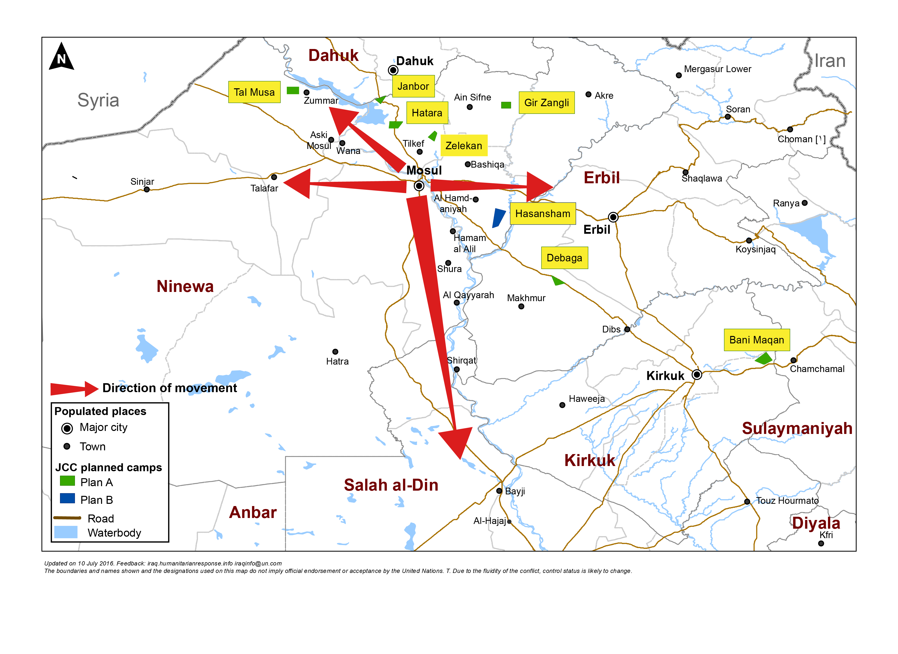
Mosul preparedness / NFI Partners / blue: current operational Partners & red: interested to join Mosul response
Quadrant II (26 Partners)
Dahuk : IOM, UNHCR, NRC, Qandil, BRHA, LWF, Save the Children, Samaritan Purse, CRS, Dorcas, Caritas, PWJ, JEN, GRC, CAPNI, CARE, Medair, IRCS, IBC, ACTED, WHH, Mission East, PIN, ZOA, French Red Cross & DRC
Quadrant III (10 Partners)
Quadrant I (19 Partners)
Ninewa : IOM, UNHCR, BCF, PWJ, Mission East, French Red Cross, Qandil, ACTED, PIN & DRC
Erbil : IOM, UNHCR, ACTED, NRC, BCF, ERC, IRW, PWJ, French Red Cross, Qandil, Medair, ZOA, Christian Aid, DRC, INTERSOS, Mercy Corps, CRS, Reach National & Dorcas
Quadrant IV (15 Partners)
Salah al-Din : IOM, UNHCR, ISHO, RIRP, Muslim Aid, INTERSOS, Mercy Hands for Humanitarian Aid, Mercy Corps & Christian Aid
Kirkuk : IOM, UNHCR, DRC, Mission East, NRC, IRCS, Save the Children & Reach National
http://sheltercluster.org/response/iraq

Slide 8
Mosul preparedness / Shelter Partners / blue: current operational Partners & red: interested to join Mosul response
Quadrant II (16 Partners)
Dahuk : IOM, UNHCR, CRS, NRC, PWJ, KURDS, CARE, Qandil, WHH, UN-Habitat, Medair, ACTED, Dorcas, ZOA, PIN & DRC
Quadrant III (6 Partners)
Quadrant I (10 partners)
Ninewa : IOM, UNHCR, Qandil, ACTED, PIN & DRC
Erbil : IOM, UNHCR, ACTED, ZOA, Dorcas, NRC, Medair, INTERSOS, CRS & DRC
Quadrant IV (12 Partners)
Salah al-Din : IOM, UNHCR, ISHO, RIRP, INTERSOS & Muslim Aid
Kirkuk : IOM, UNHCR, NRC, CRS, Save the Children, IRD, Reach National & DRC
http://sheltercluster.org/response/iraq

Slide 9
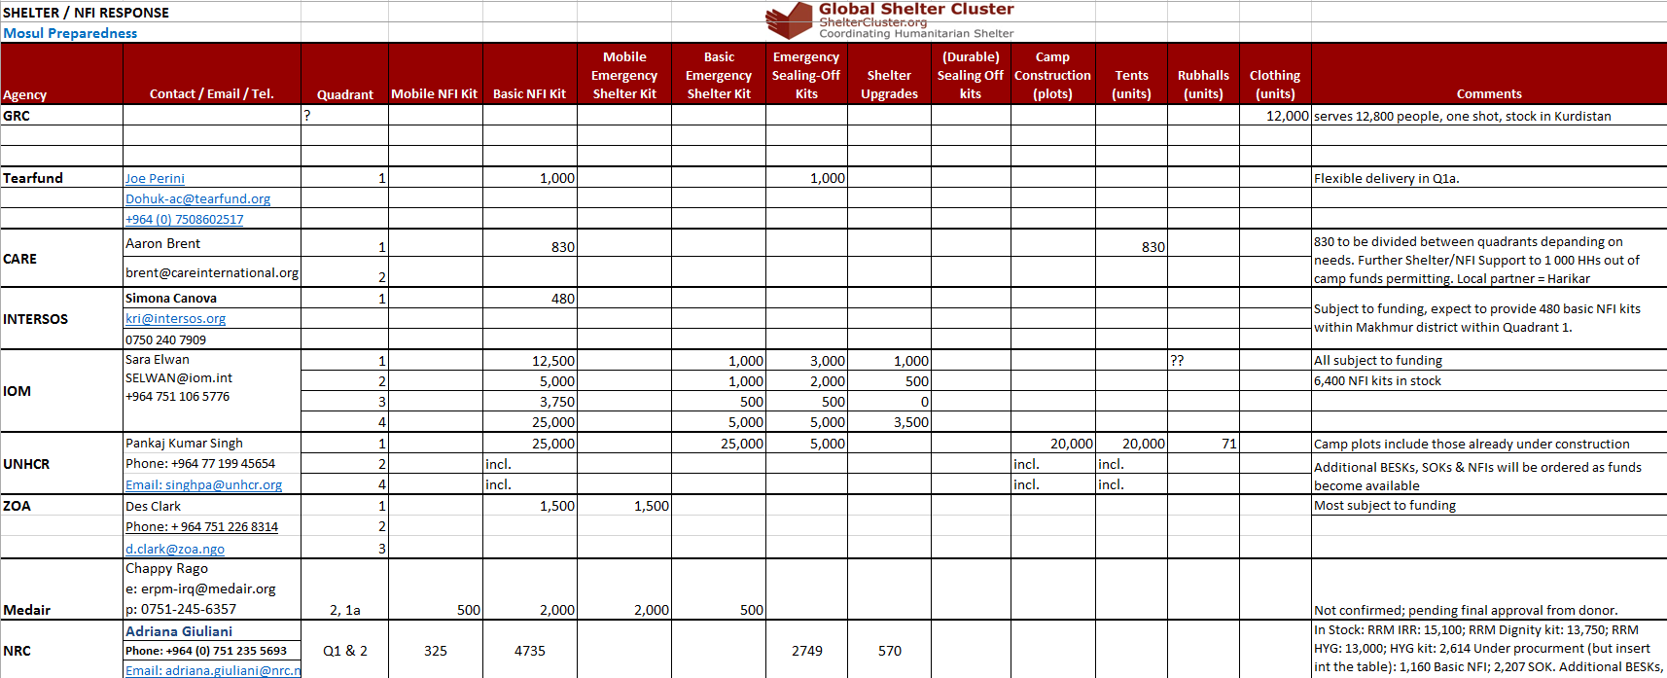
Information Management – Reporting for Mosul response
Shelter Cluster is maintaining a matrix of Mosul preparedness (and response) activities by agency to get an overview of the resources available or in the pipeline.

Slide 10
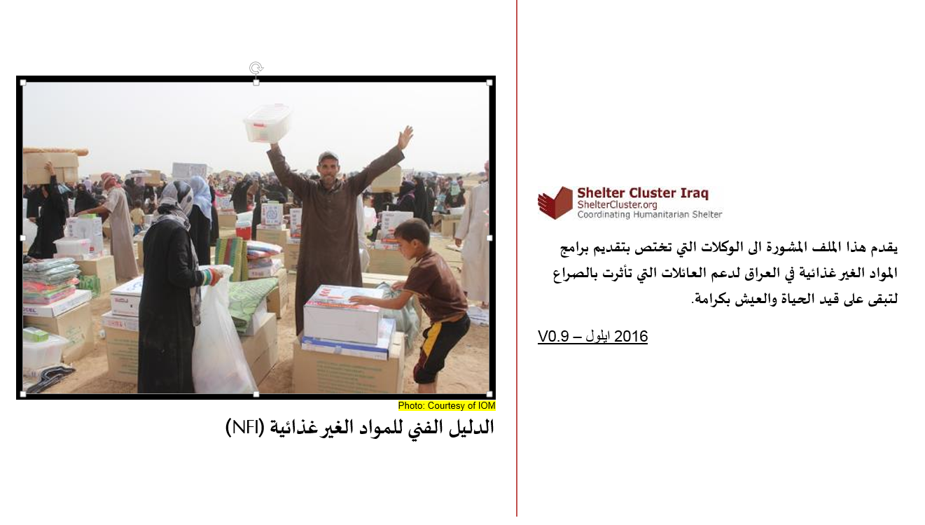
Technical Guidance Updates – Arabic Version of NFI Guidance

Slide 11
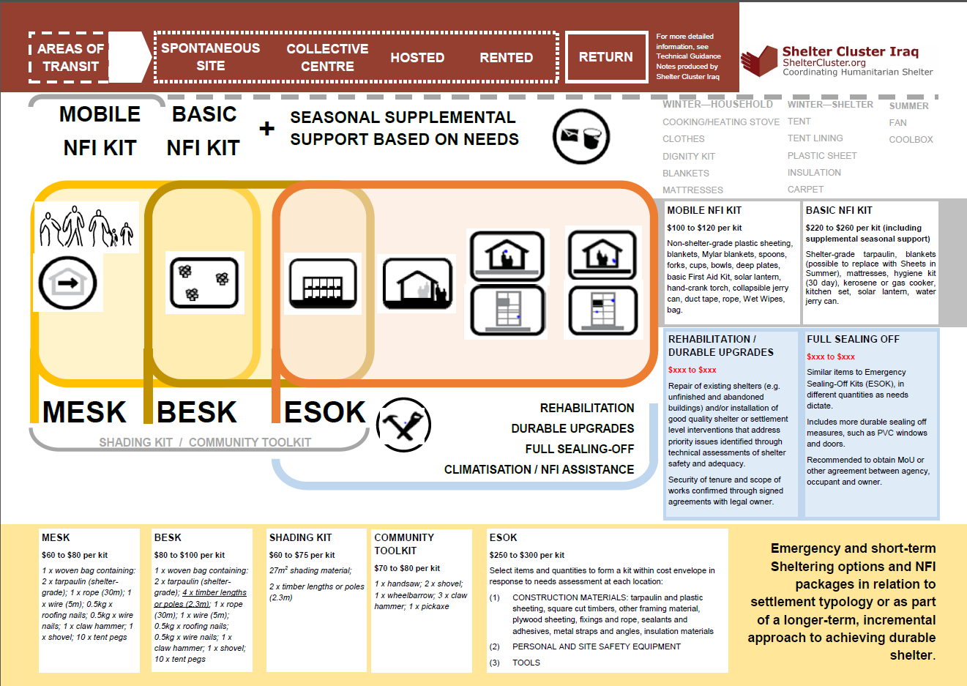
Technical Guidance Updates – Emergency Shelter Kit Training

Slide 12
Technical Guidance Updates – Emergency Shelter Kit Training
PPT Pictures from Emergency Shelter Kit Guidance – Workshop on ESK held on Oct. 5th in Dahuk

Slide 13
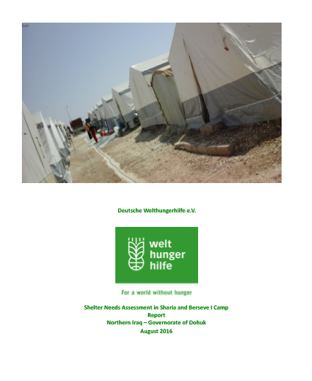
Ongoing Emergency Response
Camp Condition Report - WHH

Slide 14
Governorate and Agencies Updates Centre and South

Slide 15
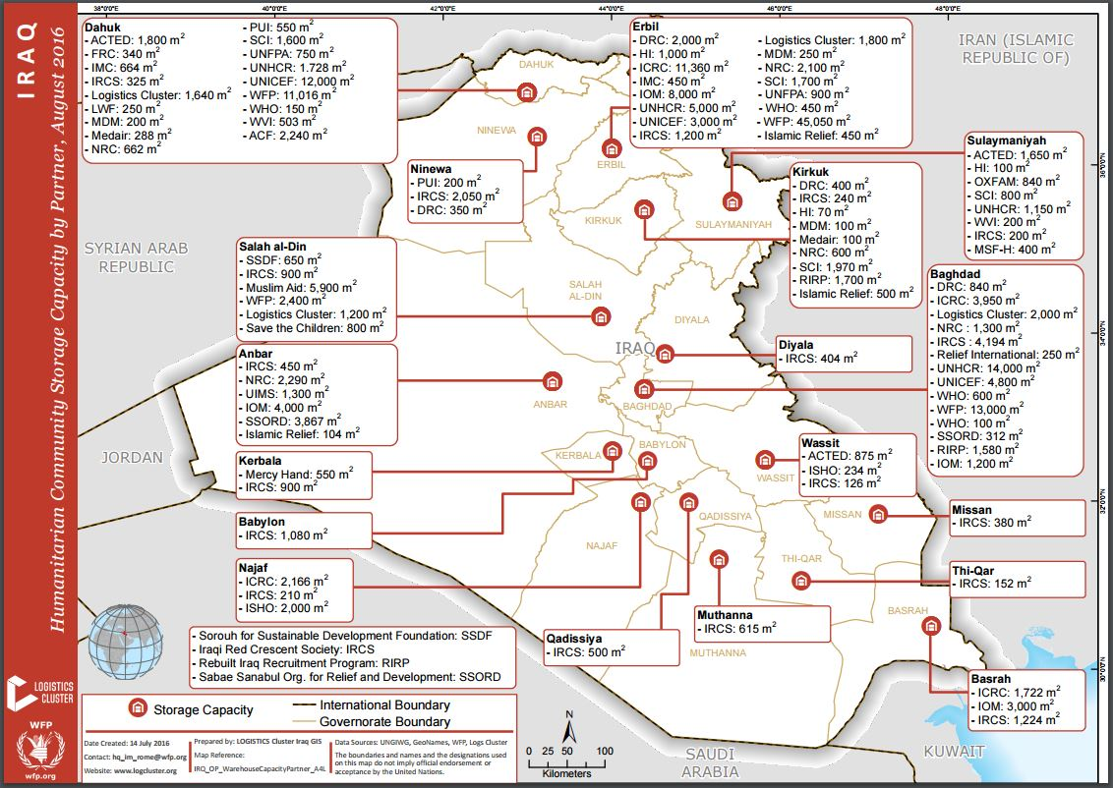
Update on Logistics (Warehousing & Distribution)

Slide 16
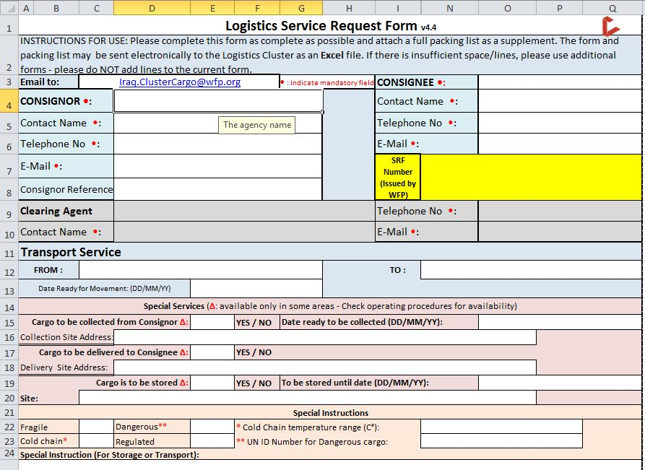
Update on Logistics (Service Request Form)

Slide 17
Updates on Humanitarian Pooled Fund Process – Mosul Preparedness
Total Shelter and NFI proposals: 25 (Incl. 11 multi-cluster)
Total budget: USD 24.5 million
After Cluster SAG review
Total approved proposals: 16 (5 multi-cluster) with initial budget: US $17.5 million
Revised budget: US $14.2 million
Last week the Advisory Board of the IHPF sanctioned a budget of US $13 million for the Shelter/NFI Cluster recommended proposals.
As such, we have secured funding for 16 Cluster partners of which 12 partners are specifically engaging in prepositioning shelter materials and NFIs.

Slide 18
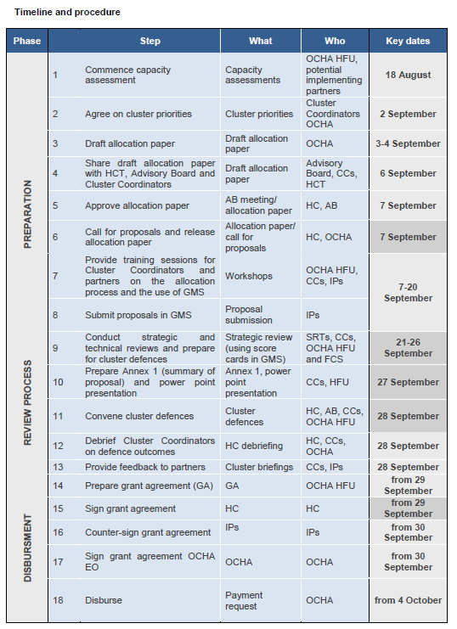
Humanitarian Pooled Fund – Mosul Preparedness

Slide 19
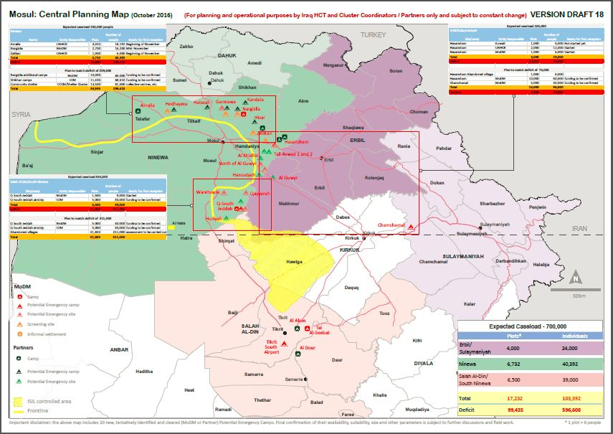
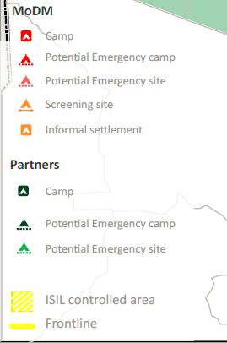
Update on Mosul Operational Planning including ConOps, Central Planning Map, Screening Centres

Slide 20
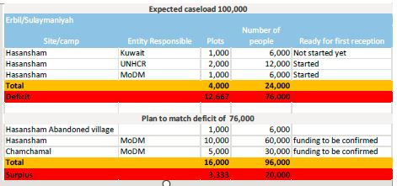
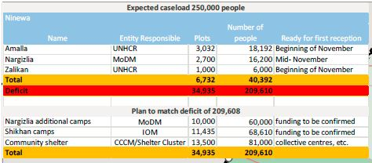
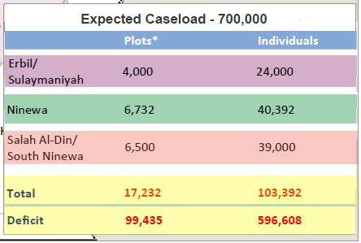
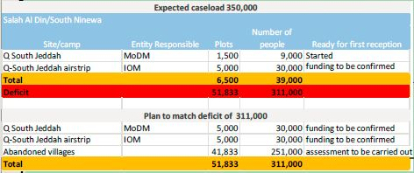
Update on Mosul Operational Planning including ConOps, Central Planning Map, Screening Centres

Slide 21
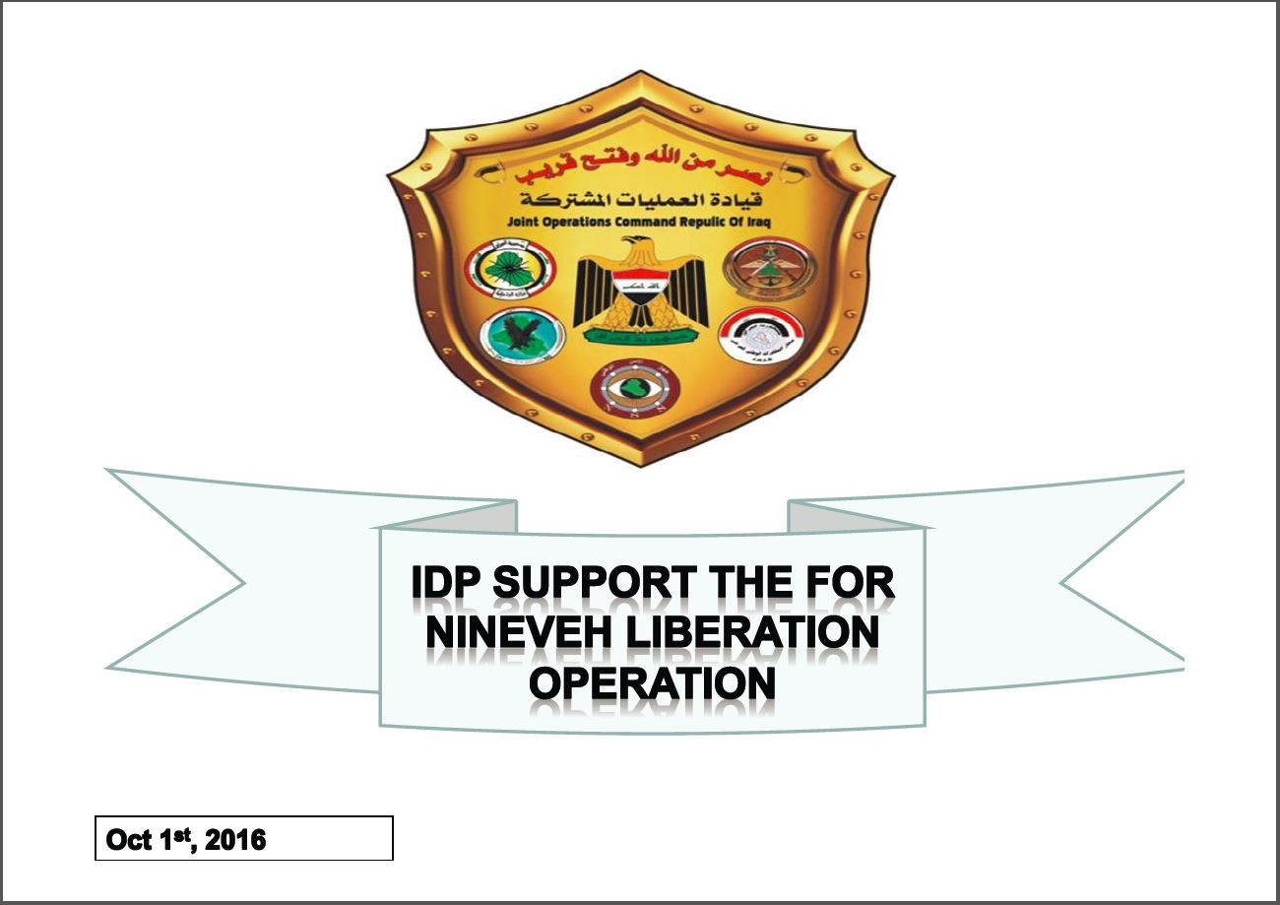
Update on Mosul Operational Planning including ConOps, Central Planning Map, Screening Centres

Slide 22
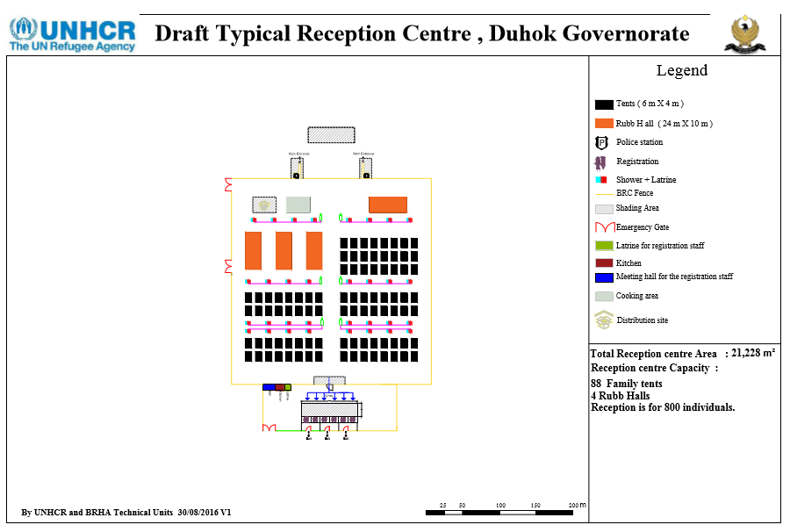
Update on Mosul Operational Planning including ConOps, Central Planning Map, Screening Centres
Madan: 800 people
Kaherta: 800 people
Kahreez: 400 people
Narghzlia: 800 people
Protection Issues

Slide 23
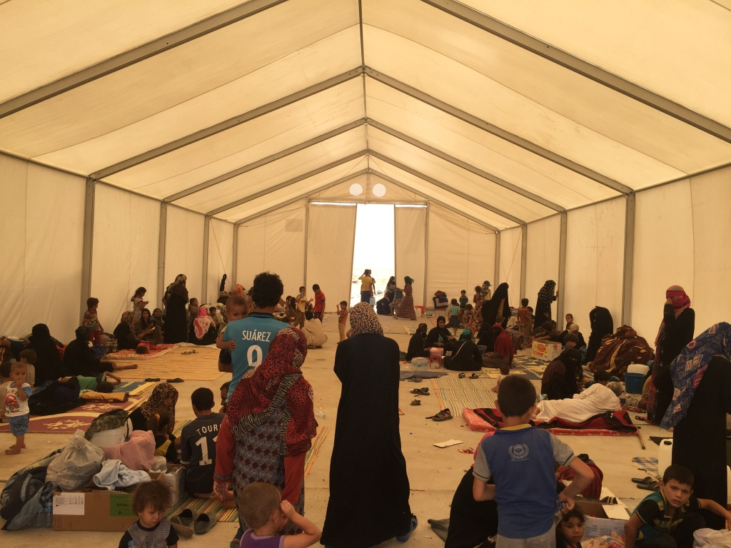
AOB
http://sheltercluster.org/response/iraq

