Slide 1
Sub-National Shelter & NFI Cluster Coordination meeting for Centre & South
Agenda
Review of action points from previous meeting
Information Management updates
Mosul Preparedness & Response Updates: Partner sheet, Cluster master sheet, Response tool
IHPF update
Governorate and Agencies Updates C&S
AOB
Monday, 19th October 2016
http://sheltercluster.org/response/iraq

Slide 2
Review of action points from previous meeting
Share report on IED incident at the stadium to emphasise danger faced during site assessments – Done
Share protection report on IDP returns in Sayeed Ghareeb/ Salah A Din for partners to take appropriate action – Done
Full RASP / Rapid RASP: update partners on the process and share the Kobo link once available – Done
Mosul Preparedness – Cluster Master Sheet / Partner Sheet: IMO to prepare partners google sheet and Consolidate the preparedness matrix – In process
Special S-NFI Cluster Mosul response tool / Update partners / partners encourage reporting their Mosul interventions using cluster specific tool – In process

Slide 3
Review of action points from previous meeting
Inter cluster Mosul response matrix: Cluster IMO to provide update based on Cluster specific Mosul response tool – Starting soon
Work with Partners , practically where to conduct a workshop of Emergency Shelter Kit Guidance for partners in C&S – In process
Have a bilateral meeting with IOM on IEC materials/ videos – In process
Share assessment reports in respective areas of operation with the shelter cluster – Cluster follow up
Mosul response: For Coordination purposes, partners are encouraged to provide information on any agency working on shelter related activities in your respective AoR but not known to the cluster – Cluster follow up
Visibility for shelter and NFI partners – Cluster follow up

Slide 4
Information Management – Cluster achievement Jan. – Sept. 16
 | Target (HHs) | NFI reached HHs and %tage |  | Shelter reached HHs and %tage
Country wide | 196,536 | 134,026 | 68% | 34,463 | 18%
KR-I | 46,719 | 13,419 | 29% | 4,006 | 9%
Centre & South | 149,816 | 120,607 | 81% | 30,457 | 20%
Funding status (from FTS _ Oct. 18th 2016): 37% of 180 million. – 2016 HRP underfunded
http://sheltercluster.org/response/iraq

Slide 5
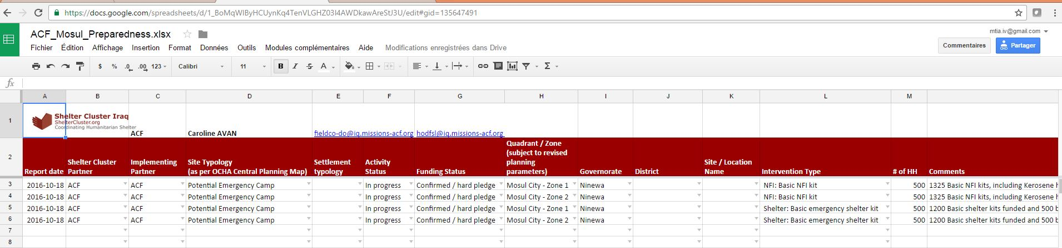
Mosul Preparedness & Response Updates: Partner sheet, Cluster master sheet, Response tool
Partner sheet:
Till Oct. 18th 2016, the cluster has provided individual google sheet to 40 cluster partners engaged in Mosul Preparedness and Response
Data requested

Slide 6
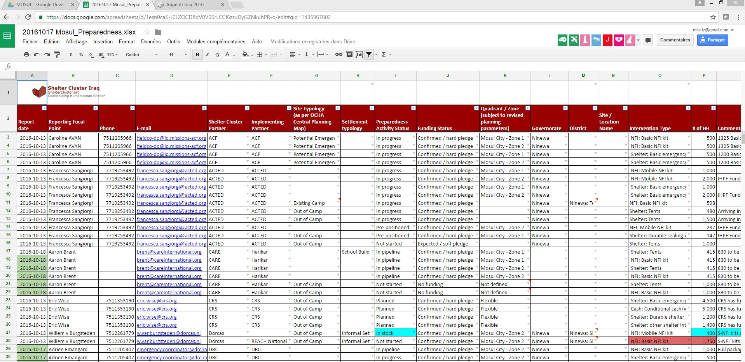
Mosul Preparedness & Response Updates: Partner sheet, Cluster master sheet, Response tool
Cluster master sheet:
Consolidated from partner sheet
Information sharing – Analysis, Infographics – Advocacy for Fund raising

Slide 7
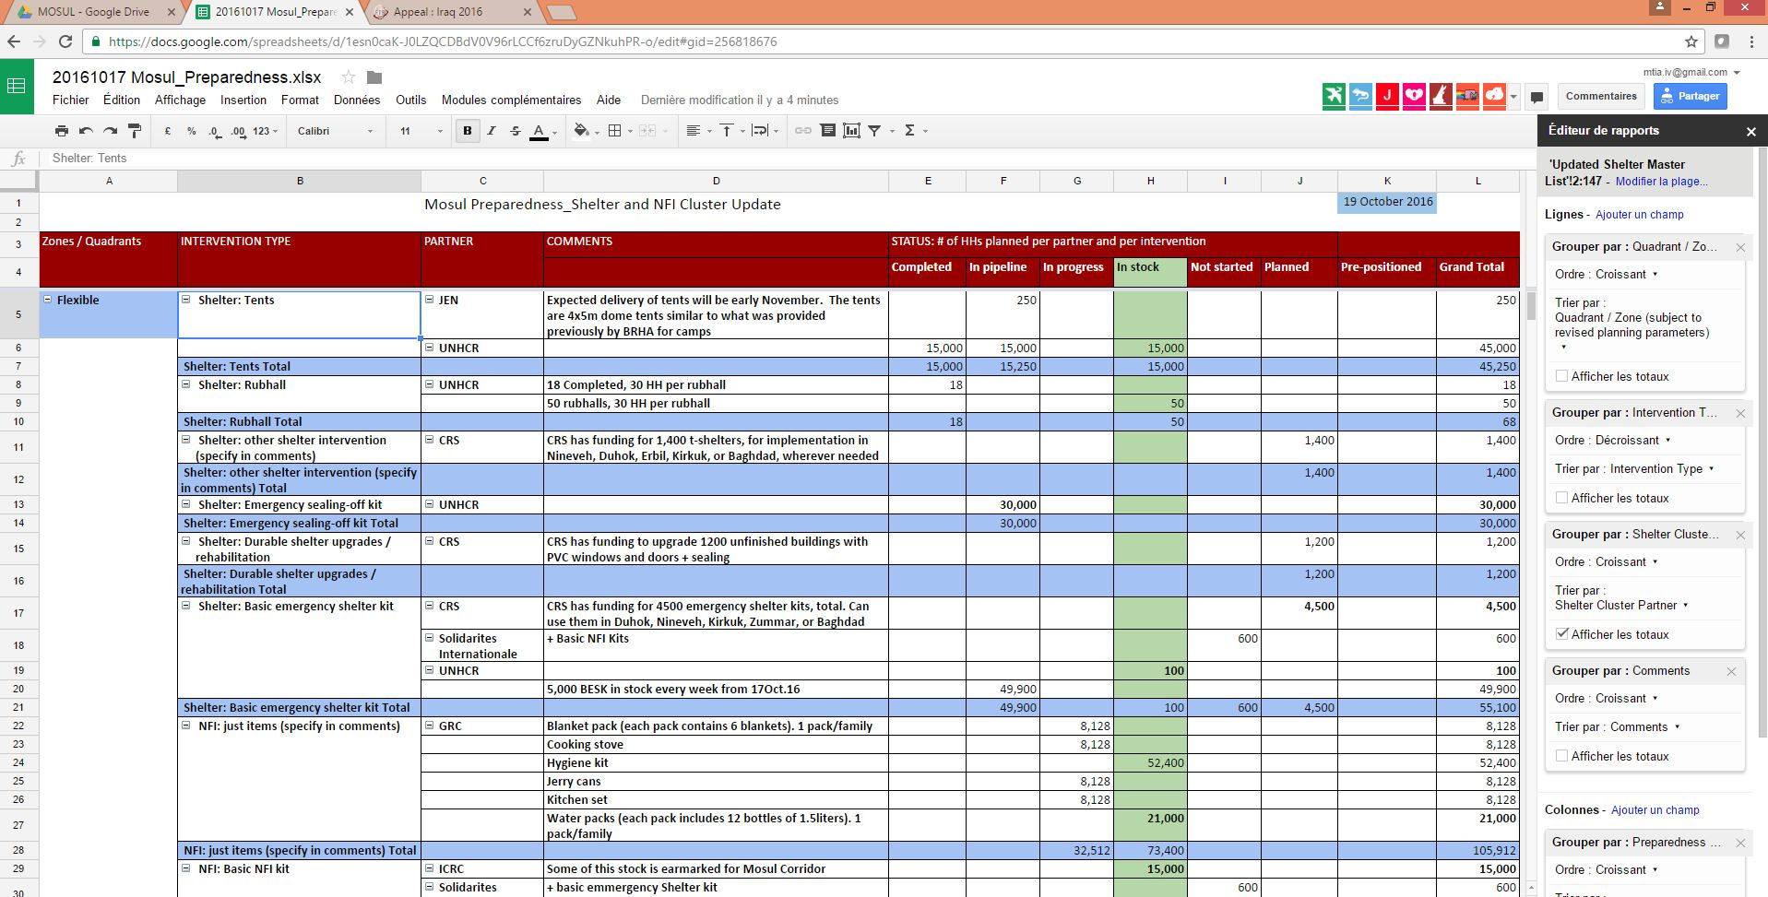
Mosul Preparedness & Response Updates: Partner sheet, Cluster master sheet, Response tool

Slide 8
Mosul Preparedness & Response Updates: Partner sheet, Cluster master sheet, Response tool
Total Camps: 10
Ready to receive IDPs: 7 Camps
Under construction: 3 Camps
To be assessed: 1
Emergency Sites: 14 :

Slide 9
Mosul Preparedness & Response Updates: Partner sheet, Cluster master sheet, Response tool
CCCM (Camps and Emergency Sites Master list) & Shelter and NFI (Preparedness Master Sheets & Summary Sheet):
http://bit.ly/mosul_camps_masterlist
Rapid RASP – real time data upload & IOM DTM Daily update.
http://bit.ly/Mosul_RapidRasp_data
CCCM assessments -Live-feed 24/7 Map
http://arcg.is/2ecS904

Slide 10
Mosul Preparedness & Response Updates: Partner sheet, Cluster master sheet, Response tool
Creation of simple Kobo form, capturing key information + GPS points is most effective method. Allows for:
GPS location
Real-time reporting on activities (program staff complete form at distribution location, upload to server once in area with Wi-Fi)
Reporting requests completed in 5 minutes at distribution
Update: REACH has completed the response matrix and now migrating the matrix into Kobo Form

Slide 11
Updates on Humanitarian Pooled Fund Process – Mosul Preparedness
Total Shelter and NFI proposals: 25 (Incl. 11 multi-cluster)
Total budget: USD 24.5 million
After Cluster SAG review
Total approved proposals: 16 (5 multi-cluster) with initial budget: US $17.5 million
Revised budget: US $14.2 million
Last week the Advisory Board of the IHPF sanctioned a budget of US $13 million for the Shelter/NFI Cluster recommended proposals.
As such, we have secured funding for 16 Cluster partners of which 12 partners are specifically engaging in prepositioning shelter materials and NFIs.

Slide 12
Governorate and Agencies Updates Centre and South

Slide 13
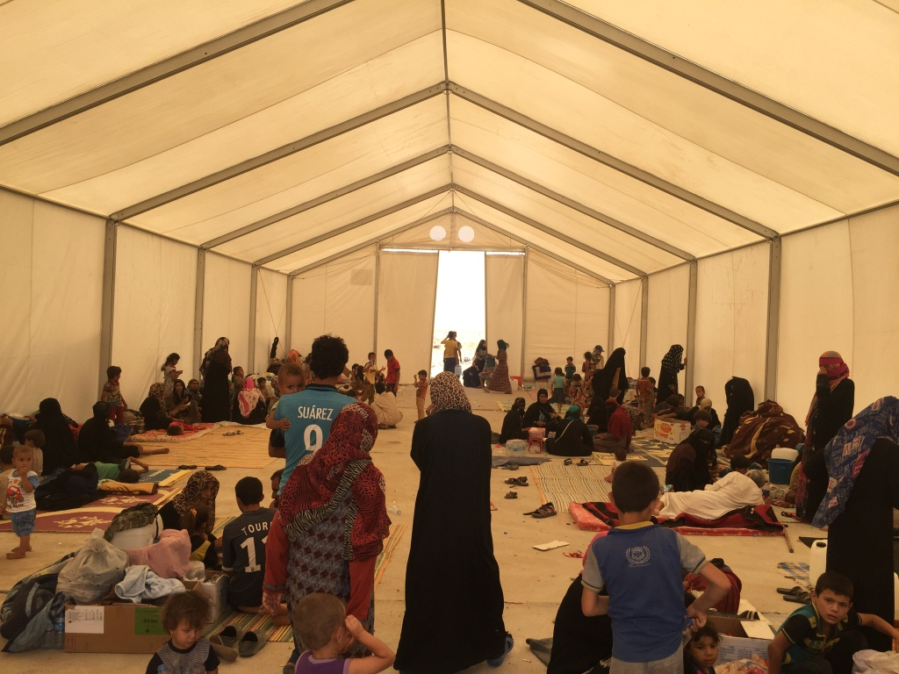
AOB
http://sheltercluster.org/response/iraq

