Slide 1
Sub-National Shelter & NFI Cluster Coordination meeting for KR-I
Agenda
Review of action points from previous meeting
Information Management updates
Mosul Preparedness & Response Updates
  Cluster Preparedness and Response
  Capacity issues
  Adjustment capacity to adapt to changing scenarios / assumptions (e.g. “in camp” to “out-of-camp” settings)
Governorate and Agencies Updates
Update on HNO/HRP/Flash Appeal processes
Shelter/NFI Cluster issues: Organigram; tasks; responsibilities; workflows; work-plans and SAG
AOB
Wednesday, 26th October 2016
http://sheltercluster.org/response/iraq

Slide 2
Review of action points from previous meeting
IM will send an email once the inter-cluster matrix is finalized followed by the tool finalization
IM will send the google sheet to partners. Partners should add their IHPF number (if available)
IM will share the gap analysis
Partners are called upon for their assistance to provide Kurdish translation.

Slide 3
Information Management – Cluster achievement Jan. – Sept. 16
 | Target (HHs) | NFI reached HHs and %tage |  | Shelter reached HHs and %tage
Country wide | 196,536 | 134,026 | 68% | 34,463 | 18%
KR-I | 46,719 | 13,419 | 29% | 4,006 | 9%
Centre & South | 149,816 | 120,607 | 81% | 30,457 | 20%
Funding status (from FTS _ Oct. 18th 2016): 37% of 180 million. – 2016 HRP underfunded
http://sheltercluster.org/response/iraq

Slide 4
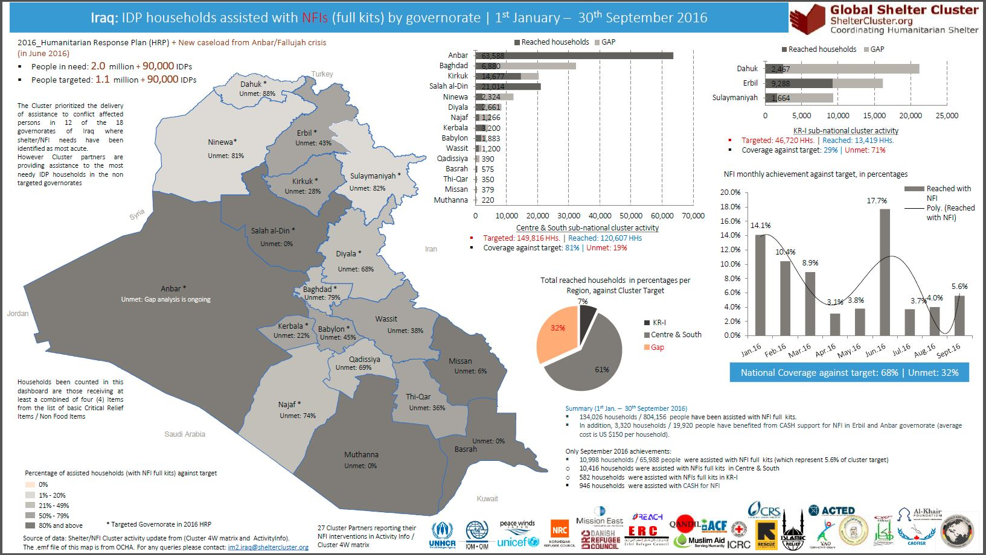
Information Management – Cluster achievements Jan. – Sept. 16
http://sheltercluster.org/response/iraq

Slide 5
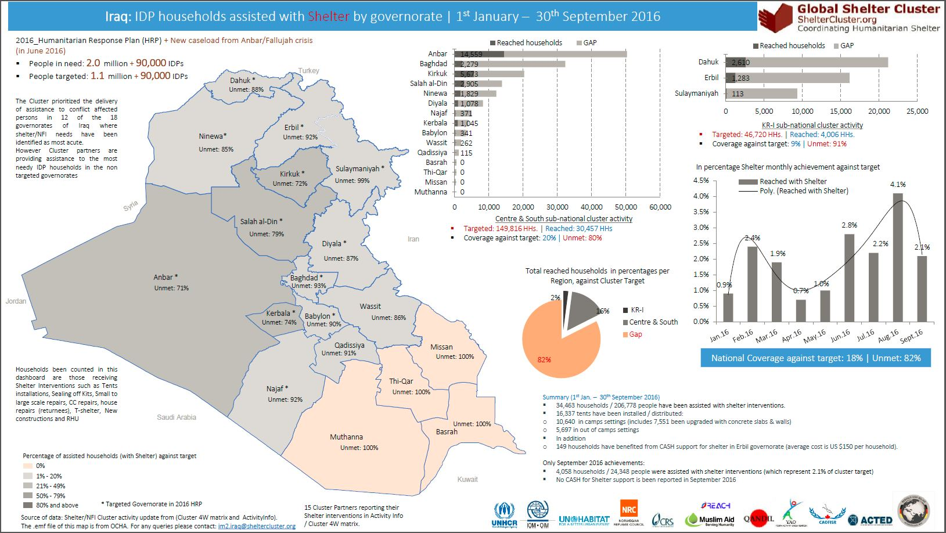
Information Management – Cluster achievements Jan. – Sept. 16
http://sheltercluster.org/response/iraq

Slide 6
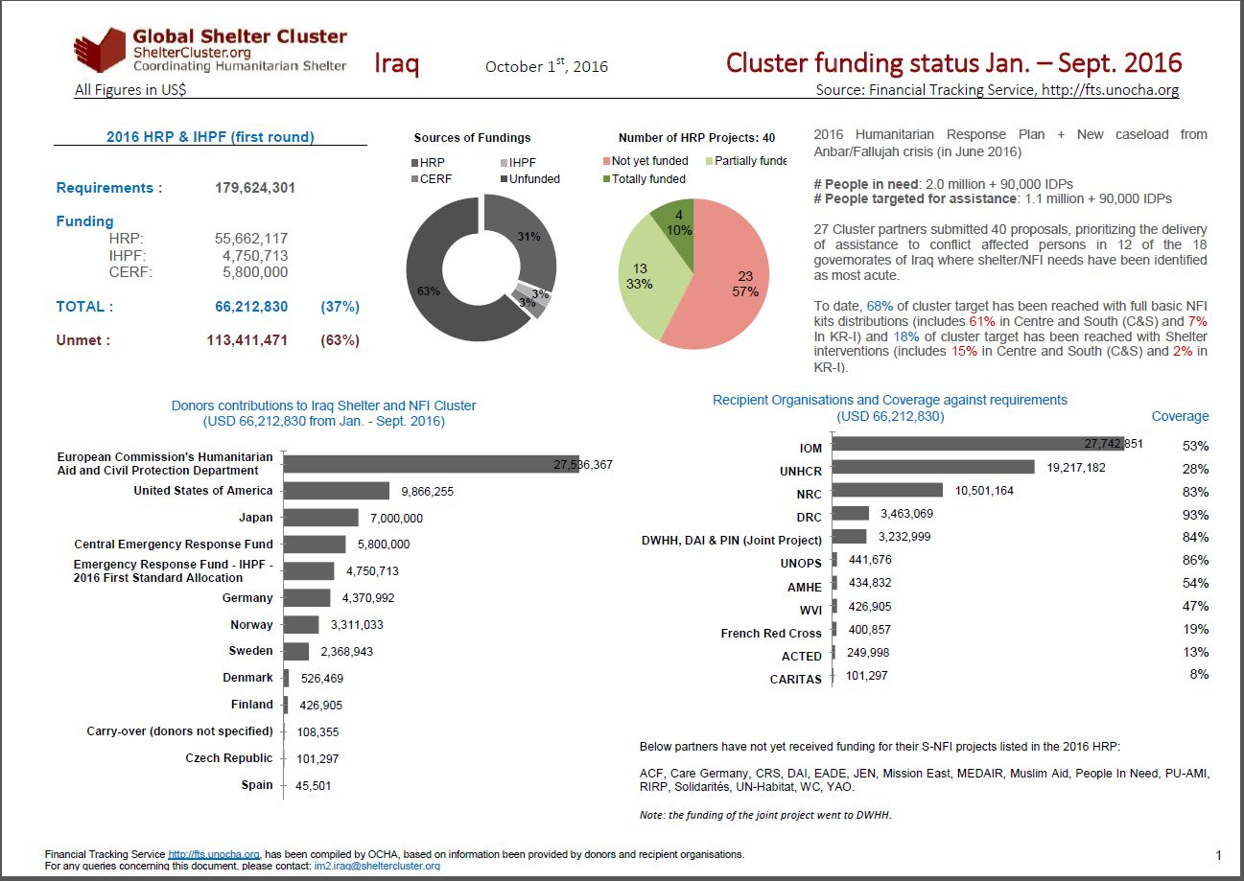
http://sheltercluster.org/response/iraq

Slide 7
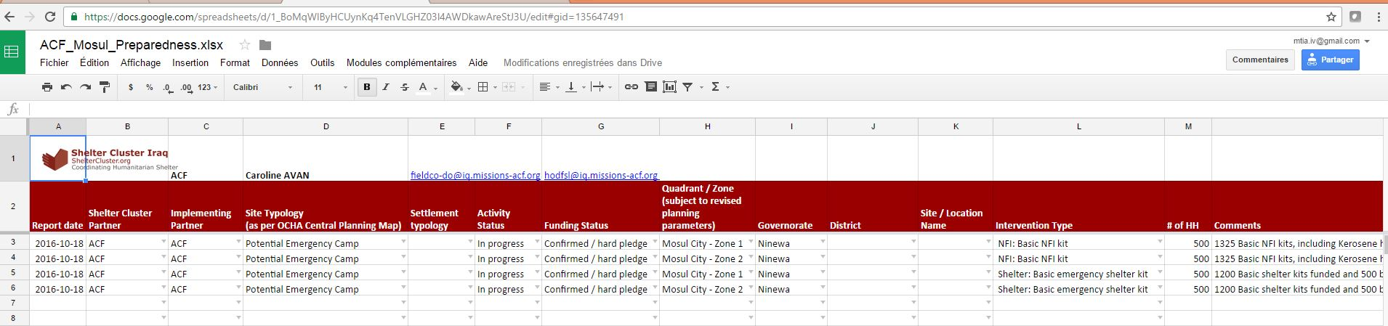
  Mosul Preparedness & Response Updates: Cluster Preparedness and Response
Partner sheet:
To data the cluster has provided individual google sheet to 42 cluster partners engaged in Mosul Preparedness and Response
Data requested

Slide 8
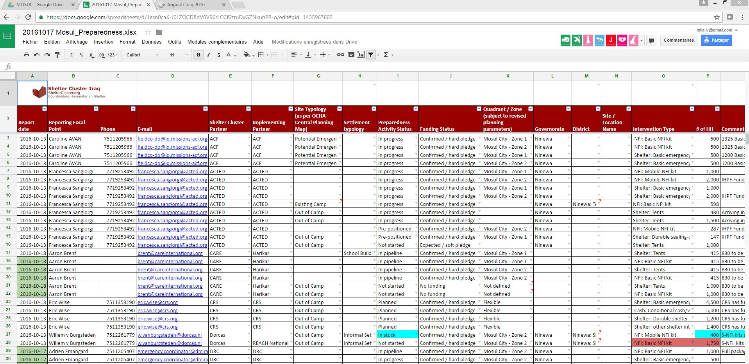
Mosul Preparedness & Response Updates: Cluster Preparedness and Response
Cluster master sheet:
Consolidated from partner sheet
Information sharing – Analysis, Infographics – Advocacy for Fund raising

Slide 9
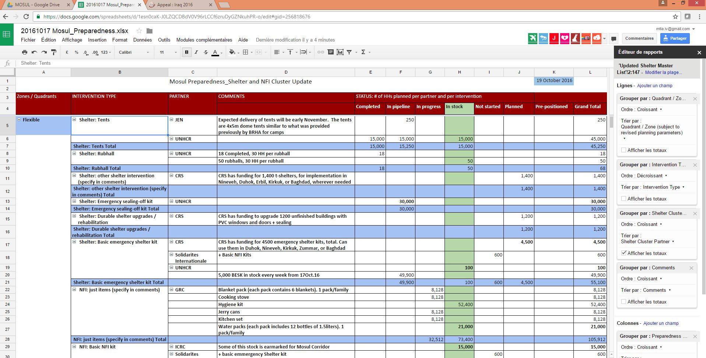
Mosul Preparedness & Response Updates: Cluster Preparedness and Response

Slide 10
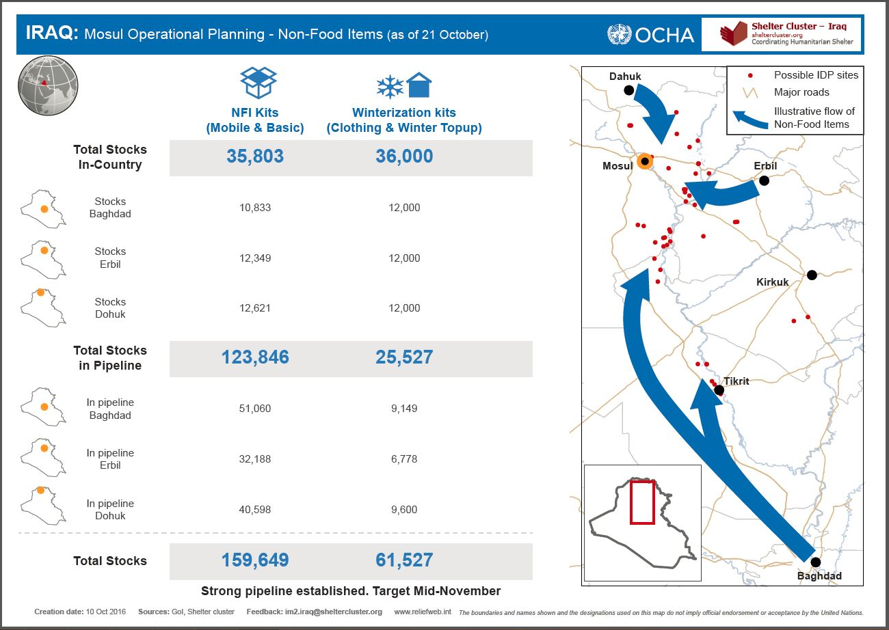
Mosul Preparedness & Response Updates: Cluster Preparedness and Response

Slide 11
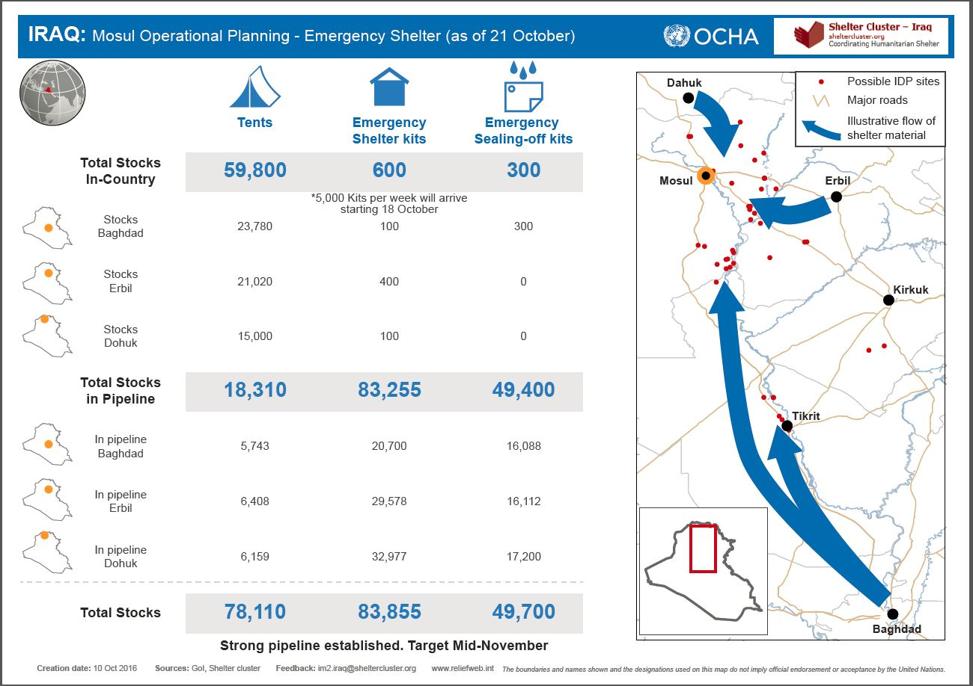
Mosul Preparedness & Response Updates: Cluster Preparedness and Response

Slide 12
Mosul Preparedness & Response Updates: Cluster Preparedness and Response / Reporting
Creation of simple Kobo form, capturing key information + GPS points is most effective method. Allows for:
  GPS location
  Real-time reporting on activities (program staff complete form at distribution location, upload to server once in area with Wi-Fi)
  Reporting requests completed in 5 minutes at distribution
  Update: REACH has completed the response matrix and now migrated into Kobo Form
  6 Slides presentation on how to report into Kobo

Slide 13
  Mosul Preparedness & Response Updates:
Capacity and reporting issues: kits vs. single items; relevance of information
Adjustment capacity to adapt to changing scenarios / assumptions (e.g. “in camp” to “out-of-camp” settings)
Other response options for displaces and non-displaced

Slide 14
Governorate and Agencies Updates

Slide 15
Update on HNO/HRP/Flash Appeal processes
THE PLAN (unconfirmed):
Extend 2016 HRP beyond 2016, into 1st quarter of 2017
Draft 2017 HRP from December to February
Revise Mosul Flash Appeal

Slide 16
Shelter/NFI Cluster issues
Cluster work-streams
Review interaction chart between stakeholders and levels
Current distribution of tasks in KR-I
Revive SAG

Slide 17
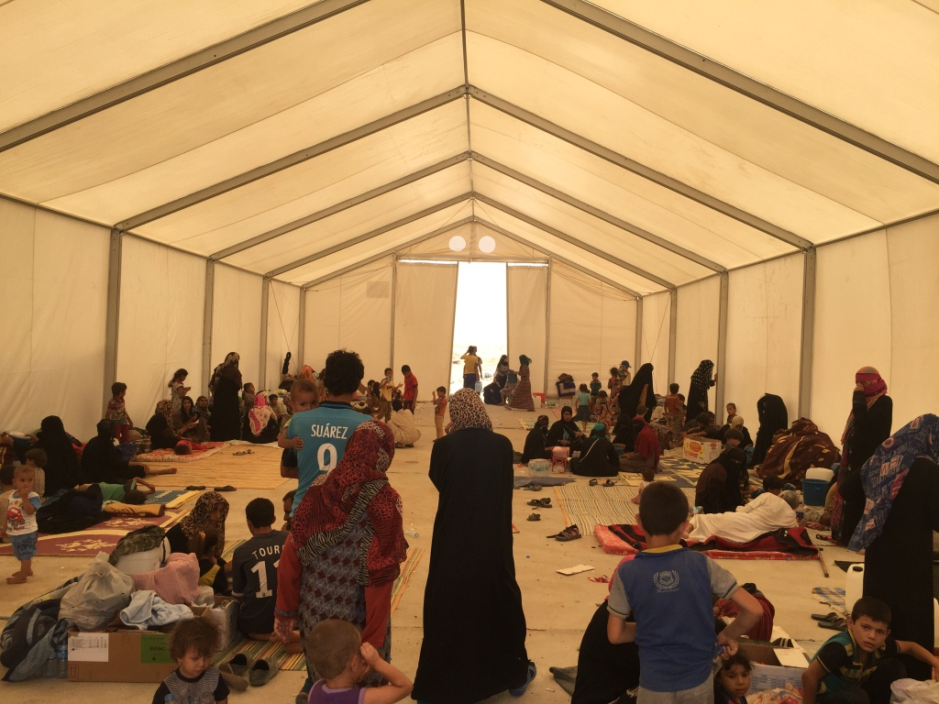
AOB
http://sheltercluster.org/response/iraq

