Slide 1
Sub-National Shelter & NFI Cluster Coordination meeting for C &S
Agenda
Review of action points from previous meeting
Information Management updates
Mosul Preparedness & Response Updates
Cluster Preparedness and Response
Capacity issues
Adjustment capacity to adapt to changing scenarios / assumptions (e.g. “in camp” to “out-of-camp” settings)
Guidelines for use of Schools as temporary shelter
Governorate and Agencies Updates
Update on HNO/HRP/Flash Appeal processes
Shelter/NFI Cluster issues: Organigram; tasks; responsibilities; workflows; work-plans and SAG
AOB
Wednesday, 02nd November 2016
http://sheltercluster.org/response/iraq

Slide 2
Review of action points from previous meeting
Work with Partners on training workshop for the Emergency Shelter Kits and agree on deadline for submission of participants names and finalise budget – Budget is Done only to agree on workshop date pending.
Share assessment reports for tent replacements – Only IOM has indicated to share the report on Anbar tents replacement .
Share IHPF visibility logo with Partners - Done
Share infographics on cluster activities - Done
Inform cluster on google updates - Ongoing

Slide 3
Review of action points from previous meeting
Finalize shooting cluster IEC materials/ videos with IOM and DRC – Work in progress
Share the RASP Kobo link with Partners with clear PowerPoint on how to use the Kobo tool -Done
Mosul response: For Coordination purposes, partners are encouraged to provide information on any agency /organization working on shelter related activities in your respective AoR but not known to the cluster. – No info received so far
Update the winterization excel sheet shared by the cluster- NOT received

Slide 4
Information Management – Cluster achievement Jan. – Sept. 16
 | Target (HHs) | NFI reached HHs and %tage |  | Shelter reached HHs and %tage
Country wide | 196,536 | 134,026 | 68% | 34,463 | 18%
KR-I | 46,719 | 13,419 | 29% | 4,006 | 9%
Centre & South | 149,816 | 120,607 | 81% | 30,457 | 20%
Funding status (from FTS _ Oct. 18th 2016): 37% of 180 million. – 2016 HRP underfunded
http://sheltercluster.org/response/iraq

Slide 5
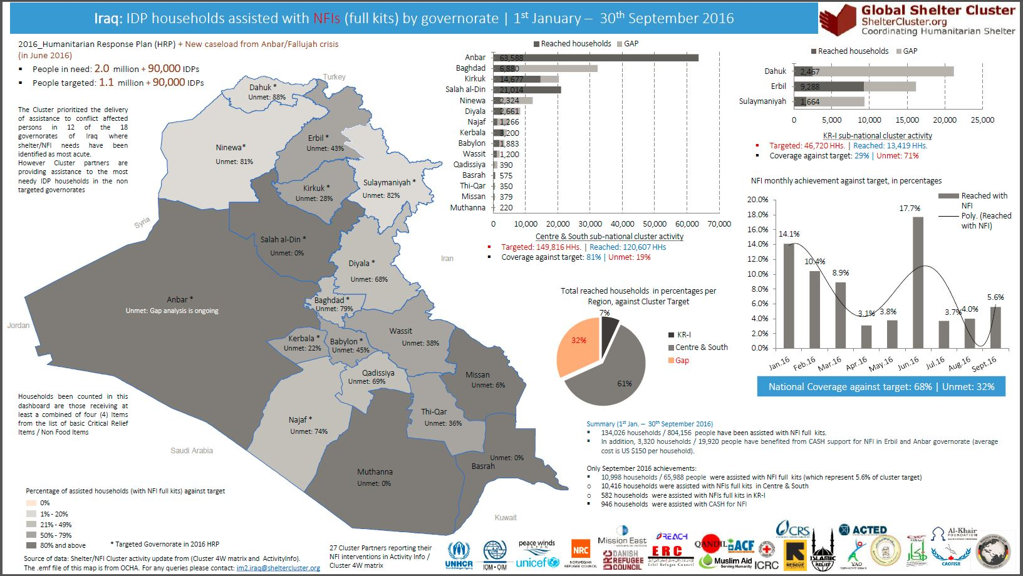
Information Management – Cluster achievements Jan. – Sept. 16
http://sheltercluster.org/response/iraq

Slide 6
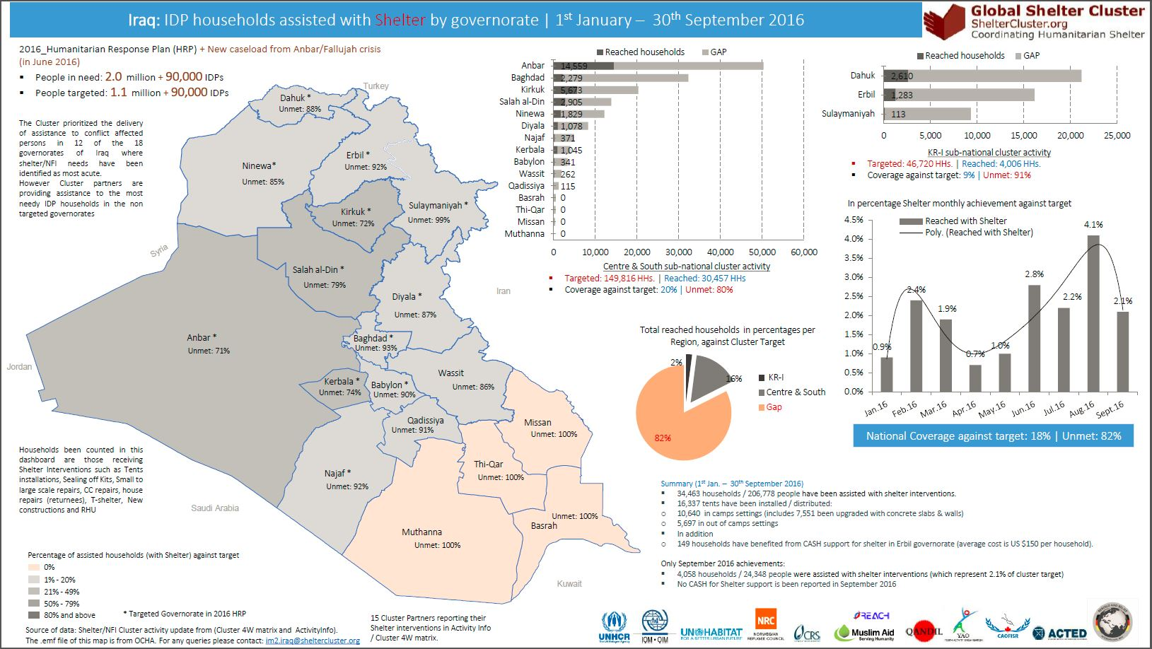
Information Management – Cluster achievements Jan. – Sept. 16
http://sheltercluster.org/response/iraq

Slide 7
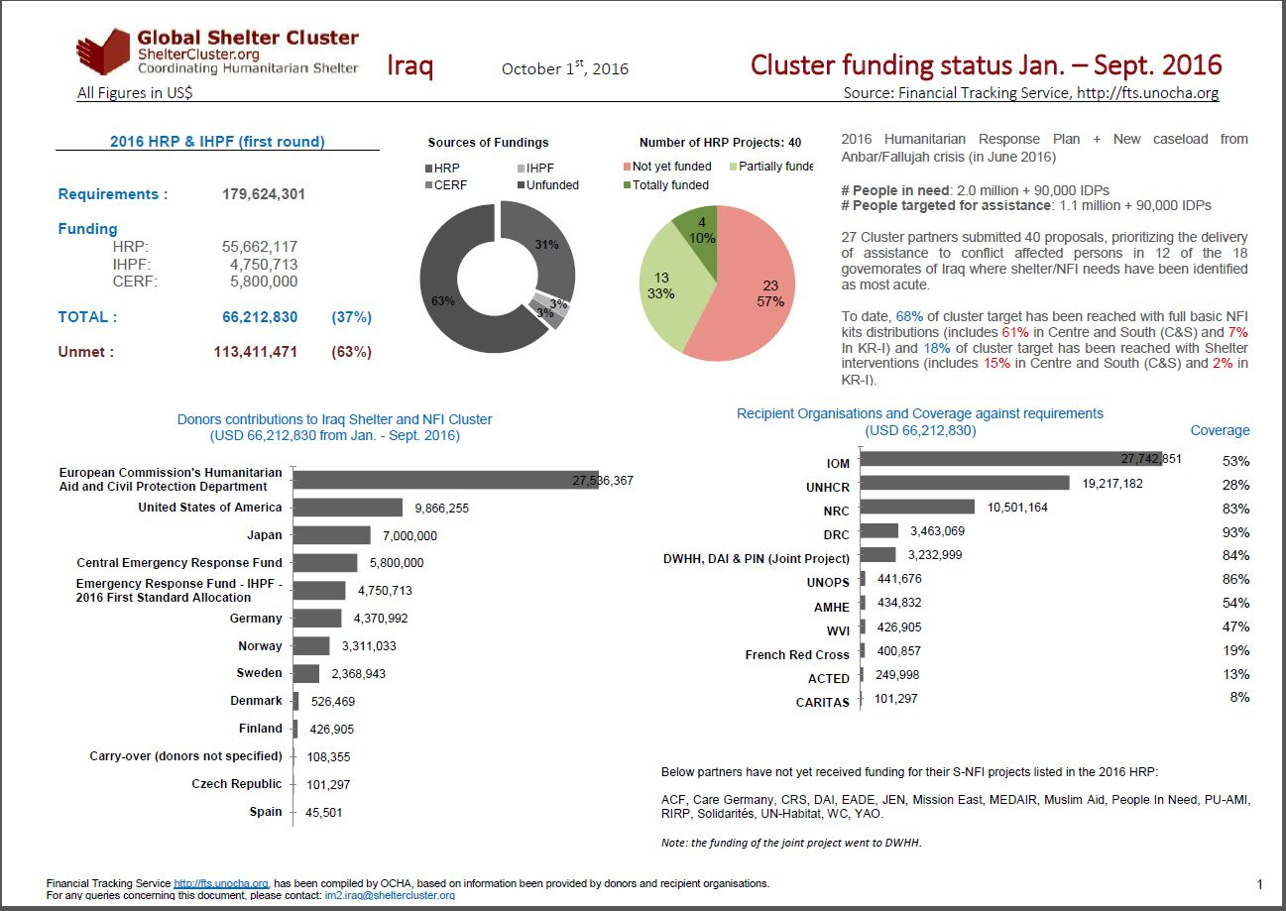
http://sheltercluster.org/response/iraq

Slide 8
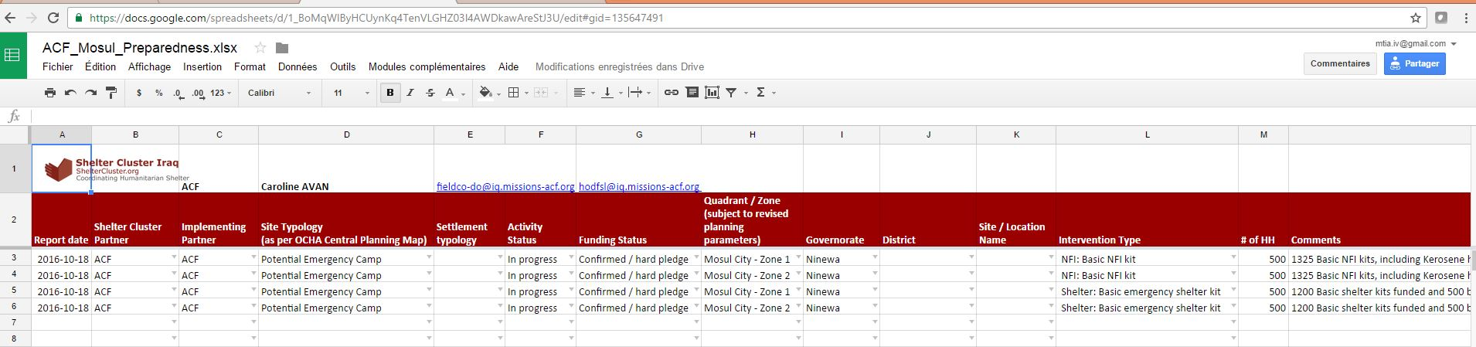
Mosul Preparedness & Response Updates: Cluster Preparedness and Response
Partner sheet:
To data the cluster has provided individual google sheet to 42 cluster partners engaged in Mosul Preparedness and Response
Data requested

Slide 9
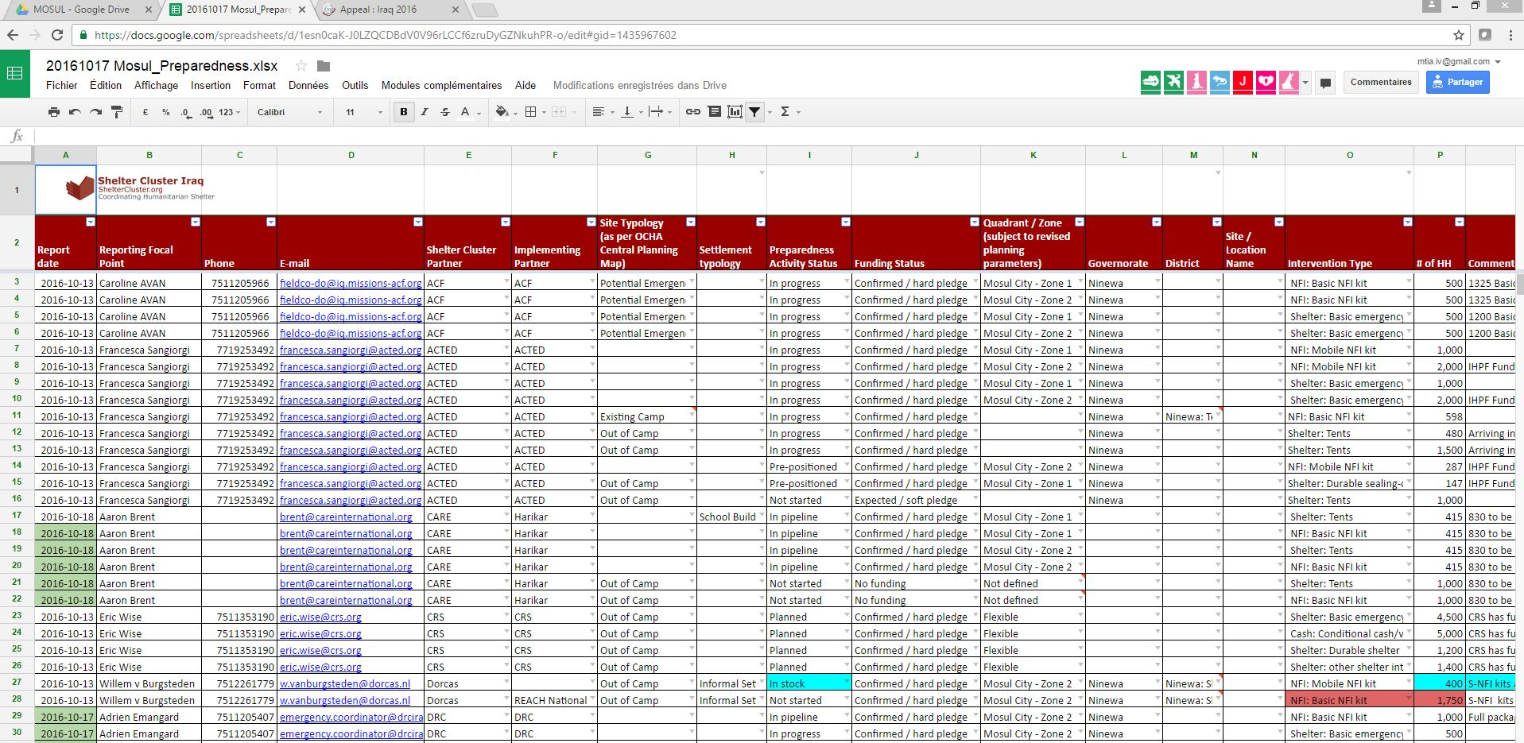
Mosul Preparedness & Response Updates: Cluster Preparedness and Response
Cluster master sheet:
Consolidated from partner sheet
Information sharing – Analysis, Infographics – Advocacy for Fund raising

Slide 10
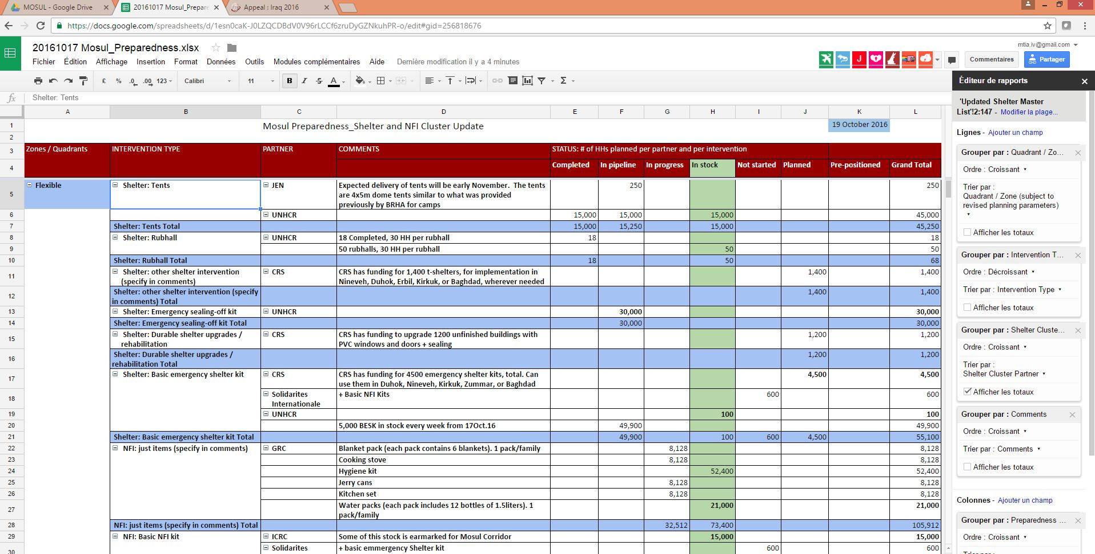
Mosul Preparedness & Response Updates: Cluster Preparedness and Response

Slide 11
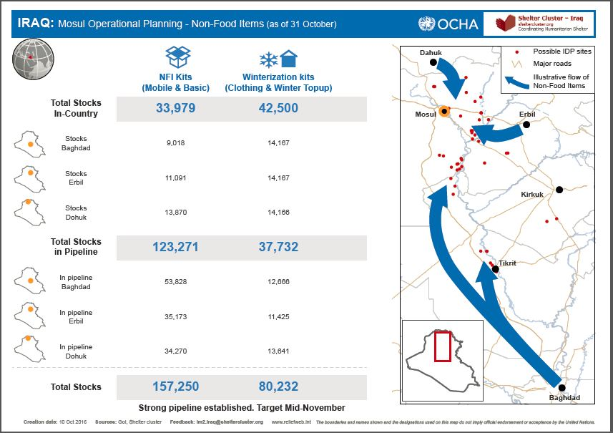
Mosul Preparedness & Response Updates: Cluster Preparedness and Response

Slide 12

Mosul Preparedness & Response Updates: Cluster Preparedness and Response

Slide 13
Mosul Preparedness & Response Updates: Cluster Preparedness and Response / Reporting
Creation of simple Kobo form, capturing key information + GPS points is most effective method. Allows for:
GPS location
Real-time reporting on activities (program staff complete form at distribution location, upload to server once in area with Wi-Fi)
Reporting requests completed in 5 minutes at distribution
Update: REACH has completed the response matrix and now migrated into Kobo Form
6 Slides presentation on how to report into Kobo

Slide 14
Mosul Preparedness & Response Updates:
Capacity and reporting issues: kits vs. single items; relevance of information
Adjustment capacity to adapt to changing scenarios / assumptions (e.g. “in camp” to “out-of-camp” settings)
Other response options for displaces and non-displaced
Guidelines for use of Schools as temporary shelter (next slide)

Slide 15
Mosul Preparedness & Response Updates:
Guidelines for use of Schools as temporary shelter
When schools are designated as temporary shelter, due diligence must be observed at all times as outlined in the Guidelines for use of schools as temporary shelter developed by the Education Cluster. These guidelines have been shared with Partners though mail chimp on 23th October 2016 by the cluster in three languages, English, Arabic and Kurdistan.
Key issues to note:
The DoE, headmaster and PTA should be involved in the development of guidelines on the use of each school as a shelter
When a school is selected as shelter, a deadline for the return to its original function should be
established from the beginning, communicated to all, and respected.
Shelter Cluster and CCCM Cluster to work with authorities on finding alternative accommodation options so that the schools can be vacated as soon as possible.

Slide 16
Mosul Preparedness & Response Updates:
Guidelines for use of Schools as temporary shelter
When the coexistence of displaced and students is inevitable
School areas used by displaced people should be separated from areas used by learners.
If separation is not possible, it is necessary to set time slots for the use of water points in order to avoid any conflict between the learners and displaced.
Please find more details in the guidelines

Slide 17
Governorate and Agencies Updates

Slide 18
Update on HNO/HRP/Flash Appeal processes
THE PLAN (unconfirmed):
Extend 2016 HRP beyond 2016, into 1st quarter of 2017
Draft 2017 HRP from December to February
Revise Mosul Flash Appeal

Slide 19
Shelter/NFI Cluster issues
Cluster work-streams
Review interaction chart between stakeholders and levels
Current distribution of tasks in KR-I
Revive SAG

Slide 20
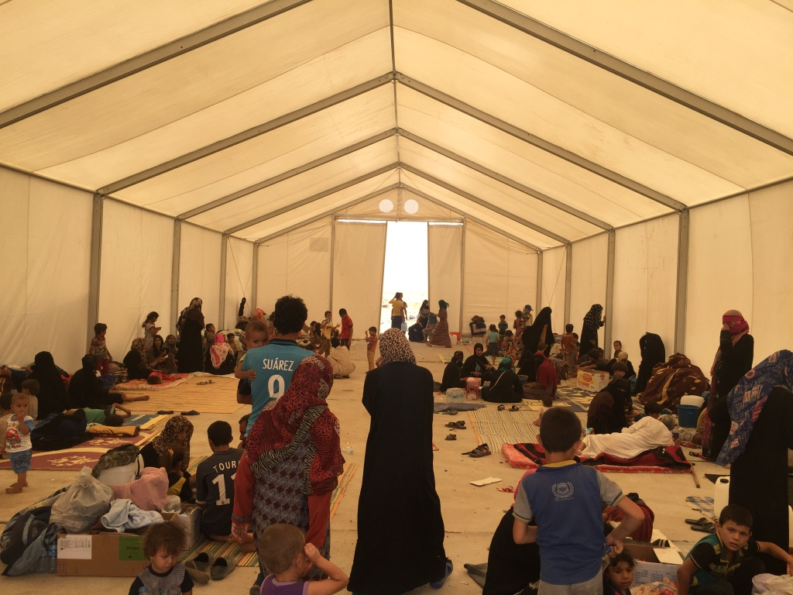
AOB
http://sheltercluster.org/response/iraq

