Slide 1
Sub-National Shelter & NFI Cluster Coordination meeting for C &S
Agenda
Review of action points from previous meeting
Information Management updates
Mosul Preparedness & Response Updates (Preparedness Infographic and Kobo reporting)
Key issues
Tent replacement assessment,
Winterization,
Training on Emergency Shelter Kit
Huge Numbers of new IDPs in Salah al-Din without Response
Governorate and Agencies Updates
Update on HNO/HRP/Flash Appeal processes
AOB
Wednesday, 16th November 2016
http://sheltercluster.org/response/iraq

Slide 2
Review of action points from previous meeting
Partners to inform CCCM which partners are engaged in shelter related activities- Ongoing
IM to add names of districts in Kobo tool – Done
Partners to inform the cluster on their winterization plan – Not received

Slide 3
Information Management Update
Monthly IM products: dashboard/Infographics
October 2016 update will be released very soon together with a consolidated 4W matrix and the analysis tool.
Mosul responses have to be reported also into Activity Info which is the inter-cluster reporting platform.
Deadline to report your country wide - Nov.16 achievements is Dec. 5th 2016.
Remember that all IM products and other relevant cluster supporting tool are available on the cluster webpage: http://sheltercluster.org/response/iraq
http://sheltercluster.org/response/iraq

Slide 4
Mosul Preparedness & Response Updates (Preparedness Infographic and Kobo reporting)
Preparedness: very good reporting level – 34 partners are constantly updating their stocks. 8 partners are still not reporting their preparedness sheet.
Consolidated Master Sheet can be found here
Current preparedness infographic is been revised to reflect preparedness and response on one page document.
Next infographic (preparedness & response) will be produced on Thursday Nov.17th 2016
http://sheltercluster.org/response/iraq

Slide 5
Mosul Preparedness & Response Updates (Preparedness Infographic and Kobo reporting)
Response:
very good reporting level from 13 operational partners: CRS, DRC, IOM, IRCs/FRC, MODM, NRC, QRCs, Reach National, Samaritan’s Purse, Save the Children, Tearfund, World Vision, UNHCR.
http://sheltercluster.org/response/iraq

Slide 6
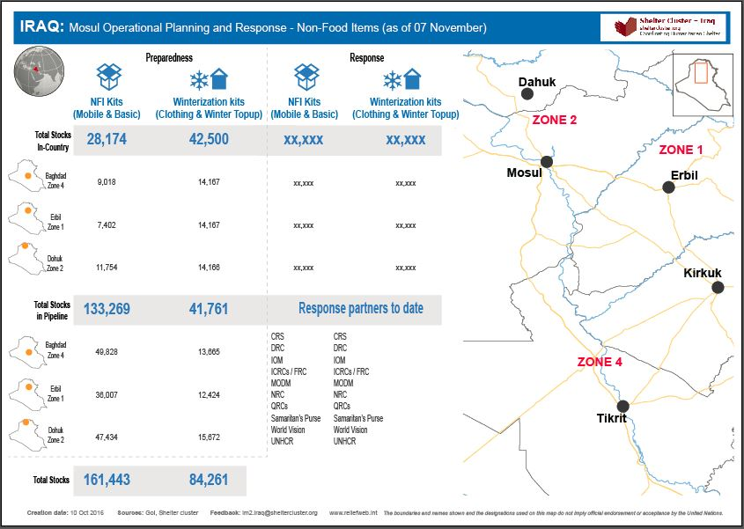
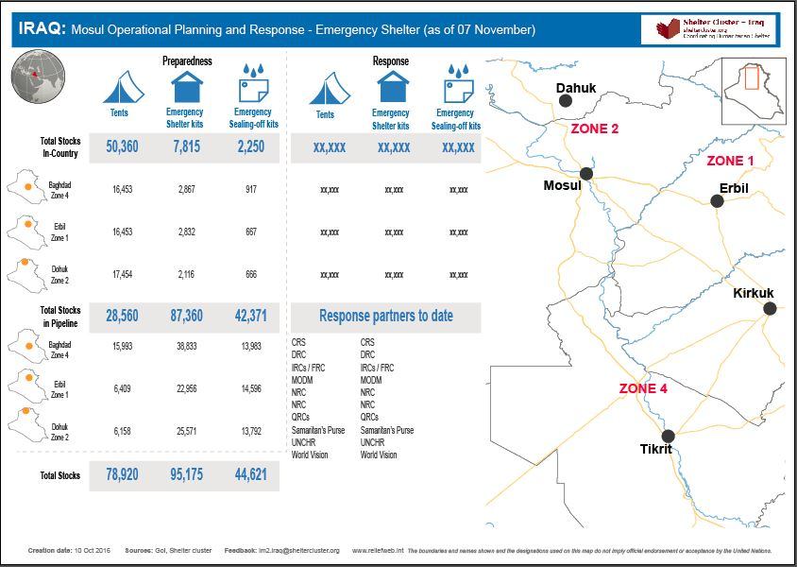
Mosul Preparedness & Response Updates (Preparedness Infographic and Kobo reporting)
Current preparedness infographic is been revised to reflect preparedness and response on one page document each.
Next infographic (preparedness & response) will be produced on Thursday Nov.17th 2016
http://sheltercluster.org/response/iraq

Slide 7
Key issues
Tent replacement assessment,
Winterization,
Training on Emergency Shelter Kit
Huge Numbers of new IDPs in Salah al-Din without Response
Tent replacement assessment
The cluster has received assessments reports from IOM, NRC and DRC on tent replacement in Anbar:
from IOM : 262 tents require replacement in AAF (in 11 camps)
from NRC : 291 tents require replacement in AAF (in 13 camps)
From DRC : 468 tents require replacement in AAF, Bzeibiz and Al-Khalidija (in 16 camps) – initial figures
http://sheltercluster.org/response/iraq

Slide 8
Key issues
Tent replacement assessment,
Winterization,
Training on Emergency Shelter Kit
Huge Numbers of new IDPs in Salah al-Din without Response
Winterization
Cluster Coordination Team met with MODM – KR-I to discuss winter distribution specially kerosene
MODM – KR-I: targeting 200,000 IDP households / 1.2 million people with 200 litres of kerosene per households
Partners have to coordinate (as usual) their winter distributions through the cluster for better coverage.
The Cluster IM will consolidate all partners kerosene distributions: litres distributed (In-kind & Cash), number of beneficiaries, where, when, …. and share the consolidated matrix on weekly basis.
http://sheltercluster.org/response/iraq

Slide 9
Key issues
Tent replacement assessment,
Winterization,
Training on Emergency Shelter Kit
Huge Numbers of new IDPs in Salah al-Din without Response
Training on Emergency Shelter Kit
Budget for the training has been secured (USD 3,800). IOM and UNHCR will cover 50% each.
In addition UNHCR will provide the Emergency Shelter Kits to be used for the training.
Training venue will be Al Mansour Hotel
25 Participants have expressed interest, including MODM
The Partners are requested to re-confirm the final training dates; Henri (S-NFI Sub-national Cluster Coord. For KR-I will facilitate the training)
http://sheltercluster.org/response/iraq

Slide 10
Key issues
Tent replacement assessment,
Winterization,
Training on Emergency Shelter Kit
Huge Numbers of new IDPs in Salah al-Din without Response
Huge Numbers of new IDPs in Salah al-Din without Response
Normal Caseload:
From recent Mosul:
Needs:
http://sheltercluster.org/response/iraq

Slide 11
Governorate and Agencies Updates

Slide 12
Update on HNO/HRP/Flash Appeal processes
The possible PLAN – developing :-
Extend 2016 HRP beyond 2016, into 1st quarter of 2017
Draft 2017 HRP from December 2016 to February 2017
Revise Mosul Flash Appeal in the coming 7 days, the cluster will send out guidelines for input from Partners

Slide 13
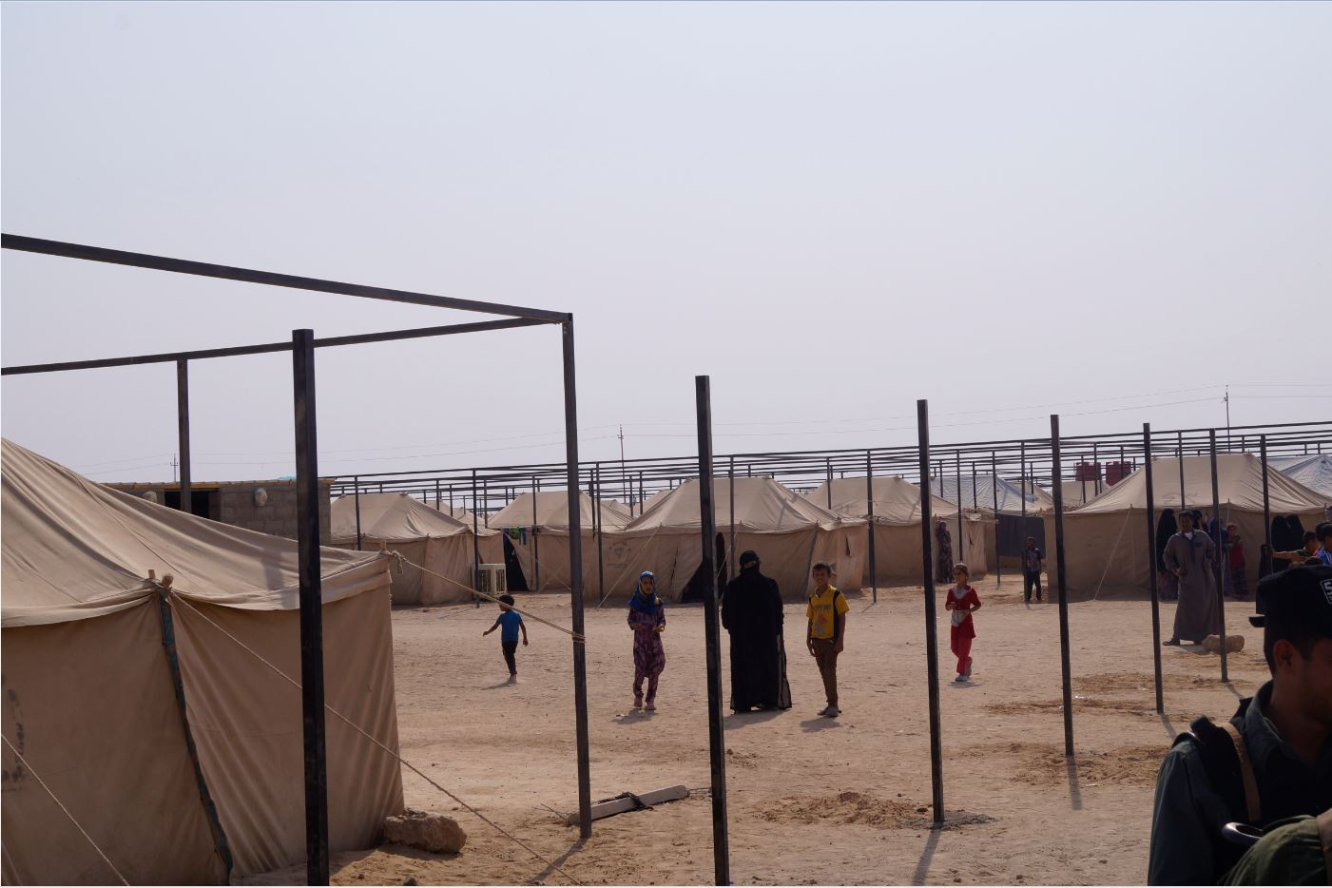
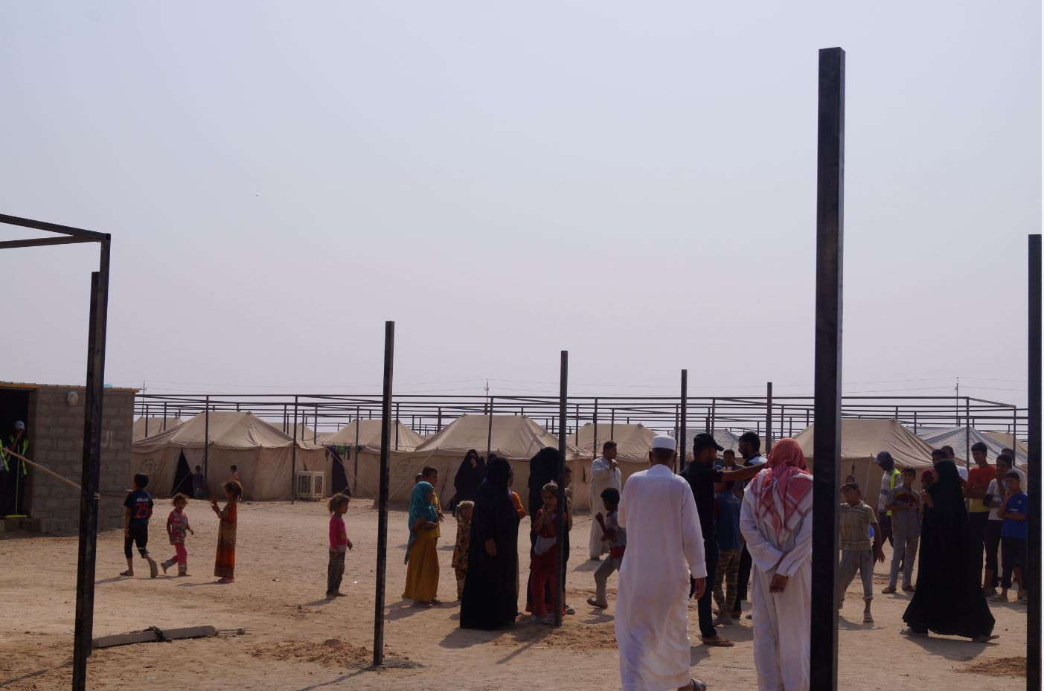
AOB – Construction of tent shadings in Fallujah
http://sheltercluster.org/response/iraq

Slide 14
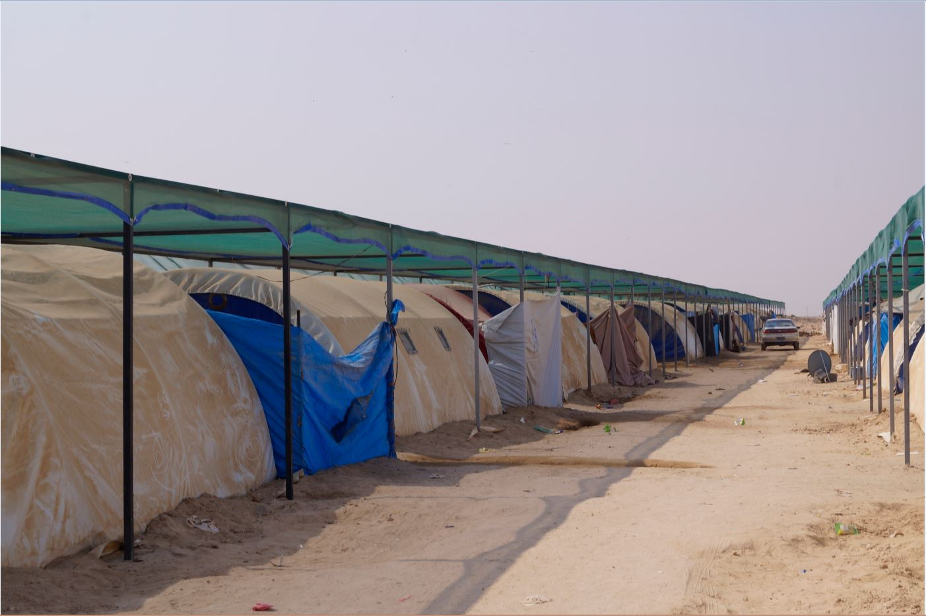
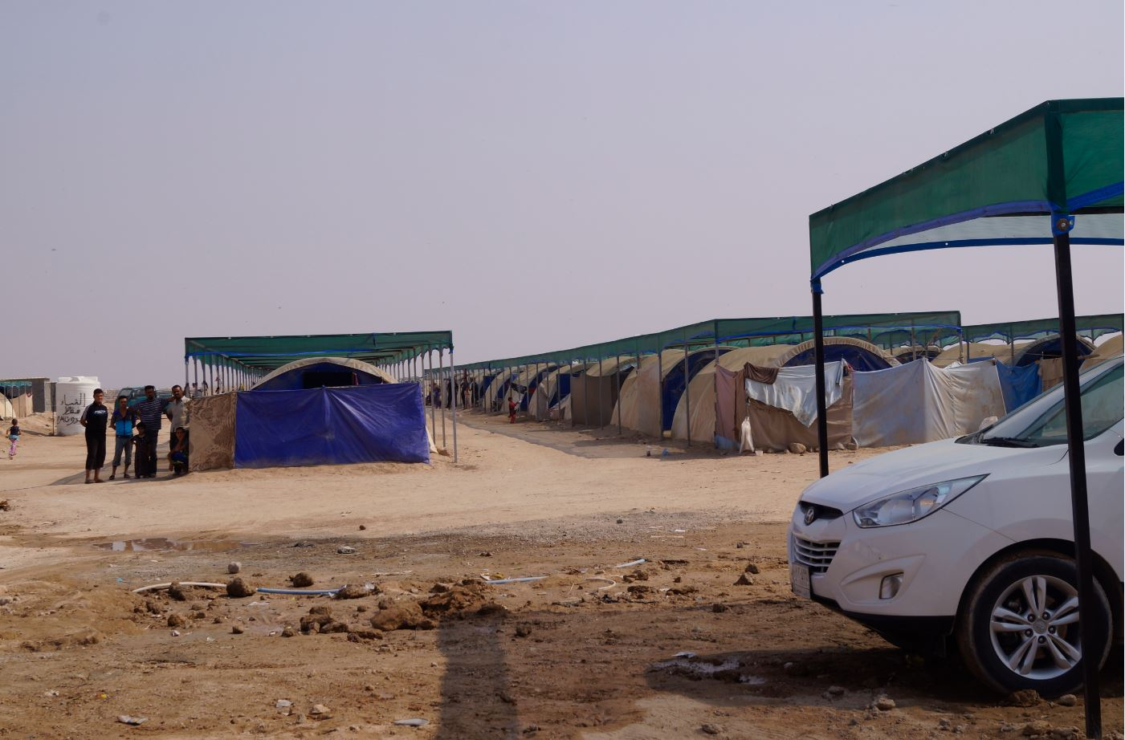
AOB – Construction of tent shadings in Fallujah
http://sheltercluster.org/response/iraq

Slide 15
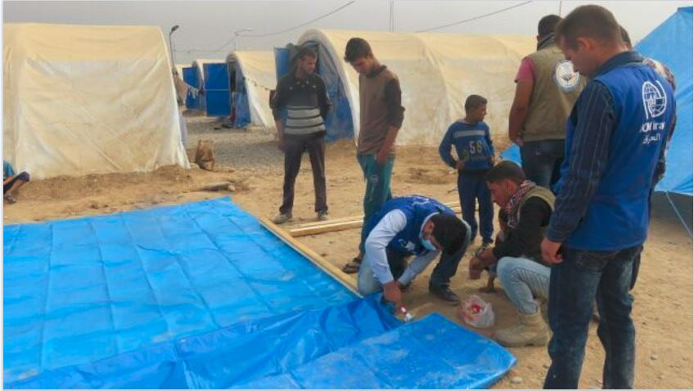
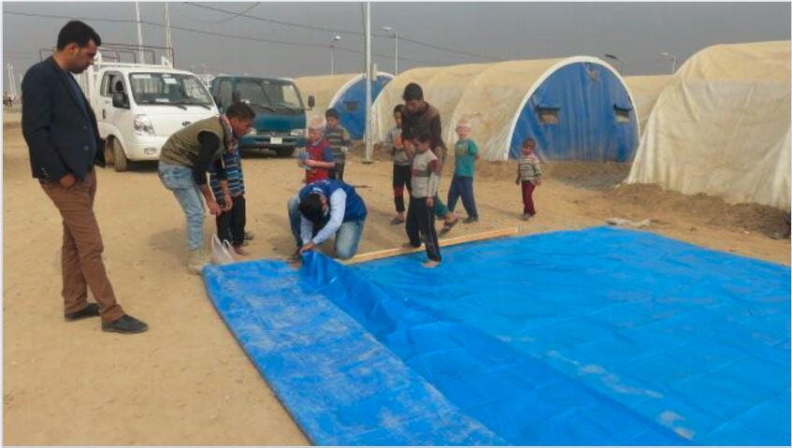
AOB – Construction of Emergency Shelters in Jadah
http://sheltercluster.org/response/iraq

Slide 16
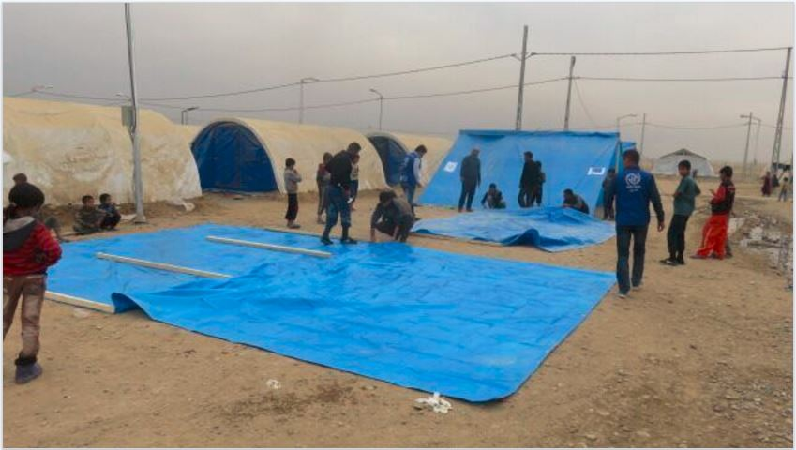
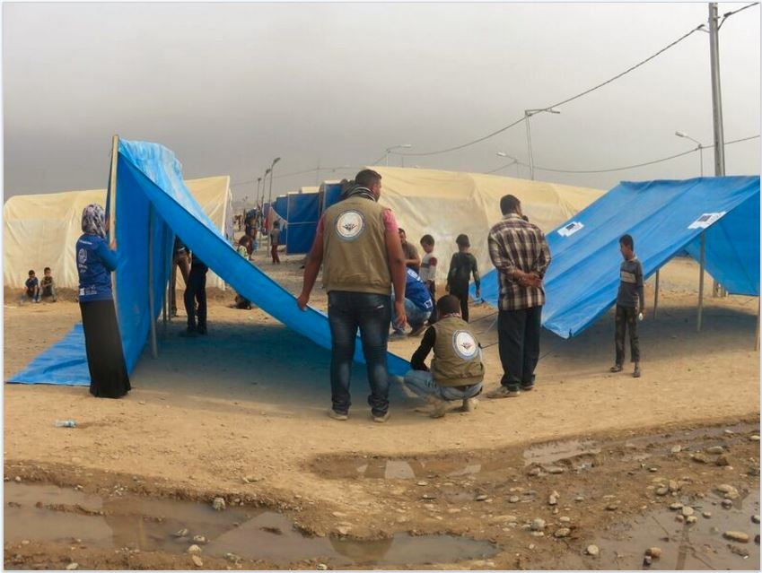
AOB – Construction of Emergency Shelters in Jadah
http://sheltercluster.org/response/iraq

Slide 17
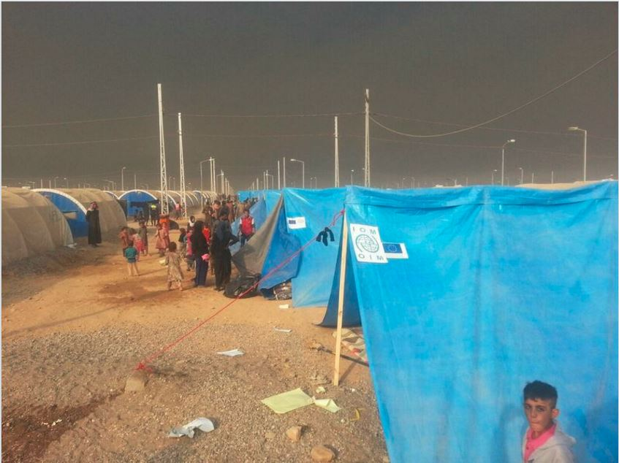
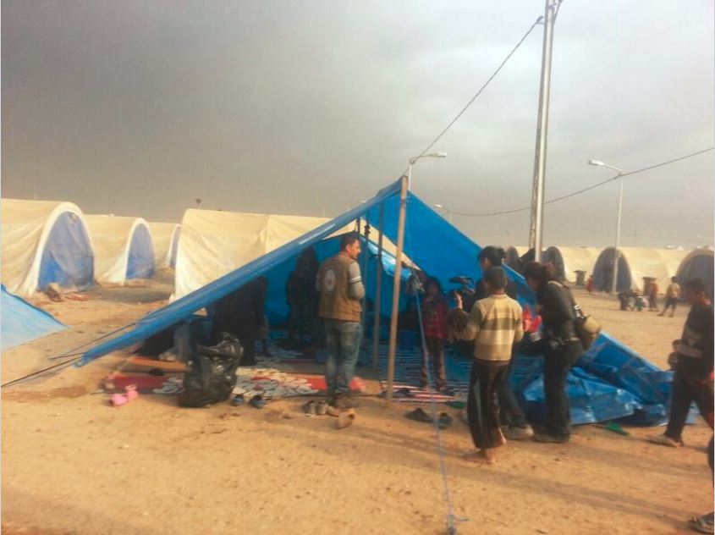
AOB – Construction of Emergency Shelters in Jadah
http://sheltercluster.org/response/iraq

