Slide 1
Sub-National Shelter & NFI Cluster Coordination meeting for KR-I
Agenda
New Cluster Team Members and Introductions
Update on 2017 HRP and planning process
Information Management Update
Review Mosul preparedness against response
Pre-planning of activities & Gap analysis
Governorate and Agencies Updates
AOB
Wednesday, 21st December 2016
http://sheltercluster.org/response/iraq

Slide 2





1. Cluster Team Structure
Ryan Smith
Roving Cluster Coordinator (Duhok) - Zone 2 Focal Point
Catholic Relief Services
+964 (0) 751 755 8451
coordroving.iraq@sheltercluster.org
Richard Evans - UNHCR National Cluster Coordinator - Zone 4 Focal Point +964 (0) 771 994 5694 coord.iraq@sheltercluster.org Michel Tia - IOM Information Management Officer - National +964 (0) 750 021 1720 im2.iraq@sheltercluster.org Cornelius Weira - IOM Sub National Co-Chair - Centre and South Mobile +964 (0) 751 234 2548 coord4.iraq@sheltercluster.org Surge Capacity - Phil Duloy - Shelter Box - Bo Hurkmans - UNHCR | Michael Gloeckle - NRC National Co-Chair - Technical Coordinator - Zone 1 Focal Point +964 (0) 750 878 7793 coord2.iraq@sheltercluster.org Ryan Smith - Catholic Relief Services Dahuk & Zone 2 Focal Point +964 (0) 751 755 8451 coordroving.iraq@sheltercluster.org

Slide 3
2. Update on HRP
An update was shared by the Cluster on website – http://www.sheltercluster.org/documents/hrp-update-shelter-and-nfi-cluster
Key dates:
OPS is open as of 17th December 2016 to start entering projects
15th January 2017 - OPS closes
26th January 2017 – finalisation of projects
Next Steps:
OCHA training
Cluster meetings to finalise strategy and activities
Review information needs, start to write narrative
Internal meetings to discuss scale, location and activities for 2017

Slide 4
3. Information Management Update
November 2016 - IM products: dashboard/Infographics
  The update will be released very soon together with a consolidated 4W matrix and the analysis tool.
 | 162,079 | HHs Reached (with Basic NFI Kits distributions) | 59,990 | HHs Reached (with Shelter interventions)
Response | 82% | of Cluster 2016_HRP Target | 31% | of Cluster 2016_HRP Target
GAP | 34,457 | Represent 18% | 136,546 | Represent 69%
http://sheltercluster.org/response/iraq

Slide 5
3. Information Management Update
Mosul responses have to be reported also into Activity Info which is the inter-cluster reporting platform.
Deadline to report your country wide - Dec.16 achievements is Jan. 5th 2017.
Remember that all IM products and other relevant cluster supporting tool are available on the cluster webpage: http://sheltercluster.org/response/iraq
http://sheltercluster.org/response/iraq

Slide 6
4. Review Mosul preparedness against response
Preparedness: 45 Partners are involved – but 37 partners are constantly updating their preparedness stocks. 8 partners are still not sharing their information.
Current preparedness infographic is been revised to reflect preparedness and response on one page document.
Updated infographic (preparedness & response) will be shared through the website:
http://sheltercluster.org/mosul-dashboard
Updated 4W will be shared through the website:
http://sheltercluster.org/mosul-operational-presence
http://sheltercluster.org/response/iraq

Slide 7
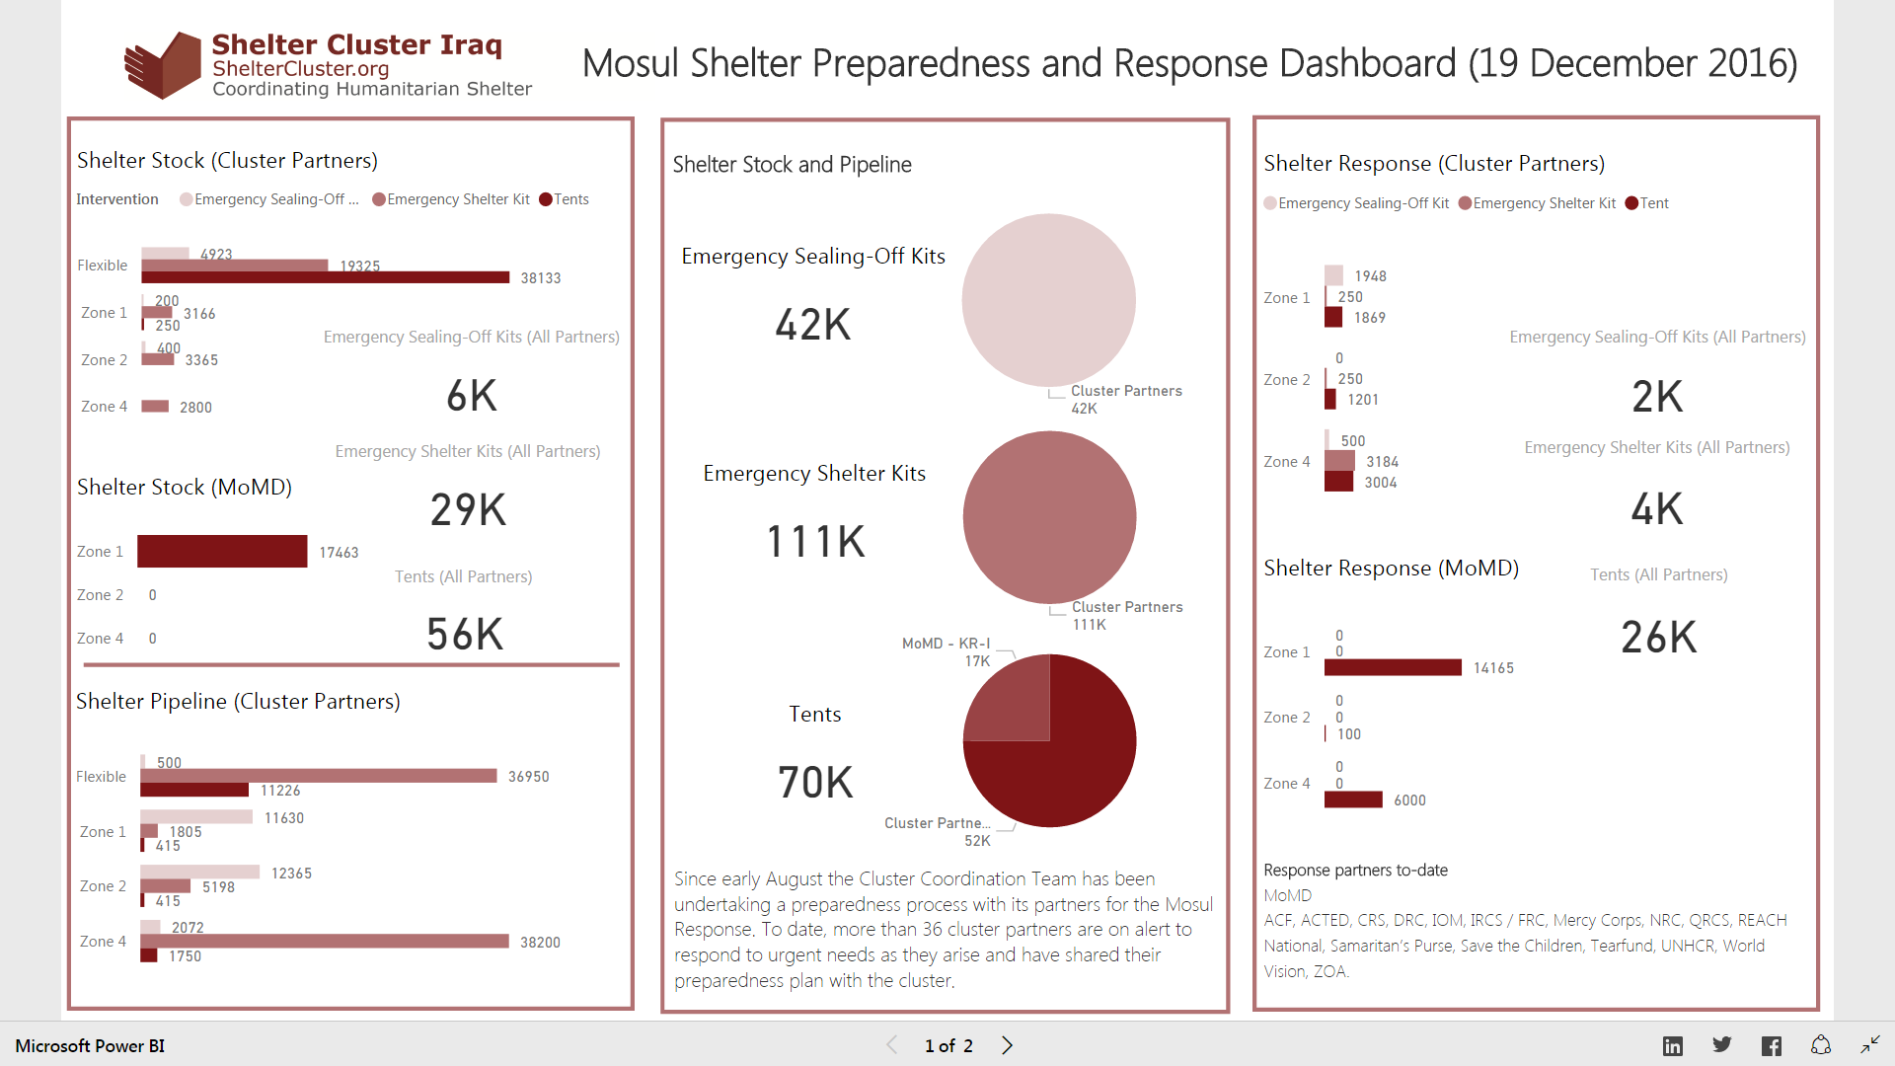
4. Review Mosul preparedness against response

Slide 8
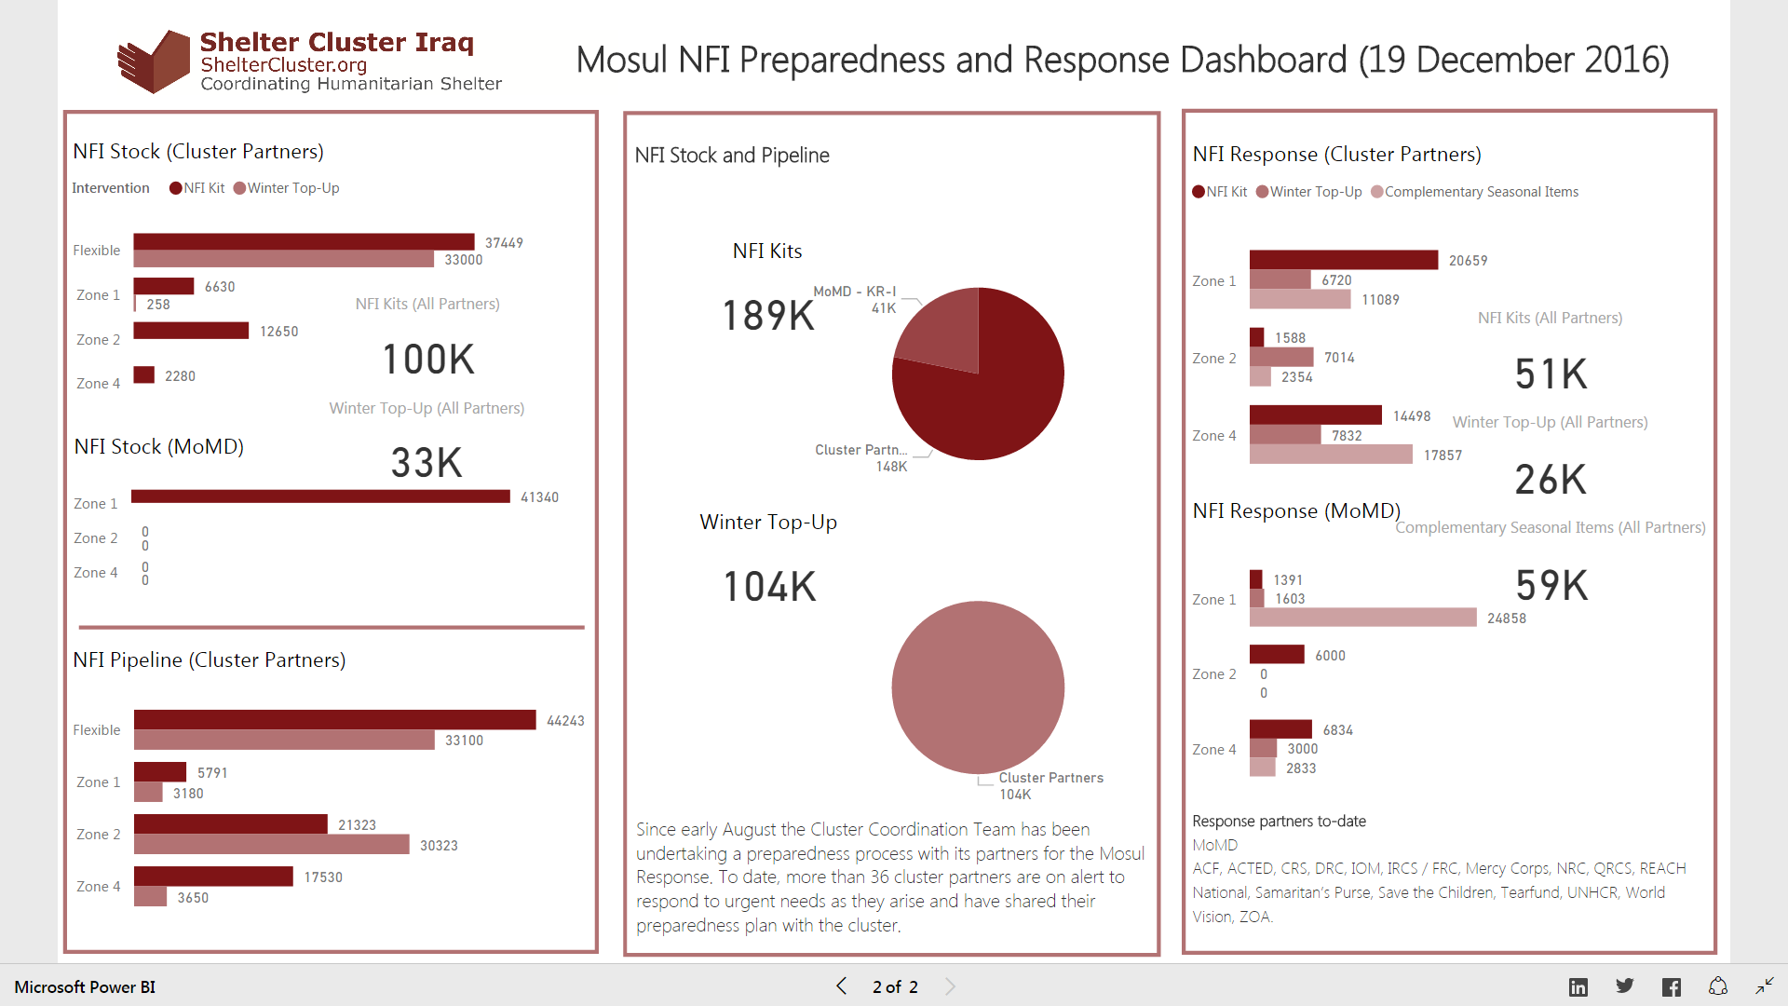
4. Review Mosul preparedness against response

Slide 9
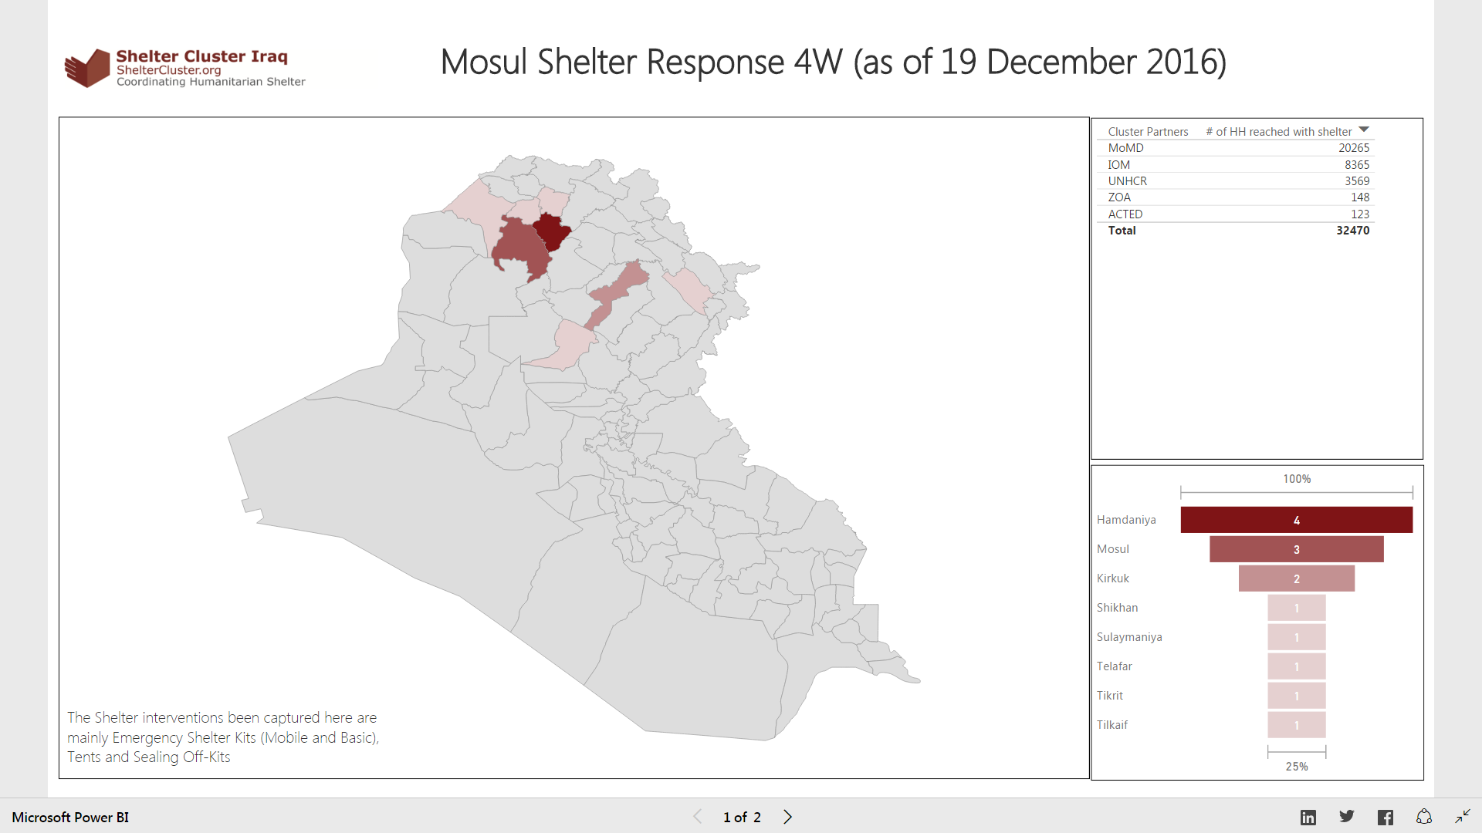

Slide 10
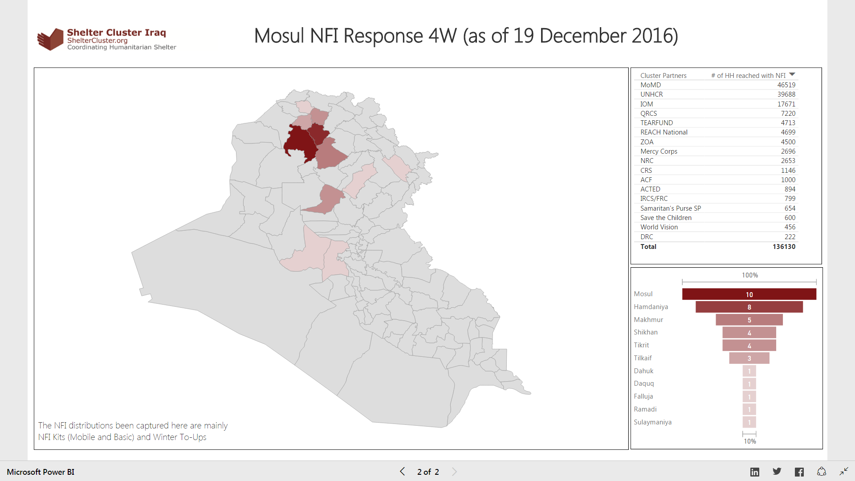

Slide 11
4. Review Mosul preparedness against response
Not started: No funding or no access to the location to implement
In pipeline: Purchase order signed / funding secured
In stock: In country and in warehouse
Pre-positioned: In sub-warehouse or at a set location (camp etc.) ready for distribution
Planned: Distribution plan for coming two weeks (when and where)
Completed: Distributed/implemented, should be uploaded via Kobo form
To be removed
In progress

Slide 12
5. Pre planning and Gap Analysis
Is there a coordination gap between Preparedness & Reported Response?
Reported Shelter / NFI Need – (e.g. IDP call centre, assessments, field visits)
‘Need’ received by Cluster
Is it a Gap that needs to be filled?
Is it a need that will be covered by an active partner with resources?

Slide 13
6. Governorate and Agencies Updates
Partner update on issues of concern
(no reporting on figures …..)

Slide 14
7. AOB
  Tent replacement:
    REACH survey
  Others:
http://sheltercluster.org/response/iraq

