Slide 1
Sub-National Shelter & NFI Cluster Coordination meeting for KR-I
Agenda
New Cluster Team Members and Introductions
Update on 2017 HRP and planning process
Information Management
Cluster Technical Guidelines – upcoming guidelines
Access Issues to East Mosul
Areas of Activity within the Zones
Governorate and Agencies Updates
AOB
Wednesday, 4th January 2017
http://sheltercluster.org/response/iraq

Slide 2




1. Cluster Team Structure
Ryan Smith
Roving Cluster Coordinator (Duhok) - Zone 2 Focal Point
Catholic Relief Services
+964 (0) 751 755 8451
coordroving.iraq@sheltercluster.org
Richard Evans - UNHCR National Cluster Coordinator - Zone 4 Focal Point +964 (0) 771 994 5694 coord.iraq@sheltercluster.org Michel Tia - IOM Information Management Officer - National +964 (0) 750 021 1720 im2.iraq@sheltercluster.org Cornelius Weira - IOM Sub National Co-Chair - Centre and South Mobile +964 (0) 751 234 2548 coord4.iraq@sheltercluster.org | Michael Gloeckle - NRC National Co-Chair - Technical Coordinator - Zone 1 Focal Point +964 (0) 750 878 7793 coord2.iraq@sheltercluster.org Ryan Smith - Catholic Relief Services Dahuk & Zone 2 Focal Point +964 (0) 751 755 8451 coordroving.iraq@sheltercluster.org

Slide 3
2. Update on HRP
An update was shared by the Cluster on website – http://www.sheltercluster.org/documents/hrp-update-shelter-and-nfi-cluster
Key dates:
OPS is open as of 17th December 2016 to start entering projects
15th January 2017 - OPS closes
16th – 19th Review of Projects
23rd January – Cluster Defence
26th January 2017 – finalisation of projects
Next Steps:
OCHA training
Cluster meetings to finalise strategy and activities
Review information needs, start to write narrative
Internal meetings to discuss scale, location and activities for 2017

Slide 4
3. Information Management Update
Mosul responses have to be reported also into Activity Info which is the inter-cluster reporting platform.
Deadline to report your country wide - Dec.16 achievements is Jan. 5th 2017.
Remember that all IM products and other relevant cluster supporting tool are available on the cluster webpage: http://sheltercluster.org/response/iraq
http://sheltercluster.org/response/iraq

Slide 5
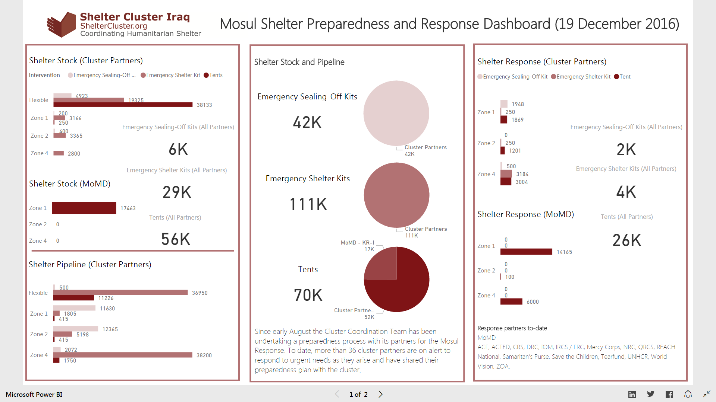
4. Review Mosul preparedness against response

Slide 6
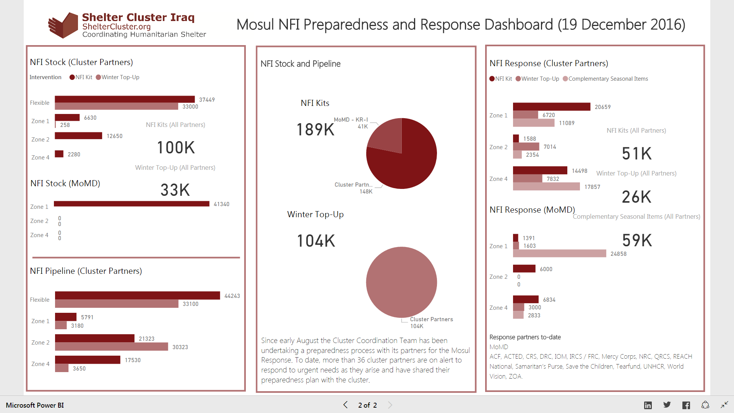
4. Review Mosul preparedness against response

Slide 7
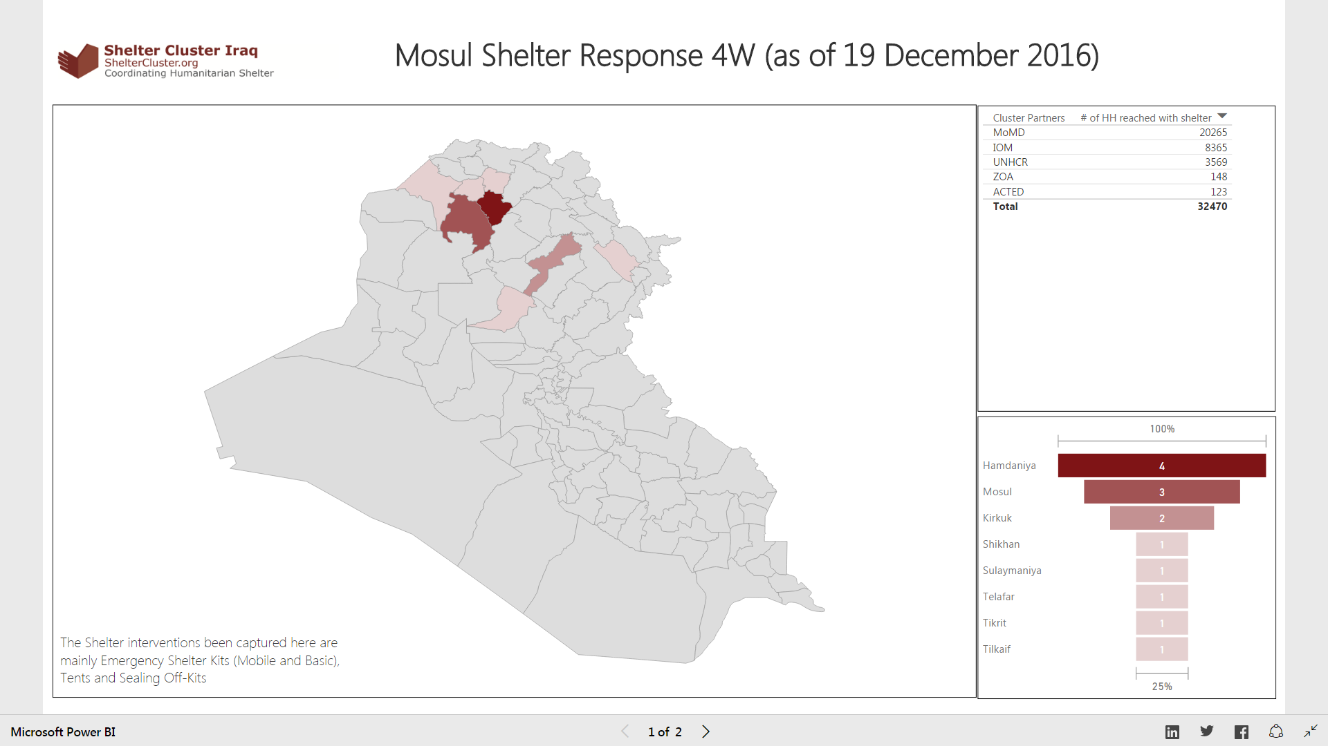

Slide 8
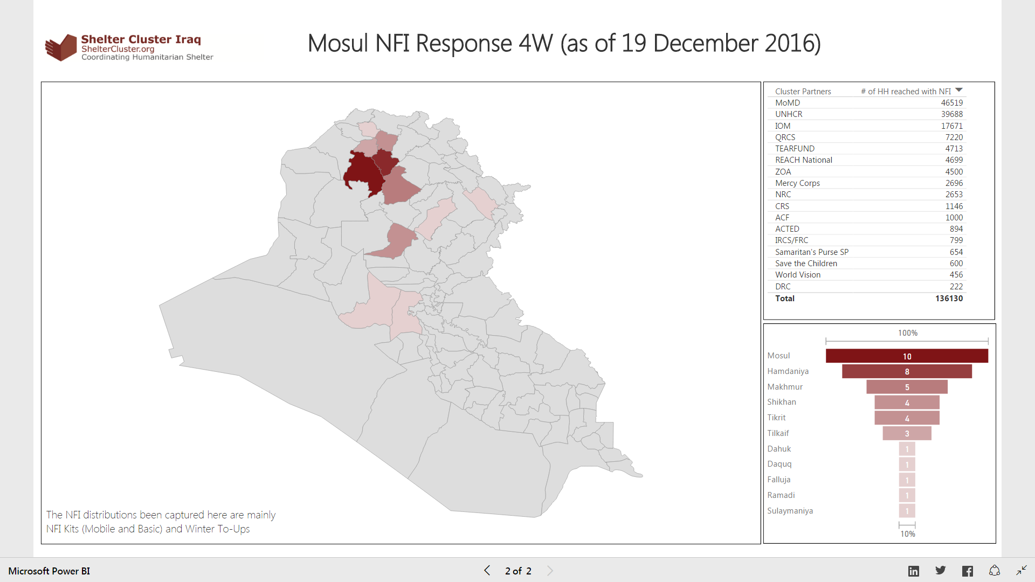

Slide 9
3. Review Mosul preparedness against response
Not started: No funding or no access to the location to implement
In pipeline: Purchase order signed / funding secured
In stock: In country and in warehouse
Pre-positioned: In sub-warehouse or at a set location (camp etc.) ready for distribution
Planned: Distribution plan for coming two weeks (when and where)
Completed: Distributed/implemented, should be uploaded via Kobo form
iom, jen, cnsf, qrcs, adra and acted have updated since last notice ☺
FRC, GRC, MHE, NRC, PIN, REACH, TEARFUND, WVI, ZOA, CRS, UIMS – have not ☹
We will consider excluding inputs older than 2 months after 5 January 2017, since otherwise the accuracy of the stock and pipeline figures cannot be guaranteed. In case your stock and/or pipeline has remained the same and you have nothing new to report, please let us know so we maintain your inputs in our records.

Slide 10
4. Cluster Technical Guidelines – upcoming guidelines
The Cluster has the following guidelines on its website:
Emergency Sealing-Off Kit(s) – ESOK – Technical Guidance
NFI Technical guidance V09 (English and Arabic)
Emergency Shelter Kit – Guidance and Flyer V04
Settlement Typology Responses
Shelter Unfinished and Abandoned Building guidance
Under preparation:
Climatisation Guidelines – winter and summer
Tent Information Note
Resources for Kerosene, Propane and other flammable liquid and gas storage and use
Any other requests?

Slide 11
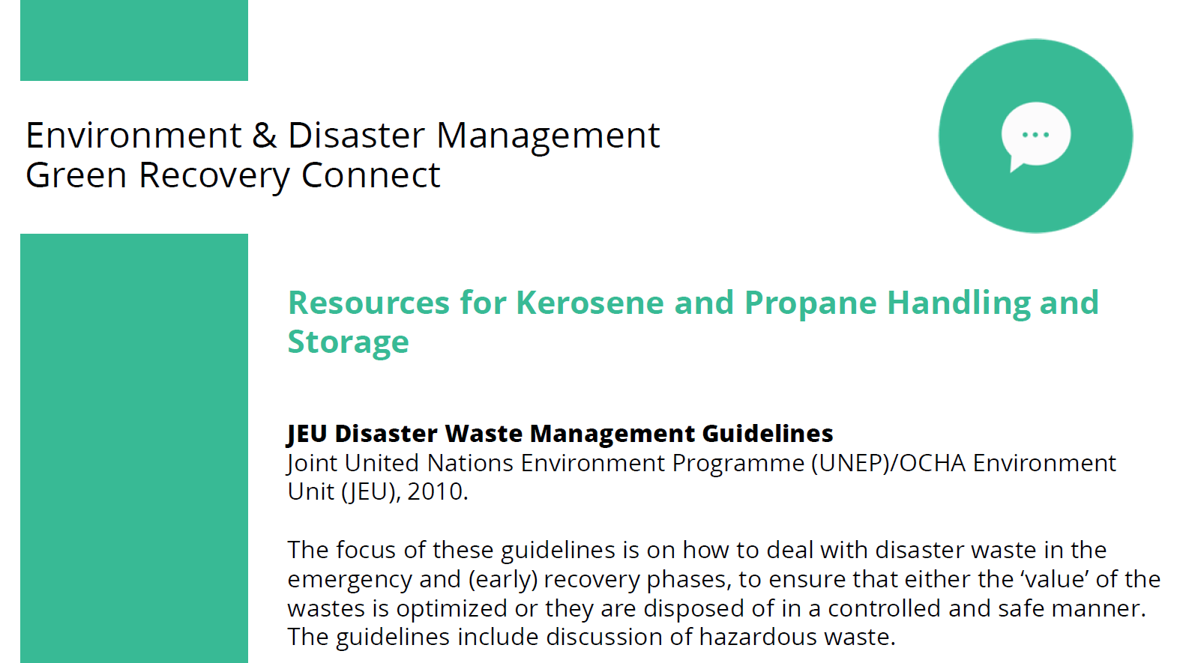
Resources for Kerosene and Propane Handling & Storage

Slide 12
Basic safety links on flammable liquid and gas storage and use
End user safety: National Fire Protection Association safety tips: http://www.nfpa.org/public-education/by-topic/safety-in-the-home/gasoline-and-propane/gasoline-at-home/gasoline-safety-tips
Safe gas cylinder handling: http://www.airproducts.com/~/media/files/pdf/company/safetygram-10.pdf
Storage and handling of flammable liquids: US Occupational Safety and Health Administration: https://www.osha.gov/dte/library/TrngandMatlsLib_FlammableLiquids.pdf
Secondary containment for storage: Section of USEPA spill prevention, control, and countermeasure guidance https://www.epa.gov/sites/production/files/2014-04/documents/4_secondarycontainment_impracticability_2014.pdf
Transportation guidance: US Department of Transportation https://www.transportation.gov/regulations/lists-significant-dot-guidance-documents
This site has links to guidance for all modes of transportation (rail, road, etc.).

Slide 13
5. Access Issues to East Mosul
There are now several access point to East Mosul:
Batella, Basika and Bybokt roads open
Are the districts of East Mosul in need of NFIs, SOKs or Shelter Kits?
Is there an issue with access?
What can the Cluster do to help facilitate access?
- Duty Governor of Ninewa coordination meeting on distributions has now been planned

Slide 14
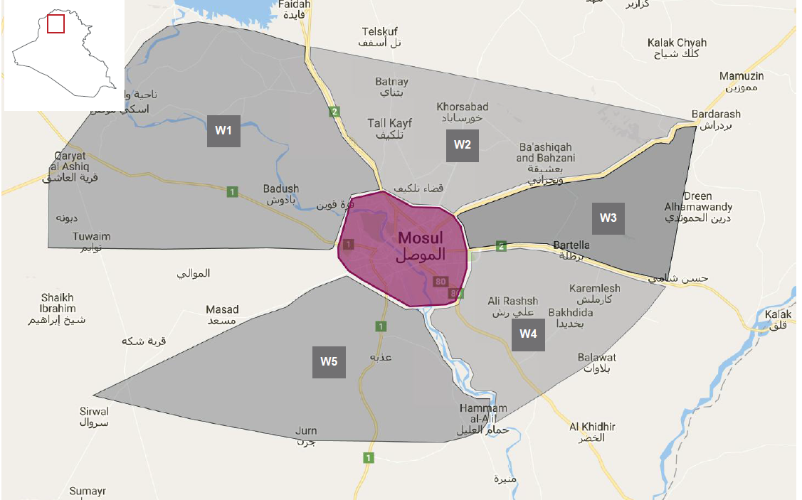
6. Areas of Activity within the Zones

Slide 15
7. AOB
Any Other Business?
Next meeting will be Wednesday 18th January, 11:30am, Ned Colt
http://sheltercluster.org/response/iraq

