Slide 1
Sub-National Shelter & NFI Cluster Coordination meeting for C &S
Agenda
Review of action points from previous meeting
Information Management updates
Mosul Preparedness and Response Updates
Update on 2017 HRP and planning process
Key Issues
Winterization , (Anbar)
Tent replacement, (Anbar)
Governorate and Agencies Updates
AOB
Wednesday, 11th January 2017
http://sheltercluster.org/response/iraq

Slide 2
Review of action points from previous meeting
Reminder to share winterisation plans and response – Done
Share tent replacement list with UNHCR for immediate action from UNHCR- Done
Follow up with MODM on Kerosene Distribution for Centre and South – received updates on Kerosene distribution , MODM has so far provided 50 liters of kerosene per family.
Activity Info reporting for month of December 2016 – Deadline was 5th January 2017
Share contact information for inclusion on Mosul Response Skype – Michel to Update
Share content of NRC winterization kit for out of camp distribution - Pending
Share ToR for Salah a Din Shelter and NFI Focal Point – Done
Report Mosul response activities on the Mosul Kobo response tool. Michel to Update
Share latest infographics and response on Mosul- Michel to Update

Slide 3
3. Information Management Update
Mosul responses have to be reported also into Activity Info which is the inter-cluster reporting platform.
Remember that all IM products and other relevant cluster supporting tool are available on the cluster webpage: http://sheltercluster.org/response/iraq
http://sheltercluster.org/response/iraq

Slide 4
Mosul Preparedness & Response Updates
Preparedness: 45 Partners are involved – but 37 partners are constantly updating their preparedness stocks. 8 partners are still not sharing their information.
Current preparedness infographic is been revised to reflect preparedness and response on one page document.
http://sheltercluster.org/response/iraq

Slide 5
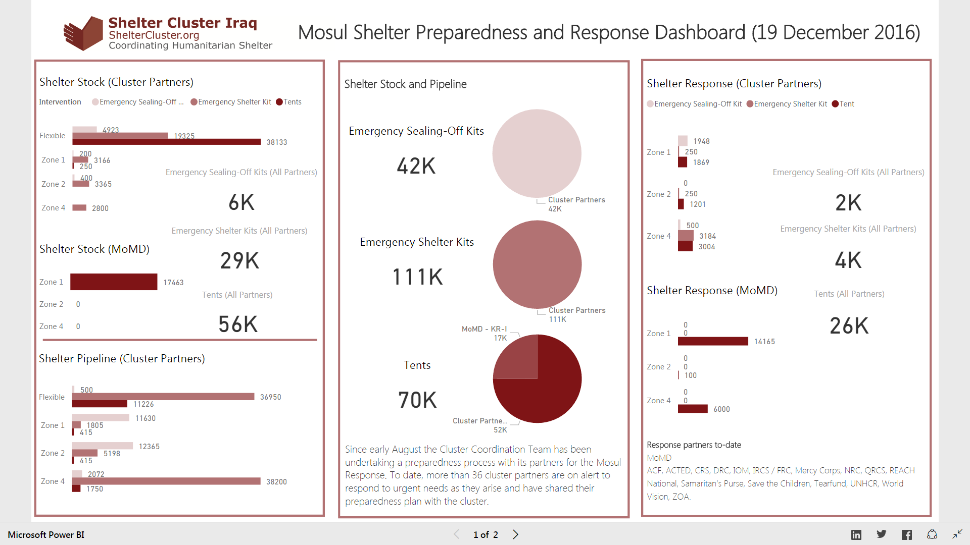
4. Review Mosul preparedness against response

Slide 6
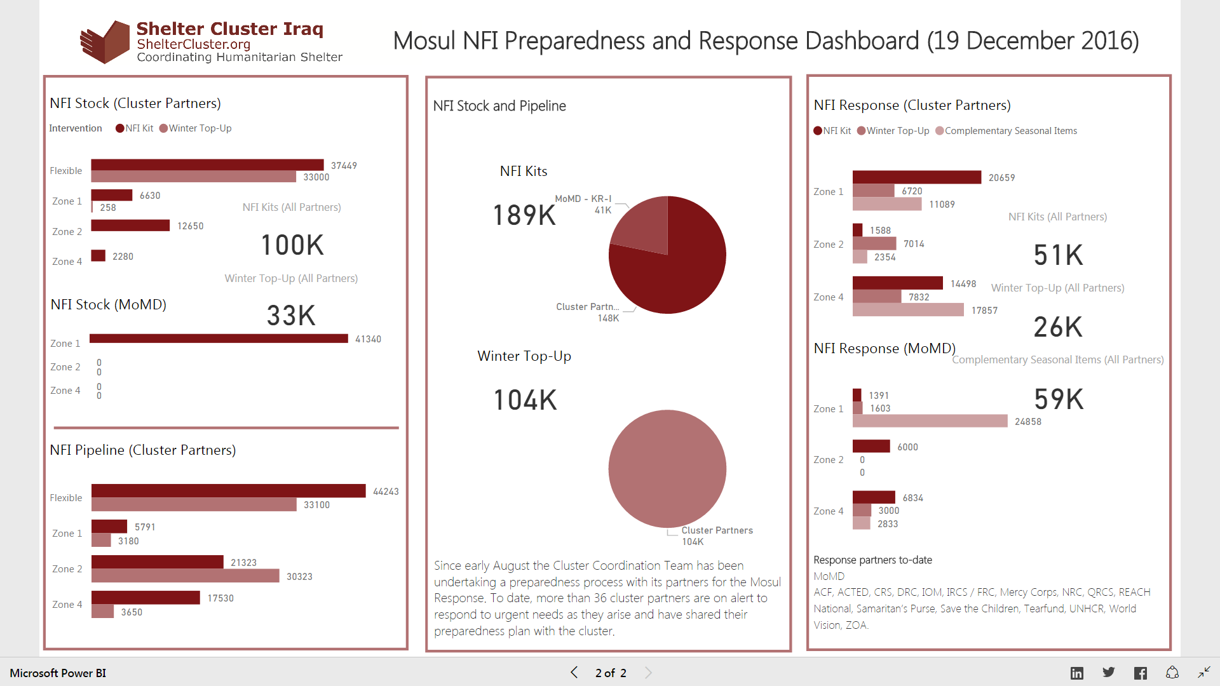
4. Review Mosul preparedness against response

Slide 7
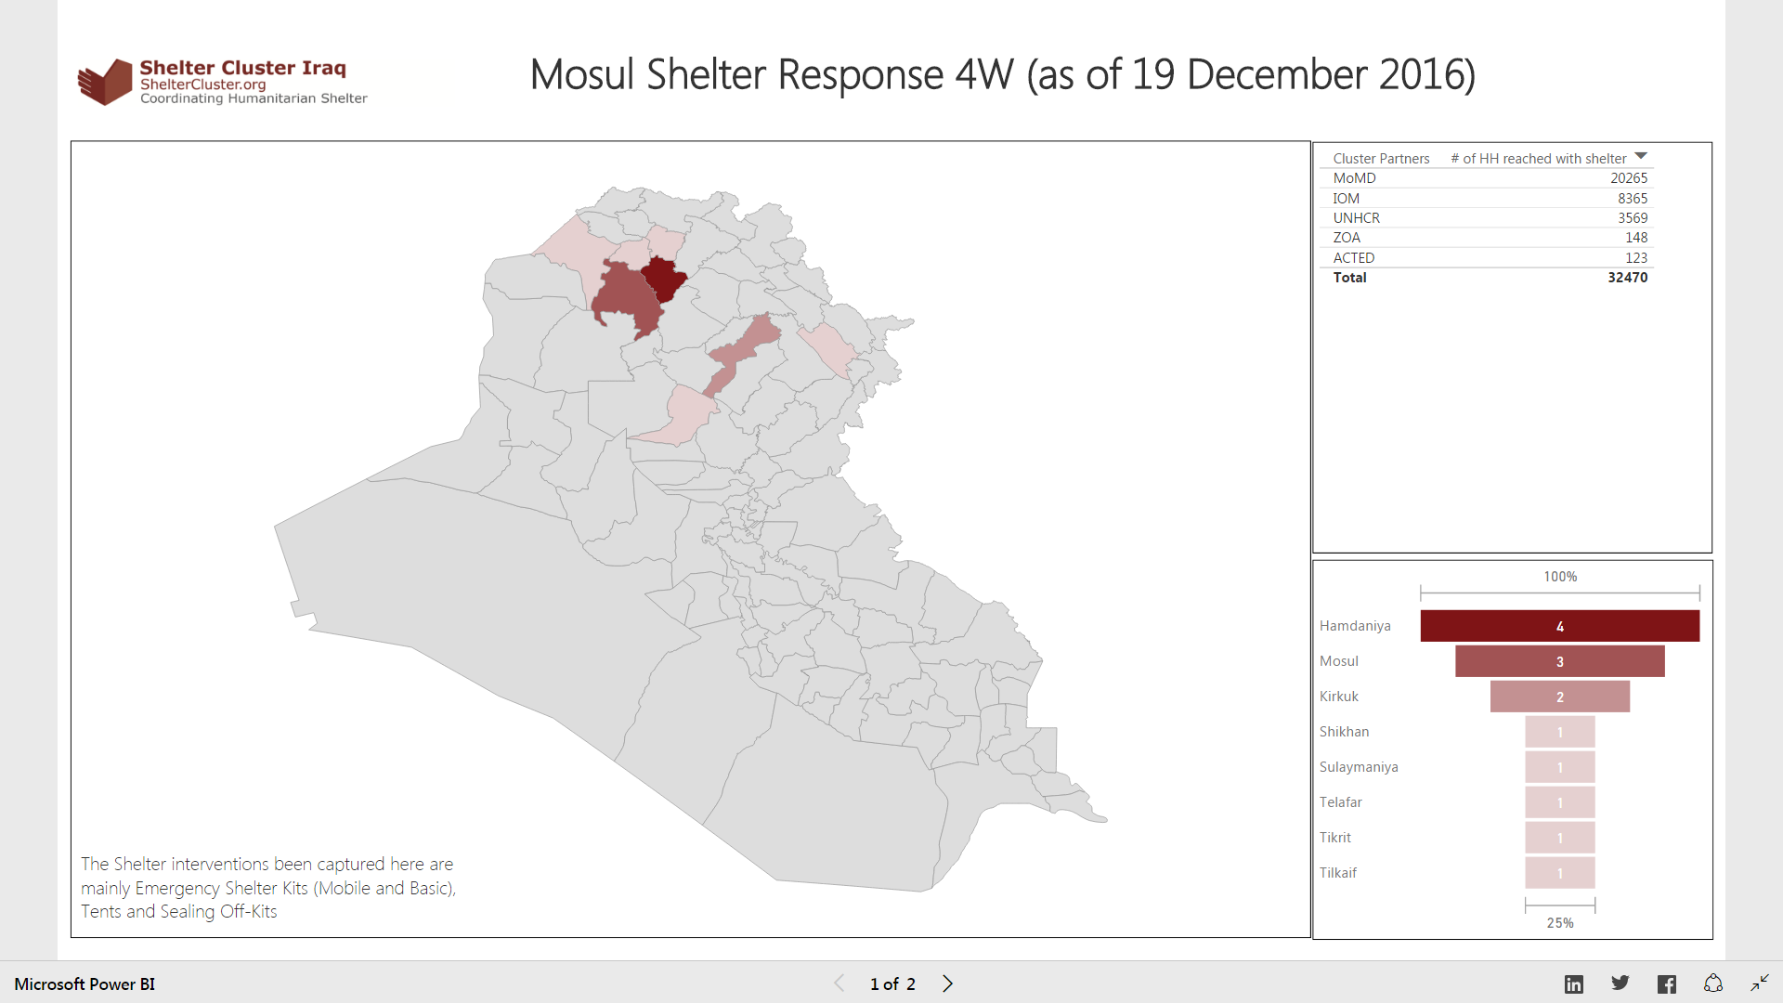

Slide 8
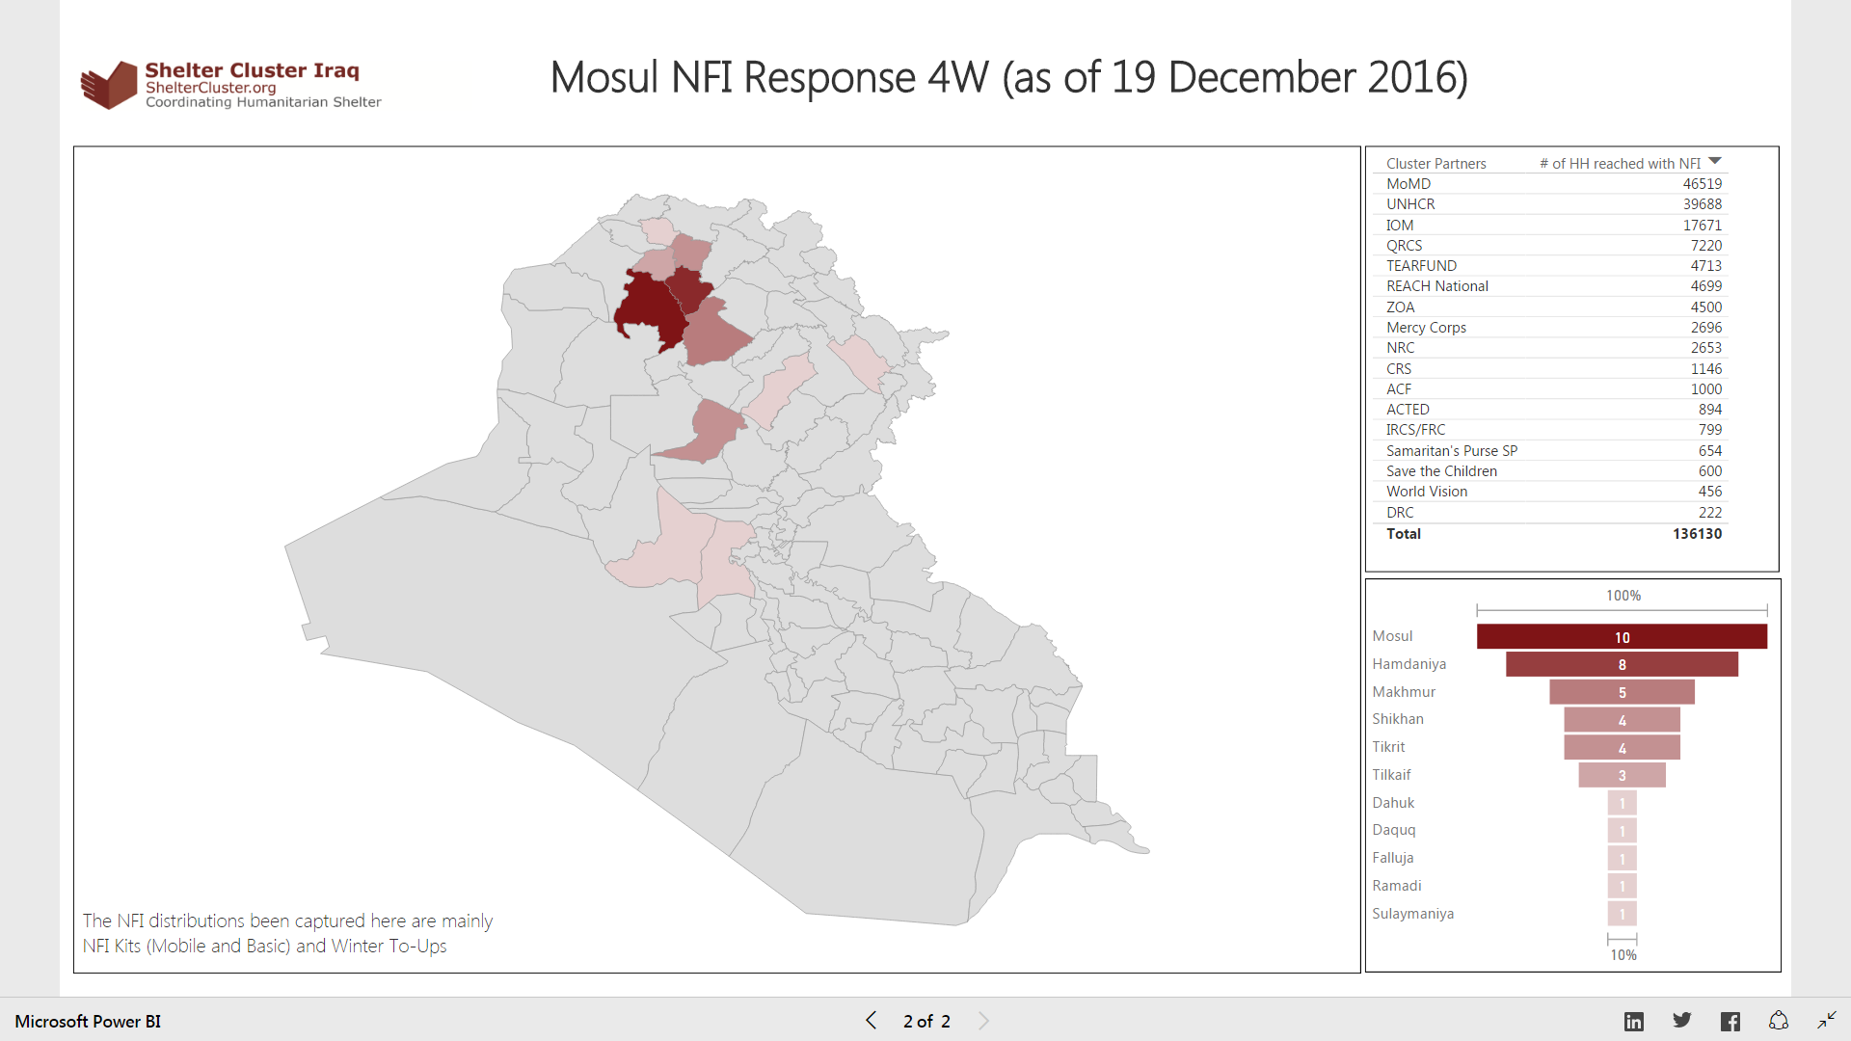

Slide 9
3. Review Mosul preparedness against response
Not started: No funding or no access to the location to implement
In pipeline: Purchase order signed / funding secured
In stock: In country and in warehouse
Pre-positioned: In sub-warehouse or at a set location (camp etc.) ready for distribution
Planned: Distribution plan for coming two weeks (when and where)
Completed: Distributed/implemented, should be uploaded via Kobo form
iom, jen, cnsf, qrcs, adra and acted have updated since last notice ☺
FRC, GRC, MHE, NRC, PIN, REACH, TEARFUND, WVI, ZOA, CRS, UIMS – have not ☹
We will consider excluding inputs older than 2 months after 5 January 2017, since otherwise the accuracy of the stock and pipeline figures cannot be guaranteed. In case your stock and/or pipeline has remained the same and you have nothing new to report, please let us know so we maintain your inputs in our records.

Slide 10
2. Update on HRP
An update was shared by the Cluster on website – http://www.sheltercluster.org/documents/hrp-update-shelter-and-nfi-cluster
Key dates:
OPS is open as of 17th December 2016 to start entering projects
15th January 2017 - OPS closes
16th – 19th Review of Projects
23rd January – Cluster Defence
26th January 2017 – finalisation of projects
Next Steps:
OCHA training
Cluster meetings to finalise strategy and activities
Review information needs, start to write narrative
Internal meetings to discuss scale, location and activities for 2017

Slide 11
Key Issues
Winterization,
Tent replacement ,
Only 4 Partners have shared winterizations plans so far:- UNHCR; NRC ,MHE and Islamic Relief Iraq. Partners are requested to share winterization plans and response.
UNHCR has replaced 500 tents for damaged of IDPS in Biez Biz area. 704 critical tents still needed.
MODM has so far 50 liters to every IDP family in center and south. UNHCR has also distributed 20 liters to some families in Anbar and has reported into activity info.
Islamic relief /Iraq will target Baghdad ( planning to cover all IDPs camps populations in Baghdad .
http://sheltercluster.org/response/iraq

Slide 12
Governorate and Agencies Updates

Slide 13
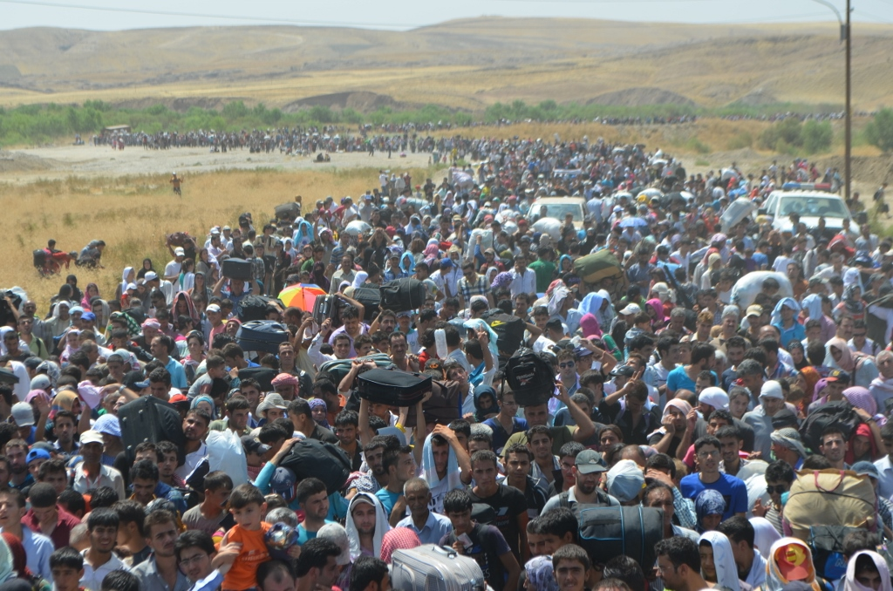
AOB

Slide 14
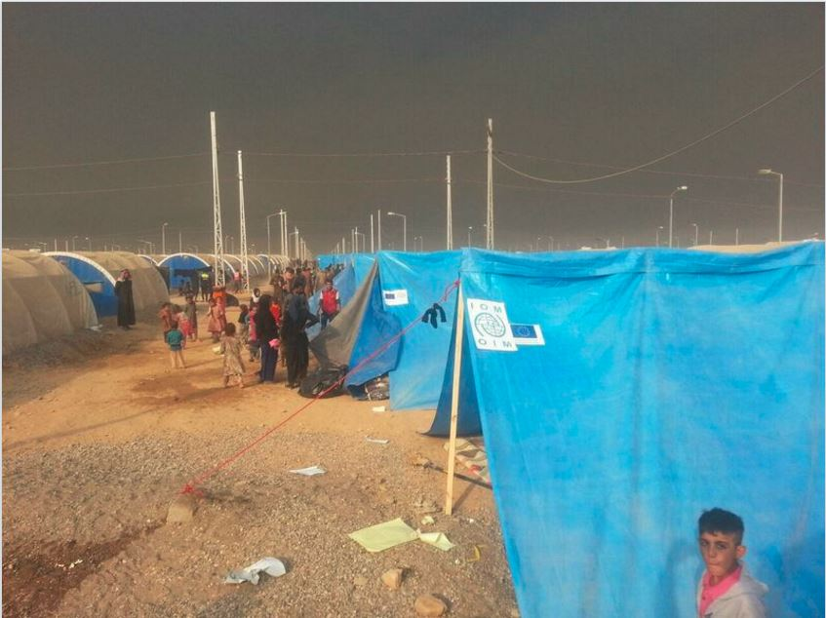
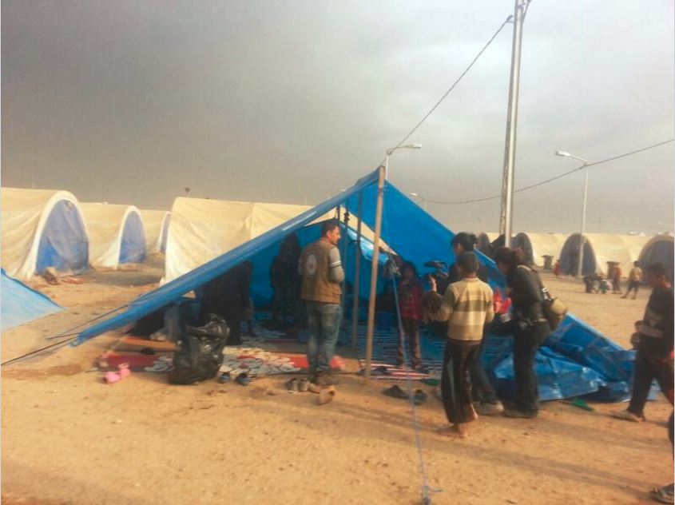
THANKS
http://sheltercluster.org/response/iraq

