Slide 1
Sub-National Shelter & NFI Cluster Coordination meeting for KR-I
Agenda
Introductions and Action Points
Update on 2017 HRP and planning process
Information Management
Cluster Technical Guidelines – Information
Mosul – Zone Central
CCCM update on camp situation
Global Shelter Cluster and training opportunity
Governorate and Agencies Updates
AOB
Wednesday, 18th January 2017
http://sheltercluster.org/response/iraq

Slide 2




1. Cluster Team Structure
Ryan Smith
Roving Cluster Coordinator (Duhok) - Zone 2 Focal Point
Catholic Relief Services
+964 (0) 751 755 8451
coordroving.iraq@sheltercluster.org
Richard Evans - UNHCR National Cluster Coordinator - Zone 4 Focal Point +964 (0) 771 994 5694 coord.iraq@sheltercluster.org Michel Tia - IOM Information Management Officer - National +964 (0) 750 021 1720 im2.iraq@sheltercluster.org Cornelius Weira - IOM Sub National Co-Chair - Centre and South Mobile +964 (0) 751 234 2548 coord4.iraq@sheltercluster.org | Michael Gloeckle - NRC National Co-Chair - Technical Coordinator - Zone 1 Focal Point +964 (0) 750 878 7793 coord2.iraq@sheltercluster.org Ryan Smith - Catholic Relief Services Dahuk & Zone 2 Focal Point +964 (0) 751 755 8451 coordroving.iraq@sheltercluster.org

Slide 3
1. Action Points from 4/1/17 meeting
Ryan Smith
Roving Cluster Coordinator (Duhok) - Zone 2 Focal Point
Catholic Relief Services
+964 (0) 751 755 8451
coordroving.iraq@sheltercluster.org
HRP nominations Preparedness Stocks Goggle sheet updated by agencies Please include access issues in the notes column within preparedness sheet for the time being. If required, SCT-IM can add it as a new category Cluster to review gas vs kerosene and provide some draft guidance Any ideas or needs for technical guidance – please send to Michael Review tent guideline and provide comments Request to partners to share any distributions guidelines Request to partners to provide any further details about obstacles, barriers etc. Request to partners to share areas of activity with the Cluster so we can put agencies against wedges

Slide 4
2. Update on HRP
An update was shared by the Cluster on website – http://www.sheltercluster.org/documents/hrp-update-shelter-and-nfi-cluster
Key dates:
OPS has now closed!!
18th & 19th Review of Projects
23rd January – Cluster Defence
24th – 26th: OPS will open for 2nd round of editing
26th January 2017 – finalisation of projects
How much $$$$:
Shelter Cluster is reviewing 74 projects, for 40 different agencies,
Total value is $336 million, last year envelope was $174 million. Cuts??
Shelter 2nd highest behind Food Security,
Total value = $1. 76 billion.

Slide 5
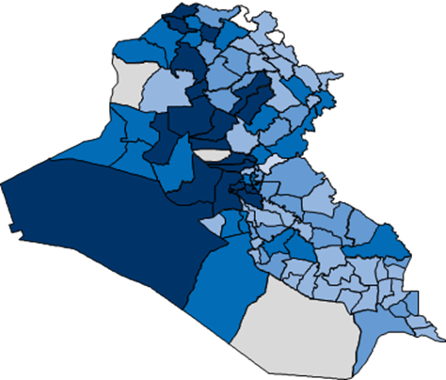
3. Information Management Update
2017 Humanitarian Need Overview (HNO): Severity Map & PiN.
Indicator | Weight
Presence of IDPs in camps | 2
Presence of IDPs in collective centres | 3
Presence of IDPs in host families | 1
Presence of IDPs in informal settlements | 3
Presence of IDPs in rented accommodation | 1
Presence of returnees | 2
Presence of IDPs in unfinished or abandoned buildings | 3
The map is based on DTM datasets (22 December 2016) for IDPs and returnees
http://sheltercluster.org/response/iraq

Slide 6
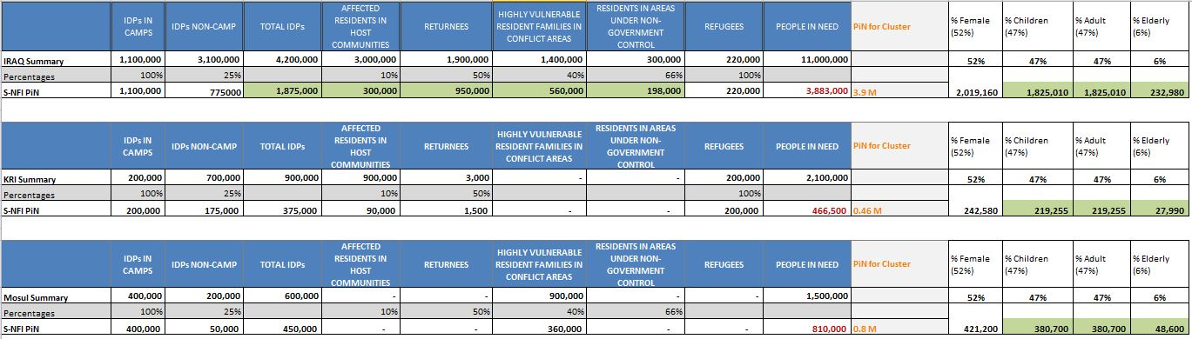
3. Information Management Update
2017 Humanitarian Need Overview (HNO): Severity Map & PiN.
The percentage we’re using here are from UNICEF analysis on All year IDPs, based on Population estimates based on IOM Assessments (March 2015) and REACH MCNA (March 2015).
http://sheltercluster.org/response/iraq

Slide 7
3. Information Management Update
Currently : working on new operational indicators to be uploaded into 2017 Activity Info.
Shelter and NFI Cluster will have a separate database in Activity Info but linked to the Inter-cluster one.
The reason is because of our Mandatory Cluster Generic attributes
Where: governorate, district, camp, emergency site, out of camp, zone + GPS : Already included in the Databases
Activity status: planned, ongoing, completed
Modality: In kind / Cash
Cash-based intervention type: voucher, conditional cash
Average Cost of Intervention: IQD
Average Cost of Intervention: USD
When: reporting date, start date, completion date
Mosul responses have to be reported also into Activity Info which is the inter-cluster reporting platform.
Remember that all IM products and other relevant cluster supporting tool are available on the cluster webpage: http://sheltercluster.org/response/iraq
http://sheltercluster.org/response/iraq

Slide 8
3. Information Management Update
Review Mosul preparedness against response
Not started: No funding or no access to the location to implement
In pipeline: Purchase order signed / funding secured
In stock: In country and in warehouse
Pre-positioned: In sub-warehouse or at a set location (camp etc.) ready for distribution
Planned: Distribution plan for coming two weeks (when and where)
Completed: Distributed/implemented, should be uploaded via Kobo form
Updated Infographics/Dashboards and 3W

Slide 9
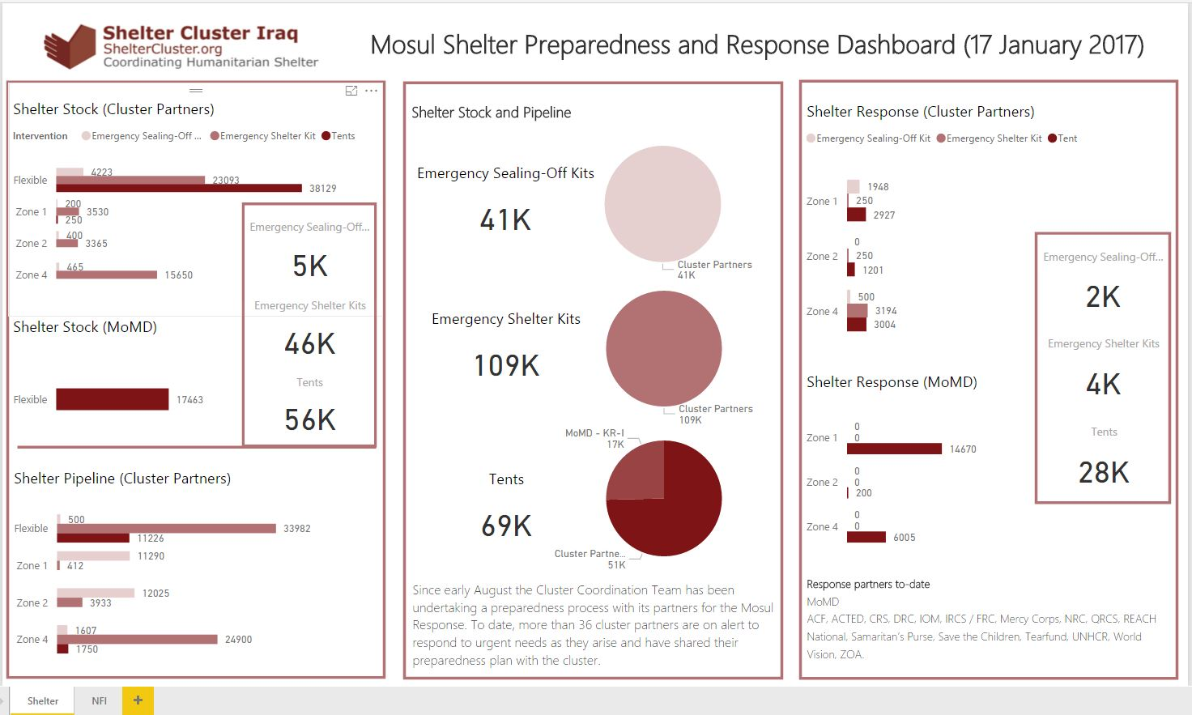

Slide 10
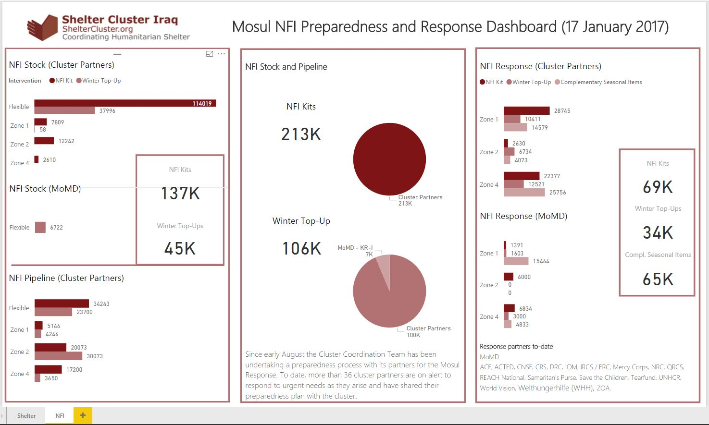

Slide 11
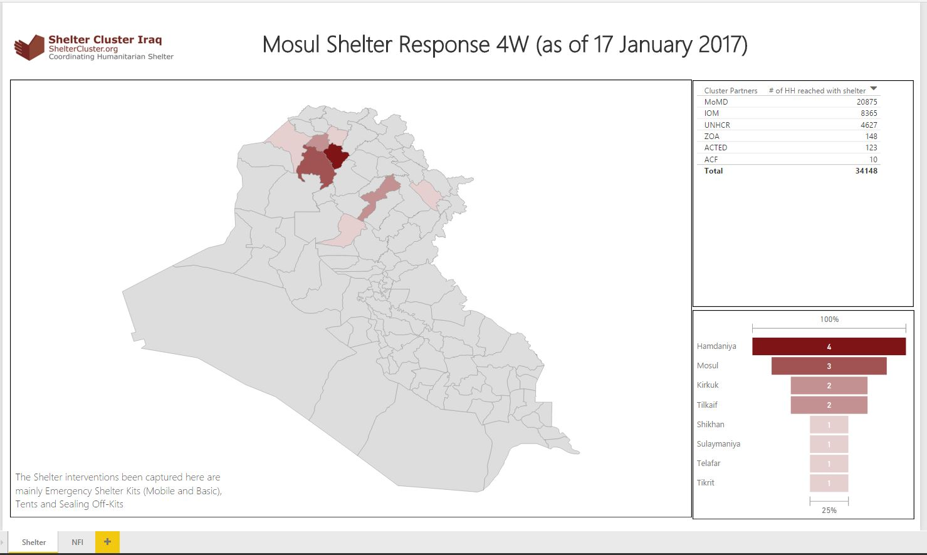

Slide 12
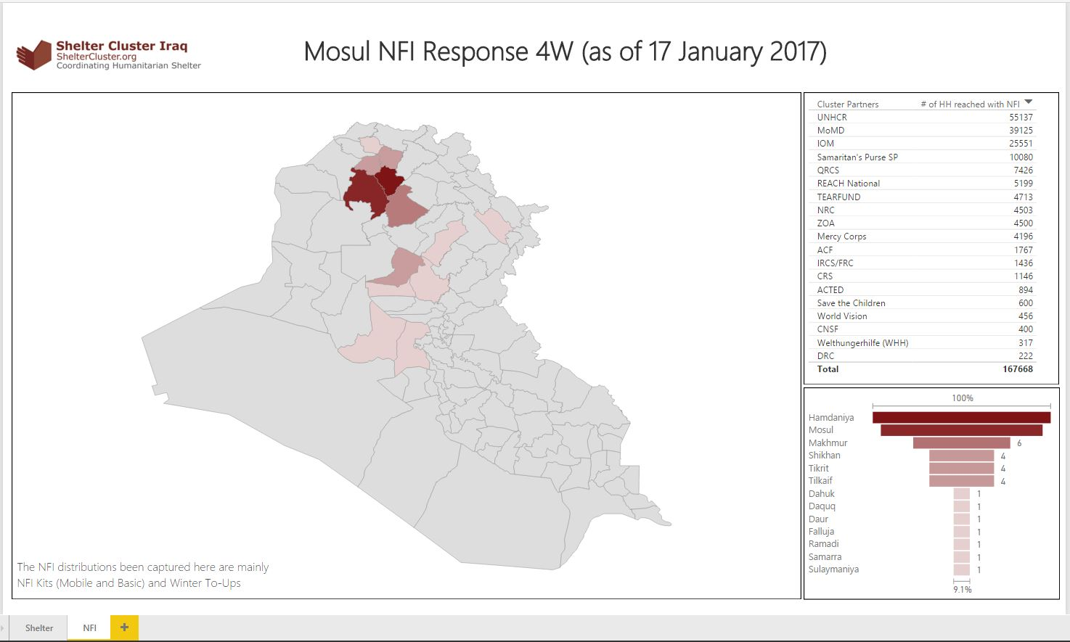

Slide 13
4. Cluster Technical Guidelines – Information
New resources on website:
Resources for Kerosene, Propane and other flammable liquid and gas storage and use
Waiting for SAG approval:
Tent Information note (no comments were received)
Under preparation:
Kerosene versus LPG Gas Cooking Stove Information Note
Climatisation Guidelines – winter and summer

Slide 14
4. Cluster Technical Guidelines – Information
“Tools to Reduce the Risk of Gender Based Violence (GBV) in Shelter Programmes”, guidance document for shelter actors:
http://sheltercluster.org/sites/default/files/docs/gbvtoolkit-trial_edition-web_version.pdf (please provide feedback to gbv@sheltercluster.org)
Video developed by Global Shelter Cluster on safe distributions:
https://www.youtube.com/watch?v=_y35Er-uCtU
Any other requests?

Slide 15
Mosul City Response:
Update by Zone Central Coordinator
Stuart Shepherd
shepherds@un.org
+964 751 740 3577

Slide 16
6. CCCM Update on Camp Situation

Slide 17

7. Global Shelter Cluster
Conflict
Natural Disasters
Deployment of Global and Roving Focal Points for Coordination and Technical Coord.
To set-up clusters until longer-term team is deployed
To cover gaps
For training or reinforcement
35 GSC partners
SAG
Support team
Rosters
Deployment of Assessment Coordinator and GIS database to implement a joint detailed assessment.
Notes:
As you know the Global Shelter Cluster is co-lead by UNHCR and IFRC. IFRC is the convener for natural disasters and UNHCR the lead for conflict emergencies.
There are around 30 partners of the GSC including NGOs, Red Cross Red Crescent, and UN Agencies.

Slide 18
15th Edition - Humanitarian Shelter Coordination
Application deadline: 5th February 2017
Start date: 27th February 2017
First phase: Tutored distance learning: This will take place during a period of five weeks (27 February - 2 April 2017) and participants will study through the online Red Cross Red Crescent e-learning platform. This first phase deals with most of the theoretical basis of the course.
Second phase: A 6-day face to face workshop (from 24 to 29 April 2017 in Geneva, Switzerland). The face to face workshop is based on a scenario that simulates the deployment to and coordination of an evolving emergency.
https://www.sheltercluster.org/events/14th-edition-humanitarian-shelter-coordination-master-level-short-course

Slide 19
8. AOB
Any Other Business?
Next meeting will be Wednesday 1st February, 11:30am at NCCI?
http://sheltercluster.org/response/iraq

