Slide 1
Sub-National Shelter & NFI Cluster Coordination meeting for C &S
Agenda
Review of action points from previous meeting
Information Management updates / Mosul Preparedness and Response Updates
Update on 2017 HRP and planning process
Key Issues
  Winterization, (Anbar)
    Kerosene for out of camp (Who is doing it?)
  Tent replacement, (Anbar)
    No Report from MODM (3,000 tents replaced in Anbar)
Governorate and Agencies Updates
AOB
Wednesday, 25th January 2017
http://sheltercluster.org/response/iraq

Slide 2
Review of action points from previous meeting
Follow up with Colleagues in Erbil on EU in kind Shelter items for possible tent replacement in Anbar – Done ( No in kind tents at the moment)
Follow up with MODM on list of Kerosene distribution – MODM has so far distributed 3,000 Tents in Anbar
Follow up on list of Kerosene distributions by UNHCR – Done ( UNHCR provided list)
Monthly reporting into activity info – On going
Share latest infographics – Done
Upload 2017 HRP Partner proposals into the OPS , each line of response will be a separate proposal (Done)
Send email to Islamic Relief and NRC on winter kits distributions in Baghdad - Done
Share winter distribution reports with cluster – NRC /UNHCR have shared

Slide 3
2. Information Management Update
2016 Cluster achievements and funding status
Special Mosul Preparedness and Response
2017 HRP / HNO
  Severity Map
  PiN
  Reporting – Cluster Indicators and Activity Info
http://sheltercluster.org/response/iraq

Slide 4
2. Information Management Update
2016 Cluster achievements (Jan. – Dec.) | 2016 Funding Status (Jan. – Dec.)
Target Initial: 1.1 M Review (Falluja & Mosul): 1.3 M | Request: $290 M HRP: $180 M Mosul Flash Appel: $110 M
Reached NFI Kits: 1.3 M Shelter Interventions: 0.5M | Funded: $100.2 M HRP: $80.1 M (44.6% of requirement) Mosul Flash Appel: $20.1 M (18.3% of requirement)
Dashboard | Dashboard not yet completed: will show Donors, Partners, Projects and Funding status.
http://sheltercluster.org/response/iraq

Slide 5
2. Information Management Update
Review Mosul preparedness against response
Not started: No funding or no access to the location to implement
In pipeline: Purchase order signed / funding secured
In stock: In country and in warehouse
Pre-positioned: In sub-warehouse or at a set location (camp etc.) ready for distribution
Planned: Distribution plan for coming two weeks (when and where)
Completed: Distributed/implemented, should be uploaded via Kobo form
Updated Master Sheet, Infographics/Dashboards and 3W

Slide 6
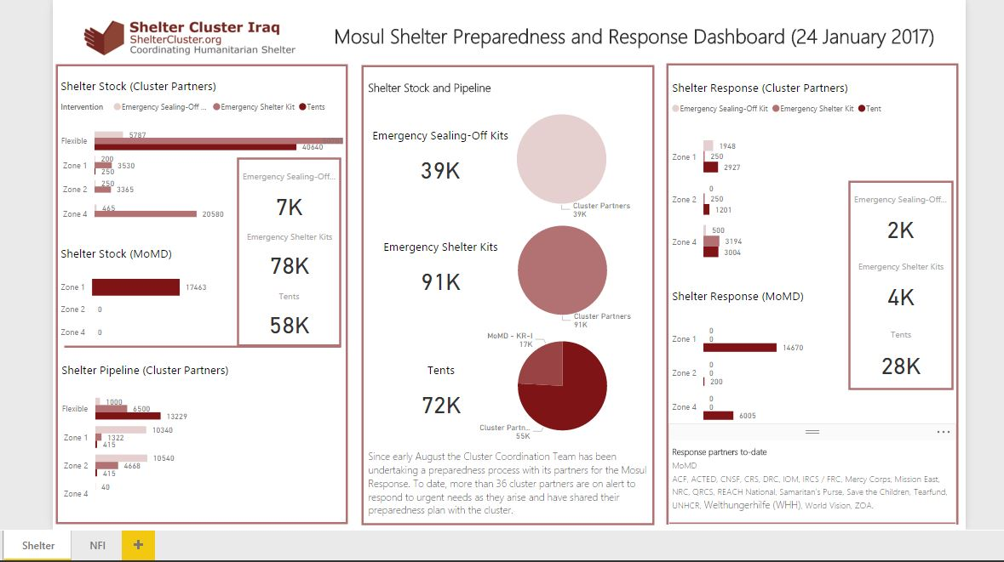

Slide 7
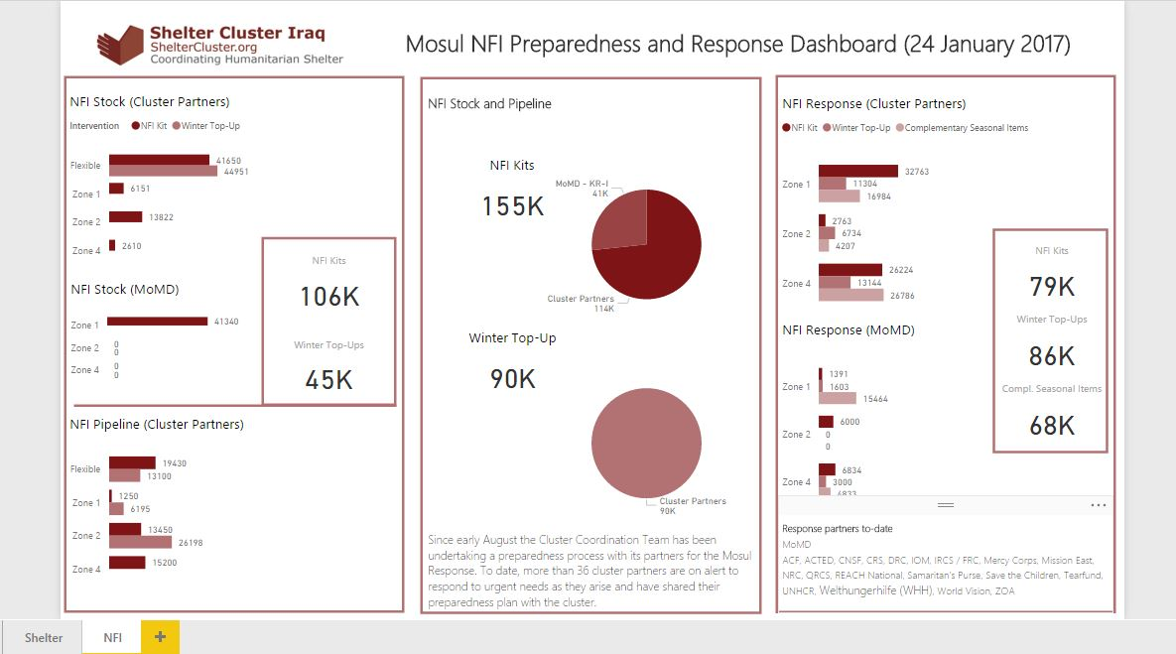

Slide 8
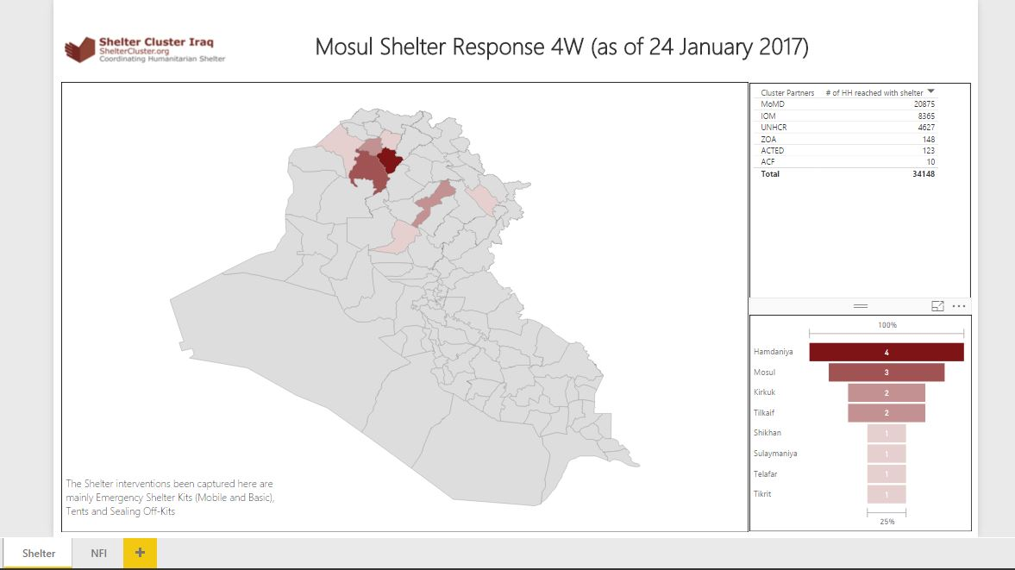

Slide 9
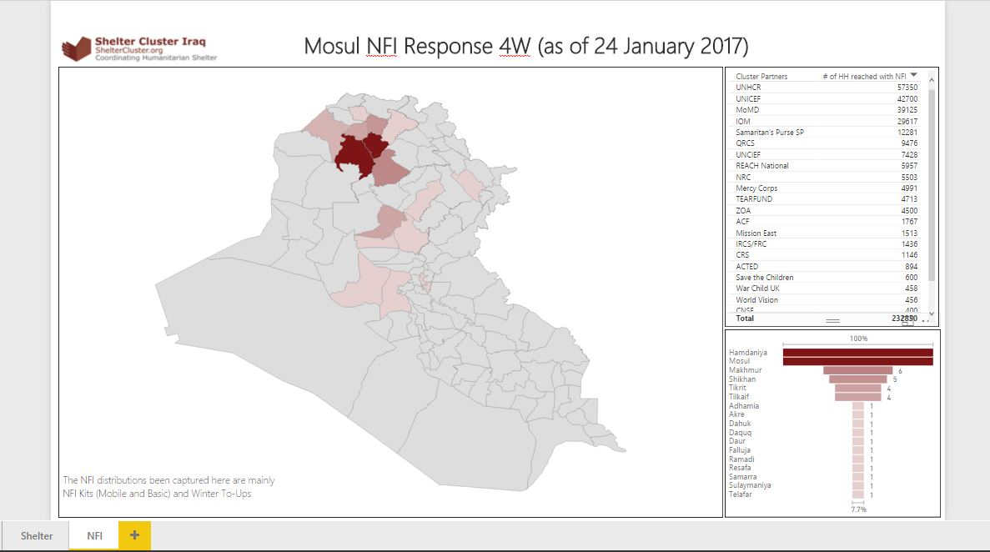

Slide 10
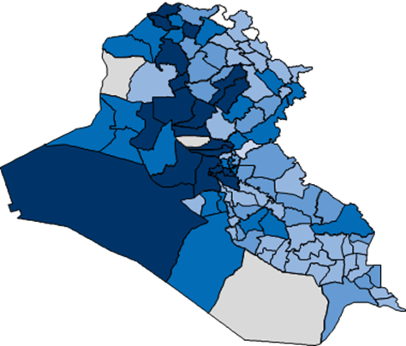
2. Information Management Update
2017 Humanitarian Need Overview (HNO): Severity Map & PiN.
Indicator | Weight
Presence of IDPs in camps | 2
Presence of IDPs in collective centres | 3
Presence of IDPs in host families | 1
Presence of IDPs in informal settlements | 3
Presence of IDPs in rented accommodation | 1
Presence of returnees | 2
Presence of IDPs in unfinished or abandoned buildings | 3
The map is based on DTM datasets (22 December 2016) for IDPs and returnees
http://sheltercluster.org/response/iraq

Slide 11
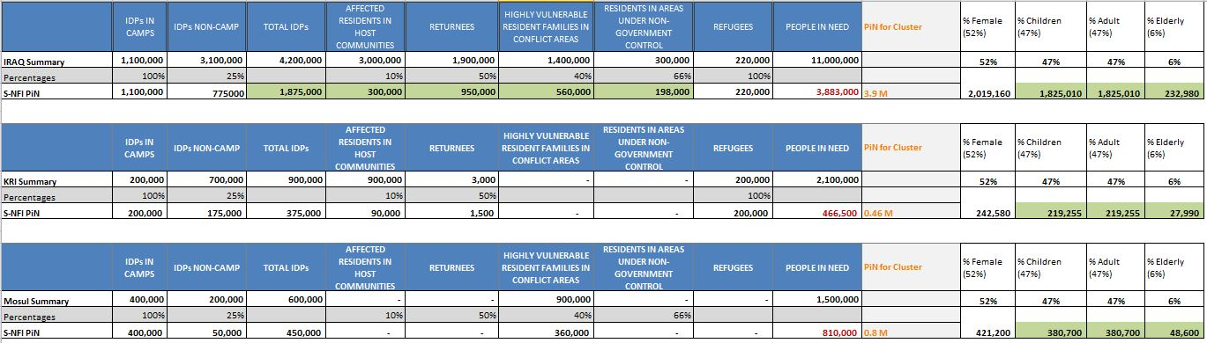
2. Information Management Update
2017 Humanitarian Need Overview (HNO): Severity Map & PiN.
The percentage we’re using here are from UNICEF analysis on All year IDPs, based on Population estimates based on IOM Assessments (March 2015) and REACH MCNA (March 2015).
http://sheltercluster.org/response/iraq

Slide 12
2. Information Management Update
  Reporting – Cluster Indicators and Activity Info
  Cluster operational indicators to be uploaded into 2017 Activity Info: will be shared once completed
  Shelter and NFI Cluster will have a separate database in Activity Info but linked to the Inter-cluster one.
  No 4W matrix will be developed in 2017 / only Into Activity Info as the inter-cluster reporting platform.
Remember that all IM products and other relevant cluster supporting tool are available on the cluster webpage: http://sheltercluster.org/response/iraq
http://sheltercluster.org/response/iraq

Slide 13
3. Update on 2017 HRP and planning process
An update was shared by the Cluster on website – http://www.sheltercluster.org/documents/hrp-update-shelter-and-nfi-cluster
Defense was completed on 23rd January
Feedback has been received partners with recommended projects have been contacted.
Final changes in OPS to be made by 28th January.

Slide 14
4. Cluster Key Issues
Winterization
Kerosene for out of camp (Who is doing it?)
UNHCR and MODM in Camps (Gaps in Anbar)
Camp 32 (Shuhada Camp – 400 Families)
Camp 11 (Caravan Camp 580 families)
Camp 6 (UM Al Quraa camp 180 Families)
Suzan Camp 270 Families
camp 33 (Abrar 100 Families)
Biez Bieze , sector 1,2, 3 and 4
Kilo 18 - 500 Families not covered
Kahlidiya camp 10 – 180 Families not covered
Khalidiyah Camp 14. 100 Families .
Tent replacement
  No Report from MODM (3,000 tents replaced in Anbar)
  Lists of receiving camps to be obtained
http://sheltercluster.org/response/iraq

Slide 15
5. Governorate and Agencies Updates

Slide 16
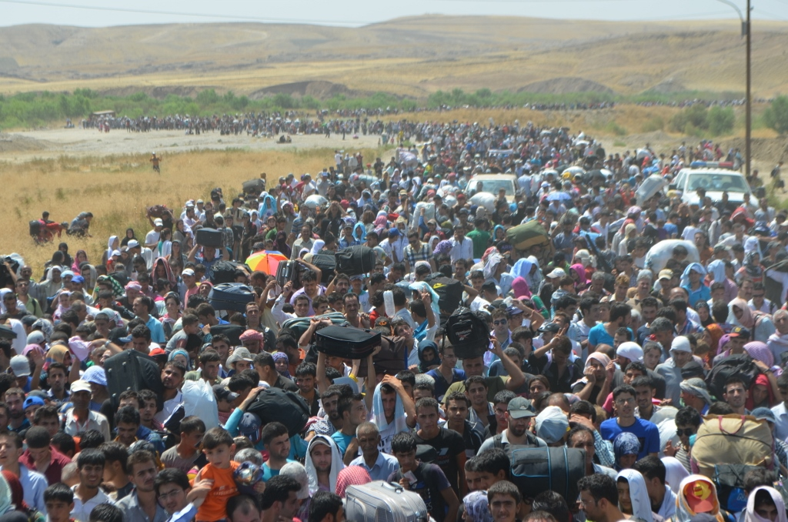
6. AOB

Slide 17
Cluster Technical Guidelines – Information
New resources on website:
Resources for Kerosene, Propane and other flammable liquid and gas storage and use
Waiting for SAG approval:
Tent Information note (no comments were received)
Under preparation:
Kerosene versus LPG Gas Cooking Stove Information Note
Climatisation Guidelines – winter and summer

Slide 18
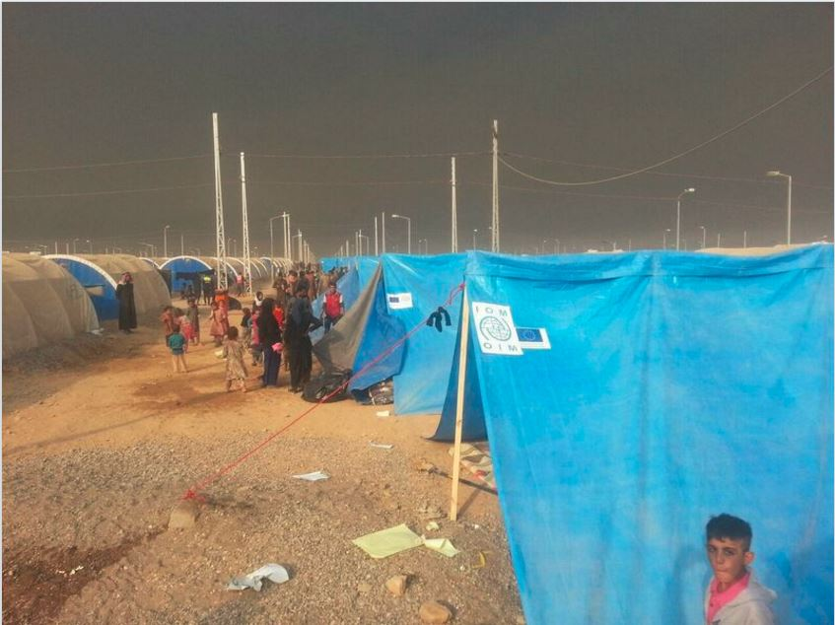
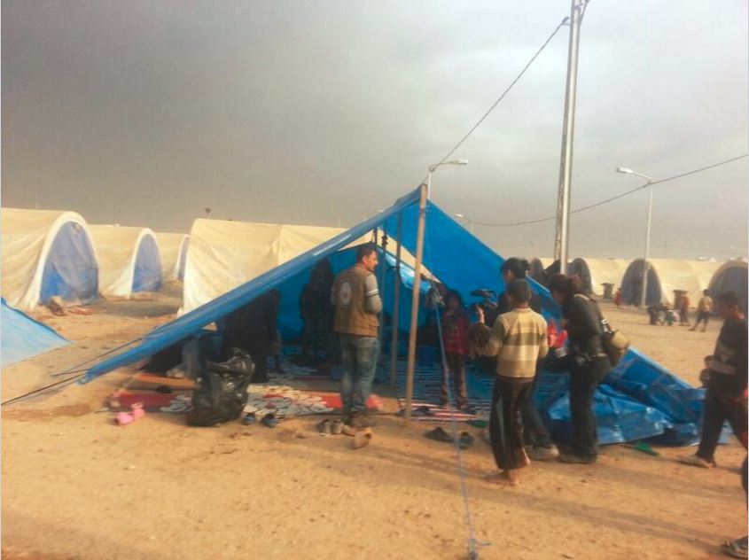
THANKS
http://sheltercluster.org/response/iraq

