Slide 1
Sub-National Shelter & NFI Cluster Coordination meeting for KR-I
Agenda
Introductions and Action Points
Update on 2017 HRP
Information Management
Cluster Technical Guidelines – Information
ESKs
Distribution Guidelines
Global Shelter Cluster and training opportunity
AOB
Wednesday, 1st February 2017
http://sheltercluster.org/response/iraq

Slide 2




0. Cluster Team Structure
Ryan Smith
Roving Cluster Coordinator (Duhok) - Zone 2 Focal Point
Catholic Relief Services
+964 (0) 751 755 8451
coordroving.iraq@sheltercluster.org
Richard Evans - UNHCR National Cluster Coordinator - Zone 4 Focal Point +964 (0) 771 994 5694 coord.iraq@sheltercluster.org Michel Tia - IOM Information Management Officer - National +964 (0) 750 021 1720 im2.iraq@sheltercluster.org Cornelius Weira - IOM Sub National Co-Chair - Centre and South Mobile +964 (0) 751 234 2548 coord4.iraq@sheltercluster.org | Michael Gloeckle - NRC National Co-Chair - Technical Coordinator - Zone 1 Focal Point +964 (0) 750 878 7793 coord2.iraq@sheltercluster.org Shada Qahoush- Catholic Relief Services Ninewa & Mosul Focal Point +964 (0) 751 755 8451 coordroving.iraq@sheltercluster.org

Slide 3
1. Action Points from 19/01/17 meeting
Ryan Smith
Roving Cluster Coordinator (Duhok) - Zone 2 Focal Point
Catholic Relief Services
+964 (0) 751 755 8451
coordroving.iraq@sheltercluster.org
CCCM Cluster Coordinator (Mosul response): Veronica Costarelli, COSTAREL@unhcr.org, 0773 419 8351
Logistics Cluster Coordinator: Julie Vander Wiel: 0780 915 6204 Julie.vanderwiel@wfp.org,
CMCOORD for access issues: lindent@un.org, 0751 135 2884
UNHCR ESKs for distribution by partners: Fern Tilakamonkul Dunnapar, tilakamo@unhcr.org
Revised contacts for Mosul:
East Mosul - William Strangio : 0751 135 2877 - strangio@un.org
West Mosul - Nasr Muflahi : 0782 780 6727 - muflahi@un.org

Slide 4
2. Update on HRP
OVERVIEW OF 2017 PROJECTS AND REQUIREMENTS
Original Value of all submissions (USD): | 340,236,141
Final Value of Requested Portfolio (USD): | 175,313,708
Original Number of projects: | 82
Final # of Projects approved in recommended Portfolio: | 52
# of Total Partners in portfolio: | 29
# of National Partners in portfolio: | 6
Final Financial Requirements in KR-I (USD) | 41,918,452
Final Financial Requirements – Mosul Response (USD) | 59,515,318
Final Financial Requirements in the Rest of Iraq (USD) | 73,879,938
Final Financial Requirements – First Line Activities (USD) | 98,386,943
Final Financial Requirements – Second Line Activities (USD) | 65,667,247
Final Financial Requirements – Full Cluster Response (USD) | 11,259,517

Slide 5
3. Information Management Update
2016 Cluster achievements and funding status
Special Mosul Preparedness and Response
2017 HRP / HNO
Indicators / Target
Reporting – Cluster Indicators and Activity Info
http://sheltercluster.org/response/iraq

Slide 6
3. Information Management Update
2016 Cluster achievements (Jan. – Dec.) | 2016 Funding Status (Jan. – Dec.)
Target Initial: 1.1 M Review (Falluja & Mosul): 1.3 M | Request: $290 M HRP: $180 M Mosul Flash Appel: $110 M
Reached NFI Kits: 1.3 M Shelter Interventions: 0.5M | Funded: $100.2 M HRP: $80.1 M (44.6% of requirement) Mosul Flash Appel: $20.1 M (18.3% of requirement)
Dashboard | Dashboard not yet completed: will show Donors, Partners, Projects and Funding status.
http://sheltercluster.org/response/iraq

Slide 7
3. Information Management Update
Review Mosul preparedness against response
Not started: No funding or no access to the location to implement
In pipeline: Purchase order signed / funding secured
In stock: In country and in warehouse
Pre-positioned: In sub-warehouse or at a set location (camp etc.) ready for distribution
Planned: Distribution plan for coming two weeks (when and where)
Completed: Distributed/implemented, should be uploaded via Kobo form
Updated Master Sheet, Infographics/Dashboards and 3W

Slide 8
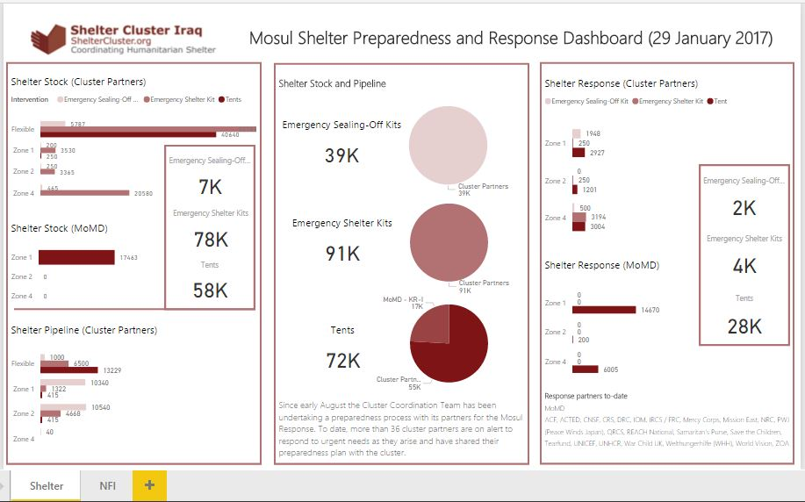

Slide 9
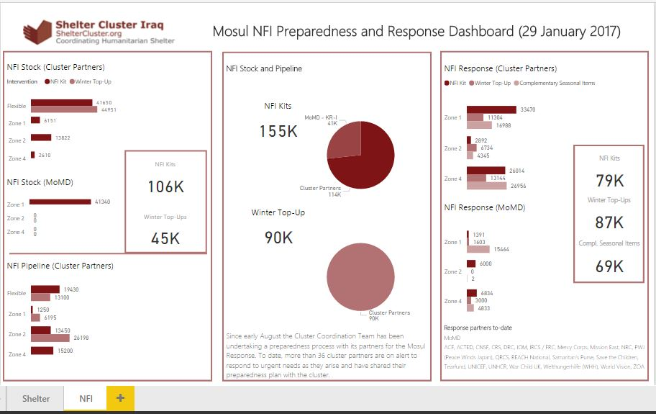

Slide 10
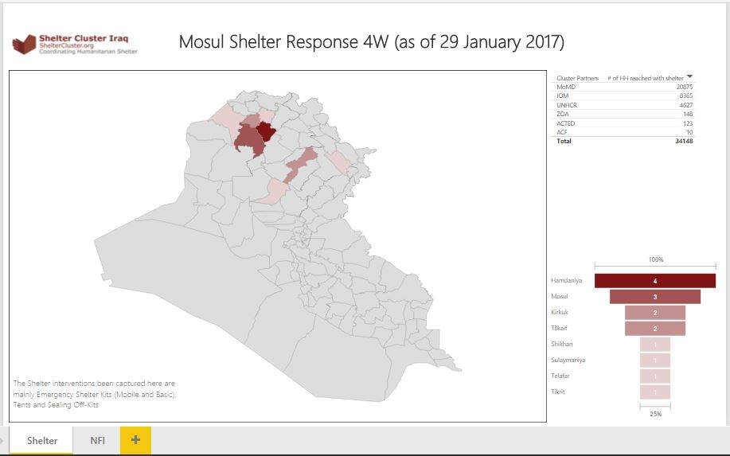

Slide 11
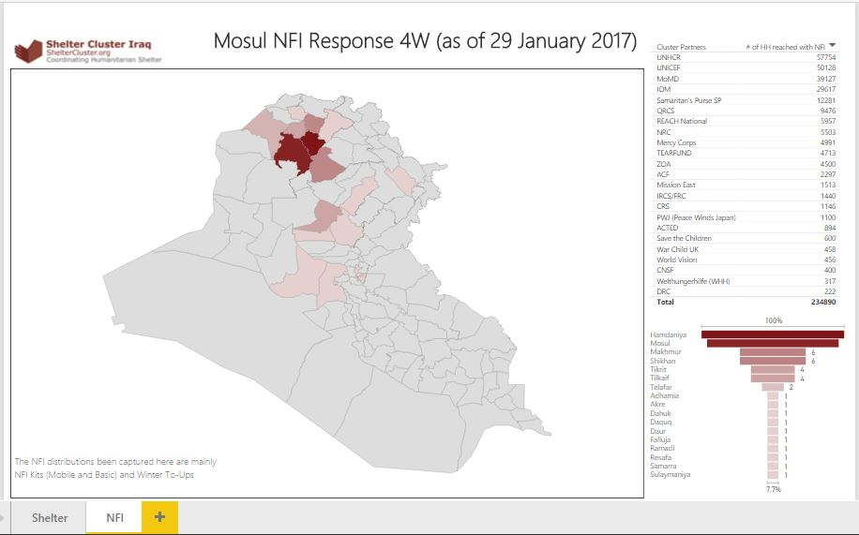

Slide 12
3. Information Management Update
Reporting – Cluster Indicators and Activity Info
Cluster operational indicators to be uploaded into 2017 Activity Info: will be shared once completed
Shelter and NFI Cluster will have a separate database in Activity Info but linked to the Inter-cluster one.
No 4W matrix will be developed in 2017 / only Into Activity Info as the inter-cluster reporting platform.
Remember that all IM products and other relevant cluster supporting tool are available on the cluster webpage: http://sheltercluster.org/response/iraq
http://sheltercluster.org/response/iraq

Slide 13
4. Cluster Technical Guidelines – Information
New resources on website:
Resources for Kerosene, Propane and other flammable liquid and gas storage and use
Kerosene versus LPG Gas Cooking Stove Information Note
Tent Information note (no comments were received)
Under preparation:
Climatisation Guidelines – winter and summer
NFI Guidelines v11 – will be sent out today

Slide 14
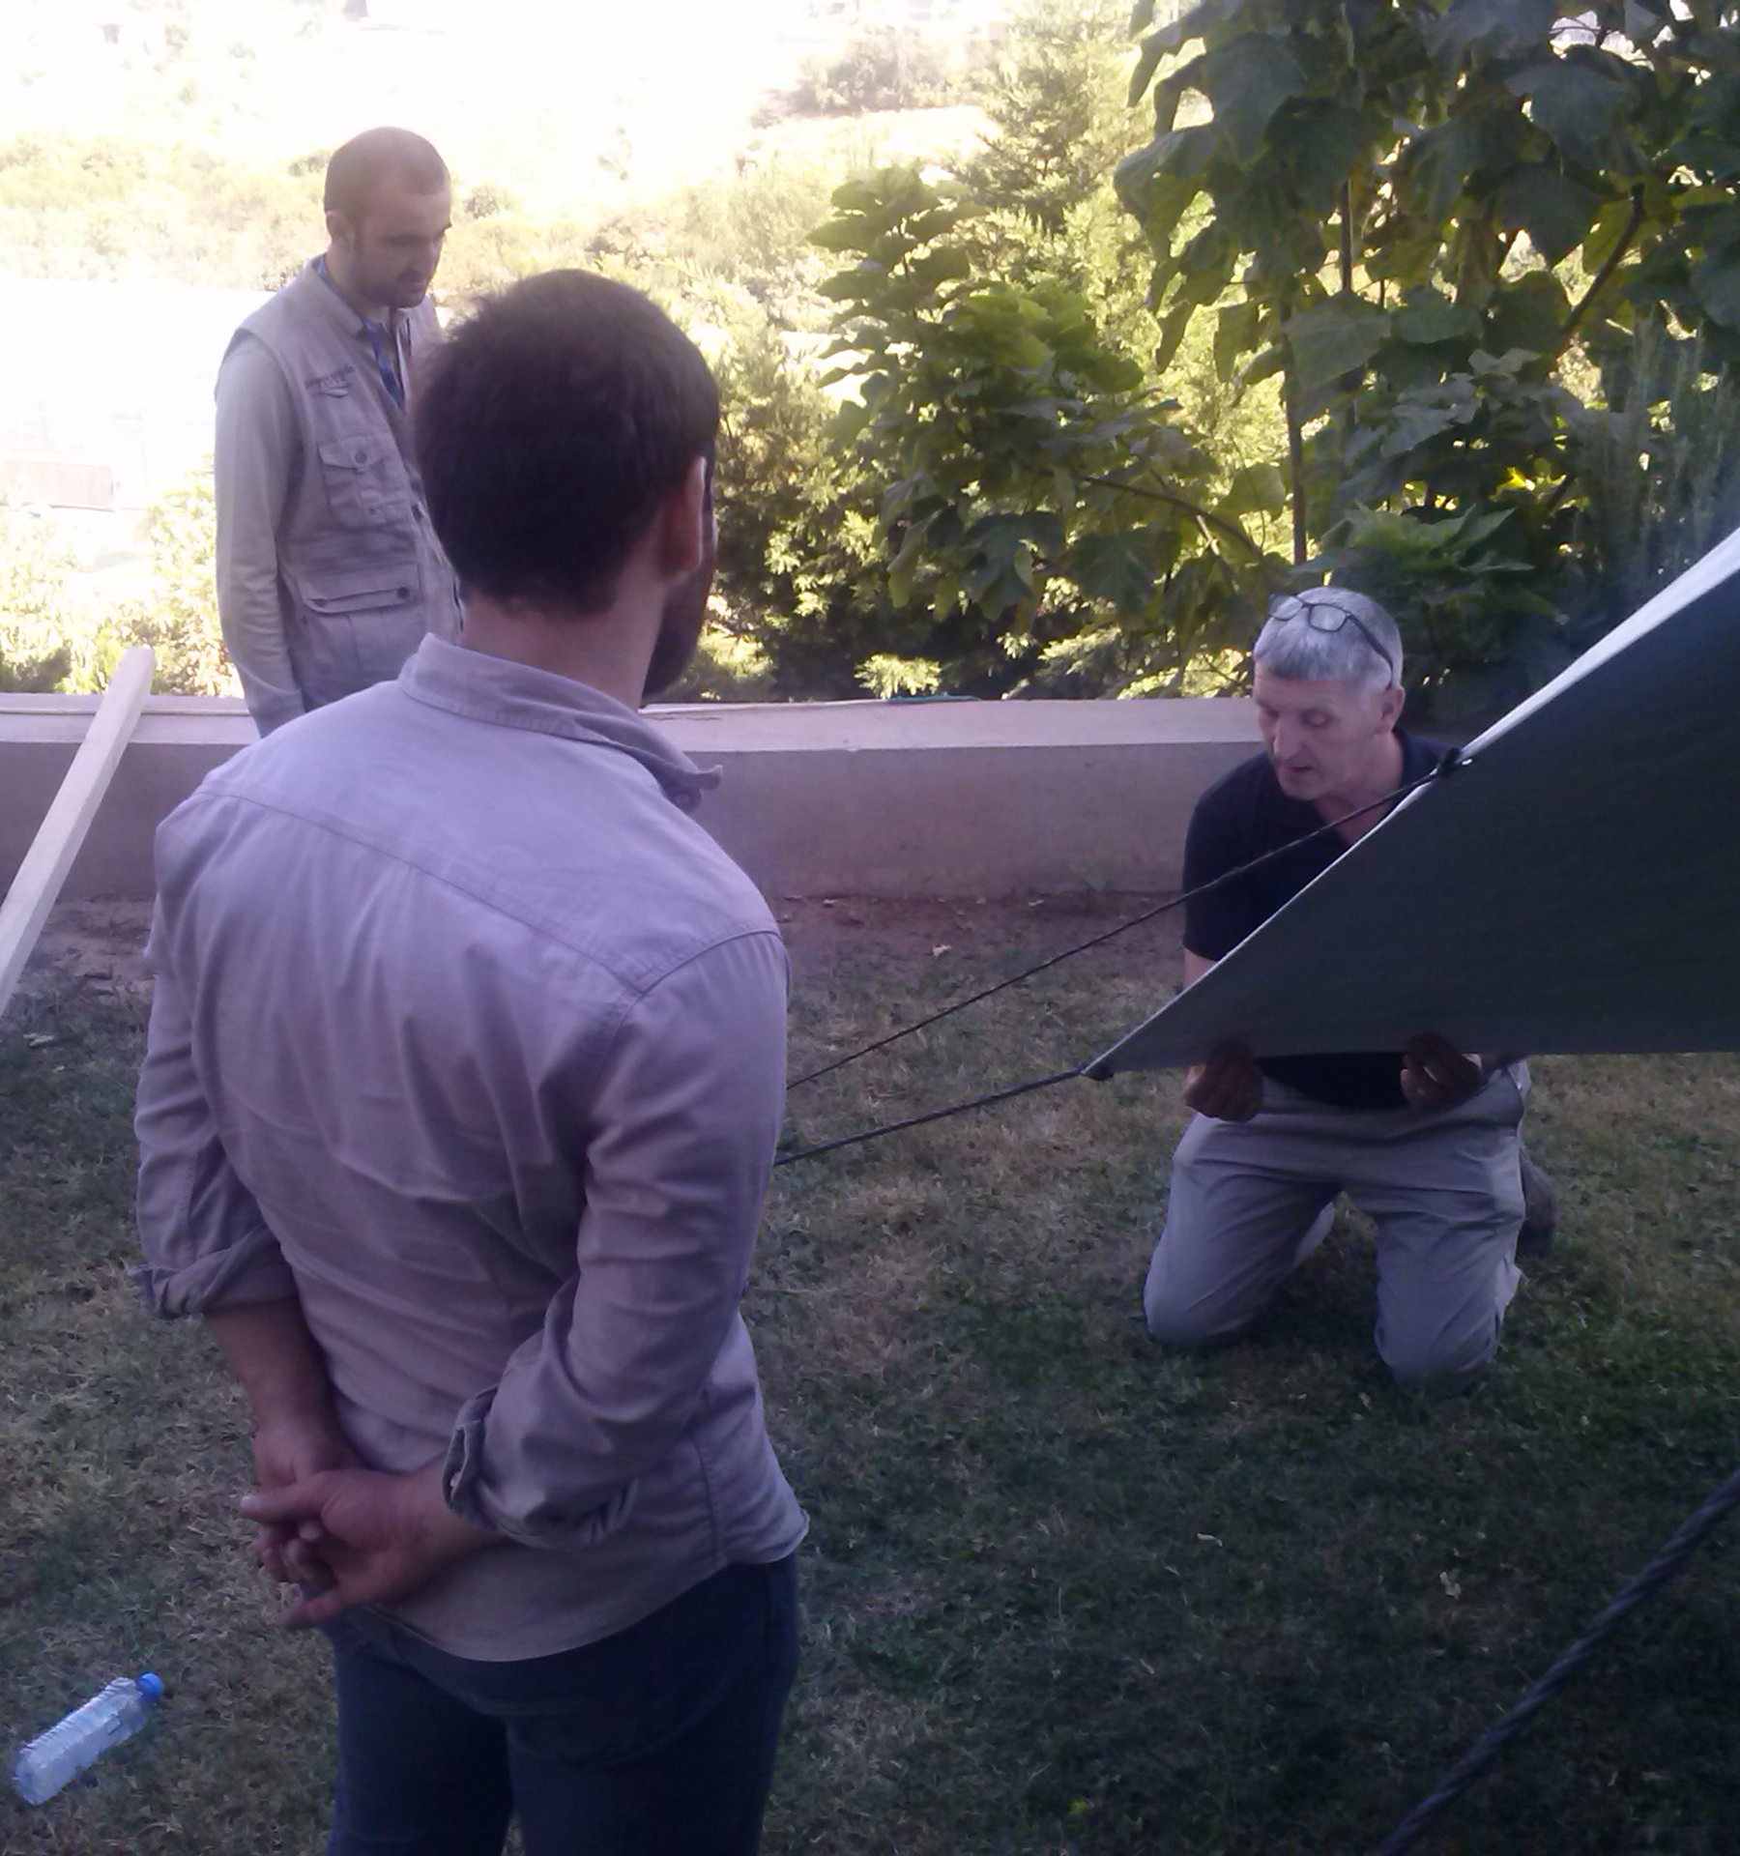
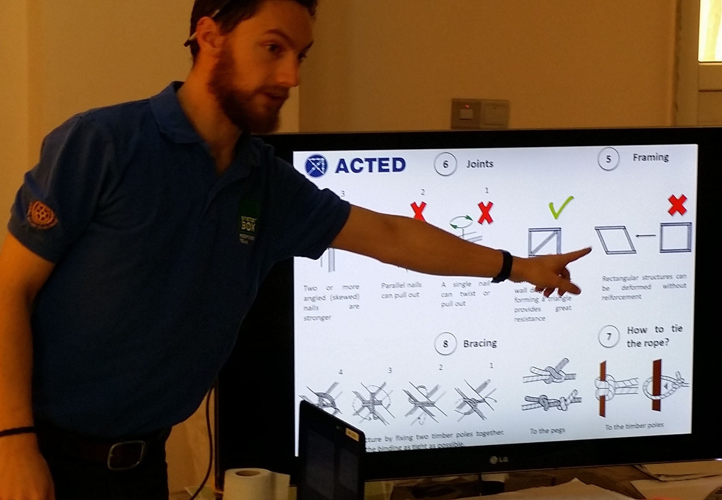
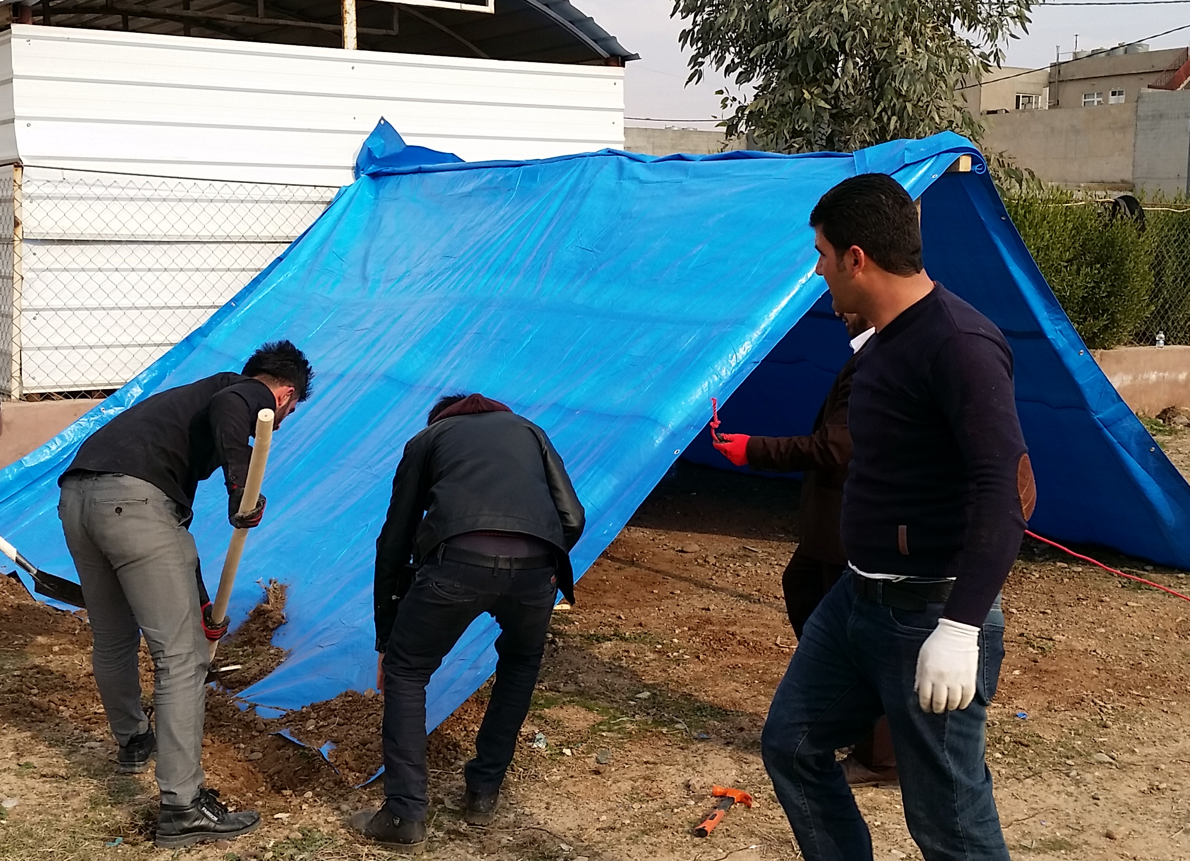




5. Shelter/NFI has held 3 ESK trainings to date for NGO partners
With support from:

Slide 15


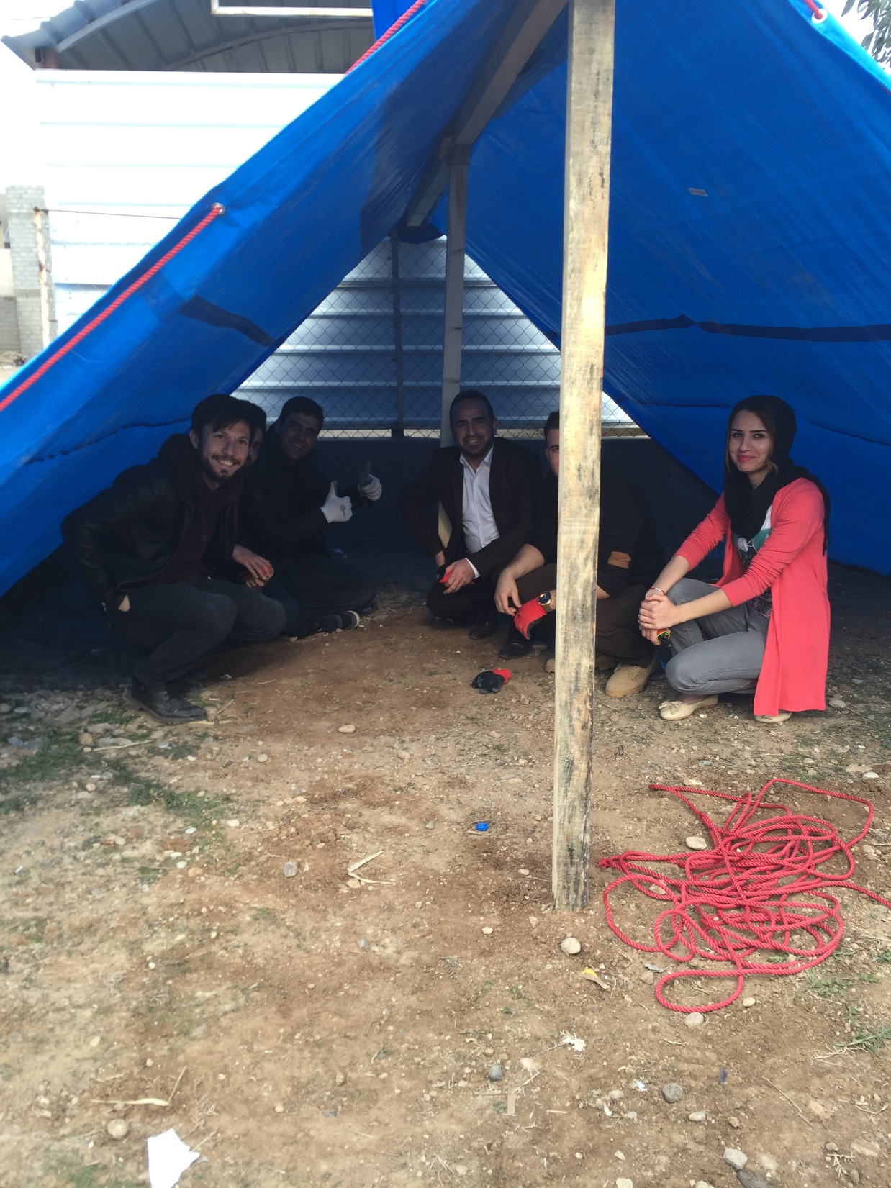
PIN ESK Training
Date: 21.01.2017
Place: PIN Field Office Kalak
Participants: 14 PIN field and education
officers
Supervisors: Dominika Rypa, Andrea Quaden
PIN Emergency Progr. Managers
Facilitators: Ryan Smith, Michael Gloeckle
Shelter Cluster
Theoretical and Practical Training
with a focus on BESK

Slide 16
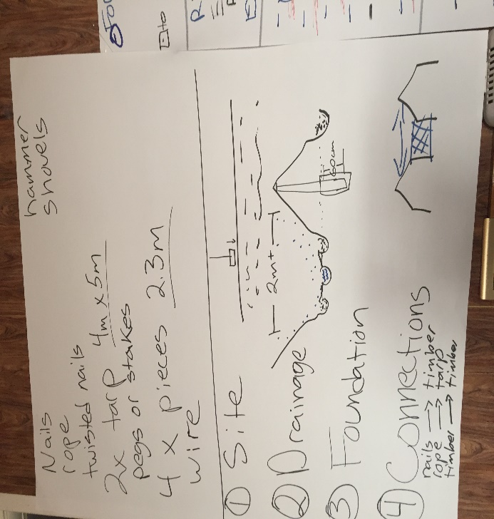
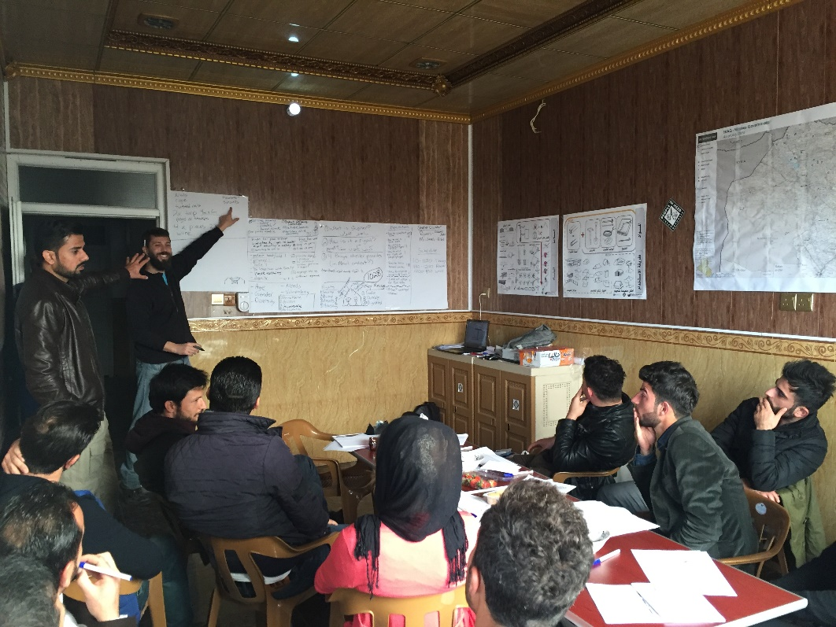
SESSION 1 – THEORETICAL TRAINING
Expectations
What is shelter?
Shelter as a human right?
Four things shelter provides (in the Mosul context)
How to construct a shelter

Slide 17
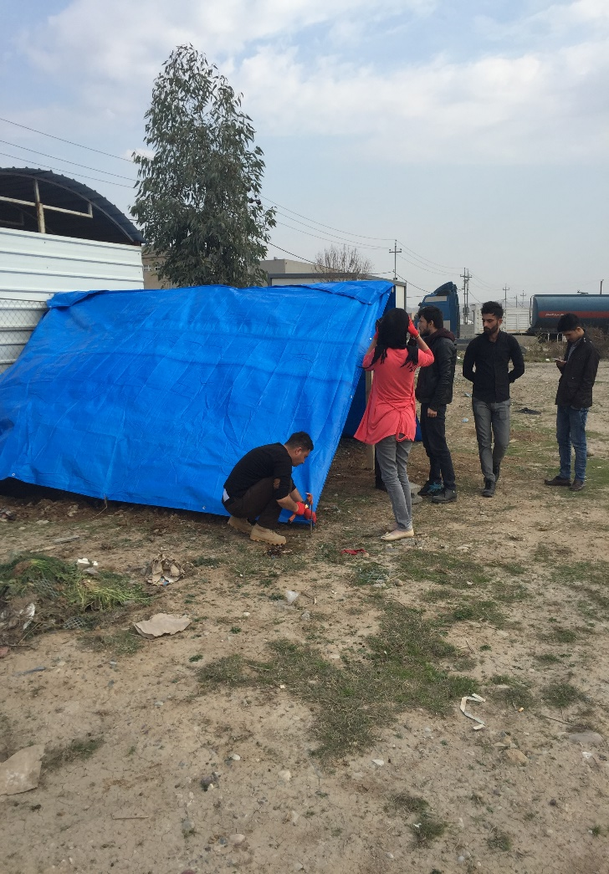
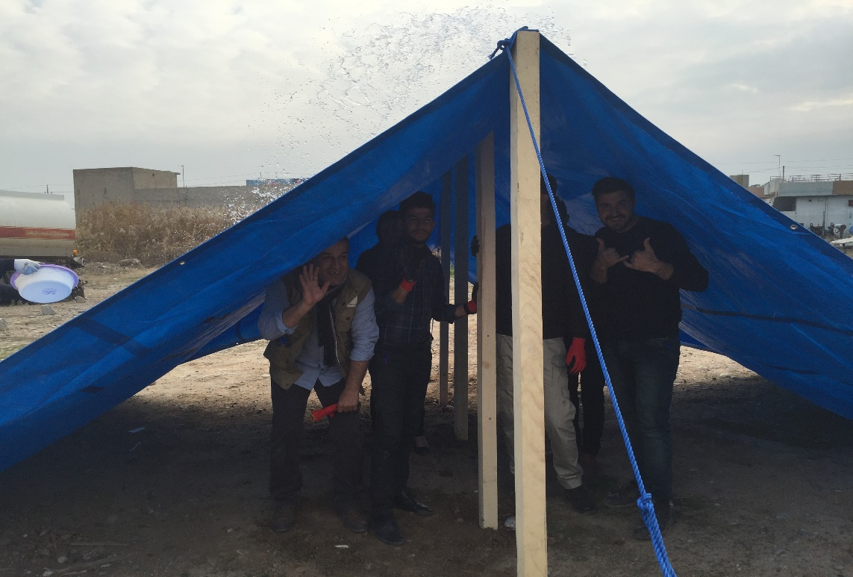
SESSION 2 – PRACTICAL TRAINING
The team was split in two:
Team Omar: Building a shelter attached to a structure
Team Art: Building a shelter in the open space

Slide 18
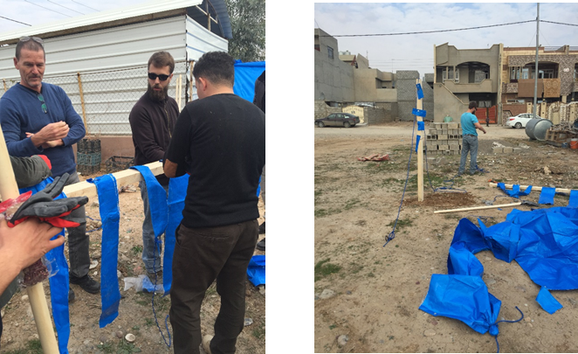
SESSION 2 – PRACTICAL TRAINING
Practical advise to strengthen the shelter
Technical advise to construct basic shelter for Bartella Screening Site, where PIN planned to intervene the following day

Slide 19
Lessons Learned
BESK material is not sufficient, some items are missing, quality of the tarp is not high
The BESK has limitations in terms of the shelter it can provides
The team learnt how to support beneficiaries in using the BESK
Importance of IEC or support from the team on the ground
In general, shelter trainings are essential for the team to understand what they distribute, which challenges kits pose, how to support beneficiaries in using shelter kits

Slide 20
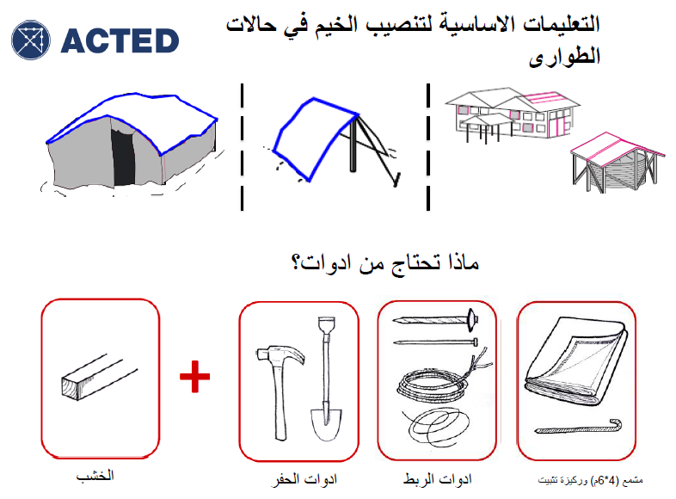
5. Shelter/NFI ESK Training
Questions?
Experiences?
Interest in further training?

Slide 21
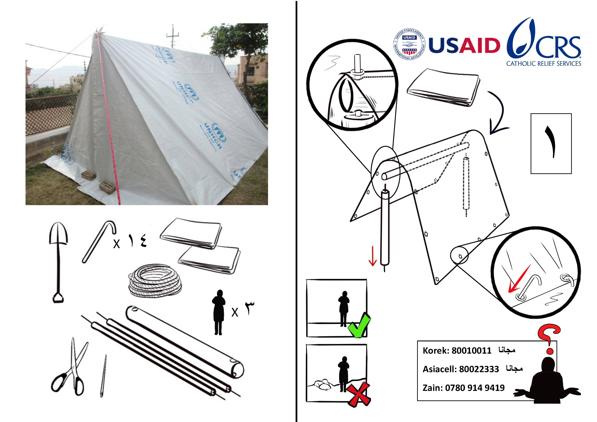
5. Shelter/NFI ESK Training

Slide 22
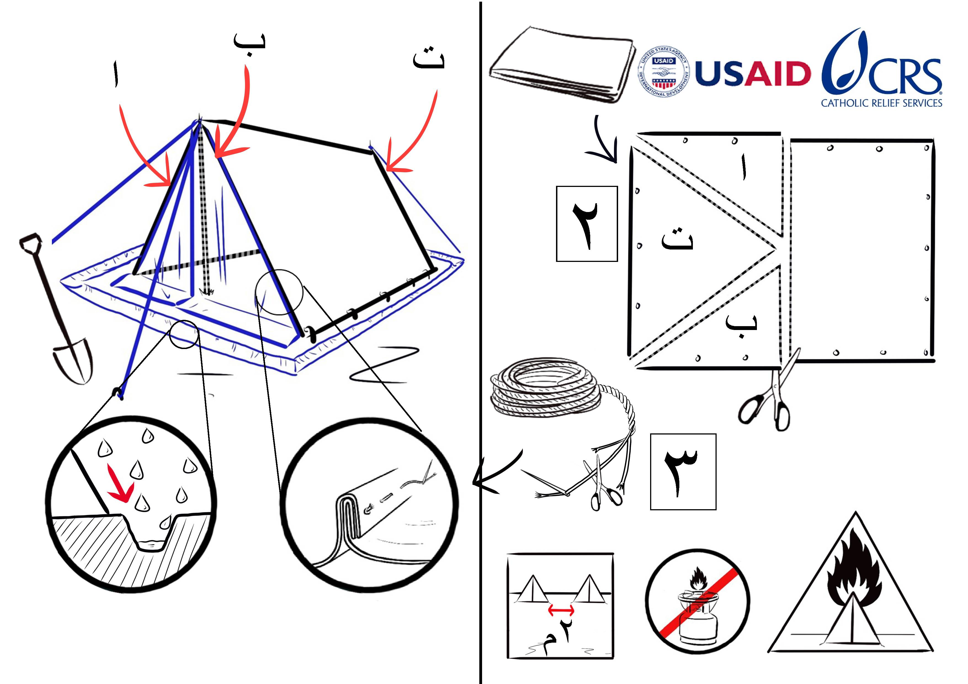

Slide 23
Video
IOM Developed Video about the ESK setup
https://www.dropbox.com/sh/jkkc1ln758dbffa/AAAp0sxMghFI-n4149tXm35la?dl=0

Slide 24
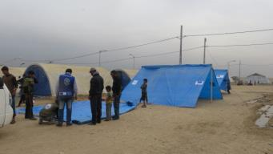
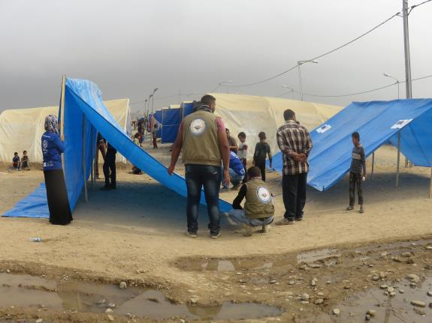
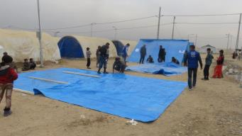
Photos
Jaddeh Camp

Slide 25
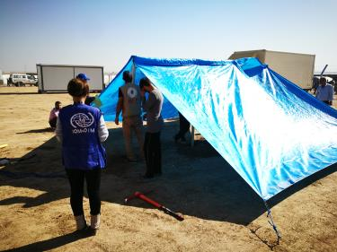
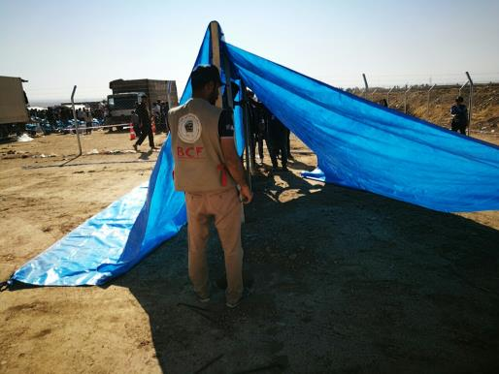
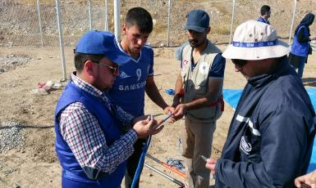
Photos
Khazar Camp

Slide 26
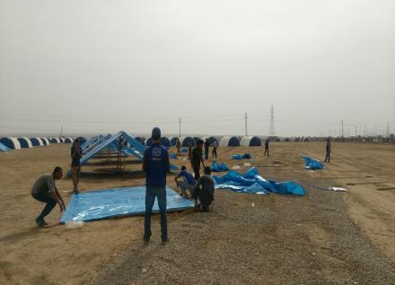
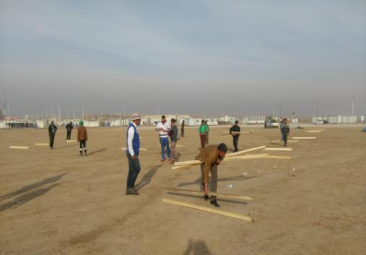
Photos
Training for IDPs

Slide 27
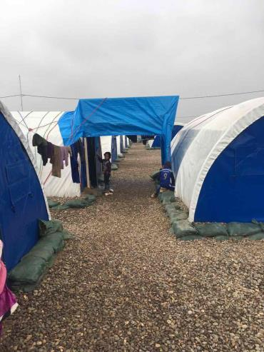
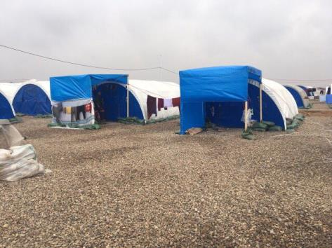
Photos
Haji Ali Site (other Idea )

Slide 28
Advantage and Disadvantage
Advantage | Disadvantage
Simply to use , basic tools known by every one | Functionally the kit is for summer supplementary
Easy to carry and transport to other locations | The Families do not have Idea to use theses item during winter
Easy to distribute | No mat supplied with the kit for floor
In emergency can be use by more than one family | Can’t install without briefing from the staff about how use the kit
Design can change in case increasing more wooden pole

Slide 29
6. Distribution Guidelines
There are several guidelines being adapted to ‘Newly Taken Areas’:
UNHCR / OCHA – 1 pager
WFP – 9 page with proposed site layout – although food, is applicable to NFI/ESKs/SOKs etc.
NRC

Slide 30
7. 15th Edition - Humanitarian Shelter Coordination
Application deadline: 5th February 2017
Start date: 27th February 2017
First phase: Tutored distance learning: This will take place during a period of five weeks (27 February - 2 April 2017) and participants will study through the online Red Cross Red Crescent e-learning platform. This first phase deals with most of the theoretical basis of the course.
Second phase: A 6-day face to face workshop (from 24 to 29 April 2017 in Geneva, Switzerland). The face to face workshop is based on a scenario that simulates the deployment to and coordination of an evolving emergency.
https://www.sheltercluster.org/events/14th-edition-humanitarian-shelter-coordination-master-level-short-course

Slide 31
8. AOB
New SAG – nominations to Richard Evans – put in line “Nominations to for SAG”
Next meeting will be Wednesday 15th February, 11:00am at NCCI?
http://sheltercluster.org/response/iraq

