Slide 1
Sub-National Shelter & NFI Cluster Coordination meeting for C &S
Agenda
Review of Action Points
Update on 2017 HRP
Information Management
Cluster Technical Guidelines – Information
Key Issues
Hawija Response Planning –ESK ; SOKs for IDPs in AUBs; ESK Training
Distribution guidelines - UNOCHA / WFP /NRC - Centre and South context.
Tent Replacement Updates
Shelter interventions for returnees in critical shelter in Anbar and Diyala – Partner input
Winterization Updates – Winter top up and Kerosene
Governorates Updates
AOB – Anbar governorate camp closures, ….
Wednesday, 8th February 2017
http://sheltercluster.org/response/iraq

Slide 2
Review of action points from previous meeting
NRC to share list of camps that received the 300 NFI Kits in AAF- Done
Share Anbar governorate google sheet response link – There is an objection ; IMO to advise
Share approved list of activity info indicators – Done
Share breakdown of families receiving provided tents for replacements and winter kits by MODM in Anbar – Outstanding , follow up continues
Ensure Coordination with MODM before distribution of Kerosene in Kilo 18 – Being coordinated
Invite CRS to the Anbar coordination forum comprising IOM, IRD, UNHCR, NRC and DRC-CCCM?
Coordinate amongst yourselves/ partners before distributions- encouraged

Slide 3
2. Update on HRP
OVERVIEW OF 2017 PROJECTS AND REQUIREMENTS
Original Value of all submissions (USD): | 340,236,141
Final Value of Requested Portfolio (USD): | 175,313,708
Original Number of projects: | 82
Final # of Projects approved in recommended Portfolio: | 52
# of Total Partners in portfolio: | 29
# of National Partners in portfolio: | 6
Final Financial Requirements in KR-I (USD) | 41,918,452
Final Financial Requirements – Mosul Response (USD) | 59,515,318
Final Financial Requirements in the Rest of Iraq (USD) | 73,879,938
Final Financial Requirements – First Line Activities (USD) | 98,386,943
Final Financial Requirements – Second Line Activities (USD) | 65,667,247
Final Financial Requirements – Full Cluster Response (USD) | 11,259,517

Slide 4
3. Information Management Update
2016 Cluster achievements and funding status
Special Mosul Preparedness and Response
2017 HRP / HNO
  Indicators / Target
  Reporting – Cluster Indicators and Activity Info
http://sheltercluster.org/response/iraq

Slide 5
3. Information Management Update
2016 Cluster achievements (Jan. – Dec.) | 2016 Funding Status (Jan. – Dec.)
Target Initial: 1.1 M Review (Falluja & Mosul): 1.3 M | Request: $290 M HRP: $180 M Mosul Flash Appel: $110 M
Reached NFI Kits: 1.3 M Shelter Interventions: 0.5M | Funded: $100.2 M HRP: $80.1 M (44.6% of requirement) Mosul Flash Appel: $20.1 M (18.3% of requirement)
Dashboard | Dashboard : showing Donors, Partners, Number of Projects and their Funding status.
http://sheltercluster.org/response/iraq

Slide 6
3. Information Management Update
Review Mosul preparedness against response
Not started: No funding or no access to the location to implement
In pipeline: Purchase order signed / funding secured
In stock: In country and in warehouse
Pre-positioned: In sub-warehouse or at a set location (camp etc.) ready for distribution
Planned: Distribution plan for coming two weeks (when and where)
Completed: Distributed/implemented, should be uploaded via Kobo form
Updated Master Sheet, Infographics/Dashboards and 3W

Slide 7
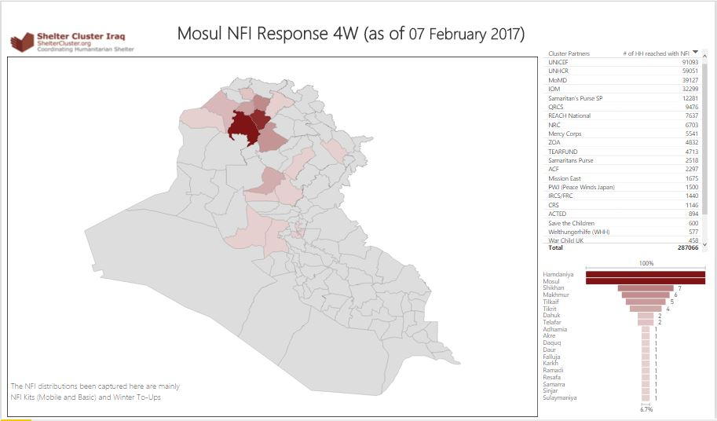
3. Information Management Update
MoMD
ACF
ACTED
CARE
CNSF
CRS
DRC
IOM
IRCS/FRC
Medair
Mercy Corps
Mission East
NRC
PWJ (Peace Winds Japan)
QRCS
REACH National
Samaritan's Purse SP
Save the Children
TEARFUND
UNHCR
UNICEF
War Child UK
Welthungerhilfe (WHH)
World Vision
ZOA

Slide 8
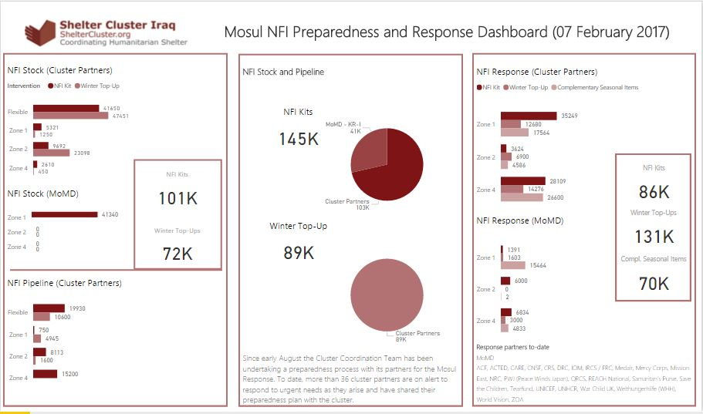
3. Information Management Update
MoMD
ACF
ACTED
CARE
CNSF
CRS
DRC
IOM
IRCS/FRC
Medair
Mercy Corps
Mission East
NRC
PWJ (Peace Winds Japan)
QRCS
REACH National
Samaritan's Purse SP
Save the Children
TEARFUND
UNHCR
UNICEF
War Child UK
Welthungerhilfe (WHH)
World Vision
ZOA

Slide 9
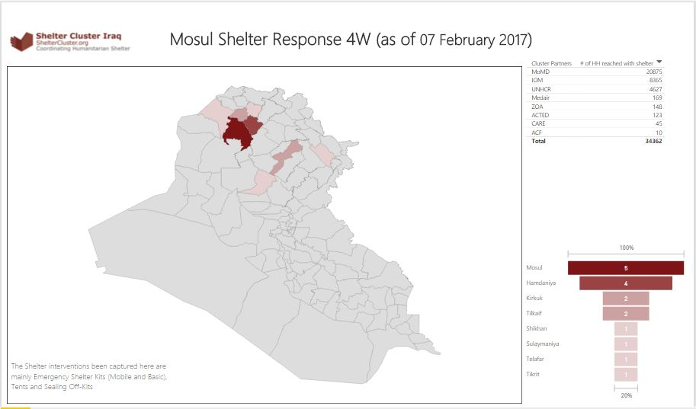
3. Information Management Update
MoMD
ACF
ACTED
CARE
CNSF
CRS
DRC
IOM
IRCS/FRC
Medair
Mercy Corps
Mission East
NRC
PWJ (Peace Winds Japan)
QRCS
REACH National
Samaritan's Purse SP
Save the Children
TEARFUND
UNHCR
UNICEF
War Child UK
Welthungerhilfe (WHH)
World Vision
ZOA

Slide 10
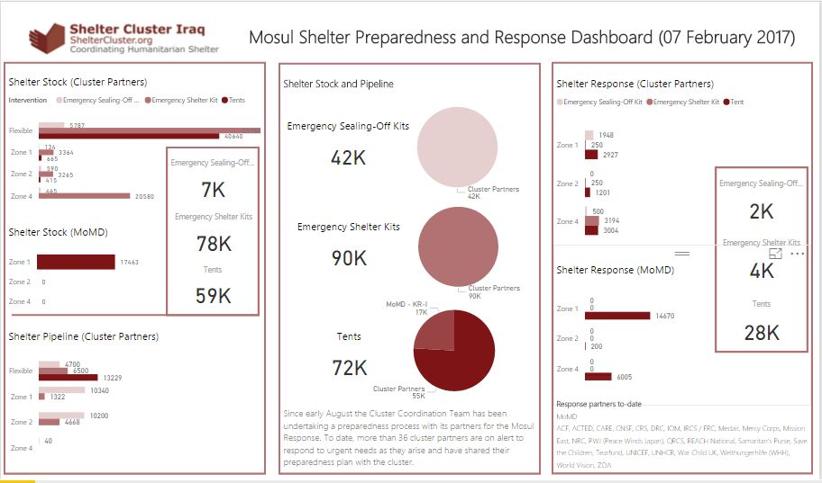
3. Information Management Update
MoMD
ACF
ACTED
CARE
CNSF
CRS
DRC
IOM
IRCS/FRC
Medair
Mercy Corps
Mission East
NRC
PWJ (Peace Winds Japan)
QRCS
REACH National
Samaritan's Purse SP
Save the Children
TEARFUND
UNHCR
UNICEF
War Child UK
Welthungerhilfe (WHH)
World Vision
ZOA

Slide 11
3. Information Management Update
  Reporting – Cluster Indicators and Activity Info
  Cluster operational indicators to be uploaded into 2017 Activity Info: Completed, uploaded and shared
  Shelter and NFI Cluster will have a separate database in Activity Info but linked to the Inter-cluster one.
  No 4W matrix will be developed in 2017 / only Into Activity Info as the inter-cluster reporting platform.
For IDPs response in 2017: ActivityInfo reporting for January 2017 is open 10-17 February 2017. However one additional week (till 24 February 2017) will be given to Shelter and NFI Cluster partners.
Remember that all IM products and other relevant cluster supporting tool are available on the cluster webpage: http://sheltercluster.org/response/iraq
http://sheltercluster.org/response/iraq

Slide 12
4. Cluster Technical Guidelines – Information
New resources on website:
Resources for Kerosene, Propane and other flammable liquid and gas storage and use
Kerosene versus LPG Gas Cooking Stove Information Note
Tent Information note (no comments were received)
Under preparation:
Climatisation Guidelines – winter and summer
NFI Guidelines v11

Slide 13
5. Key Issues / Hawija Response Planning
36,000 Individuals are expected to be displaced from Hawija ; potentially including Salah a Din
Partners called upon to prepare to respond; gaps exist in out of camp IDPs in Salah a Din.
Prepositioning of ESK and SoKs required
As per IOM’s latest DTM report 130, 188 Individuals are living in critical shelter:-
  81,564 IDPs are living in AUBs
  5,058 IDPs are living in School buildings
  936 IDPs are living in Religious buildings
  42,630 IDPs are living with the host community
The Cluster is planning a second ESK training for C&S as soon as sponsors are identified. Potential sponsors are requested to come forward

Slide 14
5. Key Issues / Distribution Guidelines
IMC/ IRC report on Anbar- January 2017 ( Acting on our Commitments to Women and Girls in South Central Iraq: Preventing, Mitigating, and Responding to Gender-based Violence) . Key highlights concerning Shelter and NFIs interventions in the report:-
  Grave concerns about sexual exploitation and abuse (SEA) including women and girls being forced to exchange sex for basic needs (e.g., food, goods)
  Insufficient coordination among government and humanitarian agencies and a lack of urgency in humanitarian response resulting into denial of refuge, safety and security to IDPs
  Families leaving camps due to insecurity and/or limited access to assistance at the of onset of winter.
  In Bzeibez and Khalidiya, reports about some NGOs bringing relief items which they take back after taking photos with IDPs ; Lack of winterization kits, including warm clothes and heaters (reports of young children dying between ages 0-3 due to the cold weather)
Your views on how best distributions of relief items can be implemented to enhance accountability ,
Should we develop or adopt uniform distribution guidelines ? i.e. WFP/OCHA/NRC

Slide 15
5. Key Issues / Tent Replacement Updates
No. | Partner | Distributions Locations | No Tents Replaced | Total Need-Anbar Governorate | Anbar -Outstanding Tent Repalcement Need
1 | MODM | AAF, HTC, Khalidiya;Beiz Biz | 3000 | 23,000 | 20,000
2 | UNHCR | Beiz Biz | 500 |  | 19,500
3 | NRC | AAF, HTC, Khalidiya;Beiz Biz | 318 |  | 19,182
4 | CRS | AAF(60 T-shelter Al.Tahadi Camp;100 T-shelter in Al.Bashaer Camp; 70 T-Shelter in Zawbaa Camp.) | 230 |  | 18,952
5 | UNHCR | Beiz Biz; AAF | 394 |  | 18,558

Slide 16
5. Key Issues / Shelter interventions for returnees in critical shelter in Anbar and Diyala
The Cluster is tracking gaps and responses for returnees – Partners are requested to provide information on responses for returnees
So far the following gaps have been identified;-
  1,398 returnees living in critical shelter in Heet district
  2,375 returnees living in critical shelter in Ramadi District
  40,362 returnees are living in abandoned and unfinished buildings (AUBs) , in need of support with NFIs, shelter kits, sealing off kits in Diyala

Slide 17
5. Key Issues / Winterization Updates – Winter top up and Kerosene
Winter top up including kerosene feature amongst top three priorities in Anbar camps. Partners are requested to accelerate response in Anbar camps and out of Camp IDPs.
Critical Gaps have been sited in these camps :-
  Camp 32 (Shuhada Camp – 400 Families)
  Camp 11 (Caravan Camp 580 families)
  Camp 6 (UM Al Quraa camp 180 Families)
  Suzan Camp 270 Families
  camp 33 (Anbar 100 Families)
  Beiz Biz , sector 1,2, 3 and 4
  Kilo 18 - 500 Families not covered
  Khalidiya camp 10 – 180 Families not covered
  Khalidiya Camp 14. 100 Families .

Slide 18
5. Key Issues / Governorate and Agencies Updates

Slide 19
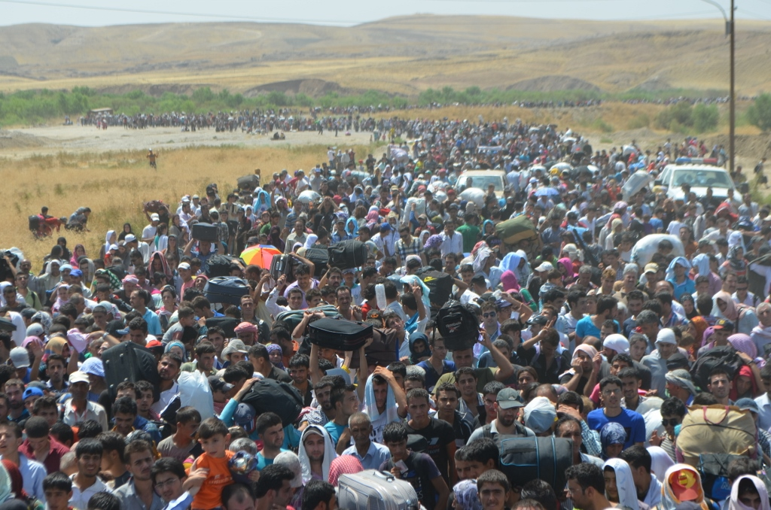
6. AOB

Slide 20
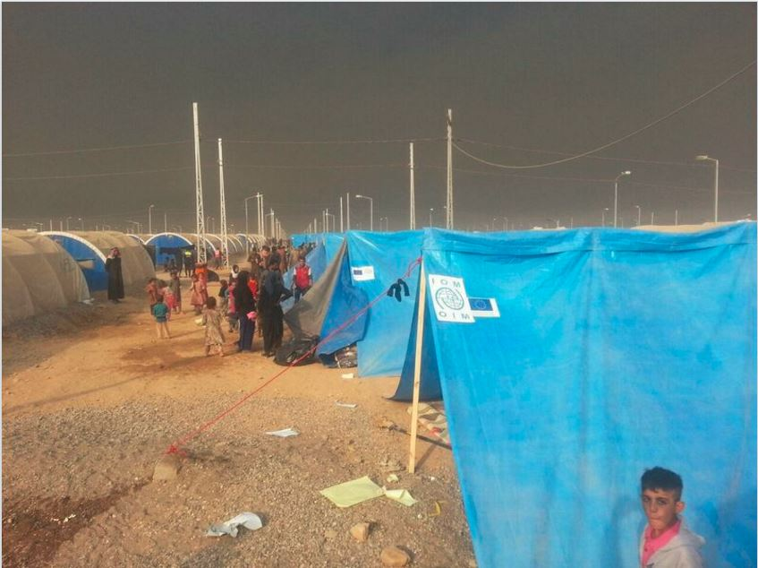
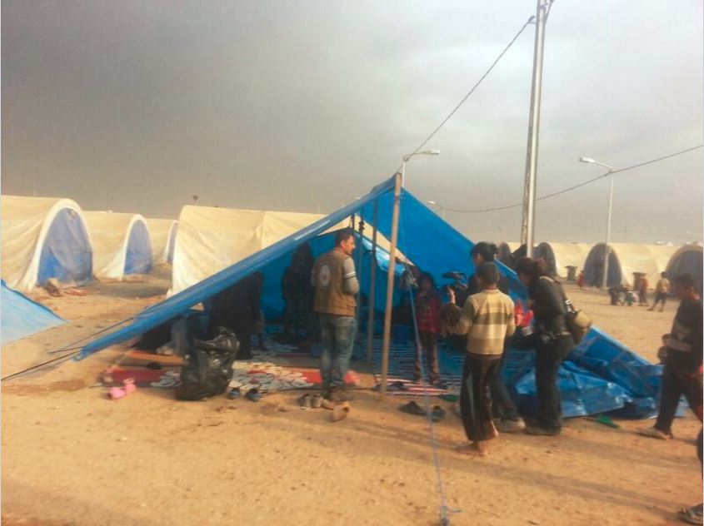
THANKS
http://sheltercluster.org/response/iraq

