Slide 1
Shelter & NFI Cluster Coordination meeting for KR-I and Mosul
Agenda
Introductions and Action Points
Cluster Technical Guidelines – Information
Information Management & Activity Info
Post Distribution Monitoring (PDM)
UNOPS Call Centre
West Mosul - Shelter & NFI Camps
AOB
Wednesday, 15th February 2017
http://sheltercluster.org/response/iraq

Slide 2




0. Cluster Team Structure
Ryan Smith
Roving Cluster Coordinator (Duhok) - Zone 2 Focal Point
Catholic Relief Services
+964 (0) 751 755 8451
coordroving.iraq@sheltercluster.org
Richard Evans - UNHCR National Cluster Coordinator +964 (0) 771 994 5694 coord.iraq@sheltercluster.org Michel Tia - IOM Information Management Officer - National +964 (0) 750 021 1720 im2.iraq@sheltercluster.org Cornelius Weira - IOM Sub National Co-Chair - Centre and South Mobile +964 (0) 751 234 2548 coord4.iraq@sheltercluster.org | Michael Gloeckle - NRC National Co-Chair - Technical Coordinator +964 (0) 750 878 7793 coord2.iraq@sheltercluster.org Shada Qahoush- Catholic Relief Services Ninewa & Mosul Focal Point +964 (0) 751 755 8451 coordroving.iraq@sheltercluster.org

Slide 3
1. Action Points from 01/02/17 meeting
Ryan Smith
Roving Cluster Coordinator (Duhok) - Zone 2 Focal Point
Catholic Relief Services
+964 (0) 751 755 8451
coordroving.iraq@sheltercluster.org
Distributions Guidelines – Shelter & NFI and Food Cluster are preparing joint guidelines incorporating GBV and Child protection guidelines – available shortly. Skype Group for Nimrud is now up and running and has been a great success No significant comments on latest NFI Guidelines so will pass. SAG has been finalized, CSNF, ZOA, NRC, Mercy Corps, UN-Habitat, IOM & UNHCR

Slide 4
2. Cluster Technical Guidelines – Information
New resources on website:
NFI Guidelines v11
Under preparation:
Climatisation Guidelines – winter and summer
Distribution Guidelines in newly taken areas

Slide 5
3. Information Management Update
  2017 HRP Reporting – Cluster Indicators and Activity Info
  Cluster operational indicators to be uploaded into 2017 Activity Info: completed and shared
  Shelter and NFI Cluster will have a separate database in Activity Info but linked to the Inter-cluster one.
  No 4W matrix will be developed in 2017 / only Into Activity Info as the inter-cluster reporting platform. How to go about it ??
http://sheltercluster.org/response/iraq

Slide 6

Activity Info
Activity Info is the only reporting platform the Shelter and NFI cluster will be using in 2017 to capture all shelter interventions and NFI distributions undertaken in the country.
From now on, Activity Info will be our only source of information for the cluster internal dashboards but also the cluster contributions/inputs to any inter-cluster reports or dashboards in Iraq.
If so, how can a Partner report into Activity Info?
http://sheltercluster.org/response/iraq

Slide 7
2017 Shelter & NFI Cluster
Revised Reporting Template in ActivityInfo
How to report?
http://sheltercluster.org/response/iraq

Slide 8
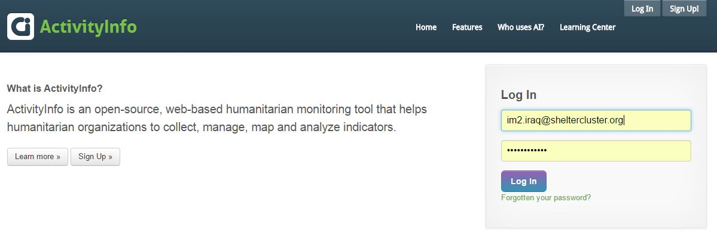
HOW TO REPORT?
Get a USER account in coordination with your respective Cluster Information Management Officer.
Get a Training and/or relevant supporting tools on how to report.
https://www.activityinfo.org
Log in using the mail address you provided while creating your USER account
http://sheltercluster.org/response/iraq

Slide 9
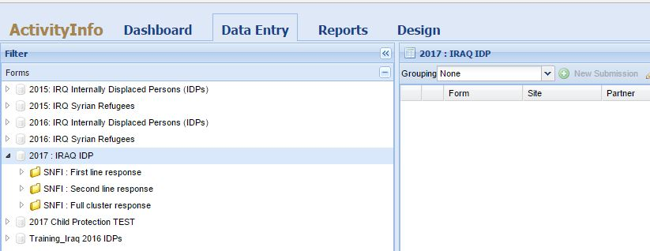
HOW TO REPORT?
Once you’ve logged in:
1 - select Data Entry
2 - select related Data Base (2017: IRAQ IDP), where you can see all clusters folders per response line or per strategic objectives.
http://sheltercluster.org/response/iraq

Slide 10
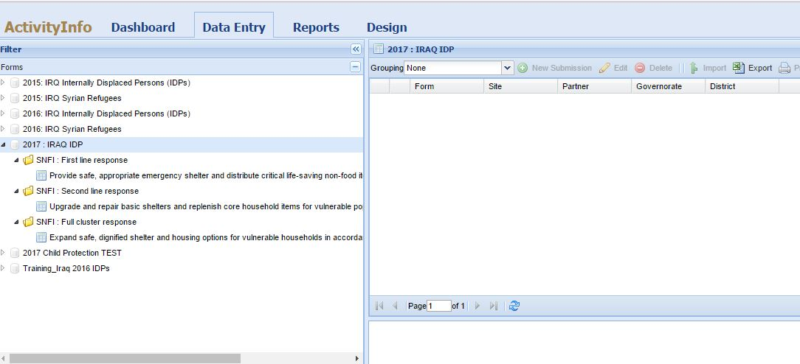
HOW TO REPORT?
For Shelter and NFI, under each Response Line, you have the Strategic Objective
Select the objective then click on New submission
http://sheltercluster.org/response/iraq

Slide 11
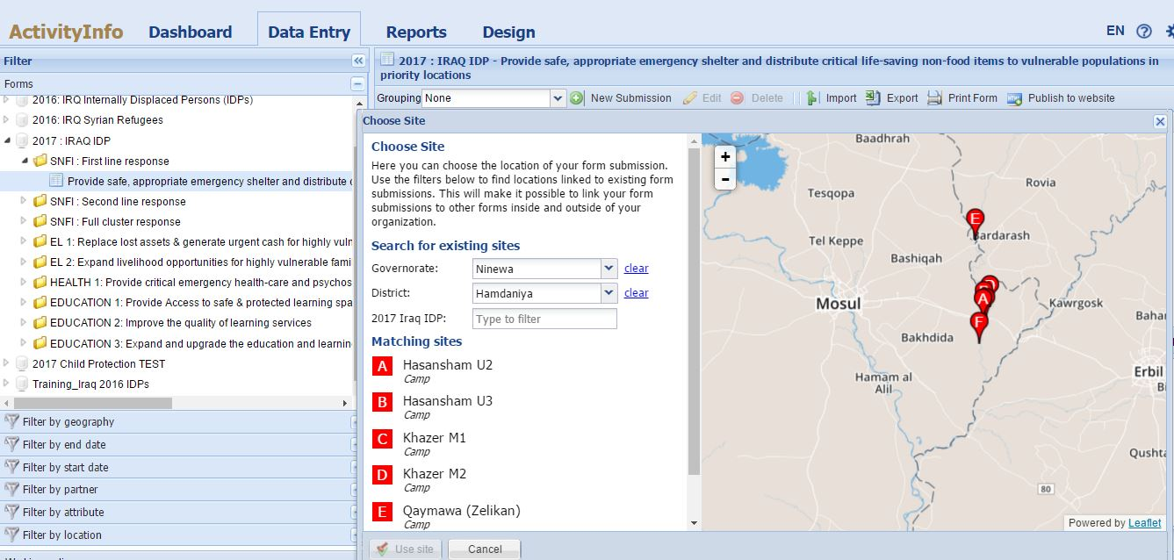

HOW TO REPORT?
Select the Governorate then the District.
Under Matching sites: double click on the Camp or District (if you’re reporting at district level).
http://sheltercluster.org/response/iraq

Slide 12
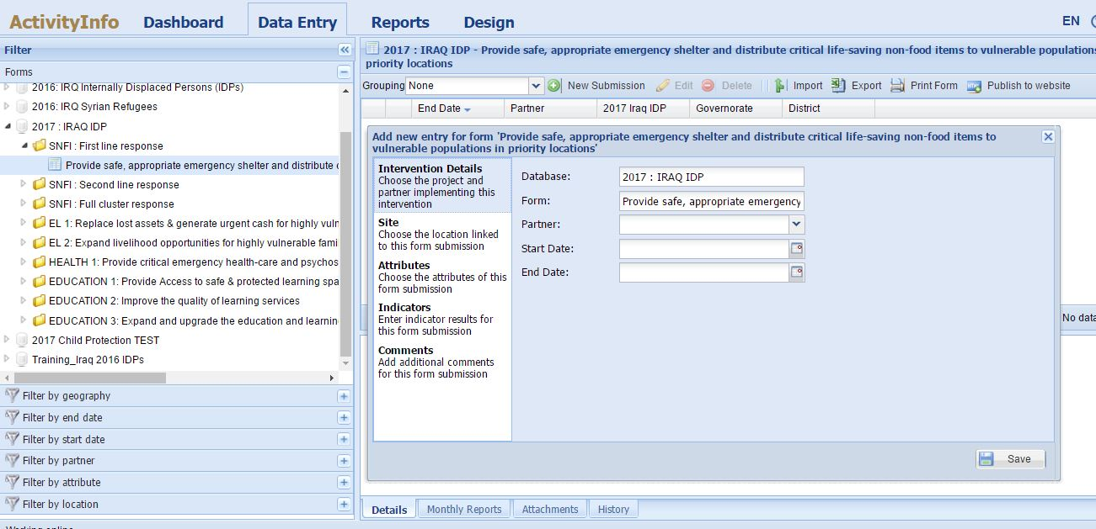
HOW TO REPORT?
The data entry starts here once you’ve selected the exact location of your interventions.
Please go through each step of this window and make sure you provide necessary information.
You can even upload a picture or a document only once you’ve saved your entries
http://sheltercluster.org/response/iraq

Slide 13
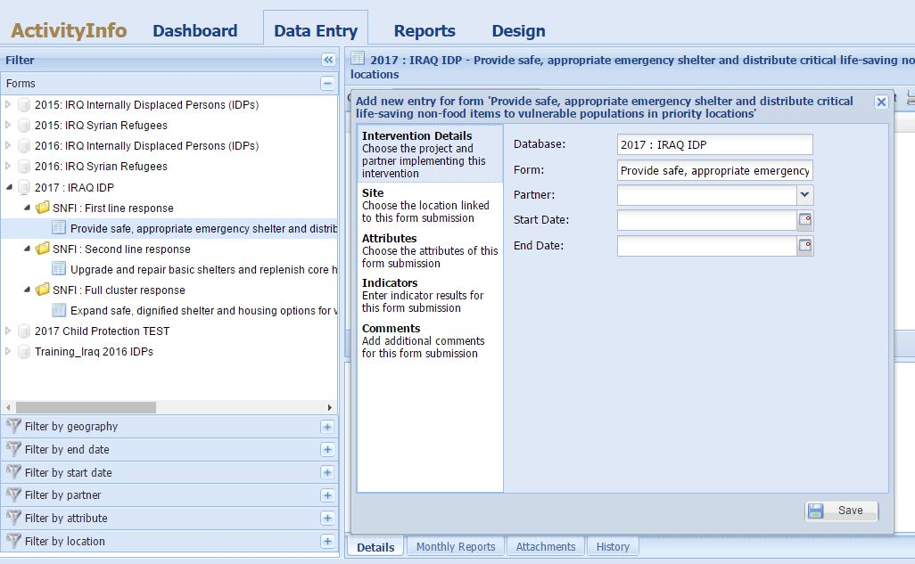
HOW TO REPORT?
Add here starting and ending date of your Shelter interventions or your NFI distributions you are reporting.
Please make sure start & end dates are within the same month.
If distribution is going into the other month, please do a second entry for that other month once opened in AI.
http://sheltercluster.org/response/iraq

Slide 14
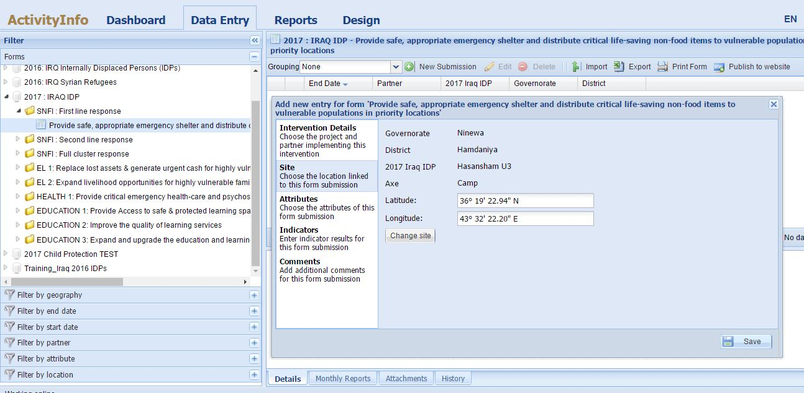
HOW TO REPORT?
Here is to double check the location you’ve selected. In case it is not the one you wanted, you can change !!
http://sheltercluster.org/response/iraq

Slide 15
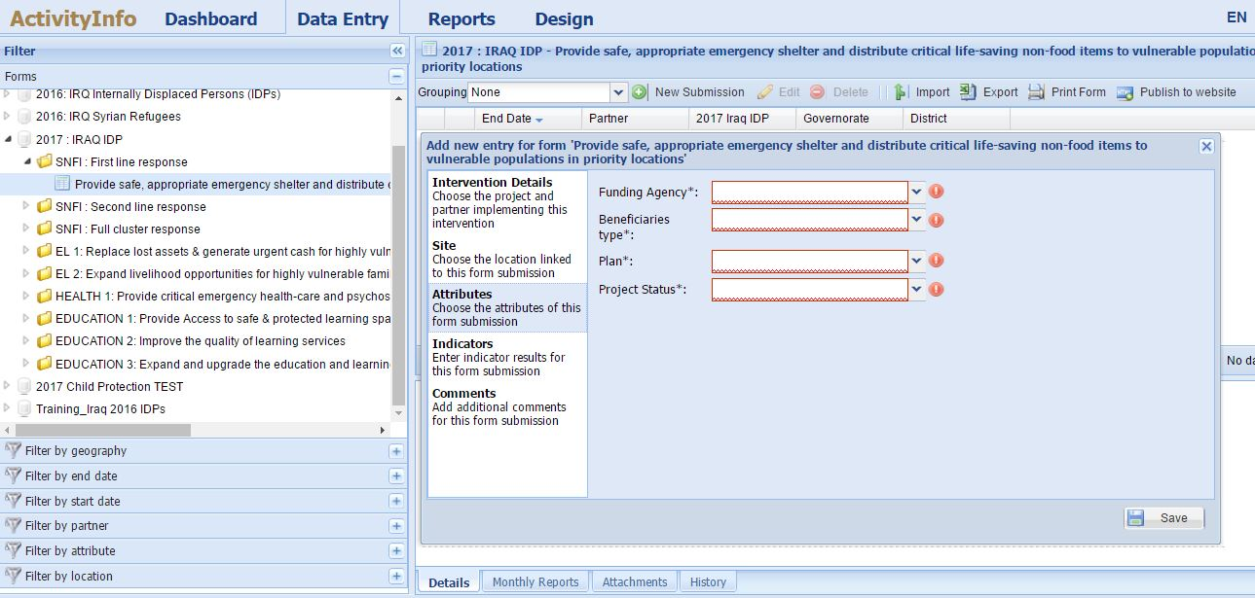
HOW TO REPORT?
Here are four sets of attributes all mandatory !!
http://sheltercluster.org/response/iraq

Slide 16
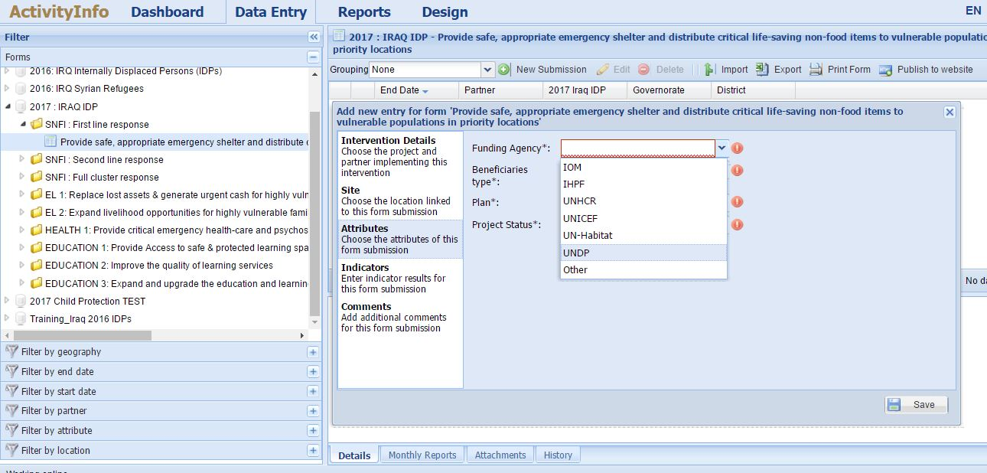
HOW TO REPORT?
Select the funding agency
http://sheltercluster.org/response/iraq

Slide 17
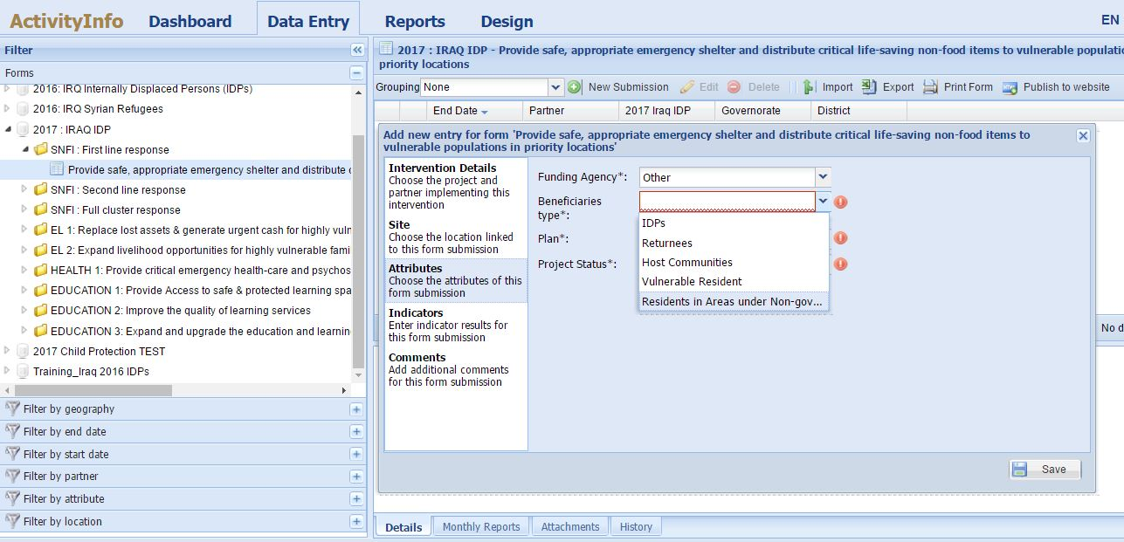
HOW TO REPORT?
Select the beneficiaries type
http://sheltercluster.org/response/iraq

Slide 18
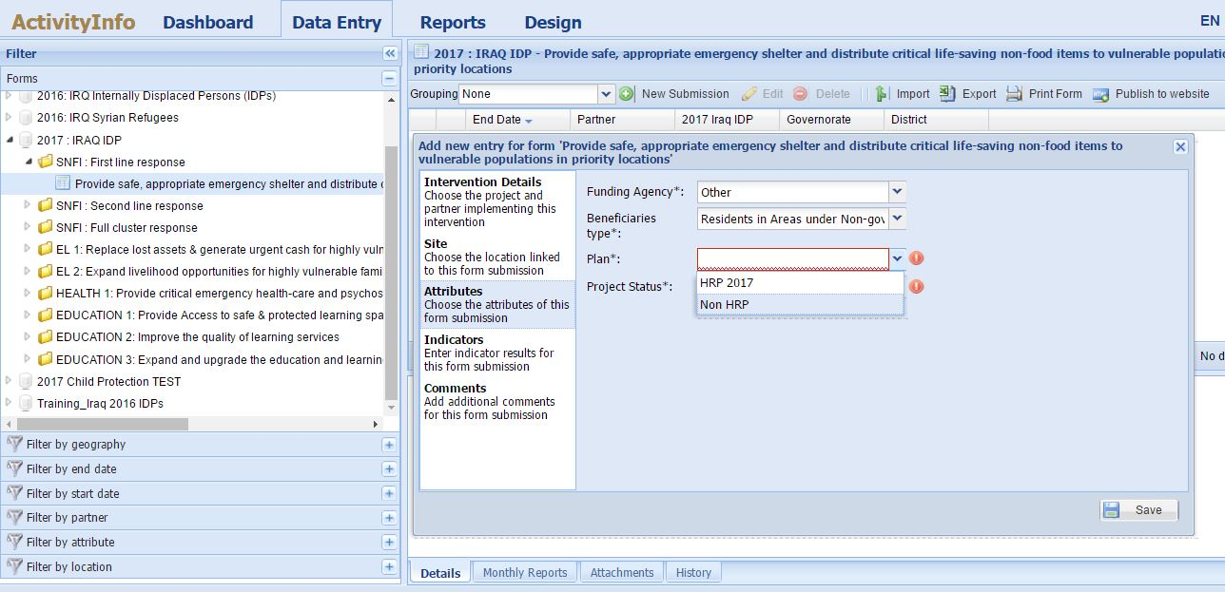
HOW TO REPORT?
Selecting the response plan ! Is your project part of the 2017 HRP (recorded in OPS) or Non HRP (not recorded in OPS)
http://sheltercluster.org/response/iraq

Slide 19
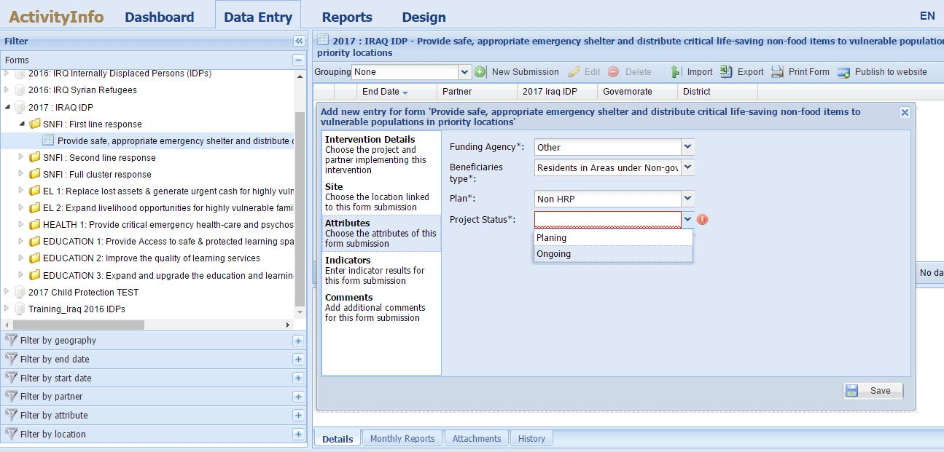
HOW TO REPORT?
Select the Project Status
http://sheltercluster.org/response/iraq

Slide 20
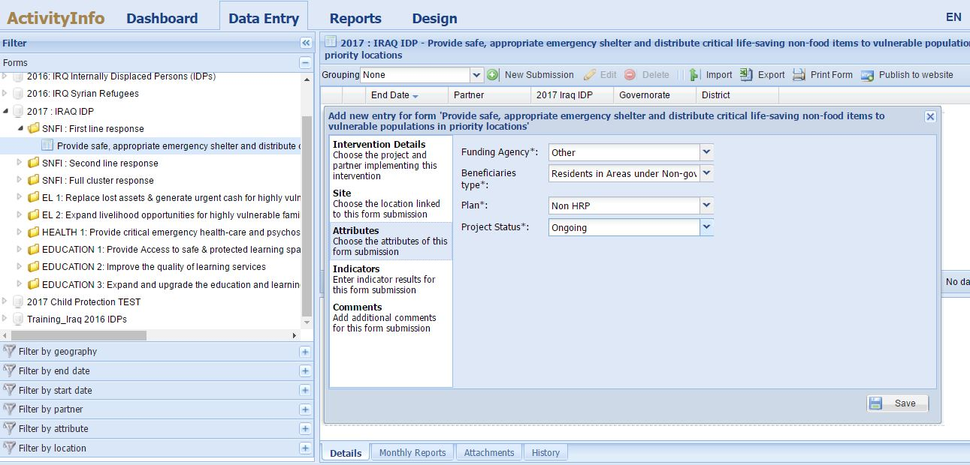
HOW TO REPORT?
Here you’ve fully informed the attributes.
Then click on Indicators to report your achievements.
As you’ll see the indicators are linked to the respective activities.
http://sheltercluster.org/response/iraq

Slide 21
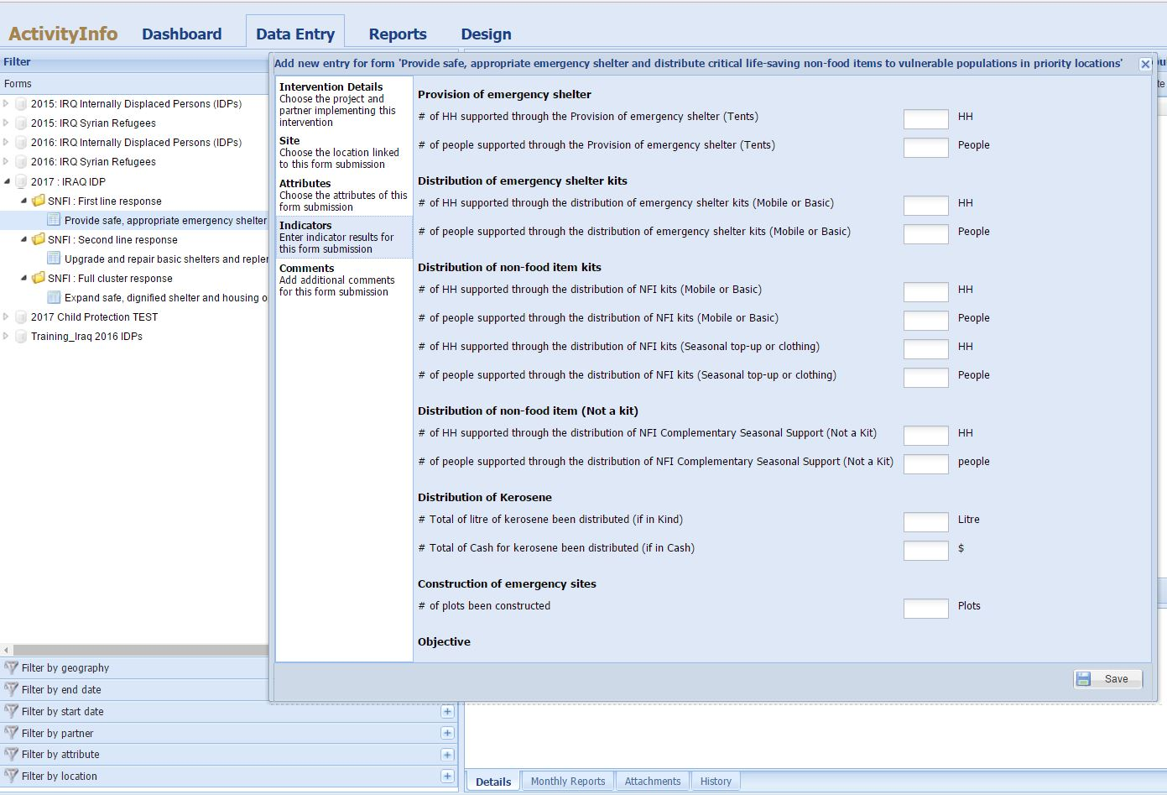
HOW TO REPORT?
Activities and Indicators under First line response
Always SAVE your data before closing the window
http://sheltercluster.org/response/iraq

Slide 22
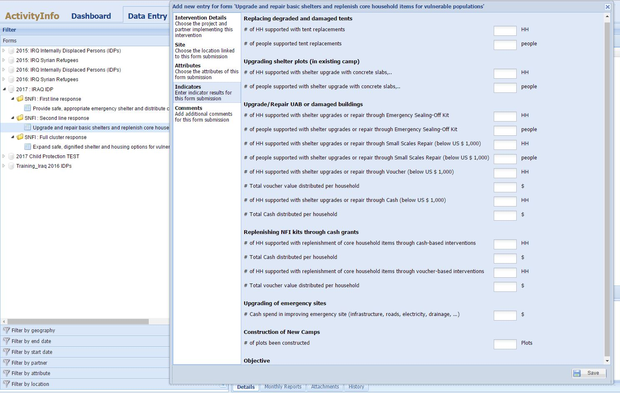
HOW TO REPORT?
Activities and Indicators under Second line response
http://sheltercluster.org/response/iraq
Always SAVE your data before closing the window

Slide 23
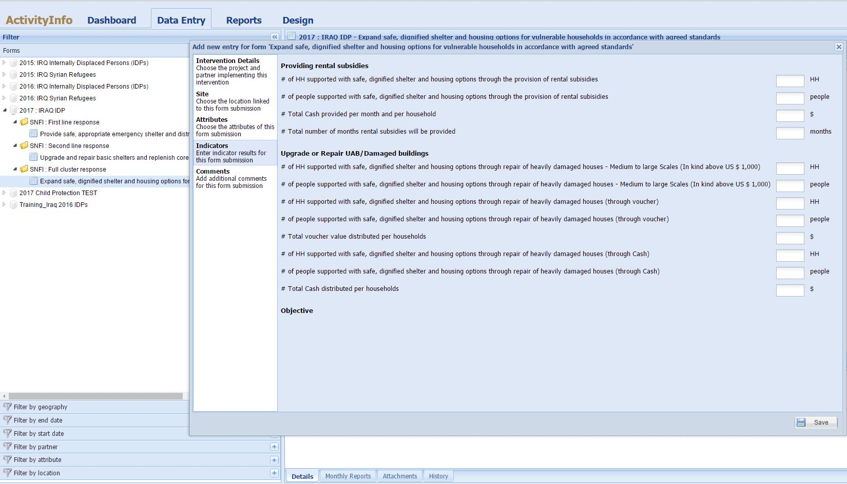
HOW TO REPORT?
Activities and Indicators under Full cluster response
Always SAVE your data before closing the window
http://sheltercluster.org/response/iraq

Slide 24
WHAT IS THE OUTCOME?
A Partner can export at any time, all partners data/input from AI as below.
2016 | 2017
http://sheltercluster.org/response/iraq

Slide 25
HOW TO REPORT?
If any challenges with your access or data entry, please liaise with your respective Cluster Information Management Officer.
We’re open to suggestions or bilateral discussions to improve our reporting to better reflect your interventions.
THANKS FOR YOUR CONTRIBUTIONS
Remember that all IM products and other relevant cluster supporting tool are available on the cluster webpage: http://sheltercluster.org/response/iraq
http://sheltercluster.org/response/iraq

Slide 26
4. ACTED PDM PROCESS
ACTED’s Appraisal, Monitoring & Evaluation Unit Post Distribution Monitoring Process
Iraq and NE Syria
Presented to the Iraq Shelter/NFI Cluster
15th February 2017

Slide 27
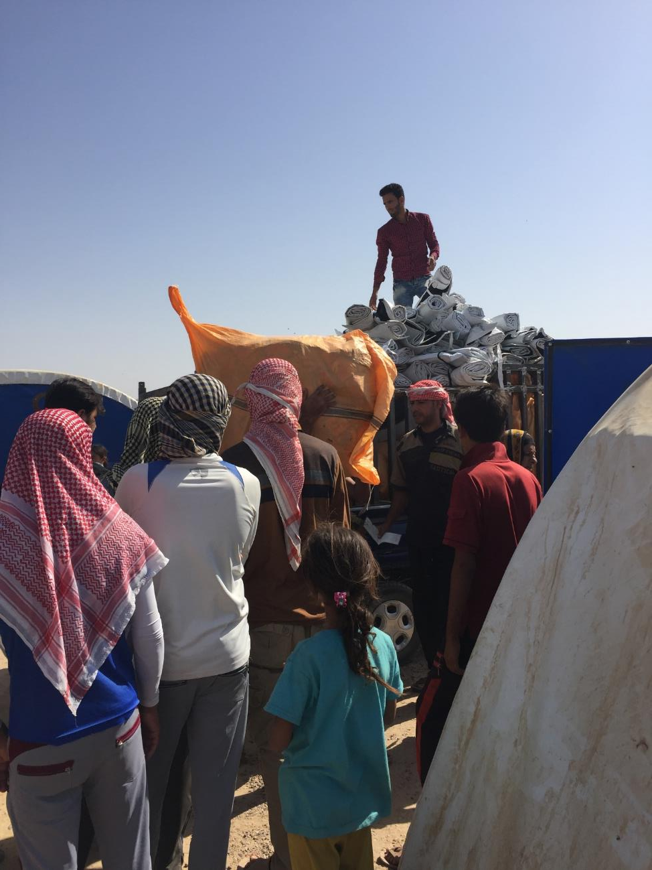
Why PDMs?
Feedback to Project team
  Improve performance
  Design better projects
Accountability to beneficiaries
Contractual requirement
  PDMs themselves or as tool to measure indicators

Slide 28
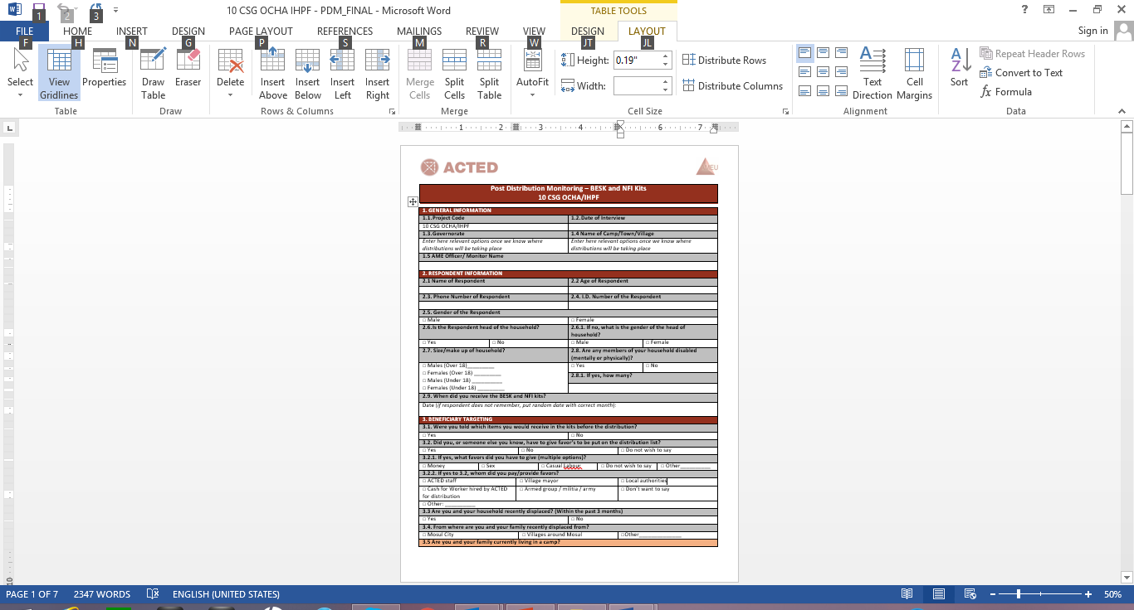

PDM Process
Project workplan approved and procurement
Distribution takes place
Input into report
Design tool
Administer PDM
Analyze data and write report
Program and test tool
Confirm methodology

Slide 29
How to design a PDM
1
2
Translate the tool
Program and test the tool
3
Determine sampling strategy
Determine methodology
Modify closest existing tool to align with project specifications
Receive input from project team
Observe distribution if possible

Slide 30
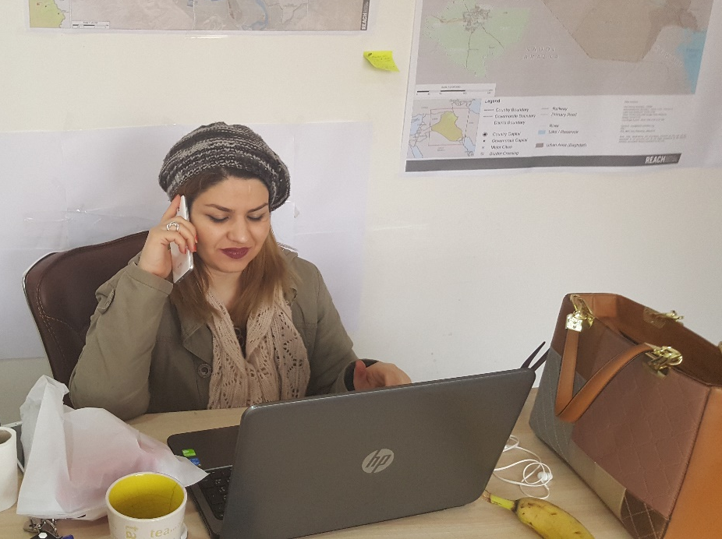
Who conducts them, where and when?
In the field at HH level vs by phone (resources, security, efficiency)
Observation only available in the field
Permanent staff vs enumerators
  Training
  # of interviews to be conducted
2 to 4 weeks post distribution

Slide 31
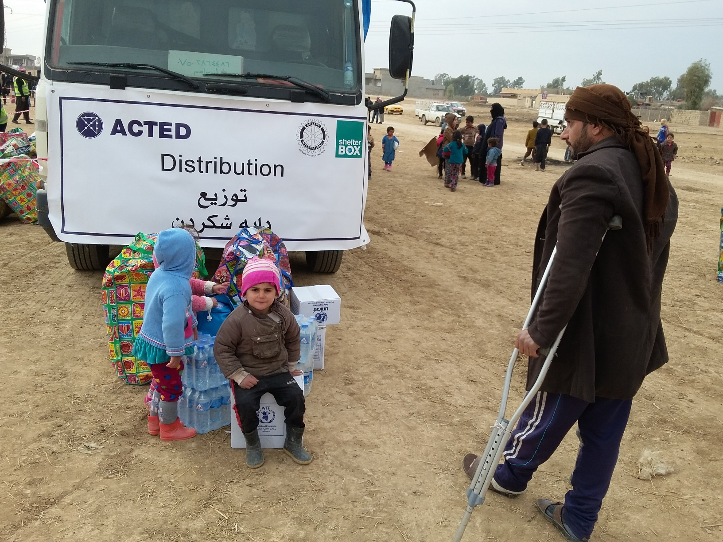
Questions?

Slide 32

5. Internally Displaced Persons Information Centre
On behalf of the UN Humanitarian Country Team in Iraq, UNOPS built and implements a national toll-free humanitarian hotline that allows displaced populations to access information on humanitarian services, provide feedback, and lodge complaints.
Increasing information exchange
Improve dialogue with affected communities
Strengthen the ability to listen and respond to the needs of affected communities
Accountability in Action
Advocacy

Slide 33
5. Services
Request for information on humanitarian services:
  Request assistance (food, NFIs, health, education, legal assistance)
  Replace legal documents
  Help in dealing with gender based violence
  Removing unexploded ordnance
Feedback and complaints on services provided
To reach a call centre operator toll free from any Iraqi mobile phone, dial 80069999

Slide 34
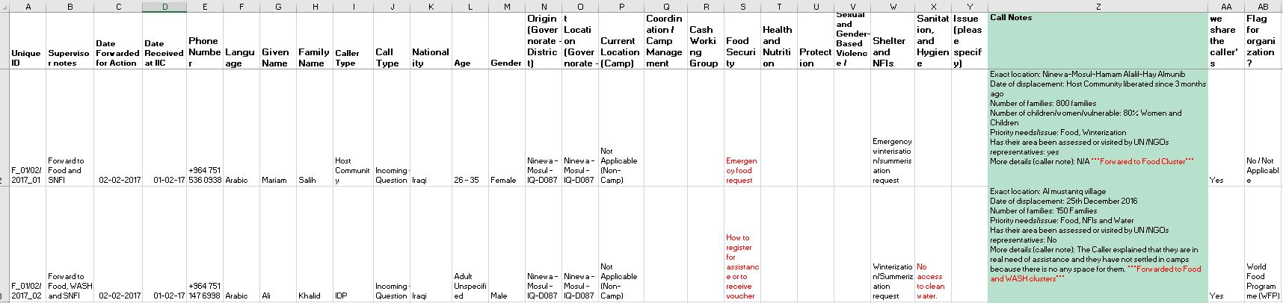
5. Example

Slide 35
5. Flow of Information
Focal points/area?
(Partners)
Affected population
Iraq IIC
Clusters
Separately
(Partners)
Partner’s hotline

Slide 36
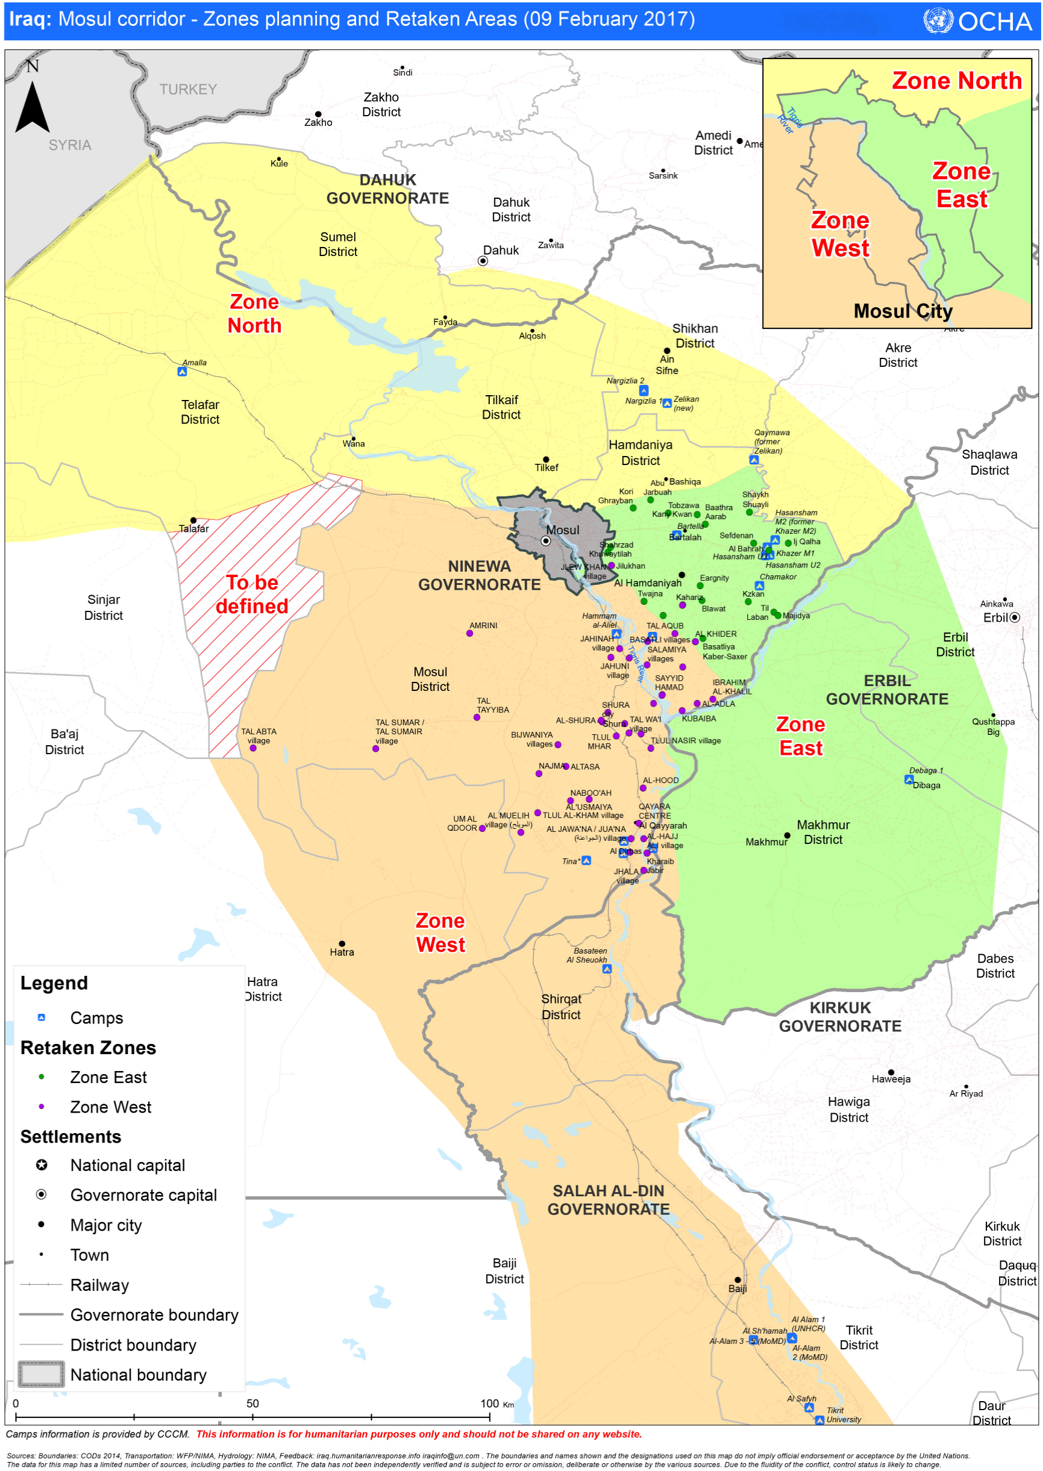

Slide 39
7. West Mosul – Camp Support
Dohuk Camps
Camp | Main NFI partners BNFI/CRI | NFI top up (inc. special needs) | Clothes, (UNICEF under 14) | Kerosene
Amalla | UNHCR |  |  | UNHCR?
Qaymawa | UNHCR |  |  | UNHCR?
Nargizlia 1 | UNHCR | WVI, PWJ | Tearfund | MoMD?
Nargizlia 2 | UNHCR | CRS |  | MoMD?
Zelikan (new)

Slide 40
7. West Mosul – Camp Support
Hassansham Camps
Camp | Main NFI partner(s) BNFI/CRI | NFI top up (inc. special needs) | Clothes (UNICEF under 14) | Kerosene
Chamakor | MoMD/UNHCR |  |  | MoMD
Hassansham M2 | MoMD/UNHCR |  |  | MoMD
Hassansham U2 | MoMD/UNHCR |  |  | MoMD
Hassansham U3 | MoMD/UNHCR |  |  | MoMD
Khazer M1 | MoMD/UNHCR |  |  | MoMD

Slide 41
7. West Mosul – Camp Support
Ninewa Governorate & Zone West Camps
Camp | Main NFI partners BNFI/CRI | NFI top up (inc. special needs) | Clothes (UNICEF under 14) | Kerosene
As Salamyaih
Bartella
Hammam al-Aliel | SC, QRCS, UNHCR?
Haj Ali | IOM |  |  | MoMD/IOM
Jed’ah | UNHCR?
Qayyarah A/strip | IOM |  |  | MoMD/IOM

Slide 42
8. AOB
Shelter and NFI Assessments in east Mosul
  ACTED Snapshots
  Joint Cluster Assessment??
Next meeting will be Wednesday 1st March, 11:00am at NCCI
http://sheltercluster.org/response/iraq

