Slide 1
Sub-National Shelter & NFI Cluster Coordination meeting for C &S
Agenda
1. Review of Action Points
2. Information Management (Activity Info Reporting)
3. Key Issues
AUBs /IDPs evictions, Kirkuk and Tikrit
Summer kits Plans
Anbar Mission – observations, pictures
4. Governorates Updates
Shelter interventions for returnees in critical shelter in Anbar and Diyala – Partner input
Winterization Updates – winter top up and Kerosene
Tent Replacement Updates
Anbar governorate camp closures updates.
5. AOB
Wednesday, 22nd February 2017
http://sheltercluster.org/response/iraq

Slide 2




0. Cluster Team Structure
Ryan Smith
Roving Cluster Coordinator (Duhok) - Zone 2 Focal Point
Catholic Relief Services
+964 (0) 751 755 8451
coordroving.iraq@sheltercluster.org
Richard Evans - UNHCR National Cluster Coordinator +964 (0) 771 994 5694 coord.iraq@sheltercluster.org Michel Tia - IOM Information Management Officer - National +964 (0) 750 021 1720 im2.iraq@sheltercluster.org Cornelius Weira - IOM Sub National Co-Chair - Centre and South Mobile +964 (0) 751 234 2548 coord4.iraq@sheltercluster.org | Michael Gloeckle - NRC National Co-Chair - Technical Coordinator +964 (0) 750 878 7793 coord2.iraq@sheltercluster.org Shada Qahoush- Catholic Relief Services Ninewa & Mosul Focal Point +964 (0) 751 755 8451 coordroving.iraq@sheltercluster.org

Slide 3
Review of action points from previous meeting
Share distribution plans with Shelter and NFI Cluster IMO – Ongoing
Share two names of persons from each partner with IMO to be granted access to A.I - Ongoing
Share link with Partners of NFI guidelines Vs 11 for comments in cluster meeting minutes -Done
Share IMC/IRC January 2017 report on Anbar -Done
Provide AAF camp nomenclature to CRS - Done
Provide list of latest Kerosene and CRI distributions to Cluster -Done
Provide list of MODM distribution and tent replacement to Cluster –Not Received yet

Slide 4
2. Information Management Update
2017 HRP Reporting – Cluster Indicators and Activity Info
Cluster operational indicators to be uploaded into 2017 Activity Info: completed and shared
Shelter and NFI Cluster will have a separate database in Activity Info but linked to the Inter-cluster one.
No 4W matrix will be developed in 2017 / only Into Activity Info as the inter-cluster reporting platform. How to go about it ??
http://sheltercluster.org/response/iraq

Slide 5

Activity Info
Activity Info is the only reporting platform the Shelter and NFI cluster will be using in 2017 to capture all shelter interventions and NFI distributions undertaken in the country.
From now on, Activity Info will be our only source of information for the cluster internal dashboards but also the cluster contributions/inputs to any inter-cluster reports or dashboards in Iraq.
If so, how can a Partner report into Activity Info?
http://sheltercluster.org/response/iraq

Slide 6
2017 Shelter & NFI Cluster
Revised Reporting Template in ActivityInfo
How to report?
http://sheltercluster.org/response/iraq

Slide 7
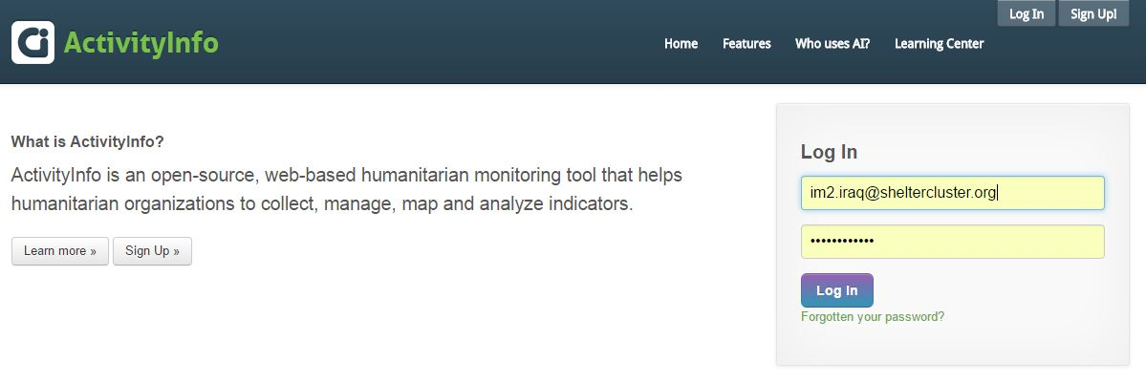
HOW TO REPORT?
Get a USER account in coordination with your respective Cluster Information Management Officer.
Get a Training and/or relevant supporting tools on how to report.
https://www.activityinfo.org
Log in using the mail address you provided while creating your USER account
http://sheltercluster.org/response/iraq

Slide 8
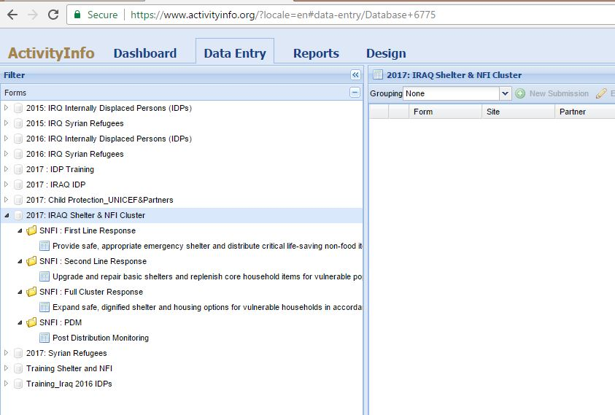
HOW TO REPORT?
Once you’ve logged in:
1 - select Data Entry
2 - select related Data Base (2017: IRAQ Shelter & NFI Cluster), where you can see the folders per response line or per strategic objectives.
http://sheltercluster.org/response/iraq

Slide 9

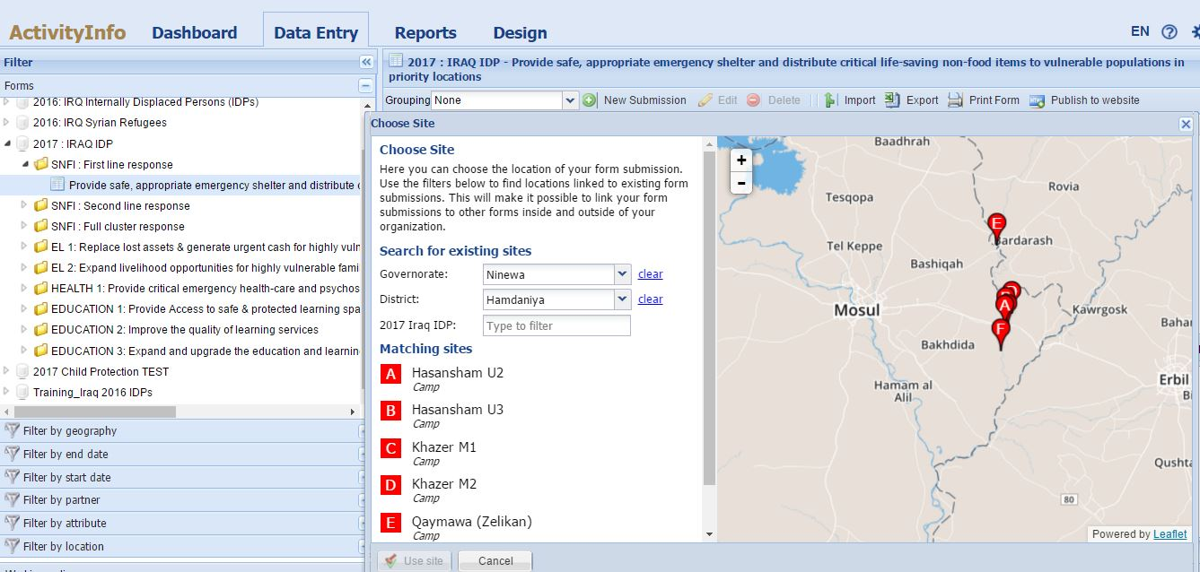
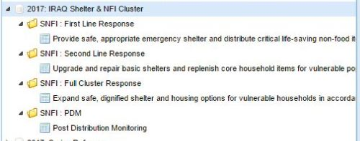
HOW TO REPORT?
Select the Governorate then the District.
Under Matching sites: double click on the Camp or District (if you’re reporting at district level).
Select the Governorate then the District.
Under Matching sites: double click on the Camp or District (if you’re reporting at district level).
http://sheltercluster.org/response/iraq

Slide 10
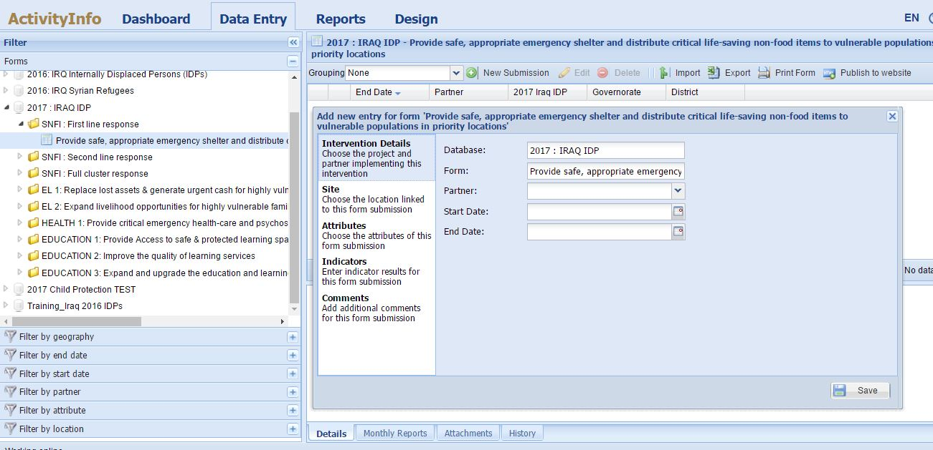
HOW TO REPORT?
The data entry starts here once you’ve selected the exact location of your interventions.
Please go through each step of this window and make sure you provide necessary information.
You can even upload a picture or a document only once you’ve saved your entries
The data entry starts here once you’ve selected the exact location of your interventions.
Please go through each step of this window and make sure you provide necessary information.
You can even upload a picture or a document only once you’ve saved your entries
http://sheltercluster.org/response/iraq

Slide 11
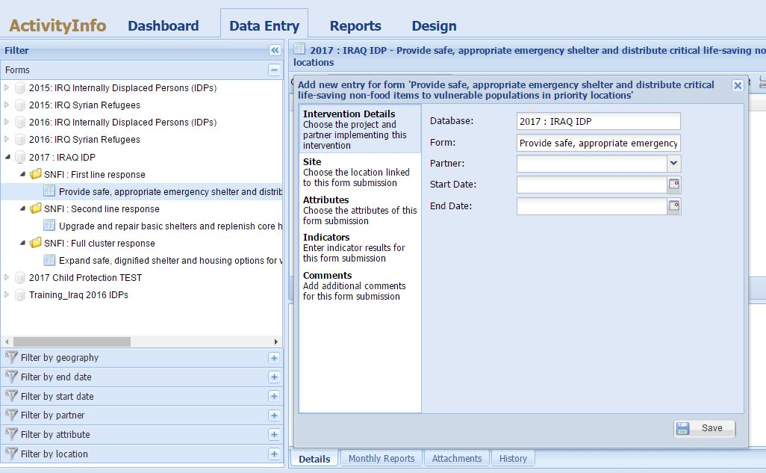
HOW TO REPORT?
Add here starting and ending date of your Shelter interventions or your NFI distributions you are reporting.
Please make sure start & end dates are within the same month.
If distribution is going into the other month, please do a second entry for that other month once opened in AI.
Add here starting and ending date of your Shelter interventions or your NFI distributions you are reporting.
Please make sure start & end dates are within the same month.
If distribution is going into the other month, please do a second entry for that other month once opened in AI.
http://sheltercluster.org/response/iraq

Slide 12
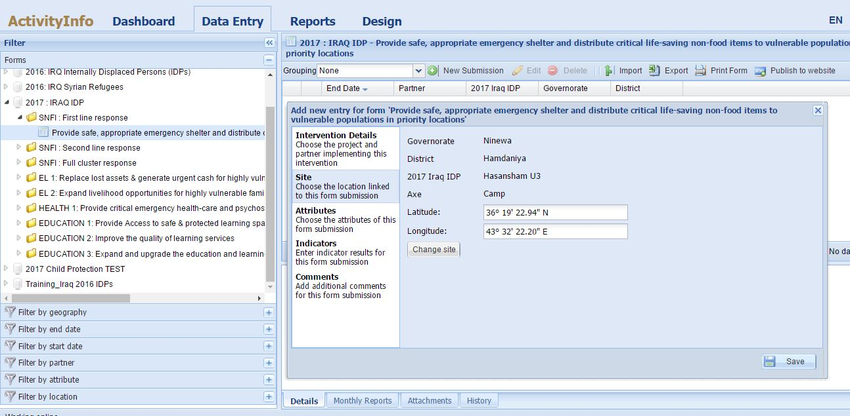
HOW TO REPORT?
Here is to double check the location you’ve selected. In case it is not the one you wanted, you can change !!
Here is to double check the location you’ve selected. In case it is not the one you wanted, you can change !!
http://sheltercluster.org/response/iraq

Slide 13
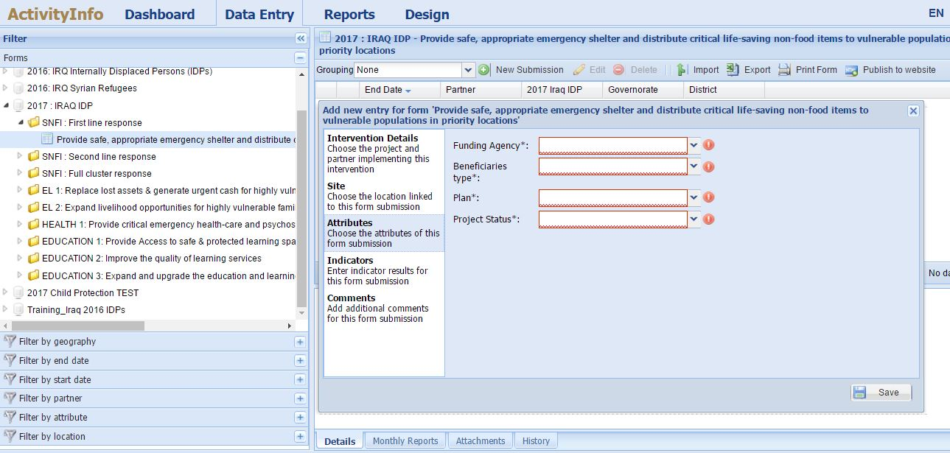
HOW TO REPORT?
Here are four sets of attributes all mandatory !!
Here are four sets of attributes all mandatory !!
http://sheltercluster.org/response/iraq

Slide 14
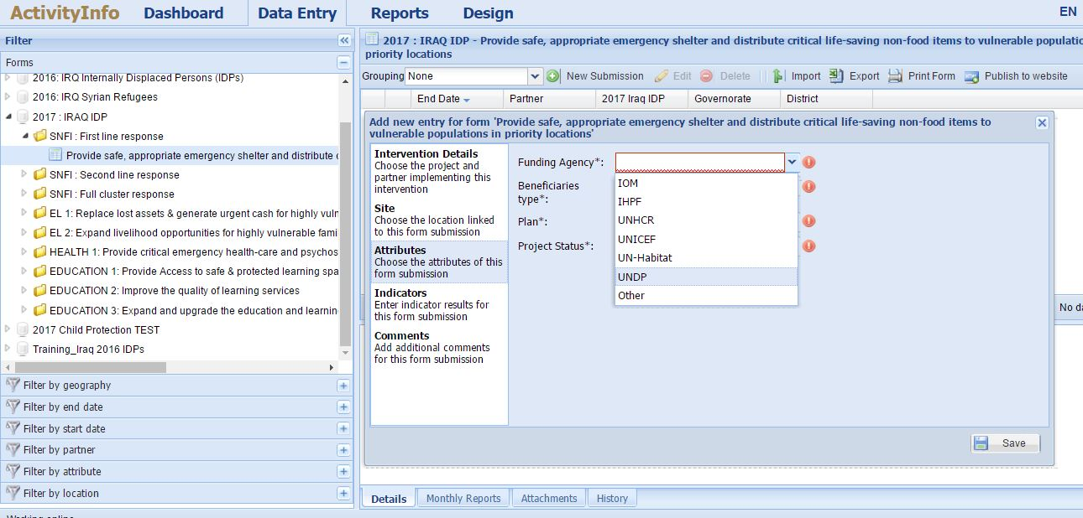
HOW TO REPORT?
Select the funding agency
Select the funding agency
http://sheltercluster.org/response/iraq

Slide 15
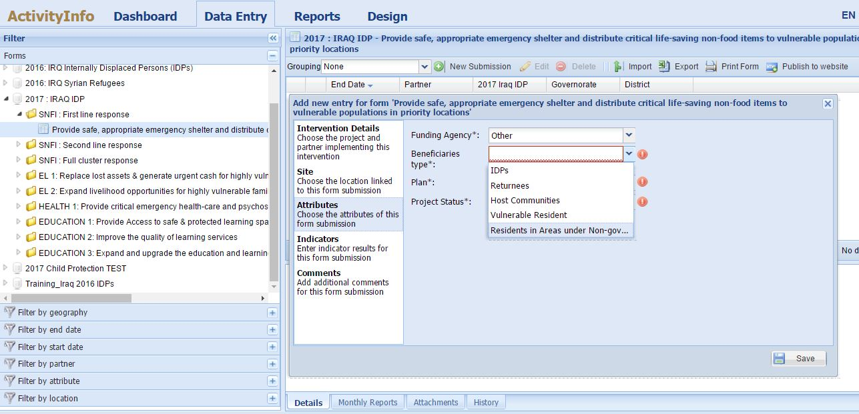
HOW TO REPORT?
Select the beneficiaries type
Select the beneficiaries type
http://sheltercluster.org/response/iraq

Slide 16
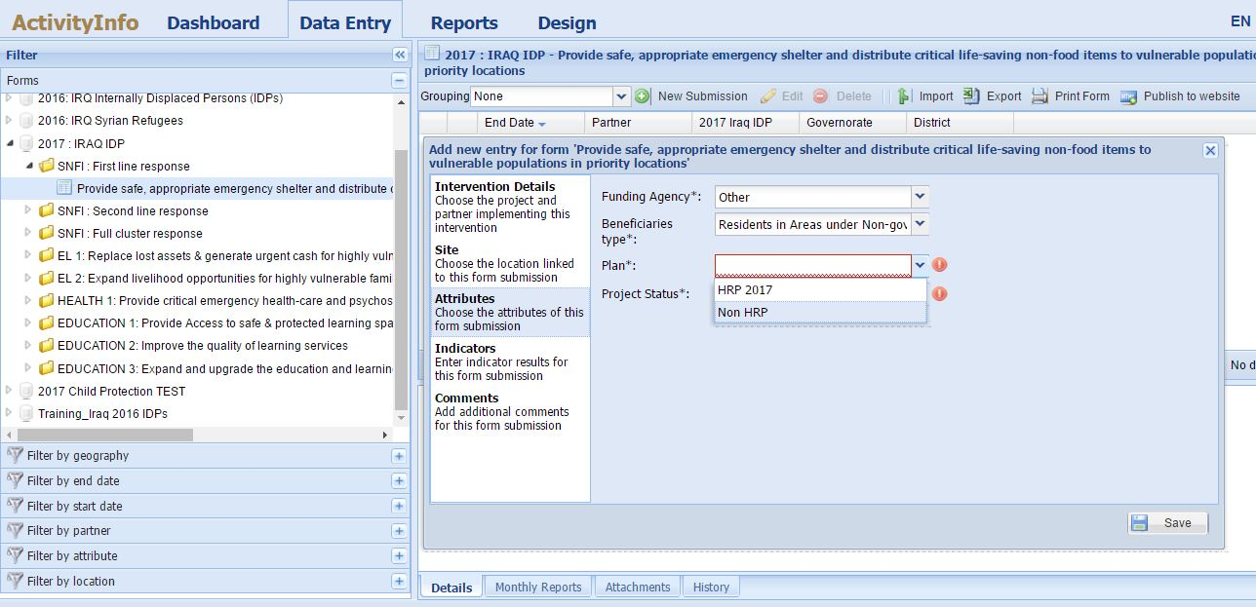
HOW TO REPORT?
Selecting the response plan ! Is your project part of the 2017 HRP (recorded in OPS) or Non HRP (not recorded in OPS)
Selecting the response plan ! Is your project part of the 2017 HRP (recorded in OPS) or Non HRP (not recorded in OPS)
http://sheltercluster.org/response/iraq

Slide 17
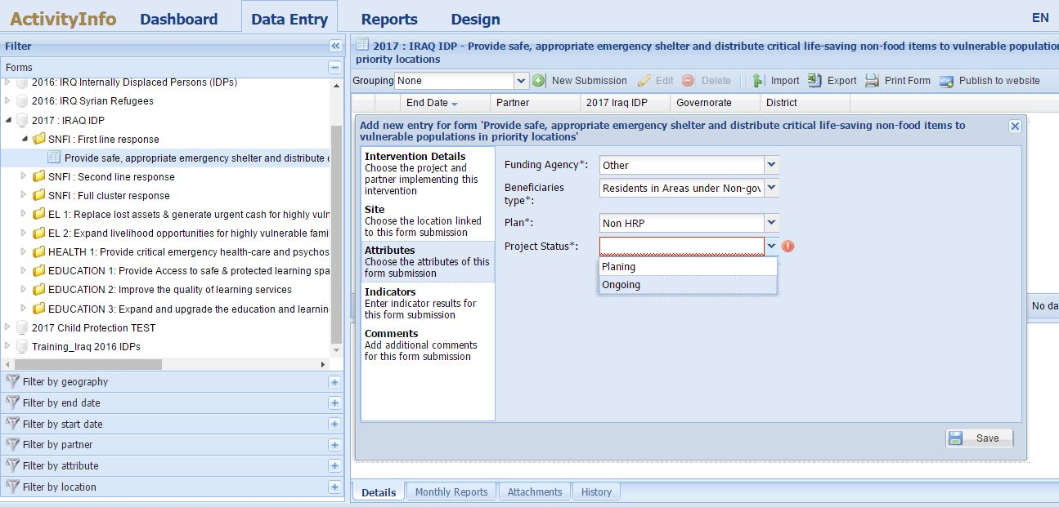
HOW TO REPORT?
Select the Project Status
Select the Project Status
http://sheltercluster.org/response/iraq

Slide 18
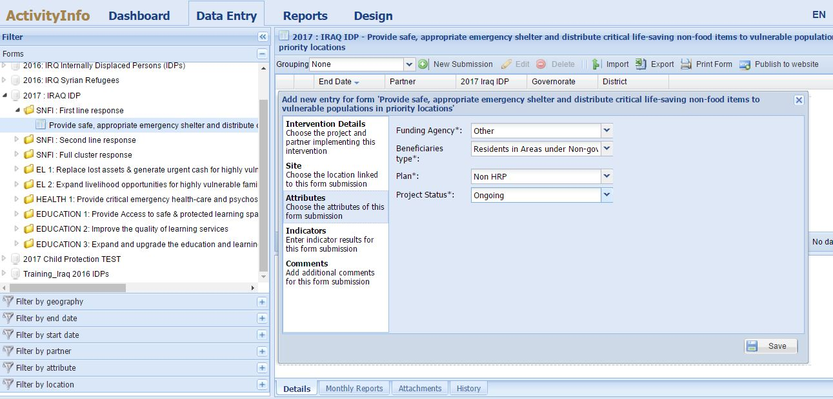
HOW TO REPORT?
Here you’ve fully informed the attributes.
Then click on Indicators to report your achievements.
As you’ll see the indicators are linked to the respective activities.
Here you’ve fully informed the attributes.
Then click on Indicators to report your achievements.
As you’ll see the indicators are linked to the respective activities.
http://sheltercluster.org/response/iraq

Slide 19
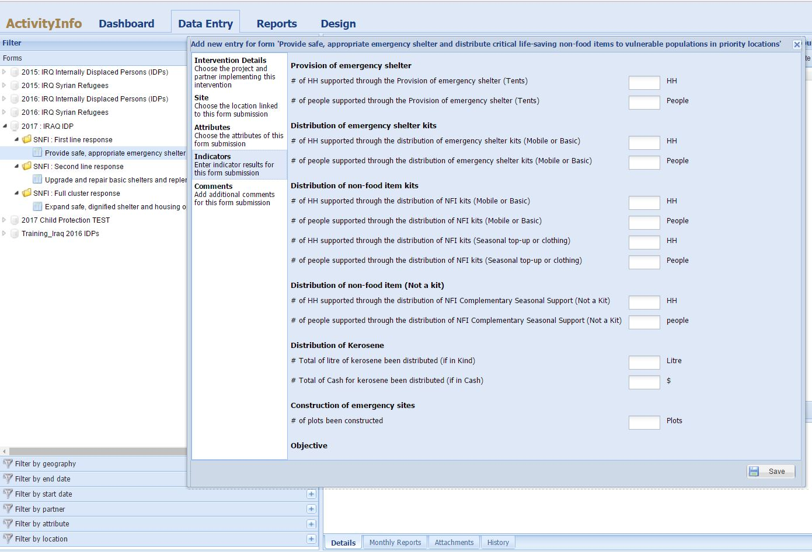
HOW TO REPORT?
Activities and Indicators under First line response
Activities and Indicators under First line response
Always SAVE your data before closing the window
Always SAVE your data before closing the window
http://sheltercluster.org/response/iraq

Slide 20
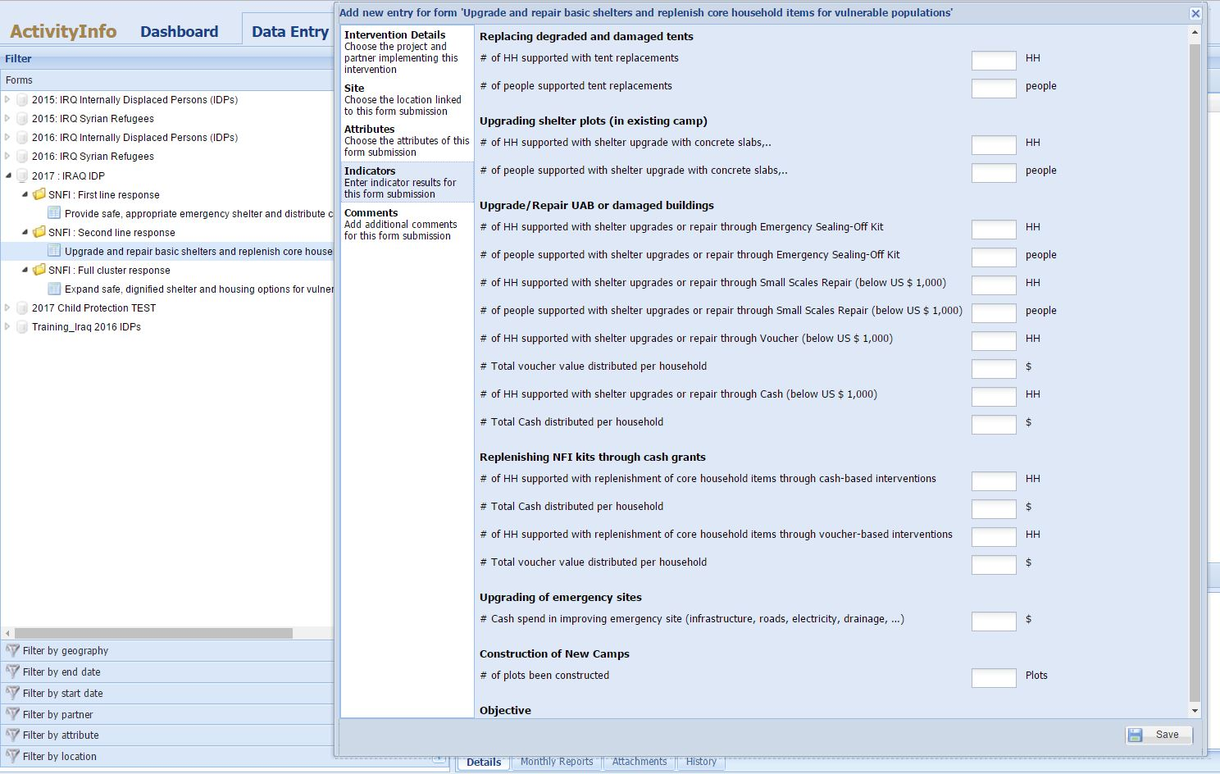
HOW TO REPORT?
Activities and Indicators under Second line response
Activities and Indicators under Second line response
Always SAVE your data before closing the window
http://sheltercluster.org/response/iraq
Always SAVE your data before closing the window

Slide 21
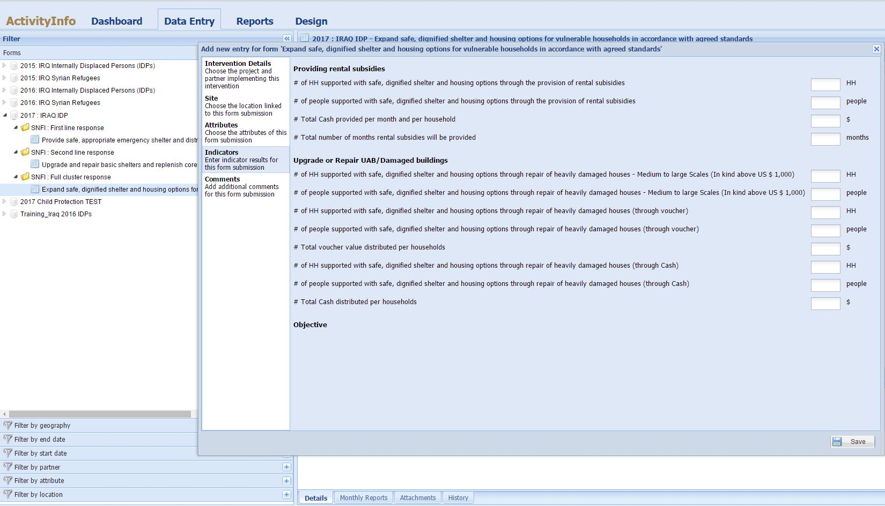
HOW TO REPORT?
Activities and Indicators under Full cluster response
Always SAVE your data before closing the window
http://sheltercluster.org/response/iraq

Slide 22
HOW TO REPORT?
If any challenges with your access or data entry, please liaise with your respective Cluster Information Management Officer.
We’re open to suggestions or bilateral discussions to improve our reporting to better reflect your interventions.
THANKS FOR YOUR CONTRIBUTIONS
http://sheltercluster.org/response/iraq

Slide 23
4. Key Issues
AUBs /IDPs evictions, Kirkuk and Tikrit
Reports of evictions of IDPs living in AUBs /Out of Camp have been received by the Cluster ; government is moving all evicted IDPs to Al Shahama and Al Alam 3MODM Camps.
A total of 20,000 Individuals will be affected in Tikrit alone.
IDPs living in Dream city , Qaddissiya and Shakalaw among those to be evicted
A 10 day notice was given, OCHA engaged the local authorities and some flexibility on the deadline has been agreed.
Similar evictions taking place in Kirkuk
Colleagues in Kirkuk to provide regular updates on numbers and areas affected.

Slide 24
4. Key Issues
Summer kits Plans
Partners are reminded to get ready with the summer plans . Once the window is open in AI Partners will upload the plans.
Partners who have not submitted names of two focal points from your organization for access to the activity info , please do so asap.

Slide 25
4. Key Issues
Anbar – AAF Mission – observations, pictures
Some IDPs living out of Camp did not receive winterization support despite receiving the same assistance last season- these are IDPs living in AAF . The IDPs are living in the self settled arrangements in the community and religious buildings .
The Mission visited 33 Families ( 218 individuals) from Jofa Sahra and Zobar close to West of Baghdad. The families have lived in this location since 2014.
IOM has supported these families with NFIs , six months ago, SOKs and shelter upgrades
Further support is needed on Shelter upgrades ( especially on roofing , doors and lighting ) and summer Kits
Electrical wiring has been improved in camps under IOM in AAF
CRS is doing T-Shelters , questions on beneficiary selection.

Slide 26
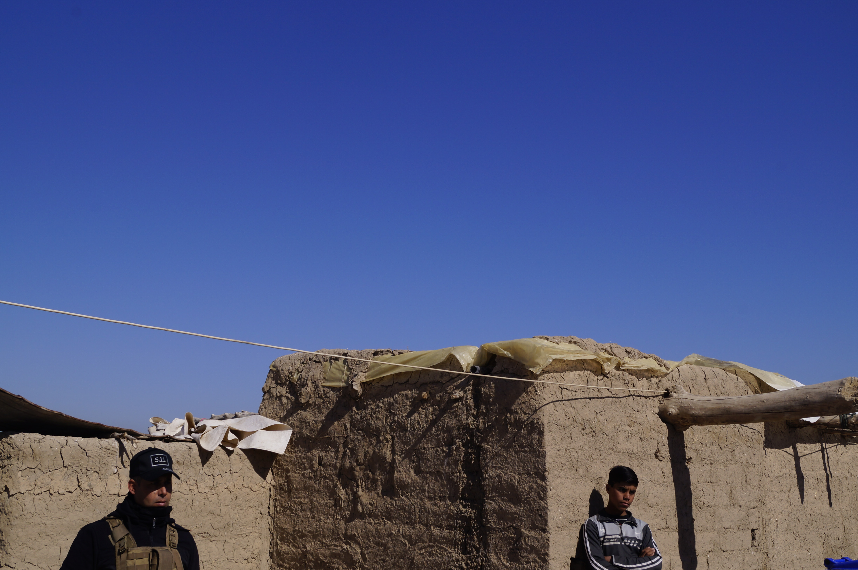
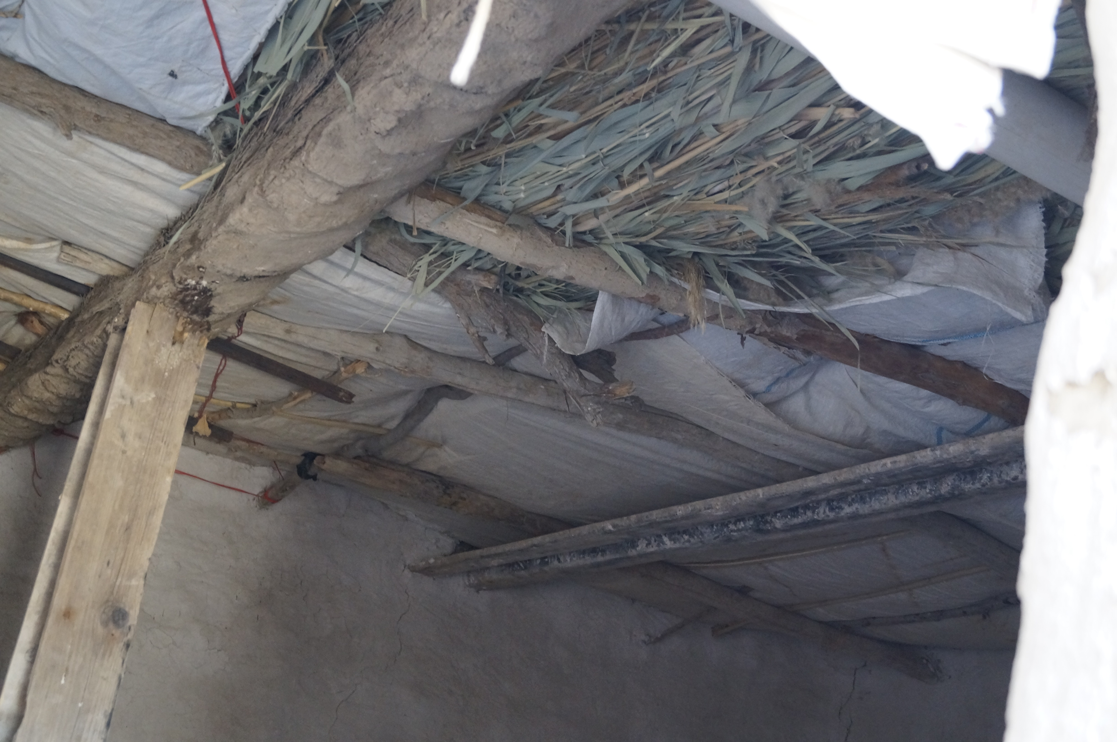
AAF -Mission Pictures
Shelter for IDPs out of Camp In AAF
Roof from inside one of the shelters for IDPS out of camp in AAF

Slide 27
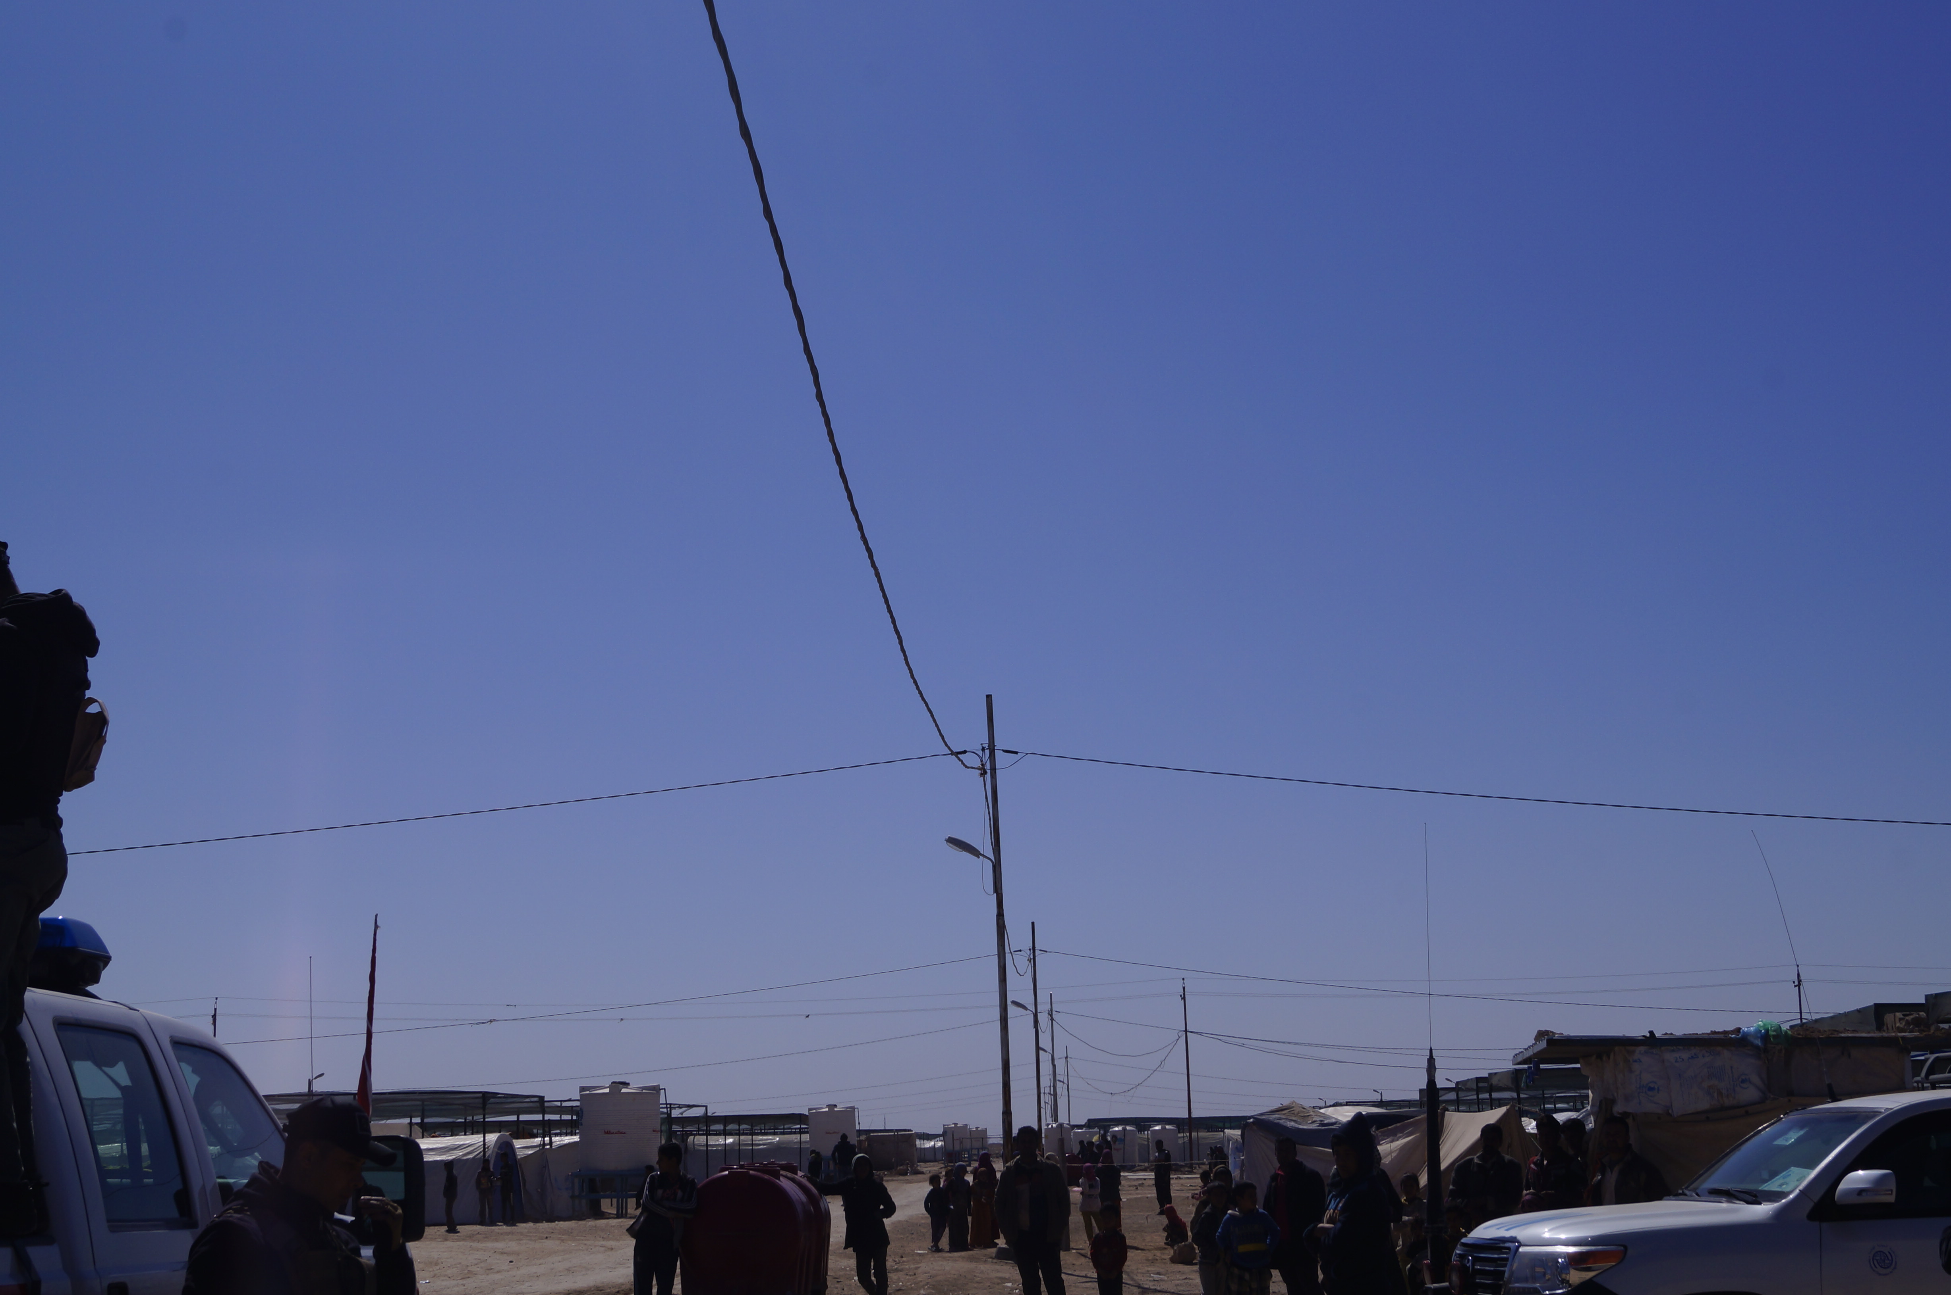
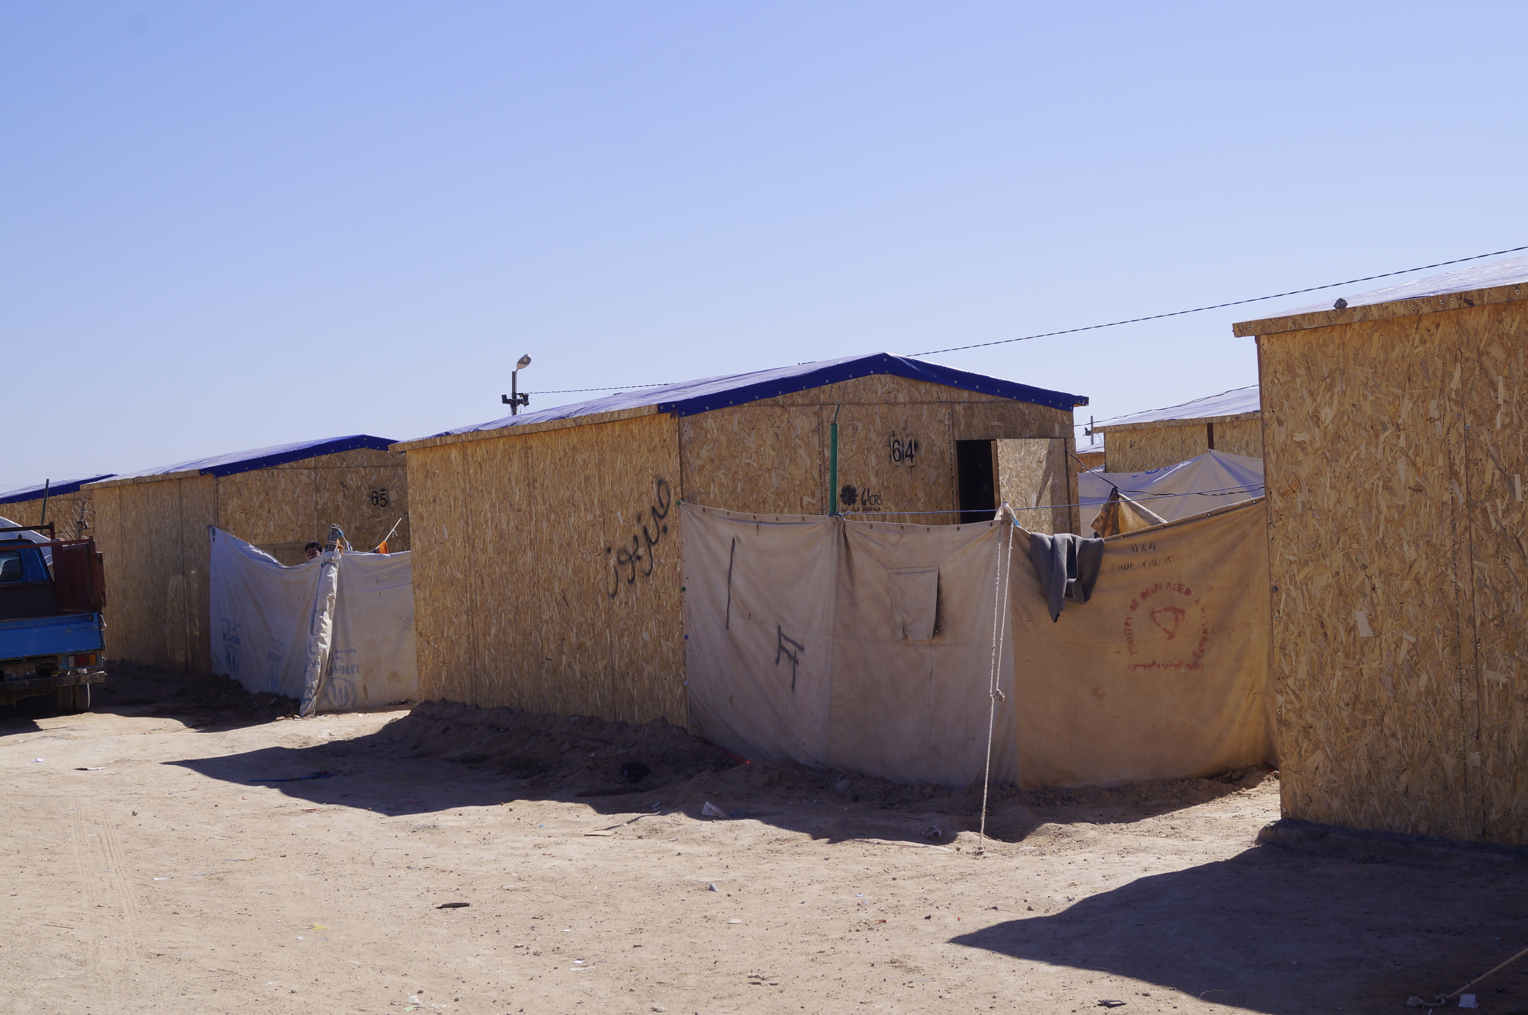
AAF -Mission Pictures
Previously these cables were laying on ground- IOM has raised them on electrical poles with circuit breakers
SRS’ T-Shelters in AAF – as part of tent replacement

Slide 28
5. Governorates updates
Shelter interventions for returnees in critical shelter in Anbar and Diyala – Partner input
Winterization Updates – winter top up and Kerosene
Tent Replacement Updates
Anbar governorate camp closures updates.

Slide 29
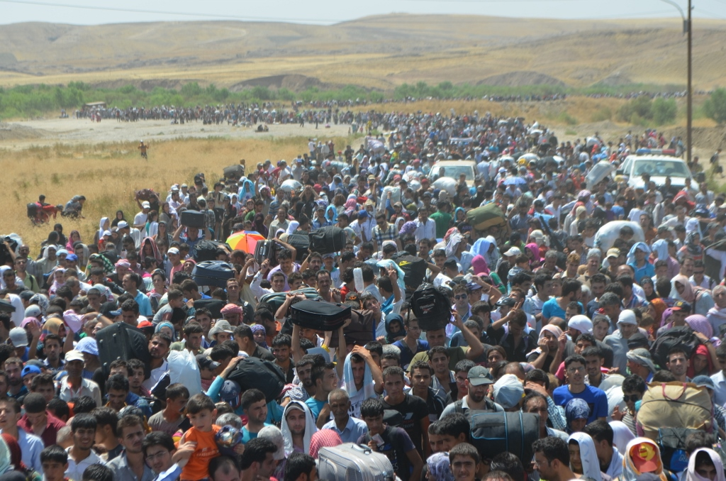
6. AOB

Slide 30
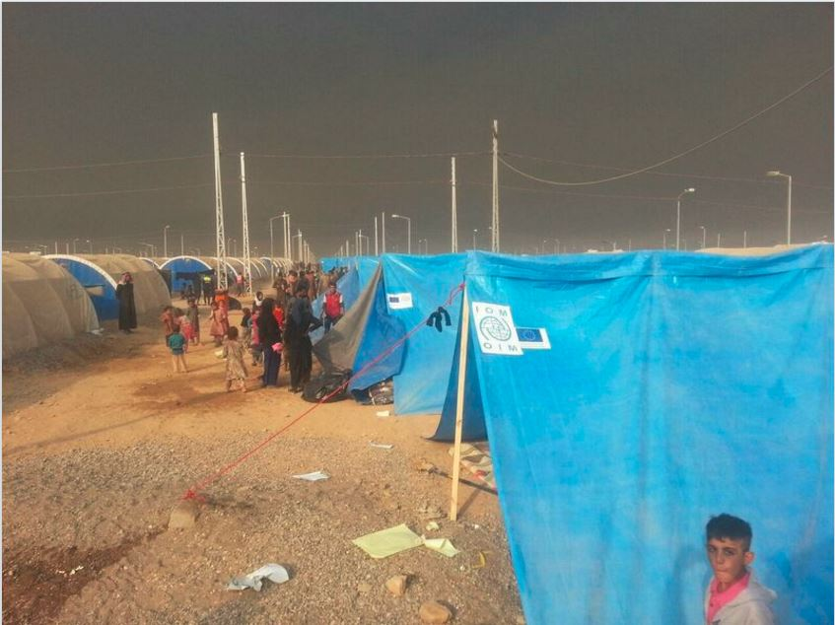
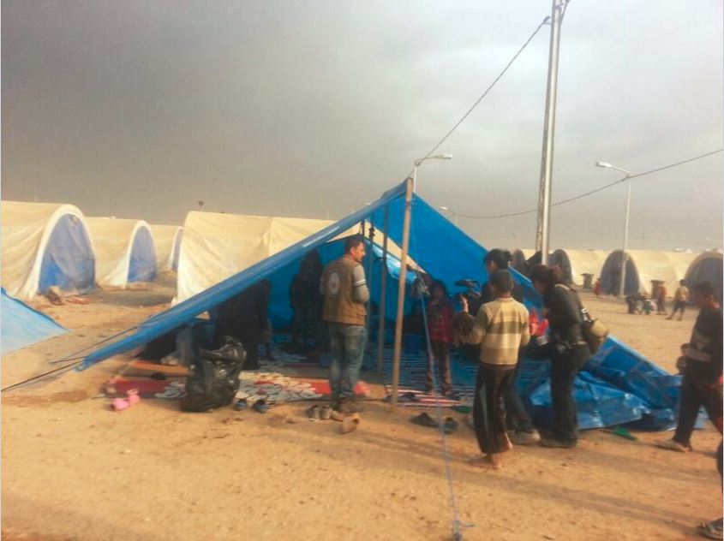
THANKS
http://sheltercluster.org/response/iraq

