Slide 1
National Shelter & NFI Cluster Coordination including KR-I and Mosul
Agenda
Introductions and Action Points
Information Management & Activity Info
Assessments
Field Level Coordination
West Mosul - Shelter & NFI Camps
AOB
- Partner Updates
- NFIs vs CRIs
Wednesday, 1st March 2017
http://sheltercluster.org/response/iraq

Slide 2




1. Cluster Team Structure
Ryan Smith
Roving Cluster Coordinator (Duhok) - Zone 2 Focal Point
Catholic Relief Services
+964 (0) 751 755 8451
coordroving.iraq@sheltercluster.org
Richard Evans - UNHCR National Cluster Coordinator +964 (0) 771 994 5694 coord.iraq@sheltercluster.org Michel Tia - IOM Information Management Officer - National +964 (0) 750 021 1720 im2.iraq@sheltercluster.org Cornelius Weira - IOM Sub National Co-Chair - Centre and South Mobile +964 (0) 751 234 2548 coord4.iraq@sheltercluster.org | Michael Gloeckle - NRC National Co-Chair - Technical Coordinator +964 (0) 750 878 7793 coord2.iraq@sheltercluster.org Shada Qahoush- Catholic Relief Services Ninewa & Mosul Focal Point +964 (0) 751 755 8451 coordroving.iraq@sheltercluster.org

Slide 3
2. Information Management Update
2017 HRP Reporting – Activity Info & Cluster contributions to the Inter cluster dashboard & Operational Presence.
2017: IRAQ Shelter & NFI Cluster : this is the name of Shelter and NFI Cluster database in Activity Info.
2017 Cluster contributions : in terms of coverage (achievements & operational presence) should be coming from Activity Info.
As no 4W matrix been developed in 2017 how partners can have access to the overall cluster data? Extract data from AI.
http://sheltercluster.org/response/iraq

Slide 4

2. Information Management Update
2017 Shelter & NFI Cluster
How to extract data from ActivityInfo
once you’ve logged in..
http://sheltercluster.org/response/iraq

Slide 5
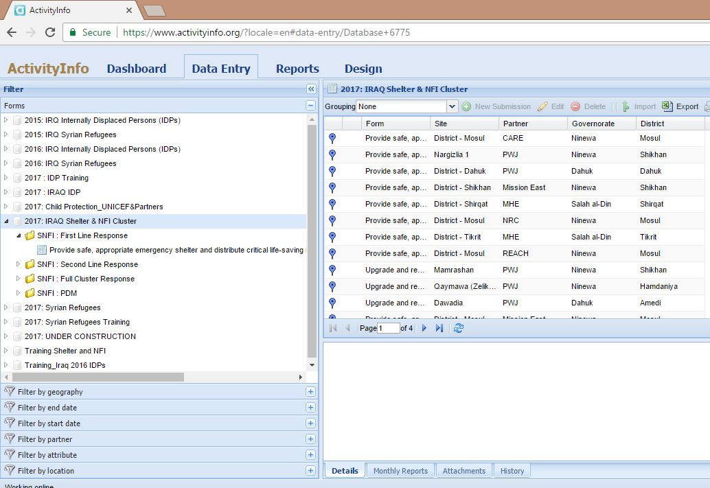
How to extract data from Activity Info once you’ve logged in :
Click on Data Entry
Select the database or the Form
Click on Export
http://sheltercluster.org/response/iraq

Slide 6
Should we stop reporting Mosul Response into KOBO and keep updating Activity Info?

Slide 7
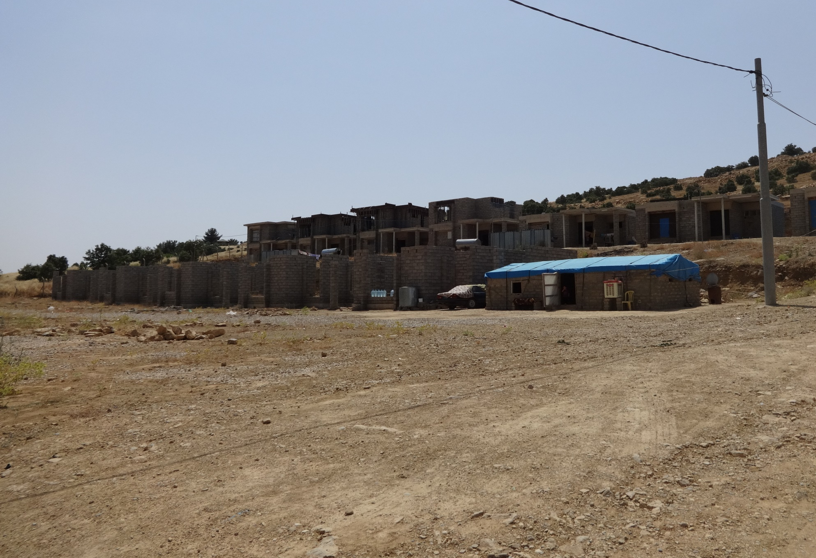
3. Multi-Cluster Needs Assessment IV
Shelter Cluster
Erbil, 1 March 2017

Slide 8
Background to MCNA IV
Objective: Cluster-driven process that provides comprehensive evidence base of needs amongst internally displaced populations (IDPs) living in non camp-settings across the whole of Iraq.
Type of assessment: MCNAs focus on the needs, perceptions and vulnerabilities of IDPs outside of camps at household level; how they prioritise their needs and view quality of assistance (across all sectors).
Provides ‘big picture’, comparative overview (nation-wide, district and governorate level) based on primary data, for specific sectors.
Ideally used as evidence-base by clusters to guide HNO/HRP process, and complement cluster-driven interventions.
Recurring , nation-wide, longitudinal analysis: The MCNA IV is a nation-wide assessment, and will collect comparable data at the district-level in Centre-South for the third time, and for the fourth time in KRI.
Nation-wide scope allows for country-wide comparisons at the governorate and district level.
MCNA is the only assessment which allows for nation-wide analysis of trends over time (third year in a row).
Background
Methodology
Indicator Review
Q&A

Slide 9
Overview of MCNA cycle
Research design
Indicators, forming the basis of the survey tool, are reviewed at the cluster-level ahead of data collection.
Preliminary findings
Preliminary findings presentations are held with all operational clusters (within 1-2 weeks of data collection).
Analysis
Cluster feedback informs in-depth analysis tailored to cluster-specific needs and triangulation of data.
Dissemination
Final output and cluster-specific findings shared with cluster partners including the open access dataset.
Data collection
Majority of data is collected directly by REACH. For some inaccessible areas partners collect data.
Background
Methodology
Indicator Review
Q&A

Slide 10
MCNA IV and HNO/HRP process
HRP Alignment: MCNAs usually align with the HNO/HRP process to inform multi-cluster programming.
Cluster-driven assessment: Cluster leads are included throughout the process.
Open access dataset: clean dataset with cluster leads for dissemination, and can be used as a resource for additional data analysis.
Open access dataset: clean dataset to be shared this week among cluster leads to allow for more in-depth anaylsis by IMOs
Background
Methodology
Indicator Review
Q&A
2017 HRP
Why MCNA IV?
Will provide up to date needs information to aid planning for interventions going forward (across sectors) and can inform potential HRP 2017 Review.
HRP Advanced Executive Summary version launched in mid-December due to Mosul offensive with possibility of a revised version to be published later on (without preliminary HNO).
Funding allocations for international partners to begin within the next few weeks based on project portfolios submitted in January 2017.
Aiming to be disseminated by June 2017, this is timely as there is a significant gap in a comprehensive needs assessment (over 1 year since the last MCNA).
Will be supplemented with MCNA V ahead of HRP 2018 process.

Slide 11
Methodology
Coverage
Whole of Iraq assessment (security permitting), which plans to cover:
18 Governorates (based on accessibility and not all districts).
75% of districts to be covered (82 of the 109 districts will be covered that have an IDP presence).
Areas omitted due to security include: Anbar (6 districts), Baghdad (8 districts), Erbil (2 districts), Kirkuk (Hawiga), Ninewa (7 districts) and Salah -al-Din (5 districts).
Extended coverage from MCNA III: Partial access to Kirkuk, Salah -al-Din and Anbar.
Data collection conducted by trained national enumerators starting in mid-March and to complete in mid- April.
Sampling
Household level data collection with significant results at governorate level, with a 95% confidence level and 10% margin of error; and a district level significance with a 90% confidence level and 10% margin of error.
Cluster sampling using GIS points based off IOM DTM data on IDP population size and respective location in Iraq.
Background
Methodology
Indicator Review
Q&A

Slide 12
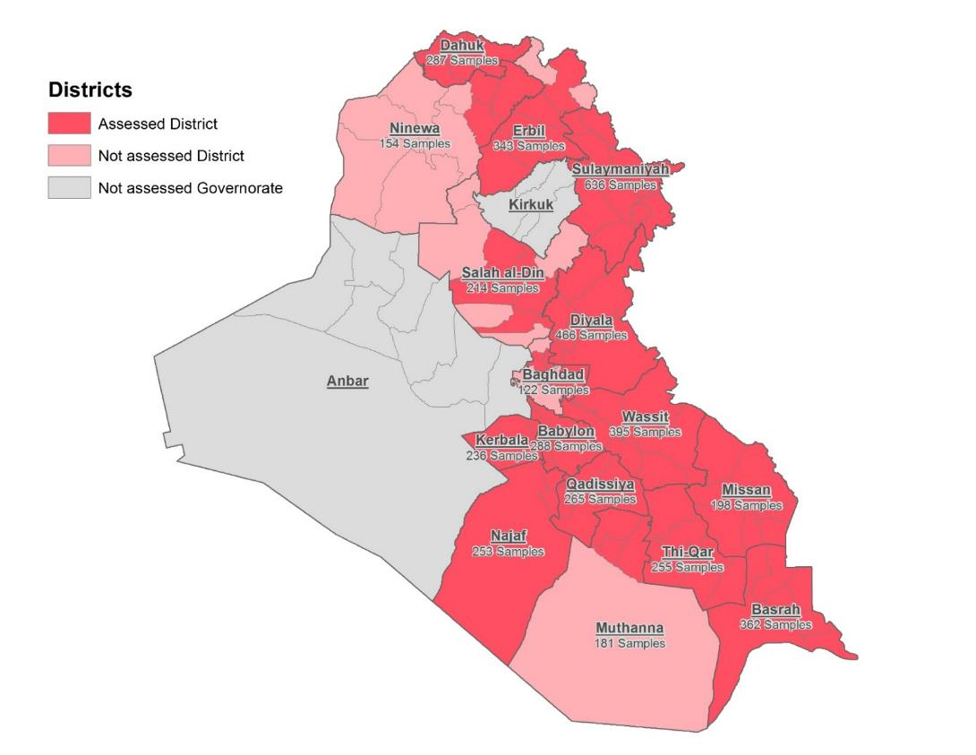
Methodology
Coverage of areas during previous MCNA (III)
Background
Methodology
Indicator Review
Q&A

Slide 13
Indicator Review
Background
Methodology
Indicator Review
Q&A
Indicator Review Process:
Using the indicators from the previous MCNA III round:
Cluster Coordinator to disseminate to all Shelter/NFI partners for review;
Consolidated feedback to be provided to REACH by 8 March (1 week period);
REACH reviews and, if needed, amends the tool and analytical frame in response to FSC feedback.
Key considerations:
Minor revisions only to enable longitudinal trend analysis. Please keep in mind that this tool has undergone full cluster review three times prior to this round.
Please review based on relevance; if something is agreed as no longer relevant than can be removed.
Additional indicators can only be included by deleting another indicator, so would require a strong rationale and clarity on which indicator would be removed.
REACH can opt to keep an indicator if deemed crucial to other clusters or general longitudinal analysis.

Slide 14
Indicator Review
Background
Methodology
Indicator Review
Q&A
Q&A
REACH contacts:
Tessa Richardson: Tessa.Richardson@reach-initiative.org
Homera Cheema: Homera.Cheema@reach-initiative.org

Slide 15
Rapid Needs Assessment (RNA) mechanism
WHAT: Single rapid tool. | NOT In-depth sectoral assessment
WHY: Trigger either response or more detailed sector specific assessments. At a minimum, can flag a hotspot; at maximum, inform emergency response. | NOT identifying key priorities for the long term
WHO: All partners | -
WHEN/WHERE: Used at the very earliest stages in areas where no assessment mechanisms are in place. | NOT taking the place of existing assessments such as the Rapid RASP, RPA, MVAM, etc. Can trigger them and help prioritise access missions, RRM distributions, Emergency Response, sectoral assessments, etc.
HOW: Used for remote or on site info gathering at community level via DO or KI. ‘Quick and dirty’ and ‘good enough’ principle. | NOT conducted at household level.

Slide 16

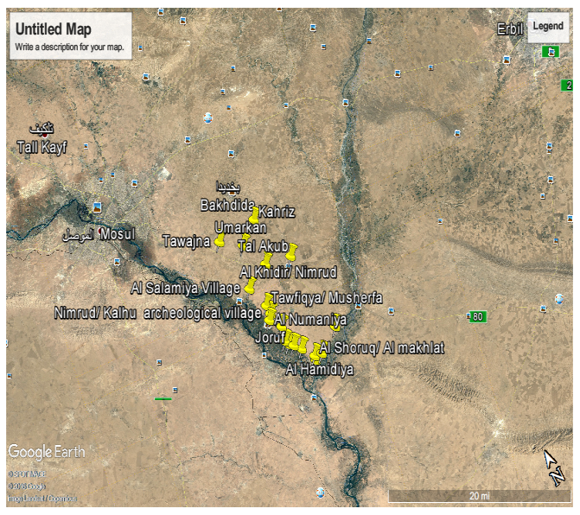
4. Field Level Coordination
Nimrod sub-district, Al Hamdaniya district, Ninewa governorate

Slide 17

Challenges
Many actors, some unknown, some not very responsive
Coordination efforts started in January 2017
Aligning assessment and distribution efforts
Needs of other sectors, no other focal points
Outcomes
Communication between partners on a bilateral level as well as via the skype group
Most actors took part in the coordination efforts
Duplications could be avoided (partners were able to cancel planned distributions)

Slide 18
Lessons Learnt
Willingness of actors to coordinate efforts was very strong
Feedback was very positive as soon as PIN announced to be focal point
Duplications could be avoided and gaps often filled
Field based coordination should be set up at the beginning of a response, this would help to properly track activities and improve the over all response
Field based coordination could be for all major sectors, as information gathering is very easy and integrated responses often implemented

Slide 19
Field based coordination takes some time and efforts. However, in an underfunded humanitarian crisis like in Iraq, it is a very good tool to respond timely and effectively to the needs of the affected population.
It should not be an exception, but a norm!

Slide 20
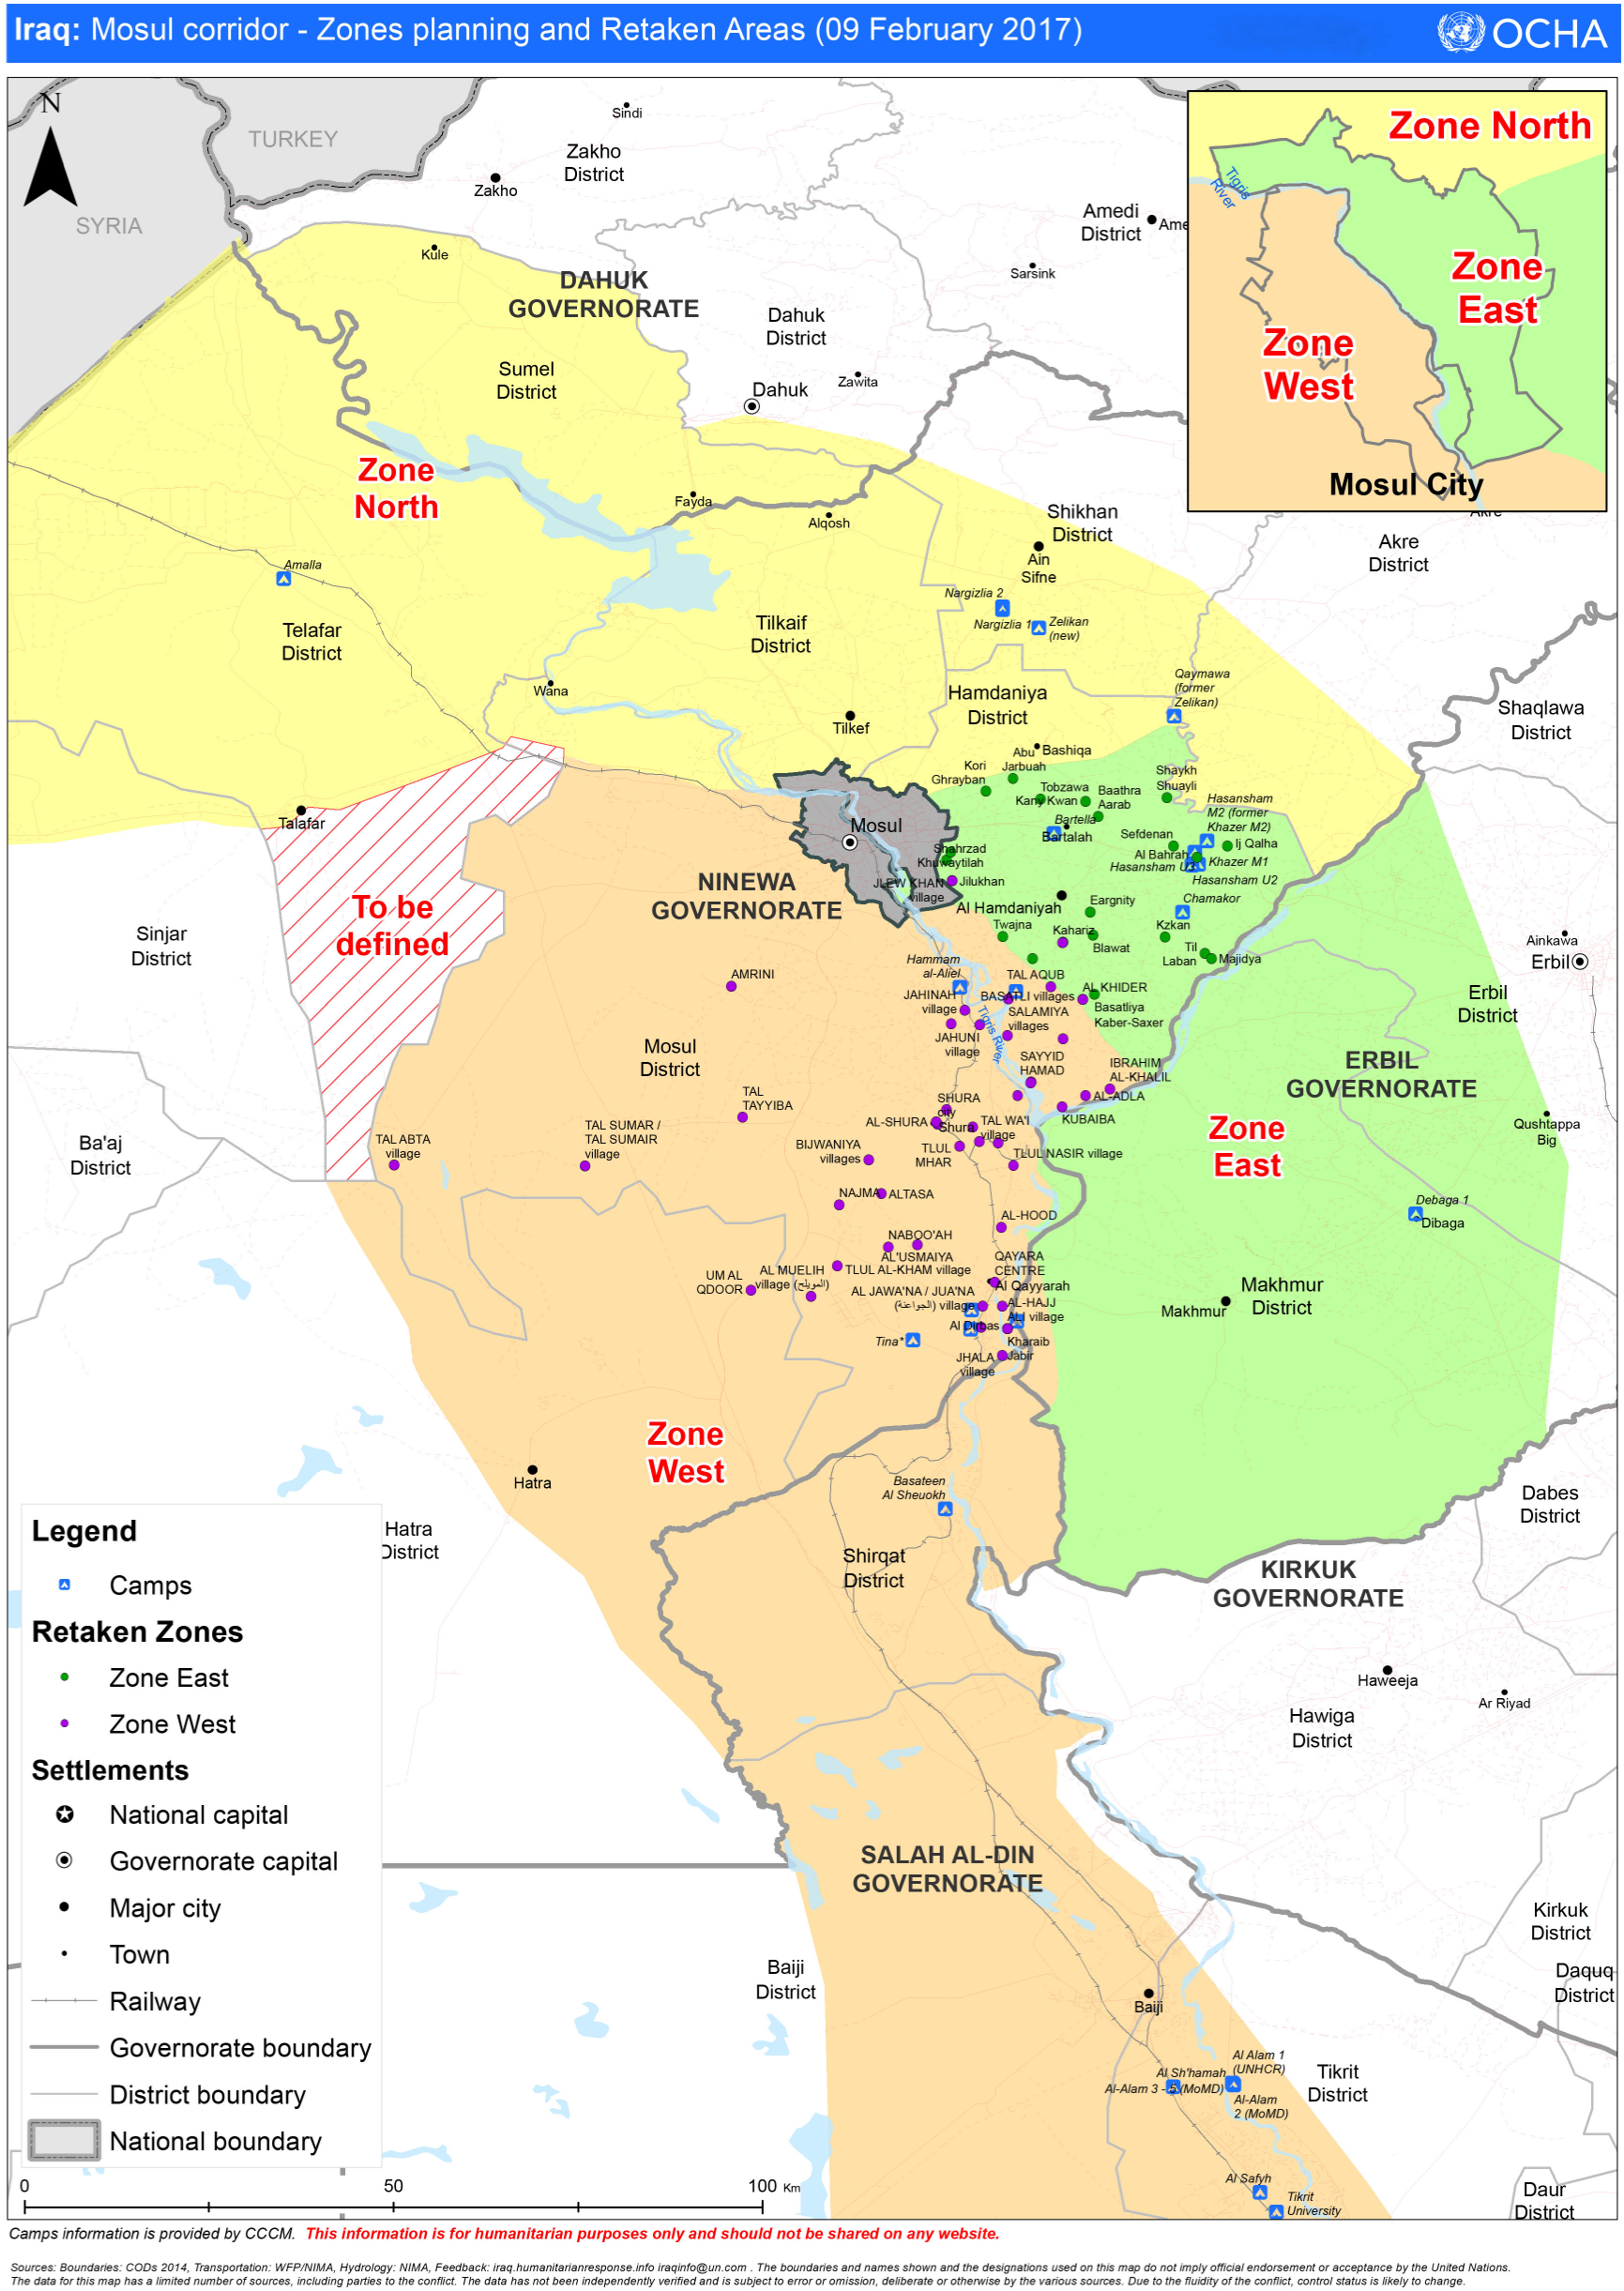
5. West Mosul – Shelter & NFI Camps

Slide 22

West Mosul Camps and E-Sites Preparedness Status | 24th Feb 2017
 | CAMPS/E-SITES | PLOTS | STATUS | TIMELINE | NOTES
EAST | Chamakor (UNHCR) | 2,400 plots |  | Ready | The camp construction is ready. Partners have been identified and they are in standby.
 | Khazer M1 (MoDM) | 1,000 plots |  | Ready | Due to the number of returnees, the camp has now space available to welcome newly arrivals. If the number of returnees increase in the coming days, then more than 1,000 plots will be available.
 | Hasansham M2- extension | 1,000 plots |  | By Beginning of March | The construction of the site is 80% completed, including wash facilities.
 | Hasansham U2 (UNHCR) | 1,500 plots |  | By Beginning of March | The construction of the site is 70% completed. Partners have been identified.
 | CAMPS/E-SITES | PLOTS | STATUS | TIMELINE | NOTES
WEST | Haj Ali (IOM) | 2,640 plots 2,640 plots |  | By Beginning of March By Mid-March | The plots are already under construction. The construction of wash facilities could delay a bit the preparedness of the site and postpone the schedule.
 | Qayyarah Airtrip (IOM) | 5,000 plots |  | By Mid- March | The construction of plots is in progress. NRC will start the work of the wash facilities for 3,000 plots in the coming week. Once the first 1,000 plots are ready, we could start to allocate newly arrival in the extension.
 | Jad’ah IV extension (MoDM) | 1,500 plots |  | By Beginning of March | The plots are ready. The construction of wash facilities has started this week. Identification of partners to cover the extension is ongoing.
 | Hammam Al-Aliel 1 (MoDM) | 4,000 plots |  | By Mid-March | Wash facilities need to be upgraded by Wash partners before the arrival of new IDPs. Identification of partners is still ongoing. The camp has been fenced. Camp Management Agency has been identified, however we will need an official approval from local authorities. Camp has currently half capacity to be occupied, WASH facilities support only occupation of one block for every two
 | Hammam Al-Aliel 1 (UNHCR) | 5,000 plots |  | By End of March | UNHCR has started the site planning.
 | As-Salamiyah | 2,500 plots |  | By Mid/End March | The plots construction is ongoing but the construction of wash facilities has not started yet. Preposition of partners is ongoing. The camp is not fenced.
 | CAMPS/E-SITES | PLOTS | STATUS | TIMELINE | NOTES
NORTH | Nargizlia 1 | 1,000 plots |  | Ready | Due to the number of returnees, the camp has now space available to welcome newly arrivals. If the number of returnees increase in the coming days, then more than 1,000 plots will be available.
 | Nargizlia 3 (new Zelikan) | 4,360 plots |  | By Mid-March | The construction of the site is 80% completed, including wash facilities.
 | Amalla | 3,032 plots |  | Ready | The camp construction is ready. Partners have been identified and they are in standby.
Info: Veronica COSTARELLI – costarel@unhcr.org
1
1
2
2
3
3
3
4
4
4
5
5
6
KEY:
1
Camps Ready
Camps about to be ready
Camps in progress
New camps under construction
Camps ready but unlikely to be used
Camps unlikely to be used
2
3
4
5
6

Slide 23
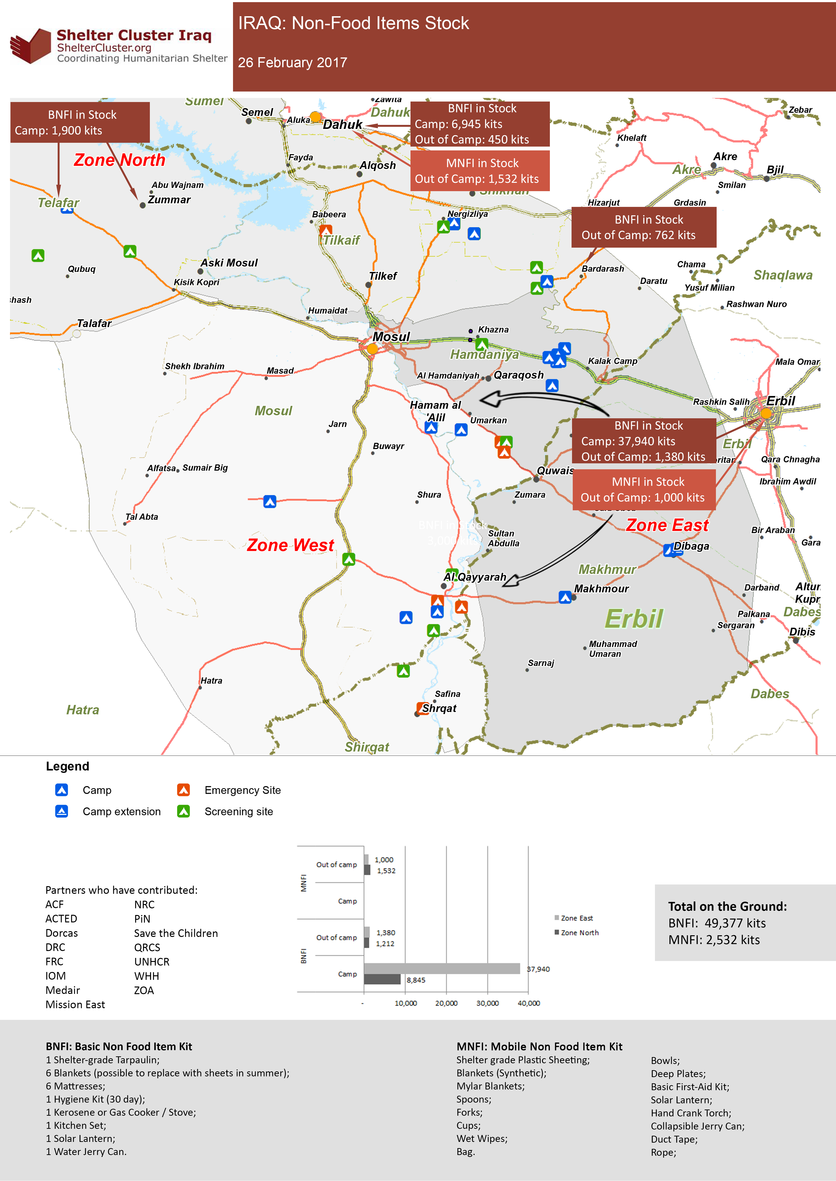
Stocks

Slide 24
Dohuk Camps
Camp | Main NFI partners BNFI/CRI | NFI top up (inc. special needs) | Clothes, (UNICEF under 14) | Kerosene
Amalla | UNHCR | NRC |  | UNHCR?
Qaymawa | UNHCR |  |  | UNHCR?
Nargizlia 1 | UNHCR | WVI, PWJ | Tearfund | MoMD?
Nargizlia 2 | UNHCR | CRS |  | MoMD?
Zelikan (new)

Slide 25
West Mosul – Camp Support
Hassansham Camps
Camp | Main NFI partner(s) BNFI/CRI | NFI top up (inc. special needs) | Clothes (UNICEF under 14) | Kerosene
Chamakor | MoMD/UNHCR |  |  | MoMD
Hassansham M2 | MoMD/UNHCR |  |  | MoMD
Hassansham U2 | MoMD/UNHCR |  |  | MoMD
Hassansham U3 | MoMD/UNHCR |  |  | MoMD
Khazer M1 | MoMD/UNHCR |  |  | MoMD

Slide 26
West Mosul – Camp Support
Ninewa Governorate & Zone West Camps
Camp | Main NFI partners BNFI/CRI | NFI top up (inc. special needs) | Clothes (UNICEF under 14) | Kerosene
As Salamyaih | ?????? | PiN, ACTED
Bartella | ??????
Hammam al-Aliel | UNHCR & MA | SCI
Haj Ali | IOM |  |  | MoMD/IOM
Jed’ah | UNHCR & MA
Qayyarah A/strip | IOM |  |  | MoMD/IOM

Slide 27
6. AOB
Partner Update?
New Publication from IOM - http://iomiraq.net/reports/rehabilitating-repairing-and-upgrading-critical-shelters-and-damaged-houses-0
NFIs vs CRIs
https://www.sheltercluster.org/iraq/documents/20170215-nfi-technical-guidance-v11
https://www.sheltercluster.org/sites/default/files/docs/Selecting%20NFIs%20for%20Shelter%202009.pdf
Next meeting will be Wednesday 15th March, 11:00am at NCCI
http://sheltercluster.org/response/iraq

