Slide 1
National Shelter & NFI Cluster Coordination including KR-I and Mosul
Agenda
Introductions
Information Management & Activity Info
Shelter Box
Climatisation Guidelines
West Mosul - Shelter & NFI Camps
AOB
- Partner Updates
- Out-of-Camp Response - NFI stocks, replenishments, funding
Wednesday, 15th March 2017
http://sheltercluster.org/response/iraq

Slide 2





1. Cluster Team Structure
Richard Evans - UNHCR National Cluster Coordinator +964 (0) 771 994 5694 coord.iraq@sheltercluster.org Michel Tia - IOM Information Management Officer - National +964 (0) 750 021 1720 im2.iraq@sheltercluster.org Cornelius Weira - IOM Sub National Co-Chair - Centre and South Mobile +964 (0) 751 234 2548 coord4.iraq@sheltercluster.org | Michael Gloeckle - NRC National Co-Chair - Technical Coordinator +964 (0) 750 878 7793 coord2.iraq@sheltercluster.org Shada Qahoush- Catholic Relief Services Ninewa & Mosul Focal Point +964 (0) 751 755 8451 coordroving.iraq@sheltercluster.org Abdoulaye Dieye -NORCAP Assistant National IM im2.iraq@sheltercluster.org Laurence West - UNHCR Sub National Coordinator – KRI Mobile + 964 771 911 0574 coord3.iraq@sheltercluster.org

Slide 3
2.Information
Management
Update
http://sheltercluster.org/response/iraq

Slide 4


3.
ShelterBox responds to humanitarian crises during the emergency phase, around the world, supporting households through the effective and timely provision of shelter aid.
In achieving the short to medium term outcomes of increased physical protection, improved psychological wellbeing and organisational accountability, we intend that our interventions help build resilience and promote self-recovery.
We work hard to ensure that our interventions compliment the efforts of other humanitarian stakeholders in a coordinated fashion.
We believe that following do no harm principles is as important as the physical assets we provide.

Slide 5
OUR COMMITMENT
We commit to delivering the following in pursuit of evolving excellence in shelter provision:
Embed an approach that sees shelter as a process towards recovery.
Deliver context specific and needs-driven aid that enables the beneficiaries in their recovery process.
Work with affected communities through consultation, participation, training and communication.
Be transparent in all that we do.
Be effective in all aspects of our operations.
Deliver to the minimum humanitarian standards.
Partner and coordinate for the greater good of beneficiaries.
Value and represent our donors by demonstrating the effective, efficient and ethical use of resources.

Slide 6
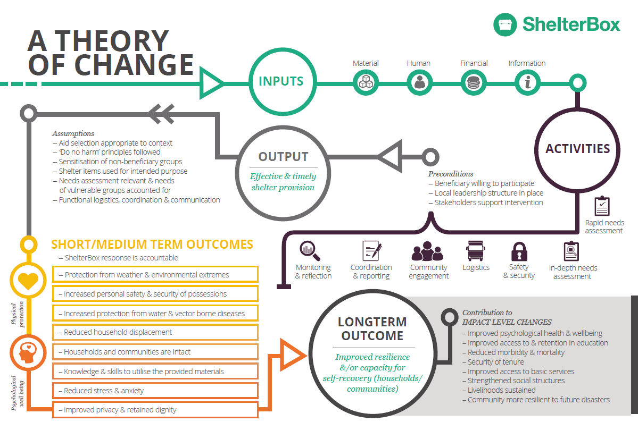

Slide 7
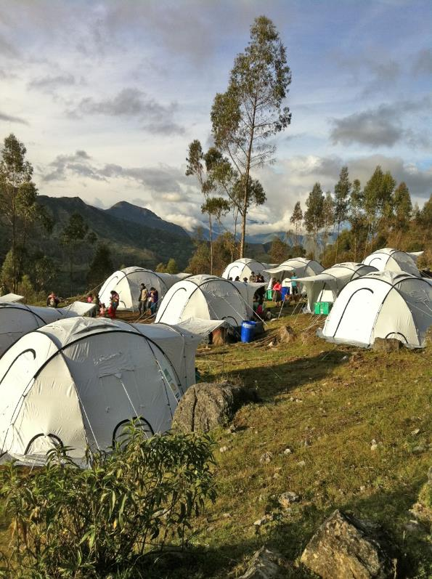
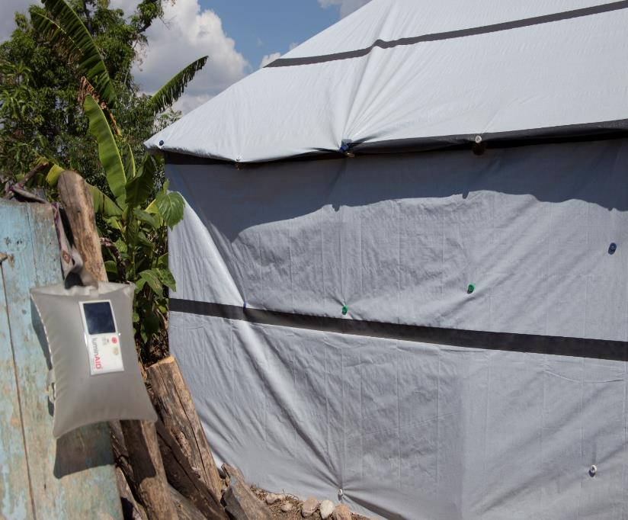

Slide 8
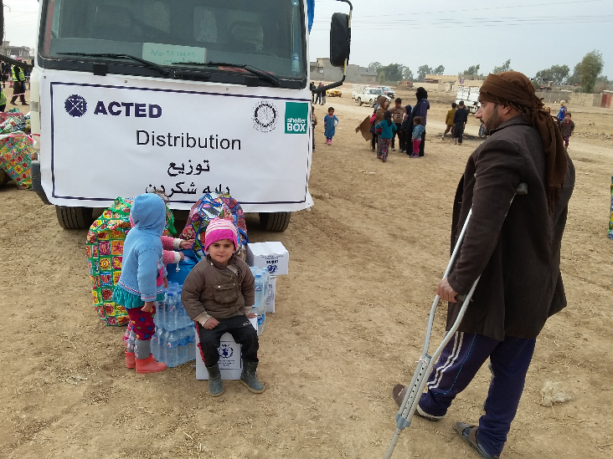

Slide 9
ShelterBox’s True North:
No family without shelter ©

Slide 10
4. Climatisation Guidelines – Seasonal Top Up
Summer Top Up Items:
Fan
Coolbox
Shading Net
Bedsheets
Water Jerrycan
Quilts
Winter Top Up Items:
Winter Clothing
Thermal Roll Mat
Carpet
Kerosene Heater
Kerosene Jerrycan
Kerosene
Mattress
Unrestricted or restricted cash assistance transfer values for seasonal top ups?

Slide 11
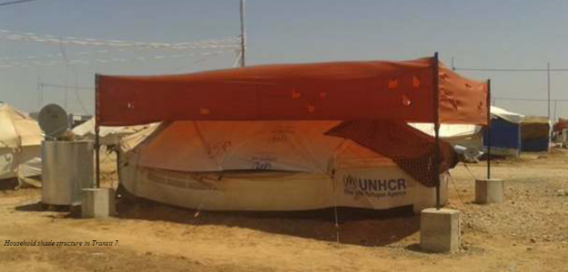
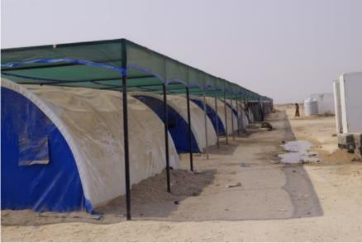
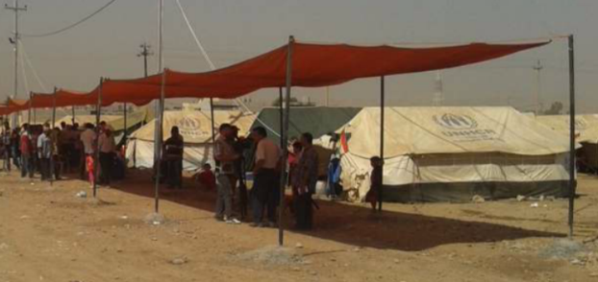
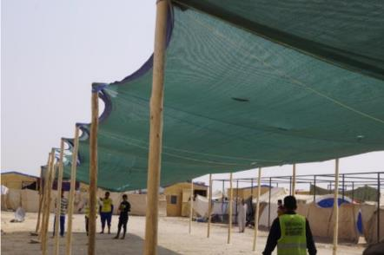
4. Climatisation Guidelines – Examples of Shading
Photos: Courtesy of NRC Iraq
Photos: Courtesy of AAF/NRC

Slide 12
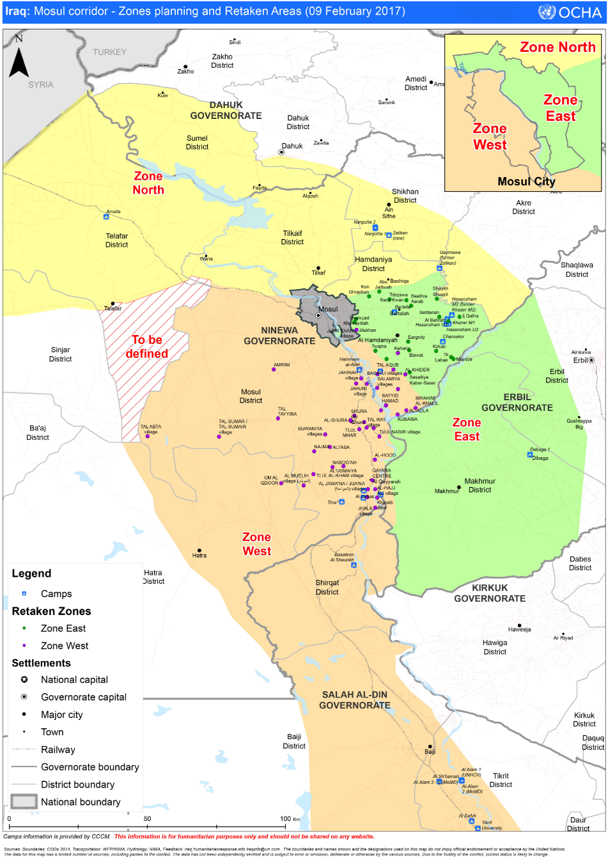
5. West Mosul – Shelter & NFI Camps

Slide 13
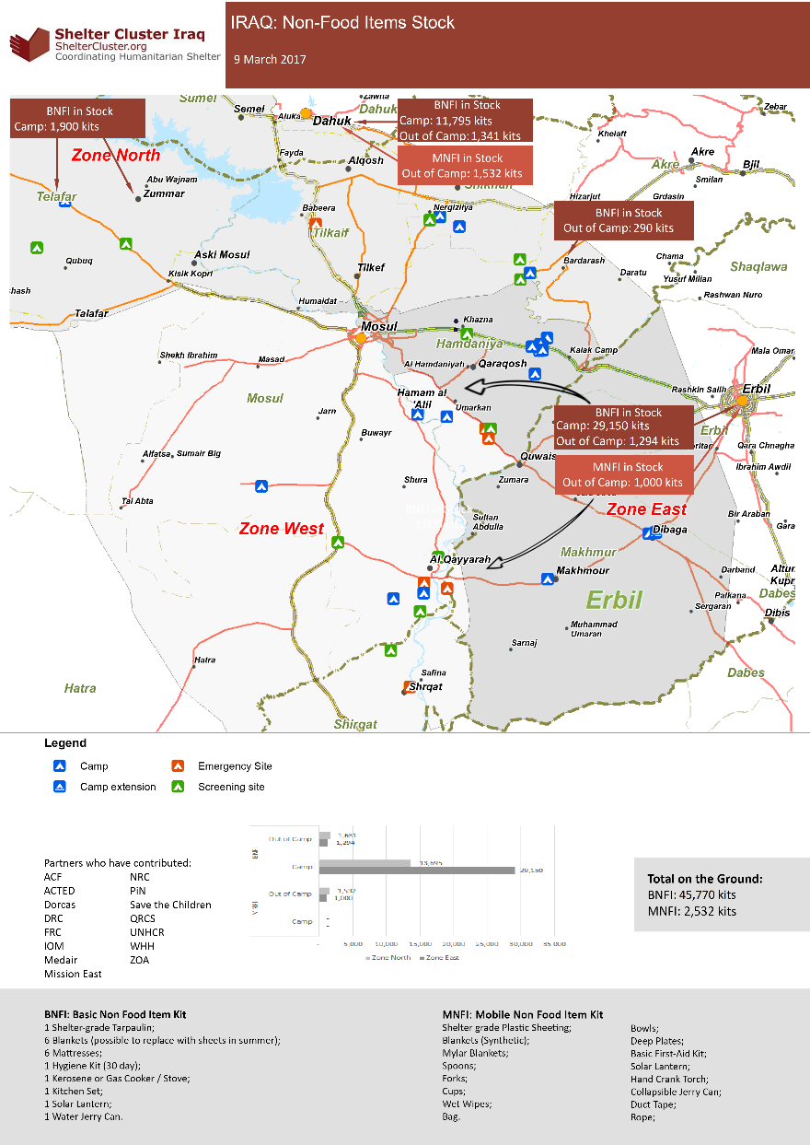
Stocks

Slide 14
Dohuk Camps
Camp | Main NFI partners BNFI/CRI | NFI top up (inc. special needs) | Kerosene
Amalla | UNHCR | NRC | UNHCR?
Qaymawa | UNHCR |  | NHCR?
Nargizlia 1 | UNHCR | WVI, PWJ | MoMD?
Nargizlia 2 | UNHCR | CRS | MoMD?
Zelikan (new) | WHH/ME/DORCAS | UNHCR | MoMD?

Slide 15
West Mosul – Camp Support
Hassansham Camps
Camp | Main NFI partners BNFI/CRI | NFI top up (inc. special needs) | Kerosene
Chamakor | MoMD/UNHCR |  | MoMD
Hassansham M2 | MoMD/UNHCR |  | MoMD
Hassansham U2 | MoMD/UNHCR |  | MoMD
Hassansham U3 | MoMD/UNHCR |  | MoMD
Khazer M1 | MoMD/UNHCR |  | MoMD

Slide 16
West Mosul – Camp Support
Ninewa Governorate & Zone West Camps
Camp | Main NFI partners BNFI/CRI | NFI top up (inc. special needs) | Kerosene
As Salamyaih | UNHCR | PiN, ACTED
Bartella | ??????
Hammam al-Aliel | UNHCR / MA / NRC | SCI
Haj Ali | IOM |  | MoMD/IOM
Jed’ah | UNHCR & MA
Qayyarah A/strip | IOM |  | MoMD/IOM

Slide 17
6. AOB
Out-of-Camp Response
http://maps.unhcr.org/en/irq_cccm_rapid_rasp
https://docs.google.com/spreadsheets/d/1I3fM8by1uwh5LXs8gsqcczpmr6HdsoemYRiW2KAO-MA/edit#gid=21490522
NFI stocks, replenishments, funding
Partner Updates
Next meeting will be Wednesday 29th March, 11:00am at NCCI
http://sheltercluster.org/response/iraq

