Slide 1
Sub-National Shelter & NFI Cluster Coordination meeting for C&S
Agenda
Review of action points
Information management updates
Key issues
Update on Preparedness and Response – Tikrit and Kirkuk
Assistance to IDPs in Al Kasnazan Camp (NFIs & tent replacement)
Update on tent replacement (Anbar , Baghdad)
Governorate Updates
AoB
NFI Technical Guidelines – Vs 11
Preparations for the summer
Wednesday, 15th March 2017
http://sheltercluster.org/response/iraq

Slide 2
Review of action points from previous meeting
Access to Activity Info (AI) for reporting: Partners to provide names / email of focal points – On going
Activity Info training session: cluster coordinator to communicate to all partners venue and date - Done
Partners to provide comments on NFI Technical Guidance Vrs 11 – ongoing process
UNHCR to provide list of MODM beneficiaries of tents and kerosene in Anbar - Done
RASP (camp & out of camp): cluster to share the raw data of RASP with Partners – ongoing process
AUB/Eviction cases in Tikrit: cluster to refer case to Centre & South ICCG for action - Done
Preparation for summer: cluster to share the Technical Guidance on Climatisation and Seasonal Support with partners – Ongoing

Slide 3
Information Management
Activity Info
Cluster Dashboards, Infographics and Maps
Inter Cluster Sitreps, dashboards, Infographics and maps
Online 4W: https://www.humanitarianresponse.info/en/operations/iraq/2017-dashbords

Slide 4
Cluster Key Issues
Update Mosul Preparedness and Response
New arrivals of IDPs are expected in Tikrit and Kirkuk due to on going military operations in West Mosul and Hawiija.
Partners are called upon to update their preparedness stocks, pipelines

Slide 5
Cluster Key Issues
Assistance to IDPs in Al Kasnazan Camp (NFIs & tent replacement)
The camp currently hosts 525 families, mainly from Salah al-Din and Al Kaim (western Anbar).
Families continue to arrive as the situation remains critical in areas under ISIL control.
In February more than 50 new families arrived from Al Kaim, while 70 more are expected to arrive soon according to Baghdad Operations Command.
Need to replace old/damaged tents. Currently there are 600 plots (including tents and caravans), MoMD provides additional tents on request especially for new arrivals from Al Kaim however MoMD does not always cover tents replacements.
NFIs/CRIs are distributed by UNHCR. Many of the families have more than 6 people and would require extra NFI items (for example blankets and sheets) to cover their needs
Humanitarian partners need to sustain the assistance to Al Kasnazan Camp as Salah al-Din IDPs are yet to return and Al Kaim IDPs could grow in number as operations to retake their areas could escalate in coming months

Slide 6
Cluster Key Issues
Update on tent replacement (Anbar, Baghdad)
No. | Partners | Distributions Locations | No Tents Replaced | Total Need-Anbar Governorate | Anbar -Outstanding Tent Replacement Need
1 | MODM | AAF, HTC, Khalidiya;Beiz Biz | 3000 | 23,000 | 20,000
2 | UNHCR | Beiz Biz | 500 |  | 19,500
3 | NRC | AAF, HTC, Khalidiya;Beiz Biz | 318 |  | 19,182
4 | CRS | AAF (60 T-shelter Al-Tahadi Camp; 100 T-shelter in Al-Bashaer Camp; 70 T-Shelter in Zawbaa Camp) | 230 |  | 18,952
5 | UNHCR | Beiz Biz; AAF | 394 |  | 18,558
6 | UNHCR | AAF | 111 |  | 18,449
7 | UNHCR | HTC | 139 |  | 18,309
8 | MODM | Al Kahlidiya 3 | 89 |  | 18,220
9 | MODM | Kilo 18 | 151 |  | 18,069

Slide 7
Governorate Updates
Baghdad
Kirkuk
Anbar
Basrah
Salah al-Din

Slide 8
AOB
NFI Technical Guidance
Vs 11 can be found on the Iraq Shelter Cluster website on this link: https://www.sheltercluster.org/iraq/documents/20170215-nfi-technical-guidance-v11
Partners are strongly recommended to distribute only BNFIs kits in Camps.
Preparations for the summer
The Cluster is preparing for the summer response. The Technical Guidance on Climatisation and Seasonal Support was shared with partners, for consideration in their Mosul and non-Mosul planning

Slide 9
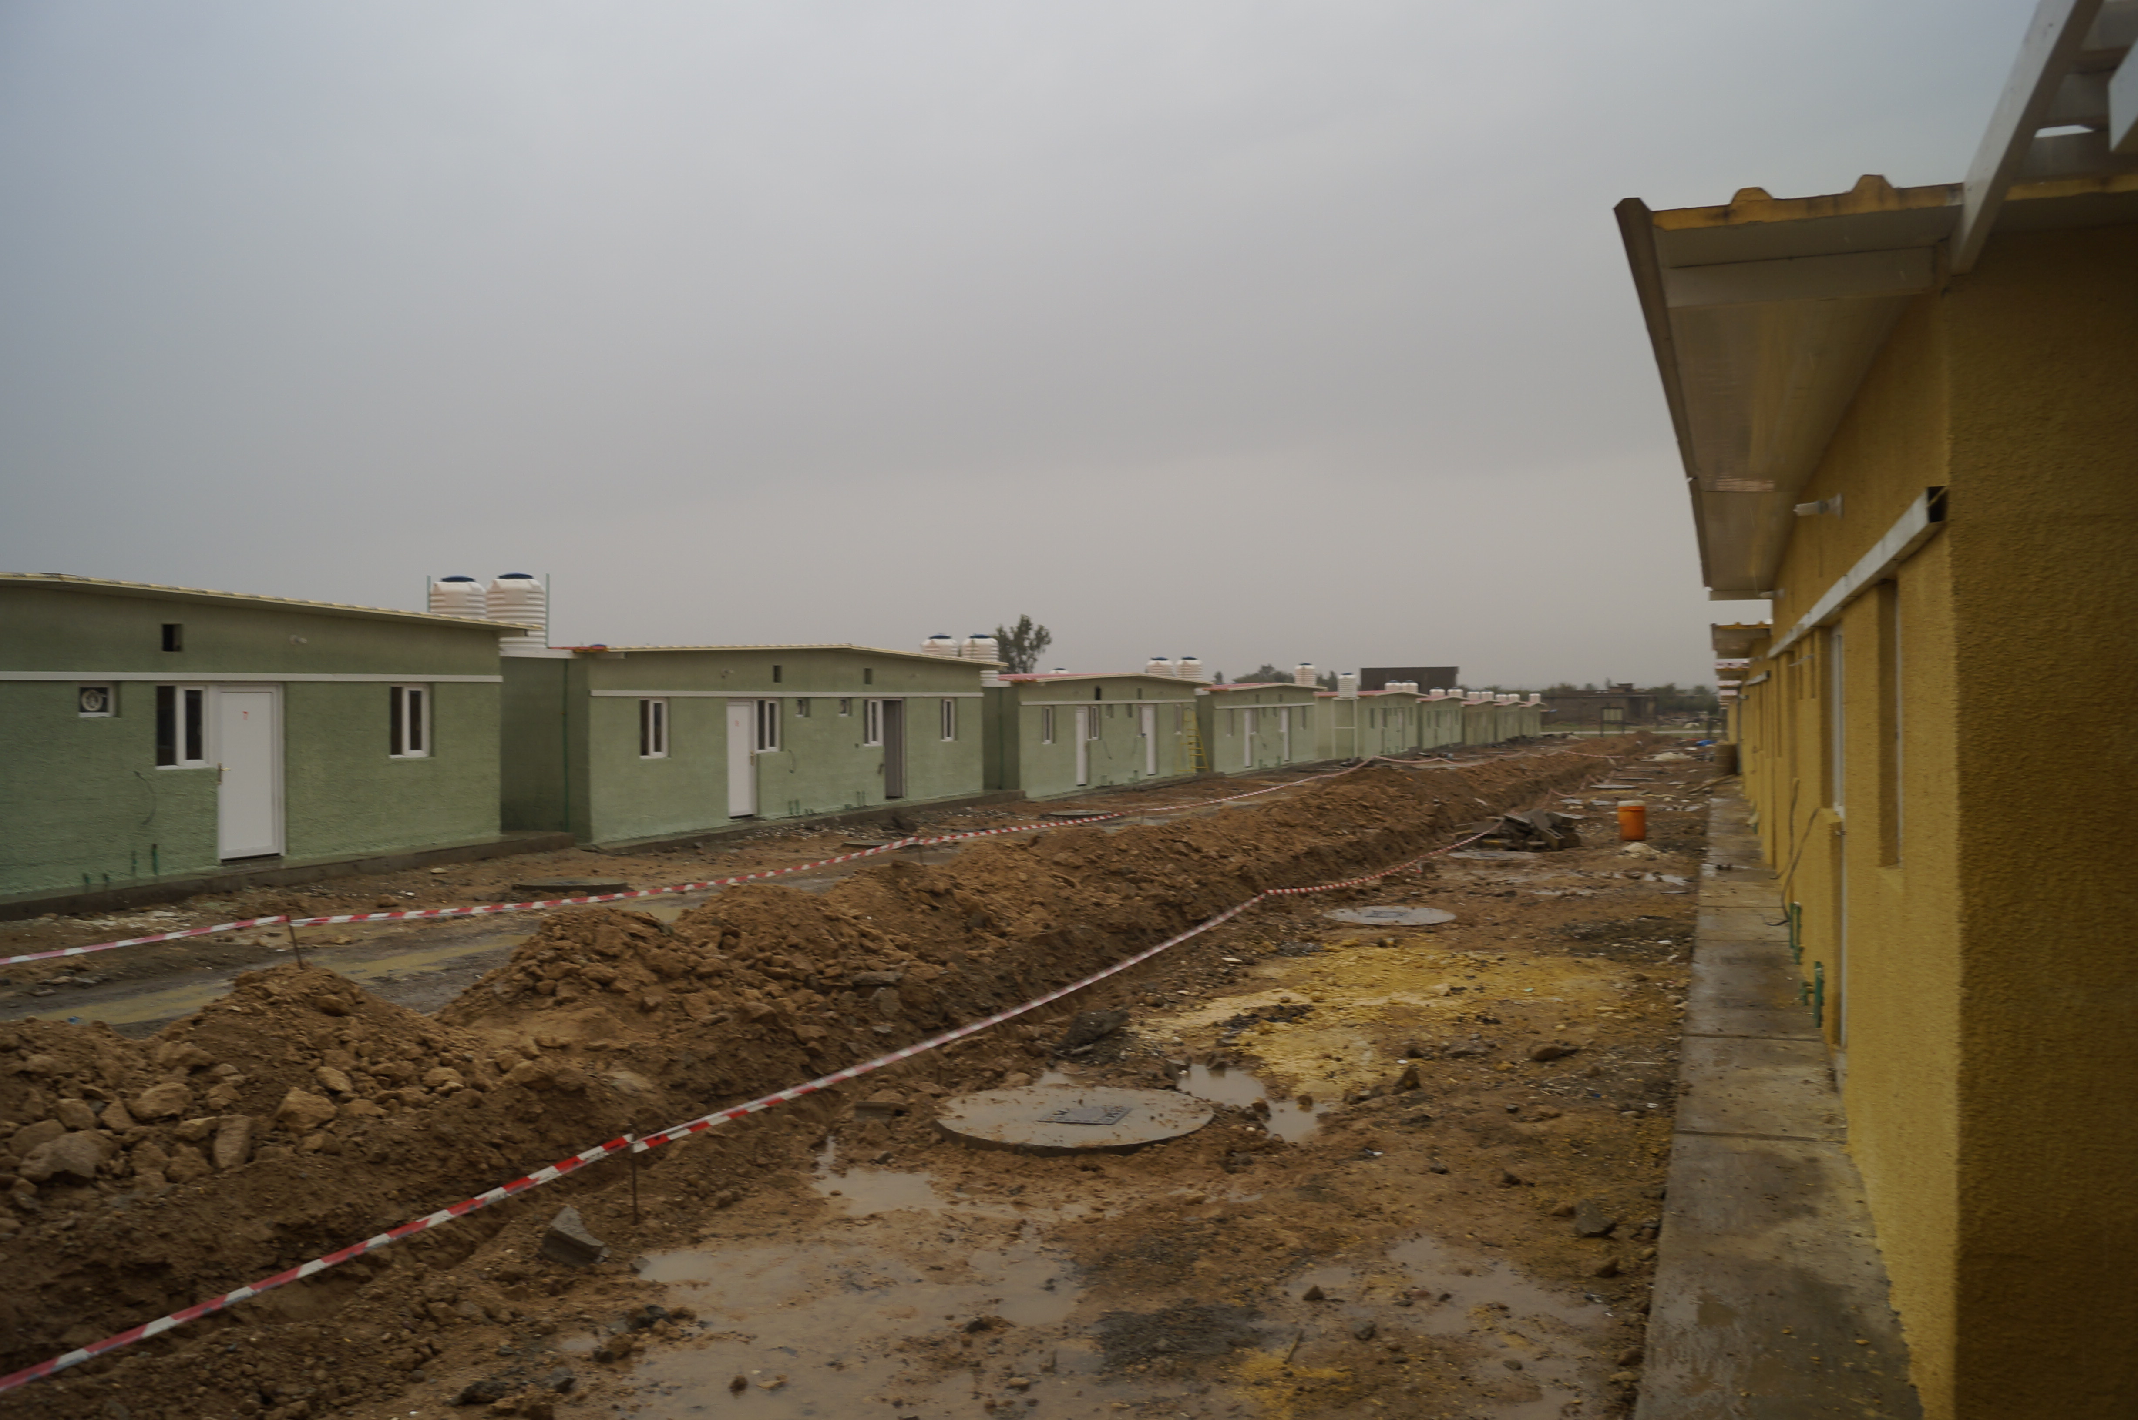
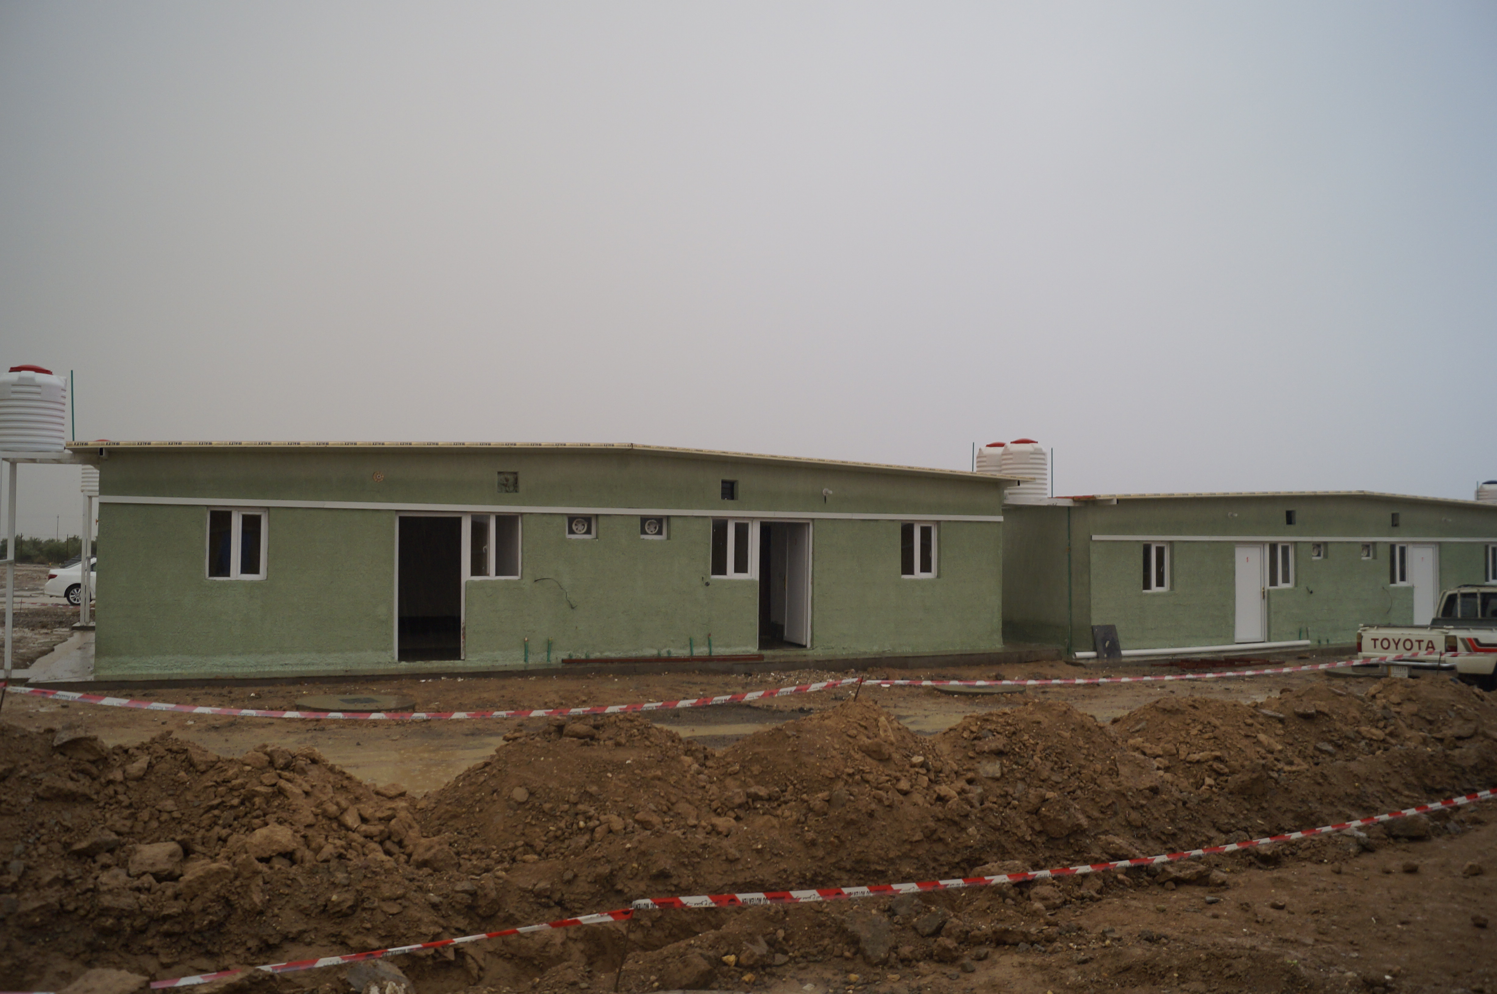
Salah al-Din : 170 Transitional Shelters (2 bedrooms each) built by IOM for Returnees in Alam in Tikrit district.

Slide 10
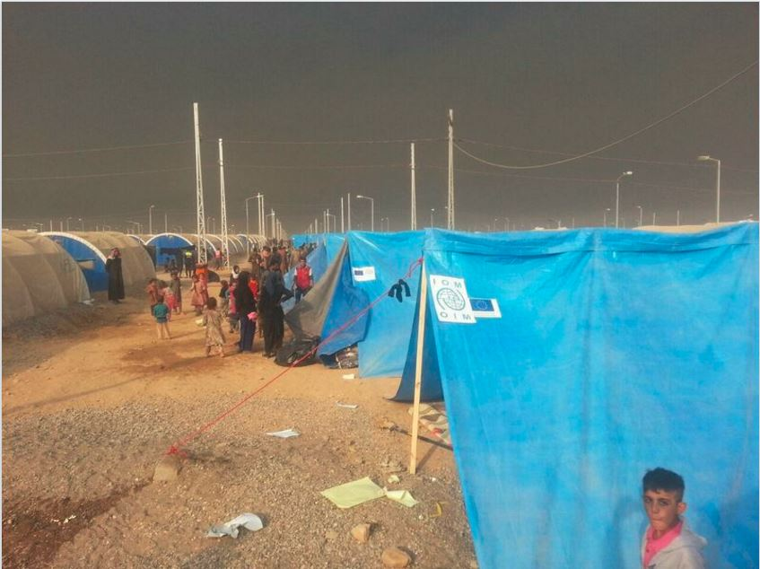
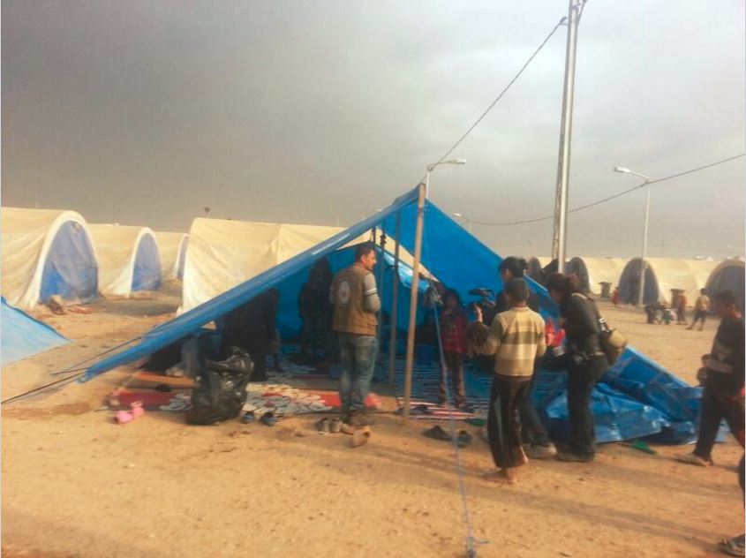
THANKS
http://sheltercluster.org/response/iraq

