Slide 1
Dahuk Shelter & NFI Cluster Coordination Meeting
Agenda
Introductions
Zone north camps
Arrivals
Gaps
Existing camps update and issues
Newly retaken areas and out of camp response
Responses and assessments since last meeting
Up coming responses by partners
Coordinating assessment and response in advance with the cluster
IHPF Q&A
Launch of RNA in Mosul by OCHA
Discuss on issues partners want to resolve
Key updates by partners
General notifications
Security updates
New projects
Updates from national level
NFI kits lists
Climatisation guidelines
AOB
Tuesday, 11th April 2017
http://sheltercluster.org/response/iraq

Slide 2
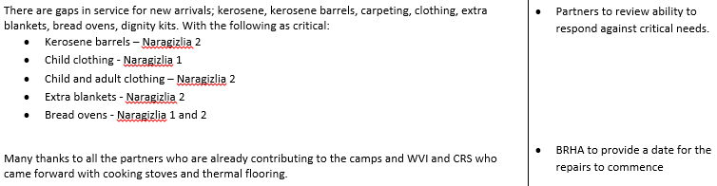

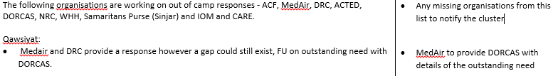

Update on Previous Action Points
http://sheltercluster.org/response/iraq

Slide 3
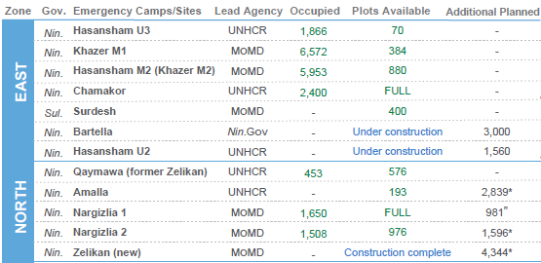
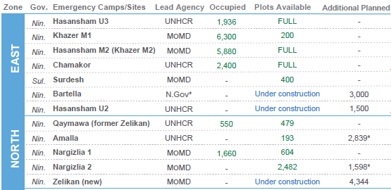
Zone North Camps
9th April
Zelikan construction completes
}
16th March
}
Nargazilia 1 slowly fills, but will increase in capacity
Returns in Zone East Camps, also seen in Zone North

Slide 4
Zone North Camps
Gaps
Camp | Tents | Basic NFI | Cooking stove | Heating Stove | Gas for Cooking (if gas stove) | Kerosene | Kerosene Barrels | Winterization | Carpeting | Clothing Ages 0-14 | Clothing Ages 15+ | Quilts / Heavy Blanket | Extra Blankets | Bread Ovens
Qaymawa | UNHCR | UNHCR | WVI | UNHCR | WVI | MoMD/BRHA | UNHCR | UNHCR | #N/A | Tearfund | Tearfund | UNHCR | Multiple Partners | IKL
Amalla | UNHCR | UNHCR | UNHCR | UNHCR |  | MoMD/BRHA? | UNHCR | UNHCR |  |  |  | UNHCR
Nargizlia 1 | MoMD/BRHA | UNHCR | WVI | UNHCR | WVI | MoMD/BRHA/PWJ | WVI | UNHCR | PWJ |  | Tearfund | UNHCR | Iraq RC + War Child
Nargizlia 2 | MoMD/BRHA | UNHCR | WVI | UNHCR | WVI - 4,500 | MoMD/BRHA? | WVI - 1,907 | UNHCR | CRS |  | Tearfund - 500 | UNHCR | IKL - 450 CRS - ?
Zelekan | MoMD/BRHA | DORCAS, WHH, MISSIONEAST& NRC | DORCAS, WHH, MISSIONEAST& NRC | DORCAS, WHH, MISSIONEAST& NRC | DORCAS, WHH, MISSIONEAST& NRC | MoMD/BRHA? |  | DORCAS, WHH, MISSIONEAST& NRC | DORCAS, WHH, MISSIONEAST& NRC |  |  | DORCAS, WHH, MISSIONEAST& NRC
Various area in the process of confirmation.
Known gaps for cooking gas and bread ovens.

Slide 5
Existing Camps
Assessments are in final stages of completion by:
KURDS
REACH
BRHA
Prioritisation method of S-NFI activities is underway within the cluster and will be shared with UNHCR and BRHA before a final draft version is agreed.
Following alignment it will be shared with cluster partners.
The final version will be used to create a clear set of prioritise which can be shared with partners against their ability to respond as well as donors.

Slide 6
Newly Retaken Areas & Out of Camp Response
Assessments and responses since the last meeting:
Area | Responders
Qawsiyat | Medair, DRC & DORCAS
Rashidiya | DRC
Bareema | DORCAS
Qalatuk | CARE
Khorsebad | CARE + REACH-I, Tearfund, ACTED (assess only), ???

Slide 7
Newly Retaken Areas & Out of Camp Response
Upcoming partner assessments and responses?
Are partners planning assessments outside of the previous areas?
Do partners have ongoing responses or are planning responses?
Coordination mechanism
To be defined – speaking with key partners and slowly aiming to meet all
Building upon the previous approach, consider whether we need to refresh, amend, start a fresh etc.
In the interim:
Check in with the cluster before assessments are conducted
Send assessments to the cluster, including needs matched against response
The cluster will support by matching partners together and forming a complete response and considering the types of programming i.e. MPCA, in-kind etc
Send final reports and update Activity Info

Slide 8
IHFP Q&A
Do you have questions?
Can we help to direct you to the right person?

Slide 9
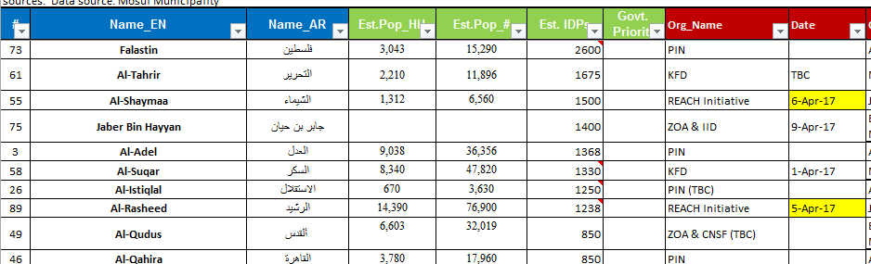
Launch of Rapid Needs Assessment in Mosul by OCHA
RNAs create a snapshot of need at neighborhood level across East and limited areas in West Mosul
Mosul neighborhoods are divided and allocated to an agency for assessment only
Follow up RNA can be launched to maintain an understanding across the city

Slide 10
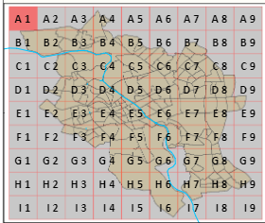
Launch of Rapid Needs Assessment in Mosul by OCHA
Are you interested in participating or accessing data?
Useful links:
Skype group - https://join.skype.com/oWjc9wDMNJLc
Details of tool
Iraq: RNA User Guide for KOBO Installation(EN) – in English Iraq: RNA (Rapid Needs Assessments) Questionnaire - in English and Arabic Iraq Inter-agency Rapid Needs Assessment (RNA) Tool - The Approach In Brief – in English Iraq: RNA Methodology and Procedures for Enumerators(EN) – in English Iraq: Assessment Working Group TORs (Endorsed) – in English
Outputs
Here - Baseline with satellite imagery
Here - Mosul quarters map
Here - Online interactive editable map to track RNAs
RNA results currently shared daily through Skype group and online map shows where
they have been conducted. Pending discussion through the assessment working group
on Thursday more information and access to the server will be available.

Slide 11
Issues to solve
To shift the meeting towards focusing on issues.
Already on the table is coordinating out of camp responses.
Are they other issues we can aim to solve today or during the next meeting?

Slide 12
Key Updates by Partners
General notifications:
Programmatic updates all are required to be informed of?
Change in staffing?
Change in area of operation?
Security updates:
Have medium or major incidents occurred during the previous two weeks?
When, where and why?
Updates from those working in forward or high risk areas:
I.e. Rashidiya or Bareema
Projects:
Have you signed new funding recently?
Is a closing project creating a geographic gap?

Slide 13
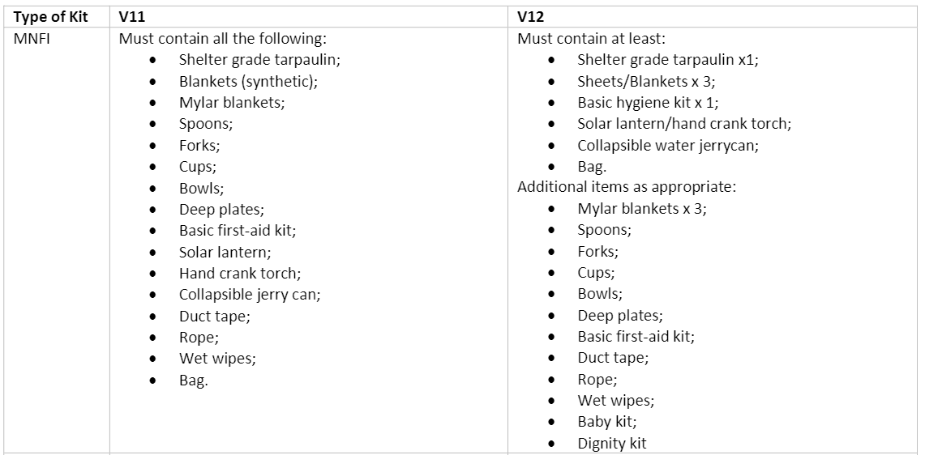
Updates from National Level
NFI Kit Lists
MNFI, BNFI, Summer and Winter have been update through national level SAG
Aim to simplify and unify
Complete Technical Guidance to be released shortly
MNFI Kit List:

Slide 14
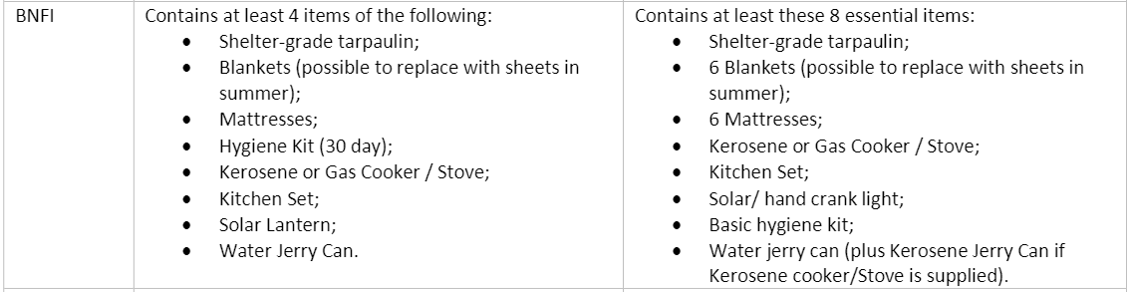
Updates from National Level
BNFI kits
Increased to include all relevant items rather than a selection

Slide 15
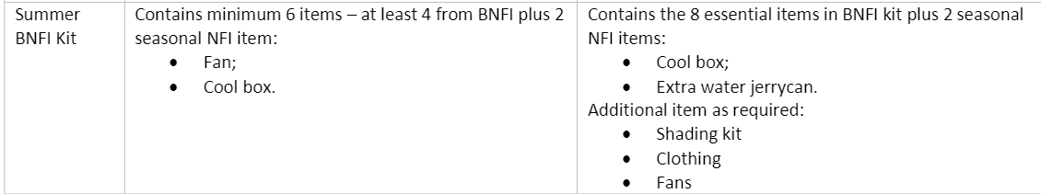
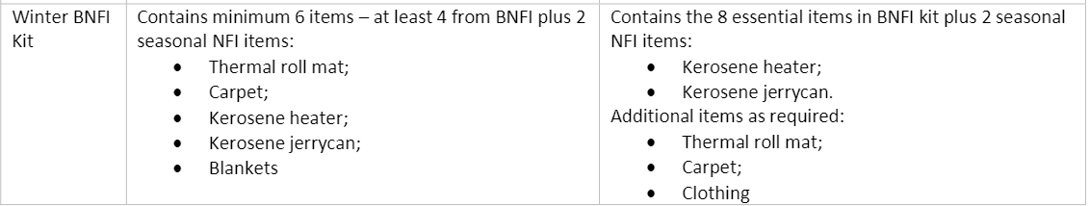
Updates from National Level
Summer Top Up
Winter Top Up

Slide 16
Any Other Business
What multi lateral issues have we not covered?
Meeting minute rotation – please can partners volunteer to take minutes on a rotational basis?
UNHCR 28th March
ACTED 11th April
??? 25th April
??? 9th May
??? 23rd May
Contacts database – sent around with last minutes and will be sent around again today. Thanks to NRC for checking and updating, please partners check and update!
Anyone whose name is in green has already been checked and update
If someone is no longer working for your organization please remove them
Cluster contacts on next slide
Thanks for attending!

Slide 17





1. Cluster Team Structure
Richard Evans - UNHCR National Cluster Coordinator +964 (0) 771 994 5694 coord.iraq@sheltercluster.org Michel Tia - IOM Information Management Officer - National +964 (0) 750 021 1720 im2.iraq@sheltercluster.org Cornelius Weira - IOM Sub National Co-Chair - Centre and South Mobile +964 (0) 751 234 2548 coord4.iraq@sheltercluster.org | Michael Gloeckle - NRC National Co-Chair - Technical Coordinator +964 (0) 750 878 7793 coord2.iraq@sheltercluster.org Shada Qahoush- Catholic Relief Services Ninewa & Mosul Focal Point +964 (0) 751 755 8451 coordroving.iraq@sheltercluster.org Abdoulaye Dieye -NORCAP Assistant National IM im2.iraq@sheltercluster.org Laurence West - UNHCR Sub National Coordinator – KRI Mobile + 964 771 911 0574 coord3.iraq@sheltercluster.org

