Slide 1
Sub-National Shelter & NFI Cluster Coordination meeting for C&S
1. Review of action points from previous meeting
2. Information Management Updates
3. Update on 1st 2017 IHPF allocation
4. Key Issues
a. NFI Guidance Update – SAG Approved
b. Western Anbar Operational Plan (Partner Stocks , Pipeline)
c. Tent Replacement tracking (Anbar and Baghdad)
5. Governorate Updates
6. AoB
Wednesday, 19th April 2017
http://sheltercluster.org/response/iraq

Slide 2
Review of action points from previous meeting
UNHCR to share list of camps receiving new arrivals - Done
Partners to ensure activity info reporting before the 6th of following month- Ongoing
Partners reminded to nominate activity info focal points reminded to do so – Ongoing
Partners requested to share plans, stocks and to support anticipated influx from Western Anbar – Ongoing
Cluster to share planning figures for anticipated Western Anbar Influx. On agenda .
Partners requested to share plans, stocks and pipeline for summer preparation – Ongoing
UNHCR to share information on location and number of tents replaced in Anbar lately - Done
UNHCR to conduct rapid assessment in Al Ghazaliya Camp (Scout Camp) to determine number of tents requiring replacement – UNHCR to Update
IOM requested to share information on location and number of homes rehabilitated in Centre and South - Done

Slide 3
Information Management Updates / Cluster achievements from Activity Info from January – March 2017
ACTED
Al Khair
CAOFISR
CARE
CNSF
CRS
DRC
EADE
IOM
ISHO
IVY
JEN
Medaire
MHE
Mission East
Muslim Aid
NRC
PIN
PWJ
Qandil
QRC
REACH
RIRP
SAMARITAN'S PURSE
SCI
Tearfund
UNHCR
WHH
WVI
YAO
ZOA International
First Line Response : 31 partners reporting their interventions

Slide 4
Information Management Updates / Cluster achievements from Activity Info from January – March 2017
Second Line Response : 7 partners reporting their interventions
CNSF
CRS
IOM
JEN
PWJ
REACH
YAO

Slide 5
Information Management Updates / Cluster achievements from Activity Info from January – March 2017
Full Cluster Response : 1 partner reporting their interventions
IOM

Slide 6
First 2017 Standard Allocation / Update for Clusters
Cluster Funding Portfolio: USD 5 million
Applicants: 21 Partners have applied for USD 15 million
Project approval process is ongoing, Cluster SRT meeting on Tuesday and Wednesday to do the Technical review of the submissions, Score them according to IHPF Allocation paper/strategy and the Cluster priorities.
Cluster SRT recommended proposals will be presented to the IHPF Advisory Board.

Slide 7
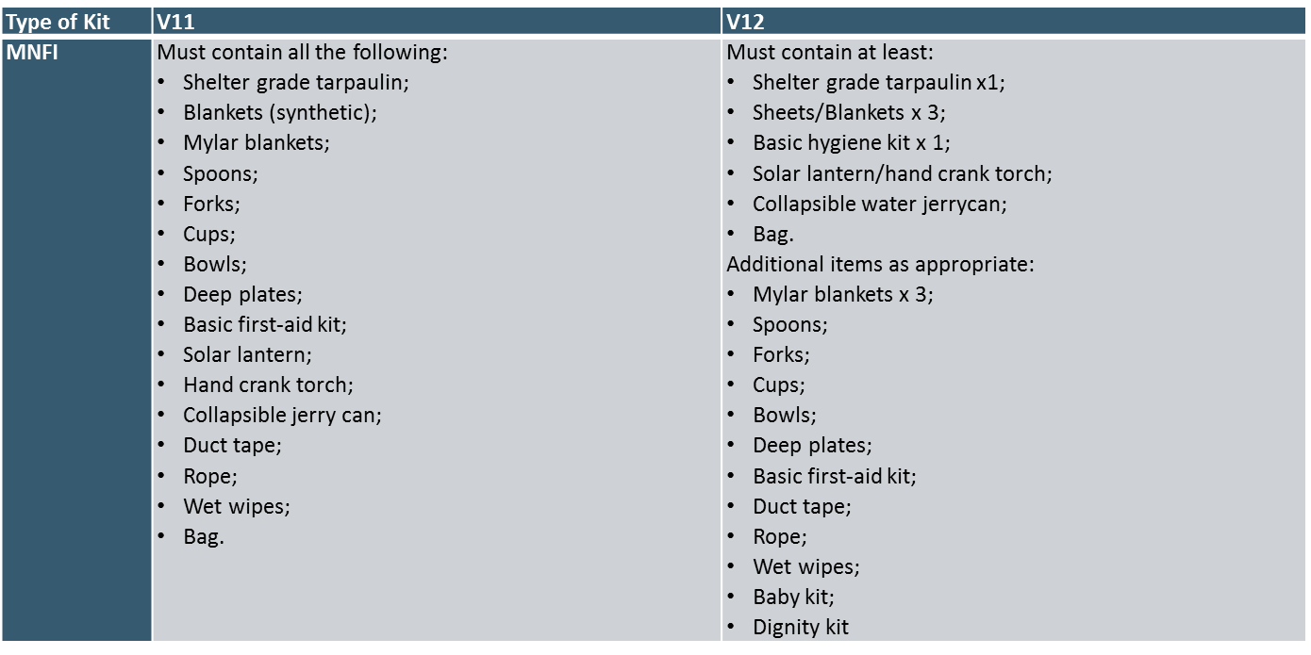
Cluster Key Issues / NFI Guidance Update – SAG Approved

Slide 8
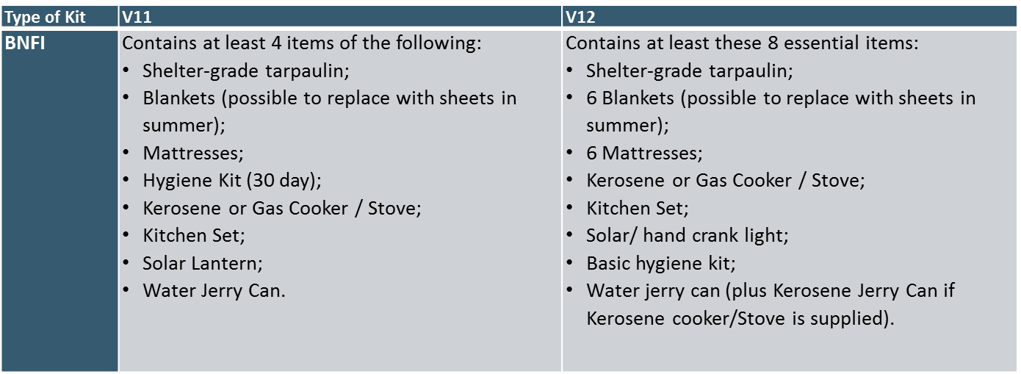
Cluster Key Issues / NFI Guidance Update – SAG Approved

Slide 9
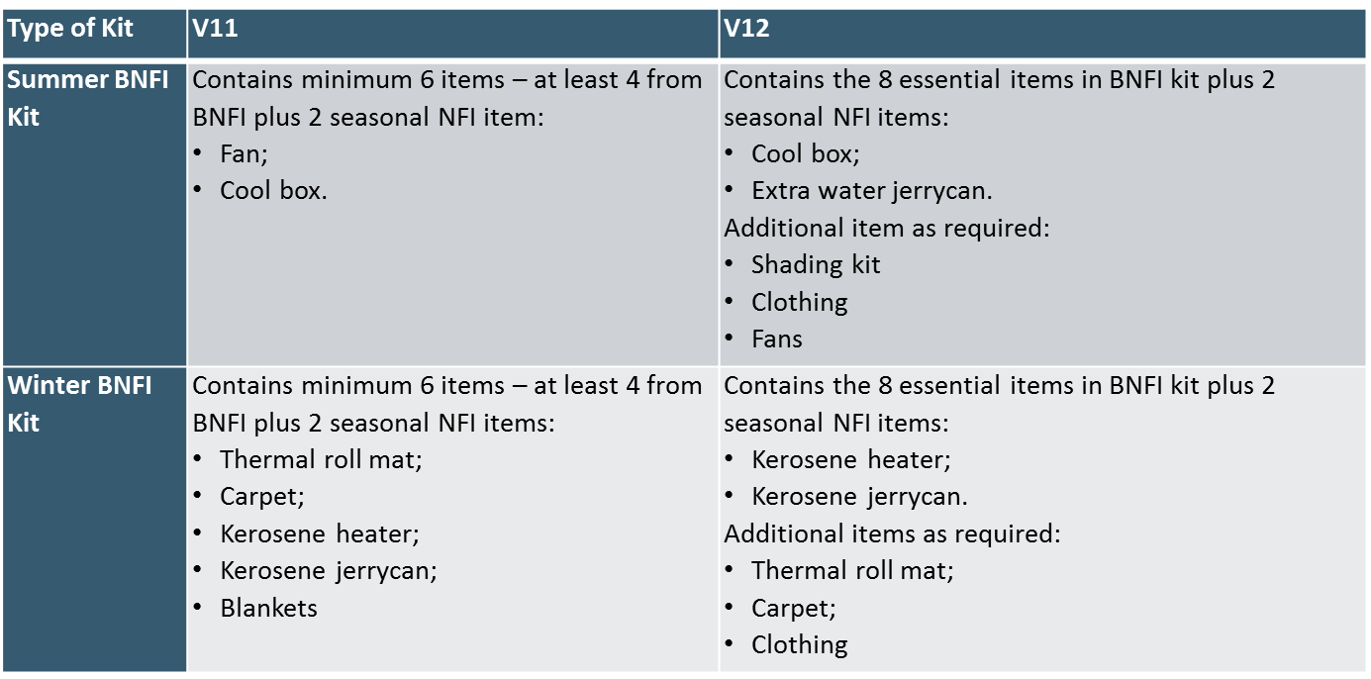
Cluster Key Issues / NFI Guidance Update – SAG Approved

Slide 10
Cluster Key Issues / Western Anbar Operational Plan ( Partner Stocks , Pipeline)
100,000 – 120,000 Individuals remain in Ru’ua , Ana and Ka’ im
60,000 Individuals or 10,000F anticipated to be displaced towards Eastern Anbar
Some IDPs anticipated to remain near home at an agricultural institute facilities close to Ka’ im.
All new arrivals to be accommodated in camps , Kilo 18, HTC, AK , and AAF. Kilo 60 to be maintained by MODM as a transit site.
Kilo 18 will be officially designated as an MODM camp to receive IDPs . Capacity to be scaled up to an additional 1,000 tents.
Excess new arrivals to be accommodated in 4,000 arrival slots in HTC, AK and AAF.
MODM will provide 5,000 tents
MODM has requested support specifically for 5,000 kits of CRIs/NFIs.
Next Steps.
Mapping of stocks and pipeline ( Partners to provide updates on stocks for NFIs and pipeline)
Cluster will compile its contingency plan and share information with OCHA as part of a cluster wide approach

Slide 11
Cluster Key Issues / Tent replacement updates in Anbar and Baghdad
No. | Partners | Distributions Locations | No Tents Replaced | Total Need-Anbar Governorate | Anbar -Outstanding Tent Replacement Need
1 | MODM | AAF, HTC, Khalidiya; Beiz Biz | 3000 | 23,000 | 20,000
2 | UNHCR | Beiz Biz | 500 |  | 19,500
3 | NRC | AAF, HTC, Khalidiya; Beiz Biz | 318 |  | 19,182
4 | CRS | AAF (60 T-shelter Al-Tahadi Camp; 100 T-shelter in Al-Bashaer Camp; 70 T-Shelter in Zawbaa Camp) | 230 |  | 18,952
5 | UNHCR | Beiz Biz; AAF | 394 |  | 18,558
6 | UNHCR | AAF | 111 |  | 18,447
7 | UNHCR | HTC | 139 |  | 18,308
8 | MODM | Al Kahlidiya 3 | 89 |  | 18,219
9 | MODM | Kilo 18 | 151 |  | 18,068
10 | UNHCR | HTC | 24 |  | 18,044
11 | UNHCR | HTC &AK | 152 |  | 17,892
Total |  |  | 5,108

Slide 12
Governorate Updates
Baghdad
Basrah
Kirkuk

Slide 13
AOB

Slide 14
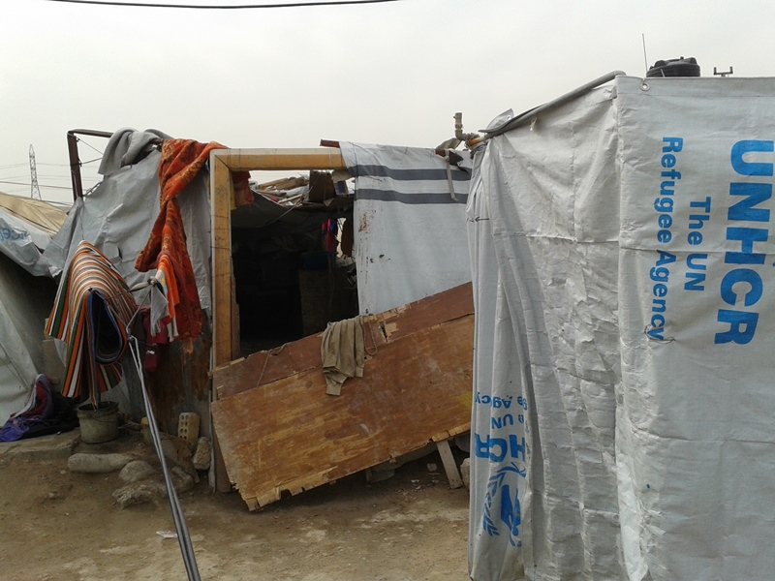
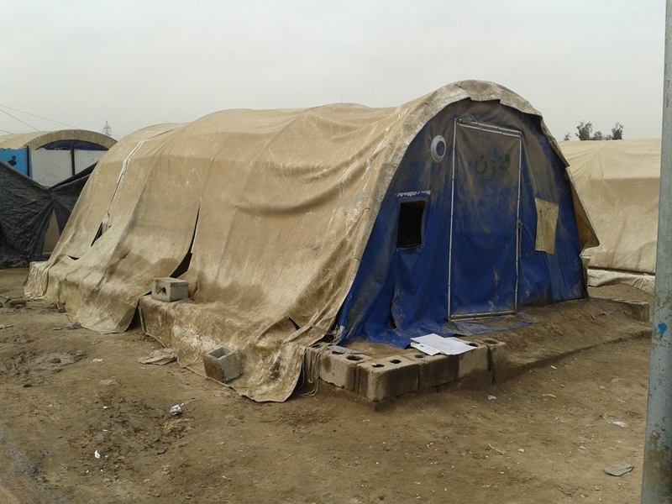
Al Ghazaliya Camp – Baghdad: Some of the damaged tents in Al Ghazaliya Camp. A total of 210 tents require urgent replacement.

Slide 15
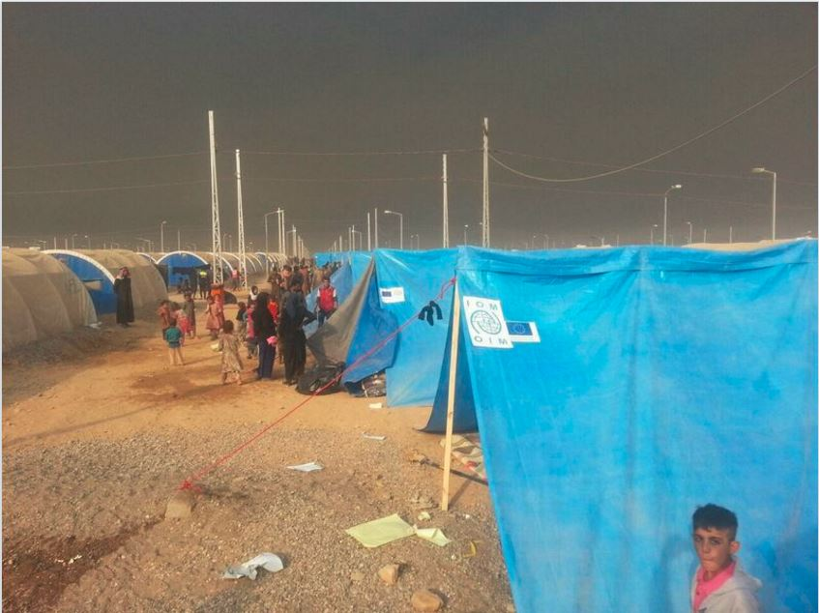
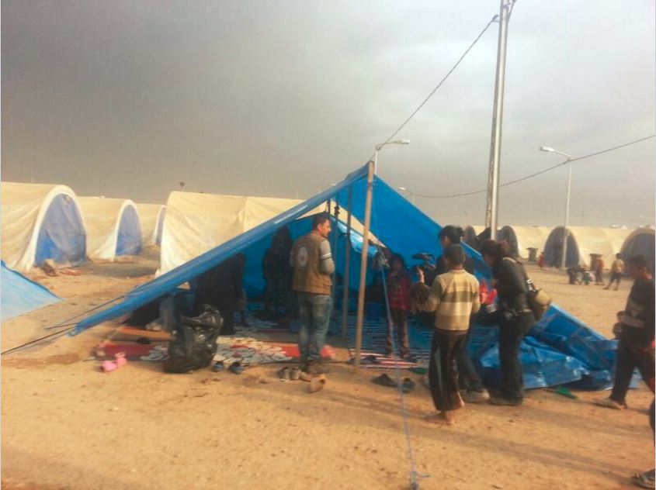
THANKS.
http://sheltercluster.org/response/iraq

