Slide 1
Dahuk Shelter & NFI Cluster Coordination Meeting
Agenda
Introductions
Previous meeting action points
Mosul response camp populations
Zone north camp gaps and needs
Newly retaken areas and out of camp response
Responses and assessments since last meeting
Up coming responses by partners
Results of RNA
Newly Retaken Areas Taskforce
Key updates by partners
General notifications
Security updates
New projects
Updates from national level
Operational discussion – distributing to undocumented IDPs
AOB
Tuesday, 25th April 2017
http://sheltercluster.org/response/iraq

Slide 2
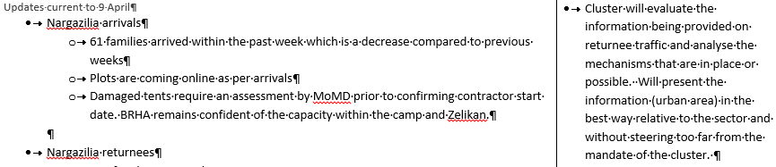



Update on Previous Action Points
http://sheltercluster.org/response/iraq

Slide 3
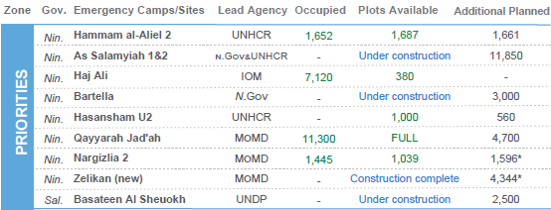
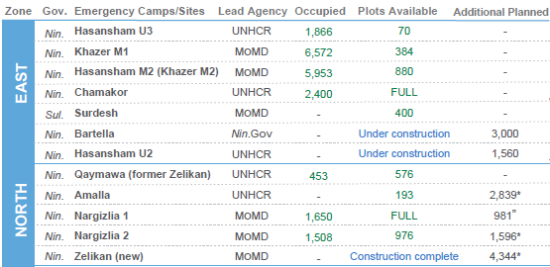
Mosul Response Camp Populations
23rd April
Returns departing Nargazilia
9th April
Zone | 23/04 | 09/04
North | 2,283 | 2,132
East | 3,938 | 2,474
West | 2,067 | 3,318

Slide 4
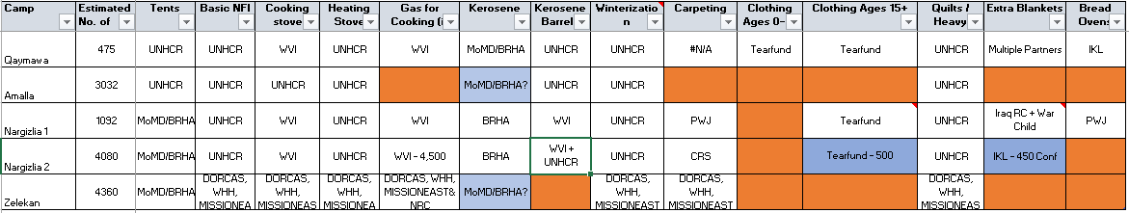
Zone North Camp Gaps
Gaps
Gaps – clothing and bread ovens
Remove – extra blankets
Zelikan – continues to be under discussion

Slide 5
Newly Retaken Areas & Out of Camp Response
Assessments and responses since the last meeting:
Area | Responders
Qawsiyat | Medair, DRC & DORCAS
Bareema | DORCAS
Alamuk & Janek | ACF
Abu Jarbuah | WHH
Shindukhah & Sahlej | NRC & DRC*

Slide 6
Newly Retaken Areas & Out of Camp Response
Upcoming partner assessments and responses?
Are partners planning assessments?
Do partners have ongoing responses or planning responses?

Slide 7
Rapid Needs Assessment in Mosul
47 districts completed, priority needs identified:
RNA presentation will be shared with minutes
KIs and communities in 27 out of 45 neighbourhoods prioritized food, while water was prioritized in13 neighbourhoods out of 45.
There was no difference in these priority needs between East and West Mosul. Other identified priority needs included medical care, employment, security, and education
Online dataset being finalized to remove sensitive data
Map updated - https://drive.google.com/open?id=1YKuG6daXEY190ZiKaSTLaAawURE&usp=sharing
Skype group active - https://join.skype.com/g34JAYwjWZqX

Slide 8
Key Updates by Partners
General notifications:
Programmatic updates all are required to be informed of?
Change in staffing?
Change in area of operation?
Security updates:
Have medium or major incidents occurred during the previous two weeks?
When, where and why?
Updates from those working in forward or high risk areas
Projects:
Have you signed new funding recently?
Is a closing project creating a geographic gap?

Slide 9
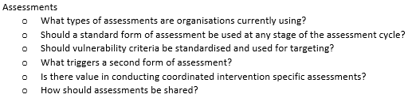
Updates from National Level
Newly Retaken Areas Taskforce
Following discussion with partners the Taskforce will holds it’s first meeting tomorrow on the topic of assessments. Subsequent meetings will follow on phases of response, coordination mechanism and reporting. ToR to be shared through Google Groups.
ToR Exert
The S-NFI Cluster is establishing a Newly Retaken Areas Taskforce to review and update the processes used during 2016 and early 2017. The objective is to work through existing processes, address new issues and provide updated guidance to all organisations conducting this type of response.
The Taskforce will involve the organisations with the largest funded programming and hold meetings in Dahuk and Erbil, aiming to establish a similar set of guidance. The Taskforce will update the Cluster on discussions, providing a full presentation when discussions are completed. The Cluster will review the updated guidelines before finalising for dissemination. The Taskforce will dissolve when the guidelines have been fully agreed.
The following organisations will participate – ACF, CARE, IOM, NRC, DRC, ACTED, DORCAS and Mission East.

Slide 10
Operational Discussion
Distributions to undocumented out of camp IDPs
What processes are partners using already?
What is the involvement of community leadership and how does this remain impartial?
Data confidentiality – how do partners share registration or beneficiary lists?
How are 2014 caseloads differentiated from new arrivals?
Have partners experienced inter-community or other security issues caused by different profiles of people attending distributions?
Should partners contribute to the resolution of this issue and how does the PDS process work?
Iraq Shelter Cluster Distribution Guideline
“A committee of local authorities can be set up in addition to the PDS to identify vulnerable families. The committee is usually composed of the local Mukhtar, Imam and PDS agent. Criteria for selection is to be communicated and explained clearly to avoid any interference to the beneficiaries' selection.”
Notes:
IS documents – potential to anticipate and resolve during registration phase?
What should be the involvement of protection staff or cluster?

Slide 11
Any Other Business
What multi lateral issues have we not covered?
I will not be present for the next cluster meeting so will delegate to someone.
The potential next scheduled discussion could be by UNMAS on demining?
Thanks for attending!

Slide 12





1. Cluster Team Structure
Richard Evans - UNHCR National Cluster Coordinator +964 (0) 771 994 5694 coord.iraq@sheltercluster.org Michel Tia - IOM Information Management Officer - National +964 (0) 750 021 1720 im2.iraq@sheltercluster.org Cornelius Weira - IOM Sub National Co-Chair - Centre and South Mobile +964 (0) 751 234 2548 coord4.iraq@sheltercluster.org | Michael Gloeckle - NRC National Co-Chair - Technical Coordinator +964 (0) 750 878 7793 coord2.iraq@sheltercluster.org Shada Qahoush- Catholic Relief Services Ninewa & Mosul Focal Point +964 (0) 751 755 8451 coordroving.iraq@sheltercluster.org Abdoulaye Dieye -NORCAP Assistant National IM im2.iraq@sheltercluster.org Laurence West - UNHCR Sub National Coordinator – KRI Mobile + 964 771 911 0574 coord3.iraq@sheltercluster.org

