Slide 1
Dahuk Shelter & NFI Cluster Coordination Meeting
Agenda
Introductions
Previous meeting action points
Mosul response camp populations
Zone north camp gaps and needs
Newly retaken areas and out of camp response
Responses and assessments since last meeting
Up coming responses by partners
Funding Updates
Key updates by partners
General notifications
Security updates
New projects
Updates from national level
AOB
Tuesday, 9th May 2017
http://sheltercluster.org/response/iraq
Notes:
Thank you to Andrea of PiN for the last meeting minutes
For Joe of Tearfund doing it today
And Julia of WHH who is doing it in two weeks time
CARE are after that!

Slide 2

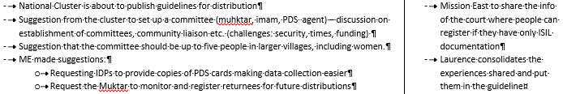

Update on Previous Action Points
tbc
http://sheltercluster.org/response/iraq
Notes:
Check with ACF on this
Coming up later in presentation
Check with ME
Not done, in progress
Index is finished and will come out with meeting minutes

Slide 3
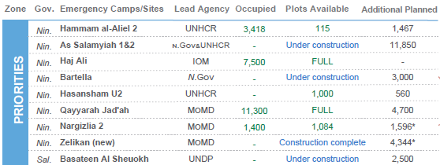
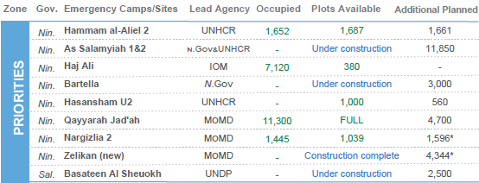
Mosul Response Camp Populations
30th April
23rd April
HAA continues to fill
Haji Ali continues to fill
Zero arrivals in the north last week

Slide 4
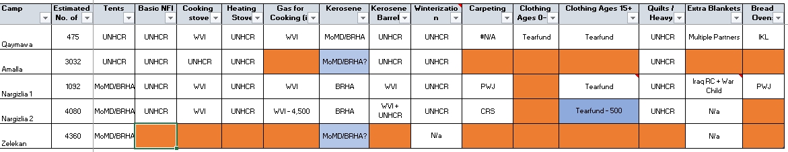
Zone North Camp Gaps
Gaps
Gaps – clothing and bread ovens
Zelikan – WHH, Mission East and DORCAS have pulled out stocks due to the end of IHPF funding which covered warehousing. If the camp is required we will look within the cluster again.

Slide 5
Newly Retaken Areas & Out of Camp Response
Assessments and responses since the last meeting:
Area | Responders
Qawsiyat | Medair, DRC & DORCAS
Alamuk, Janek and surrounding towns | ACF – S-NFI Medair – WASH & health ME – Security check NRC – Interested
Shindukhah & Sahlej | NRC & DRC
As per interim stages of response guidelines (slide 7 of 11/04/17 presentation) please can all further NGOs contact those above prior to conducting assessments in the area.
ACF and Medair to share assessments and whether they can meet the total need with the cluster / WASH & health
S-NFI cluster to source further partners to join a single coordinated response
Potential to establish a mini village cluster whilst we wait for IHPF, ECHO, OFDA funding confirmation
Notes:
Invite partners to give an update on the responses on each location

Slide 6
Newly Retaken Areas & Out of Camp Response
Upcoming partner assessments and responses?
Are partners planning assessments?
Do partners have ongoing responses or planning responses?

Slide 7
Funding Updates
The shelter cluster has visited a number of donors and found:
ECHO – closing a round of funding shortly with a second round expected later this year
OFDA – closing a round of funding shortly with expected decline from September
DFID – not funding shelter at this point
German group – 7m Euros available for NGOs
Embassies - unknown

Slide 8
Key Updates by Partners
General notifications:
Programmatic updates all are required to be informed of?
Change in staffing?
Change in area of operation?
Security updates:
Have medium or major incidents occurred during the previous two weeks?
When, where and why?
Updates from those working in forward or high risk areas
Projects:
Have you signed new funding recently?
Is a closing project creating a geographic gap?

Slide 9
Updates from National Level
XX
XX

Slide 10
Any Other Business
What multi lateral issues have we not covered?
Mission East location for an office to convert ISIS marriage certificates: https://www.google.iq/maps/place/36%C2%B017'05.5%22N+43%C2%B023'46.1%22E/@36.284854,43.3939399,490m/data=!3m2!1e3!4b1!4m5!3m4!1s0x0:0x0!8m2!3d36.284854!4d43.396134
UNMAS are confirming their ability to attending the 23rd May meeting to discuss demining
The second taskforce meeting on phases of response will be scheduled by Laurence upon his return.
No feedback on the ToR was received however this remains open to discussion
Please do consider that the questions within the ToR will set the framework of future responses and guidelines issued nationally
Michael Gloeckle has left as National Co-chair and will be replaced by Andrea Quaden of PiN starting on 9th July
Thanks for attending!

Slide 11





1. Cluster Team Structure
Richard Evans - UNHCR National Cluster Coordinator +964 (0) 771 994 5694 coord.iraq@sheltercluster.org Michel Tia - IOM Information Management Officer - National +964 (0) 750 021 1720 im2.iraq@sheltercluster.org Cornelius Weira - IOM Sub National Co-Chair - Centre and South Mobile +964 (0) 751 234 2548 coord4.iraq@sheltercluster.org | Vacant - NRC National Co-Chair - Technical Coordinator +964 (0) TBC coord2.iraq@sheltercluster.org Shada Qahoush - Catholic Relief Services Ninewa & Mosul Focal Point +964 (0) 751 755 8451 coordroving.iraq@sheltercluster.org Abdoulaye Dieye - NORCAP Assistant National IM im2.iraq@sheltercluster.org Laurence West - UNHCR Sub National Coordinator – KRI Mobile + 964 771 911 0574 coord3.iraq@sheltercluster.org

