Slide 1
Dahuk Shelter & NFI Cluster Coordination Meeting
Agenda
Introductions
Previous meeting action points
Mosul response camp populations
Mosul response camp gaps
Newly retaken areas and out of camp response
  Responses and assessments since last meeting
  Up coming responses by partners
Key updates by partners
  General notifications
  Security updates
  New projects
Updates from national level
AOB
Tuesday, 23rd May 2017
http://sheltercluster.org/response/iraq
Notes:
Thank you to Andrea of PiN for the last meeting minutes
For Joe of Tearfund doing it today
And Julia of WHH who is doing it in two weeks time
CARE are after that!

Slide 2
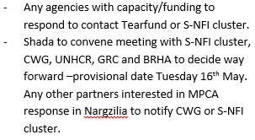


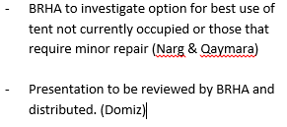




Update on Previous Action Points
http://sheltercluster.org/response/iraq
Notes:
Check with ACF on this
Coming up later in presentation
Check with ME
Not done, in progress
Index is finished and will come out with meeting minutes

Slide 3
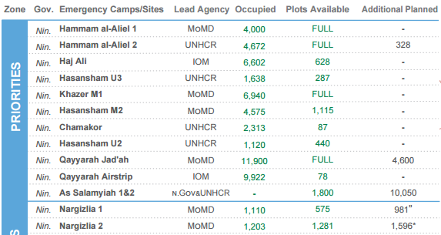
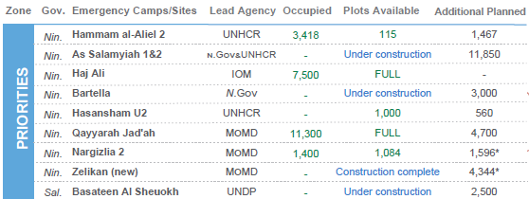
Mosul Response Camp Populations
21st May
{
30th April
Camps across the south are close to capacity
Narg occupied plots decreases

Slide 4
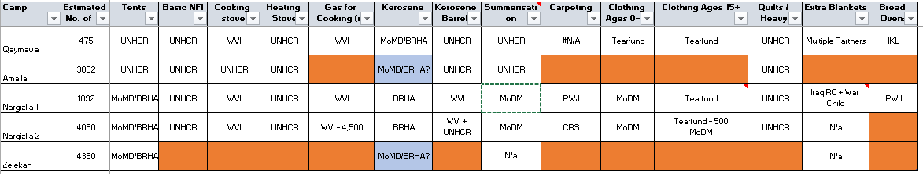
Mosul Response Camp Gaps
Gaps & Summerisation
Updates: MoDM to provide summerisation in N1+2 and Qaymara with potential for additional support in Garmawa. Support will be air water coolers, clothing, hygiene kits and torches.
Gaps:
Nargazilia – Bread ovens
Zelikan – Full NFI, if camp used
Amalla – As above, if camp used

Slide 5
Newly Retaken Areas & Out of Camp Response
Assessments and responses since the last meeting:
Area | Responders
Qawsiyat | Medair – BNFI & ESK
Alamuk, Janek and surrounding towns | ACF – S-NFI Medair – WASH & health
Khorsebad | ACTED – ESK NRC – MPCA (upcoming)
Bashiqa | Mission East
Notes:
Invite partners to give an update on the responses on each location

Slide 6
Newly Retaken Areas & Out of Camp Response
Upcoming partner assessments and responses?
Are partners planning assessments?
Do partners have ongoing responses or planning responses?

Slide 7
Key Updates by Partners
General notifications:
Programmatic updates all are required to be informed of?
Change in staffing?
Change in area of operation?
Security updates:
Have medium or major incidents occurred during the previous two weeks?
  When, where and why?
Updates from those working in forward or high risk areas
Projects:
Have you signed new funding recently?
Is a closing project creating a geographic gap?

Slide 8
Updates from National Level
Assessments and funding
A coordinated shelter assessment will be conducted in East Mosul with the potential to expand to other locations
The national level meeting at 11am on Wednesday at NCCI, Erbil will focus solely on the shelter assessment.
IHPF funding is confirmed internally and contracts should be signed shortly

Slide 9
Any Other Business
What multi lateral issues have we not covered?
Fire prevention – a meeting will be scheduled on this subject following analysis conducted by UNHCR. Invited groups include CCCM, BRHA, UNHCR, Civil Defence, GRC, Qandil, IOM, WVI & LWF.
  Do other partners have funding or experience in this area?
Meeting minutes have be done by UNHCR, ACTED, PiN, Tearfund with WHH and CARE coming up. Who’s next?
  DORCAS, Mission East, DRC, NRC, ACF, Medair?
Thanks for attending!

Slide 10





1. Cluster Team Structure
Richard Evans - UNHCR National Cluster Coordinator +964 (0) 771 994 5694 coord.iraq@sheltercluster.org Michel Tia - IOM Information Management Officer - National +964 (0) 750 021 1720 im2.iraq@sheltercluster.org Cornelius Weira - IOM Sub National Co-Chair - Centre and South Mobile +964 (0) 751 234 2548 coord4.iraq@sheltercluster.org | Vacant - NRC National Co-Chair - Technical Coordinator +964 (0) TBC coord2.iraq@sheltercluster.org Shada Qahoush - Catholic Relief Services Ninewa & Mosul Focal Point +964 (0) 751 755 8451 coordroving.iraq@sheltercluster.org Abdoulaye Dieye - NORCAP Assistant National IM im2.iraq@sheltercluster.org Laurence West - UNHCR Sub National Coordinator – KRI Mobile + 964 771 911 0574 coord3.iraq@sheltercluster.org

