Slide 1
Dahuk Shelter & NFI Cluster Coordination Meeting
Agenda
Introductions
Previous meeting action points
Mosul response camp populations
Mosul response camp gaps and summerisation
Camp priorities and fire prevention
Newly retaken areas and out of camp response inside Pesh lines
Key updates by partners
General notifications
New projects
Security and access
Updates from national level
AOB KRI
Newly retaken areas and out of camp response in GoI areas
Responses and assessments since last meeting
Up coming responses by partners
Security
AOB GoI
Tuesday, 6th June 2017
http://sheltercluster.org/response/iraq

Slide 2


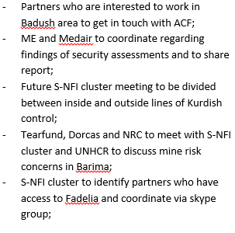

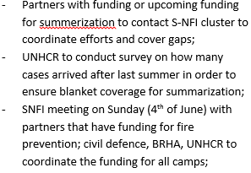

Update on Previous Action Points
http://sheltercluster.org/response/iraq

Slide 3
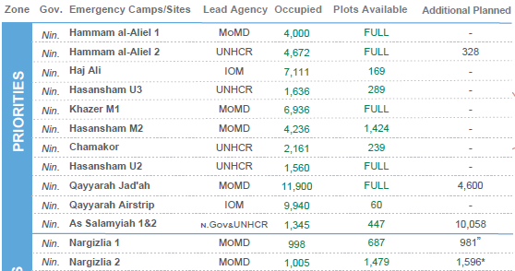
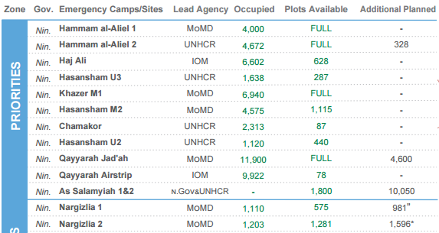
Mosul Response Camp Populations
4th June
{
21st May
Southern camps have 2,628 plots available
Narg occupied plots decreases again

Slide 4
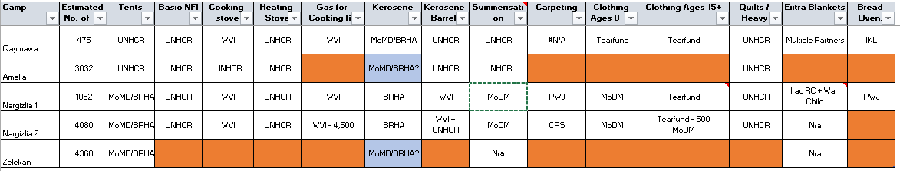
Mosul Response Camp Gaps
Gaps – No change
Gaps:
Nargazilia – Bread ovens
Zelikan – Full NFI, if camp used
Amalla – As above, if camp used

Slide 5
Mosul Response Camp Gaps
Summerisation
Gaps for jerry cans and cool boxes
Additional clothing could be useful pending assessment
Lead Agency | Site Name | Clothing | Jerry can | Cool box | Tent / HH / Community Shading | AWC | Fan | Generator O&M* | Additional Items Being Supplied
MoMD | Nargizlia 1 | MoDM | Gap | Gap |  | MoDM | N/a | N/a | Clothing?
MoMD | Nargizlia 2 | MoDM | Gap | Gap |  | MoDM | N/a | N/a | Clothing?
UNHCR | Qaymawa (former Zelikan) | MoDM | Gap | Gap | UNHCR | MoDM | N/a | N/a | Clothing?

Slide 6
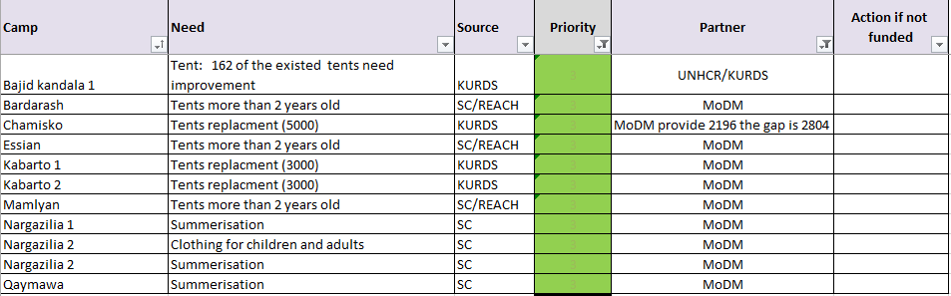
Needs in existing camps
Priority issues
Assessments conducted by KURDS, funded by UNHCR, REACH, Shelter Cluster and BRHA found a number of high needs which have been prioritized in a spreadsheet which will be shared with the minutes.
Some of the highest priority have been funded already:

Slide 7
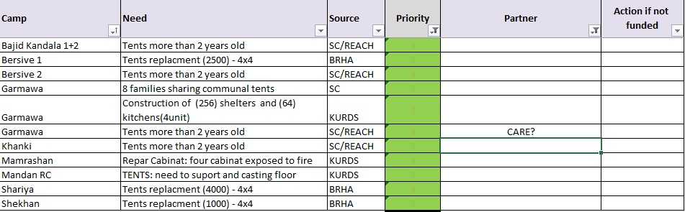
Needs in existing camps
Priority issues
Some have not and we are requesting all partners to consider their ability to support:

Slide 8
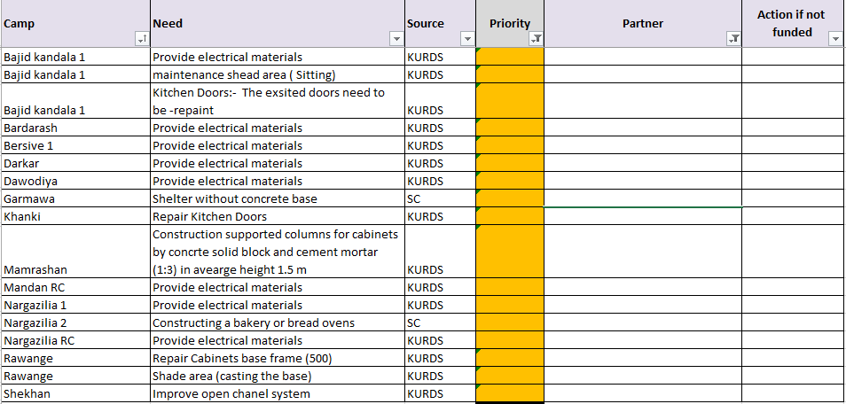
Needs in existing camps
Priority issues
Unfunded second priority issues are:

Slide 9
Needs in existing camps
Fire Prevention
A meeting was held as announced on Sunday 4th with invites and a reminder sent to a number of organisations however one organization attended and only one other informed us in advance of their inability to attend.
Fire prevention remains an important life saving activity with 208 fires in the camps during the last 18 months.
Hold the meeting directly after this or commit to Thursday, Sunday, Monday?
UNHCR
IOM
GRC
Qandil
WVI
ACTED?

Slide 10
Newly Retaken Areas & Out of Camp Response in Pesh Areas
Assessments and responses since the last meeting:
Area | Responders
Khorsebad | ACTED – ESK NRC – MPCA (upcoming)
Barima | ??? – see next slide
Notes:
Invite partners to give an update on the responses on each location

Slide 11
Newly Retaken Areas & Out of Camp Response in Pesh Areas
Barima
Following concerns over Barima a meeting hosted by OCHA was agreed and held with the following action points:
S-NFI and cash activities will be paused until further information
Concern raised at ICCG to notify other clusters
OCHA to provide written report on history, verifying reports of Pesh and civilian deaths
OCHA to contact Pesh, MAG and private demining company to assess future risk
If recommendation to take no further action, refer to OCHA using process in attached document and await further information
Inform other clusters + ICRC of final decision
Review actions which can be taken to support families
Information from MAG:
The area is highly contaminated, specifically with crush wires that cannot be detected with electronic detection due to placement
Cleared 92,820m2 around Barima
Total Item found 327 - 93 IED, 233 UXO and one AP mine
Fifteen victims ( 3 dead, and 12 injured) were reported by MAG in six different accidents which varies from 16 fatalities reported by OCHA
Information from MAG is as per their understanding and does not reference other sources such as Peshmerga, UNMAS etc

Slide 12
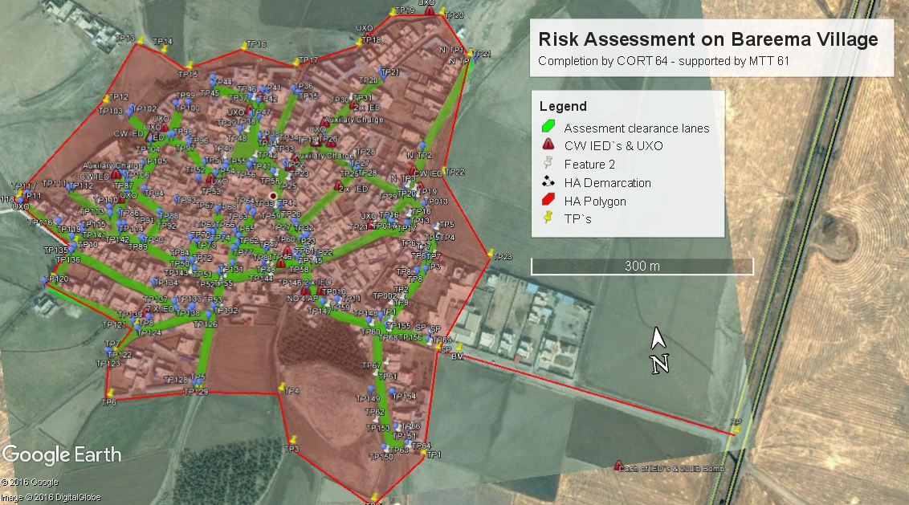

Slide 13
Newly Retaken Areas & Out of Camp Response in Pesh Areas
Remaining areas mapping soon to be completed
Key areas have been tentatively selected:
Around Wana
Around highway 2
Around Bardarash / Daraweesh Road
Bashiqa
I will check with a few more partners and release the mapping and CSV basefile to all organisations and specifically to those with stocks

Slide 14
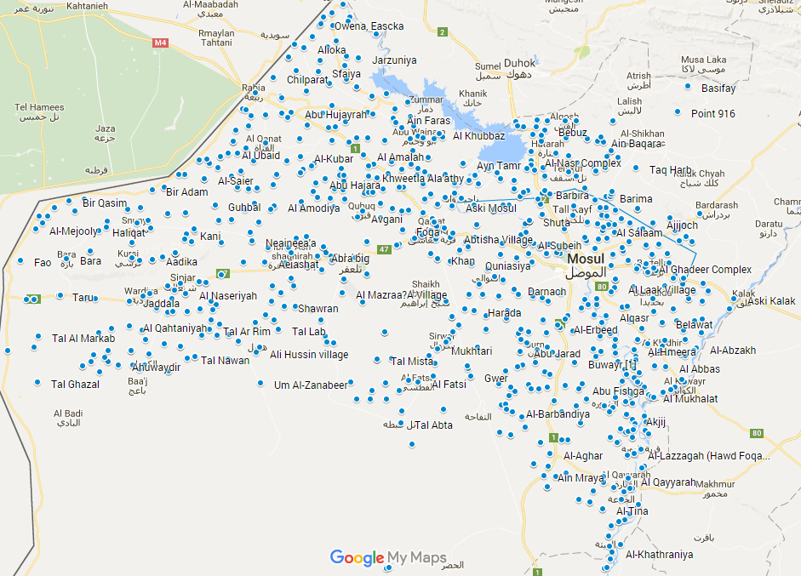

Slide 15
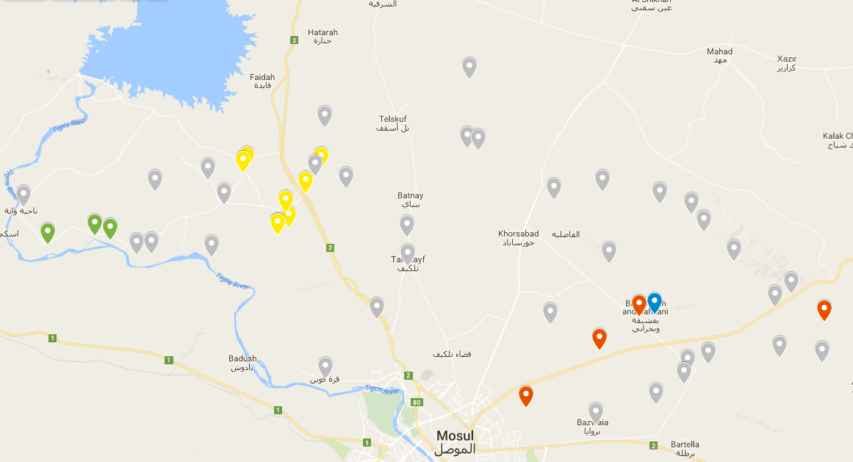

Slide 16
Newly Retaken Areas & Out of Camp Response in Pesh Areas
Upcoming partner assessments and responses?
Are partners planning assessments?
Do partners have ongoing responses or are planning responses?

Slide 17
Key Updates by Partners
General notifications:
Programmatic updates all are required to be informed of?
Change in staffing?
Change in area of operation?
Projects:
Have you signed new funding recently?
Is a closing project creating a geographic gap?
Security and access:
Problems inside Pesh lines?

Slide 18
Updates from national cluster and any other business in KRI?
What multi lateral issues have we not covered?
Updates from the national level
Safe distribution guidelines have been issued by Protection, FS and S-NFI clusters and will come around with minutes
Distribution guidelines were updated and will be shared for all Sub National clusters to comment
A war damaged buildings standard assessment is being finalized
A war damaged buildings guideline is being drafted
A donor meeting will be held next week with ECHO, OFDA and others
We will discuss planning until year end and beyond
Remaining emergency and later rehab
Priorities and gaps across KR
Potential to form a common position on rehab programming
Do partners want to advocate for specific issues?
Agenda – requests for agenda to be in writing to Laurence the week before the meeting
Meeting minutes are open for comment:
All comments must be submitted on email
To Laurence
Before COB Sunday of the next meeting

Slide 19
Part two - GoI

Slide 20
Newly Retaken Areas & Out of Camp Response in GoI Areas
Assessments and responses since the last meeting:
Area | Responders
Alamuk, Janek and surrounding towns | ACF – S-NFI Medair – WASH & health
Sheik Mohammed | ACF & ME
Al Maamel | Medair – S-NFI ACF - WASH
Tel Afar | Malteser and others?
A mapping for Tel Afar will be worked on with the potential to setup a village cluster system.
Notes:
Invite partners to give an update on the responses on each location

Slide 21
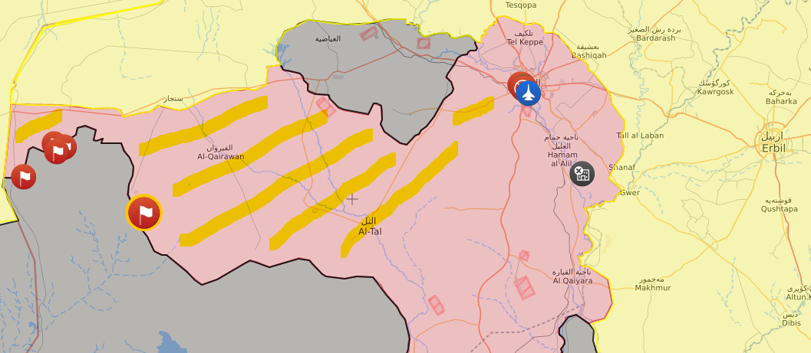

Slide 22
Security & Any Other Business
Security updates:
Have medium or major incidents occurred during the previous two weeks?
When, where and why?
Updates from those working in forward or high risk areas
What multi lateral issues have we not covered?
Meeting minutes have be done by UNHCR, ACTED, PiN, Tearfund and WHH with DORCAS, ME coming up. Who’s next?
DRC, NRC, ACF, Medair, GRC, FRC, WVI, IOM, REACH?
Thanks for attending!

Slide 23





1. Cluster Team Structure
Davide Nicolini National Cluster Coordinator +964 (0) 771 994 5694 nicolini@sheltercluster.org Michel Tia - IOM Information Management Officer - National +964 (0) 750 021 1720 im2.iraq@sheltercluster.org Cornelius Weira - IOM Sub National Co-Chair - Centre and South Mobile +964 (0) 751 234 2548 coord4.iraq@sheltercluster.org | Filled - NRC National Co-Chair - Technical Coordinator +964 (0) TBC coord2.iraq@sheltercluster.org Vacant - ACTED Ninewa & Mosul Focal Point +964 (0) 751 755 8451 coordroving.iraq@sheltercluster.org Abdoulaye Dieye - NORCAP Assistant National IM im2.iraq@sheltercluster.org Laurence West - UNHCR Sub National Coordinator – KRI Mobile + 964 771 911 0574 coord3.iraq@sheltercluster.org

