Slide 1
Sub-National Shelter & NFI Cluster Coordination meeting for C&S
1. Review of minutes of previous meeting
2. Information Management Updates
3. Issues
a.) Pre Positioning for Anbar
b.) Summer activities –Gap Analysis
c.) Tent Replacement (Kilo 18, AAF camps etc.)
d.) War Damaged Shelter Assessment Tool (WD-SAT)
4. Governorate Updates
5. AoB
Wednesday, 14th June 2017
http://sheltercluster.org/response/iraq

Slide 2




Current Cluster Team Structure
Davide Nicolini- UNHCR National Cluster Coordinator +964 (0) 771 994 5694 coord.iraq@sheltercluster.org Cornelius Weira - IOM Sub National Co-Chair - Centre and South Mobile +964 (0) 751 234 2548 coord4.iraq@sheltercluster.org Laurence West - UNHCR Sub National Coordinator – KRI Mobile + 964 771 911 0574 coord3.iraq@sheltercluster.org | Michel Tia - IOM Information Management Officer - National +964 (0) 750 021 1720 im2.iraq@sheltercluster.org Abdoulaye Dieye -NORCAP Information Management Officer - Assistant National Mobile +964 (0) 771 488 2672 im3.iraq@sheltercluster.org Ali Rasul – UNHCR Senior Cluster Associate +964 (0) 750 445 4684 snrnatassot.iraq@sheltercluster.org staff will be joining soon

Slide 3
Review of action points from previous meeting
Partners to share information with cluster on closing projects – Pending
Partners to share gaps on Summerisation in their respective areas of operation –Some progress made
Partners to share assessment reports on shelter and NFI needs in respective areas of operation – Pending
Partners to share stocks and pipeline in regard to western Anbar operational planning – Some Progress made , a few Partners have reported
Cluster to share assessment format to support Partners in data collection - Done
UNHCR to share update on latest shelter interventions in Centre and South - Done
Cluster to resend email with link for mail chimp subscription -Done

Slide 4
Information Management Updates / Activity Info - how can partners use it for their needs?
Common advantages of using Activity Info
Partners spend less time reporting and donors can view real-time information
Easy data entry – no technical or advanced computer skills are necessary
Complete integration of your data with GIS
Maintain an overview of activity progress in a rapidly changing environment
Greater capacity for analysis of trends and gaps

Slide 5
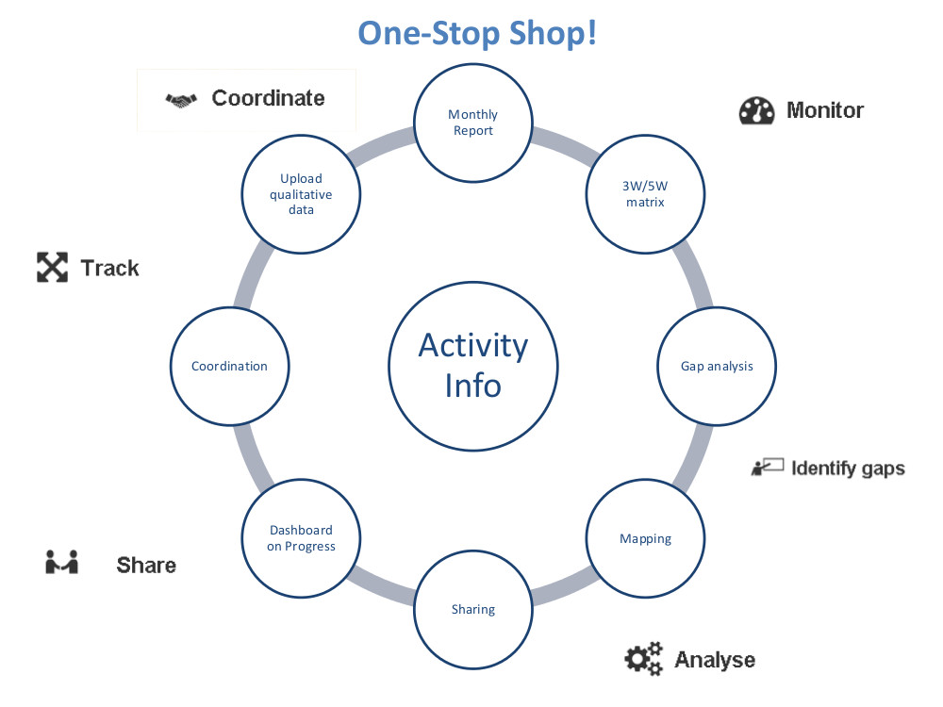
Information Management Updates
Common advantages of using Activity Info

Slide 6
Information Management Updates
ACTED experience with Activity Info (here imbedded)
Quick reminder:
1 – additional Indicators can be added once agreed with the Cluster Coordination Team
2 – Partners to make sure they always have access to the right database in Activity Info.
3 – the reporting time line here imbedded

Slide 7
Information Management Updates
From January till May 31st 2017, 1.2 million individuals have been assisted with non-food items kits which cover almost 50% of the cluster target; this includes vulnerable individuals who have benefited from shelter interventions across the Country. From the total reached beneficiaries:
In first line response, 1.1 million of vulnerable people were provided with safe and appropriate critical life-saving non-food items including appropriate emergency shelter (tents and emergency mobile or basic shelter kits).
In second line response, 0.1 million people were assisted with shelter upgrade and basic shelters repair interventions including critical life-saving non-food items replenishment.
0.005 million people were assisted in full cluster response which consist of expand safe, dignified shelter and housing options in accordance with the cluster agreed standards.

Slide 8
Cluster Key Issues / Pre Positioning for Anbar
a.) Pre Positioning for Anbar
UNHCR has pre positioned :-
2310 CRI kits prepositioned in MA WHs as 1500 kits in AMF Anbar governorate, and 1000 Kits in HTC WH,
2500 tents prepositioned in MA WHs in AMF.
QRCS has prepositioned 429 tents
MODM has prepositioned 600 tents
Partners are requested to share information on stocks and pipeline for Western Anbar anticipated Influx.

Slide 9
Cluster Key Issues / Summer activities –Gap Analysis
Site Name | # of Families | Electricity | Availability of elec. Method | Average Water (l/p/d) | Availability of Water Method | Clothing | Jerry can | Cool box | Fan
Bzebiez central camp (Al-Markazi) | 670 | Yes | Connected to grid | 10 | Water trucking |  | Gap | Gap | Gap
AL Ahssan | 280 | No | N/A | 20 | Water trucking |  | Gap | Gap | Gap
Amriyat Al-Fallujah Camp 5 | 140 | Yes | Connected to grid | Available as per needed | Connected to grid |  | Gap | Gap | Gap
Amriyat Al-Fallujah Camp 9 | 180 | Yes | Connected to grid | Available as per needed | Connected to grid |  | Gap | Gap | Gap
AK-8 | 100 | No | N/A | Available as per needed | Connected to grid |  | Gap | Gap | Gap
AK-1 | 133 |  | Generator | Available as per needed | Water trucking |  | Gap | Gap | Gap
AK-2 | 104 |  | Generator | Available as per needed | Water trucking |  | Gap | Gap | Gap
AK-3 | 64 |  | Connected to grid | Available as per needed | Water trucking |  | Gap | Gap | Gap
AK-6 | 94 |  | Connected to grid | Available as per needed | Water trucking |  | Gap | Gap | Gap
AK-7 | 108 |  | Connected to grid | Available as per needed | Water trucking |  | Gap | Gap | Gap
AK-11 | 63 |  | Generator | Available as per needed | Water trucking |  | Gap | Gap | G
Kilo 18 camp | 853 | No | N/A | 20 | Water trucking |  | Gap | Gap | Gap
Al Alam 1 | 501 | No | Generator | Available as per needed | Connected to grid |  | Gap | Gap | Gap
Al Alam 2 | 791 | No | Generator | Available as per needed | Connected to grid |  | Gap | Gap | Gap
Al Alam 3 |  | No | N/a | Available as per needed |  |  | Gap | Gap | Gap
Olympic Stadium | 1000 |  | Generator | Available as per needed | Connected to grid |  | Gap | Gap | Gap
Al Shahama and Karama Camp | 1,292 |  | N/a | No Water Supply | Water trucking |  | Gap | Gap | Gap
Al Wahda Camp - Baghdad | 42 |  |  | 20 | Connected to grid |  | Gap | Gap | Gap
Laylan -2 | 823 |  |  | Available as per needed | Connected to grid |  | Gap | Gap | Gap
Laylan -3 | 789 |  |  | Available as per needed | Connected to grid |  | Gap | Gap | Gap
Daquq | 1,767 |  |  | Available as per needed | Connected to grid |  | Gap | Gap | Gap
 | 9,794

Slide 10
Cluster Key Issues / Tent Replacement (Kilo 18, AAF camps etc.) Positioning for Anbar
No. | Partners | Distributions Locations | No Tents Replaced | Total Need-Anbar Governorate | Anbar -Outstanding Tent Replacement Need
1 | MODM | AAF, HTC, Khalidiya; Beiz Biz,Kilo 18 | 5000 | 23,000 | 18,000
2 | UNHCR | Beiz Biz | 500 |  | 17,500
3 | NRC | AAF, HTC, Khalidiya; Beiz Biz | 318 |  | 17,182
4 | CRS | AAF (60 T-shelter Al-Tahadi Camp; 100 T-shelter in Al-Bashaer Camp; 70 T-Shelter in Zawbaa Camp); AAF-16,AAF-22,AAF -24 | 460 |  | 16,952
5 | UNHCR | Beiz Biz; AAF | 394 |  | 16,558
6 | UNHCR | AAF | 111 |  | 16,447
7 | UNHCR | HTC | 140 |  | 16,308
8 | MODM | Al Kahlidiya 3 | 89 |  | 16,219
9 | MODM | Kilo 18 | 151 |  | 16,068
10 | UNHCR | HTC | 24 |  | 16,044
11 | UNHCR | HTC &AK | 152 |  | 15,892
Total |  |  | 7,339

Slide 11
Cluster Key Issues / War Damaged Shelter Assessment Tool (WD-SAT)
The Cluster has developed a standard War Damage Shelter Assessment Tool for Shelter Repair for Returnees, Stayees and Hosts
The tool will be linked to ASSIST (UNHCR database) been used already by several partners.
This will support to harmonize information collected by Partners .
The assessment tool is being pre-tested in Bartella (Ninewa Gov.) to complete the design.
A training will be conducted in Baghdad for Partners willing to use the tool.
The cluster will seek consensus from Partners on suitable dates and will communicate asap.
The tool was also Presented to Donors (in Erbil)

Slide 12
Cluster Key Issues / War Damaged Shelter Assessment Tool (WD-SAT)
Fast, observation-based assessment for targeting damaged houses for basic repairs

Slide 13
Governorate Updates
Baghdad
Basrah
Kirkuk

Slide 14
AOB
Next meeting will be Wednesday 28th June, 11:00 am at RCC4

Slide 15
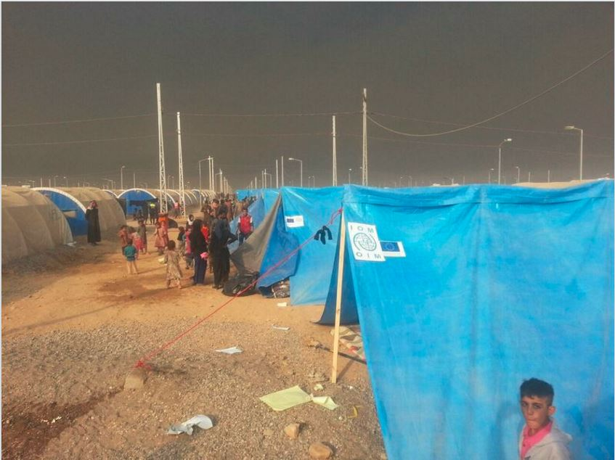
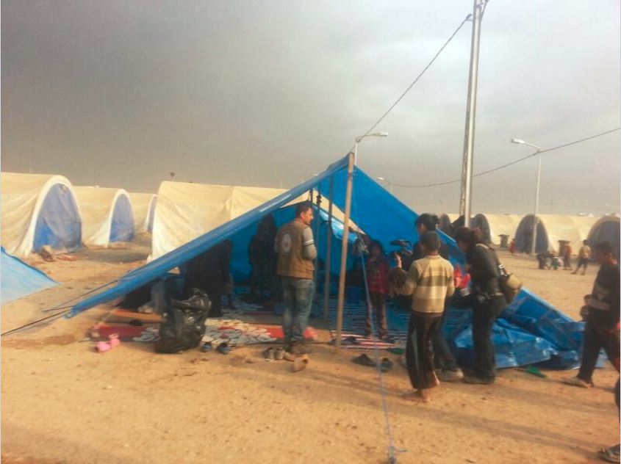
THANKS.
http://sheltercluster.org/response/iraq

