Slide 1
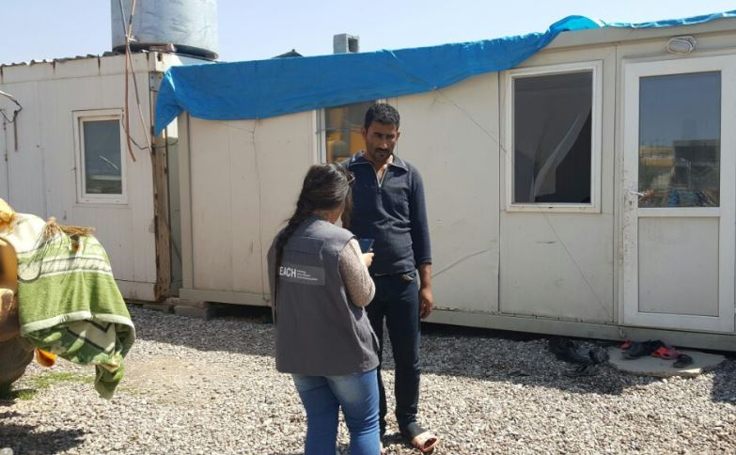
Multi-Cluster Needs Assessment IV
Presentation: Shelter/NFI Cluster

Slide 2
Introduction
Contents:
Background
Methodology
Key Findings
Next steps
Introduction
Background
Methodology
Key findings
Next steps

Slide 3
General background to MCNA IV
Objective: Cluster-driven process that provides comprehensive evidence base of needs amongst internally displaced populations (IDPs) living in non camp-settings across the whole of Iraq.
Type of assessment: MCNAs focus on the needs, perceptions and vulnerabilities of IDPs outside of camps at household level; how they prioritise their needs and view quality of assistance (across all sectors).
Questionnaire includes cluster-specific sections, questions on assistance received as well as self-reported primary needs.
Provides ‘big picture’, comparative overview (nation-wide, district and governorate level) based on primary data, for specific sectors.
Ideally used as evidence-base by clusters to guide HNO/HRP process, and complement cluster-driven interventions.
Recurring , nation-wide, longitudinal analysis: The MCNA IV is a nation-wide assessment, and will collect comparable data at the district-level in Centre-South for the third time, and for the fourth time in KRI.
Nation-wide scope allows for country-wide comparisons at the governorate and district level.
MCNA is the only assessment which allows for nation-wide analysis of trends over time (third year in a row).
Introduction
Background
Methodology
Key findings
Next steps

Slide 4
Background: Overview of MCNA cycle
Introduction
Background
Methodology
Key findings
Next steps
Research design
Indicators, forming the basis of the survey tool, are reviewed at the cluster-level ahead of data collection.
Preliminary findings
Preliminary findings presentations are held with all operational clusters
Analysis
Cluster feedback informs in-depth analysis tailored to cluster-specific needs and triangulation of data.
Dissemination
Final output and cluster-specific findings shared with cluster partners including the open access dataset.
Data collection
Majority of data is collected directly by REACH. For some inaccessible areas partners collect data.
Notes:
Indicator Review Process
Using the indicators from the previous MCNA III round:
Series of presentations were delivered to individual clusters to introduce the assessment (February-March 2017)
Opportunity for partners at cluster level to review indicators for relevance
Making sure findings are still comparable between rounds to enable longitudinal analysis
Key additions/changes
Comprehensive findings related to ‘intentions’ of IDPs relating to movement within the next 3 months
More trends in relation to area level trends and variations (north, centre and south)

Slide 5
Methodology
Iraq wide assessment
18 governorates of Iraq assessed, based on accessibility:
6,422 households interviewed in total.
78 districts covered out of 109 (72% district coverage).
Data collection in Anbar and Salah al-Din supported by Relief International.
Introduction
Background
Methodology
Key findings
Next steps
Anbar
Babylon
Baghdad
Basrah
Dahuk
Diyala
Erbil
Kerbala
Kirkuk
Missan
Muthanna
Najaf
Ninewa
Qadissiya
Salah al-Din
Sulaymaniyah
Thi-Qar
Wassit

Slide 6
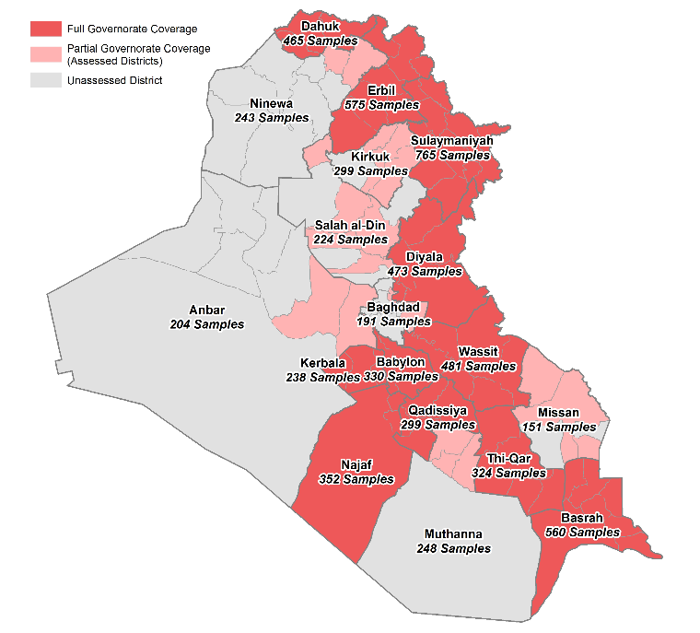
Methodology: Assessed Areas
Introduction
Background
Methodology
Key findings
Next steps

Slide 7
Methodology: Limitations & sampling
Some governorates were only partially assessed due to security concerns and authorization issues at the time of assessment. The overall governorate confidence level of 95% applies to those findings which pertain to the full sample.
Any findings presented solely on subsets of the population – e.g. households who reported that they could not afford basic needs – inevitably have a lower confidence level.
Household level sampling using random GIS points based off IOM DTM data on IDP population size and respective location in Iraq.
Significant results at governorate level, with a 95% confidence level and 10% margin of error.
Cluster sampling was employed to help the logistical challenges of collecting nationwide data.
Introduction
Background
Methodology
Key findings
Next steps

Slide 8
Key findings: Overview
Settlement Type
Shelter Type
HHs sharing
Shelter concerns
NFI
Access to assistance
Other relevant findings
Introduction
Background
Methodology
Key findings
Next steps

Slide 9
Key findings: Settlement type
Across the 18 governorates of Iraq 66% of IDP HHs reside in residential housing and 34% are living in critical shelter arrangements (26% in collective centres and 8% in informal sites).
Introduction
Background
Methodology
Key findings
Next steps
Southern governorates reported higher results for occupancy in residential housing. While over a third of IDP HHs in the northern and central governorates reported living in collective centres.
 | Collective centre | Informal site | Residential housing
North | 28% | 9% | 63%
Centre | 27% | 9% | 64%
South | 6% | 6% | 88%
Notes:
Highest results at governorate level for collective centre occupancy includes Missan (86%), Diyala (62%).
As not reported in previous rounds cannot compare how these results have changed. Not a direct comparison, but the Shelter Cluster factsheet produced in October 2016, reports 16% living in critical shelter arrangements including informal sites.

Slide 10
Key findings: Shelter type (Iraq-level)
Introduction
Background
Methodology
Key findings
Next steps
Comparison of shelter type results between MCNA III and MCNA IV generally show comparable results. Key shifts include occupancy of apartments has doubled.
Across Iraq, 6% of IDP households reported living in religious buildings. At the regional level, the highest result was recorded in the south.
Notes:
While these results are comparable, there are significant shifts which have taken place at the regional/area level which are unpacked in the next slide.
Religious buildings not reported in MCNA III.
Results in the graph for religious building does not add up to 100% as the breakdown comes from all shelter categories across the south e.g. Abandoned buildings etc, container etc).

Slide 11
Key findings: Shelter type by area
Houses:
In the southern governorates less than half of IDP HHs (46%) are living in houses compared to north (74%) and and centre (62%). For the south this represents a 7% decrease from MCNA III.
Apartments:
Occupancy of apartments in the north and centre has doubled since MCNA III, but has decreased by 5% in the South.
Religious buildings:
Highly signficant results for the southern governorates (47%) compared to 4% in centre and negligible results for the north.
Unfinished building:
The results for south and centre remained exactly the same at 1% and 11% respectively.
Introduction
Background
Methodology
Key findings
Next steps
 | MCNA III | MCNA IV
North | 7% | 13%
Centre | 5% | 13%
South | 8% | 3%
Notes:
All other categories including hotels, school, tent, container, open air, public building had results that were less than 5% and there were no major shifts when compared with MCNA III.
Religious buildings: 3% Najaf along with 1% Kerbala as well as 1% for Wassit (other 2% is made up of less than 1% results from Wassit, Qaddissiya and Muthanna as well as Missan).

Slide 12
Key findings: IDPs sharing shelter
At the country-level, 25% of IDP HHs are sharing their accomodation with atleast one other family. This figure has reduced from MCNA III by 19%.
Introduction
Background
Methodology
Key findings
Next steps
Households reporting sharing their shelter with 2-5 families has decreased from 39% in MCNA III to 24% in MCNA IV. In the South there is a significant decreasse by 16% from round III. The centre governorates also shows a significant change from the last round with a decrease of 12%.
Households reporting sharing their shelter with 6 or more sharing families highlights a key shift across the regions, specifically in the southern governorates which has decreased from 26% to negligible results.
Notes:
Nation-wide: 75% of IDP HHs across Iraq do not share their accommodation. This was 56% during MCNA III.
Regional: Average increase of 28% of IDPs not sharing across areas (more IDPs are living in single occupancy shelter arrangements than MCNA III).
Private space: 45% nationwide reported to having private space (if they shared). 69% in the north said they did not followed by 50% in the centre and 10% in the south. 19% of HHs attributed the sub-par quality of their accommodation to the lack of privacy.

Slide 13
Key findings: Shelter concerns
Across Iraq, 79% of IDP HHs reported that the shelter they are currently occupying is not of adequate quality, which is a 12% increase from MCNA III (67%).
Of this 79%, primary concerns reported include too small (45%), leaking roof (34%), broken windows (33%).
At country level, the average size of IDP accomodation per family was reported as 2,151m2.
Across the country, only 3% reported being threatened with evictions with notably high results in Missan (13%), Anbar (12% and Salah al-Din (8%).
Introduction
Background
Methodology
Key findings
Next steps
Notes:
The 2,151m2 is based on the estimate size given by those HHs who did respond to this question. Many HHs did not know the size so did not report.
HLP related questions are missing due to a glitch in the ODK form – the only section that was captured was threat of eviction which has been included in this section.

Slide 14
Key findings: Access to NFI items
Background
Methodology
Key findings
Next steps
 | Cooking fuel | Kitchen set | Light after nightfall | Access to heating fuel | Fuel storage | Winter clothes | Fan | Cool box
North | 96% | 95% | 96% | 83% | 77% | 78% | 68% | 37%
Centre | 91% | 97% | 89% | 65% | 55% | 69% | 71% | 59%
South | 99% | 99% | 99% | 84% | 82% | 92% | 100% | 97%

Slide 15
Key findings: Access to Assistance
Across Iraq 80% of IDP HHs reported receiving no shelter support in the last 6 months.
MCNA IV findings show that 15% of IDP HHs reported receiving Shelter assistance, representing a 5% decrease from MCNA III.
While assistance in the centre and south has remained comparable, it has reduced by 9% in the North from 27% to 18%.
When asked about specific shelter support received, the highest reported type was rental support (9%).
Over a quarter of IDP HHs in the south received tarpaulin.
Introduction
Background
Methodology
Key findings
Next steps
Notes:
Difference between shelter support (within last 6 months) and shelter assistance (since start of the crisis).
Shelter support: Results pertaining to specific shelter support were not included in the last round, hence no comparative results.
Most results were between 0-5%, 6-10% mark across the regional areas. More shelter support in the South 42% compared to 18% in north and centre – but this could be attributed to low cost support received at a higher level in the south.

Slide 16
Other relevant findings
Across Iraq, 74% of HHs were not able to fully afford all their basic needs.
Of these households, 32% reported were not able to afford shelter; this was highest in the north (47%), followed by the centre (22%) and the south (6%).
During MCNA III, 47% of HHs across Iraq reported that they could not afford shelter as part of their essential needs. This reduced to 32% in MCNA IV. For the northern governorates results remained comparable but reduced in the south by over 40% suggesting that HHs were increasingly able to afford shelter needs.
While food was the highest reported reason for HHs taking on debt, rent was the second most reported result (51%) – remaining at a similar level to MCNA III (53%). Households reporting taking on debt for rent increased in the centre to 60% compared to 44% in MCNA III.
Introduction
Background
Methodology
Key findings
Next steps
Notes:
The questions in relation to affordability specifically ask:
Has your household been able to afford ALL basic needs (food, water, shelter and urgent medical care)?
Which basic needs could you not fully afford? (4 options include food (55%), water (5%), shelter and health (65%))?

Slide 17
Next steps
Introduction
Background
Methodology
Key findings
Next steps
Q & A.
Feedback collated from each cluster on findings.
Open source: dataset can be disseminated to cluster partners to run own analysis/compare with own findings.
Final report compiled and shared in July 2017.
THANK YOU
Contact:
Homera Cheema (Assessment Officer)
homera.cheema@reach-intitiative.org
Tessa Richardson (Assessment Officer)
Tessa.richardson@reach-initiative.org

