Slide 1
Dahuk Shelter & NFI Cluster Coordination Meeting
Agenda
Introductions
Previous meeting action points
Mosul response camp populations
Mosul response camp summerisation
Camp priorities and fire prevention
Newly retaken areas and out of camp response inside Pesh lines
Key updates by partners
General notifications
New projects
Security and access
Updates from national level
AOB KRI
Newly retaken areas and out of camp response in GoI areas
Responses and assessments since last meeting
Up coming responses by partners
Security
AOB GoI
Tuesday, 4th July 2017
http://sheltercluster.org/response/iraq

Slide 2




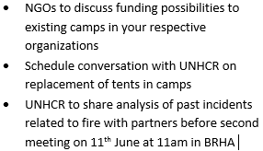



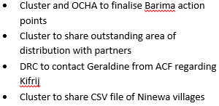
Update on Previous Action Points
http://sheltercluster.org/response/iraq
Notes:
NGO to discuss funding in camps – ask who is working in camps and which NGOs discuss, the result of the conversations etc. Have them put in the minutes.
UNHCR conversation and tents – the prioritizes spreadsheet is update to date and will be reshared with the meeting minutes by Laurence
Barima, ICCG visit occurred on 28th, you can ask OCHA to share updates during meeting
Outstanding areas of distribution – relates to a mapping, more info further in the presentation
Food cluster needs was in Al Mohammed, north of Qawisyat
Tel Afar mapping – if I have shared with you great, im still waiting on CMCoord.

Slide 3
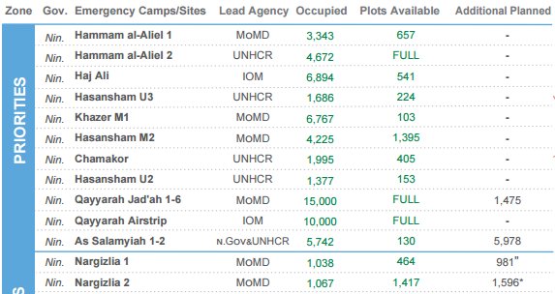
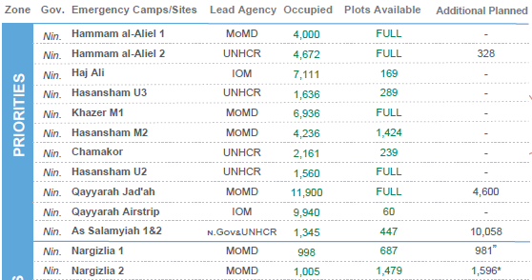
Mosul Response Camp Populations
22nd June
{
4th June
Southern camps are seeing more returns than displacement – 2,628 vs. 3,608
Narg occupied plots decreases again

Slide 4
Mosul Response Camp Gaps
Summerisation
Gaps for jerry cans and cool boxes
Lead Agency | Site Name | Clothing | Jerry can | Cool box | Tent / HH / Community Shading | AWC | Fan | Generator O&M* | Additional Items Being Supplied
MoMD | Nargizlia 1 | MoDM + PWJ | Mission East | Gap |  | MoDM | N/a | N/a
MoMD | Nargizlia 2 | MoDM + PWJ | Mission East | Gap |  | MoDM | N/a | N/a
UNHCR | Qaymawa (former Zelikan) | MoDM + PWJ | Gap | Gap | UNHCR | MoDM | N/a | N/a

Slide 5
Needs in existing camps
Prioritisation
Have any NGOs spoken internally on being able to meet any needs?
Are there any commitments we can discuss?
Fire Prevention
A meeting was held as announced on Sunday 11th and recommendations will be completed by CCCM Cluster with the support of SNFI, UNHCR field, BRHA, CD and partners.
CCCM – can you provide a deadline for a first draft?

Slide 6
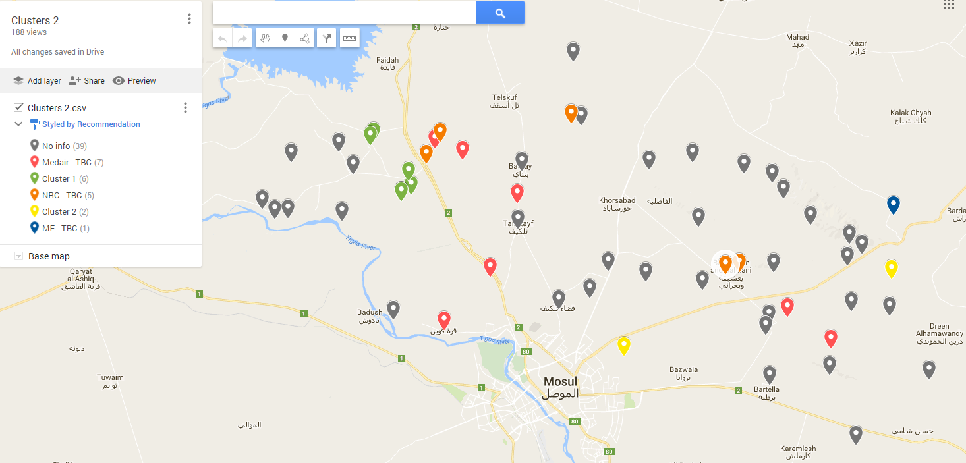
Newly Retaken Areas & Out of Camp Response in Pesh Areas
Remaining areas mapping
Notes:
Mapping created to show villages without response in grey.
Three NGOs came forward to support – Medair, NRC and Mission East

Slide 7
Newly Retaken Areas & Out of Camp Response in Pesh Areas
Assessments and responses since the last meeting:
Area | Responders
Ayadiya Sub District | WHH & Malteser
x7 villages (Kafruk, Filfal etc.) | Medair
x5 villages (Barbira, Bashiqa etc.) | NRC
Khazna | Mission East
Notes:
Invite partners to give an update on the responses on each location

Slide 8
Newly Retaken Areas & Out of Camp Response in Pesh Areas
Remaining areas mapping
Have partners conducted assessments or have dates for their locations?
Medair – seven locations
NRC – five locations
Mission East - Khazna
Following partners assessments and interventions the mapping will be updated.
Are any partners able to conduct assessments in any of the grey locations?

Slide 9
Newly Retaken Areas & Out of Camp Response in Pesh Areas
Upcoming partner assessments and responses?
Are partners planning assessments?
Do partners have ongoing responses or are planning responses?

Slide 10
Newly Retaken Areas & Out of Camp Response in Pesh Areas
Barima
Background from MAG:
The area is highly contaminated, specifically with crush wires that cannot be detected with electronic detection due to placement
Cleared 92,820m2 around Barima
Total Item found 327 - 93 IED, 233 UXO and one AP mine
Fifteen victims ( 3 dead, and 12 injured) were reported by MAG in six different accidents which varies from 16 fatalities reported by OCHA
ICCG mission was organized for the 28th July.
OCHA, are there updates following the mission?

Slide 11
Key Updates by Partners
General notifications:
Programmatic updates all are required to be informed of?
Change in staffing?
Change in area of operation?
Projects:
Have you signed new funding recently?
Is a closing project creating a geographic gap?
Security and access:
Problems inside Pesh lines?

Slide 12
Updates from national cluster and any other business in KRI?
What multi lateral issues have we not covered?
Updates from the national level
There is a new National Cluster Coordinator – Laurent de Valensart, contact details on last slide
A donor meeting was held with ECHO and OFDA
Both were very positive meeting
The SNFI cluster will work closely with ECHO on future programming
Specific focus will be on rehabilitation and a common multi donor / cluster strategy was welcomed
Reminder:
Agenda – requests for agenda to be in writing to Laurence the week before the meeting
Meeting minutes are open for comment:
All comments must be submitted on email
To Laurence
Before COB Sunday of the next meeting

Slide 13
Part two - GoI

Slide 14
Newly Retaken Areas & Out of Camp Response in GoI Areas
Assessments and responses since the last meeting:
Area | Responders
Alamuk, Janek and surrounding towns | ACF to update
Al Maamel | Medair to update
Tel Afar | Malteser feedback on 21 RNA
A mapping for Tel Afar will be worked on with the potential to setup a village cluster system.
Waiting on feedback from CMCoord
Notes:
Invite partners to give an update on the responses on each location

Slide 15
Security & Any Other Business
Security updates:
Have medium or major incidents occurred during the previous two weeks?
When, where and why?
Updates from those working in forward or high risk areas
What multi lateral issues have we not covered?
Thanks for attending!

Slide 16





1. Cluster Team Structure
Laurent de Valensart - UNHCR National Cluster Coordinator +964 (0) 771 994 5694 coord.iraq@sheltercluster.org Michel Tia - IOM National IOM +964 (0) 750 021 1720 im2.iraq@sheltercluster.org Abdoulaye Dieye - NORCAP Assistant National IMO +964 (0) 771 488 2672 im2.iraq@sheltercluster.org Ali Rasul – UNHCR Senior Cluster Associate +964 (0) 750 445 4684 snrnatassot.iraq@sheltercluster.org | Andrea Quaden - NRC National Co-Coordinator +964 (0) 7517 407 635 coord2.iraq@sheltercluster.org Laurence West - UNHCR Sub National Coordinator – KRI + 964 771 911 0574 coord3.iraq@sheltercluster.org Tonja Klansek - ACTED Roving Coordinator +964 (0) 773 725 80 92 coordroving.iraq@sheltercluster.org Cornelius Weira - IOM Sub National Coordinator - Centre and South +964 (0) 751 234 2548 coord4.iraq@sheltercluster.org

