Slide 1
Sub-National Shelter & NFI Coordination meeting for MOSUL
1. Introduction
2. Geographic coverage – follow ups- complete coverage
3W – Activity Info – current and planned projects -stock
Winterization as a part of interventions
Operational challenges
AOB
Tuesday 01st Aug. 2017
http://sheltercluster.org/response/iraq

Slide 2





Current Cluster Team Structure – since 11 July 2017
Laurent de Valensart - UNHCR National Cluster Coordinator +964 (0) 771 994 5694 coord.iraq@sheltercluster.org Michel Tia - IOM Information Management Officer - National +964 (0) 750 021 1720 im2.iraq@sheltercluster.org Cornelius Weira - IOM Sub National Co-Chair - Centre and South +964 (0) 751 234 2548 coord4.iraq@sheltercluster.org Laurence West - UNHCR Sub National Coordinator – KRI +964 (0) 771 911 0574 coord3.iraq@sheltercluster.org | Andrea Quaden - NRC National Cluster Co-Coordinator +964 (0) 751 740 7635 coord2.iraq@sheltercluster.org Abdoulaye Dieye -NORCAP Information Management Officer - Assistant National +964 (0) 771 488 2672 im3.iraq@sheltercluster.org Tonja Klansek Roving Cluster Coordinator - ACTED +964 (0) 773 725 8092 coordroving.iraq@sheltercluster.org Ali Rasul – UNHCR Senior Cluster Associate +964 (0) 750 445 4684 snrnatassot.iraq@sheltercluster.org

Slide 3
Geographic Coverage – Follow Ups – Complete Coverage
Verification of reported areas of intervention
Discussion on areas of duplication

Slide 4
2. 3W – Activity Info – Current and Planned Projects - Stock
Is everyone using Activity Info? (need for Activity Info training)
3 W for current and planned projects, stocks (planned – start within 2 weeks/confirmed budget with date)
  What data to share
  How to communicate
  How to report (skype, email, forum….)

Slide 5
3. Winterization as Part of Interventions
Distribution of SoK and ESK
  Support with installation – 1 warm room concept
  Additional caseload for winterization – follow up with recipients of SoK/ESK

Slide 6
4. Operational Challenges

Slide 7
5. AOB
Next meeting
Action points:
Unlock Activity Infio (for past reporting)
Advocate for naming miehg. In Mosul ( P code system)
Share a map – for reporting
Collate the map (bi weekly)
Each NGO/ partner assign focal point for cluster
PDM on SoK and ESK shared with clusters
Coordination with UNMAS and government on demining

Slide 8
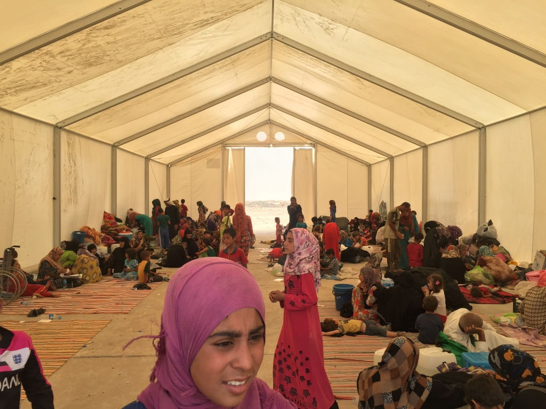
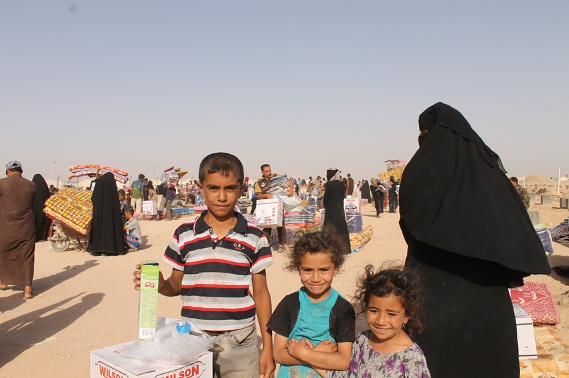
THANKS.
http://sheltercluster.org/response/iraq

