Slide 1
Shelter & WASH Working Group Meeting
Thursday 10 August, 10AM
Asia Pacific Alliance for Disaster Management

Slide 2
Agenda
Introductions & Agenda
Information Management updates
District focal point updates
NBRO policy framework
Donor meeting
AOB

Slide 3
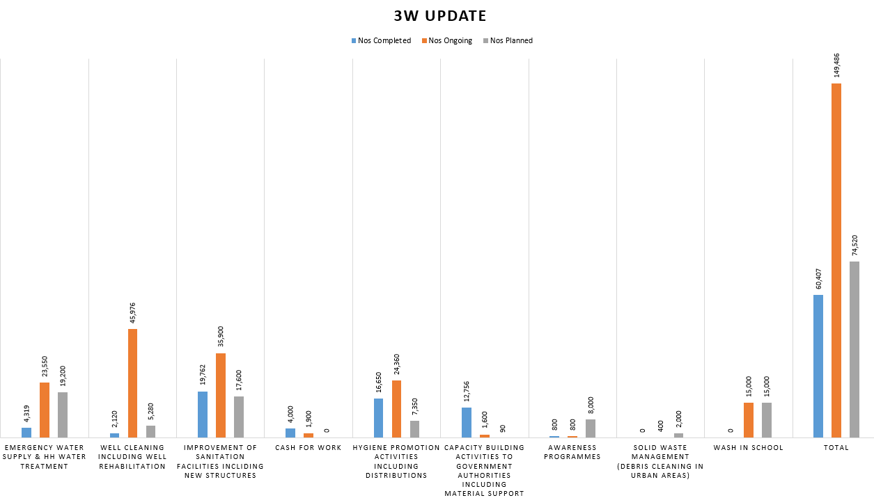

Slide 4
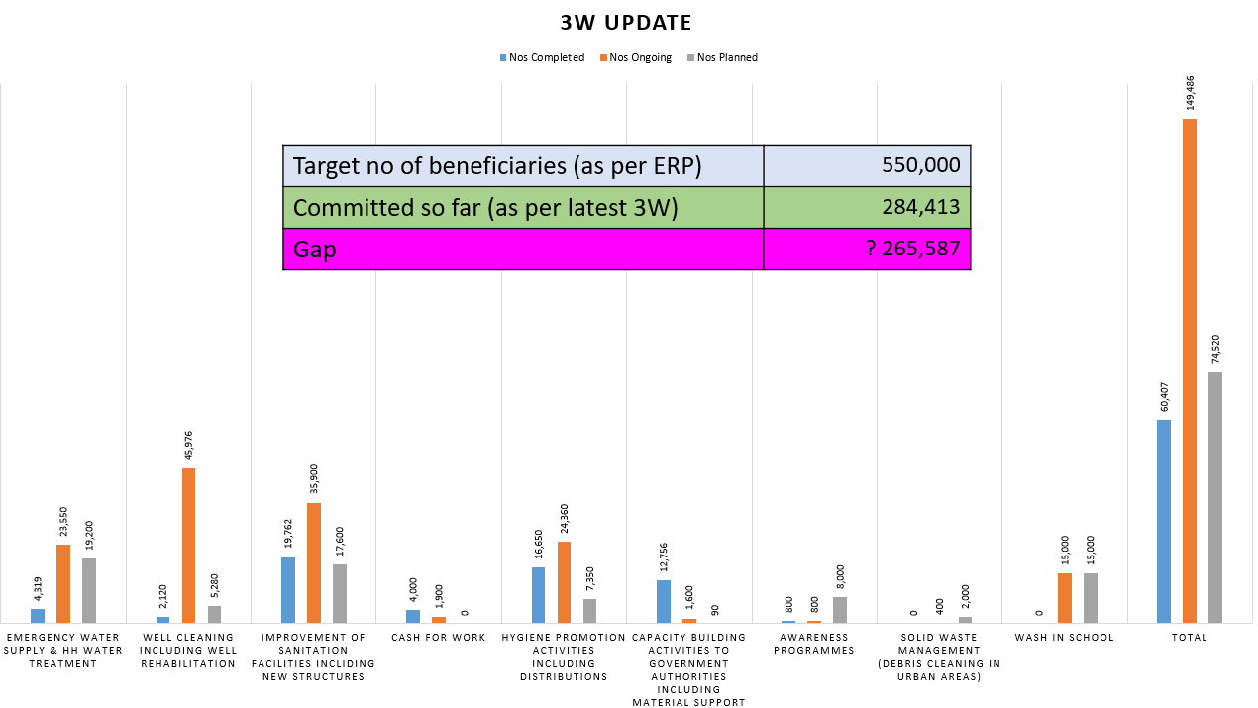

Slide 5
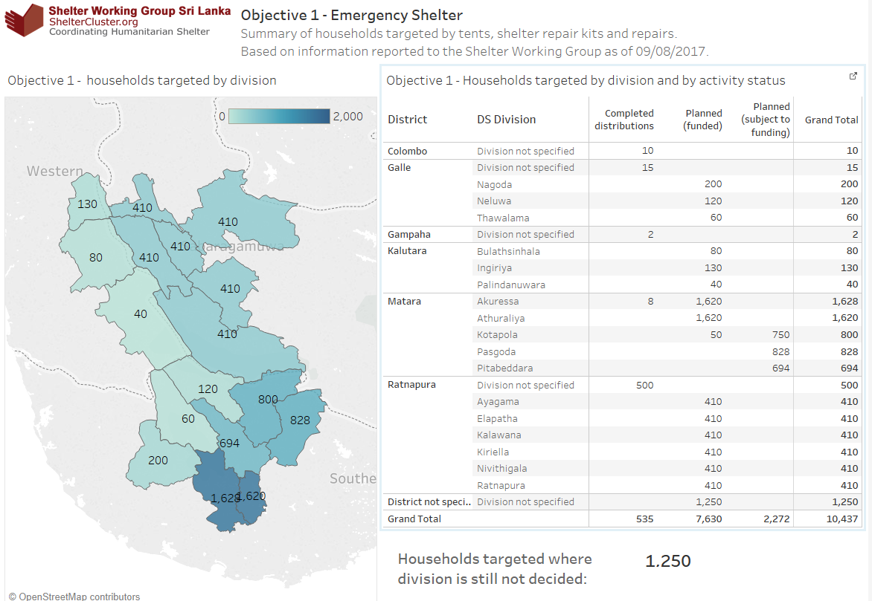

Slide 6
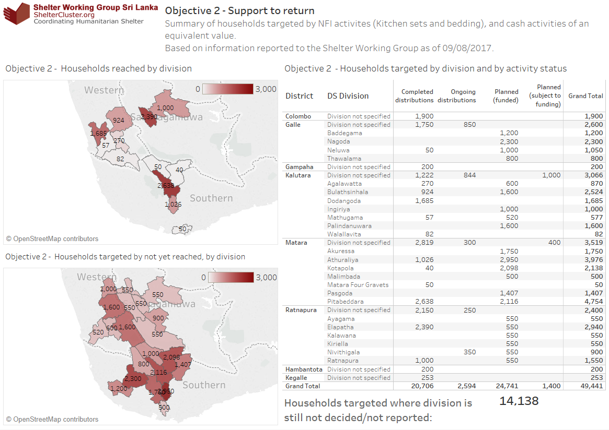
Shelter & NFI - progress to date

Slide 7
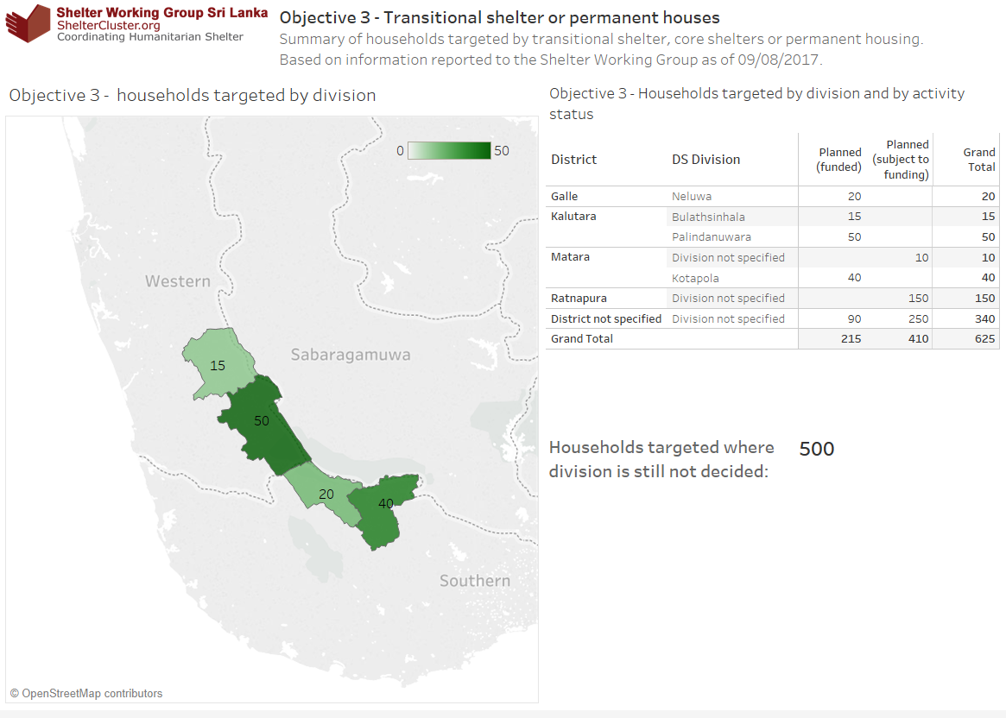
Shelter & NFI - progress to date

Slide 8
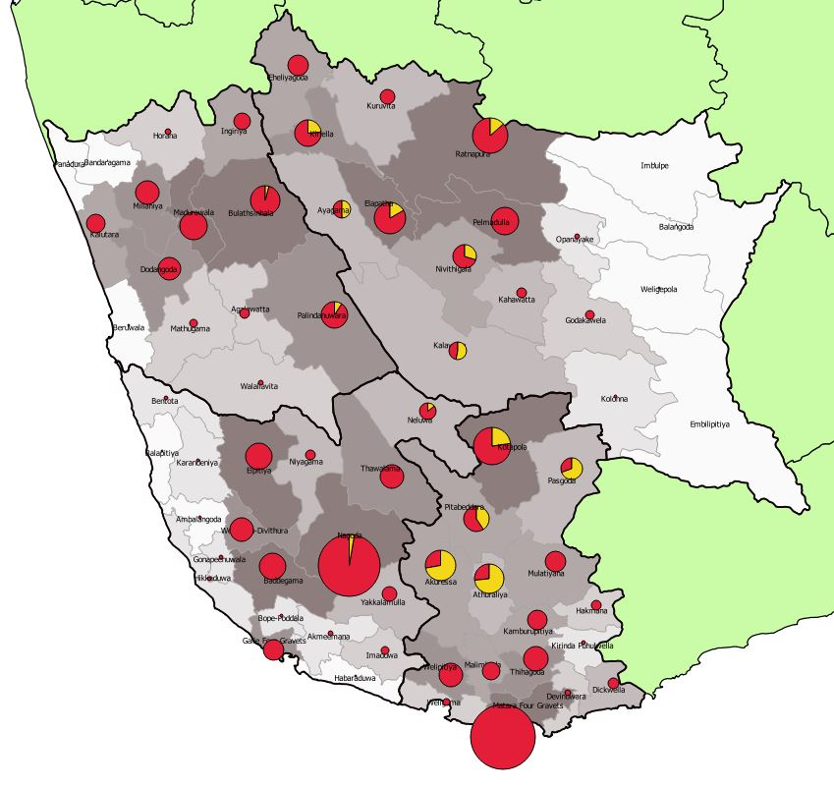

Objective 1 Division Gap
Emergency shelter (shelter repair kits and repairs) vs partial damage
Pie chart colour shows proportion of households targeted relative to damage data (partially damaged houses – district data).
Pie chart size indicates total number of partially damaged houses
Division shading represents extent of gap
    HH targeted but
    not yet reached
    Gap
HH targeted includes funded and unfunded activities as reported to SWG by 09/08/2017

Slide 9
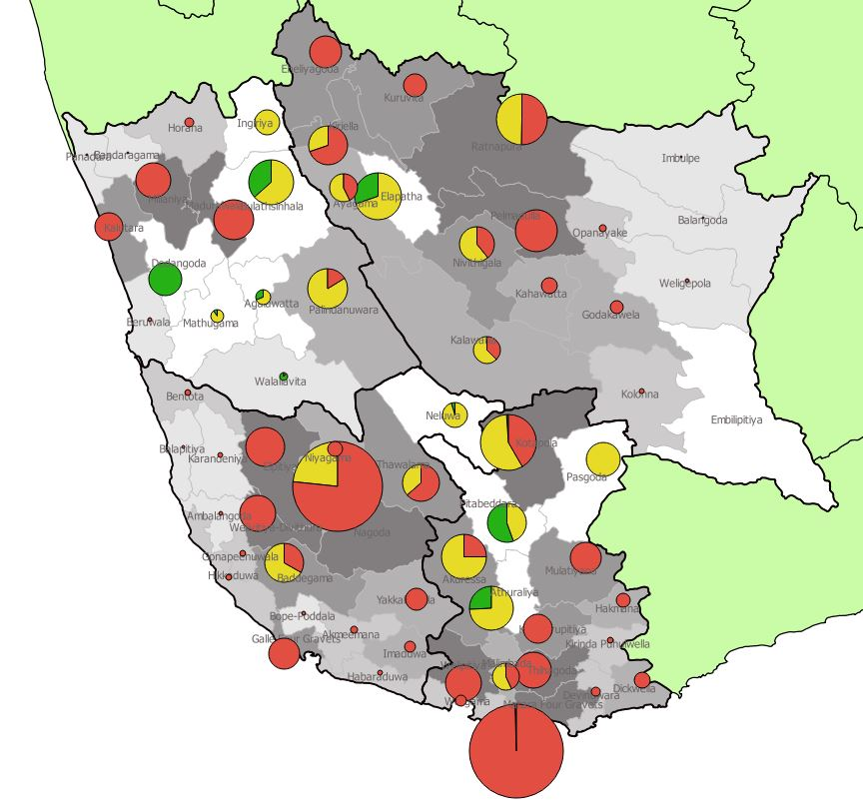
Objective 2 Division Gap
Support to return (Household NFI) vs all damage
Pie chart colour shows proportion of households targeted relative to damage data (partially damaged houses and fully damaged houses – district data).
Pie chart size indicates total number of damaged houses
Division shading represents extent of gap
    HH reached
    HH targeted but
    not yet reached
    Gap
HH targeted includes funded and unfunded activities as reported to SWG by 09/08/2017

Slide 10
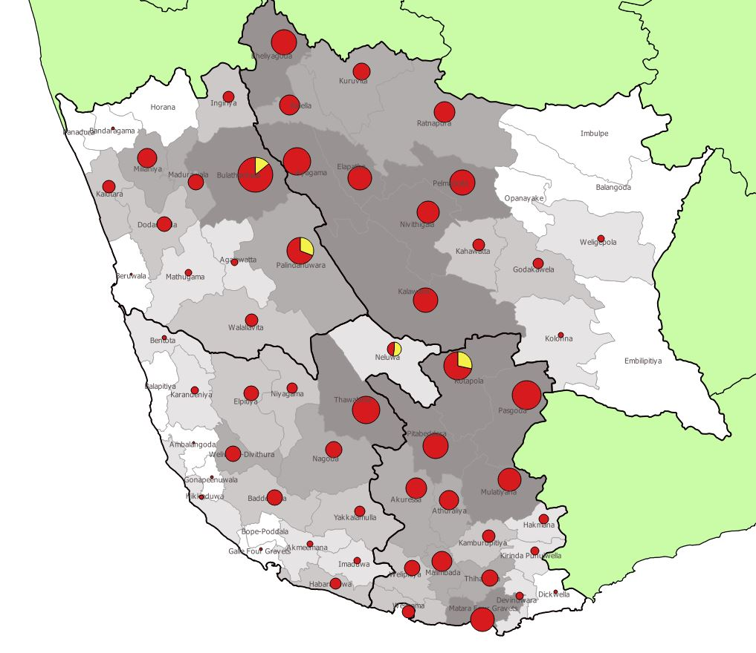
Objective 3 Gap
T/core/permanent shelter vs full damage
Pie chart colour shows proportion of households targeted relative to damage data (fully damaged houses – district data).
Pie chart size indicates total number of fully damaged houses
Division shading represents extent of gap
    HH targeted but
    not yet reached
    Gap
HH targeted includes funded and unfunded activities as reported to SWG by 09/08/2017

Slide 11
District Updates
Focal points
  WASH update
    World Vision – Kaluthra
    LEADS – Ratnapura and Matara
    Oxfam – Galle
  Shelter update
    World Vision: Ratnapura
    UN Habitat: Galle & Kalutara
    Save the Children: Matara

Slide 12


GOVERNMENT RESPONSE
No
Safe Site ?
Yes
Directly affected by Landslide
Identified as High Risk by NBRO
Resettlement
Fully Damaged (>40%)
Partially Damaged (<40%)
Govt. financial assistance
Reconstruction
Rs. 1.6 m to purchase the land with a house
To purchase a land and construct a house to provide Rs. 0.4 m and Rs. 1.2 m respectively
Rs. 1.2 m to construct a when lands are granted by the government
NITF Insurance

Slide 13
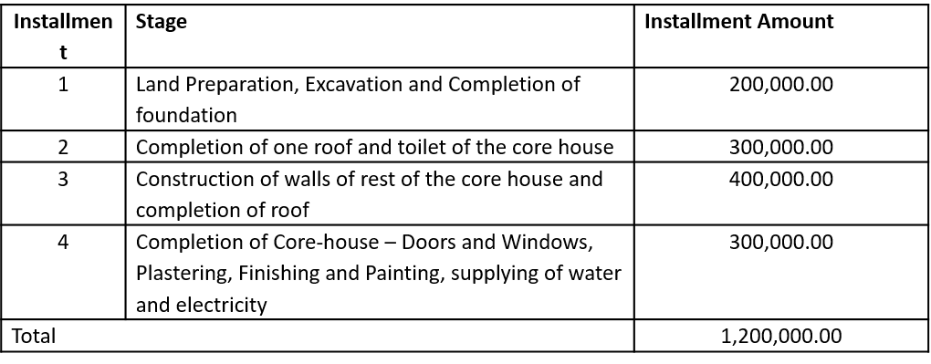
Method of construction with government financial assistance:
Two stages
  Stage 1: Construction of one room with toilet
  Stage 2: Completion of core house
Four instalments

Slide 14
GOVERNMENT RESPONSE
No
Safe Site ?
Yes
Directly affected by Landslide
Identified as High Risk by NBRO
Resettlement
Fully Damaged (>40%)
Partially Damaged (<40%)
All: technical support
Transitional /core shelter?
Transitional/core shelter?
Shelter
Repair Kit/Cash
Govt. financial assistance
Reconstruction
Rs. 1.6 m to purchase the land with a house
To purchase a land and construct a house to provide Rs. 0.4 m and Rs. 1.2 m respectively
Rs. 1.2 m to construct a when lands are granted by the government
NITF Insurance

Slide 15
Web Details
www.sheltercluster.org
https://www.sheltercluster.org/response/sri-lanka-floods-2017
Damage data visualisation:
https://public.tableau.com/profile/methunan#!/vizhome/SriLanka-DamageDataTable/SummaryDamage-District
Damage data table: https://public.tableau.com/profile/methunan#!/vizhome/SriLanka-DamageDataTable/Datatable?publish=yes
DTM: https://app.powerbi.com/view?r=eyJrIjoiZThjNmRiZTgtMjY2NC00YTEzLWFhYzMtZTlkODlkMzI4NTllIiwidCI6IjliNWVkNDg5LWZiOWEtNDVmMi04MTBjLTkyNmFlNDdjZjMzOCIsImMiOjEwfQ%3D%3D

Slide 16
Web Details

