Slide 1
Sub-National Shelter & NFI Coordination meeting MOSUL
Follow up and action points of SNFI Urban Mosul meeting (1st August)
Urban Mosul mapping
Village response mapping
Tal Afar response
AOB
Tuesday 01st Aug. 2017
http://sheltercluster.org/response/iraq

Slide 2





Current Cluster Team Structure – since 11 July 2017
Laurent de Valensart - UNHCR National Cluster Coordinator +964 (0) 771 994 5694 coord.iraq@sheltercluster.org Michel Tia - IOM Information Management Officer - National +964 (0) 750 021 1720 im2.iraq@sheltercluster.org Cornelius Weira - IOM Sub National Co-Chair - Centre and South +964 (0) 751 234 2548 coord4.iraq@sheltercluster.org Laurence West - UNHCR Sub National Coordinator – KRI +964 (0) 771 911 0574 coord3.iraq@sheltercluster.org | Andrea Quaden - NRC National Cluster Co-Coordinator +964 (0) 751 740 7635 coord2.iraq@sheltercluster.org Abdoulaye Dieye -NORCAP Information Management Officer - Assistant National +964 (0) 771 488 2672 im3.iraq@sheltercluster.org Tonja Klansek Roving Cluster Coordinator - ACTED +964 (0) 773 725 8092 coordroving.iraq@sheltercluster.org Ali Rasul – UNHCR Senior Cluster Associate +964 (0) 750 445 4684 snrnatassot.iraq@sheltercluster.org

Slide 3
Follow up on action points from previous meeting (1st Aug)
Updates in Activity Info
For any unreported activities please contact: im2.iraq@sheltercluster.org
Harmonization of municipality names
Names are used by all clusters and assessments
Online map
In work
Cluster focal points
PDM sharing
Coordination with UNMAS for additional information

Slide 4
2. 3W Urban Mosul
Partners distributing NFIs
ACTED (Jul - completed?)
DRC (Jun – completed?)
Medaire (Jun – completed?)
Mission East (Jul – completed?)
PIN (Jun – completed?)
SCI (Jul – completed?)
Partners distributing MESK/BESK
EADE/ZOA (Jul – completed?)
Medaire (Jun – completed?)
Partners distributing SoK
ACTED (Jun – completed ?)
NRC (Jul – complete)
UNHCR / Human Appeal
UN Habitat
Partners providing vouchers and MPCA
ZOA (vouchers) (Jul – completed?)
PIN (Planned)
Partners involved in repairs
Chavin (Jul – completed?)
Anyone missing?

Slide 5
3. 3 W - Village response mapping
Partners distributing NFIs
Partners distributing MESK/BESK
Partners distributing SoK
Partners providing vouchers and MPCA
Partners involved in repairs

Slide 6
4. Tal Afar Response
Support on mustering points (Bweyr, Tal Zelat, Tel Jarabia) and transit sites (Badush PS, Scorpion Junction)
Shading - PIN
Tents - QRCS
Support in informal settlements, abandoned buildings
ESK
NFI
Support by geographic area (who can respond where?)

Slide 7
5. AOB
Share composition of MESK, BESK, NFI, SoK
Next meeting: 30th August 10am ?
Action points:

Slide 8
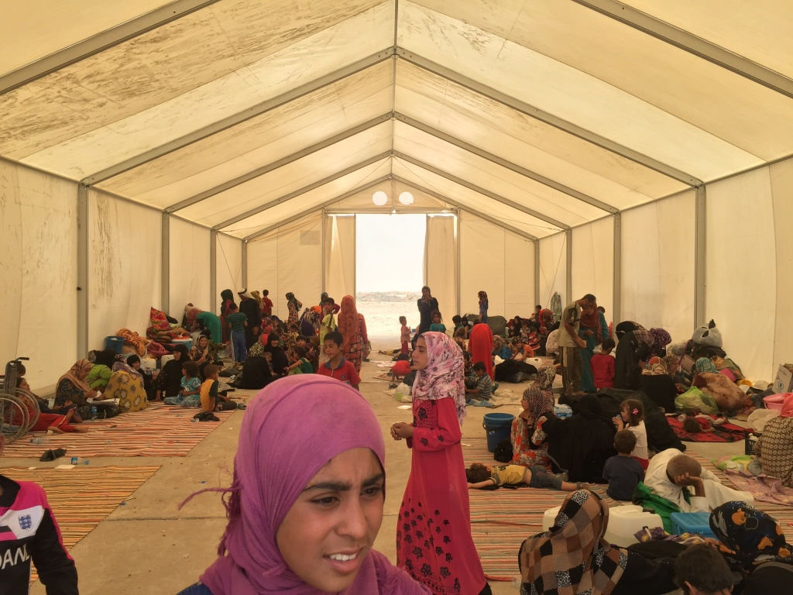
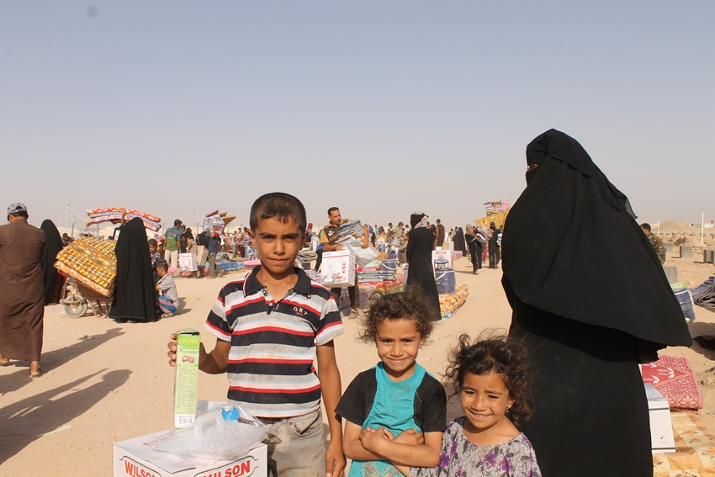
THANKS.
http://sheltercluster.org/response/iraq

