Slide 1
Shelter & WASH Working Group Meeting
Thursday 24 August, 10AM
Asia Pacific Alliance for Disaster Management

Slide 2
Agenda
Introductions & Agenda
Information Management updates
Rapid PDNA result
  WASH: 3W well cleaning
District focal point updates
Shelter updates
  Strategy update/ technical guidelines
  IEC material
AOB

Slide 3
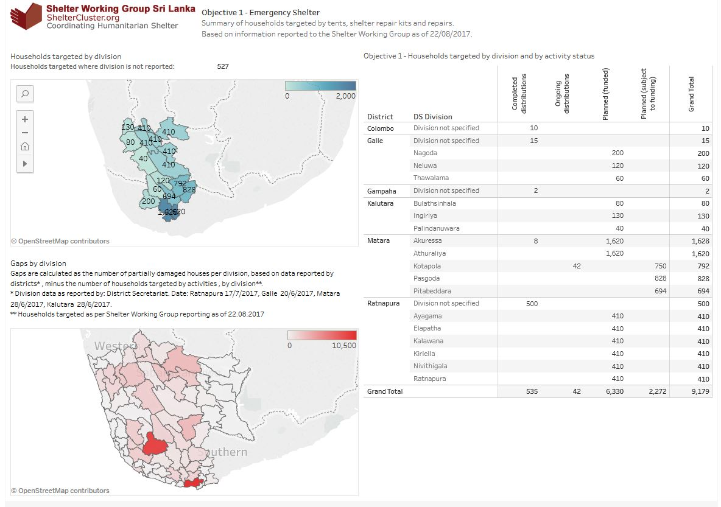

Slide 4
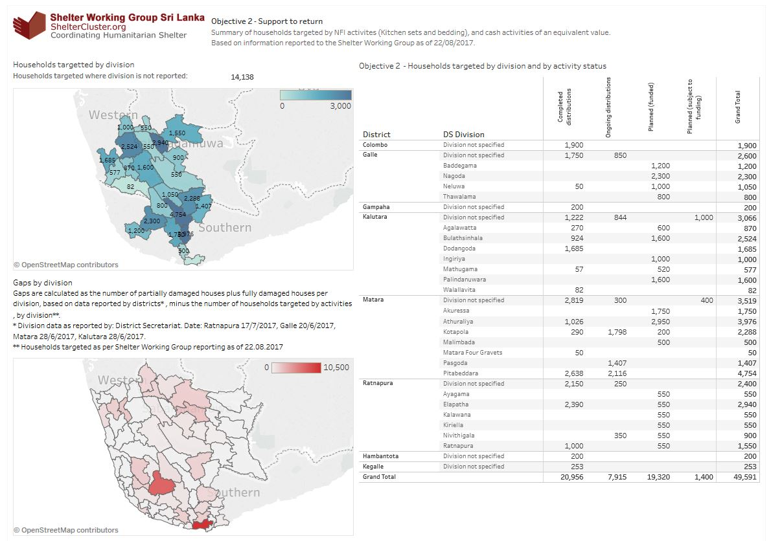

Slide 5
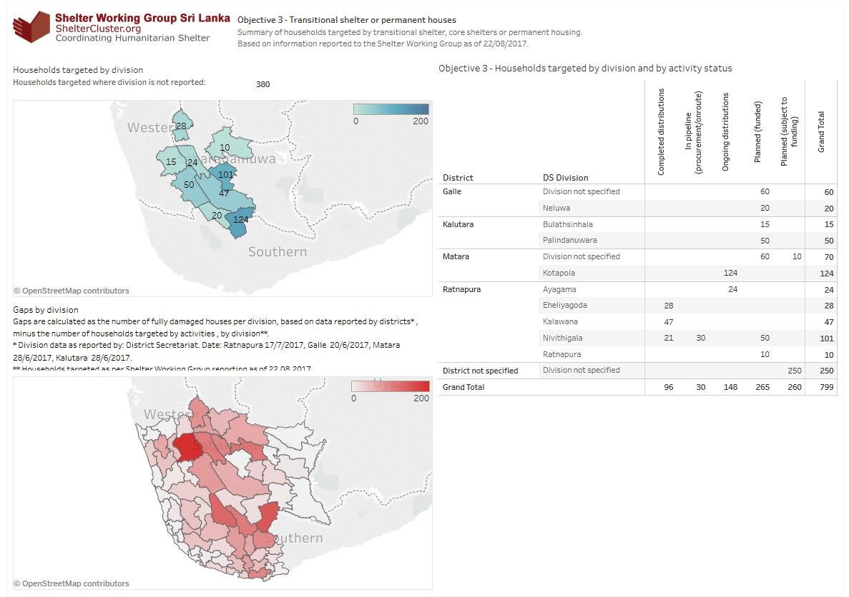

Slide 6
Renovation of WASH facilities in schools
Rathnapura District (Ayagama, Rathnapura, Kuruvita, Ehaliyagoda divisions)
  Renovation work is going on in 10 schools through a local contractor
  WASH assessment was done in another 12 schools
Matara District (Morawaka and Akurana Divisions)
  10 schools were assessed and 8 schools were selected for WASH rehabilitation

Slide 7
Observations
The Ministry of Education has provided toilets units mostly for girls, under the nutrition programme
There are no sanitation facilities for boys in some schools
Water supply is the main issue in many schools
  not continuous
  distribution system damaged and old
  source is not protected
  lack of storage

Slide 8
Rapid PDNA - WASH
PDNA complied by World Bank and UNOPS (final draft)
Assessment done in 5 Districts
  Ratnapura
  Kalutara
  Galle
  Matara
  Hambantota
However, disaster impacts of Galle and Hambantota were found to be far less than the other three districts.

Slide 9
Rapid PDNA - supply
Three types of water sources;
Pipe borne water supply of the National Water Supply and Drainage Board (NWS&DB)
Pipe borne water supply by Community-based Rural Water Supply Schemes
Shallow Dug wells (household and common)

Slide 10
Damage of NWS&DB Managed Water Schemes
District | Water supply scheme | Description of Damages |  | Affected number of consumers
 |  | Intake structures and Equipment | Other Structures
Galle | Pitigala | Boreholes and pumps |  | 1,448
 | Udugama | Boreholes, pumps and panels |  | 686
Matara | Matara Group | VSD Panels and Generator |  | 340,860
 | Karagoda- Uyangoda | Boreholes and panels |  | 9,200
 | Akuressa | Pumps and panels |  | 8,500
 | Deniyaya | Panels |  | 3,880
 | Makandura | Pumps and boreholes |  | 1,260
H'thota | Ranna |  | Pipelines and a bridge crossing | 46,200
 | Wakamulla | Pumps and panels | Slow sand filters | 12,705
Ratnapura | Ratnapura | Generator |  | 32,560
Kalutara | Ingiriya |  | Gravity transmission mains | 4,288
 | Horana |  | Distribution mains | 960
Total Number of NWSDB Consumers Affected |  |  |  | 462,547

Slide 11
Damage of Community-Managed Rural Water Schemes
District | Total community based RWS Schemes | Affected community based RWS Schemes | % Affected community based RWS Schemes
Galle | 164 | 57 | 35
Matara | 355 | 110 | 31
Hambanthota | 149 | 12 | 8
Ratnapura | 450 | 48 | 11
Kalutara | 163 | 10 | 6
Total | 1,281 | 237 | 19

Slide 12
Damage of Dug Wells
District | Total Number of Dug Wells | Affected number of dug wells | % of Affected wells
Galle | 175,756 | 7,202 | 4.1
Matara | 104,300 | 3,991 | 3.8
Hambanthota | 34,020 | 166 | 0.5
Ratnapura | 101,002 | 7,056 | 7.0
Kalutara | 192,241 | 11,264 | 5.9
Total | 607,319 | 29,679 | 4.9

Slide 13
Summary of Damages in Water Supply
District | NWS&DB managed Water Schemes | Community managed RWS Schemes | Fully Damaged number of wells | Partially Damaged number of wells | Affected number of wells | Cleaned number of wells
Galle | 2 | 57 | 5 | 150 | 7,202 | 7,202
Matara | 5 | 110 | 567 | 216 | 3,991 | 3,338
Hambanthota | 2 | 12 | 184 | 73 | 166 | 166
Ratnapura | 1 | 48 | 547 | 210 | 7,056 | 1,468
Kalutara | 2 | 10 | 1,080 | 432 | 11,264 | 10,981
Total | 12 | 237 | 2,383 | 1,081 | 29,679 | 23,155

Slide 14
Population Affected by different drinking water systems
District | NWS&DB Water Schemes |  | RWS/Community Water Schemes |  | Population Affected by Dug Wells | Total Affected Population in District
 | Number of Service Connections | Population | Number of Service Connections | Population
Galle | 560 | 2,134 | 3,052 | 12,026 | 26,317 | 40,476
Matara | 90,925 | 363,700 | 37,715 | 145,838 | 15,672 | 525,210
Hambanthota | 15,300 | 58,905 | 1,715 | 6,605 | 642 | 66,152
Ratnapura | 8,800 | 32,560 | 10,539 | 39,601 | 26,663 | 98,824
Kalutara | 1,640 | 5,248 | 2,231 | 7,917 | 46,182 | 59,347
Total | 117,225 | 462,547 | 55,252 | 211,987 | 115,476 | 790,010

Slide 15
Damage of Household Latrines
District | Population |  |  | Damages (No of Toilets)
 | Total Population | Affected Population | Affected Population% | Fully damaged toilets | Partially damaged toilets | Total Damages
Galle | 1,063,334 | 102,747 | 10% | 261 | 927 | 1,188
Hambanthota | 559,903 | 9,301 | 2% | 956 | 836 | 1,792
Kalutara | 1,221,948 | 187,883 | 15% | 1,935 | 1,693 | 3,628
Matara | 814,048 | 176,975 | 22% | 1,282 | 1,134 | 2,416
Ratnapura | 1,088,007 | 206,496 | 19% | 1,745 | 1,527 | 3,272

Slide 16
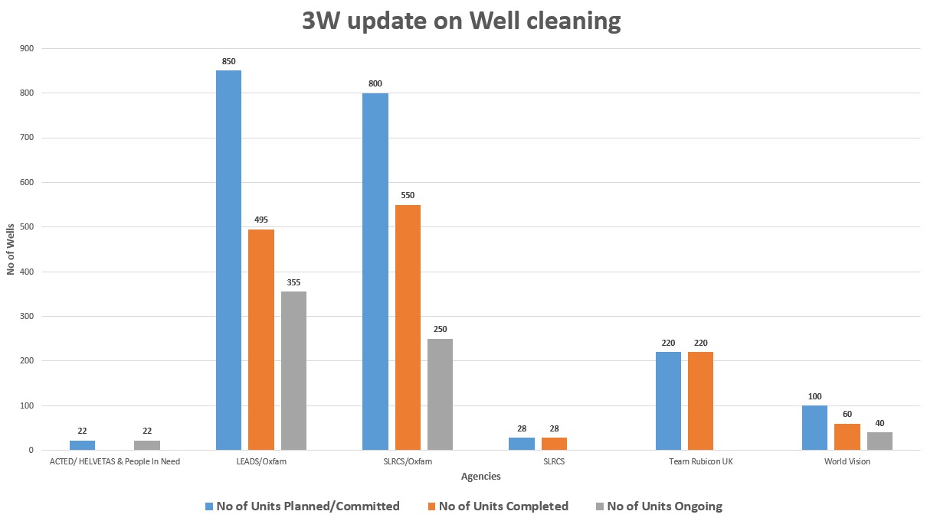
WASH – well cleaning

Slide 17
Rapid PDNA - Shelter
Fully damaged 3,138 / Partial damage 84,789
336 schools, 318 pre-schools, 92 health centres
Total damages and losses US$ 471.55 million
Recovery needs US$ 776.23 million
  Temporary shelter, accommodation
  Reconstruction, restoration
  Relocation of settlements
  Debris removal
  Technical support / DRR in construction

Slide 18
Rapid PDNA - Shelter
Challenges
  Data collection
  Reconstruction and relocation
  Inclusion communities
  Environment
Way forward
  Final PDNA 25 August, workshops next week
  Recovery planning

Slide 19
District Updates
Focal points
  WASH update
    World Vision – Kalutara
    LEADS – Ratnapura and Matara
    Oxfam – Galle
  Shelter update
    World Vision: Ratnapura
    UN Habitat: Galle & Kalutara
    Save the Children: Matara

Slide 20
Strategy update
Priority activities
  8,000 repair kits
  50,000 NFI kits
  1,000 temporary shelter (tents etc)
  1,500 transitional shelter
Targeted beneficiaries
  60,500 households

Slide 21
Technical guidelines
Strategic response
Design requirements
  Construction codes
Emergency shelter
Household non-food items
Shelter repair kits
Transitional/ core shelter
Cross-cutting
  Cash distribution
  IEC/ DRR

Slide 22
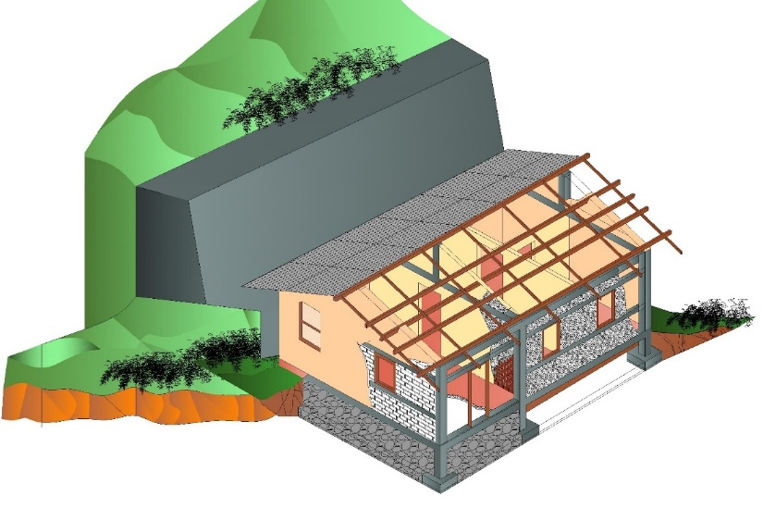
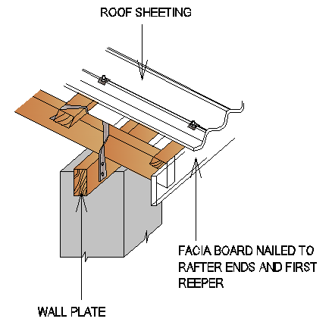
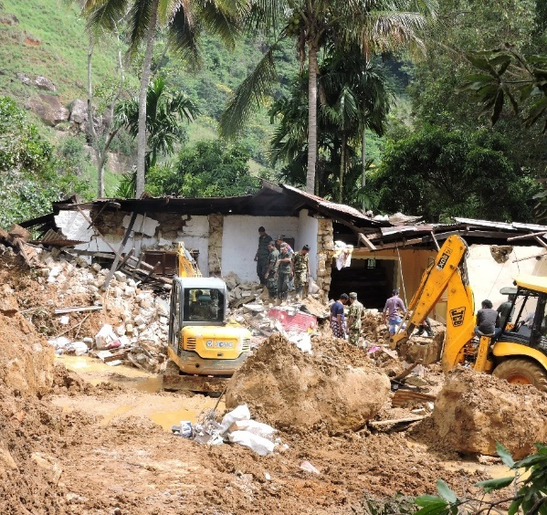
Shelter WG IEC material
Technical flyer based on NBRO material
Poster design
Co-funding

Slide 23
Web Details
www.sheltercluster.org
https://www.sheltercluster.org/response/sri-lanka-floods-2017
https://public.tableau.com/profile/methunan#!/vizhome/4WDivisionsummary_0/Obj1Dash
https://public.tableau.com/profile/methunan#!/vizhome/4WDivisionsummary_0/Obj2dash
https://public.tableau.com/profile/methunan#!/vizhome/4WDivisionsummary_0/Obj3dash
DTM: https://app.powerbi.com/view?r=eyJrIjoiZThjNmRiZTgtMjY2NC00YTEzLWFhYzMtZTlkODlkMzI4NTllIiwidCI6IjliNWVkNDg5LWZiOWEtNDVmMi04MTBjLTkyNmFlNDdjZjMzOCIsImMiOjEwfQ%3D%3D

