Slide 1
Shelter Working Group
Development Partners Roundtable
Thursday 31 August 10.30-12.00

Slide 2
Agenda
Welcome by Giuseppe Crosetti (IOM and RC a/i)
Introductions/ Agenda
Coordination
  Shelter Working Group
  Coordination: government policy framework
  Strategy, technical guidelines, IEC material
Implementation and gaps
Disaster Risk Reduction
Roundtable discussion: Community Resilience

Slide 3
Shelter Working Group
Agencies - IOM, Sri Lanka RCS / IFRC, UNHABITAT, World Vision, Save the Children, Islamic Relief, Oxfam, Shelterbox, WWF, ZOA, Stromme, SHGRC Badaraliya, Habitat for Humanity, LEADS, PARCIC, JEN
Government – DMC: NDRSC / NBRO
Private sector - APAD
WASH joint meetings
Intersector – Protection, Education, Health, Food Security
District focal points
# partners | # meetings | strategy and reports
16 | 14 | 1. Strategy, 2. IEC material, 3. Technical guidelines

Slide 4
National and district coordination among WG members, authorities
Information collection and dissemination flows.
NATIONAL
DISTRICT
DS DIVISION
GN DIVISION
HCT
AGENCIES
Intersector working group
Sectoral district focal points
Shelter Working Group
District focal point
GA
Divisional Secretary
GOVERNMENT
Grama Niladhari officer
NDRSC
District NDRSC
Divisional NDRSC
NBRO
DMC
District DMC

Slide 5
Shelter Sector Strategy
Objectives
Targeted beneficiaries
  60,500 households
 | Intervention type | Target - Priority
1 Emergency shelter | Shelter Kits/ cash | 8,000
2 Support to return | Household NFI Kits/cash | 50,000
3 Support to relocation & resettlement | Transitional Shelters | 1,000
4 Technical support | IEC materials, DRR | 1,500

Slide 6


GOVERNMENT RECOVERY FRAMEWORK
No
Safe Site ?
Yes
Directly affected by Landslide
Identified as High Risk by NBRO
Resettlement
Fully Damaged (>40%)
Partially Damaged (<40%)
Govt. financial assistance
Reconstruction
Rs. 1.6 m to purchase the land with a house
To purchase a land and construct a house to provide Rs. 0.4 m and Rs. 1.2 m respectively
Rs. 1.2 m to construct a when lands are granted by the government
NITF Insurance

Slide 7
HUMANITARIAN ASSISTANCE
No
Safe Site ?
Yes
Directly affected by Landslide
Identified as High Risk by NBRO
Resettlement
Fully Damaged (>40%)
Partially Damaged (<40%)
All: technical support
Transitional /core shelter?
Transitional/core shelter?
Shelter
Repair Kit/Cash
Govt. financial assistance
Reconstruction
Rs. 1.6 m to purchase the land with a house
To purchase a land and construct a house to provide Rs. 0.4 m and Rs. 1.2 m respectively
Rs. 1.2 m to construct a when lands are granted by the government
NITF Insurance

Slide 8
Government recovery assistance
Two stages
  Stage 1: Construction of one room with toilet
  Stage 2: Completion of core house
Stage 1: Four instalments – total LKR 1,200,000 (USD 7,850)
  Land preparation, excavation and completion of foundation – 200,000
  Completion of one room and toilet – 300,000
  Construction of walls of rest of core house and completion of roof – 400,000
  Completion of core house: doors, windows, plastering, finishing and painting, supply of water and electricity – 300,000
Stage 2: Continued - Self Recovery

Slide 9
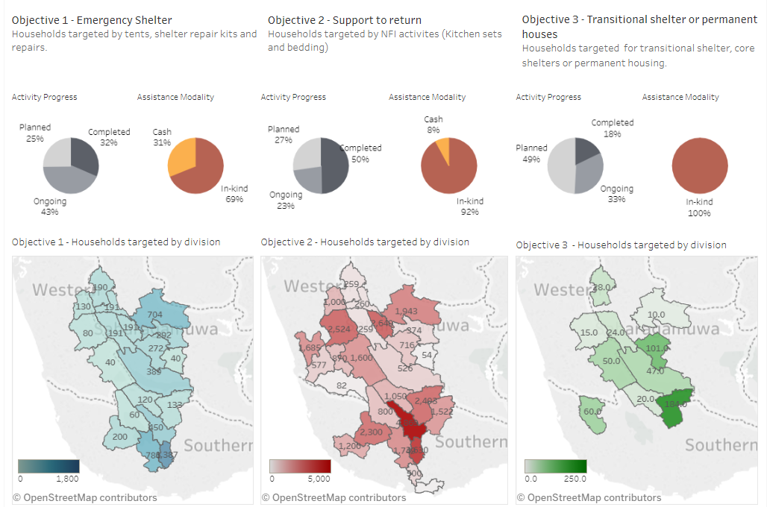
Shelter & NFI - progress 29/8/2017

Slide 10
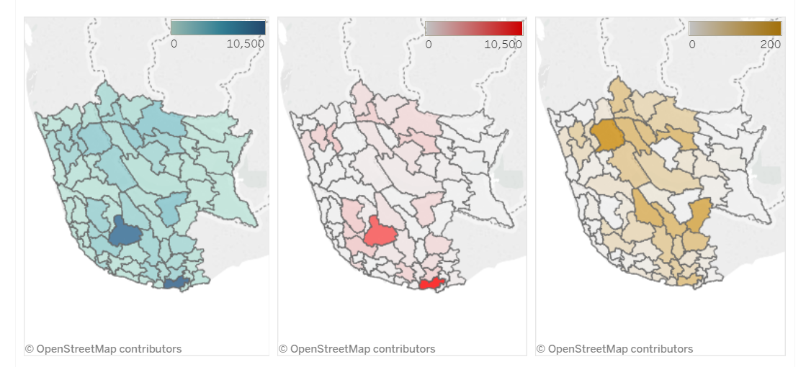
Shelter & NFI gaps
Gaps are calculated as the number of partially damaged houses plus fully damaged houses per division, based on data reported by districts*, minus the number of households targeted by division**.
*Damaged housing data for four priorty districts, reported by districts authorities as of: Galle: 20/6/2017, Matara 28/6/2017, Kalutara 28/6/2017, Ratnapura 17/7/2017.
** Households targeted as per Shelter Working Group reporting as of 29/08/2017

Slide 11
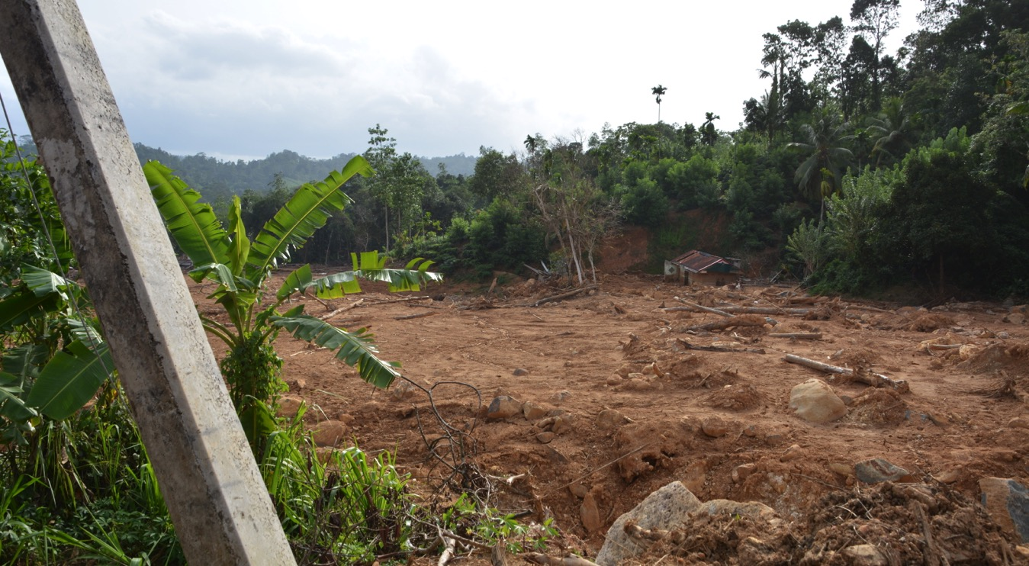
Landslide
Matara – Kotapola

Slide 12
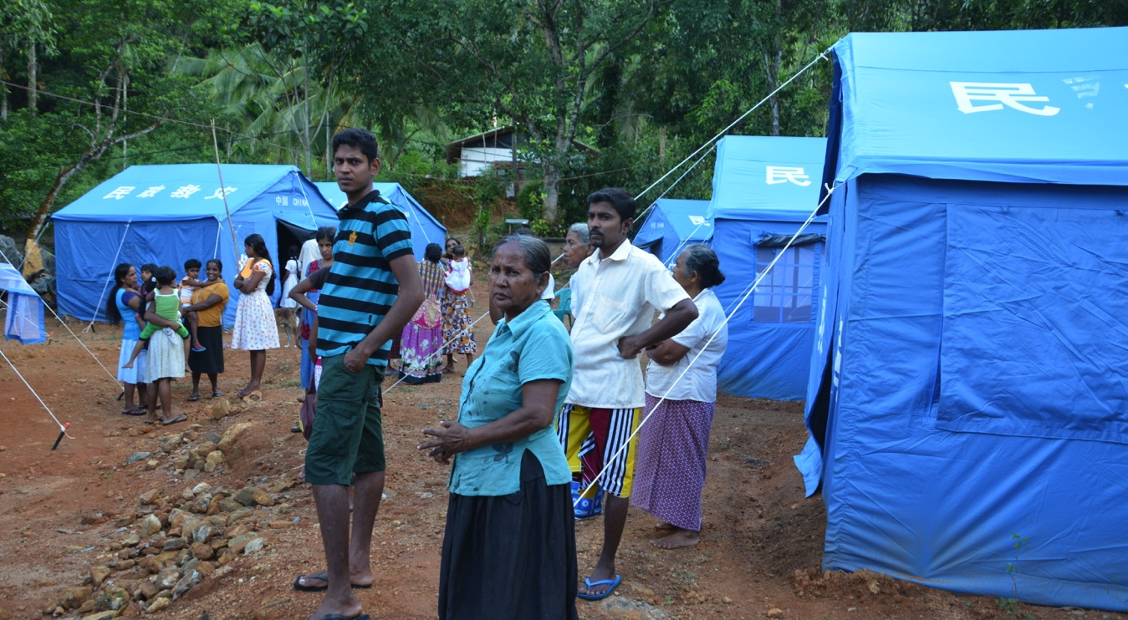
Evacuation site
Elepatha - Rathnapura

Slide 13
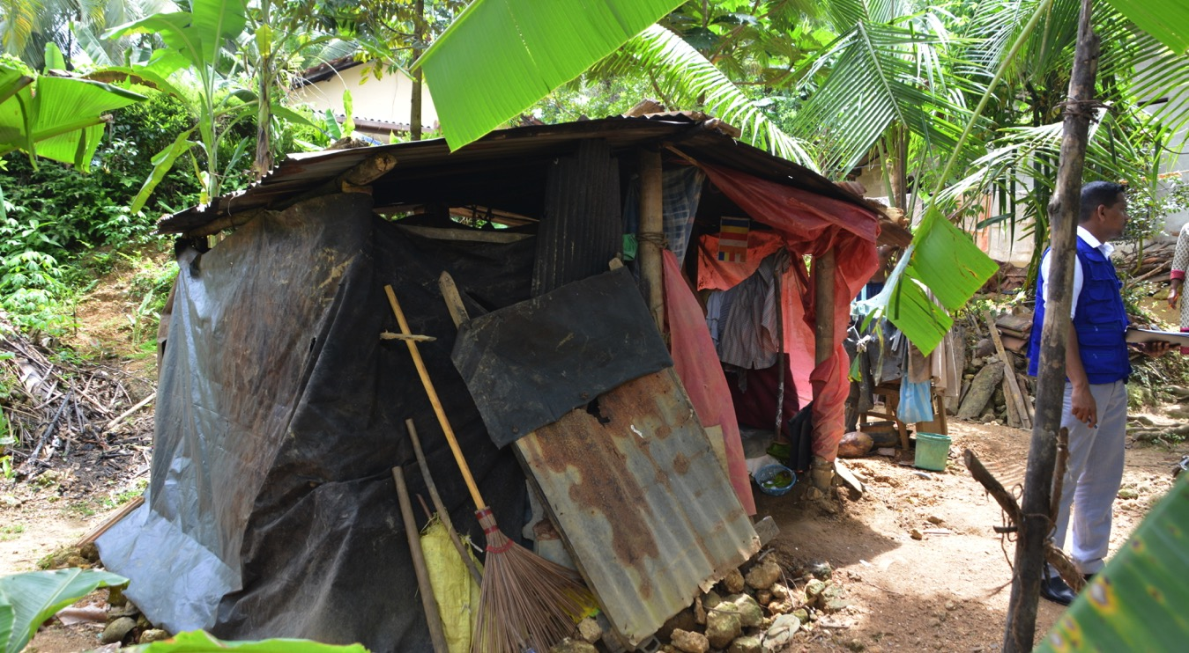
Makeshift shelter
Rathnapura Municipality

Slide 14
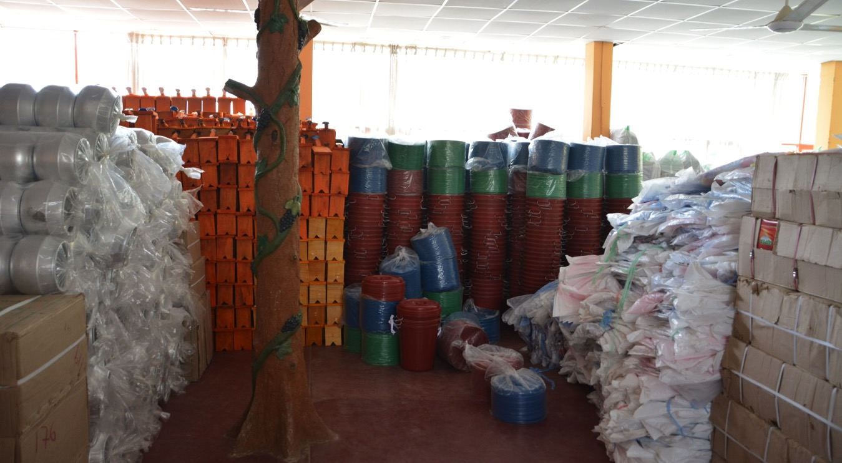
Relief items
Matara

Slide 15
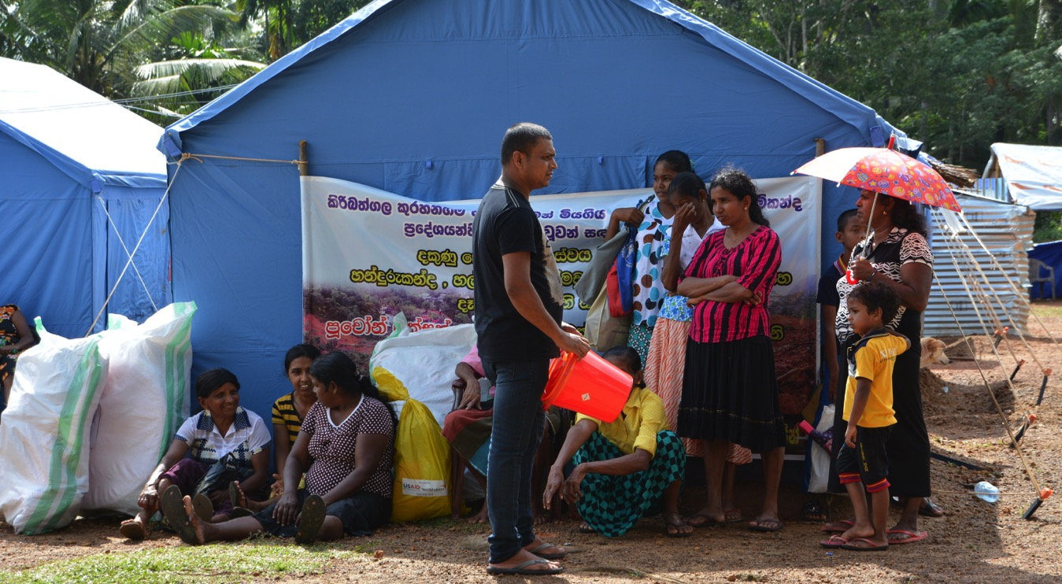
Distribution Rathnapura
Rathnapura

Slide 16
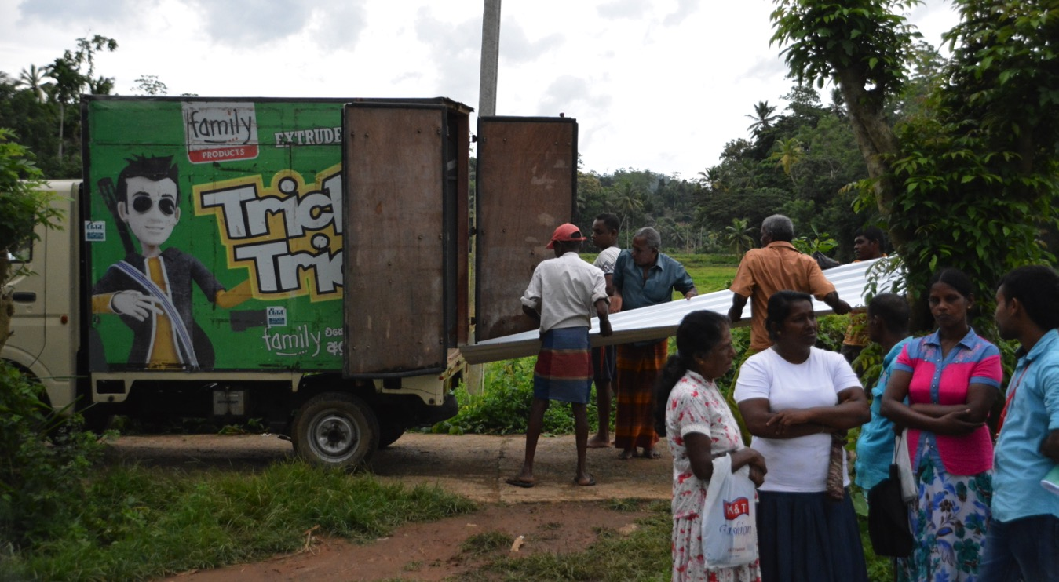
Distribution Shelter kits
Matara

Slide 17
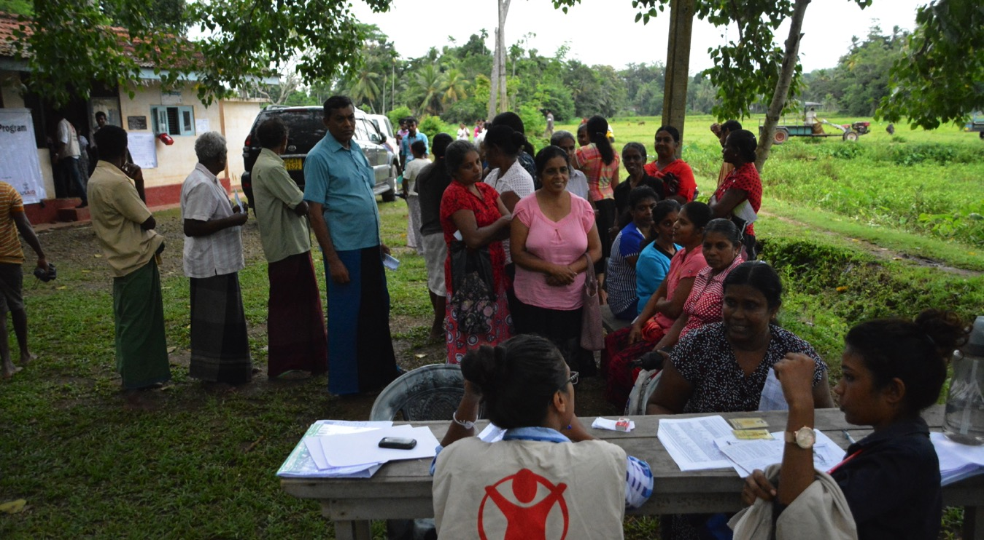
Registration for cash grant
Matara

Slide 18
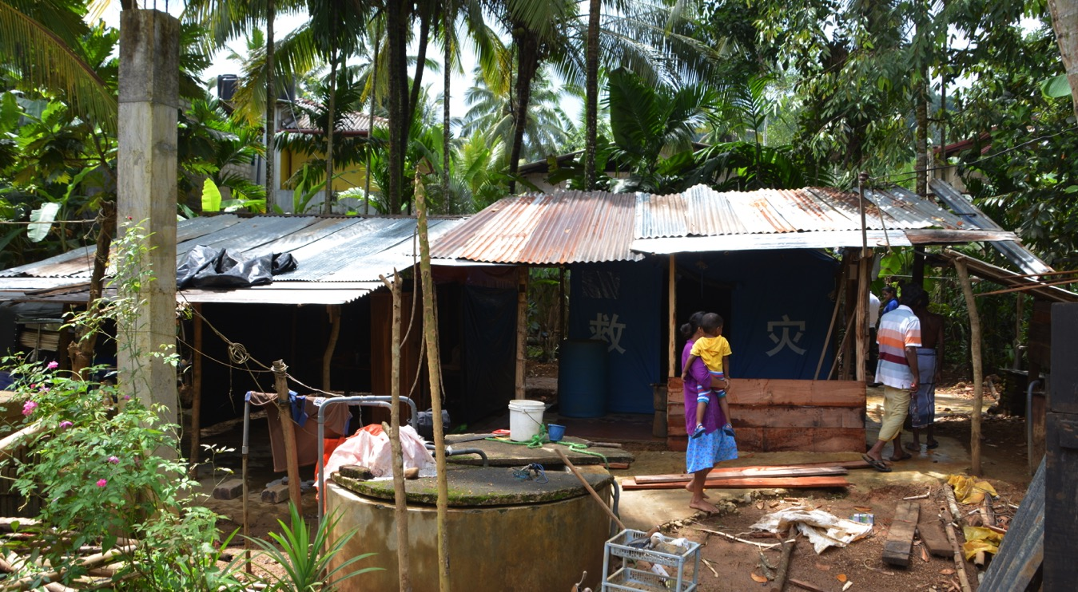
Self-recovery ‘in situ’
Rathnapura Municipality

Slide 19
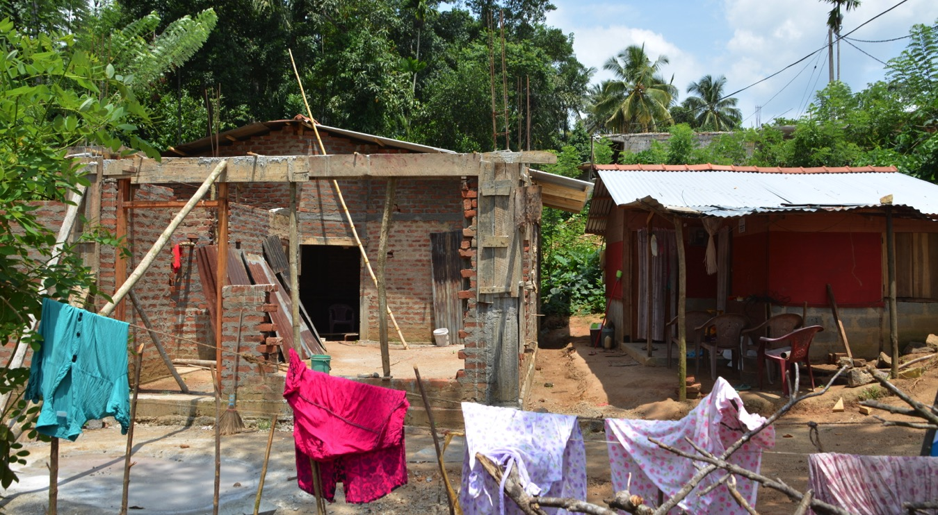
Owner-driven resettlement (Kegalle)
Kegalle

Slide 20
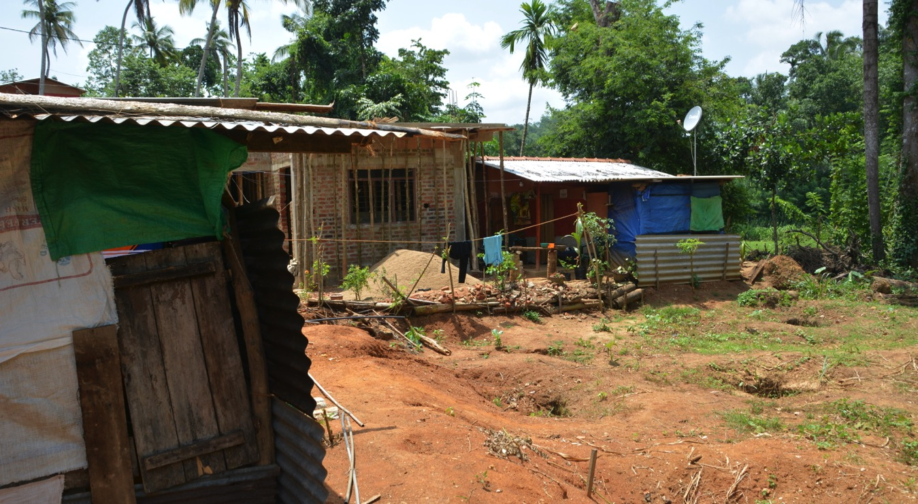
Owner-driven: different speed
Kegalle

Slide 21
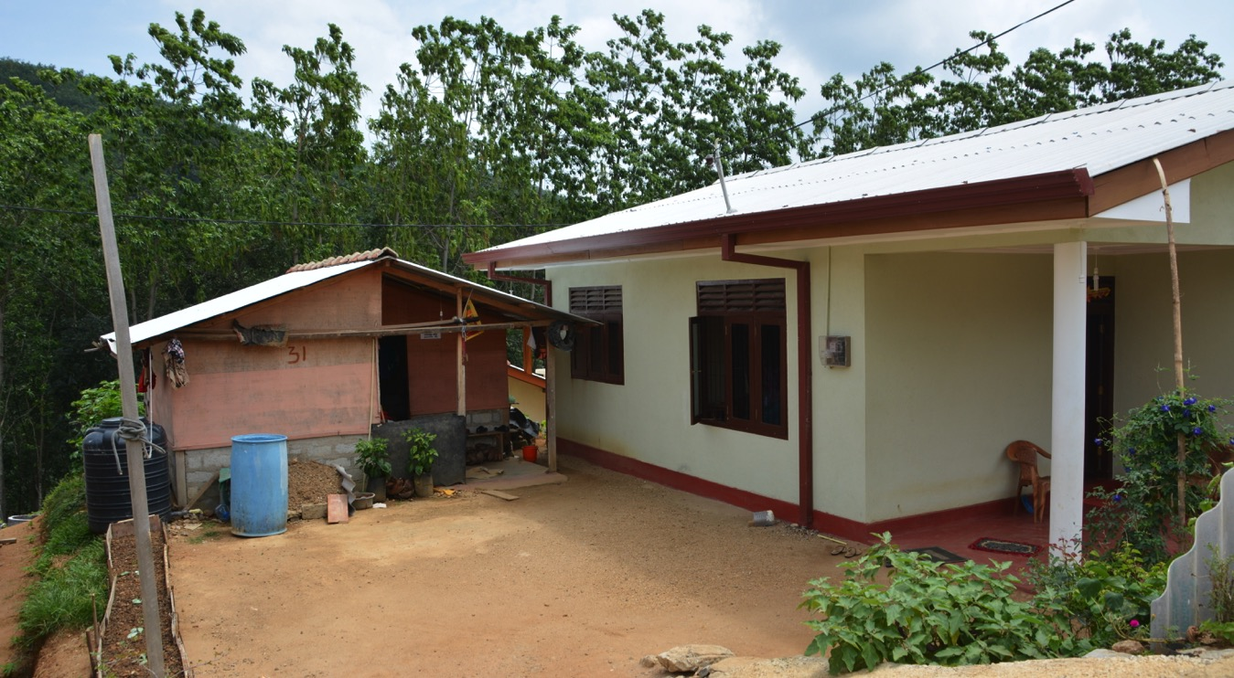
Donor-driven resettlement (Kegalle)
Kegalle

Slide 22
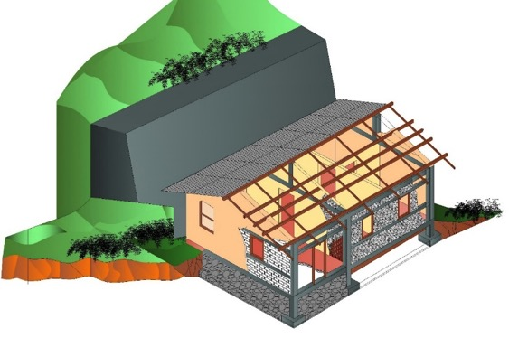
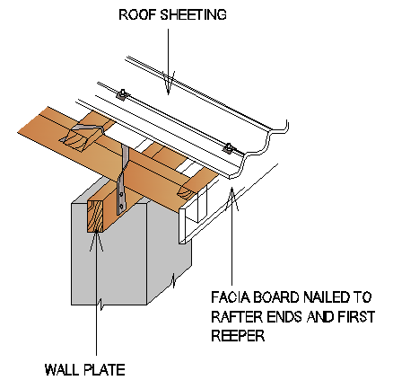
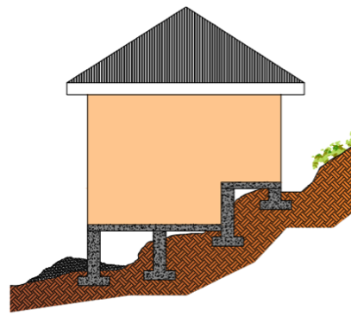
Shelter WG IEC material
Technical handouts in collaboration with NBRO
Co-funded

Slide 23
Technical guidelines
Based on the working group strategy, including:
Design requirements for new house
  Construction codes (NBRO)
Emergency shelter
Household non-food items (standard package)
Shelter repair kits (standard package)
Transitional/ core shelter
Cross-cutting
  Cash distribution (Inter-sector WG)
  Communication materials / DRR

Slide 24
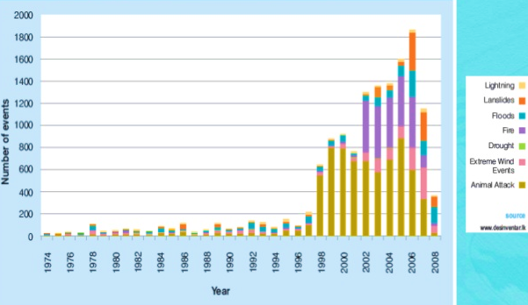
Disaster Risk Reduction
Disaster trends Sri Lanka:
DS and communities requested support on:
  community-based DRR
  first responder training
  emergency response preparedness & early warning training
  establishing safe sites and evacuation centers
  adequate stock of boats, life jackets and other rescue equipment

Slide 25
Resilience
Community resilience:
  Disaster risk reduction
  Poverty reduction
  Climate change adaptation
Participatory hazard, vulnerability, capacity and risk assessment: local context (socio-economic, environmental), disaster risk (climate change)
Design and construction practices
  codes and enforcement
  building systems and materials
  local design and construction practice
  skills, techniques, tools
Humanitarian aid
Development assistance
resilience

Slide 26
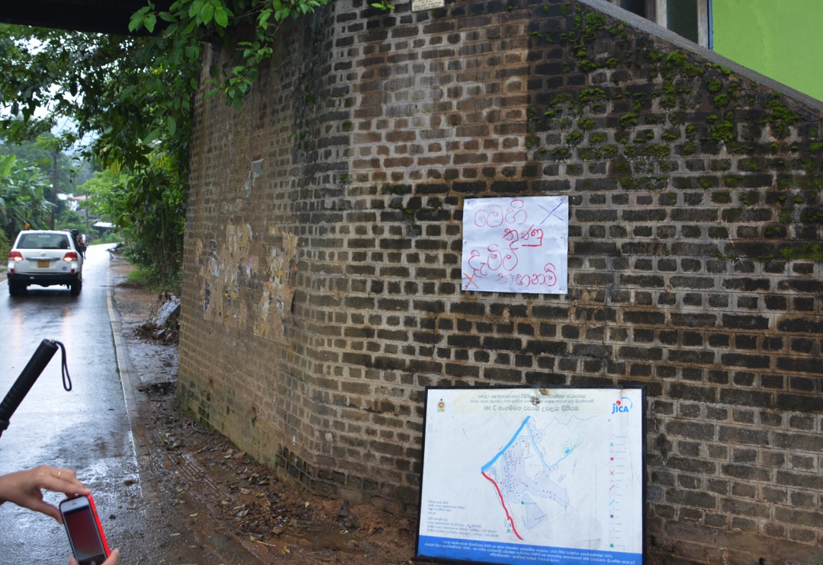
Preparedness

Slide 27
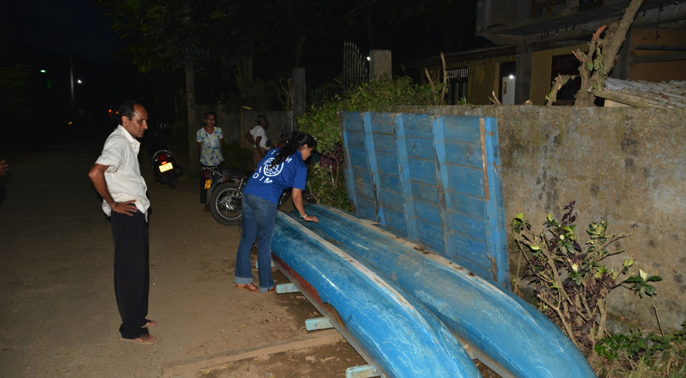
Preparedness

Slide 28
Discussion
Shelter Working group agency updates
Development partners activities and Plans
  Flexible funding
  Opportunities for collaboration - coordination
Common advocacy themes
  Government
  Private sector
  Communities

