Slide 1
Shelter & WASH Working Group Meeting
Thursday 7 September, 10AM
Consortium of Humanitarian Agencies

Slide 2
Agenda
Introductions & Agenda
New flood and landslide warnings
Information Management updates
Oxfam RTR
District Updates
Development Partners Roundtable
IEC material
AOB

Slide 3
NBRO / DMC warnings
NBRO: 7 September
>150mm rainfall / landslide code Red: evacuation notice
Rathnapura: Eheliyagoda and Ayagama
>100mm rainfall / landslide early warning level 2 Amber
Divisions in Rathnapura, Kalutara, Galle, Kegalle
DMC:
2-4 September winds partially damaged 227 houses in Polonnaruwa (Thamankaduwa DS) and 152 houses in Anuradhapura (Mihinthale DS)
6 September: 17 houses fully damaged in Colombo (Rathmalana), 8 partially in Galle, 9 in Kegalle, 6 in Vavuniya (wind) and 45 in Kurunegala
7 September: Heavy showers (100mm-150mm) expected in the Western, Sabaragamuwa and Central provinces and in Galle and Matara districts
7 September: Heavy rainfall (about 100 mm) expected in Uva province and in Ampara and Batticaloa districts

Slide 4
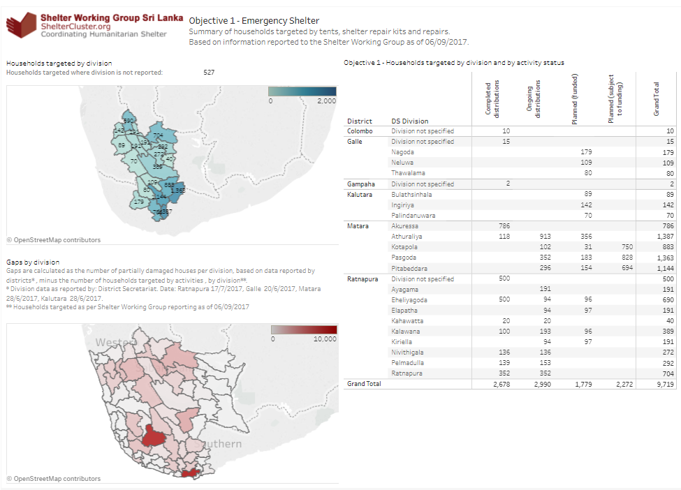

Slide 5
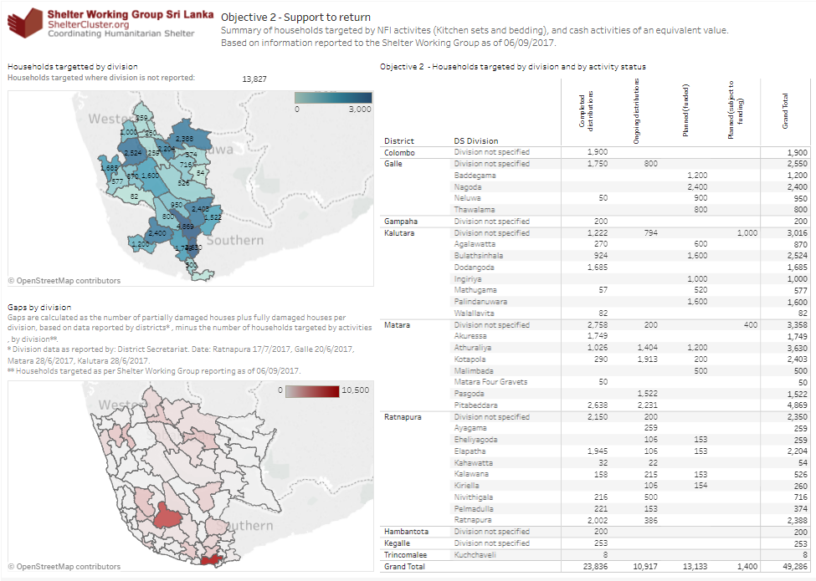

Slide 6
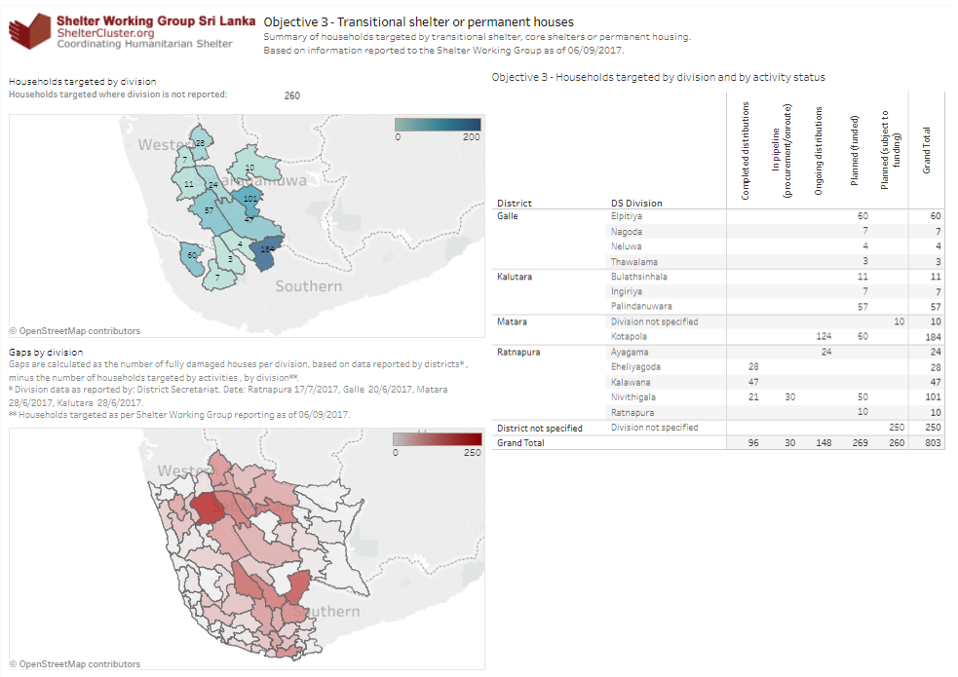

Slide 8
Oxfam’s RTR
Oxfam conducting RTR by its Global team from HQ
First draft of the report is expected by 20th Sep.2017
Key learnings and recommendations will be shared in the next WASH/Shelter cluster meeting

Slide 9
Funding Dashboard
No change.
Requirements (Requested) | $2,771,000
Funded | $2,189,295
Gap | $581,705

Slide 10
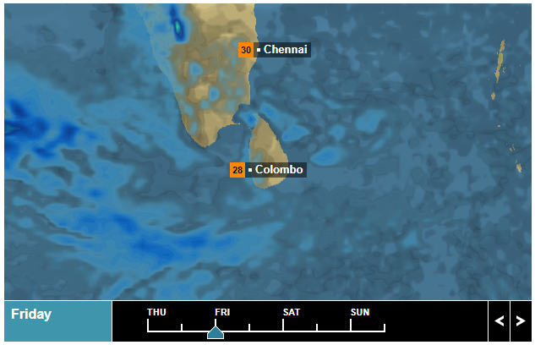
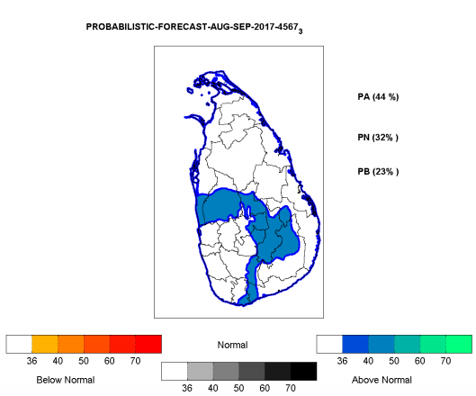
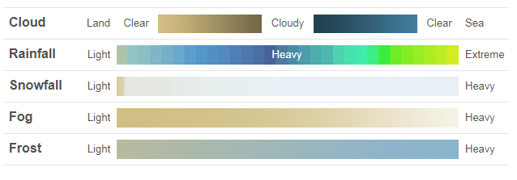
Rainfall Forecast – External Sources
BBC Weather forecasts predicts as @ 07/09 0800 Hrs, rainfall to South Western coastal and South Western hilly areas in the coming few days (< SAT).
Probabilistic Rainfall forecast: Colombo, Kalutara Gampaha, Kegalle, Moneragala, Matalle and Kandy > 55% Above AVG rainfall. (>AVG 220 mm).
Multi-model forecast – MET DEPT

Slide 11
Weather forecast for 07th September 2017 (Issued at 05.30 a.m. on 07th September 2017)
Prevailing showery condition in the island, particularly in the south western part is expected to continue.
Showers or thundershowers will occur at times in the Western, Southern, Sabaragamuwa Central and North-western provinces. Heavy falls (100-150 mm) are expected at some places, particularly in the Western, Sabaragamuwa and Central provinces and in Galle and Matara districts.
Showers or thundershowers will occur elsewhere particularly after 2.00 p.m. Heavy falls (about 100 mm) are expected at some places, particularly in the Uva province and in Ampara and Batticaloa districts.
There may be temporary localized strong winds during thundershowers. General public is kindly requested to take adequate precautions to minimize damages caused by lightning activity.

Slide 12
District Updates
Focal points
WASH update
World Vision – Kalutara
LEADS – Ratnapura and Matara
Oxfam – Galle
Shelter update
World Vision: Ratnapura
UN Habitat: Galle & Kalutara
Save the Children: Matara

Slide 13
Shelter WG - development partners roundtable
Shelter WG members and coordination
Strategy
Implementation and gaps
Government recovery framework (NBRO)
Technical guidelines and IEC material
DRR and resilience discussion
Donor priorities and expectations

Slide 14
National and district coordination among WG members, authorities
Information collection and dissemination flows.
NATIONAL
DISTRICT
DS DIVISION
GN DIVISION
HCT
AGENCIES
Intersector working group
Sectoral district focal points
Shelter Working Group
District focal point
GA
Divisional Secretary
GOVERNMENT
Grama Niladhari officer
NDRSC
District NDRSC
Divisional NDRSC
NBRO
DMC
District DMC

Slide 15
Lessons learned/ evaluation meeting
Thursday 21 September at A-PAD
Coordination, IM, Advocacy, Finance
Strategy
Agencies’ responses:
Transitional shelter
Cash
Preparedness
Please share assessments/ reviews

