Slide 1
Shelter Cluster
Preliminary findings
Multi-Cluster Needs Assessment (MCNA) –Round V
September 2017
Iraq Assessment Working Group

Slide 2
Overview of Presentation
OBJECTIVES & OVERVIEW
PROCESS OVERVIEW
METHODOLOGY
PARTNER COLLABORATION
PRIMARY DATA COLLECTION
PRELIMINARY FINDINGS
NEXT STEPS

Slide 3
OBJECTIVES & OVERVIEW
1. Presentation to AWG on 17th July explaining the objectives and methodology of the MCNA V as well as timeline for dissemination of preliminary findings, in line with the HNO/HRP timeframe.
2. Key Affected Population groups:
  IDPs in camps
  IDPs out of camps
    IDPs in informal sites
  Returnees
  “Non-displaced remaining in recently retaken areas” changed to: Non-displaced in newly accessible and conflict areas
  Host communities in high IDP density areas
3. AWG presentation on 17th July also launched the indicator review process. MCNAs are specifically aligned with the HNO/HRP process to inform multi-cluster programming.
  All clusters consulted on indicators.
  Feedback received on indicators; harmonization conducted
  4. Methodology: Original methodology later adapted in line with HNO/HRP humanitarian profile e.g. Assessment of Non-displaced in newly accessible and conflict areas. MCNA V data to support people in need calculation at cluster level.

Slide 4
MCNA to HRP: Process Overview
Research design
Indicators, forming the basis of the survey tool, are reviewed at the cluster and ICCG level.
Final Analysis
Cluster feedback informs in-depth analysis tailored to cluster-specific needs and triangulation of data ahead of Joint Assessment Workshop (ICCG).
Analysis & Preliminary findings presentation
Preliminary findings presentations delivered bilaterally with clusters.
Validation and Dissemination
Final output and cluster-specific findings shared with clusters/GBWS, while final report is shared for validation by ICCG and HCT.
Data collection
Data is collected directly by REACH and partners. Regular updates are provided to clusters.
Time: 1 - 31 July
Time: 20 -30 Sept
Time: 1 – 31 August
Time: 11- 20 September
Time: 1 - 14 September

Slide 5
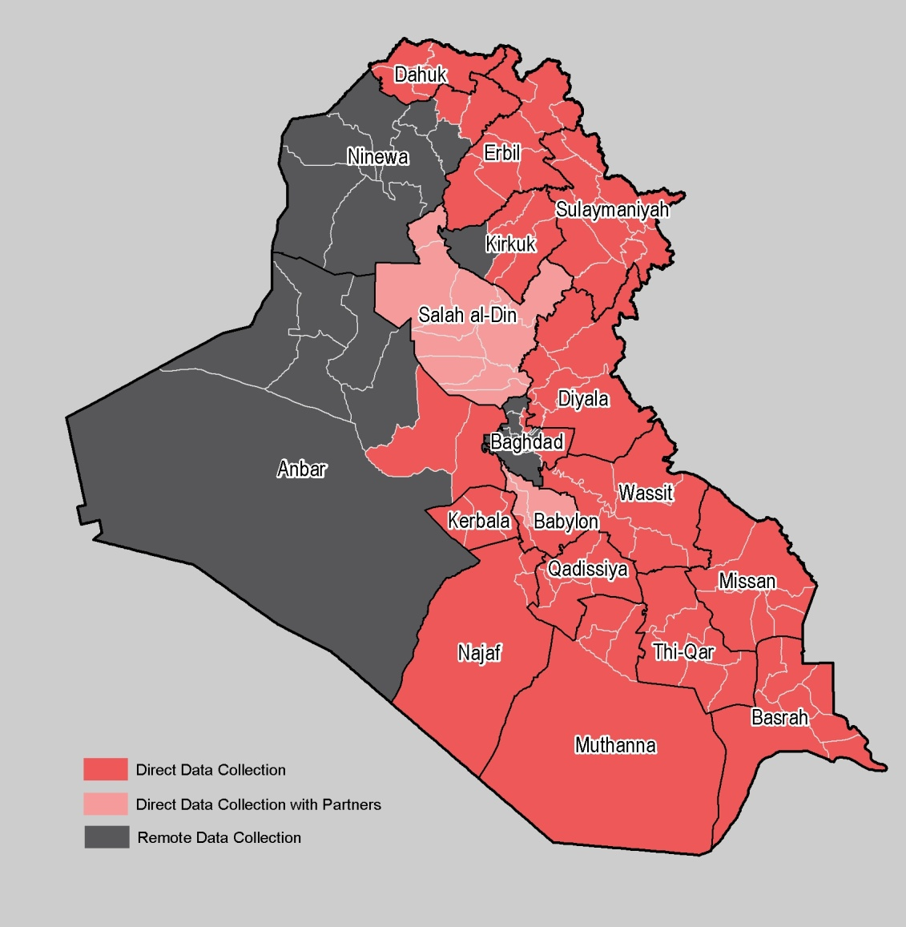
Methodology overview
Mixed methodology
  Secondary data review of existing datasets
  Household-level Data Collection in all fully directly accessible districts: representative samples of households from accessible areas
  Community-level Data Collection in not fully directly accessible areas: purposively selected key informants from sampled locations in not fully accessible districts

Slide 6
Methodology
Table 1: Population group overview
GROUP | 1. IDP families in camps | 2. IDP families outside camps | 2.a IDP families in informal sites | 3. Host community families | 4. Returnee families | 5. Non-displaced in newly accessible and conflict areas
Data set | REACH Camp profile VIII | REACH MCNA IV | REACH Informal Site Assessment / RASP | REACH: MCNA V Primary data collection | REACH: MCNA V Primary data collection | *PARTNERS: MCNA V Primary data collection
Data collection date | May 2017 | April/May 2017 | Feb/May 2017 | August 2017 | August 2017 | August 2017
Data representative at | Camp/District level | District level (of accessible districts) | Site level | National level (High IDP density locations) | District level | District level
Household interviews (directly accessible districts) | Yes, with 95% confidence level / 10% error margin | Yes, with 90% confidence level / 10% error margin |  | Yes, to achieve 95% confidence level / 5% error margin | Yes, to achieve 90% confidence level / 10% error margin | No
Key informant interviews (non-accessible districts) | No | No | Yes | No | Yes | Yes
The assessment was implemented nationwide through a mixed methods approach, consisting of:
Secondary data analysis of existing datasets on IDPs living in camps, informal sites, and in host communities
Secondary data review of other relevant data/reports
Statistically representative household survey administered in fully directly accessible districts
Key informant interviews administered in districts that are not fully directly accessible (Direct, remote via phone and in hard to reach areas, newly displaced families from those locations)
*Data collected by CAOFSIR, RNVDO, WFP, and Mercy Hands
Notes:
To highlight that for returnees – the biggest population group for primary data collection – both HH interviews and community level interviews were conducted to make sure all returnee locations were covered.

Slide 7





Partner Collaboration
Data collection conducted by:
  Canadian Aid Organization for International Society Rehab (CAOFISR)
  Mercy Hands for Humanitarian Aid
  Representative of Ninewa Voluntary for IDP (RNVDO)
  World Food Programme (WFP) – Iraq
  REACH
Secondary data review by:
  ACAPS (forthcoming)

Slide 8
Preliminary findings: Education
Household-level data is representative and consists of Returnees (95/10 at district level); IDPs out of camps (90/10 at district level); IDPs living in camps (95/10 at district level); and Host community families (95/5 at national level).
Community-level data provided alongside HH data is indicative.
Household-level analysis for each indicator is structured as follows:
  National level
  By population group (IDPs, returnees etc)
Table 2: Population groups assessed at household level
IDP families in camps | IDP families outside camps | Host community families | Returnee families
Camp/Governorate level | District level (of accessible districts) | National level (High IDP density locations) | District level
95% confidence level 10% error margin | 90% confidence level 10% error margin | 95% confidence level 5% error margin | 90% confidence level 10% error margin
Notes:
Comparitive results for each population group by district and at national level to identify gaps in needs
Summary district level data provided for each population group EV: except Host communities?
Additional guidance on how to use and understand the raw data for parners use

Slide 9
Preliminary findings: Community level coverage
  What areas are covered by the community level assessments?
  Districts where direct household data collection could not be conducted, KI interviews were conducted by REACH and partners (partner collaboration).
  Table 3: Newly accessible & conflict areas (x 6 districts) Table 4: Returnees (hard to reach) (x 17 districts)
Governorate | District
Anbar | Haditha
Kirkuk | Hawiga
Ninewa | Baaj, Mosul and Telafar
Salah –al’Din | Shirqat
Governorate | District
Anbar | Fallujah, Haditha and Heet
Baghdad | Abu Ghraib
Kirkuk | Kirkuk
Ninewa | Hamdaniya, Mosul, Sinjar, Telafar and Tilkaif
Salah-al’Din | Baiji, Balad, Daur, Samarra, Shirqat, Tikrit and Tooz

Slide 10
Settlement type (Direct Access / Household level)
Residential housing was the most frequently reported settlement type in which households reside across all applicable population groups.
  95% of host community households reported residing in residential housing, followed by 72% of returnee households, and 69% of out-of-camp IDP households.
Collective centre is second most frequently reported settlement type, with returnees reporting highest occupancy (28%), followed by out-of-camp IDPs (20%).
11% of out-of-camp IDPs are reportedly living in informal sites.
Table 5: Settlement type, by population group
Population group | Collective center | Informal site | Residential housing | Transit site
Host community / direct access | 5% | 0% | 95% | 0%
IDPs (out of camp) / direct access | 20% | 11% | 69% | 0%
Returnee / direct access | 28% | 0% | 72% | 0%
Notes:
IDPs in camps were not asked this question as settlement type is already known.

Slide 11
Settlement type (Restricted Access / Community level)
As with household level findings, residential housing is the most frequently reported settlement type. However there is significant difference where non-displaced communities in newly accessible and conflict areas* reported residential housing more frequently (71%) than the returnee population (43%).
Results for informal site were similar between returnee and non-displaced (20% and 18% respectively), but the proportion of returnees residing in collective centres was reported higher by returnees (20%) as was transit site (17%).
Figure 1: Settlement type by population group
*This population group will be referred to as "non-displaced' throughout the remainder of this presentation.
Notes:
Transit site added by shelter cluster, while no reporting at HH level, due to the way data was collected transit site was reported more frequently.

Slide 12
Shelter type (Direct Access / Household level)
In line with settlement type findings, across population groups house (residential housing) was the most frequently reported shelter type. Returnee and host community population groups reported this at 97% and 99% respectively.
IDPs out of camps reported low occupancy in the house category (73%), but occupied other shelter types such as religious building (10%), apartment (7%), and unfinished building (6%).
Across the applicable population groups, 19% of IDPs out of camps reside in critical shelters* (19%) in contrast to 1% of returnee and 0% for host community.
Table 6: Shelter type by population group
 | House | Religious building | Apartment | Unfinished building | Abandoned building | Container | Damaged building | Public building | School | Tent | Other
Host community / direct access | 97% | 0% | 3% | 0% | 0% | 0% | 0% | 0% | 0% | 0% | 0%
IDPs (out of camp) / direct access | 73% | 10% | 7% | 6% | 1% | 1% | 1% | 1% | 1% | 1% | 1%
Returnee / direct access | 99% | 0% | 0% | 0% | 0% | 0% | 1% | 0% | 0% | 0% | 0%
*critical shelter is defined as public spaces such as religious centres and schools as well as unfinished and/or abandoned buildings.
Notes:
Religious building is reported higher in IDPs (out of camp) as MCNA IV covered more of the south of Iraq. It is well known that many IDPs in the south live in religious buildings/centres.
Categories which had no national level results include: caravan, hotel, makeshift or improvised shelter, open air, RHU, Rubhall or mass tent, single family residential unit or semi-permenant structure.
Based on the definition used in previous MCNAs, critical shelter comprises of public spaces such as religious centres and schools as well as unfinished and/or abandoned buildings.

Slide 13
Shelter type (Restricted Access / Community level)
The vast majority of returnee communities reported to be residing in houses (94%), whereas a lesser majority of non-displaced communities reported so (77%).
A significant minority of non-displaced communities reported residing in tents (15%) and 4% in containers compaed with returnees who reported 0% for both these categories.
Returnees reported higher for residing in critical shelters (5%) when compared to non-displaced communities (1%).
Figure 2: : Shelter type by population group
Notes:
Container: prefab containter which serves as semi-permenant housing and exist in and outside of camps.
Include explanation of nothing reported, as a way of ranking most common shelter type and explain about this type of question in the survey.

Slide 14
Type of shelter occupancy (Direct Access / Household level)
Returnee households most frequently reported owning their property (88%), followed by host community households (75%).
Less than 10% of returnees are renting compared with 21% for host community and 72% for IDPs out of camps.
IDPs out of camps were not residing in shelters belonging to them and were either renting (72%) or squatting (26%).
Table 7: Type of shelter occupancy by population group
 | Hosted | Own | Renting | Squatted | Other
Host community /direct access | 0% | 75% | 21% | 3% | 1%
IDPs (out of camps) / direct access | 1% | 1% | 72% | 26% | 0%
Returnee / direct access | 1% | 88% | 9% | 2% | 0%
Notes:
This indicator was too specific to household level, and was not included in the community level survey.
During MCNA V, we differenciated between those HHs squatting with permission and those without: 3% of host community squatted with permission and 2% of returnee. At national level hardly anyone squatted without permission which could mean that as a temporary solution, HHs are living rent free.
Own signifies that HHs have either purchased the home outright or have some legal claim whereby they are the propreiter of the property.

Slide 15
Priority needs (Direct Access / Household level)
Households were asked to prioritise 3 needs from a list of options. Food was the highest reported need for IDPs in camps (71%), IDPs out of camps (62%) and returnees (60%). Host community households reported medical care as the top priority need (55%).
IDPs out of camps reported shelter needs at a higher proportion (23%) when compared to other population groups. Population group reporting the lowest proportion of shelter support is returnee (5%).
Table 13: Reported priority needs by population group (3 options)
 | Documentation | Education | Employment | Food | Medical care | Psychosocial support | Shelter support | Water | Registration | Sanitation | Vocational training
Host community /direct access | 0% | 9% | 41% | 50% | 55% | 21% | 6% | 17% | 2% | 8% | 10%
IDPs (in camps) /direct access | 3% | 10% | 54% | 71% | 24% | 3% | 14% | 7% | 2% | 4% | 1%
IDPs (out of camps) /direct access | 1% | 20% | 48% | 62% | 37% | 6% | 23% | 8% | 3% | 5% | 3%
Returnee /direct access | 1% | 21% | 34% | 60% | 56% | 15% | 5% | 25% | 9% | 5% | 4%

Slide 16
Rented accommodation (Direct Access / Household level)*
For those households reporting being behind on rent (7% for returnees and 4% for host community), host communities reported higher in the one month category (67%) compared to returnee (17%). 50% of returnees reported being behind with rent for 2 months.
Both population groups have the same proportion of HHs who are behind rent for over 3 months.
22% of returnees had contracts for less than 3 months compared to 2% for host community.
63% of the host community population reported having rental contracts that were more than 6 months compared to returnees, who reported this at 52%.
Table 8 : Number of months in arrears by population group
Table 9: Length of rental agreement by population group
Host community / direct access | 1 month | 67%
 | 2 months | 0%
 | 3 to 8 months | 33%
Returnee / direct access | 1 month | 17%
 | 2 months | 50%
 | 3 to 8 months | 33%
Host community / direct access | 3 months | 2%
 | 4-6 months | 10%
 | Over 6 months | 63%
 | Contract no length | 25%
Returnee / direct access | 3 months | 22%
 | 4-6 months | 7%
 | Over 6 months | 52%
 | Contract no length | 19%
*New sub-set indicator introduced during MCNA V (does not include IDPs out of camps)
Notes:
New indicator included during MCNA V.

Slide 17
Shelter assistance received (Direct Access / Household level)
  Across population groups between 80-97% of households reported not receiving any form of shelter assistance in the six months preceding data collection. Results indicate that 20% of IDPs out of camps and 14% of returnees had received shelter assistance.
  Most frequently reported assistance included rental support by IDPs out of camps and tarpaulin by returnees (both 9%).
Table 10: Breakdown of population groups reporting shelter assistance received
 | Rental support | Tent | Tarpaulin | Sun shading net | Timber | Door | Window | Electric connection | Wash | Nothing | Other
Host community /direct access | 2% | 0% | 1% | 0% | 0% | 0% | 0% | 0% | 0% | 97% | 0%
IDPs (out of camps) / direct access | 9% | 1% | 7% | 3% | 2% | 2% | 3% | 3% | 1% | 80% | 1%
Returnee /direct access | 0% | 2% | 9% | 3% | 0% | 2% | 1% | 1% | 0% | 86% | 1%
Notes:
Rental support consists of cash.

Slide 18
Shelter assistance received (Restricted Access / Community level)
  Across both population groups, 71% of communities reported not receiving any type of shelter assistance in the six months preceding data collection.
  Compared to non-displaced population, returnees reported receiving low-cost shelter assistance such as electrical connection (5%), doors (4%) and windows (1%) whereas non-displaced reported 0% across these categories.
Table 11: Shelter assistance received, by population group
 | Nothing | Tent | Nothing else reported | Door | Electric connection | Tarpaulin | Timber | Rental support | Sun shading net | Other | Window
Returnees/ restricted access | 70% | 7% | 7% | 4% | 5% | 2% | 1% | 1% | 1% | 1% | 1%
Non-displaced / restricted access | 71% | 15% | 10% | 0% | 0% | 1% | 1% | 1% | 0% | 0% | 0%
Notes:
All of the tent occupancy is from Ninewa (31% at governorate level).
For non –displaced 15 HHs were interviewed about Telefar, but following the newly displaced methodology this was undertaken in Qayarra Jaddah camp. As such the newly arrived were given tents but is not indicative of communities living in Telefar.

Slide 19
Shelter issues (Direct Access / Household level)
Broken windows, leaking roof and damp were the most reported shelter issues across population groups. Returnees reported highest for these issues: broken windows (70%), leaking roof (70%) and damp (63%).
IDPs out of camps reported a wider range of issues in comparision to host communites (12 out of the 13 categories compared with 6 out of 13 categories for host community). This indicates that IDPs out of camps are living in more vulnerable shelters when compared to the other population groups; over crowding (31%), lack of heating (26%) and without electrical connection (20%).
Table 12: Reported shelter issues by population group
 | Host community / direct access | IDPs (out of camps) / direct access | Returnee/ direct access
Broken windows | 40% | 37% | 70%
Leaking roof | 50% | 48% | 70%
Damp | 20% | 53% | 63%
Lack of heating | 0% | 26% | 0%
Unhygienic | 0% | 14% | 0%
Lack of lighting | 0% | 6% | 0%
Lack of privacy | 20% | 28% | 18%
Not secure | 0% | 9% | 13%
No electrical connection | 0% | 20% | 3%
Vectors | 30% | 37% | 18%
Cracked | 10% | 0% | 20%
Too small | 0% | 31% | 5%
Other | 0% | 2% | 3%
Notes:
Respondents could pick up to three issues that were most prevelent at HH level.
This indicator was not included at the community level as it was too specific and could not be adapted at community level.

Slide 20
Priority needs as reported at community level
Communities were asked to prioritise 3 needs from a list of options.
  For returnees, employment was the highest reported need (68%) followed by medical care (66%) and food (61%).
  For non-displaced, food was the highest reported need (60%), followed by medical care (54%) and employment (52%).
Similar to household level, at the community level shelter support was not prioritized as highly as the other basic needs.
Table 14: Reported priority needs by population group (3 options)
 | Documentation | Education | Employment | Food | Medical care | Psychosocial support | Shelter support | Water | Registration | Sanitation | Vocational training
Returnee / direct access | 2% | 40% | 68% | 61% | 66% | 10% | 2% | 27% | 4% | 1% | 2%
Non-displaced / direct access | 13% | 18% | 52% | 60% | 54% | 5% | 4% | 35% | 8% | 5% | 0%

Slide 21
MCNA V: Next Steps
Feedback on preliminary findings
  To feed into Joint Assessment Workshop (20 September 2017) including areas of interest and level of detail.
  Informing of Humanitarian Needs Overview (People in Need figures).
  Access to final, cleaned dataset.
Finalisation and sign off
  Finalisation of report and other outputs (cluster-level hand outs and maps) (October 2017)
  Presentation of lessons learned (ICCG meeting) (TBC).

