Slide 1
Shelter & WASH Working Group Meeting
Wednesday 01 November, 10AM
Asia Pacific Alliance for Disaster Management

Slide 2
Agenda
Self-Introductions/ Agenda
IM update
WASH – District focal point updates
Shelter – District focal point updates
  World Vision
  Save the Children
  UN Habitat
NBRO’s Message
IEC materials (Allocation for the Organizations)
Future need for shelter coordination/ Plan for Next Meeting
AOB

Slide 3
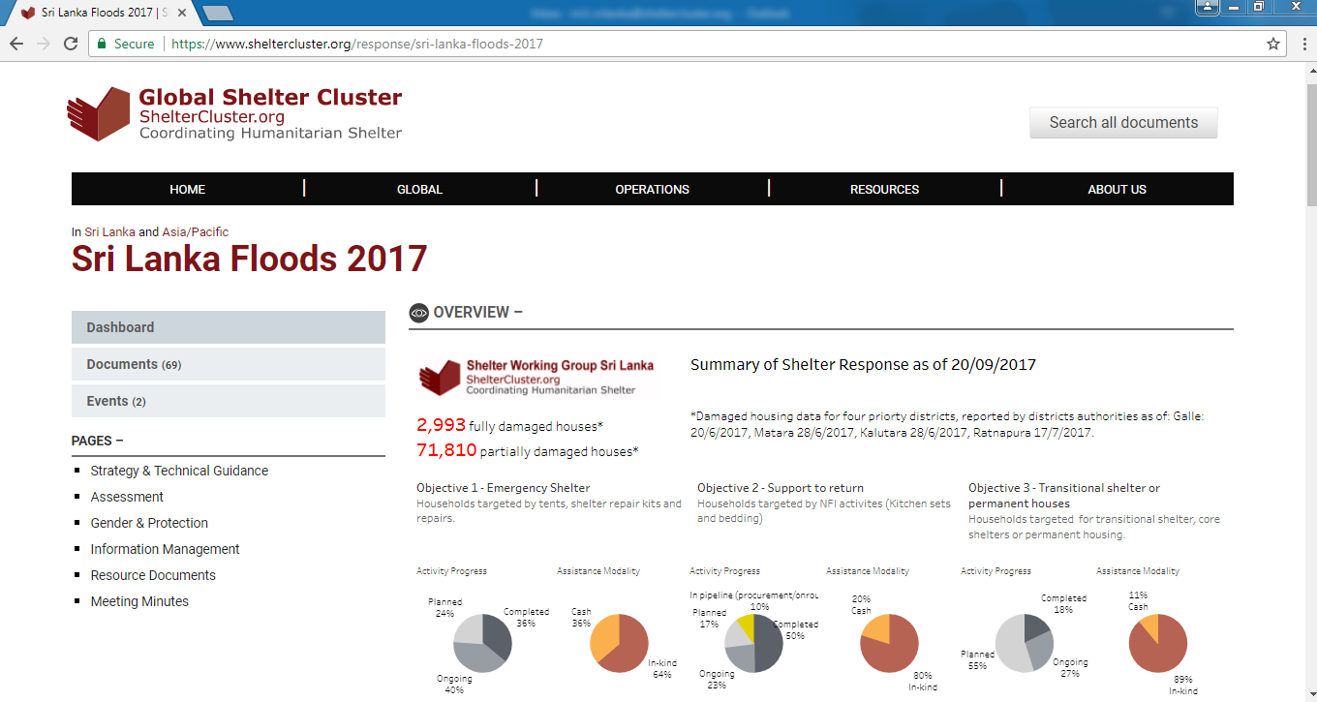
Shelter Cluster – SL 2017 https://www.sheltercluster.org/response/sri-lanka-floods-2017

Slide 4
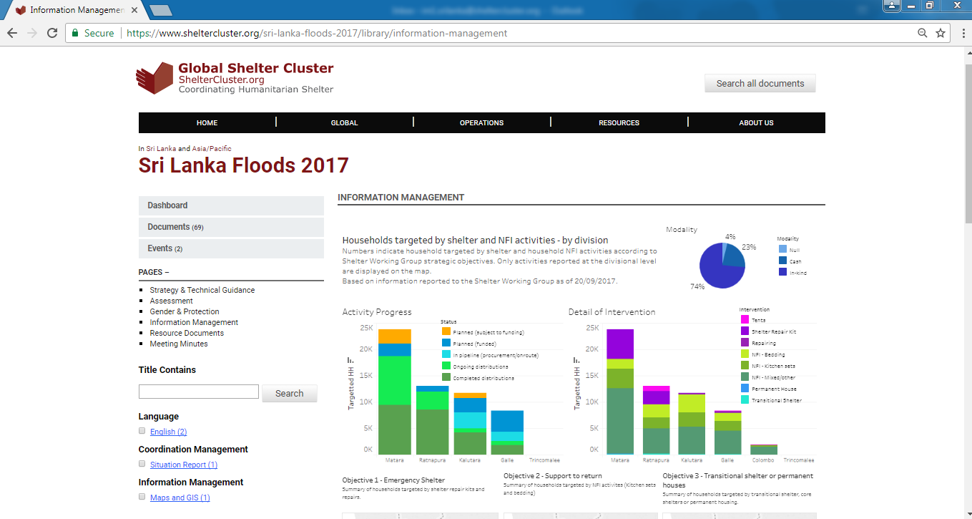
Shelter Cluster – IM Page

Slide 5
WASH – District focal point updates

Slide 6
Shelter – District focal point updates
  World Vision
  Save the Children
  UN Habitat

Slide 7
