Slide 1





Current Cluster Team Structure since 11th July 2017
Francesca Coloni - UNHCR National Cluster Coordinator +964 (0) 772 616 3725 coord.iraq@sheltercluster.org Michel Tia - IOM Information Management Officer - National +964 (0) 750 021 1720 im2.iraq@sheltercluster.org Cornelius Weira - IOM Sub National Co-Chair - Centre and South +964 (0) 751 234 2548 coord4.iraq@sheltercluster.org Laurence West - UNHCR Sub National Coordinator – KRI +964 (0) 771 911 0574 coord3.iraq@sheltercluster.org | Andrea Quaden - NRC National Cluster Co-Chair +964 (0) 751 740 7635 coord2.iraq@sheltercluster.org Abdoulaye Dieye - NORCAP Information Management Officer - Assistant National +964 (0) 771 488 2672 im3.iraq@sheltercluster.org Vacant- ACTED Roving Cluster Coordinator +964 (0) xxx xxx xxxx coordroving.iraq@sheltercluster.org Aziz ABULTIMMAN - UNHCR Senior Cluster Associate +964 (0) 750 868 6038 snrnatassot.iraq@sheltercluster.org

Slide 2
Sub-National Shelter & NFI Cluster Coordination meeting for C&S
1. Review of minutes of previous meeting
2. Information Management
a. 2017 Shelter and NFI achievements toward cluster objectives
b. 2018 HRP vs operational indicators and mandatory attributes.
3. Key Issues
a. 2018 cluster strategy & work plan
b. Summery on 2018 HNO/HRP
c. IHPF allocation on winterization
4. Governorate updates
AoB
Wednesday, 17th January 2018
http://sheltercluster.org/response/iraq

Slide 3
1. Review of action points from previous meeting
UNHCR / Shelter Cluster Sub National Coordinator to meet MODM on Kerosene distribution (done)
Shelter Cluster to share detailed winterization gap analysis spreadsheet (done)
Partners requested to share information on shelter and NFI needs in Ana, Qaim and Ru’ua (received report on market assessments from Mercy Corps)
UNHCR to share findings of the assessment on impact of cash interventions in respective intervention areas (pending)
Mercy Corps to contact ICRC on coordination on winter kits distributions in Kilo 18 (?)
UNHCR to share winterisation planned interventions (done)

Slide 4
2. Information Management - 2017 Shelter and NFI achievements
2017 HNO/HRP
Achievements
 | Rest of Iraq | KRI | Mosul | Total
# People in need | 2,044,541 | 574,146 | 1,264,313 | 3,883,000
# People targeted | 1,130,591 | 546,892 | 648,858 | 2,326,341
# OPS – approved submissions | 82 submissions – 54 approved proposals
# of partners with approved projects in the HRP | 29 | 13 | 25 | 29 partners including 6 NNGOs
Financial requirements | $73,879,938 | $41,918,452 | $59,515,318 | $175,313,708
The coverage for NFI kits stands at 87% of the cluster target
and the coverage for shelter stands at 63% of cluster target.
Funded | 175.3 M | 91.4 M | 52.1%

Slide 5
2. Information Management - 2017 Shelter and NFI achievements
2017 achievements toward Cluster Objectives - (PMR): These are Cluster overall achievements per objectives and indicators.

Slide 6
2. Information Management - 2017 Shelter and NFI achievements
However 2017 gaps to be considered remain at governorate level.

Slide 7
2. Information Management - 2018 HRP vs operational indicators and mandatory attributes
Final S-NFI operational indicators and mandatory attributes been shared with partners on 16 Jan. 2018
For 2018, ActivityInfo will remain the main channel for reporting to Clusters, thus, organizations will need to request access to the system even if you had access to 2017 database.
As of 16Jan.18, out of 43 organizations already reporting in 2017 AI database, only 23 organizations (47 staffs) have registered to have access to the 2018 AI database
Currently cluster IMOs together with OCHA IMU, are in a process of finalizing the 2018 ActivityInfo reporting database and preparing supporting document.
Training sessions will be conducted on due time.

Slide 8
3. Key Issues - 2018 cluster strategy & work plan

Slide 9
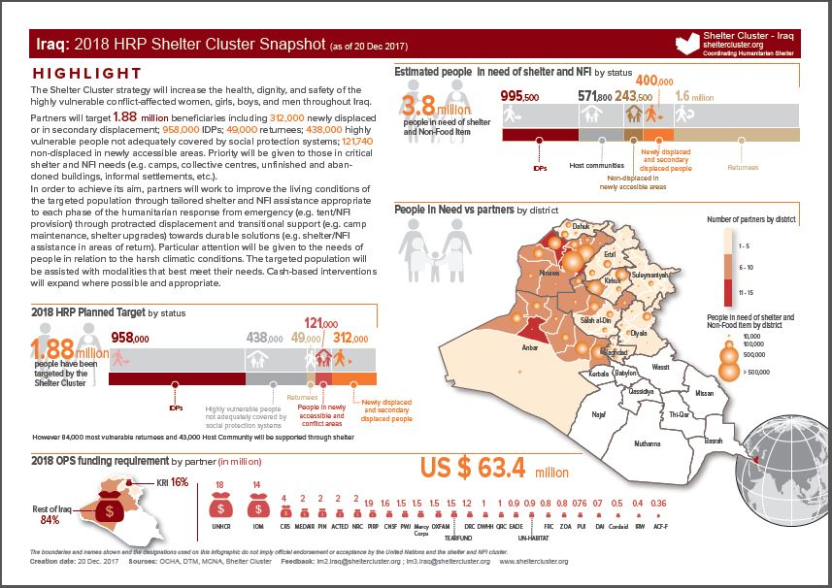
3. Key Issues - Summery on 2018 HNO/HRP
Shelter Cluster Snapshot on 2018 HRP available on the cluster webpage
https://www.sheltercluster.org/sites/default/files/docs/irq_a4_shelter_cluster_2018hrp_snapshot_20171220.pdf

Slide 10
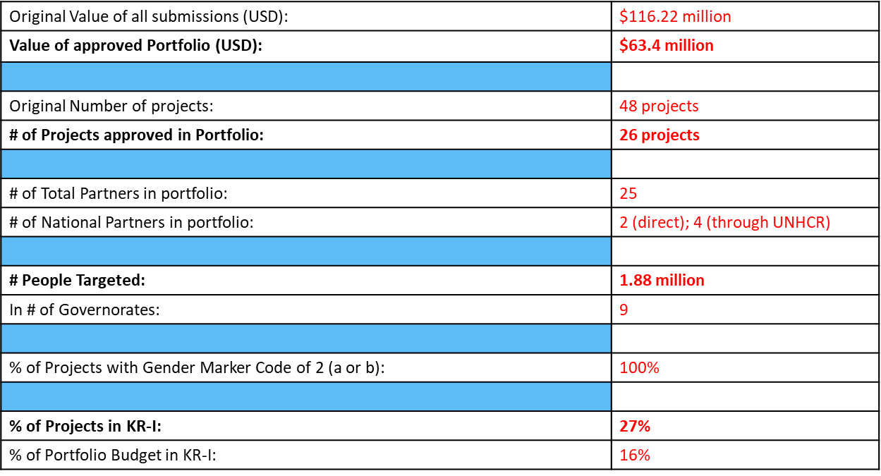
3. Key Issues - Summery on 2018 HNO/HRP

Slide 11
3. Key Issues - IHPF allocation on winterization

Slide 12
4. Governorate updates

Slide 13
5. AOB

Slide 14
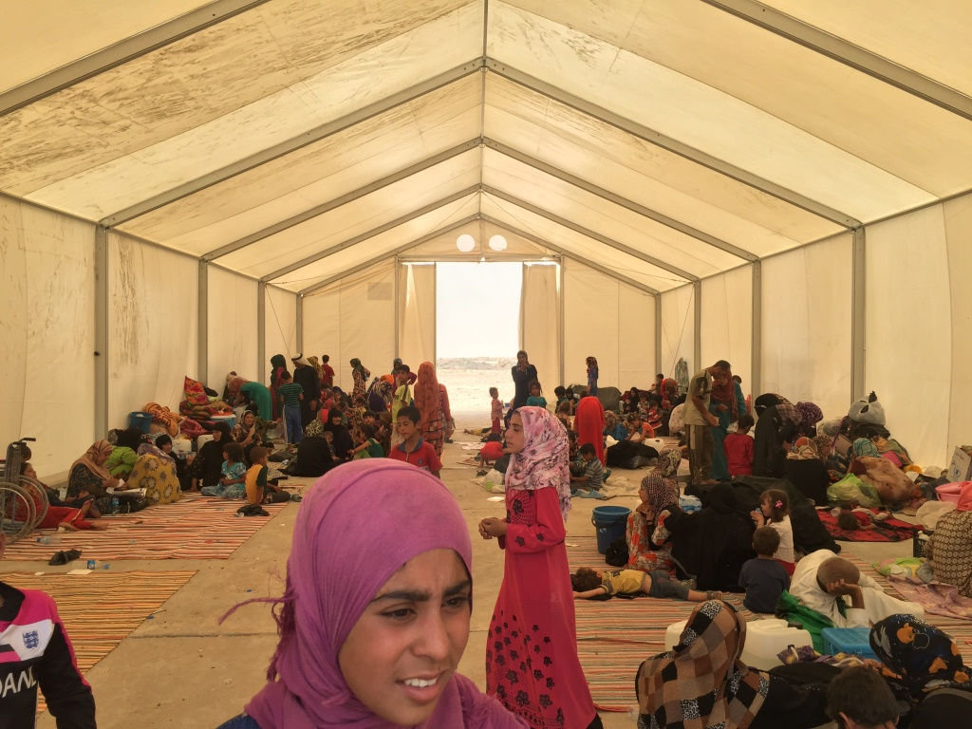
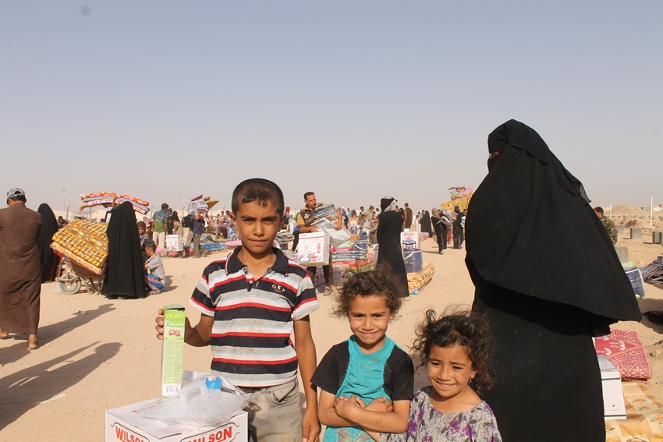
THANKS.
http://sheltercluster.org/response/iraq

