Slide 1





Current Cluster Team Structure since 11th July 2017
Francesca Coloni - UNHCR National Cluster Coordinator +964 (0) 772 616 3725 coord.iraq@sheltercluster.org Michel Tia - IOM Information Management Officer - National +964 (0) 750 021 1720 im2.iraq@sheltercluster.org Cornelius Weira - IOM Sub National Co-Chair - Centre and South +964 (0) 751 234 2548 coord4.iraq@sheltercluster.org Laurence West - UNHCR Sub National Coordinator – KRI +964 (0) 771 911 0574 coord3.iraq@sheltercluster.org | Andrea Quaden - NRC National Cluster Co-Chair +964 (0) 751 740 7635 coord2.iraq@sheltercluster.org Abdoulaye Dieye - NORCAP Information Management Officer - Assistant National +964 (0) 771 488 2672 im3.iraq@sheltercluster.org Vacant- ACTED Roving Cluster Coordinator +964 (0) xxx xxx xxxx coordroving.iraq@sheltercluster.org Aziz ABULTIMMAN - UNHCR Senior Cluster Associate +964 (0) 750 868 6038 snrnatassot.iraq@sheltercluster.org

Slide 2
Sub-National Shelter & NFI Cluster Coordination meeting for C&S
1. Review of minutes of previous meeting
2. Information Management
a. 2018 A.I database: design process, partners access
and training Partner registration for 2018 A.I database
3. Key Issues
a. Partner assessments for in and out of camp
b. 1st IHPF Allocation 2018
c. Camp Consolidation and Closure (Needs in terms of Shelter and NFIs )
4. Governorate updates
5. AoB
Wednesday, 07th February 2018
http://sheltercluster.org/response/iraq

Slide 3
1. Review of action points from previous meeting
UNHCR and Cluster Focal Points to Monitor Ministry of Oil kerosene distributions in IDP camps. (Ongoing)
Cluster IMO to share with Partners end of year Cluster Dash Board and Map in the coming week ( TBC )
Partners to register with Cluster IMO for access to 2018 Activity info database ( TBC)
IMO to disaggregate 2017 HRP funded projects from 2017 NON HRP funded projects –(IMO To update)
UNHCR will conduct verification on the 852-IDP caseload reported by IOM in AK to be in need of NFIs. ( Verification Assessments on going UNHCR to provide assistance after findings)

Slide 4
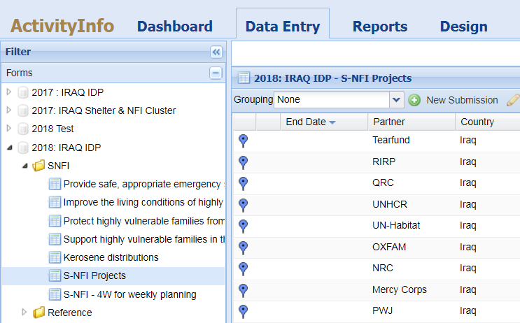
2. Information Management
2018 A.I database: design process, partners access and trainings
- The database design has been completed but remains some technical adjustments
- Particularity: common database for all clusters

Slide 5
2. Information Management.
2018 A.I database: design process, partners access and trainings
- Google form have been shared with partners and information collected will be used to give them access to the database
- AI trainings will be conducted in Erbil, Dahuk, Sulaymaniyah, Baghdad and Kirkuk governorates with the support of the sub-national coordinators

Slide 6
3. Key Issues -
a. Partner assessments for in and out of camp, what the cluster requests to know from Partners/ Shelter Cluster Focal Points
i.) MoDM kerosene Distribution
ii.) UNHCR PDM on Cash Interventions
iii.) War Damaged Shelter assessments findings
iv.) SoKs, NFIs Needs / Gaps and areas of intervention,
b. 1st 2018 -IHPF Allocation ( 36 Million USD for all Clusters ); Priority areas as shared by OCHA:-
i.) Activities supporting highly vulnerable returnees;
ii.) Activities supporting principled returns (protection, the JCMC centers, etc.)
iii) Activities supporting to maintain the camp services for the remaining IDPs, given that the Government’s camp consolidation and closure plan will likely cut services in camps.
c.

Slide 7
3. Key Issues - Summary on 2018 HNO/HRP
Camp Consolidation and Closure (Needs - Shelter & NFIs )
i.) Shelter and NFI Partners need to assess /anticipate the impact on IDPs living in camps when camp consolidation process starts .
ii. ) The Cluster has not at this stage received official confirmation on which camps will remain open.

Slide 8
4. Governorate updates

Slide 9
5. AOB

Slide 10
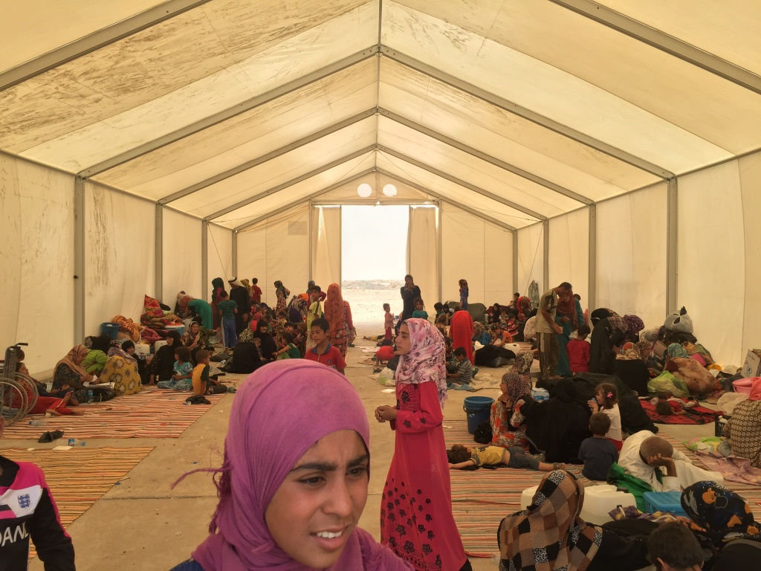
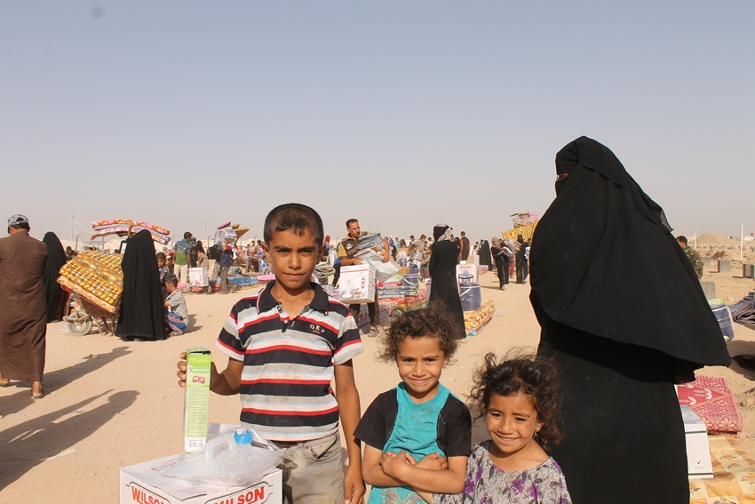
THANKS.
http://sheltercluster.org/response/iraq

