Slide 1





Current Cluster Team Structure since 11th July 2017
Francesca Coloni - UNHCR National Cluster Coordinator +964 (0) 772 616 3725 coord.iraq@sheltercluster.org Michel Tia - IOM Information Management Officer - National +964 (0) 750 021 1720 im2.iraq@sheltercluster.org Cornelius Weira - IOM Sub National Co-Chair - Centre and South +964 (0) 751 234 2548 coord4.iraq@sheltercluster.org Laurence West - UNHCR Sub National Coordinator – KRI +964 (0) 771 911 0574 coord3.iraq@sheltercluster.org | Andrea Quaden - NRC National Cluster Co-Chair +964 (0) 751 740 7635 coord2.iraq@sheltercluster.org Abdoulaye Dieye - NORCAP Information Management Officer - Assistant National +964 (0) 771 488 2672 im3.iraq@sheltercluster.org Vacant- ACTED Roving Cluster Coordinator +964 (0) xxx xxx xxxx coordroving.iraq@sheltercluster.org Aziz ABULTIMMAN - UNHCR Senior Cluster Associate +964 (0) 750 868 6038 snrnatassot.iraq@sheltercluster.org

Slide 2
Sub-National Shelter & NFI Cluster Coordination meeting for C&S
1. Review of minutes of previous meeting
2. Information Management
a. Mosul planned and operational presence
b. Iraq 3W
c. Shelter Cluster HRP Snapshot
d. Shelter Cluster Online Dashboard
3. Key Issues
a. 1st IHPF Allocation 2018 Updates
b. War damaged Shelter Categories, repairs in the humanitarian context.
c. Shelter and NFI Response for flood affected IDPs
d. Camp Consolidation and Closures Updates
4. Governorate updates
5. AoB
Wednesday, 21st February 2018
http://sheltercluster.org/response/iraq

Slide 3
1. Review of action points from previous meeting
Shelter Cluster Focal Point to obtain Kerosene distribution reports from Government ( UNHCR to update)
Shelter Cluster IMO to share online Shelter cluster dash board link ( IMO to Update)
Cluster to share Activity Info guidelines and training time table ( IMO to Update)
Partners to undertake registration with Cluster IMOs for 2018 activity info database access ( Ongoing )
Shelter Cluster Coordinator to present war damage shelter categories to Partners in next meeting ( To be done on 21st Feb meeting)
UNHCR to present findings of assessments in Al Khalidiya ( UNHCR to Update)
Shelter Cluster to share camp consolidation guidance note once approved by Global Shelter Cluster ( to be presented during meeting)

Slide 4
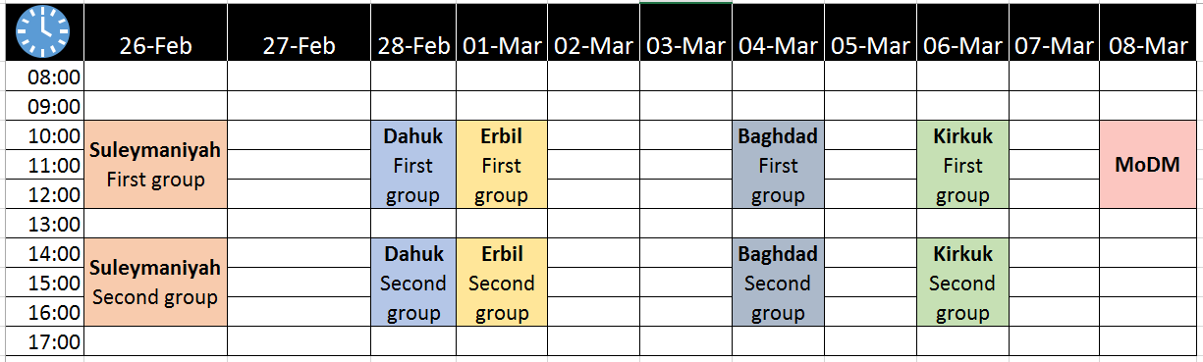
2. Information Management
2018 Activity Info database updates
- All users have been added in the database and the reporting will start in early
March for January, February and March
- Tentative Activity Info trainings time table

Slide 5
2. Information Management.
Advantages of reporting regularly: IM products updates, gap analysis, improve advocacy
- Mosul planned and operational presence
- Iraq 3W
- Shelter Cluster HRP Snapshot
- Shelter Cluster Online Dashboard

Slide 6
3. Key Issues
3. Key Issues
a. 1st IHPF Allocation 2018 Updates
The Humanitarian Coordinator (HC), in consultation with the clusters and the Advisory Board (AB) have issued the 1st 2018 IPF allocation. A total amount of up to US$ 34.55 million is available for this allocation.
The HC in discussion with the AB has set the allocation priorities as follows;
• Activities supporting highly vulnerable populations in return areas
• Activities supporting principled returns (protection, the JCMC centers/Community Recourse Centers (CRCs), etc
• Activities to maintain the camp services for the remaining IDPs
b. War damaged Shelter Categories, repairs in the humanitarian context. ( Power Point Presentation by National Cluster Coordinator ) click here

Slide 7
3. Key Issues
c. Shelter and NFI Response for flood affected IDPs
  191 families affected in K18 camp: 1182 blankets for 191 HH distributed by UNHCR.
  116 damaged tents identified in HTC and AFF camps: UNHCR will replace 116 damaged flooded tents (assessment completed on 19th Feb 2018)
  343 affected families in HTC and AAF camps: UNHCR distributed more than 343 CRI kits families (assessment ongoing)
  45 families identified in Karama Camp (Salah a din):UNHCR will distribute 45 winter kits (Assessment completed on 19th Feb 2018 ).
  Other affected locations reported :-
d. Camp Consolidation and Closures Updates`
  The guidance note “CONSIDERATION ON THE USE OF TENTS FOLLOWING CAMP CLOSURE “ version 6 has been approved by by SAG, GSC and ICCG link
  The document is in the process of endorsement by the HC and relevant authorities.

Slide 8
4. Governorate updates

Slide 9
5. AOB

Slide 10
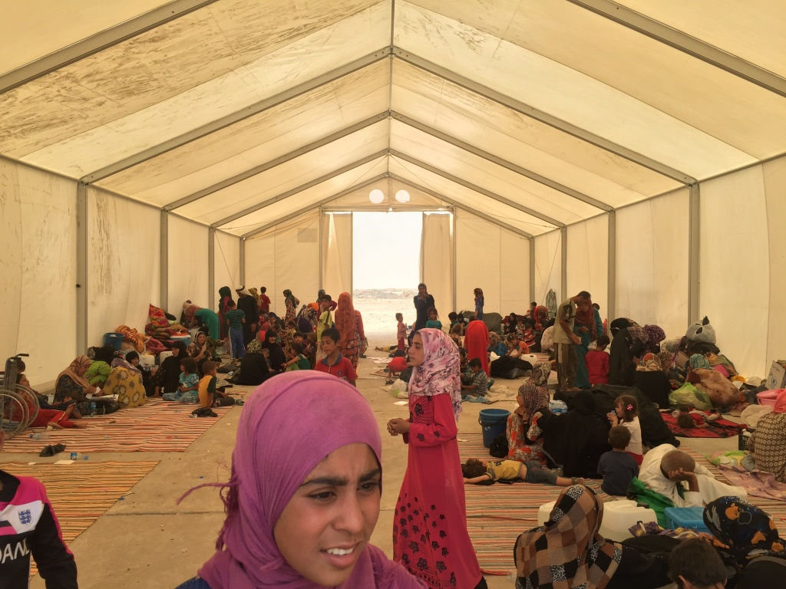
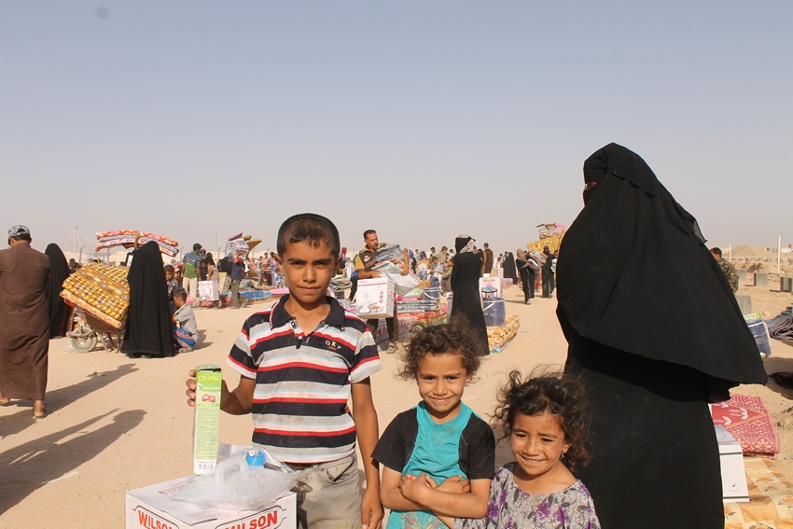
THANKS.
http://sheltercluster.org/response/iraq

