Slide 1





Current Cluster Team Structure since 11th July 2017
Francesca Coloni - UNHCR National Cluster Coordinator +964 (0) 772 616 3725 coord.iraq@sheltercluster.org Michel Tia - IOM Information Management Officer - National +964 (0) 750 021 1720 im2.iraq@sheltercluster.org Cornelius Weira - IOM Sub National Co-Chair - Centre and South +964 (0) 751 234 2548 coord4.iraq@sheltercluster.org Laurence West - UNHCR Sub National Coordinator – KRI +964 (0) 771 911 0574 coord3.iraq@sheltercluster.org | Andrea Quaden - NRC National Cluster Co-Chair +964 (0) 751 740 7635 coord2.iraq@sheltercluster.org Abdoulaye Dieye - NORCAP Information Management Officer - Assistant National +964 (0) 771 488 2672 im3.iraq@sheltercluster.org Vacant- ACTED Roving Cluster Coordinator +964 (0) xxx xxx xxxx coordroving.iraq@sheltercluster.org Aziz ABULTIMMAN - UNHCR Senior Cluster Associate +964 (0) 750 868 6038 snrnatassot.iraq@sheltercluster.org

Slide 2
Sub-National Shelter & NFI Cluster Coordination meeting for C&S
1. Review of minutes of previous meeting
2. Information Management
a. A.I Training timetable
3. Key Issues
a. 1st IHPF Allocation 2018 Sub missions
b. Kilo 18, AAF and Al Alam’ Mission Report
/findings
c. Shelter and NFI Response for flood affected . IDPs
d. Camp Consolidation and Closures Updates
4. Governorate updates
5. AoB
Wednesday, 7th March 2018
http://sheltercluster.org/response/iraq

Slide 3
1. Review of action points from previous meeting
IMO to share by mail chimp A.I am training timetable . Done
Partners to submit proposals for the 1st IHPF allocations by mid night 4th March 2018- Done
Refer Kilo 18 extension camp access by IDPs to Protection Cluster – Done
Follow up with DRC / CCCM of missing names of IDPs in HTC – Pending

Slide 4
2. Information Management – Activity Info Training Timetable

Slide 5
3. Key Issues
a. 1st IHPF Allocation 2018 Sub missions
Available for Shelter and NFI Cluster USD 5,005,000
A totals of 19 Proposals submitted in the GMS
Total amount of submissions - USD 13,472,576
5 - submissions for provision of NFIs
14 - submissions for Emergency Shelter Repairs, Transitional Shelters and Sealing off Kits
Submissions are currently under Strategic Review by SAG.

Slide 6
3. Key Issues
b. Kilo 18, Mission findings
• A number of IDPs were observed living in a section of the camp with degraded tents in Kilo 18 old camp, and MODM is currently not in position to replace these tents.
• According to Camp Management 140 tents have been damaged by the recent floods
• MODM has provided Kerosene for cooking, 40 liters of Kerosene per family, it remains unclear who is providing kerosene for heating during winter
• Forced evictions continue to happen in the camp for especially IDPs from Al Qaim, Ru’ua and Ana and Saqlawiya affecting 210 families from Saqlawiya, Qaim, Ru’ua and Ana. Only 36 families voluntarily requested to return home.
. Al Alam Cam Mission findings
•About 20 IDP families were not registered for winter cash based interventions during the recent winter assistance registration by UNHCR. According to UNHCR, these families arrived late after the registrations had been completed. UNHCR is working to solve this matter.
•Camp Management reported missing NFI items provided to some IDPs, for instance, 3 mattresses instead of 6, same applies to blankets. This was confirmed in a discussion with some affected IDP households.
•Camp Management and UNHCR have agreed to work out a lasting solution for IDP families without PDS Numbers, Camp Management proposed the DRC token system to be accepted in place of PDS for IDPs without documentation and recognized marriage certificates.
•IDPs returning home are not allowed to take tents.

Slide 7
3. Key Issues
c. Shelter and NFI Response for flood affected
K18 camp: 1182 blankets for 191 HH distributed by UNHCR.
HTC&AAF camps: UNHCR replaced 116 damaged flooded tents
HTC&AAF camps: UNHCR distributed more than 343 CRI kits for affected families Karama Camp (Salah a Din):UNHCR distributed 45 winter kits
Kilo 18, IOM distributed 875 seasonal kits
AAF Camps , IOM distributed 1,375 seasonal kits
Al Qaim , IOM distributed 500 seasonal kits
Baghdad , Al Karkh Islamic School , IOM distributed 40 full Kits
Diyala , Saad Camp , IOM distributed 250 seasonal Kits
.
d. Camp Consolidation and Closures Updates
No Updates received yet.

Slide 8
4. Governorate updates

Slide 9
5. AOB

Slide 10
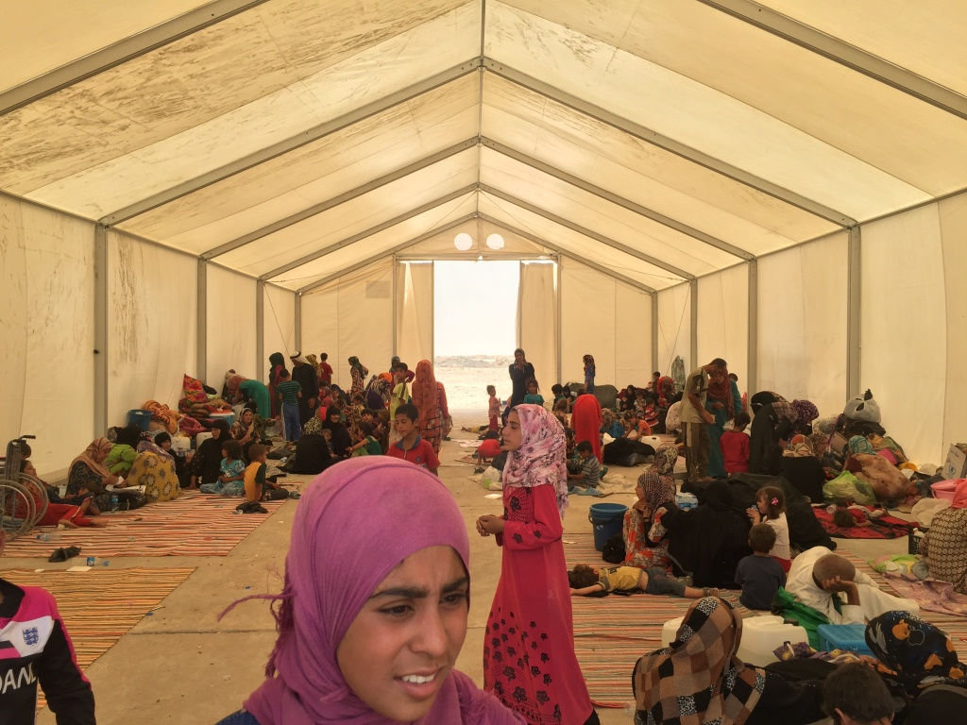
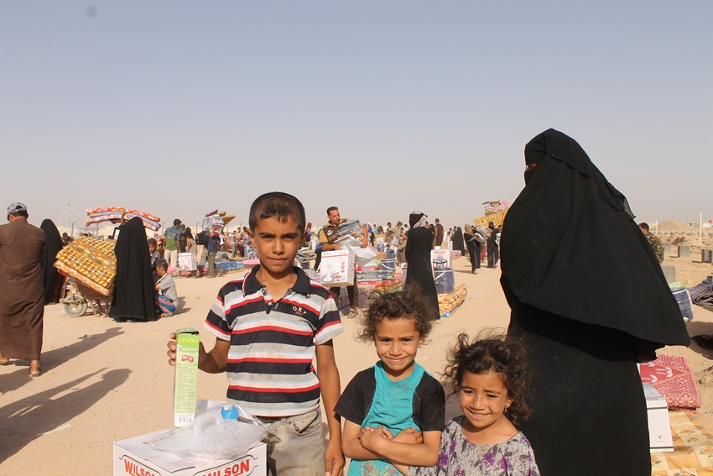
THANKS.
http://sheltercluster.org/response/iraq

