Slide 1





Current Cluster Team Structure since 11th July 2017
Francesca Coloni - UNHCR National Cluster Coordinator +964 (0) 772 616 3725 coord.iraq@sheltercluster.org Michel Tia - IOM Information Management Officer - National +964 (0) 750 021 1720 im2.iraq@sheltercluster.org Cornelius Weira - IOM Sub National Co-Chair - Centre and South +964 (0) 751 234 2548 coord4.iraq@sheltercluster.org Laurence West - UNHCR Sub National Coordinator – KRI +964 (0) 771 911 0574 coord3.iraq@sheltercluster.org | Andrea Quaden - NRC National Cluster Co-Chair +964 (0) 751 740 7635 coord2.iraq@sheltercluster.org Vacant - NORCAP Information Management Officer - Assistant National +964 (0) xxx xxx xxxx im3.iraq@sheltercluster.org Vacant- ACTED Roving Cluster Coordinator +964 (0) xxx xxx xxxx coordroving.iraq@sheltercluster.org Aziz ABULTIMMAN - UNHCR Senior Cluster Associate +964 (0) 750 868 6038 snrnatassot.iraq@sheltercluster.org

Slide 2
Sub-National Shelter & NFI Cluster Coordination meeting for C&S
1. Review of minutes of previous meeting
2. Information Management
3. Key Issues
a. 2018 First IHPF Allocation
b. Eminent IDP evictions in Tikrit and Baghdad
c. Camp Consolidation and Closures Updates
4. Governorate updates
5. AoB
Wednesday 21st March 2018
http://sheltercluster.org/response/iraq

Slide 3
1. Review of action points from previous meeting
Refer HTC matter of IDP’s names missing on register to CCCM for action - Done
Share confirmation of A.I training date and venue to Partners in C&S. Done
Refer purported closure of AK camps to CCCM cluster for clarification to IDPs living in the camp. Done
UNHCR to share latest flood assistance report .Pending

Slide 4
2. Information Management
2018 S-NFI Cluster ActivityInfo Training Sessions & Training Package
In Erbil : 4Mar.18 and 14Mar.18 – NCCI Office
In Sulaymaniyah: 8Mar.18 – UNHCR Office
In Dahuk : 12Mar.18 – UNHCR Office
In Baghdad: 20Mar.18 – UNHCR Office RICC4
In Kirkuk: 26Mar.18 – To be confirmed
The database will remain open till 5-Apr.18 for you to report your January - February and March achievements.

Slide 5
2. Information Management
2018 S-NFI War Damaged Shelter Assessment Tool
UN-HABITAT and the Shelter Cluster have developed a new tool to capture data on assessments and repairs of war damaged shelter.
Note:
https://www.sheltercluster.org/iraq/documents/war-damage-assessment-coordination-note
Revised guidelines
https://www.sheltercluster.org/iraq/documents/irqemergency-repairs-wds-guidelines
Revised tool
https://www.sheltercluster.org/iraq/documents/war-damage-assessment-coordination-collection-tool

Slide 6
3. Key Issues
a. 2018 First IHPF Allocation - Timelines

Slide 7
3. Key Issues
a. 2018 First IHPF Allocation - Progress
It has to be noted that 22 submissions were received for a total value of 16 million USD, against a max ceiling of 5 million USD
Thus the review process was very thorough, only high quality submissions were accepted
For partners rejected please reach out to Andrea Quaden, National SC Co Chair, if feedback is required.

Slide 8
3. Key Issues
b. Eminent IDP evictions in Tikrit and Baghdad
530 IDPs expected to be evicted from Saqlawiya housing complex at the end of this month. As many as 450 families may be accommodated in Al Alam camps.
A total of 59 HH evictions were recorded in February. Those evicted had primarily been staying in unfinished public schools or other public buildings. IDP families evicted from unfinished schools and public buildings either relocated to other sites in the immediate area, some to Qadissaya complex, and some returned to their AoO (i.e., Beiji city and different villages north of Beiji city).
By mid-March a total of 46 HH evictions were recorded. The eviction trend seen in February has continued into March as local level duty bearers and building contractors have continued to pressure IDPs staying in unfinished schools and public buildings, primarily in Tikrit city.
Evictions in Kasnazaniya camp in Baghdad was postponed from 15th to 20th March 2018

Slide 9
3. Key Issues
c. Camp Consolidation and Closures Updates
From Anbar Governor’s office recommendation letter on Kilo 18: -
Consolidate all sectors in kilo 18 camp.
Remove empty tents and deliver them to the returned families.
The camps managers should not allow NGOs access to camps unless they obtain JCMC approval in the governorate and provide the registration certificate issued by NGOs Directorate,

Slide 10
4. Governorate updates

Slide 11
5. AOB

Slide 12
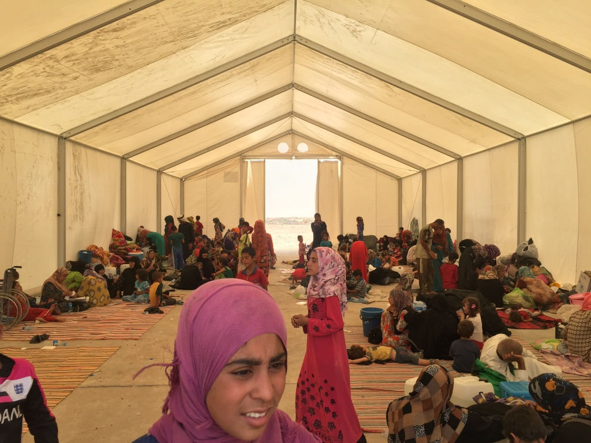
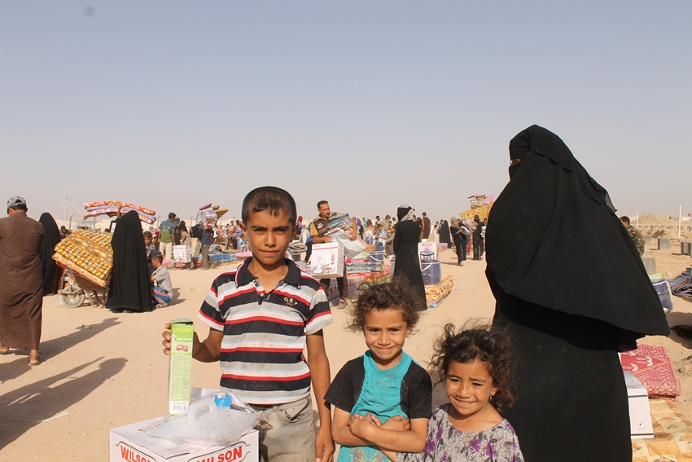
THANKS.
http://sheltercluster.org/response/iraq

