Slide 1
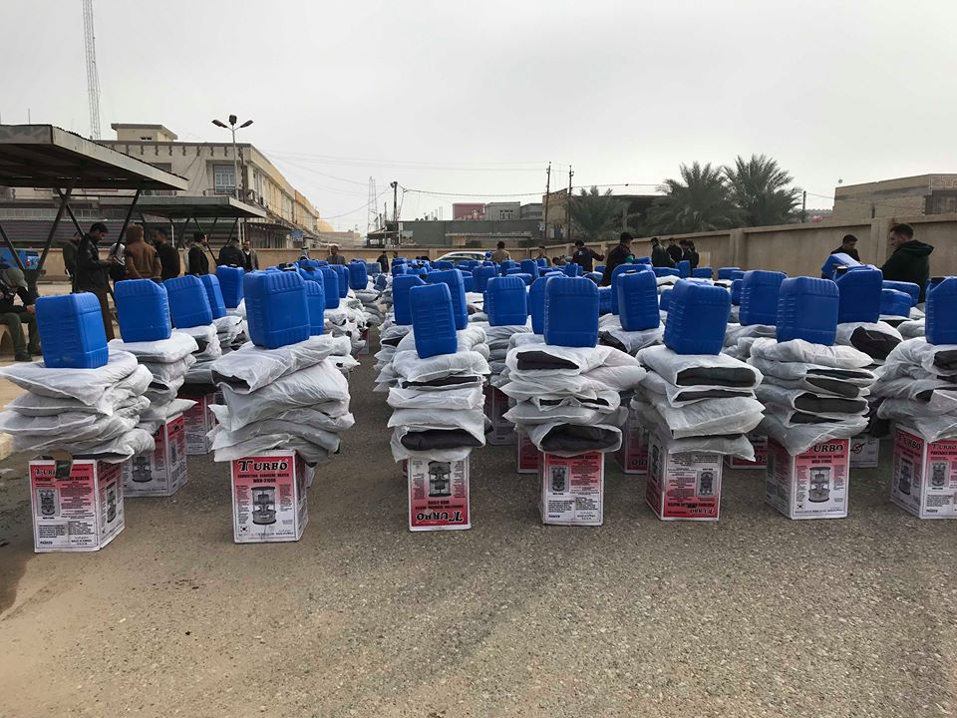
Sub-National Shelter & NFI Cluster Coordination meeting for C&S
NFI Distributions
Baquba – Diyala
23 Dec. 2018
Photo credit: IOM

Slide 2
Sub-National Shelter & NFI Cluster Coordination meeting for C&S
AGENDA
Review of minutes of previous meeting,
Information Management: 2018 Cluster achievements / Operational presence.
2019 HRP: Key figures and Upcoming ActivityInfo Training Sessions
Key issues
War Damaged Shelter Assessments and Rehabilitations
Camp consolidation / Camp closure and Evictions
Sub-National S-NFI Cluster area based coordination & Cluster focal points
Partners to update on their
S-NFI response - ongoing / planned (including winter response)
Assessments (planned, ongoing, completed)
AOB
January 23rd,2019 - 11:30am- 12:30pm

Slide 3
Review of minutes of previous meeting
Agenda Item | Action points
Winter Response | Cluster to liaise with CRS on possibility of intervening in Mahmoudiya, Baghdad – Any update? Cluster to share the tent replacement information with OFDA – Any update? Cluster to liaise with relevant partners to collect data on kerosene distributions in Camps – Ongoing process

Slide 4
Information Management - 2018 Cluster achievements / Operational presence

Slide 5
Information Management - 2018 Cluster achievements / Operational presence
Cluster achievements from ActivityInfo (1st Jan. – 31st December 2018)
People in Need | Target | Reached with NFI | Reached with Shelter
3.82 M | 1.9 M | 1,600,098 (85% of target) | 232,216 (12% of target)
63% of the total people reached with NFI distributions are in Camps, and 37% in out of Camps settings;
While 83% of total people reached with Shelter interventions are in out of camps settings, and just 17% in Camps;
42 partners have contributed to above achievements of which
40 are operating in Centre and South governorates and
11 in KR-I
9 are operating in both KR-I and C&S
Operational Presence
For more details, please refer to the cluster IM products and the online dashboard
https://www.humanitarianresponse.info/en/operations/iraq/2018-dashboard

Slide 6
2019 HRP : Key figures - People in Need and Target
 | Total # people |  | By categories (#) |  |  | By sex and age
 | Whole of Iraq | Kurdistan Region of Iraq | IDP | Returnee | Host community | % female | % of children, adult, elderly*
People in need | 2,093,926 | 334,202 | 712,732 | 992,294 | 388,900 | 49.5% | 50.7% 44.3% 5.0%
People targeted | 881,650 | 163,808 | 550,150 | 324,000 | 7,500 | 49.5% | 50.7% 44.3% 5.0%
*Children (˂18 years old); adult (18-59 years old) elderly (˃59 years)

Slide 7
2019 HRP : Key figures – Financial requirements
 | HRP 2018 | Initial HRP 2019 submissions | Outcomes of review process
# projects | 26 | 36 | 17
# partners | 25 | 26 | 16 only in KRI: 7
Financial requirements | US $ 63.4 M | US $ 160 M | US $ 74,354,054 KRI : US $ 10,753,356 (14% of total ask) Rest of Iraq: US $ 63,600,698 (86% of total ask)
Received funds | US $ 30.9 M (49%)
Based on the HPC projects – Cash based intervention - regardless of conditionality
Percentage of cash : 23%
Total financial requirements for cash : 17,101,432 USD

Slide 8
2019 HRP : Key figures - Partners
Partners
Agency for Technical Cooperation and Development | INGO
Caritas Czech Republic | INGO
Catholic Relief Services | INGO
Danish Refugee Council | INGO
Human Relief Foundation, UK | INGO
MEDAIR | INGO
Norwegian Refugee Council | INGO
TEARFUND | INGO
Terre des Hommes - Lausanne | INGO
ZOA | INGO
The Critical Needs Support Foundation | NNGO
The Engineering Association for Development and Environment | NNGO
International Organization for Migration | UN
United Nations Children's Fund | UN
United Nations High Commissioner for Refugees | UN
United Nations Human Settlements Programme (UN-HABITAT) | UN

Slide 9
2019 HRP : Upcoming ActivityInfo Training Sessions
2019 Shelter Cluster – Response Monitoring
Reporting Platform | ActivityInfo
Operational Indicators (been uploaded in ActivityInfo) | 2019 Database Forms are under development 1 – In Camps Response 2 – Out of Camps Response 3 – Contingency Plan 4 – Kerosene
Upcoming ActivityInfo Training Sessions | In the course of February 2019
Locations planned | Baghdad – Dahuk – Erbil – Kirkuk - Sulaymaniyah

Slide 10
Key issues - War Damaged Shelter (Rehabilitation, New Construction, Cash for Shelter) - OVERVIEW
Data_Type | Project data for areas
Sum of Total Damaged / Targeted Houses |  | Status
Project details | Organization | Completed | Ongoing | Planned | Grand Total
Cash for Shelter 1 Partner | UNHCR |  | 331 | 25 | 356
New construction / transitional shelter | Human Appeal | 698 |  |  | 698
3 Partners | IOM |  |  | 25 | 25
 | UNHCR | 3,500 |  | 1,500 | 5,000
Rehabilitation | ACTED | 650 |  | 78 | 728
13 Partners | CRS |  | 436 |  | 436
 | DRC |  | 133 |  | 133
 | IOM | 2,988 | 31 | 30 | 3,049
 | Local Church | 2,045 |  |  | 2,045
 | NRC | 527 |  | 266 | 793
 | PUI |  |  | 210 | 210
 | RIRP |  |  | 1,500 | 1,500
 | TheCNSF |  |  | 125 | 125
 | UNDP | 10,101 | 12,404 | 7,332 | 29,837
 | UN-Habitat | 2,906 | 431 | 150 | 3,487
 | UNHCR | 3,680 |  | 3,000 | 6,680
 | ZOA |  | 10 |  | 10
Grand Total |  | 27,095 | 13,776 | 14,241 | 55,112

Slide 11
Key issues - War Damaged Shelter (Rehabilitation, New Construction, Cash for Shelter) - PARTNERS
Status | (Multiple Items)
Project details | (Multiple Items)
Data_Type | Project data for areas
Sum of Total Damaged / Targeted Houses
Organization/agency | Total
ZOA | 10
The CNSF | 125
DRC | 133
PUI | 210
CRS | 436
Human Appeal | 698
ACTED | 728
NRC | 793
RIRP | 1,500
Local Church | 2,045
IOM | 3,074
UN-Habitat | 3,487
UNHCR | 12,036
UNDP | 29,837
Grand Total | 55,112

Slide 12
Key issues - War Damaged Shelter (Rehabilitation, New Construction, Cash for Shelter) - GOVERNORATE

Slide 13
Key issues - War Damaged Shelter (Rehabilitation, New Construction, Cash for Shelter)
Any Partners operating in WDS in Centre and South and not reporting?
Are you aware of any ‘’ghost NGOs’’ operating in WDS in Centre and South?
Future plan to review the WDS dataset through bilateral meeting with concerned partners.
Always use the revised form to submit your WDS – Interventions.

Slide 14
Key issues – Camp consolidation / Camp closure and Evictions
Partners to share any update from their area of responsibility;
And any challenges / key issues

Slide 15
Key issues - Sub-National S-NFI Cluster area based coordination & Cluster focal points
Governorate | Partner

Slide 16
Partners to update - S-NFI response - ongoing / planned (including winter response)
Governorate / Partners to share any update and any challenges / key issues
Response – ongoing / planned
Field Coordination
Access to beneficiaries
…
…

Slide 17
Partners to update - Assessments (planned, ongoing, completed)
Available resources
Iraq Assessment Tools and Guidance: https://www.humanitarianresponse.info/en/node/168141
Iraq Common Database of Indicators (CDI)
Catalogue of Assessment Tools
Iraq Assessment Registry: https://www.humanitarianresponse.info/en/operations/iraq/assessments
MAP – Assessments conducted and planned – Monthly update
2018 map (Jan. – Dec. 2018) already published
2019 data are to be collected
Our needs
Partners assessments reports, raw data, maps, …..
2019 assessment plan – partners to share their plan by 28Jan.19 CoB.

Slide 18
AOB

Slide 19
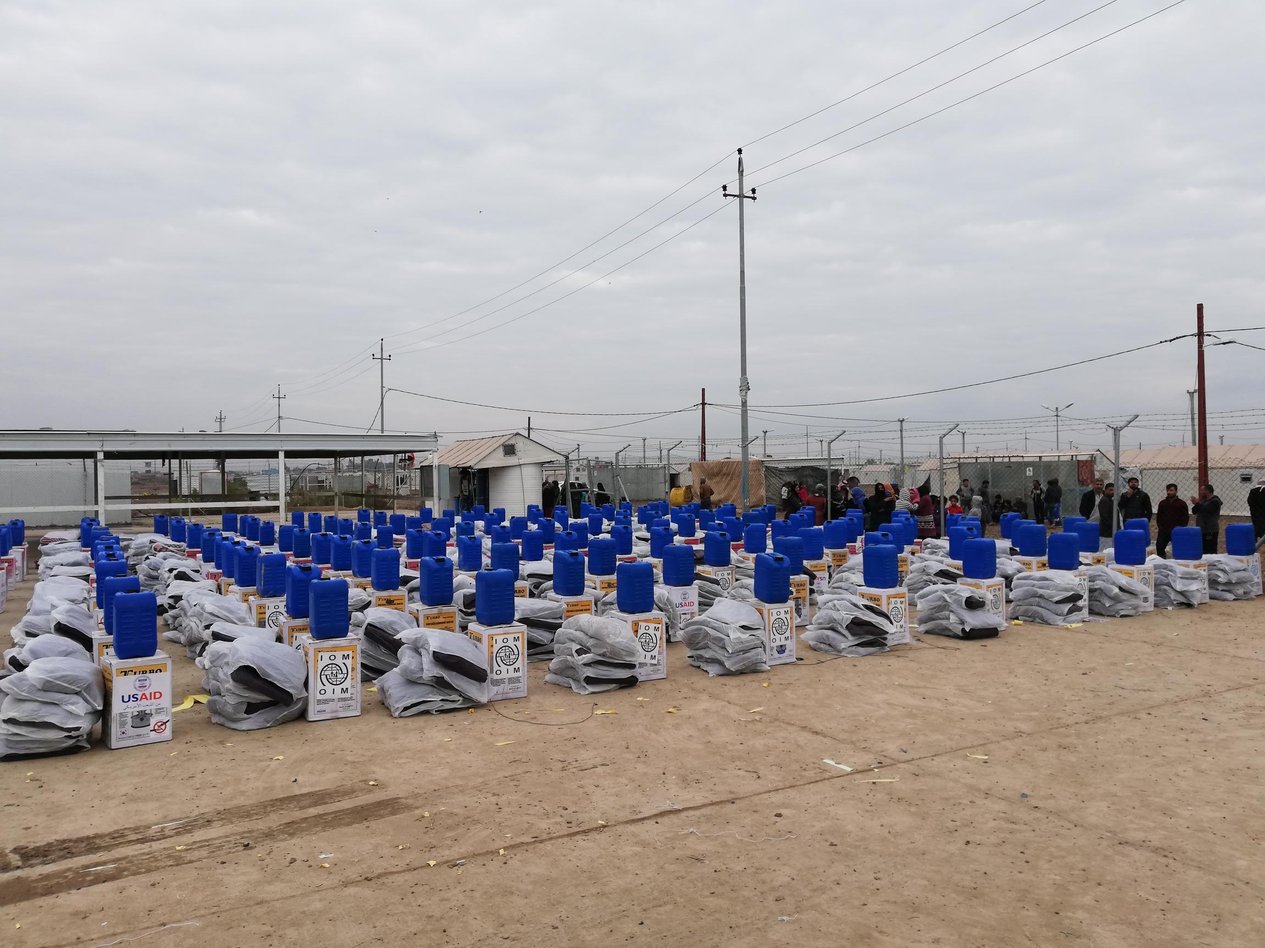
THANK YOU VERY MUCH
NFI Distributions
Abu Ghraib – Baghdad
29 Dec. 2018
Photo credit: IOM

