Slide 1
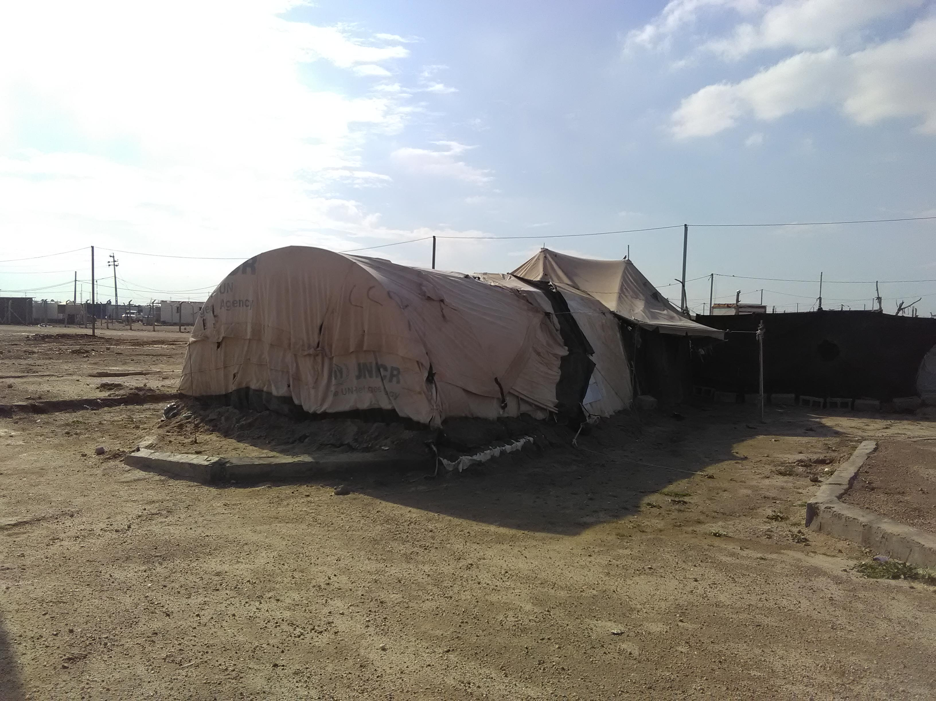
Sub-National Shelter & NFI Cluster Coordination meeting for C&S
Shelter Cluster field visit
in AAF camps (Anbar – Fallujah)

Slide 2
Sub-National Shelter & NFI Cluster Coordination meeting for C&S
AGENDA
Review of action points from minutes of previous meeting,
Key issues and Partners updates
War Damaged Shelter: who is doing what where and when - Plan / Ongoing - Assessments - Rehabilitation - Reconstruction
Camp closure / Camp consolidation – to be covered in CCCM meeting
Tents replacements – key concern and way forward
Ongoing / planned NFI response (including winter response)
2019 overall assessments (planned, ongoing, completed)
AOB
February 20th,2019 - 12:35am- 01:35pm

Slide 3
Review of action points from minutes of previous meeting
Agenda Item | Action points
Winter Response | Information Management Cluster to share and publish all IM products (Factsheet, 3W Excel from AI, PMR, Traffic Light document) related to the 2018 Cluster Overall achievements and the operational presence map – will soon be shared Cluster IMU to inform partners on due time on the ActivityInfo Training date, time & venue; And relevant training materiel to be shared in advance – on going Key issues - WDS CRS - To update the WDS Data Collection Tool based / share their proposed locations of shelter rehabilitation with shelter cluster to prevent the duplication – CRS to update Shelter Cluster – to create an email group of Partners operating in WDS in C&S for coordination purpose – done Key issues – Assessments (plan, ongoing completed) Partners to always share their assessments reports, raw data, maps whenever available Partners to share their 2019 assessment plan by 28 January. The Cluster will be circulating an email on the purpose.

Slide 4
Key issues and Partners updates
War Damaged Shelter (Rehabilitation, New Construction, Cash for Shelter) – only in Centre & South
Data_Type | (Multiple Items)
Status | (All)
Project details | (Multiple Items)
Sum of Total Damaged / Targeted Houses
Organization/agency | Total
UNDP | 21,831
UNHCR | 10,980
IOM | 2,906
UN-Habitat | 1,332
PUI | 210
ACTED | 75
ZOA | 10
Grand Total | 37,344

Slide 5
Key issues and Partners updates
War Damaged Shelter (Rehabilitation, New Construction, Cash for Shelter) – only in Centre & South

Slide 6
Key issues and Partners updates
War Damaged Shelter (Rehabilitation, New Construction, Cash for Shelter)
War Damaged Shelter - google map
https://www.google.com/maps/d/edit?mid=19Dl2zMMZYEYh2_J_DZon_sGxOo6kLBAy&ll=34.196203575460046%2C42.834840359374994&z=7
War Damaged Shelter – data collection tool

Slide 7
Key issues and Partners updates
Camp closure / Camp consolidation – to be covered in CCCM meeting

Slide 8
Key issues and Partners updates
Tents replacements – key concern and way forward
Already included in the FSMT
Questionnaire on tents issues with breakdown of:
Typologies,
Needs for replacement,
Flood risks & incidents,
And other shelter related info
Once FSMT is completed, tent info will be analysed by the S-NFI Cluster in coordination
& follow up with concerned CCCM partners.

Slide 9
Key issues and Partners updates
Ongoing / planned NFI response (including winter response)
In Centre and South, partners have almost completed their winter distributions.
The very few remaining gaps are covered on need basis after thorough assessments, to avoid re-serving same beneficiaries.

Slide 10
Key issues – 2019 priority districts

Slide 11
Key issues and Partners updates
2019 overall assessments (planned, ongoing, completed)
Available resources
Iraq Assessment Tools and Guidance: https://www.humanitarianresponse.info/en/node/168141
Iraq Common Database of Indicators (CDI)
Catalogue of Assessment Tools
Iraq Assessment Registry: https://www.humanitarianresponse.info/en/operations/iraq/assessments
Assessments conducted and planned – 2019 data are to be collected
Partners 2019 assessment plan
Partners assessments reports, raw data

Slide 12
2019 ActivityInfo Training Sessions & 2019 S-NFI / CCCM meeting plan
2019 Shelter Cluster – Response Monitoring
Reporting Platform | ActivityInfo
Operational Indicators (been uploaded in ActivityInfo) | 2019 Database Forms are under development 1 – In Camps Response 2 – Out of Camps Response 3 – Contingency Plan 4 – Kerosene
Upcoming ActivityInfo Training Sessions | Baghdad – 21Feb.19 – 1 session Erbil – 24Feb.19 – 2 sessions Dahuk Kirkuk Sulaymaniyah

Slide 13
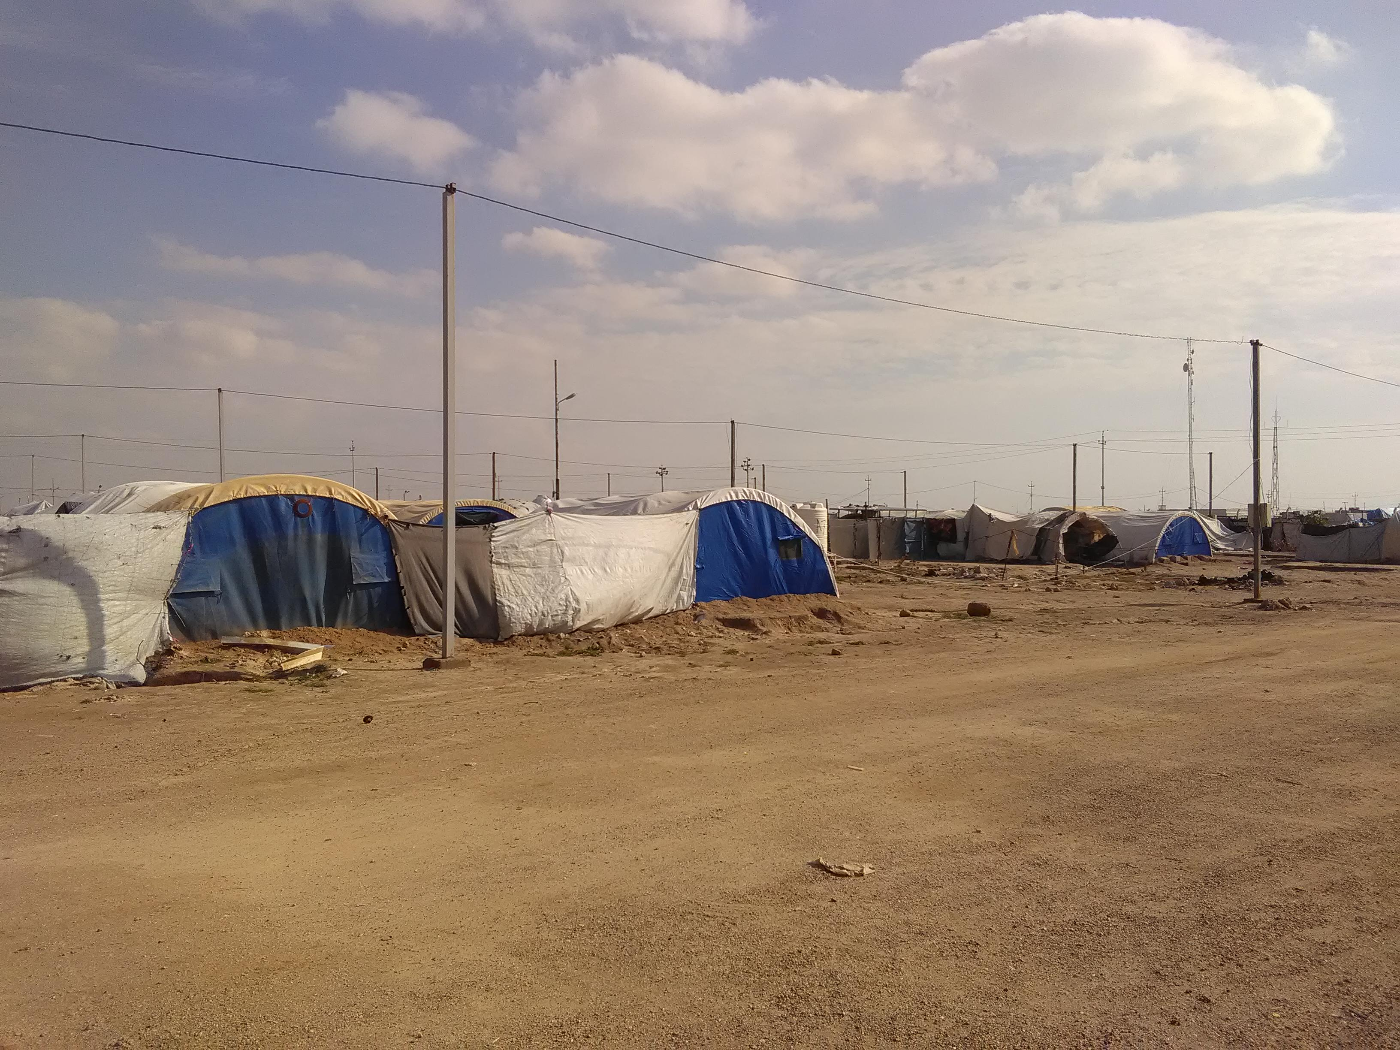
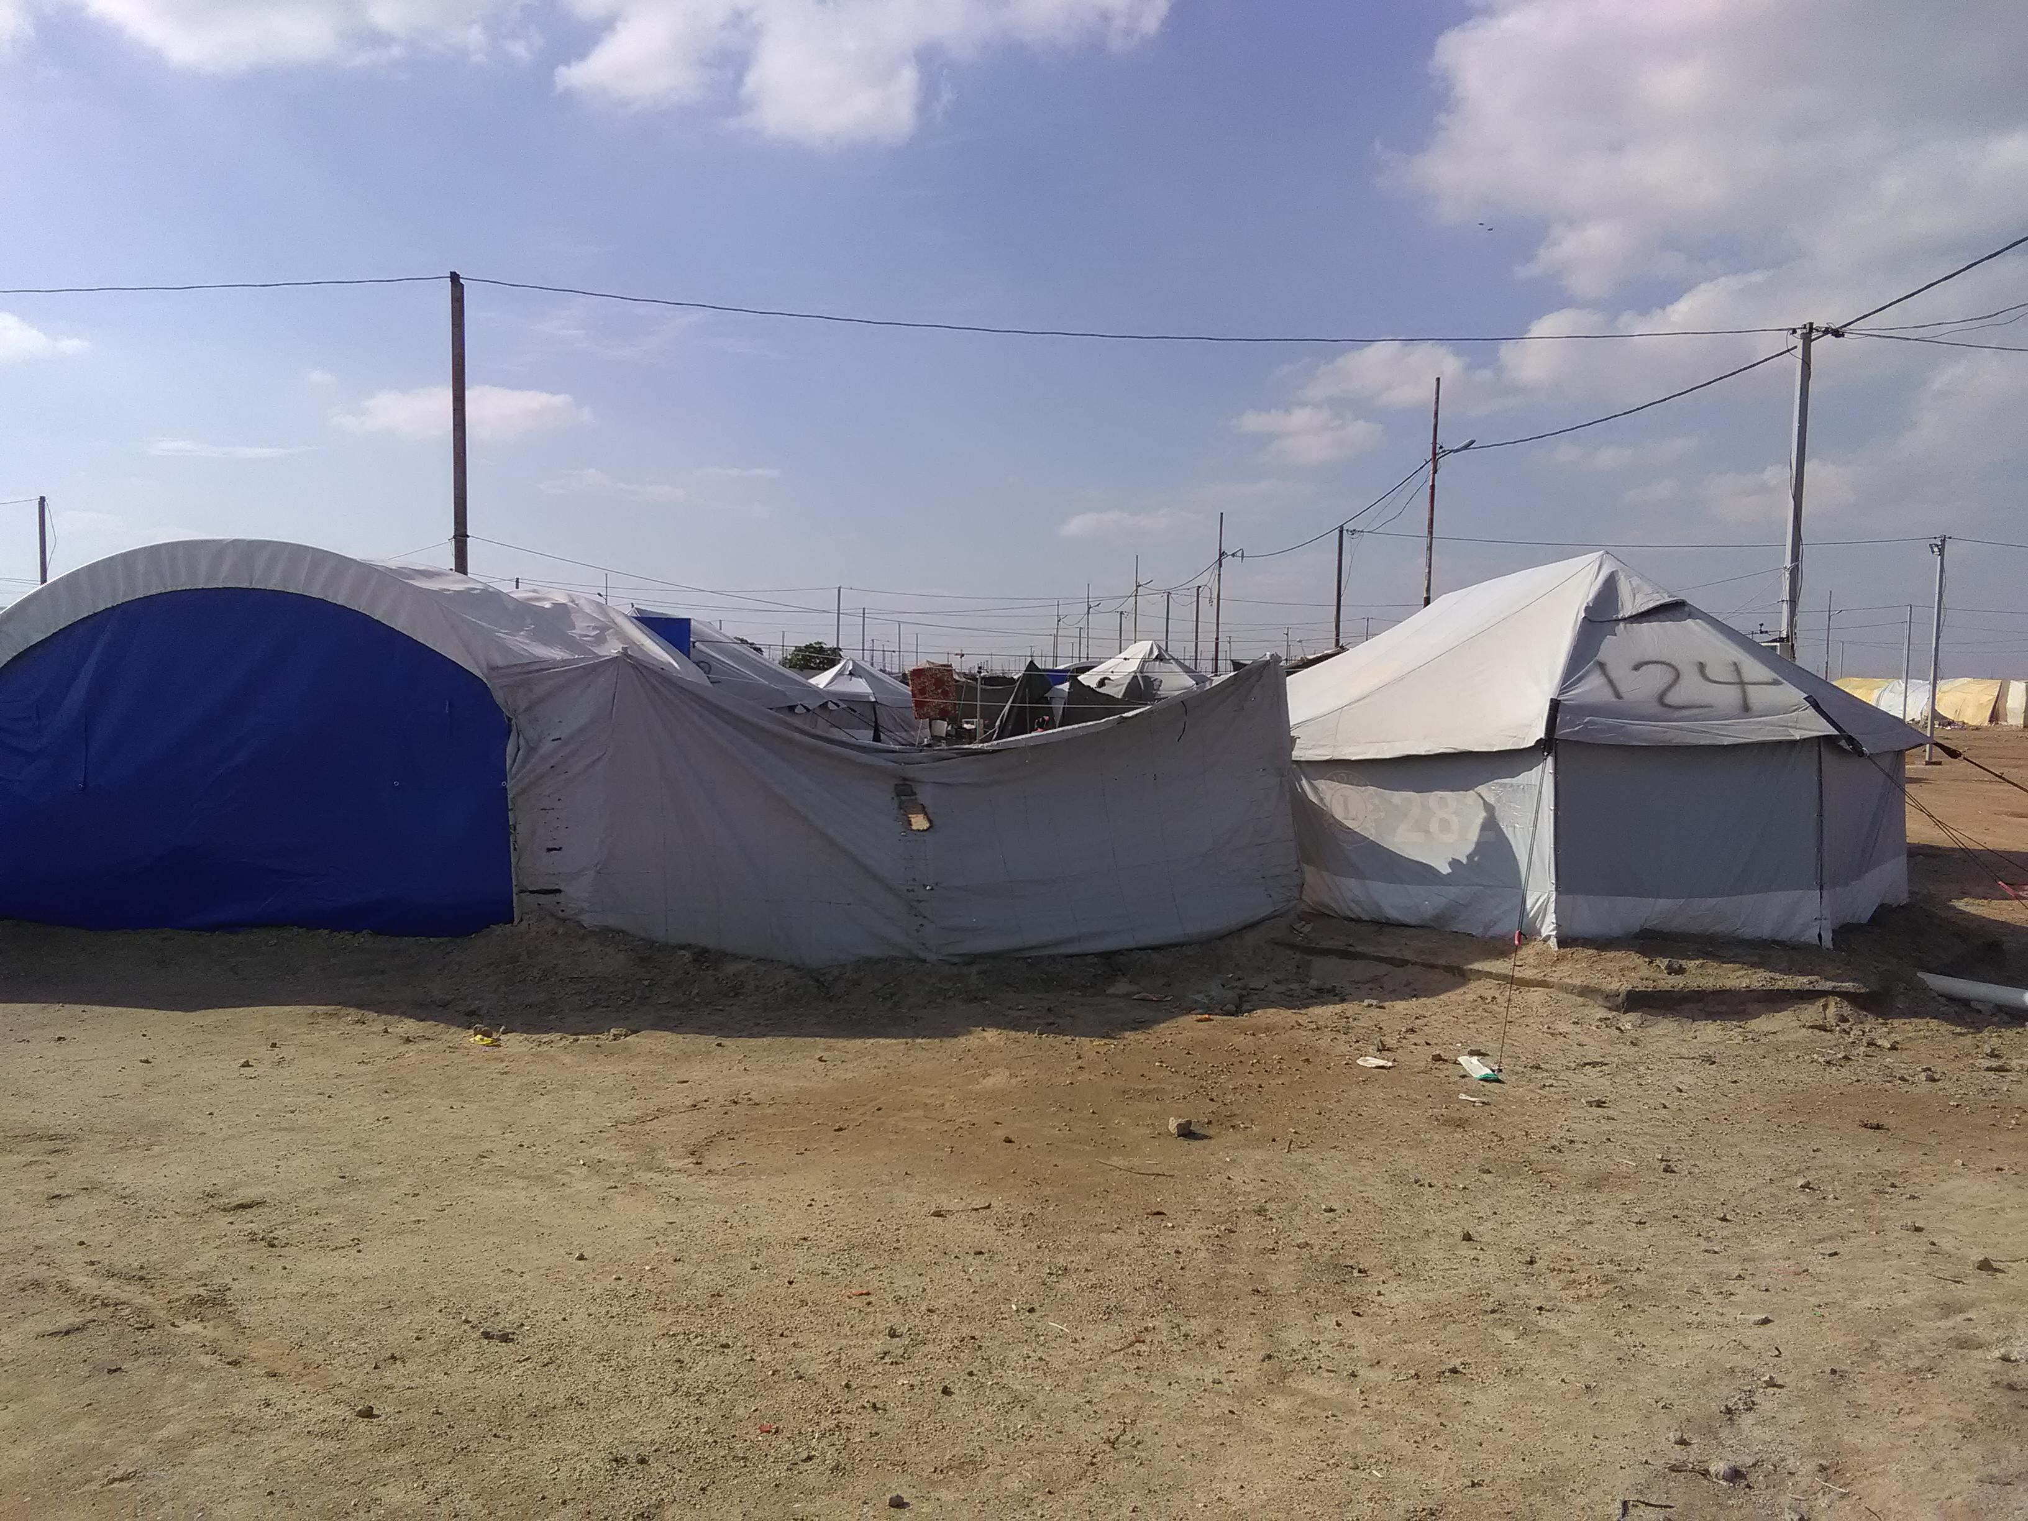
THANK YOU VERY MUCH
Shelter Cluster field visit
in AAF camps (Anbar – Fallujah)

