Slide 1
Iraq humanitarian response Centre and south Sub-National Shelter Cluster Coordination meeting
Baghdad
April 17th, 2019

Slide 2
AGENDA
Review of action points from minutes of previous meeting;
Key issues and Partners updates
Partners to update on Housing Rehabilitation interventions (Mar. & Apr. 19);
Update on flood – preparedness & response;
Information Management
ActivityInfo report: achievements & the new 4W for planning;
2019 assessments (planned, ongoing, completed);
SEVAT - Socio-Economic Vulnerability Assessment Tool;
AOB

Slide 3
Review of action points from minutes of previous meeting
# | Action Points | Focal Point | Timeline | Status
1 | Housing rehabilitation: Shelter Cluster to continuously follow up with partners, to support collecting their latest interventions details. Partners can reach out to the WDS IM Unit for support if needed (Emmanuel - im3.iraq@sheltercluster.org and Hoveen - hoveen.yaseen@un.org). | Shelter Cluster |  | Ongoing
2 | Housing rehabilitation: UNHCR to share their housing and rehabilitation area-based approach once ready. | UNHCR – Baghdad |  | Yet to be done
3 | Housing rehabilitation: IOM & UNHCR to coordinate (at field level) their Cash for Rent Programme in Anbar and Baghdad Governorates. | IOM & UNHCR |  | Ongoing
4 | Housing rehabilitation: CRS & UNHCR to coordinate (at field level) their Cash for Repair Programme in Al-Karmah (Fallujah) in Anbar Governorate. | CRS & UNHCR |  | Ongoing
5 | 2018/2019 winter response: Partners to share Lessons Learned from their respective winter response. | Shelter Cluster |  | Yet to be done
6 | 2018/2019 winter response: Shelter Cluster to share map & consolidated raw data on the winter response after partners have completed their reporting in ActivityInfo. | Shelter Cluster |  | Ongoing
7 | 2018/2019 winter response: Workshop - Lessons Learned on winter response: to be discussed. | Shelter Cluster |  | Ongoing
8 | Flood (preparedness & response plan): Shelter/CCCM Cluster to consider developing one (or updating if any), including available stocks, partners and respective areas. | Shelter & CCCM Cluster |  | Ongoing
9 | Assessments: Shelter Cluster to re-circulate the cluster 2019 priority districts. | Shelter Cluster |  | Ongoing
10 | Assessments: Raw data of the Return Index: Shelter Cluster to liaise with IOM and share relevant analysis related to shelter need in return areas. | Shelter Cluster |  | Ongoing
11 | 2019 Summer response plan: Partners requesting the cluster to support coordinating their summer response. | Shelter Cluster |  | Yet to be done

Slide 4
Key issues and Partners updates
Partners to update on Housing Rehabilitation interventions (Mar. & Apr. 19);
War-damaged shelter repairs through cash-based interventions:
8 partners and 2 Clusters (MPCA & Protection)
CRS, DRC, ICRC, IOM, Medair, Mission East, UN-Habitat and UNHCR

Slide 5
Key issues and Partners updates
Iraq: Floods update – preparedness & response
Impacts of heavy seasonal rains:
as of 3 Apr.19: 1,173 HHs displaced
as of 14 Apr.19: 1,546 HHs displaced
Diyala (approximately 400 families have been evacuated from their homes near the village of Khurnabat due to rising water levels of the Diyala River. The majority are staying with friends and relatives)
Kirkuk (an estimated 25 families have been temporarily displaced, and are residing with extended family or within municipal buildings)
Missan (an estimated 545 families have been displaced by flood waters in Missan province; however, local authorities state that up to 5,000 families living in affected districts could be threatened by displacement)
Salah al-Din (an estimated 550 families have been evacuated due to flooding, and five temporary camps have been established for the temporarily displaced in Baiji, Samarra and Tikrit districts, although many people have provisionally settled with friends and relatives)
Sulaymaniyah (experienced severe damage to agriculture and infrastructure, including roads, bridges, schools, and water treatment plants)
Wassit (limited displacement (a reported 26 families) due to flooding)
Emergency preparedness & response capacity
S-NFI / CCCM Cluster advocacy note shared with ICCG & HCT.
Availability of NFI: 6,558 NFI kits in stock, from OXFAM, SCI, TDH, IOM and UNHCR.
Concerted actions
Partners remain ready and available to respond to the assessed needs.
Some are carrying out vulnerability assessments in the affected locations.

Slide 6
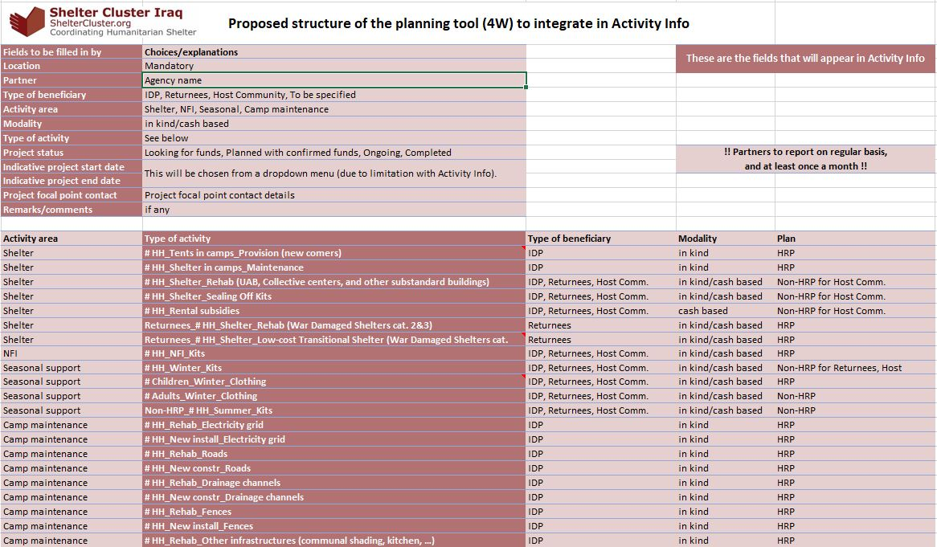
Information Management
ActivityInfo report: achievements & the new 4W for planning

Slide 7
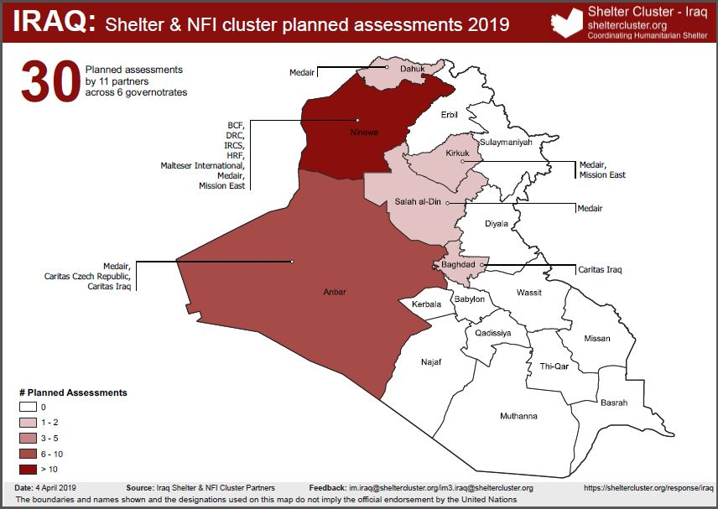
Information Management
2019 assessments (planned, ongoing, completed)

Slide 8
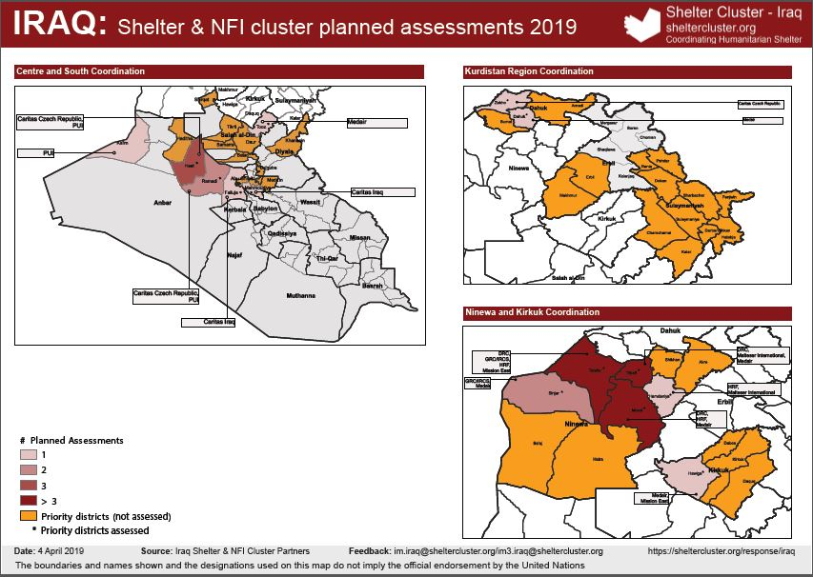
Information Management
2019 assessments (planned, ongoing, completed)

Slide 9
Information Management
2019 assessments – Priority Districts
ICCG – 10 governorates, 30 prioritized districts as per 2019 HRP
Anbar (Falluja, Ramadi, Ana);
Baghdad (Karkh);
Dahuk (Dahuk, Sumel, Zakho);
Diyala (Khanaqin, Ba'quba, Khalis);
Erbil (Erbil);
Kirkuk (Daquq, Hawiga, Kirkuk);
Najaf (Najaf);
Ninewa (Akre, Telafar, Mosul, Sinjar, Tilkaif, Shikhan, Hatra, Ba'aj);
Salah Al-Din (Balad, Tikrit, Tooz, Samarra, Baiji);
Sulaymaniyah (Sulaymaniya, Kalar);
S-NFI – 9 governorates, 31 prioritized districts as per 2019 HRP – Identified through the MCNA / DTM & Returnees dataset
Anbar (Falluja, Ramadi, Haditha, Heet);
Baghdad (Karkh, Mahmoudiya);
Dahuk (Dahuk, Sumel, Zakho);
Diyala (Khanaqin, Ba'quba);
Erbil (Erbil, Makhmur);
Kirkuk (Daquq, Hawiga, Kirkuk);
Ninewa (Akre, Telafar, Mosul, Sinjar, Tilkaif, Shikhan, Hamdaniya);
Salah al-Din (Balad, Tikrit, Tooz, Samarra, Shirqat, Daur);
Sulaymaniyah (Sulaymaniya, Kalar);

Slide 10
Information Management
SEVAT - Socio-Economic Vulnerability Assessment Tool
The SEVAT tool is finalised – the following message is from the CWG.
MPCA Vulnerability Scoring Tool 2019 Iraq v 2.0 Production
The tool cannot be shared widely, to avoid tricking the system and manipulate assessments to favour people assessed, hampering an impartial use of the tool.
CWG and SNFI Cluster would rely on you to further share with relevant people and advise to limit its usage to as much restricted number of people as possible. CWG did its best to have several layers to hide the formula but still an expert user could still find a way to access it. We are discussing about creating a platform for data collection which potentially would prevent any risk of breach for the time being, restricted dissemination is the best mitigation measure.
Only project managers and data managers with responsibility functions should be shared with the tool. They will be held responsible for any misuse of the tool.

Slide 11
AOB
Trainings : 16 different partner organisations, requesting 8 different trainings for 136 participants in Arabic (43) and English (93).
For Centre & South
Use of the Cash Working Group Socio-economic Vulnerability Assessment Tool
Data Manager / Socio-Economic Vulnerability Assessment Tool
War Damaged Shelter minimum standards and the use of BoQ
HLP / Best practices for securing tenure for each shelter activities, work flows and templates
Summary requests for trainings
Different trainings requested | 8
Training requested per AoR
KRI | 6 (94 participants)
Centre and South | 4 (30 participants)
Ninewa and Kirkuk | 2 (12 participants)

Slide 12
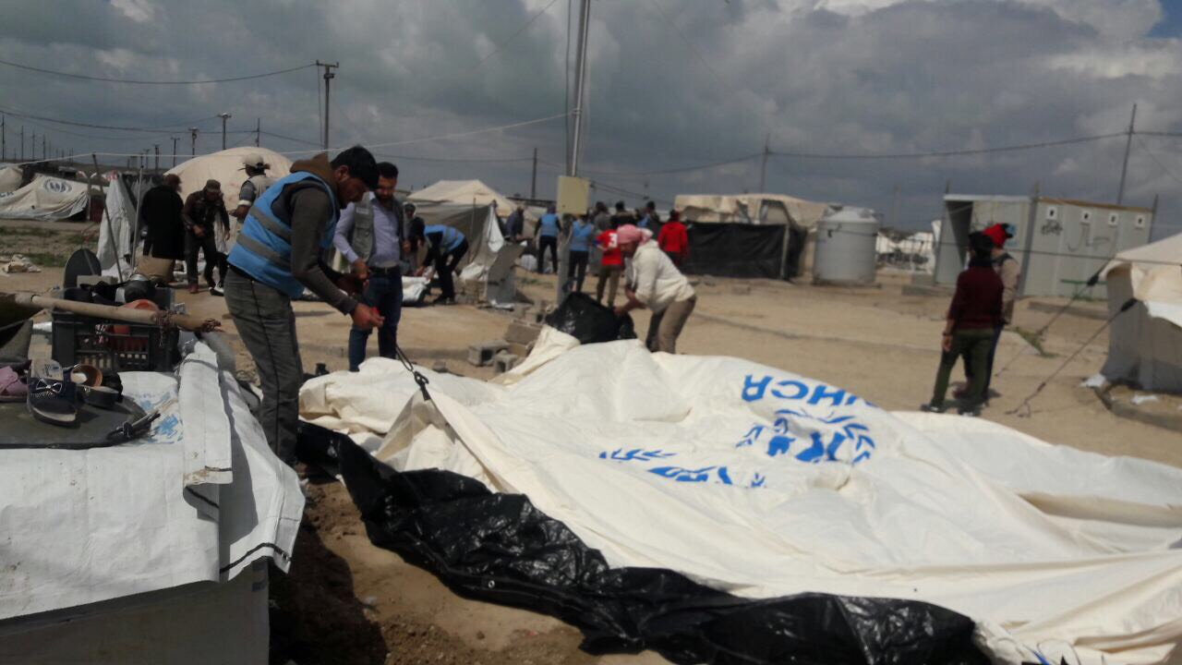
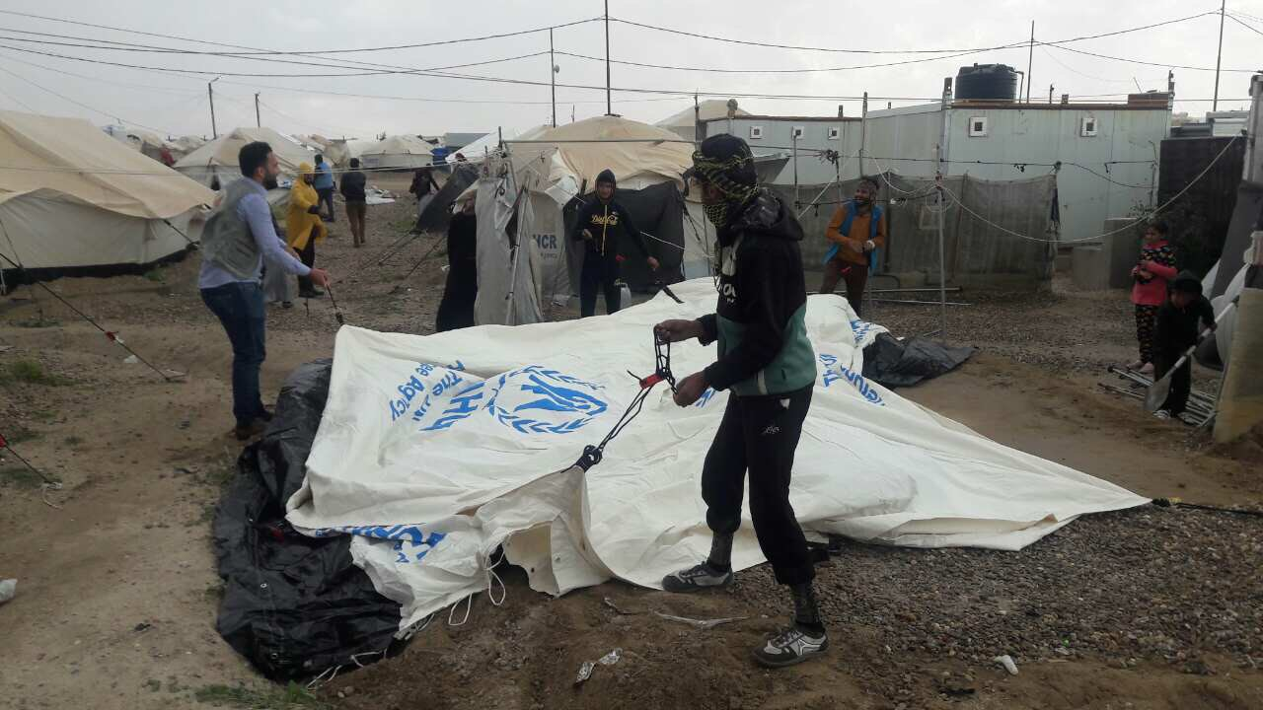
THANK YOU VERY MUCH
Photo credit to UNHCR

